Slide 1
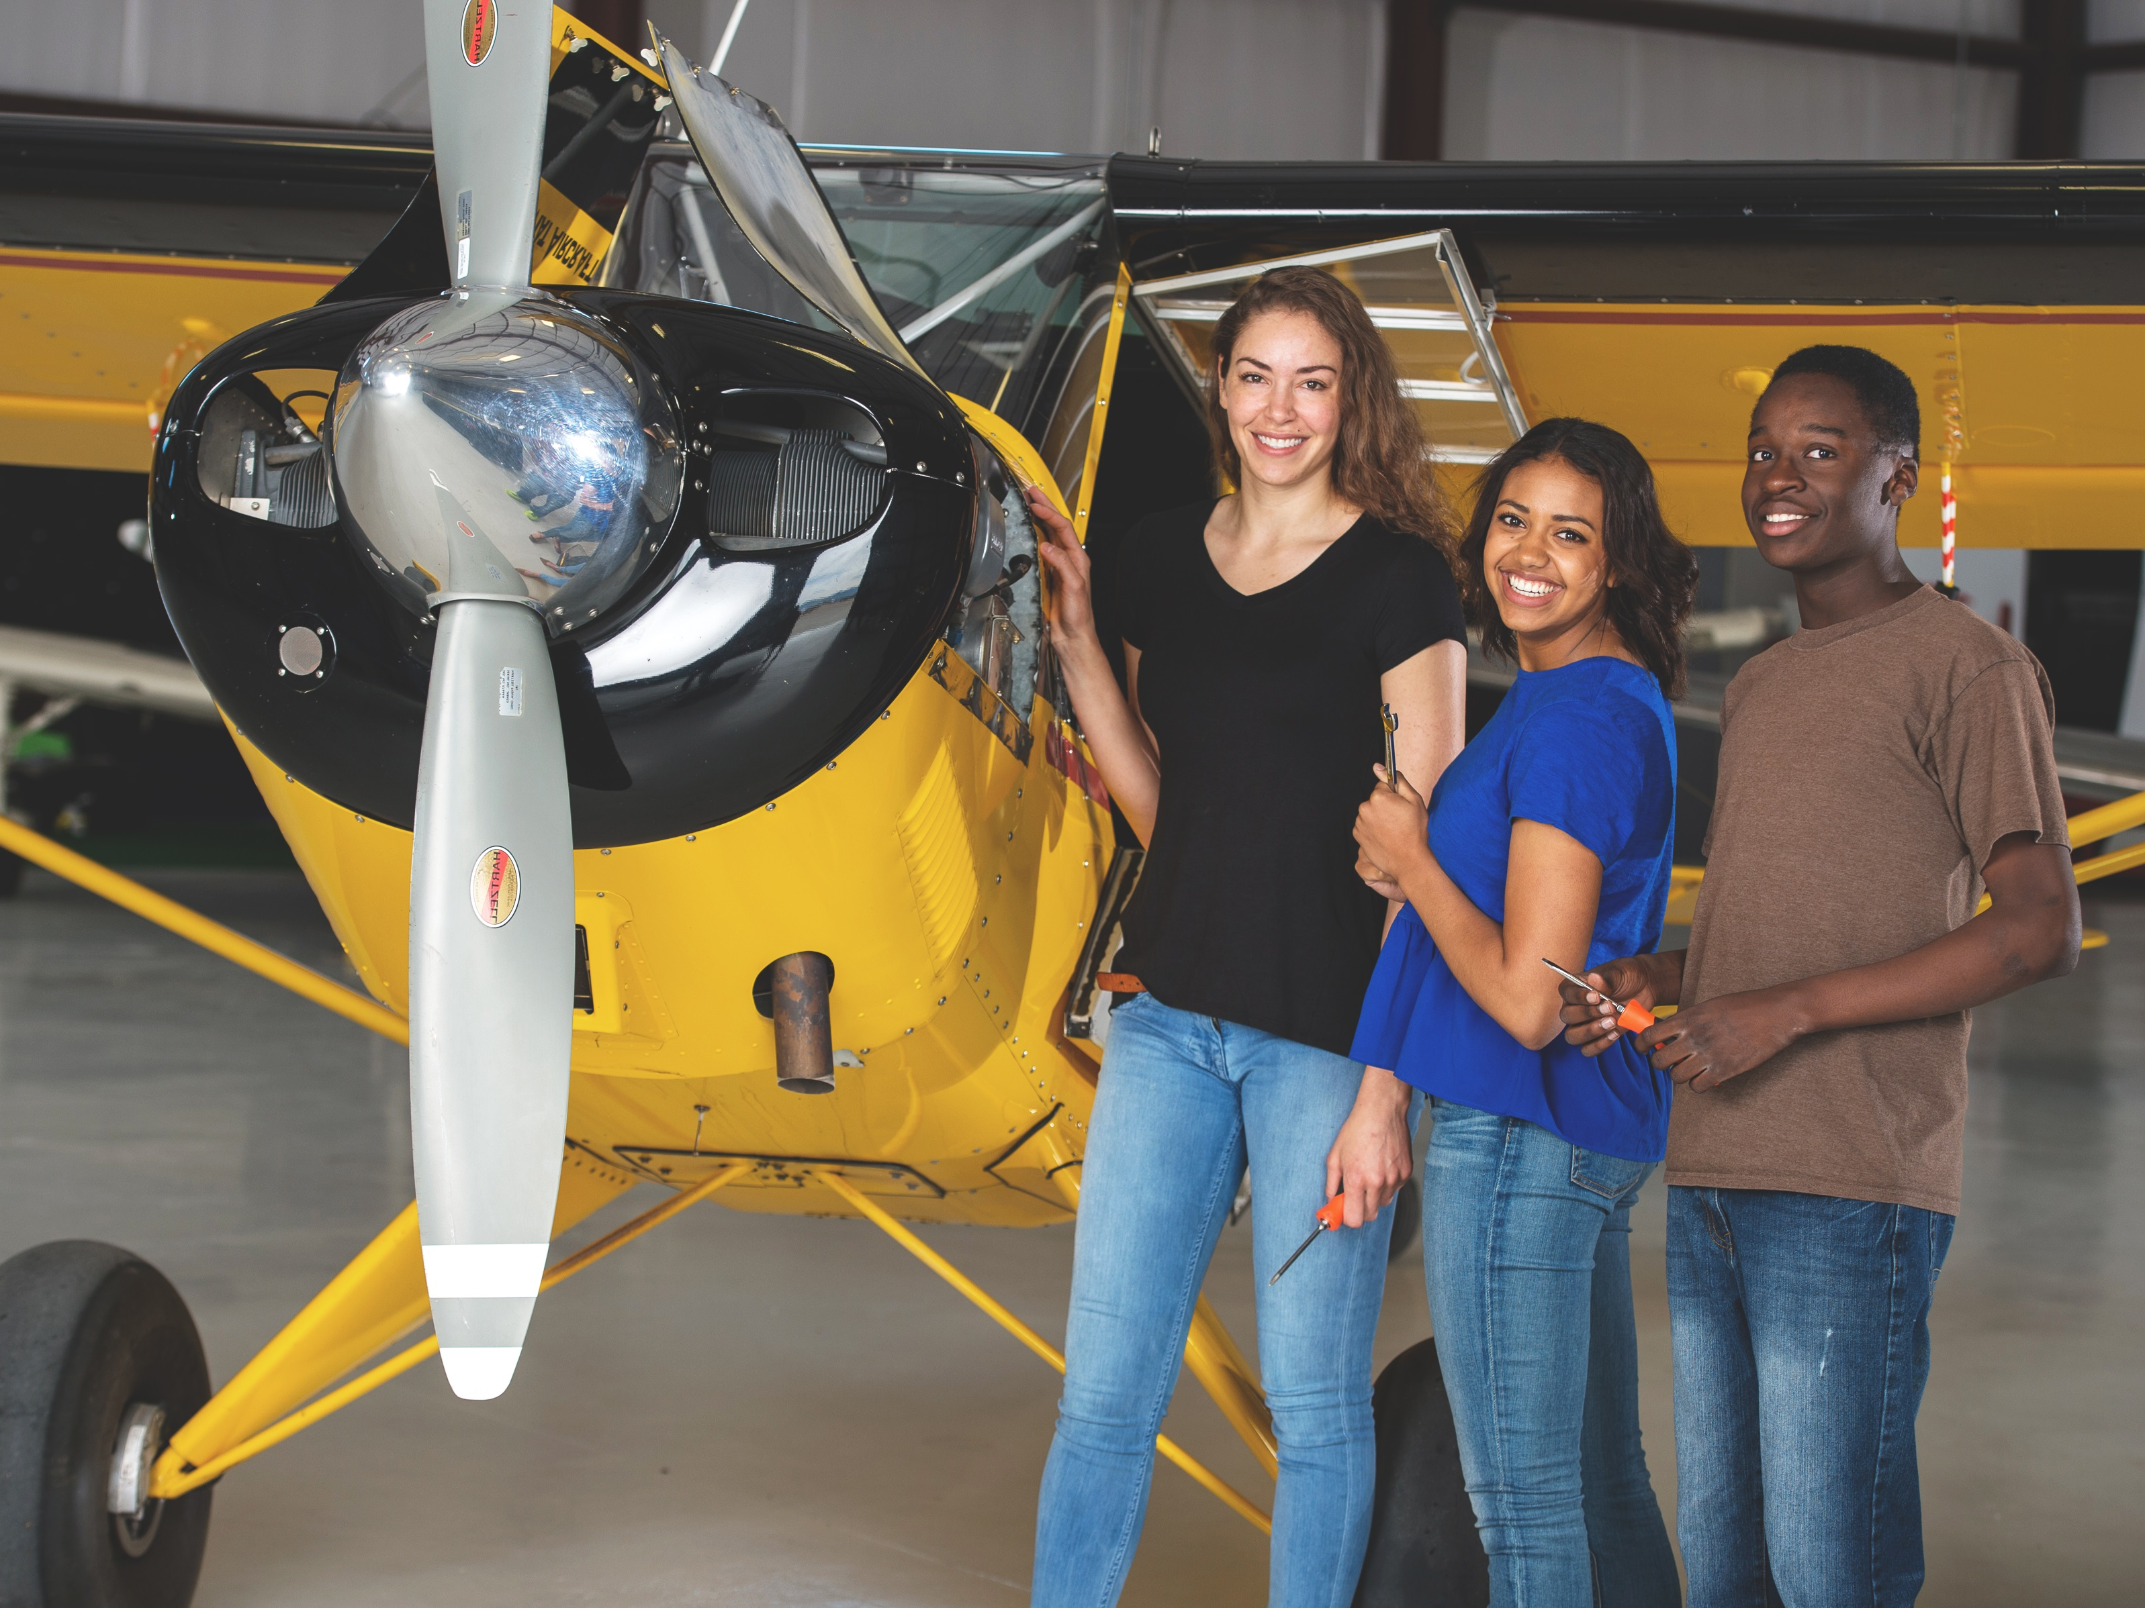
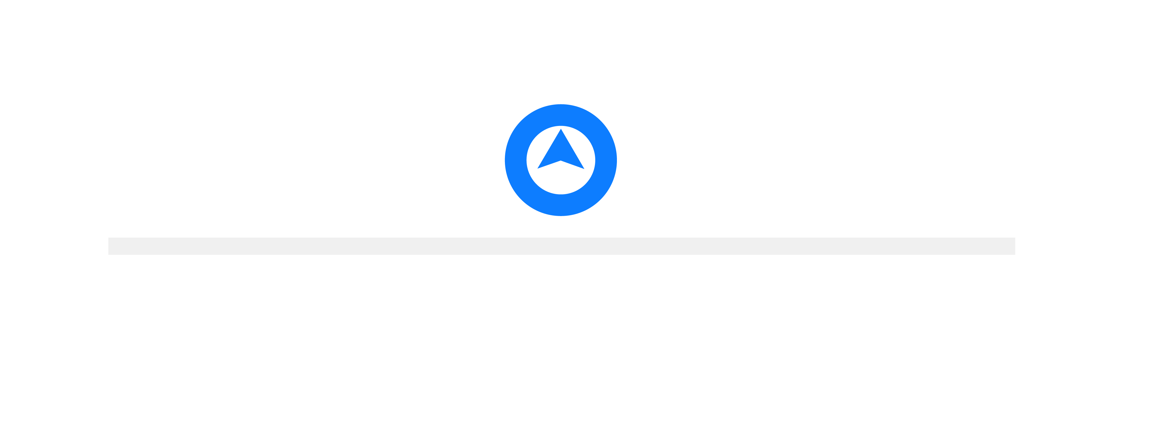
Growing Your Exploring Program with Geo-Fencing
Colin Lemon
Director of Exploring
Western Region
National Service Center
Notes:
Welcome to the webinar! Today we will be covering a new growth method for Exploring – geo-fencing.

Slide 2
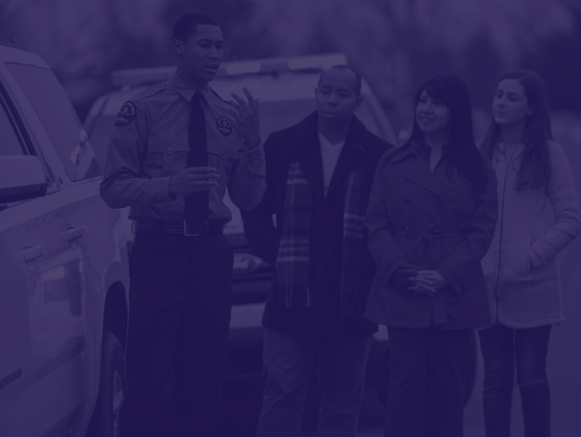
Getting Started
Build a Facebook page
Make sure it is an organization page
Must be a public page, not a private group
Notes:
To get started, your club/post/district/council should have a public organization Facebook page. This is different from a Facebook group which is more of a gathering place for communication and idea sharing. Include as much detail as you can about the organization, complete with an effective cover photo or video.

Slide 3
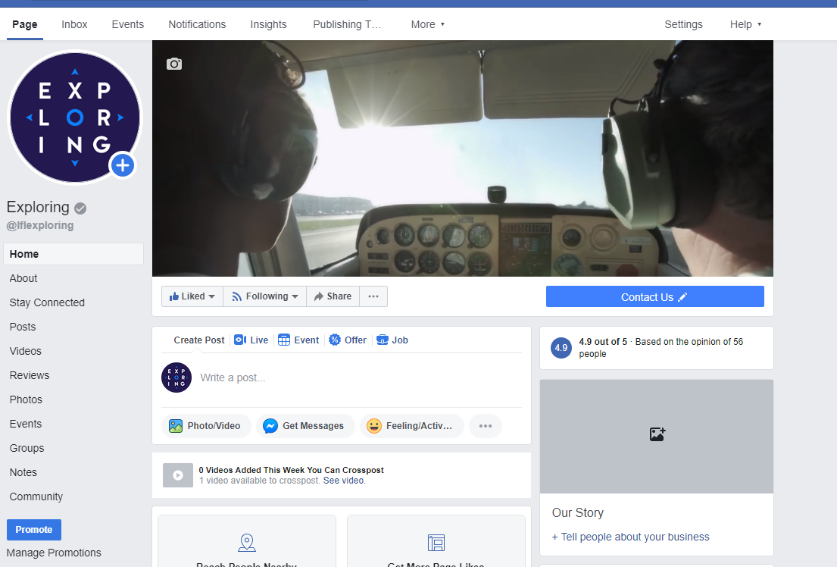
Notes:
Include as much detail as you can about the organization, complete with an effective cover photo or video.

Slide 4
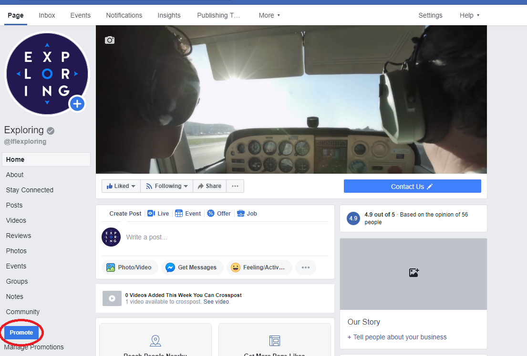
Notes:
There are two ways to geo-fence. One is by using the “Promote” button on the bottom left of the page. This is how you can set up ongoing promotions for your organization as a whole.

Slide 5
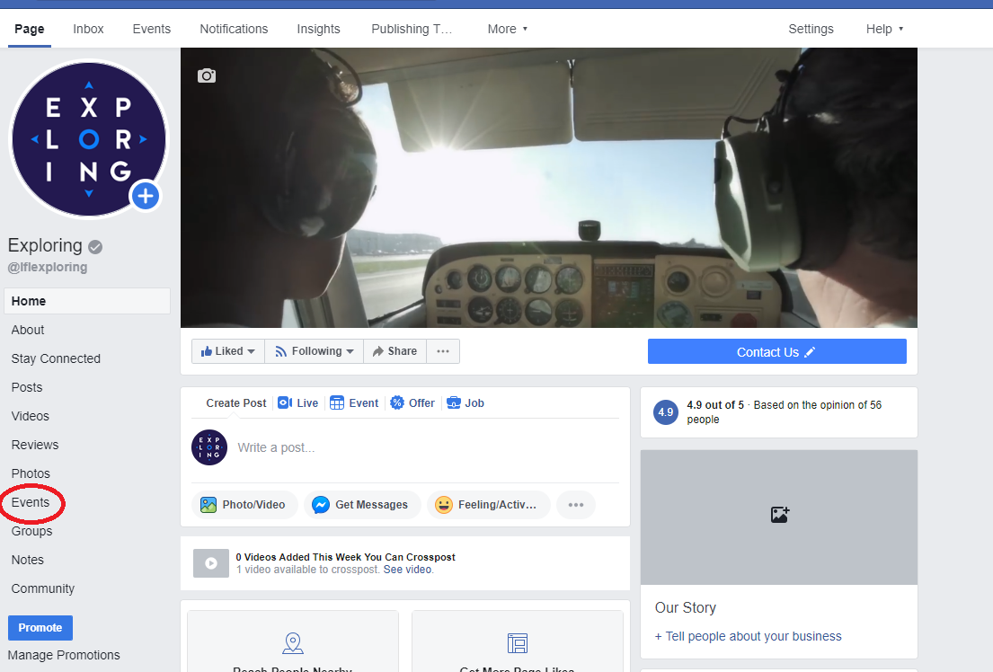
Notes:
We’re going to focus on event promotion in this webinar. Click the “Events” button on the left sidebar shown here.

Slide 6
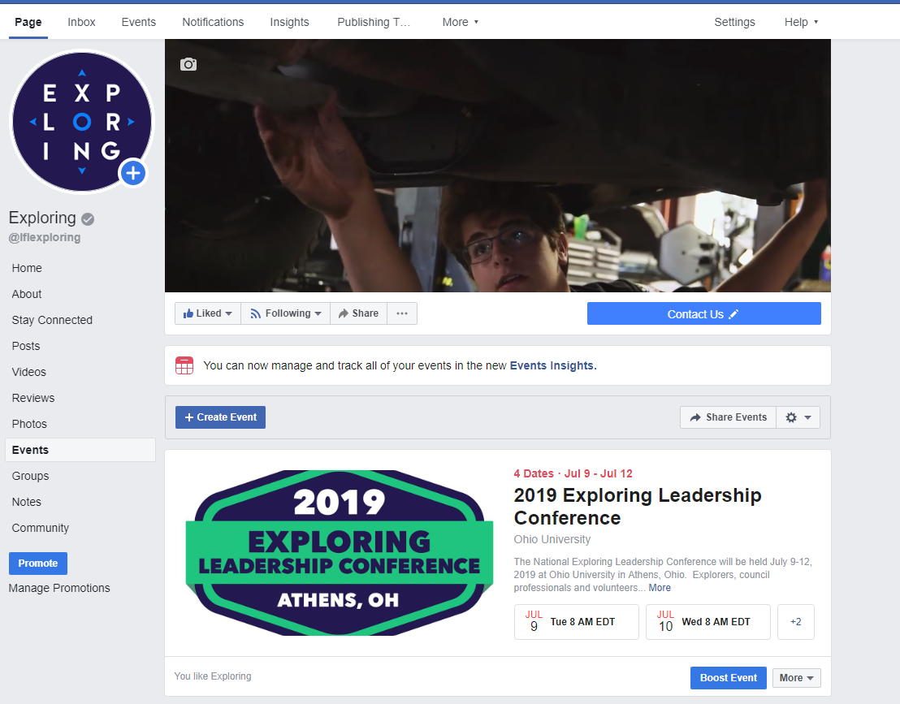
Notes:
This is the event page. If you have events already created, you will see them at the bottom of the screen.

Slide 7
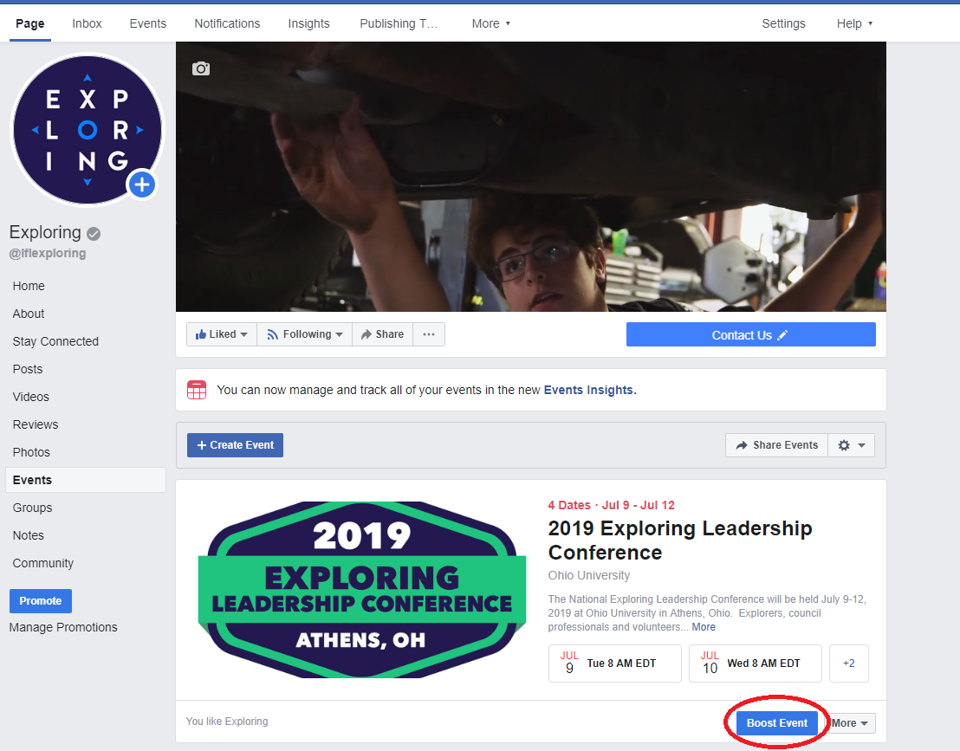
Notes:
If those events are upcoming, you can go ahead and set up the geo-fencing for them by clicking the “Boost Event” button on the bottom right of the screen.

Slide 8
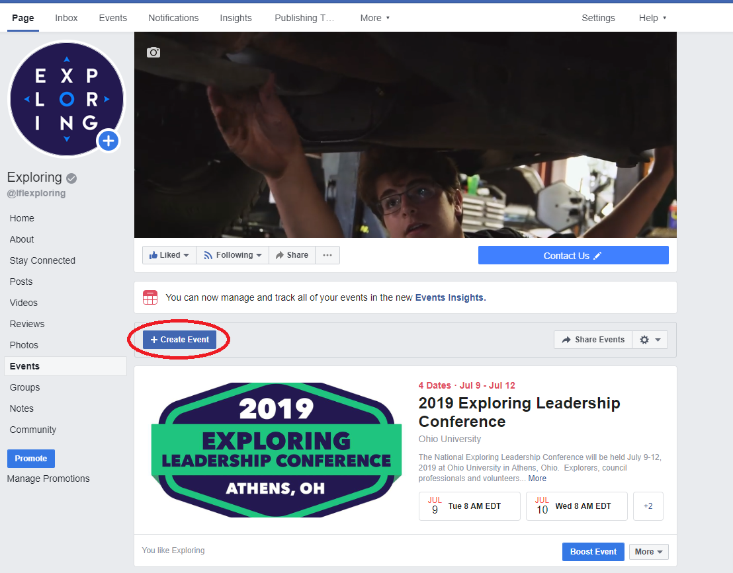
Notes:
If you need to create a new event, click on “Create Event” in the middle of the page.

Slide 9
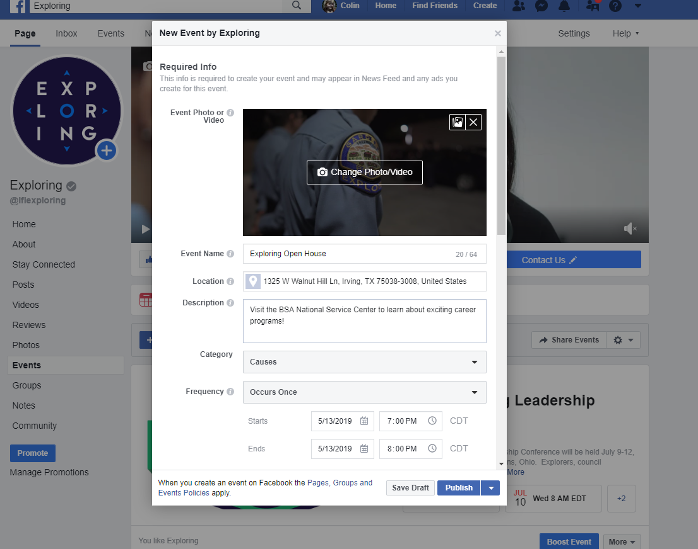
Notes:
When creating an event, you should set up an event photo or video. A video is highly recommended over a photo because people are more likely to click on a video. After that, name your event, add the location of the event, and add a brief description. Then you can choose a category, set the frequency of the event, and add the date and start/end times.

Slide 10
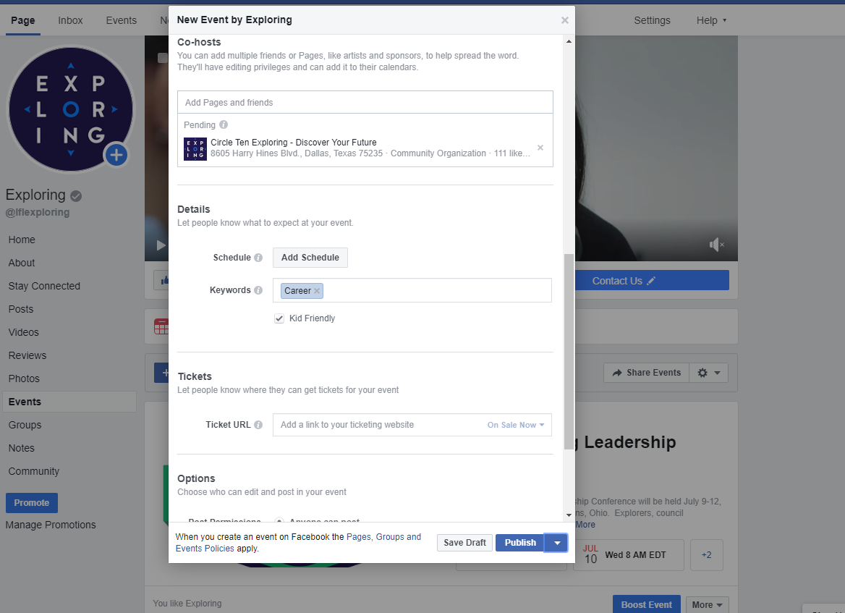
Notes:
The next option down is to add a co-host. This is optional but could increase the value of this promotion significantly. Adding a co-host means that you designate another organization as a co-host through their Facebook page. They have to approve it and if they do, your event will be promoted to their audience as well. Co-hosts might be the location of the recruitment (library, school, business) if being held at a location other than the participating organization, or it can be another organization like the council, district, chamber of commerce, other posts/clubs, etc. A co-host can also be an individual page like the mayor, superintendent, police chief, etc. Be sure you discuss this with the potential co-host before adding them to the event so they aren’t caught off-guard.
Next are the schedule and keywords. The schedule option is for adding an agenda. This gives the audience an idea of what will be covered in the meeting/event. Adding keywords will help people find your event if they are intentionally searching for those keywords.
For recruitment events, you can ignore the ticketing option. There are some other options below like setting who can post to the event page, etc.

Slide 11
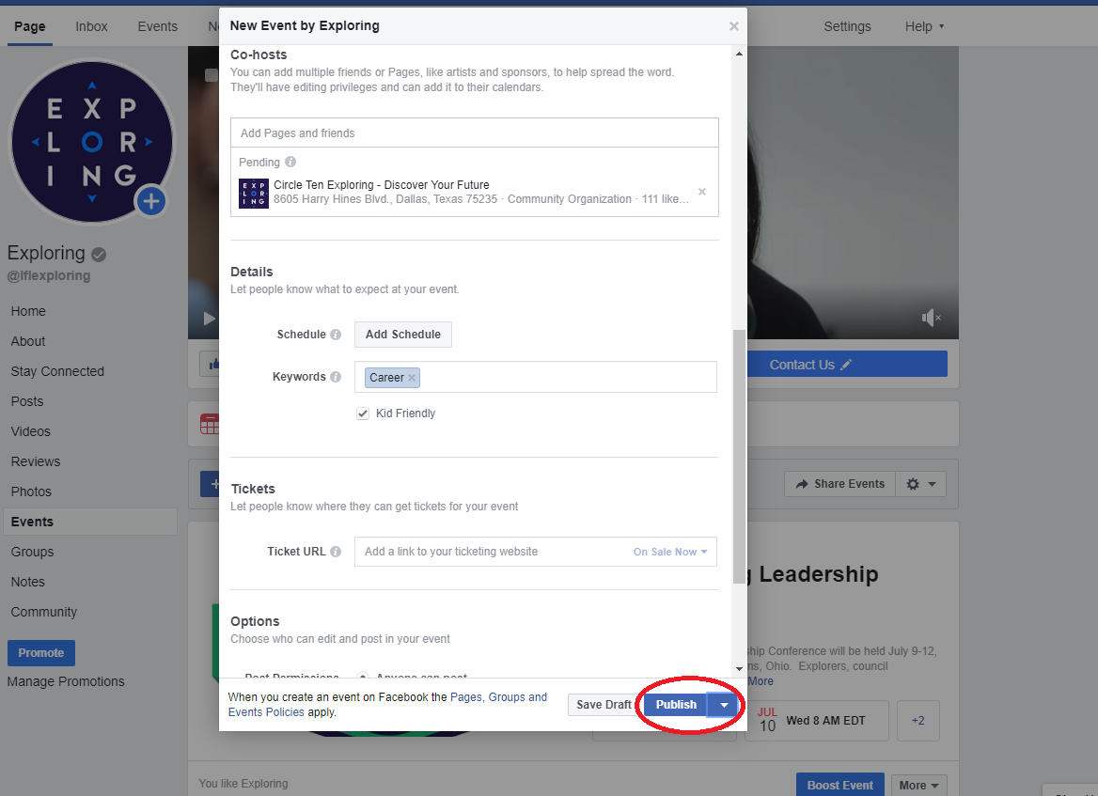
Notes:
Once you have the event details entered, click “Publish” at the bottom right to make the event go live. Alternatively, you can click the white arrow next to the “Publish” button and set a time and date for the event to publish automatically. This is especially useful if you are creating an event but don’t want it to publish until a peak social media usage time. Ideal times to post on Facebook for maximum exposure are Tuesday afternoon through Friday morning. Weekends are low traffic times to promote anything. (People seem to check Facebook at work more than at home!)

Slide 12
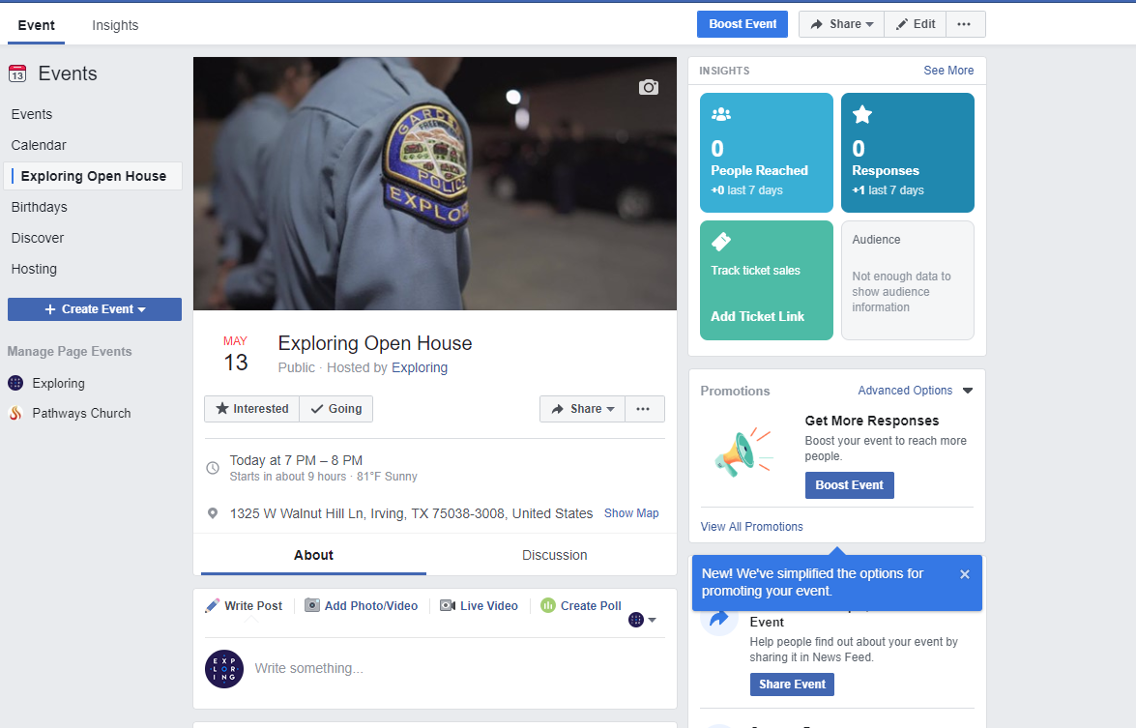
Notes:
After publishing, you will be taken to your event page.

Slide 13
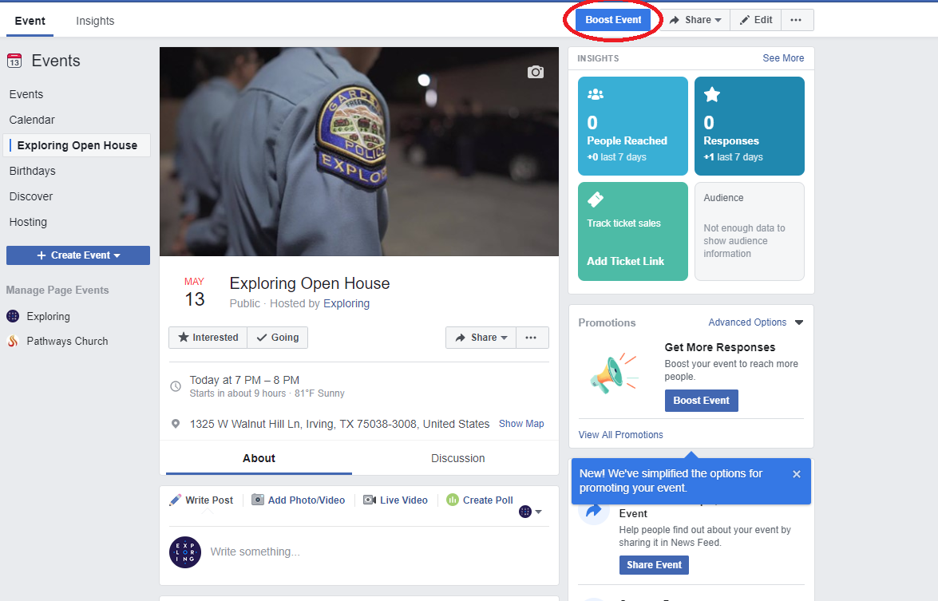
Notes:
When you’re ready to begin setting up the geo-fence promotion, click on “Boost Event” at the top of the page.

Slide 14
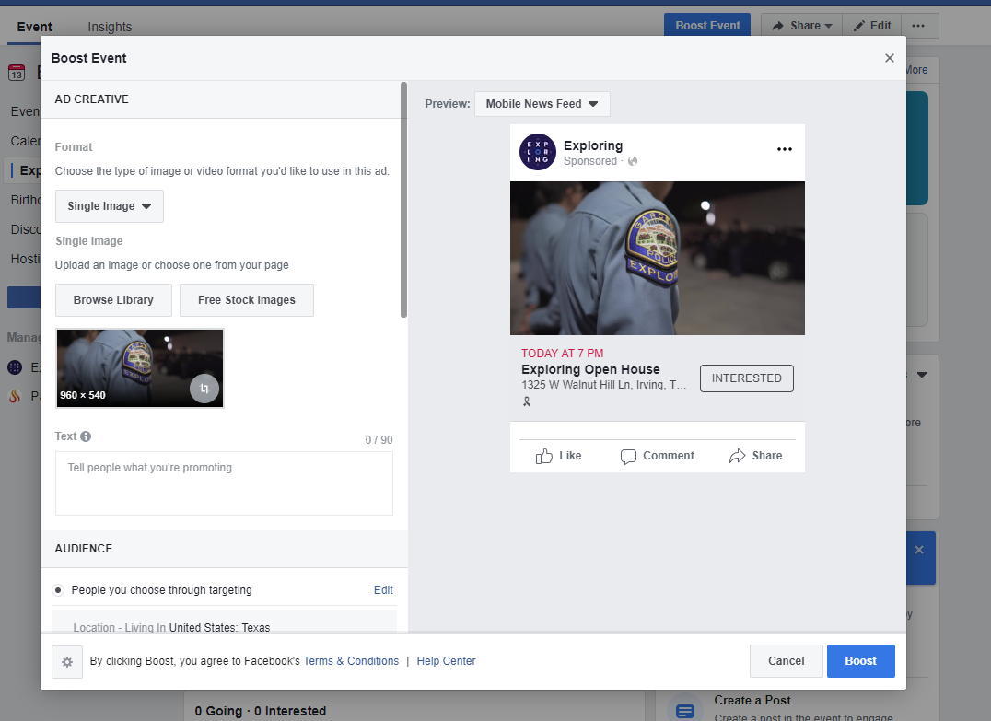
Notes:
The first detail is the promotion’s photo or video. It will default to the event’s photo or video but you can use a different one for this promotion if you like. Again, videos are highly recommended over photos if you want maximum engagement. After the photo/video, add a description of the promotion in the text box.

Slide 15
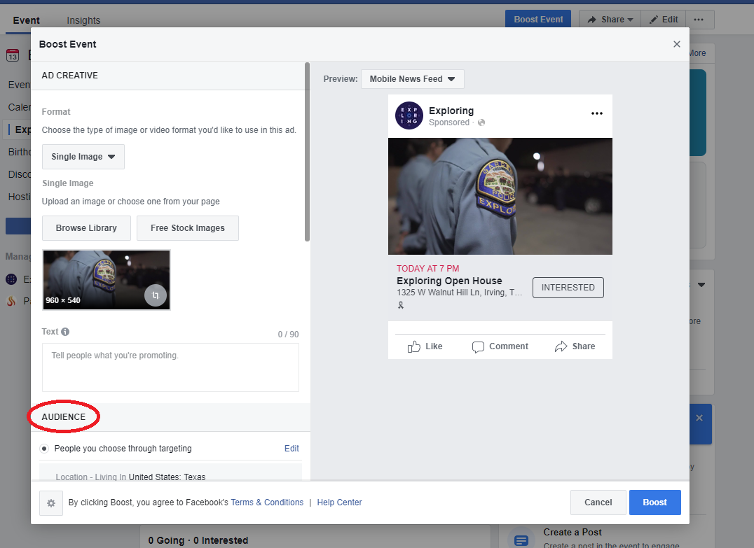
Notes:
Next, scroll down to the “Audience” section.

Slide 16
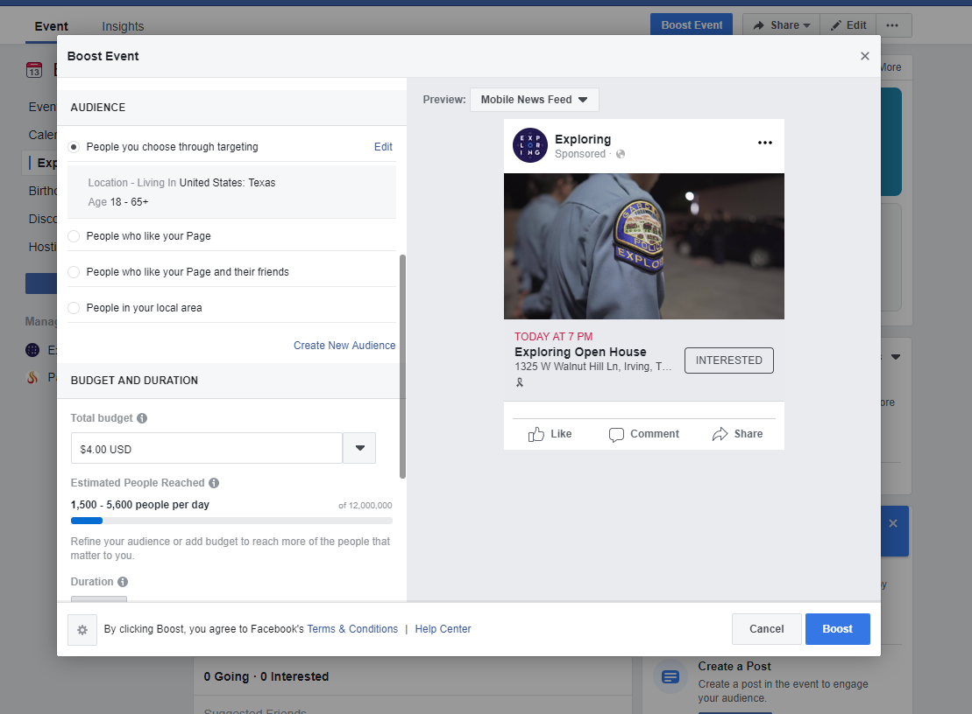
Notes:
This is where the true power of geo-fencing comes into play. On this page, you can determine the audience that you wish to receive your promotion.

Slide 17
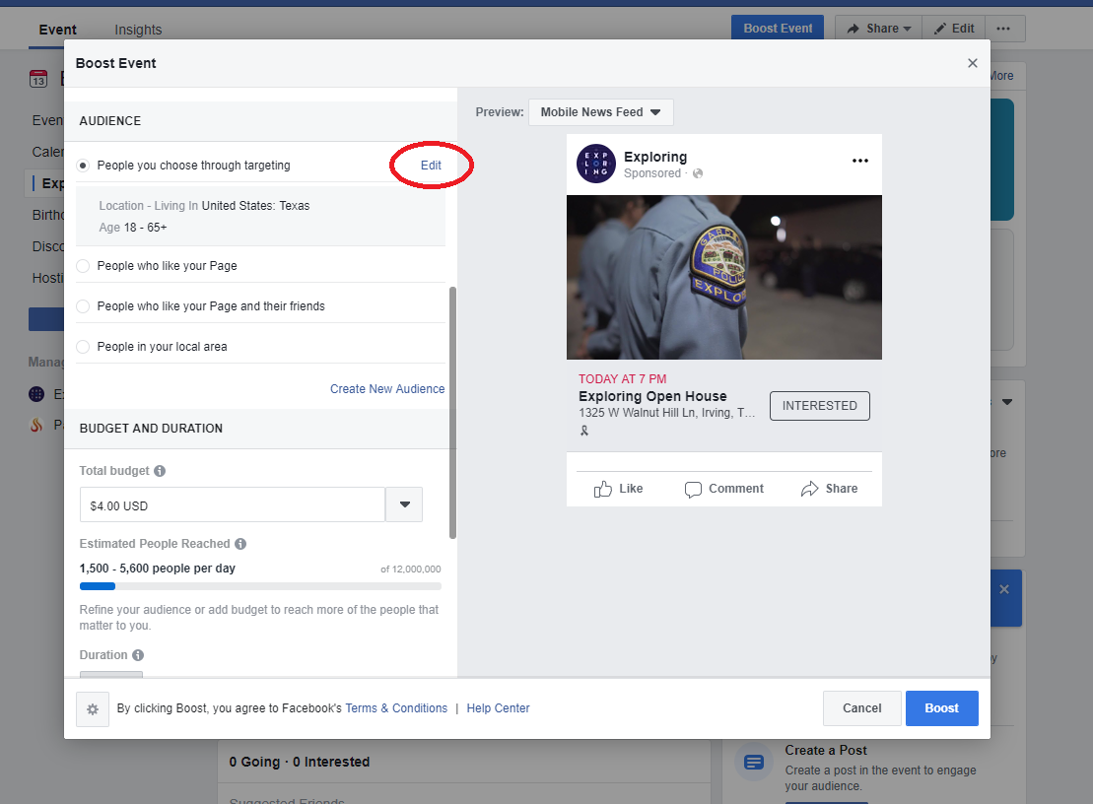
Notes:
Next to “People you choose through targeting”, click on “Edit”.

Slide 18
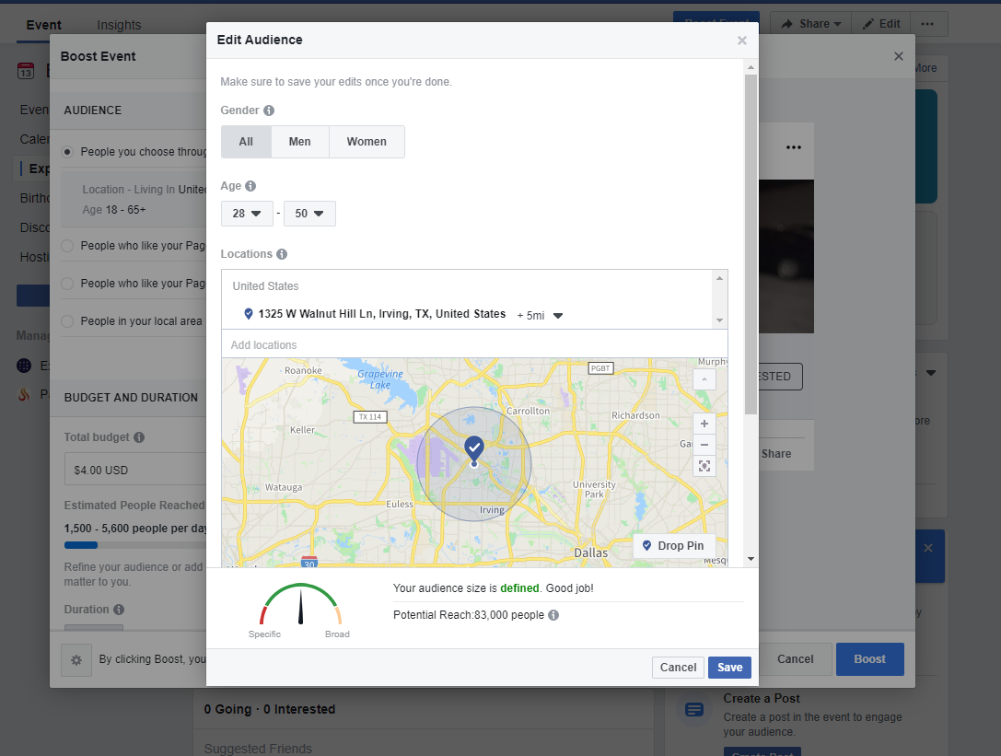
Notes:
Here you will begin setting up your audience.

Slide 19
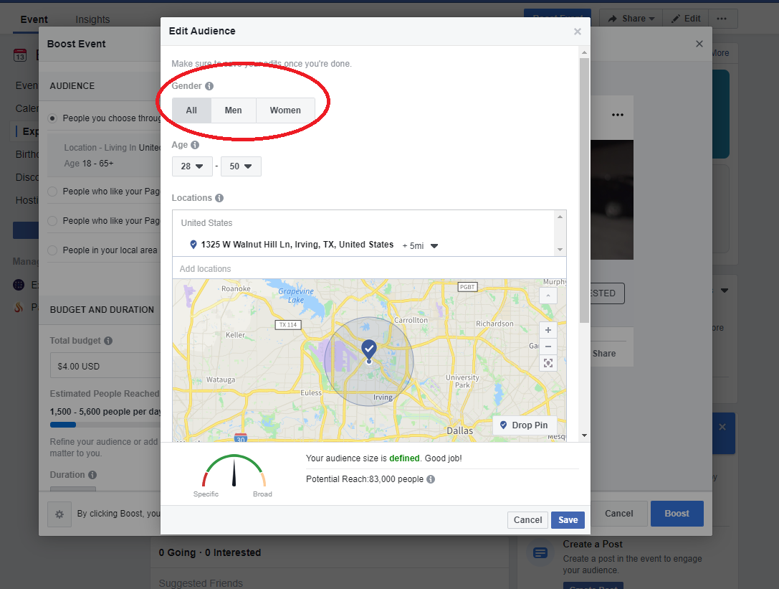
Notes:
On this page, select either men, women, or all to determine the gender of your audience. Keep in mind that women tend to check Facebook a lot more frequently than men.

Slide 20
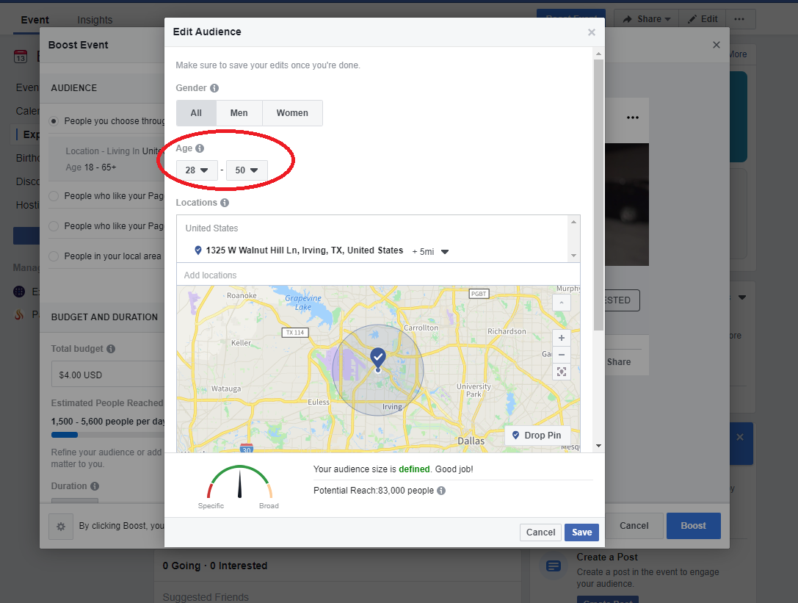
Notes:
Then select the age range. The youth audience for Exploring is most likely not who you are targeting. That age range is most likely not using Facebook but is using other social media networks. Your target for this promotion is most likely their parents or grandparents. In the example here, we have an age range of 28 to 50 years old.

Slide 21
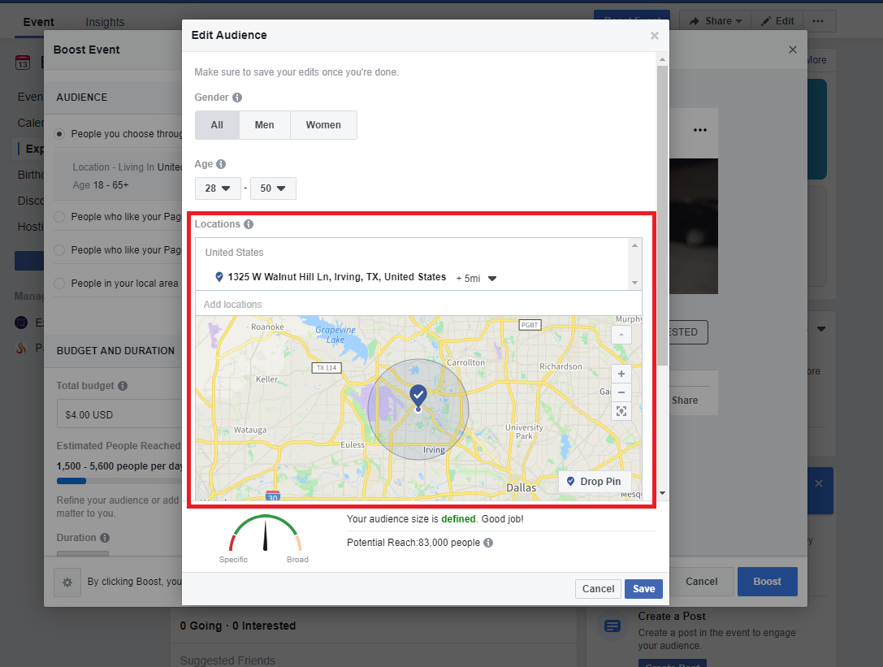
Notes:
Now you can select the geographical area you wish to reach with the promotion. You can add multiple addresses manually or click on “Drop Pin” to mark locations directly on the map. Next to each location, you can click the dropdown arrow and select the radius of your geographical area.
Adding multiple locations will increase your audience. For Cub Scouts, you might put a pin on the location of the recruitment (school), the chartered organization, a local park, a Starbuck’s close by, the public library, etc.

Slide 22
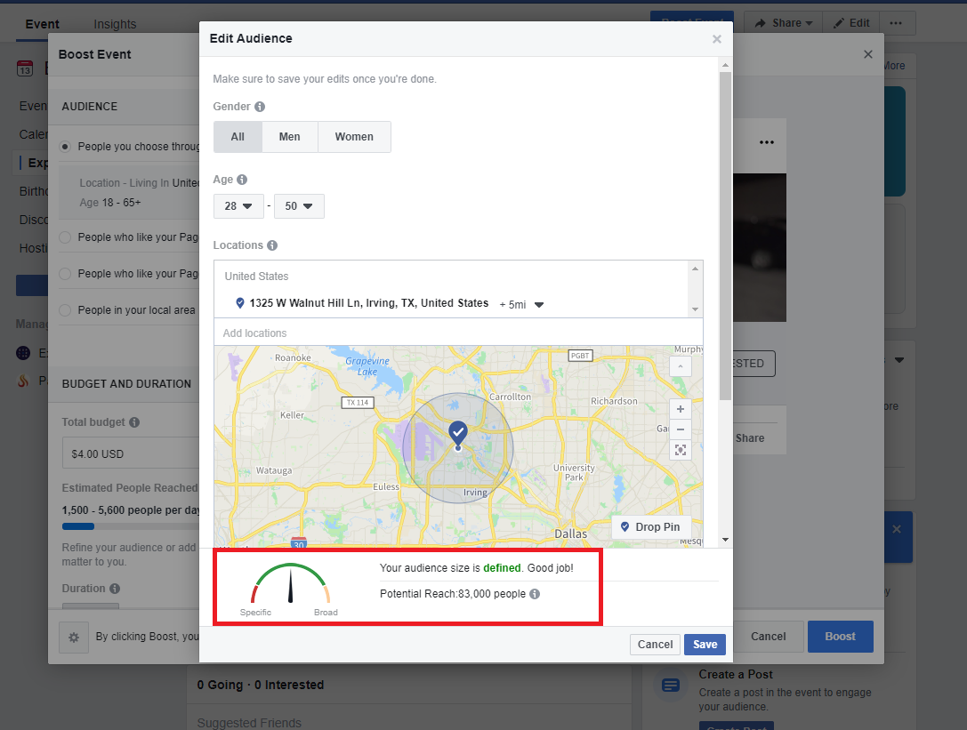
Notes:
The more specific you set these parameters, the smaller your audience becomes. If you are too specific, you will see a message here stating that and the dial will be in the red. The target is to have a defined audience in the green. This screen will give you an estimated size of your promotion’s audience.

Slide 23
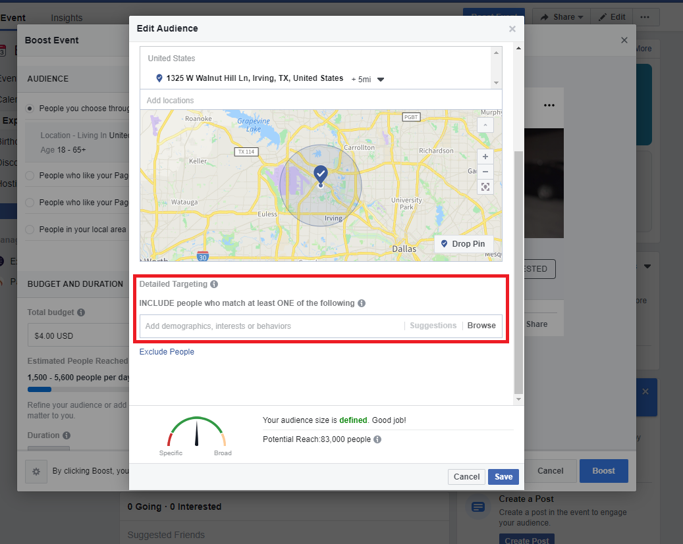
Notes:
Now scroll down to “Detailed Targeting”.

Slide 24
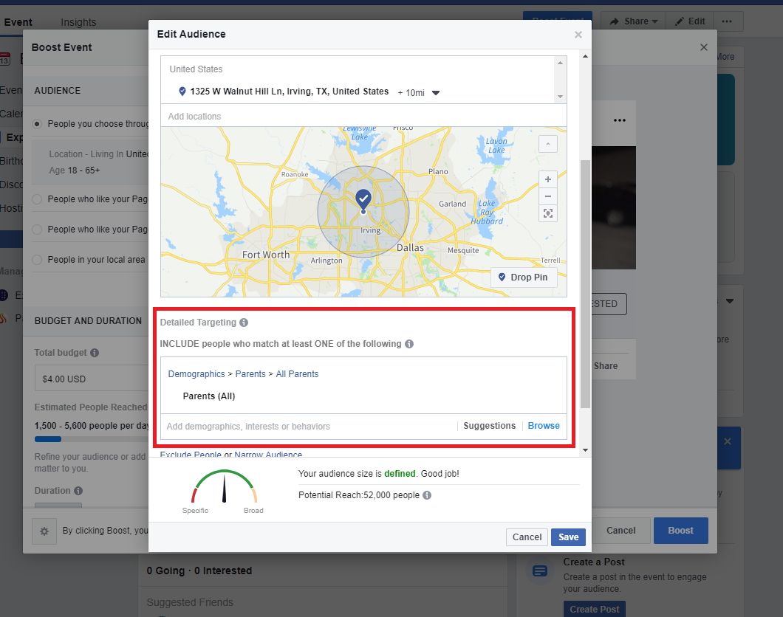
Notes:
Here you can select keywords related to demographics, interests, or behaviors. Examples are “parents of 13 to 18 year old teenagers” or “all parents”. Again, be careful not to be too specific.

Slide 25
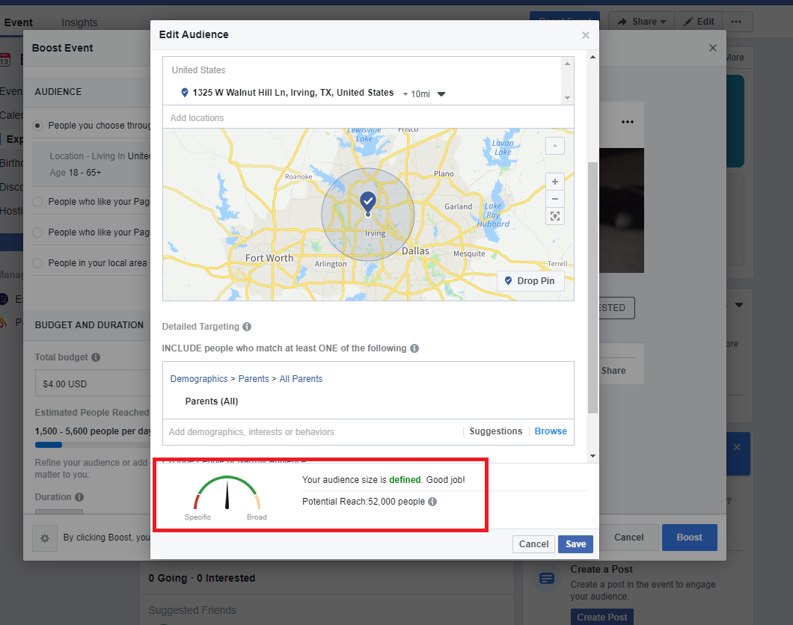
Notes:
Check your estimated audience and dial again to make sure you are in the green. Then click the save button on the bottom right.

Slide 26
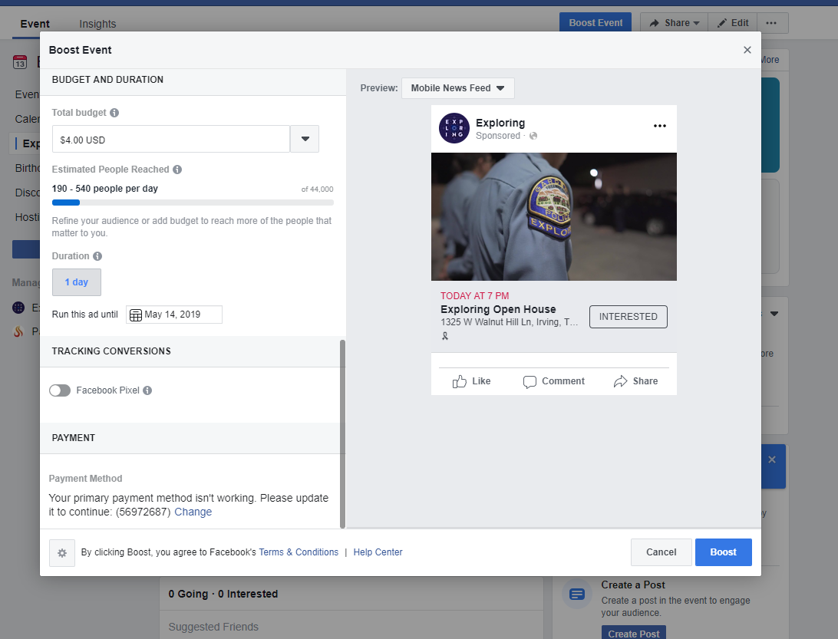
Notes:
The next step is setting up your budget for the promotion.

Slide 27
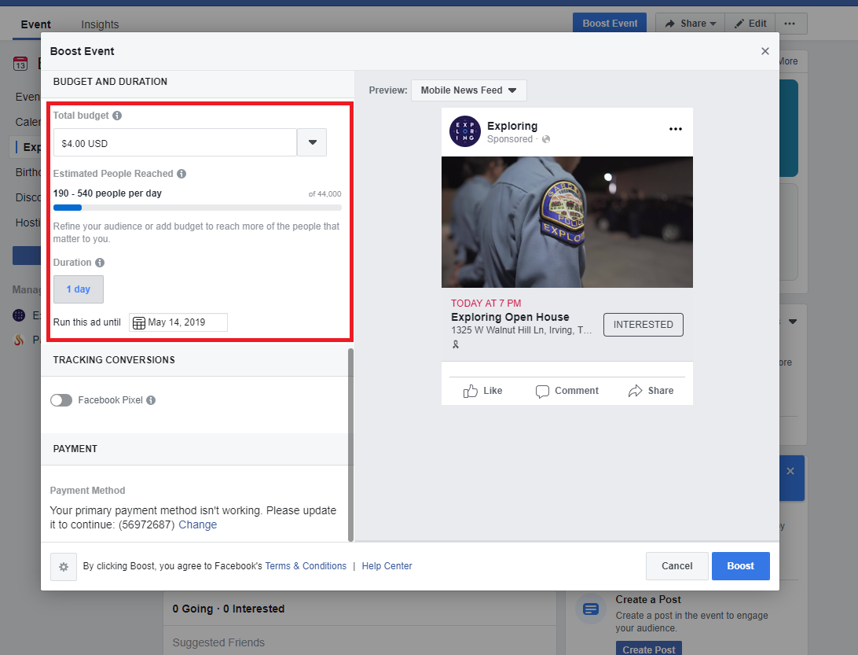
Notes:
When setting your budget, determine how much you are willing to spend at most per day of the promotion. You can budget as little as $1.00 per day. The higher your budget, the more people you will reach. This is also where you set the end date for your promotion. This will also impact the number of people reached. This is only a budget which means that it is the maximum amount of money that Facebook will spend on this promotion. It is possible that less will be spent depending on the impact.

Slide 28
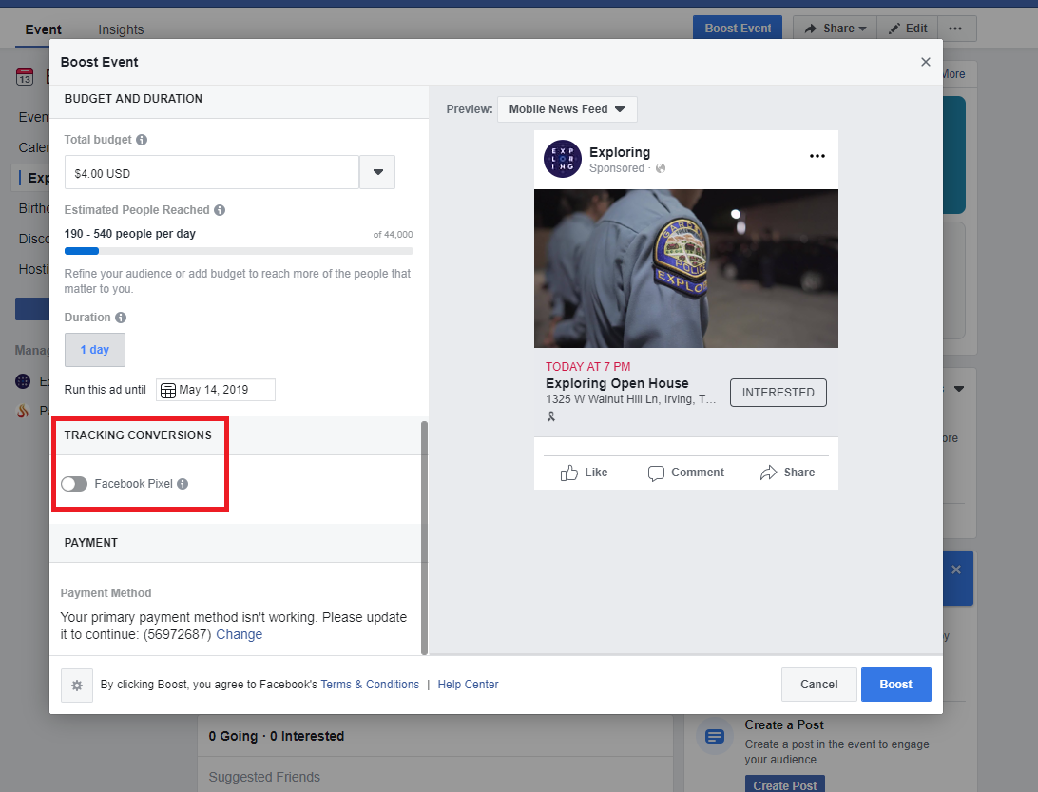
Notes:
An optional tool is “Tracking Conversions”. This is a method of imbedding what’s called a “Facebook Pixel” into your organization’s website which will allow you to track how many people visited your website as a result of this Facebook promotion. However, Facebook Pixels are a topic for another training.

Slide 29
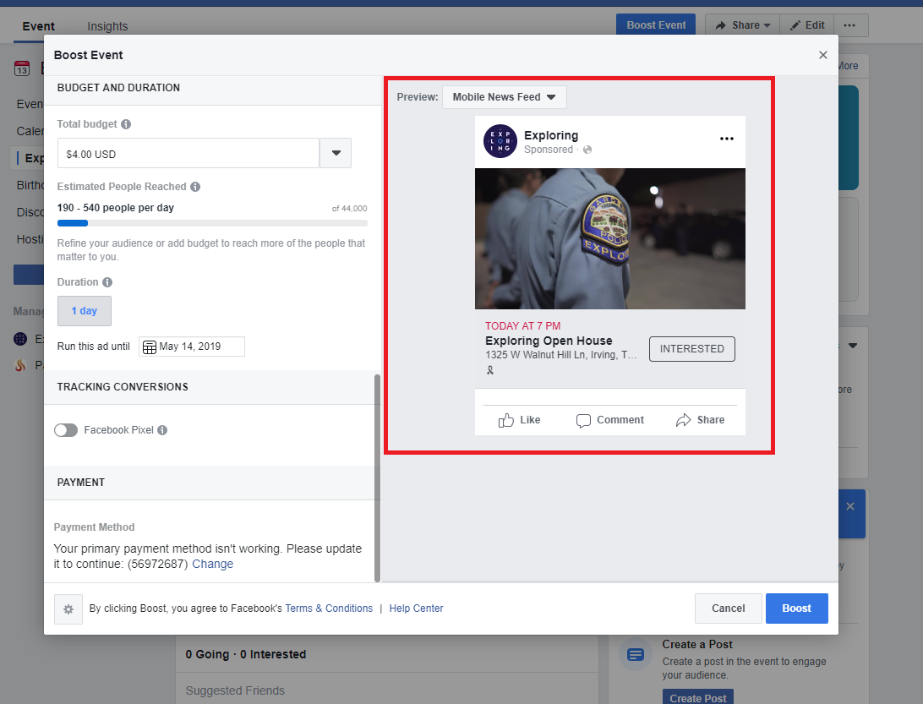
Notes:
Before launching your promotion, check this area to see what your promotion will look like to those on desktops, mobile devices, etc.

Slide 30
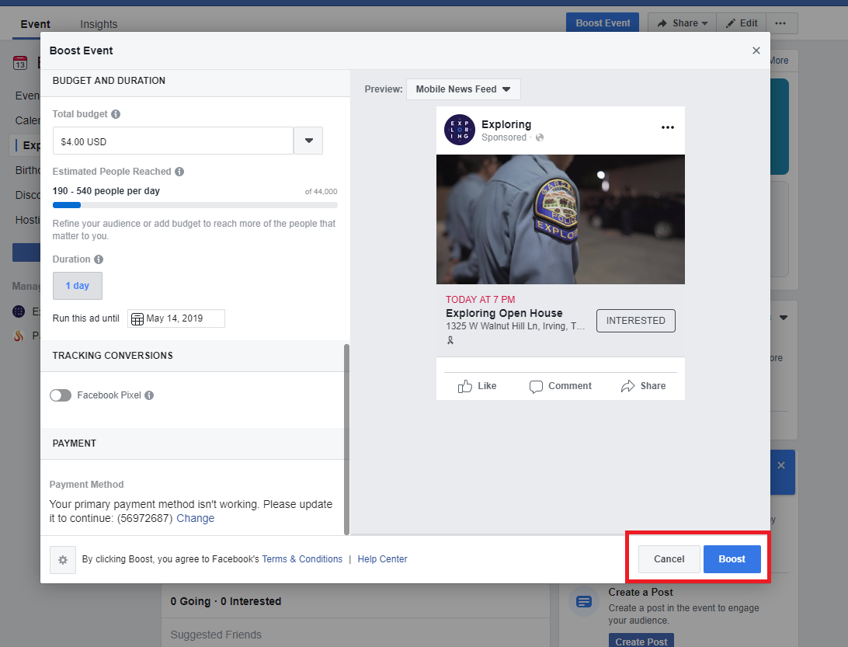
Notes:
Then click the “Boost” button at the bottom right of the screen. Congratulations! Your geo-fenced promotion is now live!

Slide 31
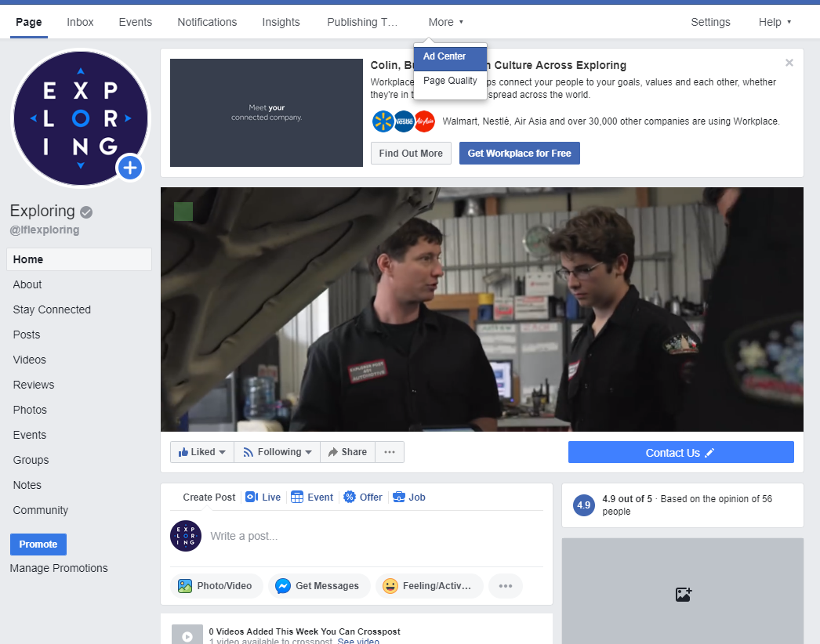
Notes:
If you’d like to keep track of how the promotion is doing, go to your organization’s main Facebook page.

Slide 32
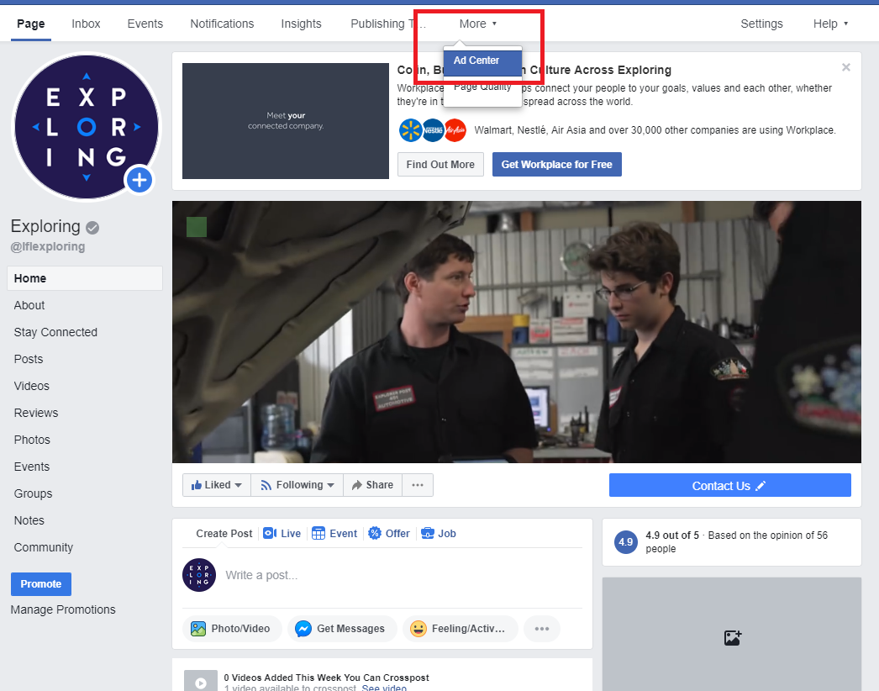
Notes:
Then click on “Ad Center” on the top menu bar.

Slide 33
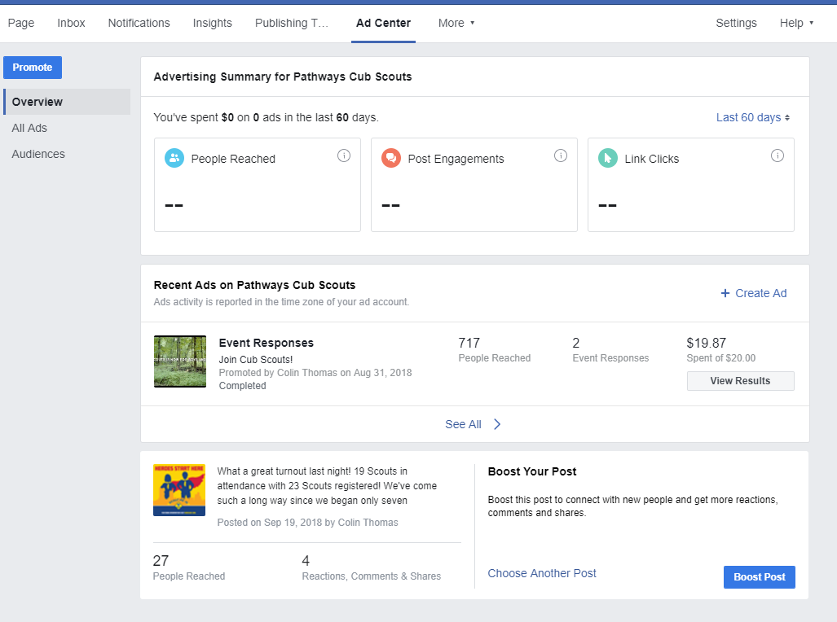
Notes:
This page shows a summary of your recent promotions for this organization. For the purposes of this demonstration, we will look at a Cub Scout pack that held a recruitment promotion during the fall recruitment season.

Slide 34
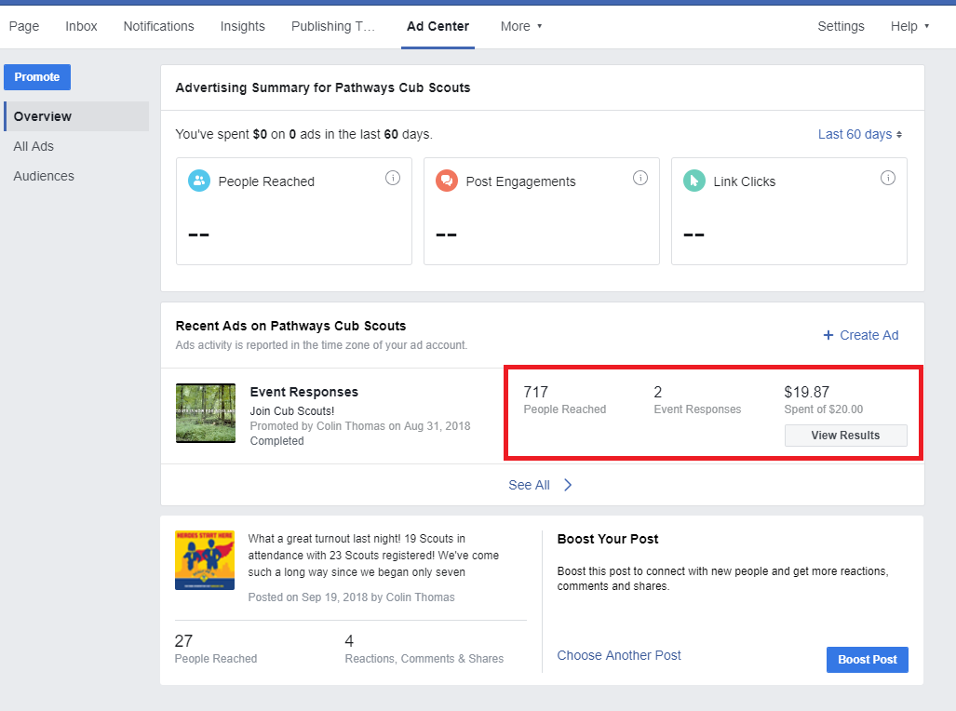
Notes:
For this particular promotion, 717 people were reached, two people actually responded to the event, and only $19.87 of the $20.00 was spent.

Slide 35
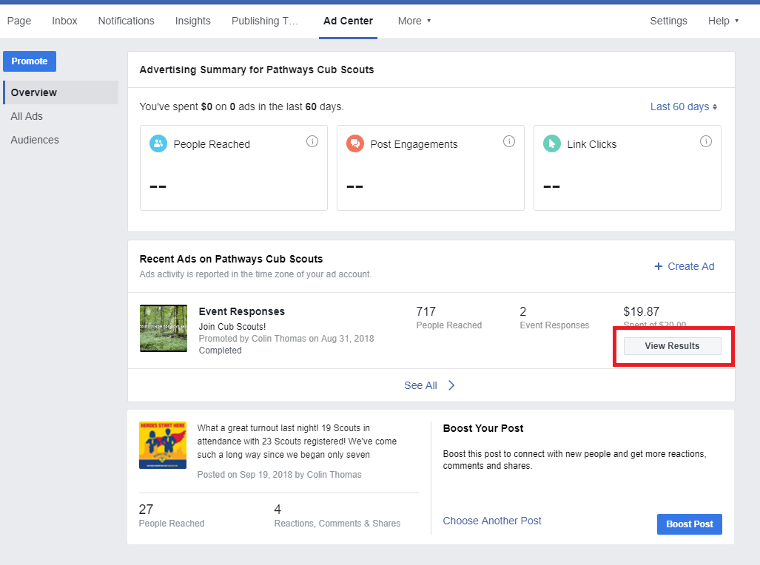
Notes:
To get more detail, click on the “View Results” button.

Slide 36
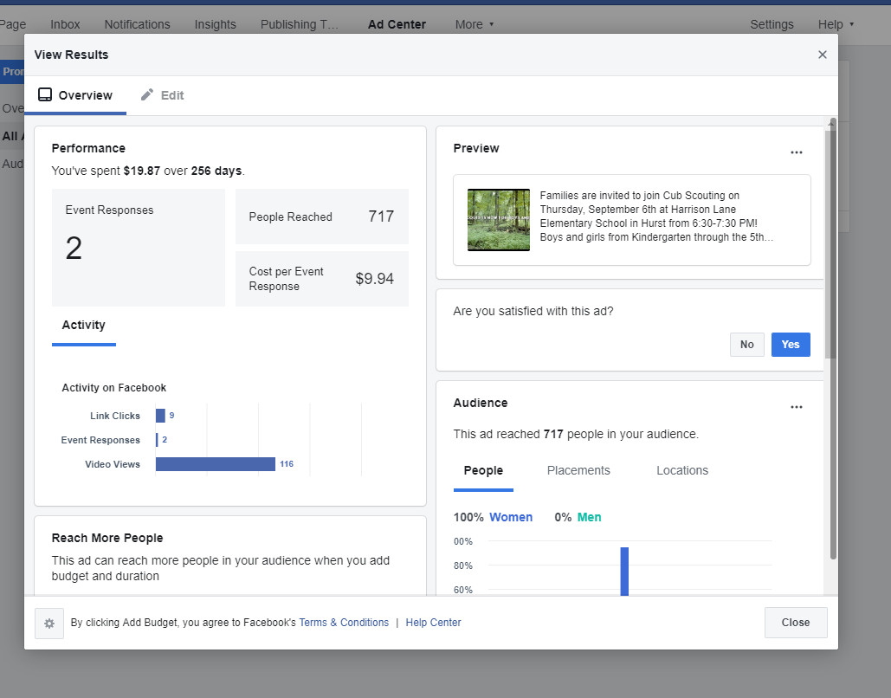
Notes:
This page gives some more detailed insights of your promotion and allows you to launch it again with an increased audience size if you choose.

Slide 37
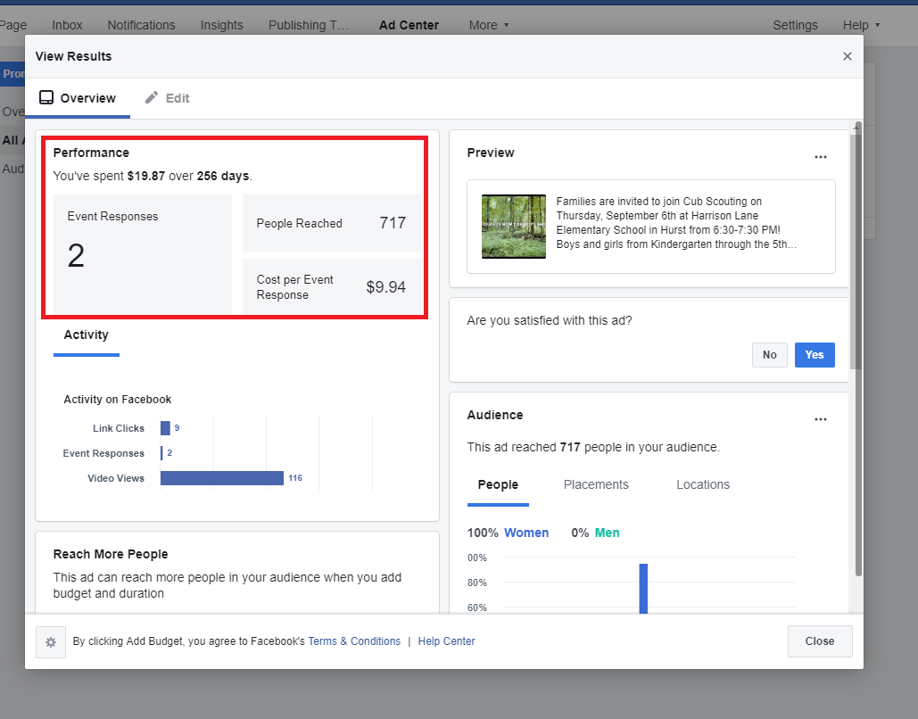
Notes:
First is the summary you saw on the previous page, plus an average amount of money spent per event response.

Slide 38
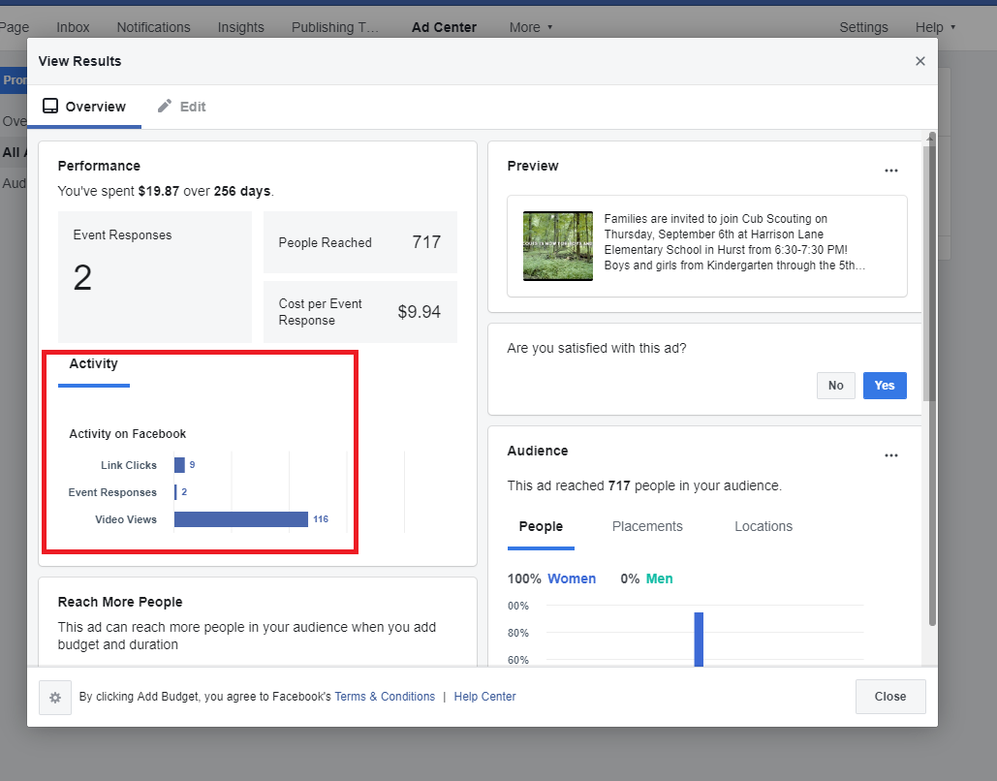
Notes:
Below that, you can see what kind of engagement you had. As you can see, videos are very effective at getting attention from your audience.

Slide 39
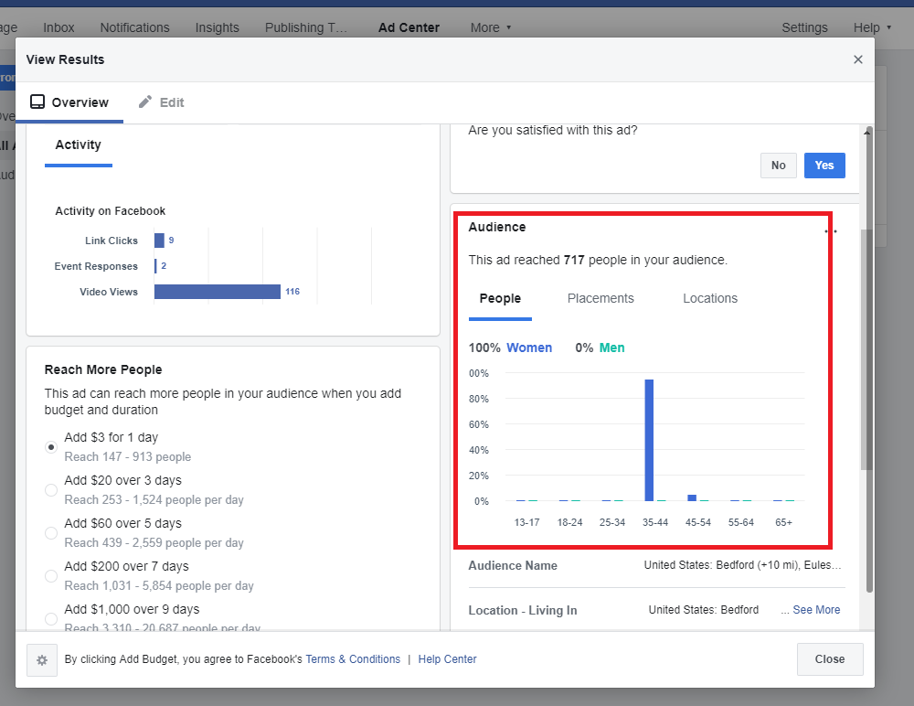
Notes:
Scroll down and look at the “Audience” section on the right. Here you can see who was receiving your promotion. In this example, it was 100% women but this event was only promoted to women.

Slide 40
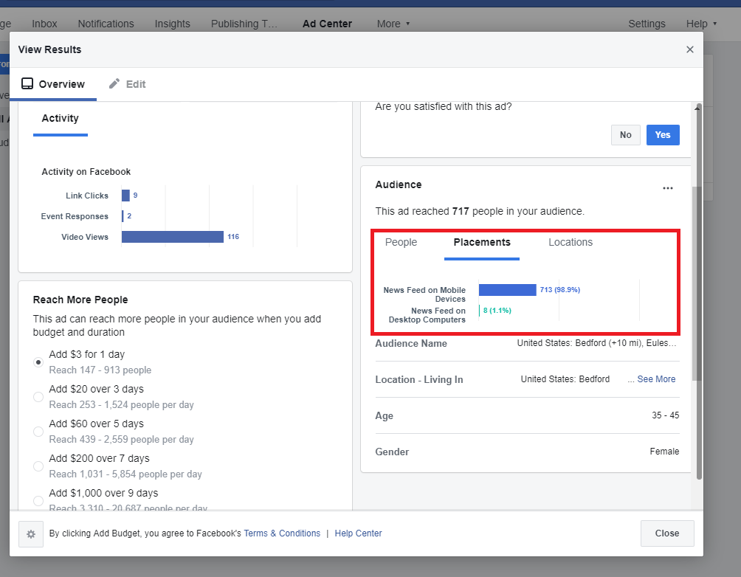
Notes:
You can click on “Placements” and see how many people viewed the promotion on mobile devices vs. desktop computers. The overwhelming majority viewed this promotion from their mobile devices so it might be a good idea to use that as a parameter on my next promotion.

Slide 41
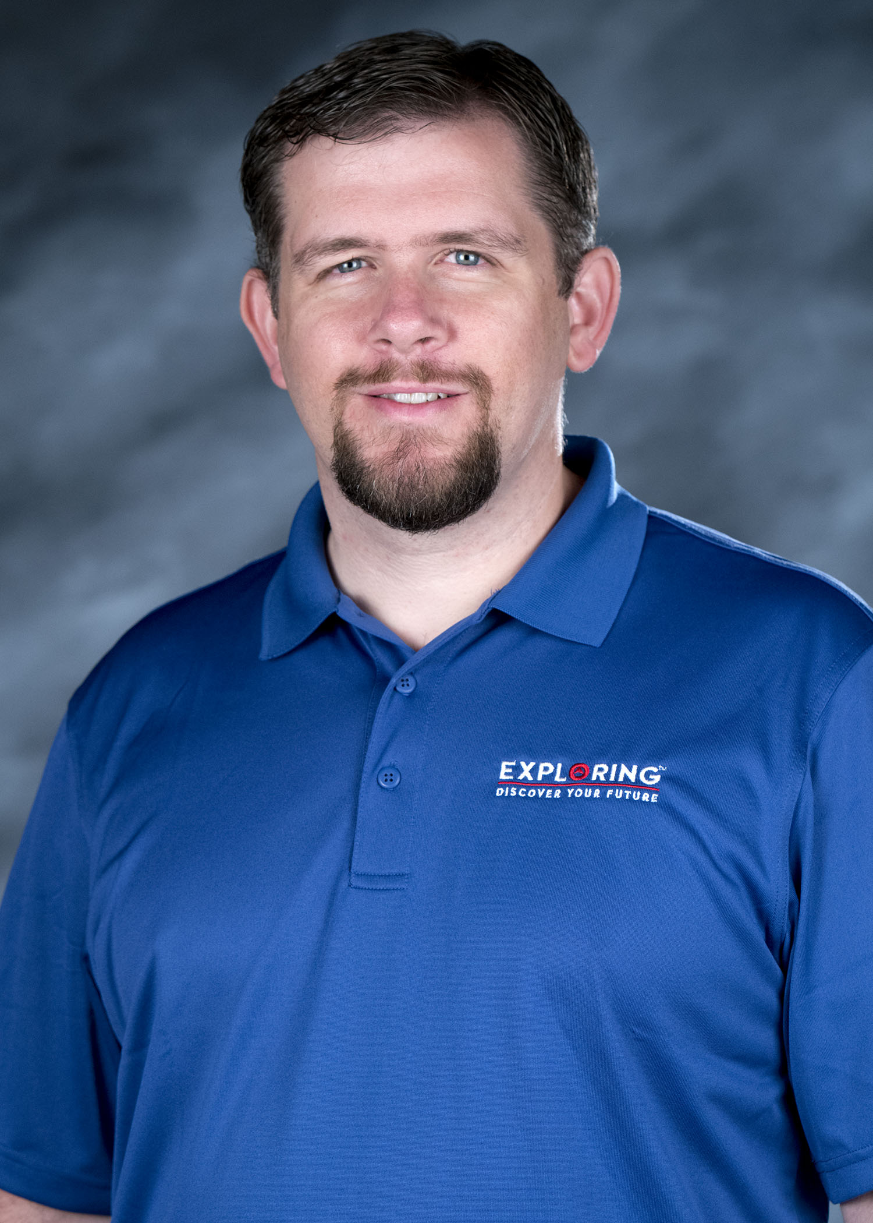
Questions?
Colin Lemon
colin.lemon@lflmail.org
972-580-2432
exploring@lflmail.org
972-580-2433
Notes:
And that’s it! Geo-fencing only takes a couple of minutes, especially if you already have your organization’s Facebook page created. Geo-fencing can be used for recruitment events, fundraisers, summer camp, general Scouting/Exploring promotions, you name it! Are there any questions?

