Slide 1
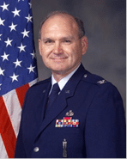

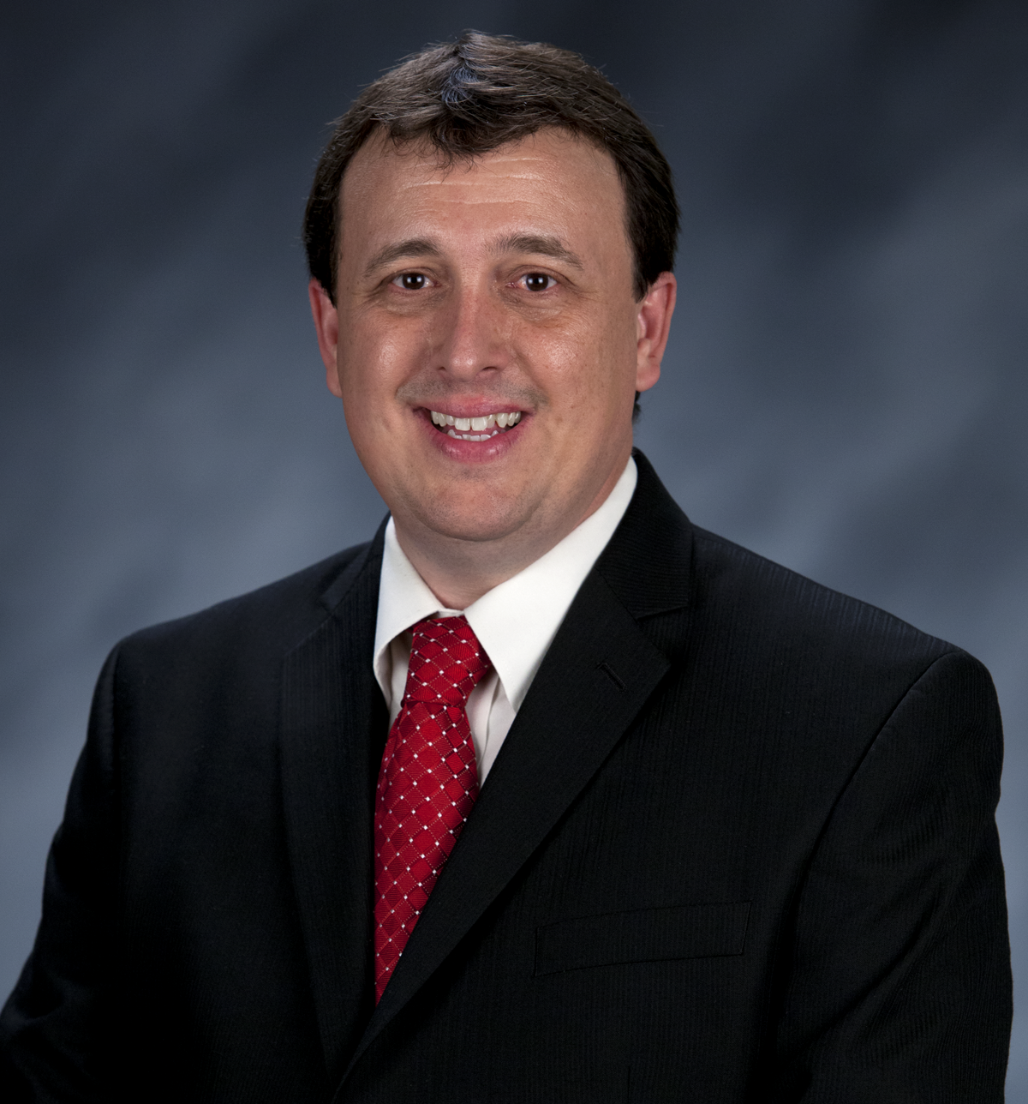
Craig Martin
Vice-Chair,
National Exploring Program Chair
NATIONAL EXPLORING
LIVE HOUR
November 8, 2023
Tim Anderson
National Director
Learning for Life & Exploring
Older Youth Programs

Slide 2

Safety Moment Ideas & Tips*

Slide 3
Safety Moment Ideas & Tips
Ideas for Safety Topics…
  The possibilities of what to cover in your safety moment are unlimited. Your subject doesn’t even need to be about an Exploring activity or an event or the participating organization’s workplace. Driving, diet, fitness, home emergency preparedness—all are worthy subjects.
  If you’re feeling overwhelmed, experiencing a safety topic block, or seeking inspiration from others, there are loads of resources online. For example, the National BSA offers excellent safety moment examples at https://www.scouting.org/health-and-safety/safety-moments/
Keep It Fresh & Fun…
    Safety moments happen often. To make them effective, vary them in terms of topics, presentation format, and style. You can use videos, first-person narratives, demonstrations, or interactive role play, and be sure to throw in some humor when appropriate
    Keep your Explorers engaged to ensure your safety moment ideas make the maximum impact

Slide 4
Safety Moment Ideas & Tips continued
Make Your Safety Moment Useful & Personal…
  Your Explorers & participating organization personnel are an excellent source for topic ideas. Seek suggestions and encourage them to share their own health and safety experiences, or share your own
  Personal Explorer or Advisor stories have a particularly strong impact. They often show vulnerability, and vulnerability is linked improved post safety. They’re also a great way to encourage communication and post team building. This is an important part of creating a strong post culture, because safety is a team effort
  But certainly don’t shy away from general safety moment ideas. For guidance, look to the weather or upcoming holidays. Winter brings icy surfaces: bring awareness to preventing slip and falls. Summertime is pool time, so address the hazard of drowning and encourage pool safety. If you’re searching for a safety moment of the day, think through the particular risks the participating organization’s workplace environment poses every day
  What is most important when choosing a topic is that it be relevant to your Explorers and their needs, and useful

Slide 5
Safety Moment Ideas & Tips continued
Anatomy of a Safety Moment…
  So you’ve homed in on your topic, and it’s one that you feel will be very useful to your post. Now what? You’ve got about five minutes to communicate the message. A few key elements to consider for a successful presentation include the following:
    Provide the “why”: Begin by letting Explorers know why you chose this topic, why you felt it was relevant to them. If the topic was someone suggestion, say so. Let post know you’re listening
    Make it concise and narrowly focused: You have a couple minutes to present your topic; stay on point and don’t try to cover too much
    Make it conversational: These are not formal safety meetings nor are they a time for you to dictate behavior. Keep the tone friendly and conversational
    Provide takeaways: Give your post ways to implement the topic you’ve presented. This makes your safety moment feel useful and applicable in the real world
    Ask and encourage questions: This is an excellent opportunity for dialog, feedback, and creating community.
.

Slide 6
Safety Moments ~
Youth / Young Adult Suicide Prevention
* Scouting Safety Moments’ Youth Suicide Prevention (see https://www.scouting.org/health-and-safety/safety-moments/youth-suicide-prevention/)
)

Slide 7
Youth / Young Adult Suicide Prevention…
Overview
Youth & young adult suicidal behavior is a problem that you may encounter in Exploring or with friends of Explorers, but it is often preventable
In order to save the life of a youth or young adult at risk, it is important to have a plan in place beforehand, know local professional resources, understand the severity of the problem, look for the signs in the Explorers you lead, understand major risk factors, and know how you can help

Slide 8
Youth / Young Adult Suicide Prevention continued
Risk Factors ~ Youth or young adults with risk factors are more likely to engage in suicidal behavior, while those with protective factors in their families and communities are less likely. While the risk factors don’t directly cause the behavior, research with youth or young adults who have attempted suicide often show that risk factors were present. They include:
Mental illness
Substance abuse
Previous suicide attempts
Non-suicidal self-injury
Low self-esteem
Having a clear plan for suicide
Having close proximity to a means of killing oneself
Severe depression
Loss of a loved one
Medical problems
Family or friend rejection
Sleep or eating problems
Withdrawing from friends and social activities
Expressing a sense of hopelessness
Being a victim of bullying

Slide 9
Youth / Young Adult Suicide Prevention continued
Protective Factors ~ Youth or young adults with protective factors include family and school connectedness, affiliation with religious organizations, safe schools, academic achievement, positive self-esteem, and active involvement in groups that promote a sense of achievement—such as our Exploring Program
When you suspect that someone might be suicidal:
If you have a plan in place, follow it
Take every threat seriously
Don’t be afraid to ask whether the person has considered suicide
Listen and accept the person at face value
Don’t give false reassurance
Notify the person’s parent or guardian and seek professional help
Report any abuse to the appropriate authorities
One easy way to engage a youth or young adult is to simply ask if something is sad, bad, or scary in their life
Resources
National Suicide & Crisis Lifeline; telephone: 988
Centers for Disease Control and Prevention
American Foundation for Suicide Prevention
American Association of Suicidology

Slide 10

LEARNING FOR LIFE CORPORATE MISSION:
To develop and deliver engaging, research based academic, character, leadership and career focused programs aligned to state and national standards that guide and enable all students to achieve their full potential.
NON-DISCRIMINATION STATEMENT:
Learning for Life programs are designed for all age groups from pre‐kindergarten and not yet age 21. Youth participation is open to any youth in the prescribed age group for that particular program. Adults are selected by the participating organization for Involvement in the program. Color, race, religion, gender, sexual orientation, ethnic background, disability, economic status or citizenship is not criteria for participation by youth or adults.
Notes:
AFFILIATION STATEMENT
Learning for Life is one of the programs that local Boy Scouts of America councils are authorized to deliver, with local executive board approval. Learning for Life is an affiliate of the Boy Scouts of America that is comprised of both a written character education curriculum for PreK – 12th graders and students with special needs, as well as Interactive career Exploring programs for 6th graders thru 20 year olds. Youth participation is open to any youth in the prescribed age group for that particular Program. Adults, 21 years of age and older, are selected by participating organizations for involvement in the Learning for Life programs. Color, race, religion, gender, sexual orientation, ethnic background, disability, economic status or citizenship is not criteria for participation by youth or adults. Youth and adults involved with Learning for Life programs, including Exploring, are registered with Learning for Life as participants. Learning for Life participants are not members of the Boy Scouts of America. Learning for Life, a District of Columbia non‐profit corporation, is a separate 501(c)(3) Corporation, with a Board of Directors that is separate from the Boy Scouts of America. While they have different policies, there are occasions when local Learning for Life and Traditional BSA programs may participate in an event. Both programs will be required to follow the appropriate guidelines, especially regarding safety. Completion of training, registration and annual fees are program specific and not transferable between programs

Slide 11

  Learning for Life Curriculum-Based Programs consists of grade specific, age-oriented, character education lesson plans that are utilized in schools and other educational settings to help instill character and ethical decision making in our youth. The available lesson plans that are offered for Learning for Life Groups include PreK-12 grades, Champions for students with special needs, along with additional digital resources. Learning for Life uses these interactive lessons to help youth make informed decisions while becoming better students and citizens.
  CURRICULUM PROGRAM VISION:
  To provide engaging and relevant PreK‐12 solutions that positively impact academic performance, social & emotional maturity, character development, and career education for all students.
www.learningforlife.org

Slide 12

  Exploring is a co-ed program for youth that are in the 6th grade through 20 years old. Exploring provides opportunities for real-world hands-on career experiences, while helping them “Discover their Future”. The program links youth with mentors and experts with partner businesses and agencies in their communities. Participating in an Exploring Club or Post ensures youth make informed decisions about careers they may or may not be interested in pursuing, while allowing businesses and organizations the opportunity to meet and cultivate future employees.
EXPLORING MISSION:
Deliver character-building experiences and mentorship that allow youth to achieve their full potential in both life and work.
EXPLORING VISION :
Shape the workforce of tomorrow by engaging and mentoring today’s youth in career and life enhancing opportunities.
www.exploring.org

Slide 13

Exploring in comparison to Traditional Scouting
 | SCOUTS BSA | VENTURING | SEA SCOUTS | EXPLORING
UNIT | Troop | Crew | Ship | Club/Post
LEADER | Scoutmaster | Advisor | Skipper | Sponsor/Advisor
YOUTH LEADER | Senior Patrol Leader | President | Boatswain | President or Agency Nomenclature
YOUTH PARTICIPANT | Scout | Venturer | Sea Scout | Participant or Explorer
RE-REGISTRATION | Charter Renewal | Charter Renewal | Charter Renewal | Renewal
SPONSOR | Chartered Org | Chartered Org | Charter Org | Participating Org
SPONSORING AGREEMENT | Charter | Charter | Charter | Memorandum of Understanding (MOU)
UNIT SERVICE | Commissioner | Commissioner | Commissioner | Service Team
YOUTH RUN | Yes | Yes | Yes | Yes
AGE SPAN | 11-18 | 13-20 | 13 - 20 | 11-13/14-20
RELIGIOUS DECLARATION | Duty to God | Duty to God | Duty to God | None
UNIFORM | Scouts BSA | Venturing (Unit Selected) | Sea Scouts (Unit Selected) | Club/Post Selected, not required

Slide 14

National Learning for Life/Exploring
National Professional Staff Direct Support
Tim Anderson
National Director,
Learning for Life/Exploring
Older Youth Programs
Vacant
Project Coordinator
Shane Calendine
Vice President Council Operations (BSA)
Susan Fitzhugh
Sr. Administrative Assistant

Slide 15

National Director/President
Tim Anderson (E)
(V) = Volunteer
(E) = Employee/Professional
Executive Board Secretary
Steven Hardy (E)
NATIONAL LEARNING FOR LIFE EXECUTIVE BOARD
Executive Board Treasurer
Lisa Fritschel (E)
LFL National Executive Board Chair
Mark Wiesenhahn (V)
---------------------------------------------------------------------------------------------
LFL National Executive Board Chair-Elect
Dan Walters (V)
----------------------------------------------------------------------------------------------
LFL National Immediate Past Executive Board Chair/Governance
Fred Markham (V)
-------------------------------------------------------------------------------------------------------------
Vice-Chair
National Exploring
Program Chair
Craig Martin (V)
Staff Advisor-Tim Anderson (E)
Vice-Chair
LFL Curriculum Based
National LFL
Program Chair
Dr. Helen Stiff-Williams (V)
Staff Advisor-Tim Anderson (E)
Vice-Chair
National Exploring
Program Commissioner
Richard “Dick” Davies (V)
Staff Advisor-Tim Anderson (E)
Vice-Chair
National Career Field
Development Chair
Bray Barnes (V)
Staff Advisor-Tim Anderson (E)
Vice-Chair
National Partnerships/
Development Chair
Vacant (V)
Staff Advisor-Tim Anderson (E)
Vice-Chair
National Marketing/
Recruitment Chair
Jeff Schweiger (V)
Staff Advisor-Tim Anderson (E)

Slide 16

Bruin1967@aol.com
Craig Martin
Vice-Chair
National Exploring Program Chair
Bruin1967@aol.com

Slide 17

National Exploring Committee & Subject Matter Experts
Craig Martin
National Exploring Program Chair,
Learning for Life Executive Board
Bruin1967@aol.com
719-331-6406
Richard (Dick) Davies
National Exploring Program Commissioner,
Learning for Life Executive Board
Exploring Chair,
National Commissioner Service Team
Richard.davies.nyc@gmail.com
914-327-7430
u

Slide 18
Current Exploring Participation Status

Slide 19
Exploring Membership Growth Opportunity…
As of… | Units |  | Youth Membership |  | Adult Membership
 | Clubs | Posts | Clubs | Posts | Clubs | Posts
31 Jan 2020 * | 395 | 4,055 | 14,903 | 80,474 | 704 | 19,095
6 Oct 2023 | 81 | 1,667 | 1,397 | 25,835 | 380 | 10,657
Opportunity | 314 | 2,388 | 13,506 | 54,639 | 324 | 8,438
* Just before the COVID-19 Pandemic shut-down all in-person meetings
Positive upward trend since 8 Sep 2023

Slide 20
Exploring Participants as of 6 October 2023
Clubs/Posts = 1,748 (+34) Youth = 27,232 (+1523) Adults = 11,037 (+218)
Career Area Units Youth Adults
Arts & Humanities 6 204 53
Aviation 43 (+1) 571 (+30) 325 (+2)
Business 12 (-1) 470 (+29) 60 (-6)
Education 38 (+1) 2,069 (+304) 200 (+11)
Communications 5 113 30
Engineering & Technology 29 (-3) 745 (+18) 187(-17)
Explorer Clubs 81 (+4) 1,397 (+127) 380 (+16)
Fire/Emergency Services 486 (+5) 5,445 (+164) 3,244 (+44)
General Interest 74 (+3) 2,091 (+46) 471 (+21)
Health Care 61 (+3) 1,752 (+332) 344 (+16)
Law Enforcement 699 (+11) 7,297 (+54) 10,556 (+3,259)
Law / Gov’t / Public Service 78 (+6) 2,079 (+499) 495 (+31)
Science 21 1,281 (+1) 105
Skilled Trades 21 227 (+33) 121 (+4)
Social Services 4 129 (+2) 27
STEM 13 (+1) 386 (+33) 62 (-4)
No Special Interest Selected 75 (+3) 1,223 (+183) 445 (+20)
NOTE: Numbers in parentheses are changes since 8 September 2023

Slide 21
National Exploring
Subject Matter Experts (SMEs)
&
Exploring Resource Advisors (ERAs)
Information

Slide 22
National Exploring Subject Matter Experts & Exploring Resource Advisors
In support to our sixteen National Service Territories (NSTs), our National Exploring Program is currently supporting each NST, along with their territory’s councils, with a National Exploring Subject Matter Expert (SME), who serves as that territory’s Exploring Resource Advisor (ERA). As a caveat, we do not presume this role is either formally or informally part of the NST organizational structure but rather a service being made available by the National Exploring Program to each NST and/or their councils. Additionally, we have an ERA dedicated to supporting the California Highway Patrol (CHP) and the councils with CHP Law Enforcement Posts as well as the posts themselves

Slide 23
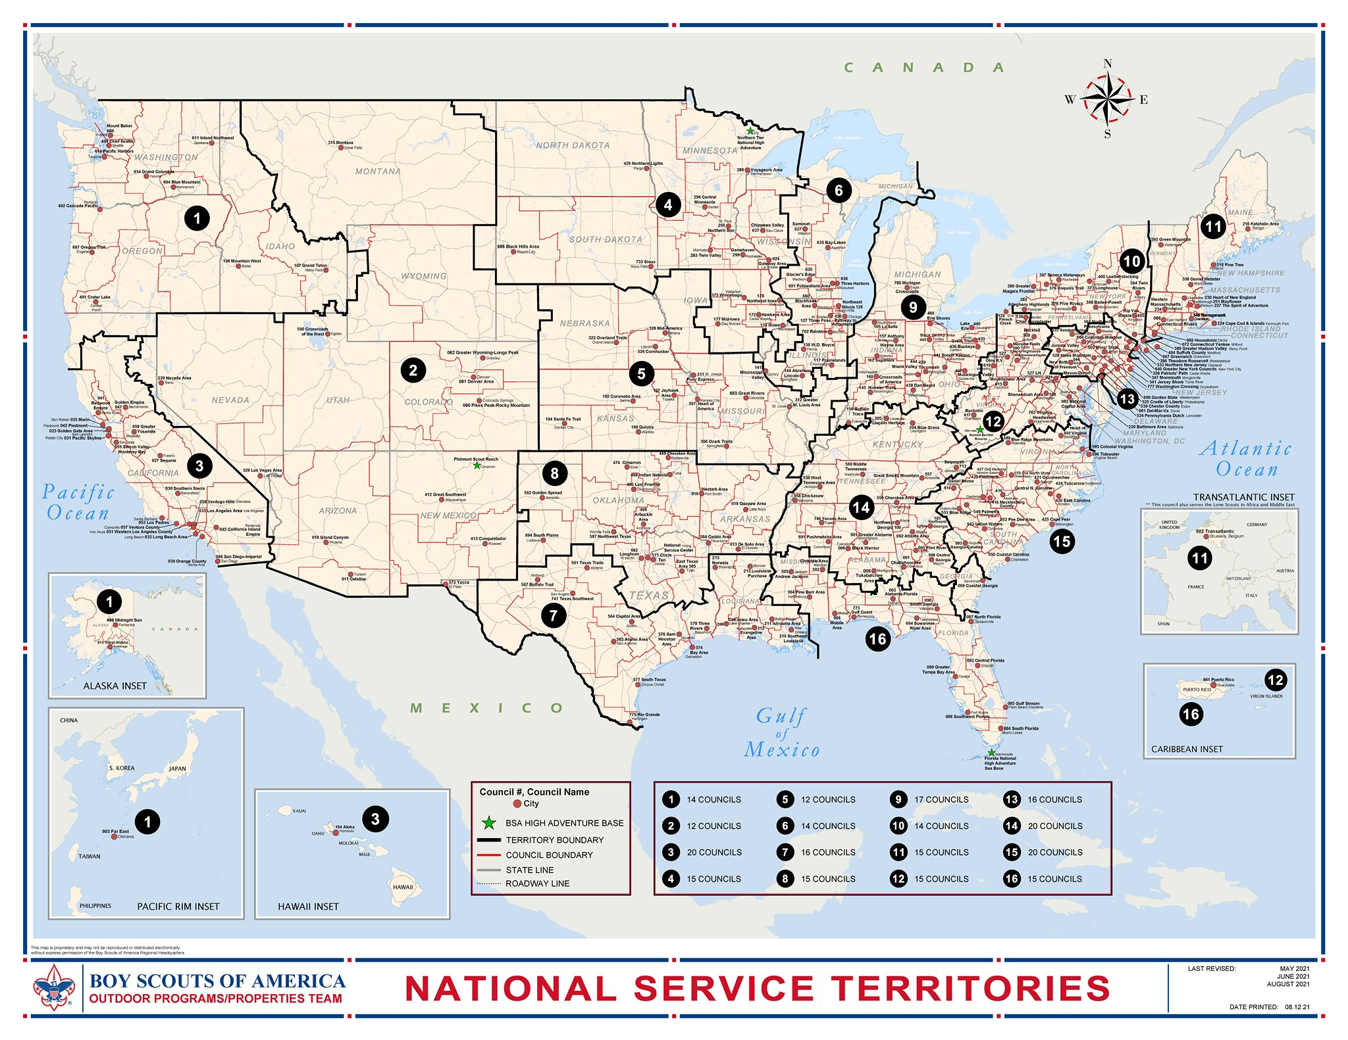
National Service Territories…

Slide 24
Current National Exploring SMEs / ERAs Team...
NST 1 ~ Suzie Steiner (Mountain West Council), who is currently an Advisor for an Exploring STEM / Robotics Post, which also encompasses trades such as machining & welding and business careers, and has previously been an assistant district commissioner, assistant & roundtable commissioner and Cub Scout den leader. Exploring Resource Advisor (ERA) supporting the NST 1 and councils within the territory
suzie@openlabidaho.org
((208) 869-2403
NST 2 & 3~ Stuart Mahler (Golden Gate Area Council), who is currently an Assistant Council Commissioner and LFL Council Exploring Chair and Executive Board Member as well as a retired police officer, an advisor in the 1987 Law Enforcement Exploring National Academy, staff member on three National Exploring Law Enforcement Exploring Conferences and Law Enforcement Explorer in his youth. Exploring Resource Advisor (ERA) supporting the NST 2 & 3 and councils within those two territories
mdc.stuart@gmail.com
(925) 519-6957
NST 4 & 5 ~ Roger Engelbart (Greater St Louis Area Council), who is currently the Assistant Council Commissioner for Training and the Engineering Chair for the Council Exploring Committee, as well as a retired Boeing Engineer involved in Nondestructive Evaluation. Exploring Resource Advisor (ERA) supporting the NST 4 & 5 and councils within those two territories
engelbart301@sbcglobal.net
(314) 920-8968

Slide 25
Current National Exploring SMEs / ERAs Team...
NST 6 ~ Richard (Dick) Davies (Glacier's Edge Council) who is the National Exploring Commissioner, Exploring Chair for the National Commissioner Service Team & National Exploring Program Committee Vice-Chair, as well as VP - Development in Glacier's Edge Council (Madison, WI), Greater New York Councils Executive Board Member, former Interim Scout Executive for the Greater New York Councils (2021 & 2022), past Northeast Region Exploring Chair and Board Member, and, in his youth, National Explorer President (1976-77) & Youth Member of National Executive Board. Exploring Resource Advisor (ERA) supporting the NST 6 and councils within the territory
richard.davies.nyc@gmail.com
(914) 327-7430
NST 7 & 8 ~ Craig Martin (Pathway to the Rockies Council), who is the National Exploring Program Committee Chair as well as a retired Senior Systems Engineer supporting Department of Defense satellite programs and a retired USAF Colonel with extensive experience building, testing, launching & operating US Air Force satellites and testing air-to-air & air-to-ground missile systems. Exploring Resource Advisor (ERA) supporting the NST 7 & 8 and councils within those two territories
bruin1967@aol.com
(719) 331-6406
NST 9 ~ Richard (Rick) Belford, Jr. (Western Massachusetts Council), who is currently the Council Executive Board’s Vice President of Membership, Executive Board member, Exploring Service Team member and a former Associate Advisor and Committee Member for two Posts and a former Scouting Professional District Executive as well as Defense Contracts Management Agency (DCMA) Contracts Manager & retired USAF Chief Master Sergeant . Exploring Resource Advisor (ERA) supporting the NST 9 & 11 and councils within those two territories
rebwme234@gmail.com
(860) 749-2028

Slide 26
Current National Exploring SMEs / ERAs Team...
NST 10 ~ Joseph (Joe) Marinelli (Seneca Waterways Council), who is the Council Executive Committee’s & Board’s former Vice President of Exploring, past President of the Finger Lakes Council and Executive Director, Finger Lakes STEM Hub as well as a retired Regional Supervising Superintendent & BOCES (service agency) CEO for 25 school districts in upstate New York. Exploring Resource Advisor (ERA) supporting the NST 10 and councils within the territory
josephjmarinelli@aol.com
(585) 704-4659
NST 11 ~ Richard (Rick) Belford, Jr.
NST 12 ~ John Brady (Del-Mar-Va Council) who is currently a member on the Council Executive Board, District Vice Chair and Sea Scout Ship 198 Committee Member as well as a former Attorney/Labor Relations Specialist for the State of Delaware & a former Scouting Professional District Executive. Exploring Resource Advisor (ERA) supporting the NST 12 & 14 and councils within those two territories
jfbrady13@icloud.com
(302) 228-8566
NST 13 ~ Linda Hassler (Monmouth Council) who is currently a member of her Monmouth Council Board of Directors and Troop 140 Committee Member as well as an Assistant Professor at Rutgers’ School of Nursing, former Northeast Region Area 5 Exploring Chair, former Exploring Post Advisor and a Tennis Explorer in her youth. Exploring Resource Advisor (ERA) supporting the NST 13 and councils within the territory
Lindajhassler@gmail.com
(732) 687-7208
NST 14 ~ John Brady

Slide 27
Current National Exploring SMEs / ERAs Team...
NST 15 & 16 ~ Kenneth (Ken) Leedham (Gulf Stream Council) who is currently a District Commissioners, Exploring service team member, associate post advisor, merit badge counselor and Wood Badge staff member as well as a full-time police officer and Law Enforcement Explorer in his youth. Exploring Resource Advisor (ERA) supporting the NST 15 & 16 and councils within those two territories
treasurecoastscouting@gmail.com
(772) 370-2800
CHP ~ Rick TerBorch (Los Padres Council), who is the former National Service Territory (NST) 3 Commissioner, Assistant Council Commissioner and Council Executive Board Member as well as a retired Chief of Police in Arroyo Grande, CA, past Los Padres Council President & Council Commissioner, past National Law Enforcement Exploring Committee Member, Exploring Advisor and over 35+ years in Law Enforcement Exploring. Exploring Resource Advisor (ERA) supporting the California Highway Patrol (CHP) and the councils with CHP Law Enforcement Posts.
rterborch@earthlink.net
(805) 441-1721

Slide 28
Current National Exploring SMEs / ERAs Team...
Additionally, any of these Exploring Resource Advisors are available to any of the NSTs and their councils on the following Exploring Career Fields
Aviation ~ Rick Belford & Roger Engelbart
Business ~ Rick Belford (Contracting & Procurement)
Communications ~ Rick Belford (Broadcasting & Public Relations) and John Brady (Broadcasting & News Reporter)
Engineering & Technology ~ Roger Engelbart, Craig Martin and Suzie Steiner (Robotics)
Health Care ~ Linda Hassler
Law & Government ~ John Brady (Law Careers) and Craig Martin & Rick Belford (Military Careers)
Law Enforcement ~ Ken Leedham, Stuart Mahler & Rick Terborch
Skilled Trades ~ Joe Marinelli & Suzie Steiner
Social Services ~ Joe Marinelli (Education), Linda Hassler (College Professor), Rick Belford & John Brady (Non-Profit / Not-For-Profit Management) and Suzie Steiner (STEM)
Other Career Fields ~ ERA, assisting your NST, will find the best individual to assist you for other Exploring Career Fields

Slide 29
National Exploring Program Opportunities

Slide 30
US Forest Service – Fire Posts National Expansion
BACKGROUND:
  US Forest Service-FIRE has three Explorer Posts in Los Angeles County CA
  They want to expand the program to other National Forests across the US and need help from National Exploring Office to make this happen
On 7 Feb 2023, Craig spoke with Oscar Vargas (in Forest Services WO Fire & Management Office in Los Angeles County CA)
  They have developed a brochure patterned after other Exploring Fire & EMS Post membership recruitment efforts and want National Exploring Office approval to use it, which I requested he sent to me so I could forward to Tim Anderson (National Director of Exploring)
  They are interested in talking with other agencies or organizations points of contact who also have experience in a national Exploring Program presence to glean the best practices from them about growing their programs nationally
After this conversation, I asked our National Exploring Resource Advisor supporting the NST 3 and their councils to also reach out Oscar
  On 9 Feb 2023, Stuart reached out to Oscar and told him that he had previously assisted the California Highway Patrol to create and train their adult leaders within ten pilot Explorer Posts in the Bay Area. Later CHP expanded their program statewide

Slide 31
US Forest Service – Fire Posts National Expansion
After this conversation, I asked our National Exploring Resource Advisor supporting the NST 3 and their councils to also reach out Oscar (continued)
  On 17 Feb 2023, Stuart reached out again to Oscar and gave him the Reader's Digest version of starting the CHP Exploring Law Enforcement Program throughout California
On 17 Feb 2023, Oscar sent Craig a copy of the Forest Service’s propose brochure patterned after other Exploring Fire & EMS Post membership recruitment efforts
  Forward it to Tim Anderson (National Director of Exploring) for approval
  Oscar requested again any info or best practices for nationalizing their Explorer program
  Also wanted to know what the normal/average cost it to register an Explorer across the country. And, can they pay a standard rate for their posts or does the cost change across the country?
  On 2 March 2023, Craig Martin informed (via e-mail) that, per Tim Anderson (National Director of Exploring), the US Forest Service – FIRE proposed brochure was approved for Forest Service use without any caveats

Slide 32
US Forest Service – Fire Posts National Expansion
  On 6 March 2023, Dan Walters (National LFL Executive Board Chair-elect, ), Dick Davies (National Exploring Commissioner), Jeff Schweiger (Vice Chair for Marketing & Recruitment, National LFL Executive Board), Stuart Mahler (National Exploring Resource Advisor supporting NST 3 & 2) and Craig Martin (National Exploring Committee Chair) had an excellent Zoom with Oscar Vargas & Daphne (Giselle) Denzel-Koehn (the US Forest Service - FIRE representatives) about the expansion of their sponsored posts across all their nine regions. (NOTE: Giselle Denzel-Koehn will be the US Forest Service - FIRE lead point of contact with the National Exploring Program and Oscar Vargas will be assisting her)
    As an aside, their posts are a combination of Fire, EMS & Aviation Exploring Career Areas.
    They want their youth & adult membership fees to be identical no matter where each post is located in the United States, i.e., National Fee & council fees is one amount like the California Highway Patrol (CHP) is going to have.
    They understand there is an annual unit renewal when each post renews their MOU. Also, they like the calendar year registration (January thru December) too from a budgetary perspective. We need to obtain agreement ASAP that there is only one council fee (added to the national membership fee of $45) no matter where these posts are located across the nation!! We suggest that additional membership 'council fee' be $20 like the CHP will be getting! How do we make this a reality?
    They were not aware of the Exploring clubs opportunity but they are interested in that possibility.
    Stuart Mahler (National Exploring SME & National Exploring Resource Advisor) is our primary point of contact from the National Exploring Program Committee.

Slide 33
US Forest Service – Fire Posts National Expansion
To the e-mail that I sent Tim Anderson (National Director of Exploring) which captured the info on the previous slide, Tim responded, “Craig, lots to unpack here ...can we please get the team [Dan Walters, Dick Davies, Jeff Schweiger, Bray Barnes, Stuart Mahler & Craig Martin] together (zoom call) to unpack all these requests (have open discussion)? I have some comments/thoughts, and we need to talk through some of the opportunities as it pertains to this partnership. While some things could be similar to CHP, it may be very challenging to replicate that 'exactly' due to unique circumstances. In addition, new partnerships during our bankruptcy creates even more discussion. Anyway, definitely not something we can resolve over texts (will take some collaborative efforts from Bray, Dan, you, etc). Feel free to set up a meeting...."
Zoom meeting with Tim Anderson to discuss the above still needs to be scheduled

Slide 34
21 -22 October 2023
National BSA Program Development Committee (PDC)
In-Person Meeting

Slide 35

October 2023 In-Person* Meeting in Dallas TX
Saturday October 21
9:00 to 10:00 am General Committee Items
10:00 to 12:00 pm Work Session 1 (Work and Report)
12:00 to 1:00 pm Lunch
1:00 pm to 3:00 pm Work Session 2 (Work and Report)
3:00 pm to 5:00 pm Work Session 3 (Work and Report)
6:00 pm Dinner
Sunday October 22
9:00 to 11:00 am Work Session 4 (Work and Report)
11:00 to 12:00 pm Debrief/Wrap-up
12:00 pm Adjourn
  * In addition to Craig Martin, both Dick Davies & Jeff Schweiger also attended as part of our Exploring Program participation
Notes:
Dallas: This will be a Working Session. In breakout groups we will brainstorm a series of topics with reports back to the whole group.

Slide 36
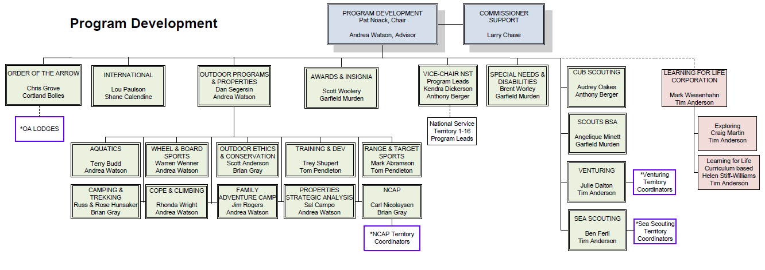
Program Development Committee
Notes:
Program encompasses a very broad set of unit based, activity based and support Subcommittees.
We report to the National Operations Leadership Committee (NOLC). Which includes the following committees:

Slide 37
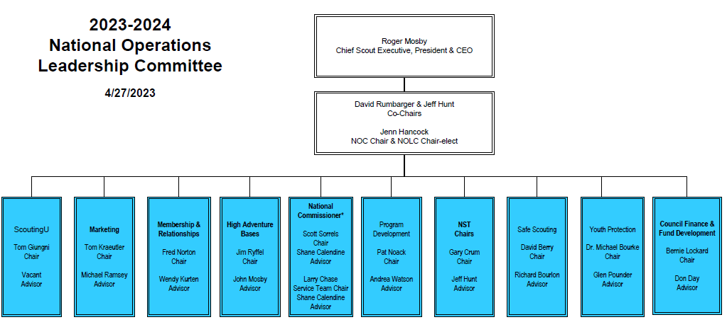
National Operations Leadership Committee

Slide 38
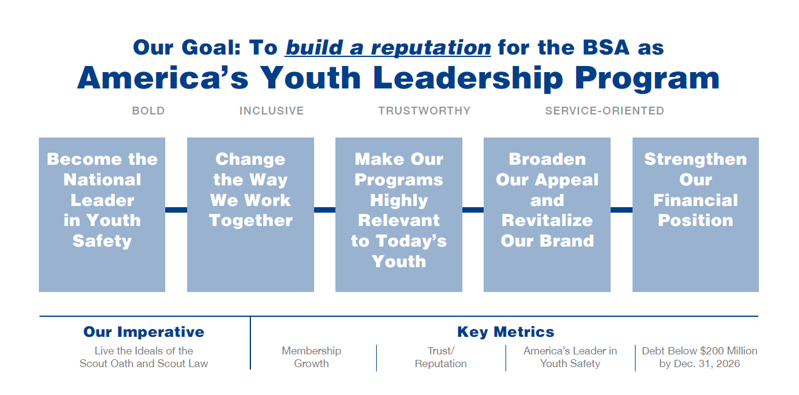
Scouting Forward Roadmap
Notes:
Freddy Norton and Wendy Kurten

Slide 39
PDC Priorities 2023-2024
Relevant Program
  Support Councils in helping Units deliver programs as written.
  Simplify manuals, literature, and resources to make it easier to deliver Scouting programs.
  Continued focus on diversity, equity and inclusion and creating a welcoming environment for diverse members.
  Focus on additional program models that provide program in new delivery models.
Culture of Safety
  Promote delivery of all programs as written to improve safety at all levels.
  Emphasize BSA safety initiatives and industry safety standards.
Revitalize BSA Brand
  As part of Membership Growth, work to eliminate barriers to growth and retention.

Slide 40
Prioritization Process for Working With Scouting U
Prioritization parameters
  Major Changes in Program that need to be reflected in training
  Safety Changes that need to be reflected in training
  Diversity aspects that need to be reflected in training
  Training that needs to be moved to new technology platforms
  Number of participants impacted
Process
  Recommendations from Subcommittees by Sept 12th to Pat including fit with prioritization parameters
  Will select Top 10 and Second 10 to be sent to Scouting U

Slide 41
Prioritization Process for Working With Scouting U
On 24 Oct 2023, Pat Noack send the following, “PDC Training Priorities – We’ve continued to work with Scouting U on how to build a stronger relationship with them. As part of that, we agreed to provide them with our PDC priorities. I thank everyone for the input into how your Subcommittee’s needs fit the prioritization parameters we established and sent to you (see attached). Shane, Andrea and I looked at your input and established a three tier system of PDC priorities to share with Scouting U. Andrea and I were able to meet last week with Tom Giugni, Chair of Scouting U Committee, and Wendy Kurten, Staff Advisor to Scouting U, to describe our results and to get their input as well. We left that meeting with agreement from them on the priorities (see next slide) and with a plan for moving forward with the First Tier priorities.”

Slide 42
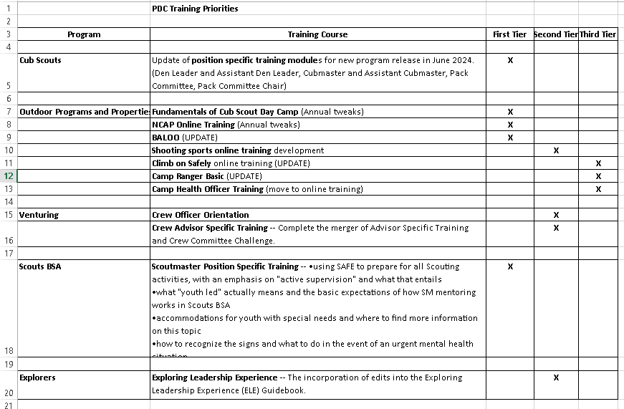
Prioritization Process for Working With Scouting U

Slide 43
Prioritization Process for Working With Scouting U
On 24 Oct 2023, Pat Noack also described the moving forward plan as follows:
We will hold a joint planning meeting for each of the 5 First Tier priorities in the first part of Nov 2023
A short Statement of Work will be completed to document:
  The PDC representatives, Scouting U representatives and Other Scouting group representatives (e.g., Safe Scouting) that are needed as part of the work effort
  The scope will be documented so everyone is on the same page for the work effort expected
  Estimated start and end time of the work effort
  (Note: The Statement of Work template is still being developed and will need to be agreed to with Scouting U. My hope is that it is simple and one page.)
The goal is for everyone to have a better understanding of who is responsible for what, how we will work together, and the timelines we’re looking at
The moving forward plan also anticipates that the priorities might change as PDC’s needs change or because of timing elements of when First Tier work will be ready to go

Slide 44
National Exploring Program Committee

Slide 45
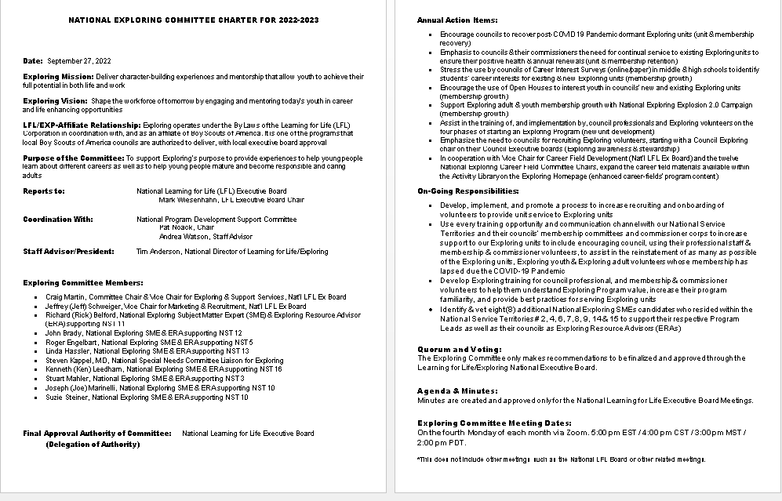
National Exploring Committee Charter…

Slide 46
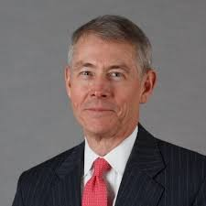
National Exploring Program Commissioner
Richard (Dick) Davies
Richard.davies.nyc@gmail.com
(914) 327-7430
Recent Scouting History
Interim Scout Executive for two years Greater
New York Councils ~ 2021 – 2022
Stepped down as Council Commissioner to take role
Formerly VP – Membership, VP – Scoutreach and Manhattan Borough President
Eagle Scout from Wisconsin
Exploring History
Exploring Chair, National Commissioner Service Team ~ Nov 2022 – TBD
National Exploring Program Commissioner, National LFL Executive Board ~ Nov 2022 -TBD
Area and Northeast Regional Exploring Chair and Board Member ~ 2018 – 2021
National Exploring Committee ~ 1976 – 1979
National Explorer President ~ 1976-77; Youth Member of National Executive Board
Professional Career
Since 2016, angel investor and advisory board member for start-up companies
Consultant to investment management industry
Most of career on business side of investment management industry (business unit management, client and product development) with Alliance Bernstein and Russell investments
Last ten years through 2016 working with largest 401k and other defined contribution plans around the world.

Slide 47
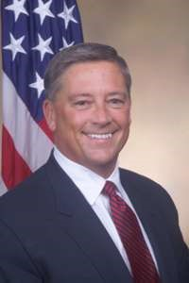

Bray Barnes
Vice-Chair
National Career Field Development Chair

Slide 48

National Exploring Career Field Committee Chairs
Vice Chair
National Career Field Development Chair
Bray Barnes (V)
Tim Anderson (E)
Aviation Chair
Hal Shevers (V)
Arts & Humanities Chair
Lorenzo
Di Bonaventura (V)
Business Chair
Vacant (V)
Communications Chair
Don Dare (V)
Engineering &
Technology Chair
Kurt Kalafsky (V)
Fire & EMS Chair
Harold A. Schaitberger (V)
Health Care Chair
Nancy DiLiegro (V)
Law & Government Chair
Col. Calvin Lowrie (V)
Law Enforcement Chair
Paul Vanderplow (V)
Science Chair
John Graham (V)
Skilled Trades Chair
Brent Booker (V)
Social Services Chair
Vacant (V)

Slide 49

Barriers to Abuse Update
As part of our ongoing commitment to abuse prevention, the Boy Scouts of America, to include Exploring, is updating the adult supervision requirements for overnight activities
This update enhances the minimum “two deep leadership” requirements by additionally requiring every adult present on overnight activities to be a registered member of the Boy Scouts of America or Exploring
These adults must submit an adult application and registration fee, undergo a criminal background check, a volunteer screening database check and must complete mandatory Youth Protection training.
A limited exception for parents and legal guardians of Cub Scout youth attending overnight with their children is planned due to the family centric nature of Cub Scouting
All Cub Scout Packs, Scouts BSA Troops, Venturing Crews, Sea Scouting Ships, Exploring Posts, council, and district overnight programs will be required to comply with this update by September 1, 2023. We encourage early adoption prior to the effective date
This updated Barrier to Abuse will be referenced as part of the Guide to Safe Scouting, Exploring’s Safety First Guidelines, Youth Protection and Adult Leadership section, Scouting’s Barriers to Abuse. Youth Protection and Barriers to Abuse FAQ’s will be expanded to include additional FAQ’s as they are developed

Slide 50
Topic(s) of the Month
Exploring Program Resources
Awards & Recognition
www.exploring.org
Simply scroll to the bottom of the home page and search within the 3 boxes labeled:
“Unit Resources”, Council Resources”, & “Forms”

Slide 51

National Exploring
Volunteer of the Month
The National Volunteer of the Month will be recognized on www.exploring.org
and will receive a certificate and polo shirt from the National Exploring Team!
Nominees should be submitted using the link below
http://bit.ly/ExpVolMonth

Slide 52
2019 National Exploring Volunteer(s) of the Month
April / Mickey Boylan / Old North State Council, Greensboro, NC
May / Daniel Sherwin / Longhorn Council, Ft. Worth, TX
June / Chief James Pushee / Daniel Webster Council, Manchester, NH
July / Scott Hart / Circle Ten Council, Dallas, TX
August / Dick Davies / Greater New York Council, New York, NY
September / Sgt. Jose Diaz / Connecticut Rivers Council, East Hartford, CT
October/ Asst. Chief Martin Birkenfeld / Golden Spread Council, Amarillo, TX
November/ Craig Martin/Pikes Peak Council/Colorado Springs, CO

Slide 53
2020 National Exploring Volunteer(s) of the Month
April / Paul Vanderplow / ATF
May / Chief Ron Pray / Golden Spread Council
June / Dawn Gowen / Costal Georgia Council
July /Fred Markham/ Caddo Area Council
August /Dan Walters/ Golden Gate Area Council
September/George Denise/ Silicon Valley Monterey Bay Council
October/Amanda Clay/ Atlanta Area Council
November/LT. Darla Gray / Greater St. Louis Area Council
December/Sgt Erin Lunsford/Silicon Valley Monterey Bay Council

Slide 54
2021 National Exploring Volunteer(s) of the Month
June / Mike Goldstein / Northern Star Council
July / John Barrett / Circle Ten Council
August / Anthony Jackson / Michigan Crossroads Council
September/ Captain Ryan Ira / Silicon Valley Monterey Bay Council
October/ Eirinn Rickard / Greenwich Council
November/ Mark Wiesenhahn/ National LFL/Exploring Board Chair

Slide 55
2022 National Exploring Volunteer(s) of the Month
May / Wiley “Skeet” Gibble / Cherokee Area Council
June / DuWayne “Duwey” Dixon / Northern Star Council
July / Ronda Williams / Great Trail Council
August / Jeff Schweiger / National Capital Area Council
October / Daric Parent / Circle Ten Council
November/ Sergeant Leonardo Gonzalez /Silicon Valley Monterrey Bay Council
December/ Heather MacInnes/ Western Massachusetts Council

Slide 56
2023 National Exploring Volunteer(s) of the Month
May / Stuart Mahler / Golden Gate Area Council
June / Richard “Rick” Belford Jr. / Western Massachusetts Council
July /
August /
September/
October /
November/
December/

Slide 57
National Exploring Volunteer of the Month
November 2023
Roger Engelbart
Greater St Louis Area Council
(National Exploring SME)

Slide 58
Example Nomination Write-Up
George Denise completed his Exploring Fast Start training on 1/01/2011 and his most recent position is Service Team Chair for my district since February 2018. He has been involved with every aspect from FOS and volunteer recruitment to membership, product sales, program and unit service. George helped Exploring District achieved significant growth in our FOS campaign and 5% membership growth last year. We are at 61% of our FOS goal for the year, second highest percentage in our council. As we shelter-in-place, he secured a dynamic guest speaker for our Science Night and saved us $650 in shipping cost in our Make A Mask Challenge. His efforts made it possible for us to donate thousands of pieces of protective medical gear to 7 medical facilities in 2 counties. He supported a 15 year old Scout in the Medical Explorer program whom has wanted to make a difference. What started as a local mask-making challenge turned into a multi-city effort through connections of Scouting friends in Dallas, TX and Orange County, CA to Santa Clara county .

Slide 59
National Exploring
Volunteer of the Month
The National Volunteer of the Month will be recognized on www.exploring.org
and will receive a certificate and polo shirt from the National Exploring Team!
Nominees should be submitted using the link below
http://bit.ly/ExpVolMonth

Slide 60
v
EXPLORING UPDATES
REMINDERS
Tim Anderson
National Director
Learning for Life & Exploring
National Director Older Youth Programs

Slide 61

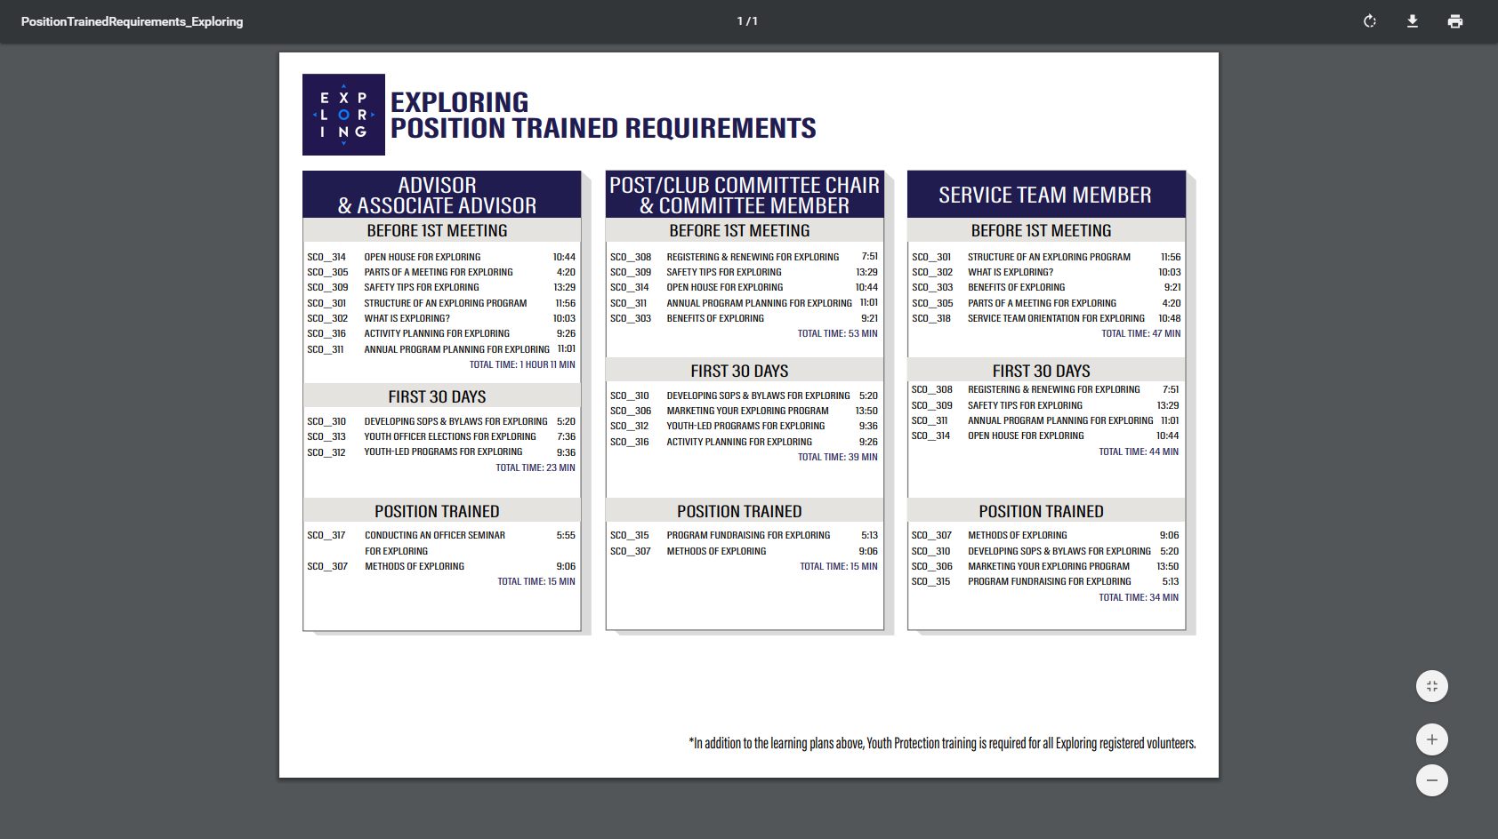
EXPLORING PARTICIPANT POLICY
“EP” (18 THROUGH 20 YR OLD EXPLORERS)
Effective August 1, 2020, all applicants 18 through 20 years old must complete and submit an adult application, consent to a criminal background check, and successfully complete Youth Protection training.
However, an 18- through 20-year-old will still be considered an Adult Exploring Participant in the post and will not be considered an adult leader. Therefore, an “EP” will not be allowed to fulfill adult leadership roles pertaining to Two-Adult Leadership and other requirements that require leadership to be at least 21 years of age.
All Exploring Participants “EP” will continue to count as youth within your youth membership reports.
Visit the link below for an infographic as well as a Q & A to assist you in implementing this important new policy. http://filestore.scouting.org/filestore/se-packet/2020-08-10/Exploring-Participant-Policy-FINAL-2.pdf

Slide 62
EXPLORING REGISTRATION FEES
Effective August 1, 2023, Exploring fee updates:
- Exploring Youth $50.00
- Exploring Adult Participants (18-20) $50.00
- Exploring Adults $50.00
- Exploring Post/Club Annual Renewal Fee $100.00
- There is no additional “Joining Fee” for Exploring
The updated membership fees will take effect August 1, 2023, for new members in the 2023-2024 program year.
The national membership fee helps cover the cost of essential services, including program resources, liability insurance for those participating in approved Scouting activities, criminal background checks, youth protection, and the development of intellectual property for national, council, and unit programs. As we move forward, we will continue to look at the membership fee structure and how we deliver the Scouting program for future generations.

Slide 63
NEWLY UPDATED EXPLORING APPLICATIONS
The newly updated Exploring applications are available now for download online at www.exploring.org
New Post/Club Application (SKU# 655197)
Youth Application (SKU# 634698)
Adult Application (SKU# 634699)
-Includes the new 18-20 Exploring Participant (EP) Code, which will became mandatory beginning August 1st, 2020.
*New applications are available at the National Distribution Center .

Slide 64

Newest Technology for Exploring
BeAnExplorer “Equivalent”
“joinexploring.org”
“joinexploring.com”
Scoutbook for Exploring
Online Registration
Online Renewal

Slide 65

*Exploring Leadership Experience
*Coming soon for Exploring youth
Resume Builder that will help recognize Explorers
This online, mentor assisted, self-paced and guided experience will allow our Explorers to…
Have an opportunity to discover their inner leadership potential
Gain practical leadership experience – participate in a capstone project
Work with a mentor to gain professional leadership experience
Be recognized with a Nationally Certified Leadership Experience Certificate that will help improve their resume and recognize their overall Exploring Experience.

Slide 66
ONLINE
REGISTRATION
FOR EXPLORING

Slide 67
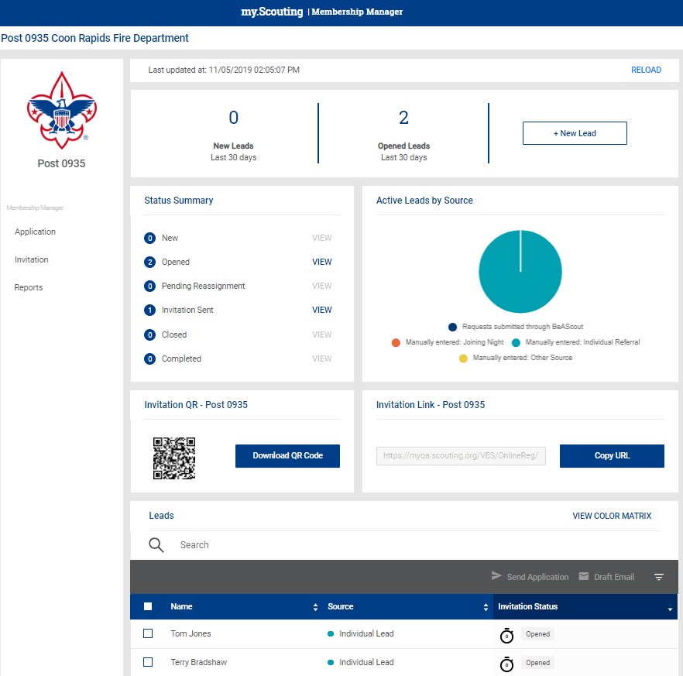
Invitation Manager
There is no BeAnExplorer…yet ☺

Slide 68
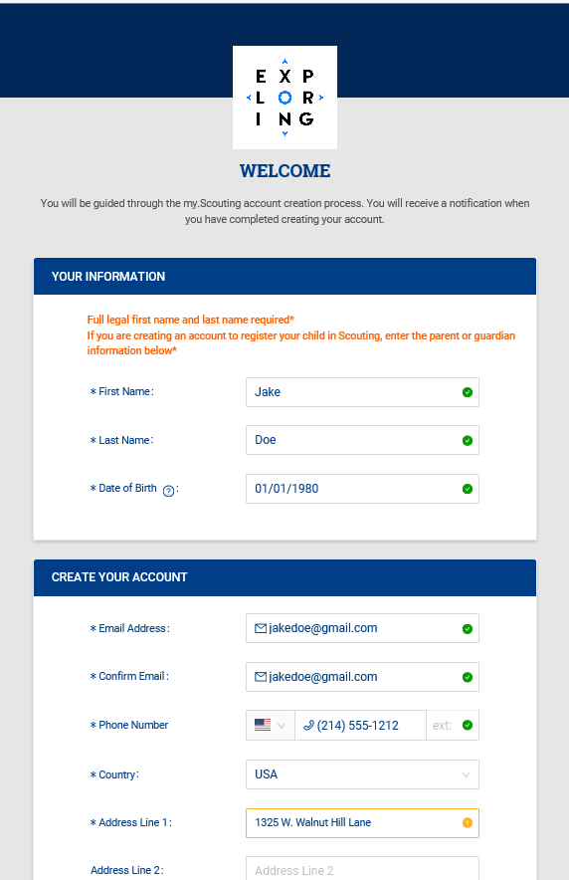
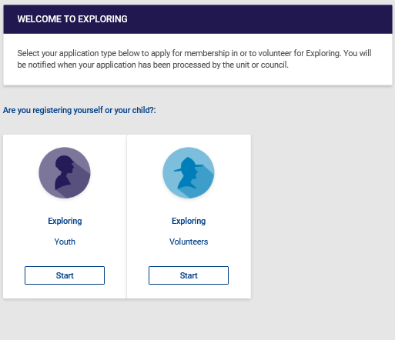
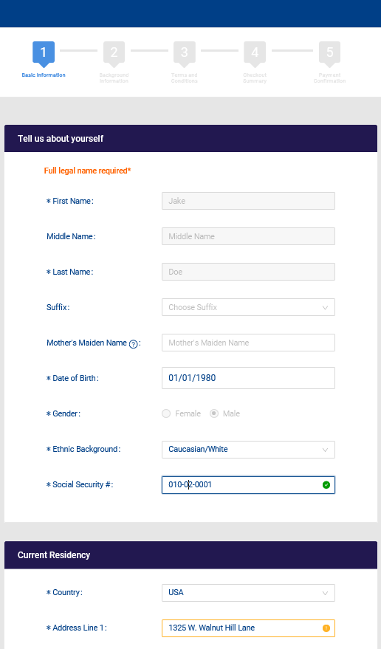
Create Account & Complete Application

Slide 69
ONLINE
RENEWAL/
”RECHARTERING”
FOR EXPLORING

Slide 70
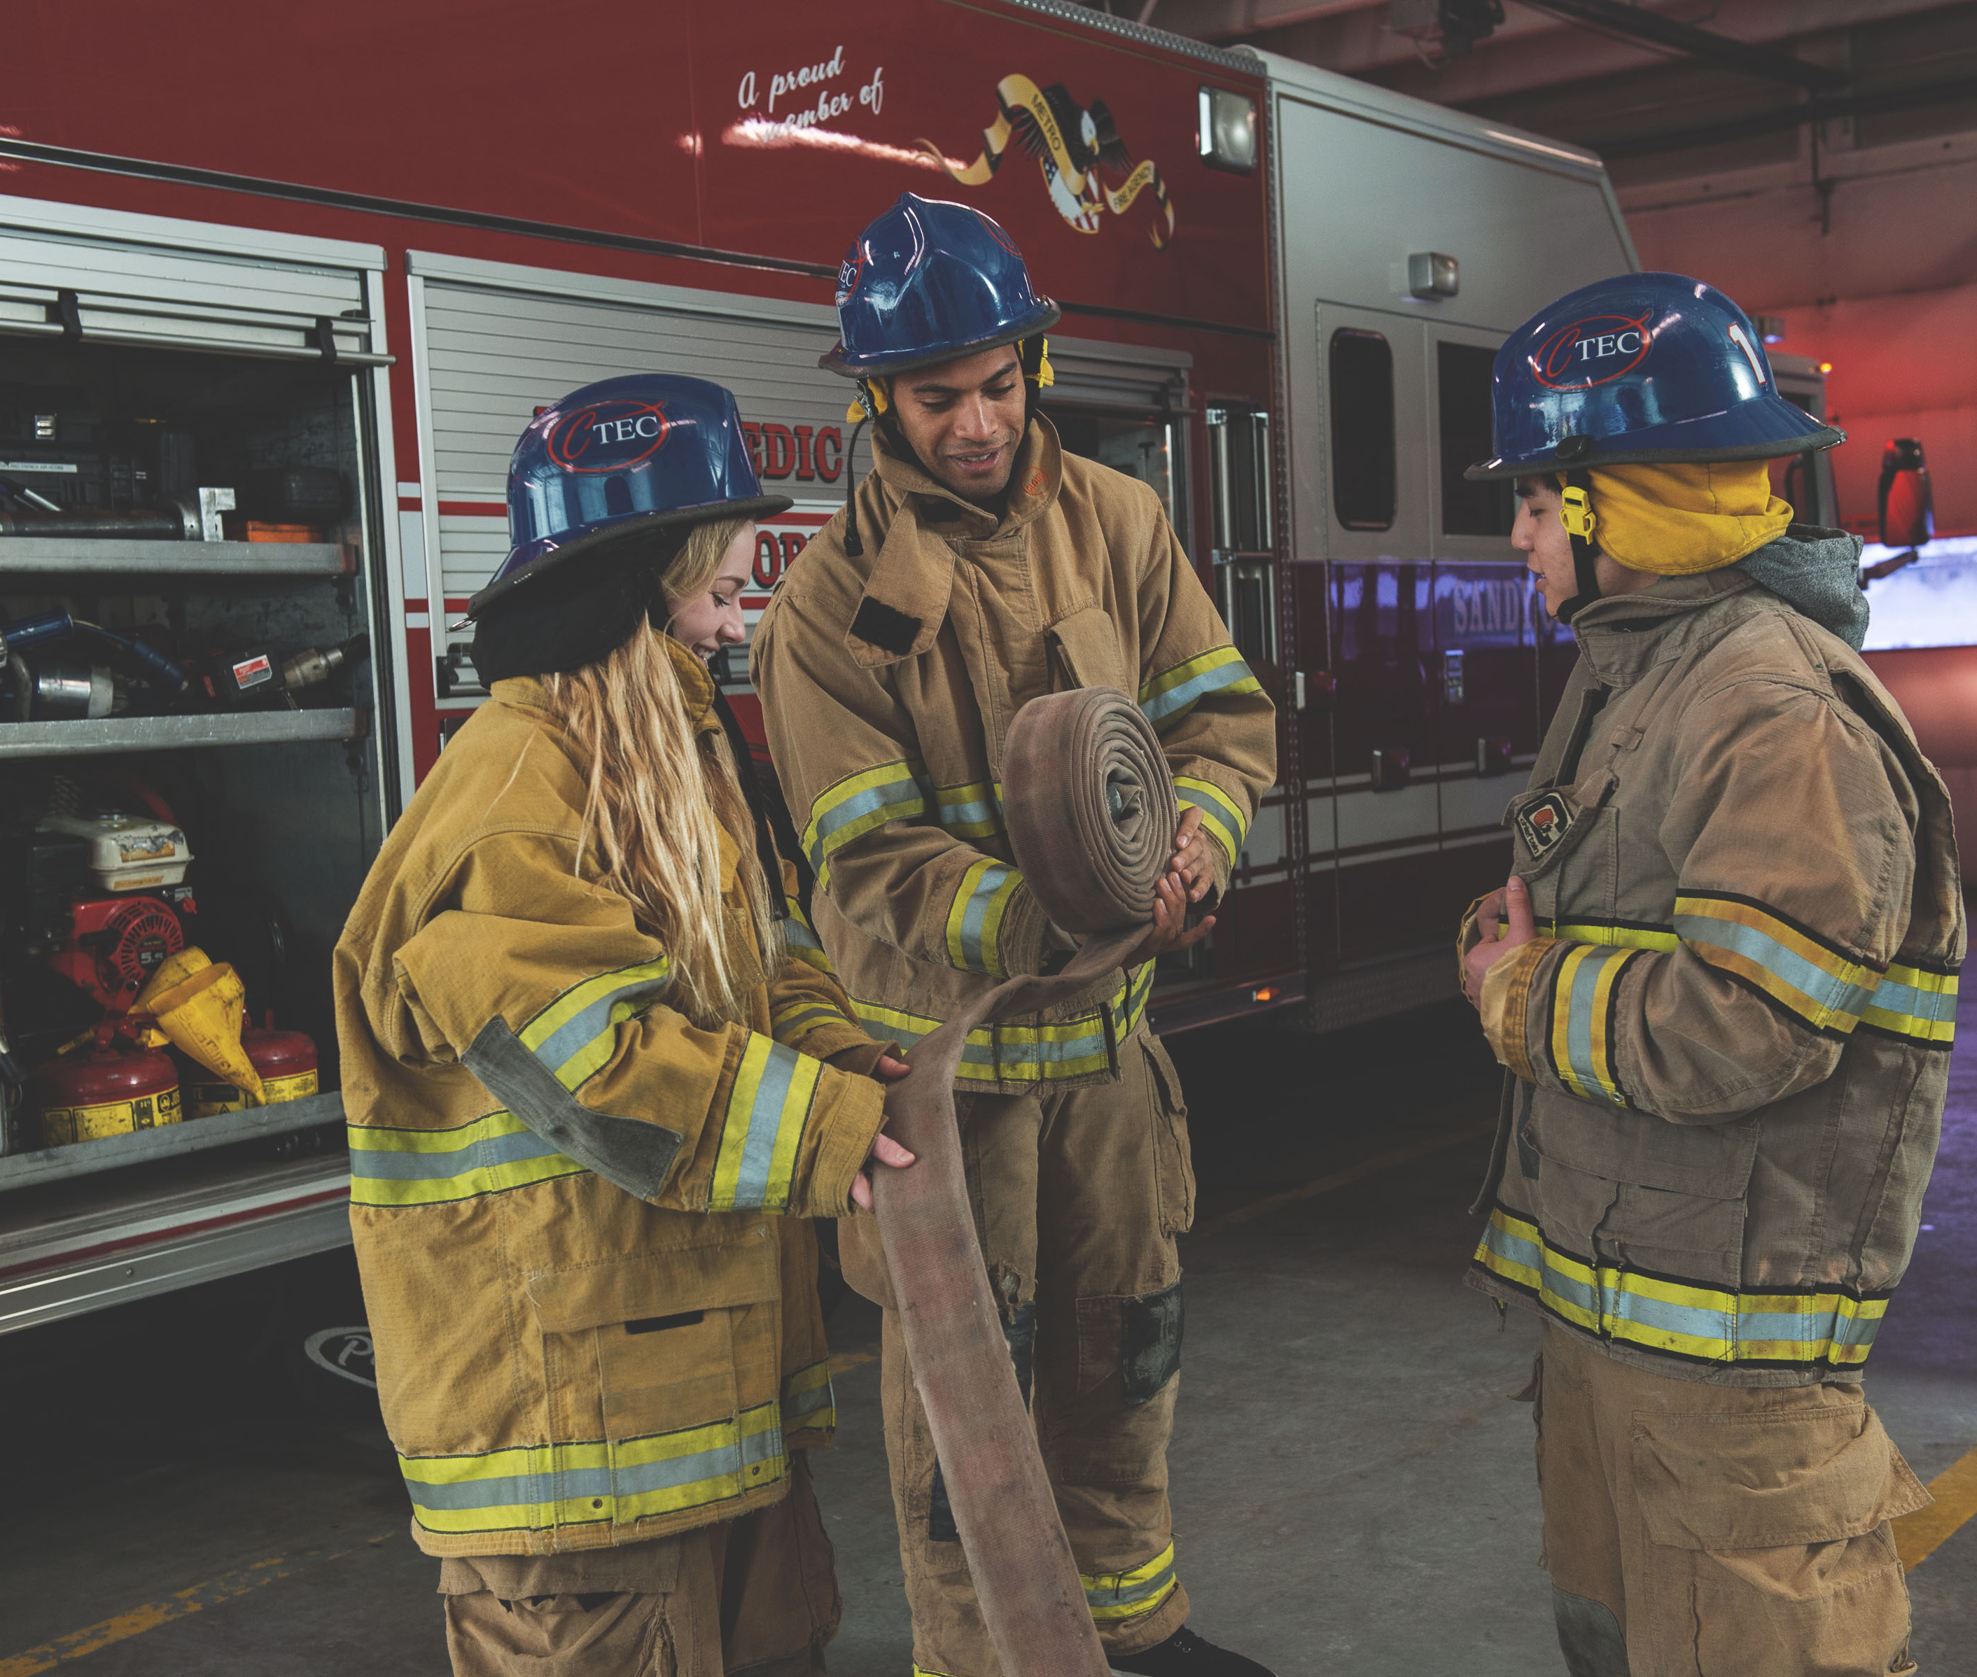
UNIT
“RENEWAL”
Aug 2023 – Feb 2024 Recharters

Slide 71
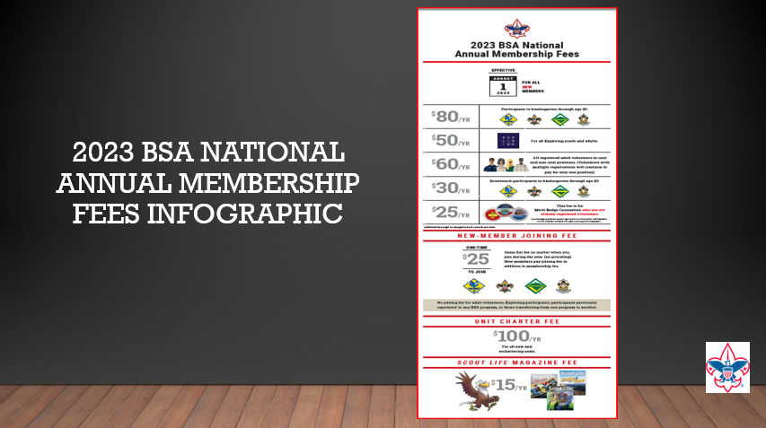

Slide 72

Charter Process
Units will continue to renew AS IS through the February 2024 rechartering
February 2024 units will have a one-month lapse (Sept 2023 – Jan 2024 continue to have 2-month lapse)
March 2024 units will be the first to renew using the new unit charter process (currently affects 737 units nation-wide)

Slide 73
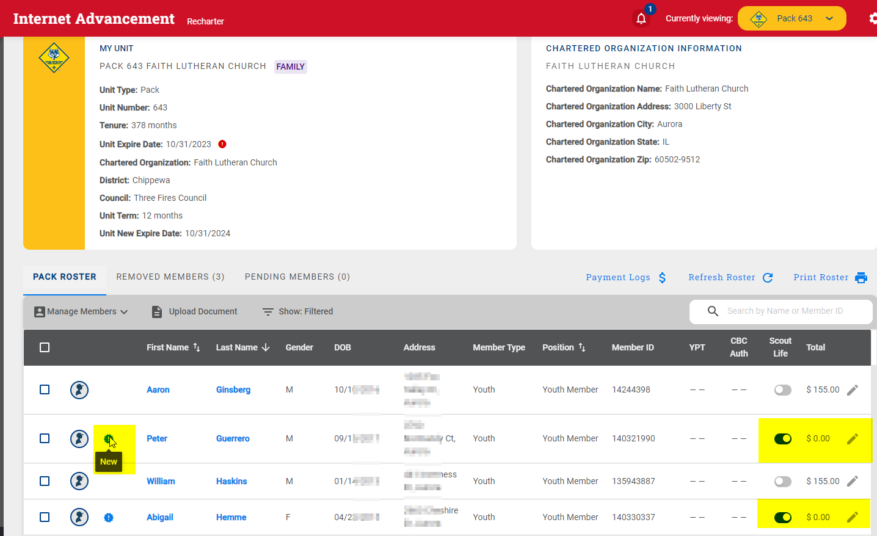

Slide 74
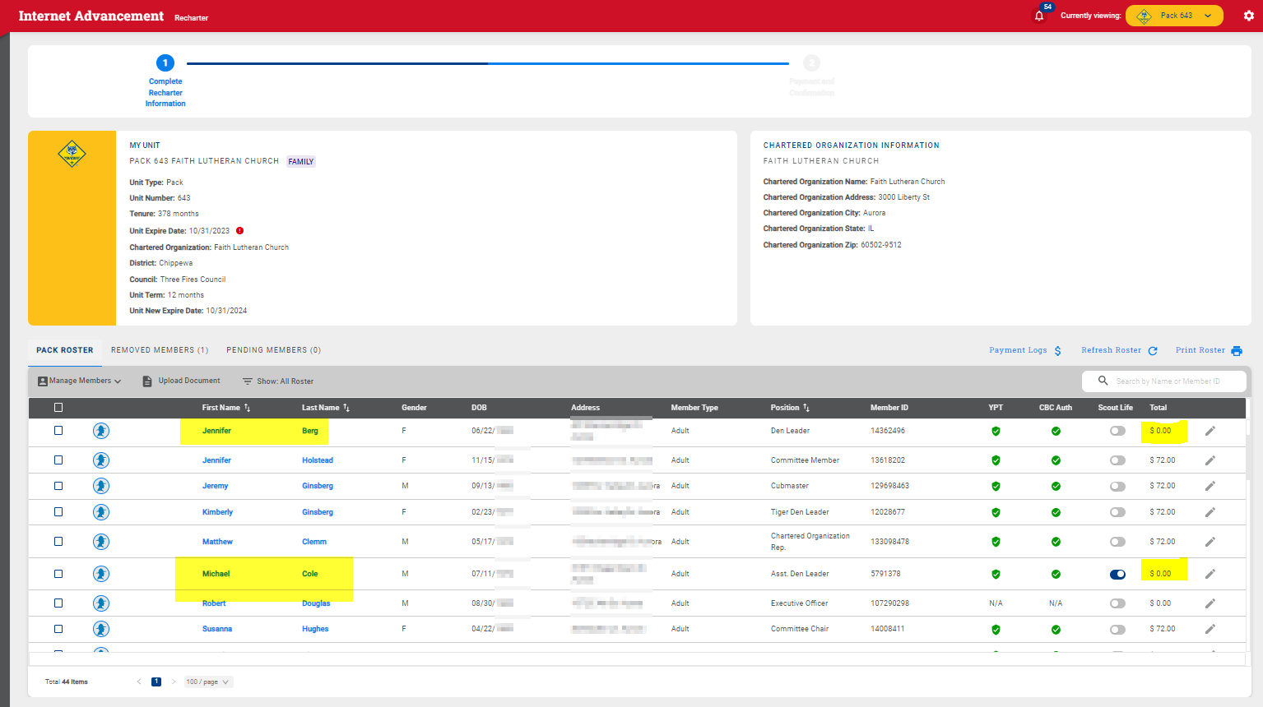

Slide 75
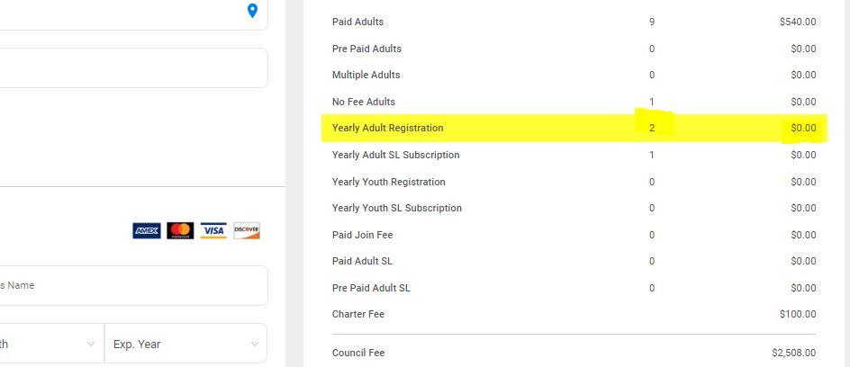

Slide 76
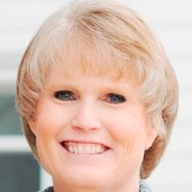
https://www.scouting.org/commissioners/internet-rechartering/
Information included is:
Training Video
FAQ’s
User Guides
Internet Recharter Guidelines
Summary of Enhancements
Recharter Demo Tool
New Online Rechartering/Renewal System
https://advancements.scouting.org/login
Donna Arnold
Manager of Shared Services
Member Data Outsourcing Solutions

Slide 77
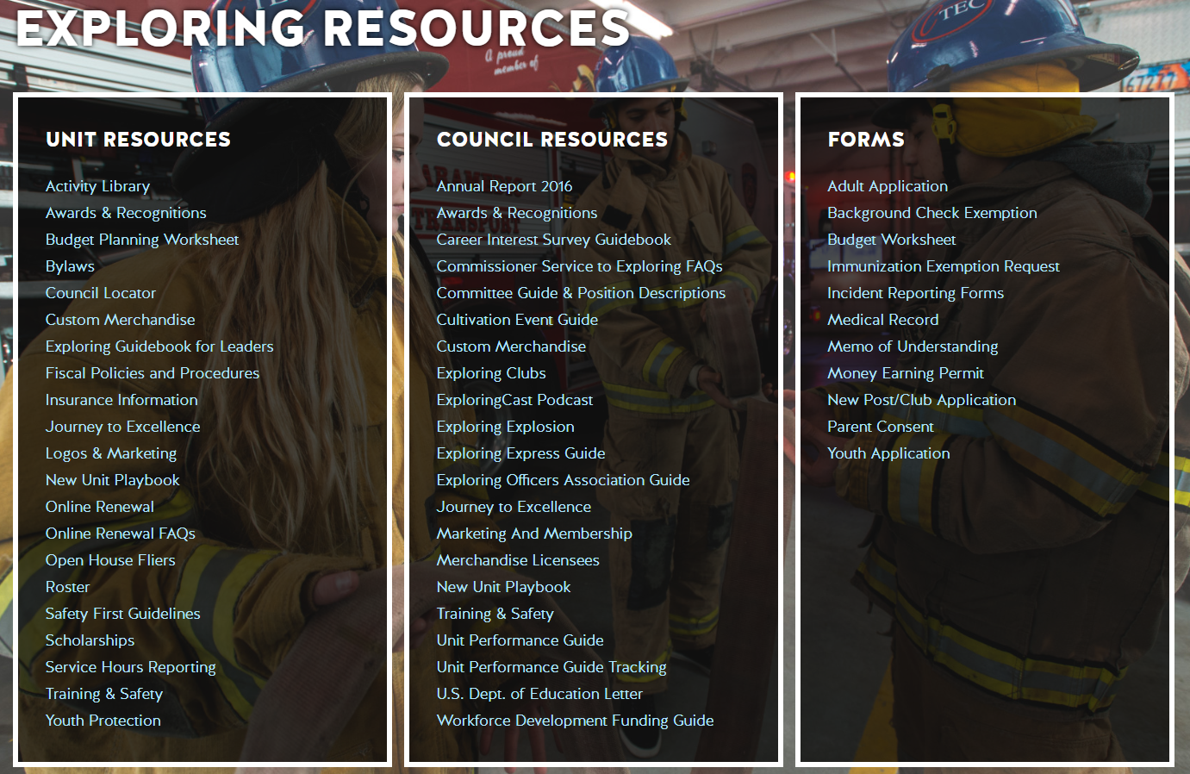
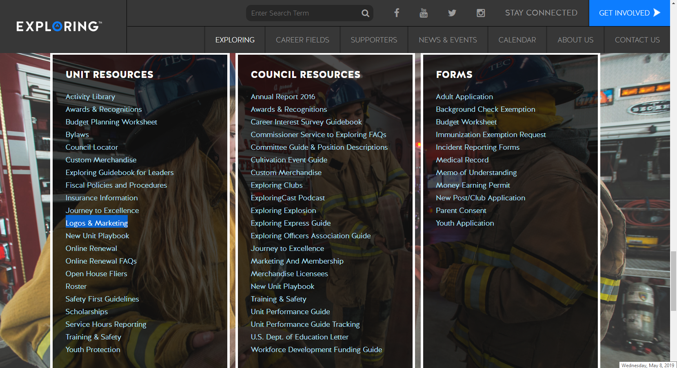

Slide 78
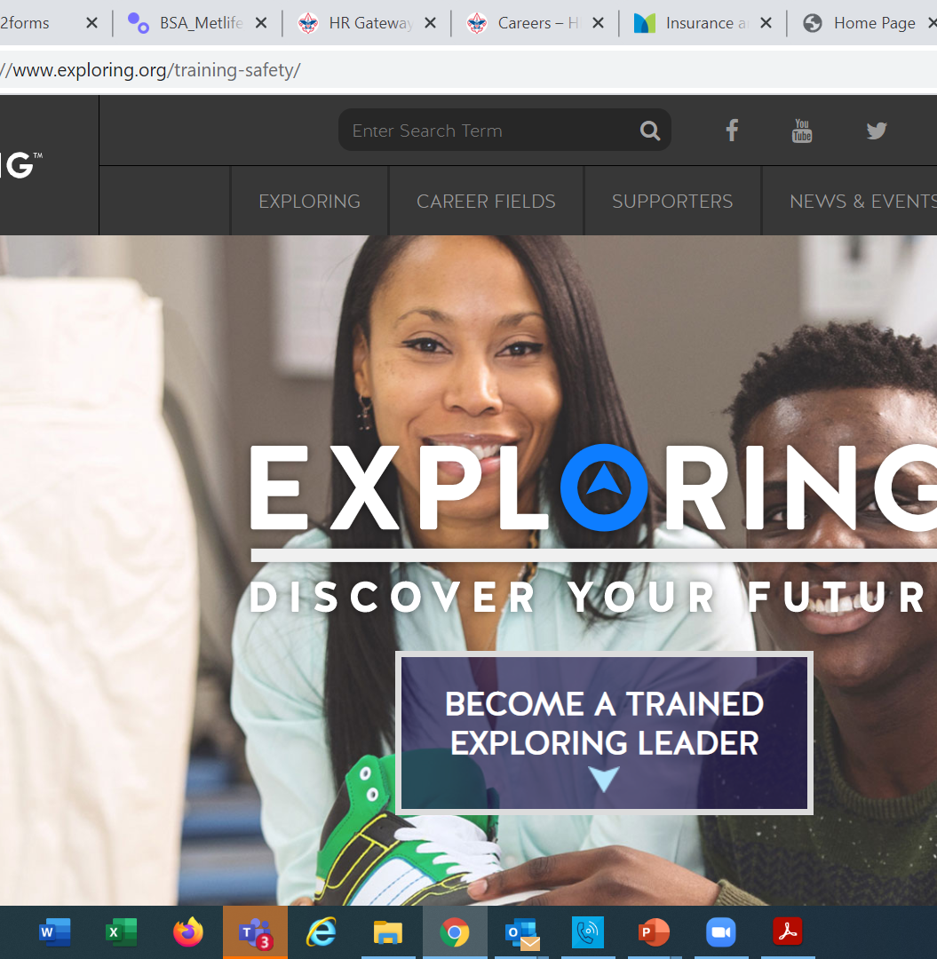
  Exploring Training

Slide 79
Exploring Position-Specific Training Modules
Update Status

Slide 80
Exploring Position-Specific Training Modules Update Status …
The Exploring Leader Training Modules have also been formatted to be experienced through the learning center via computer or smart device.
Login in to https://my.scouting.org/ . If you need to create an account and do not know your member ID number, please contact your local BSA council office/service center
Once you log in, locate the blue box on the right side of your screen labeled “Click here to access Exploring Training”
After logging in, you may also click “Menu” in the top left corner and select “My Training”. Under Training Courses by Program, select “Exploring Adult Training”
You may select between the three available Exploring learning plans (based on position). Anyone is welcome to complete the trainings
NOTE: In addition, the “Servicing Exploring Units Module for Commissioners” has been updated within the Learn Center.
We would like to sincerely thank the many Exploring professionals and volunteers that helped make this important update happen!

Slide 81
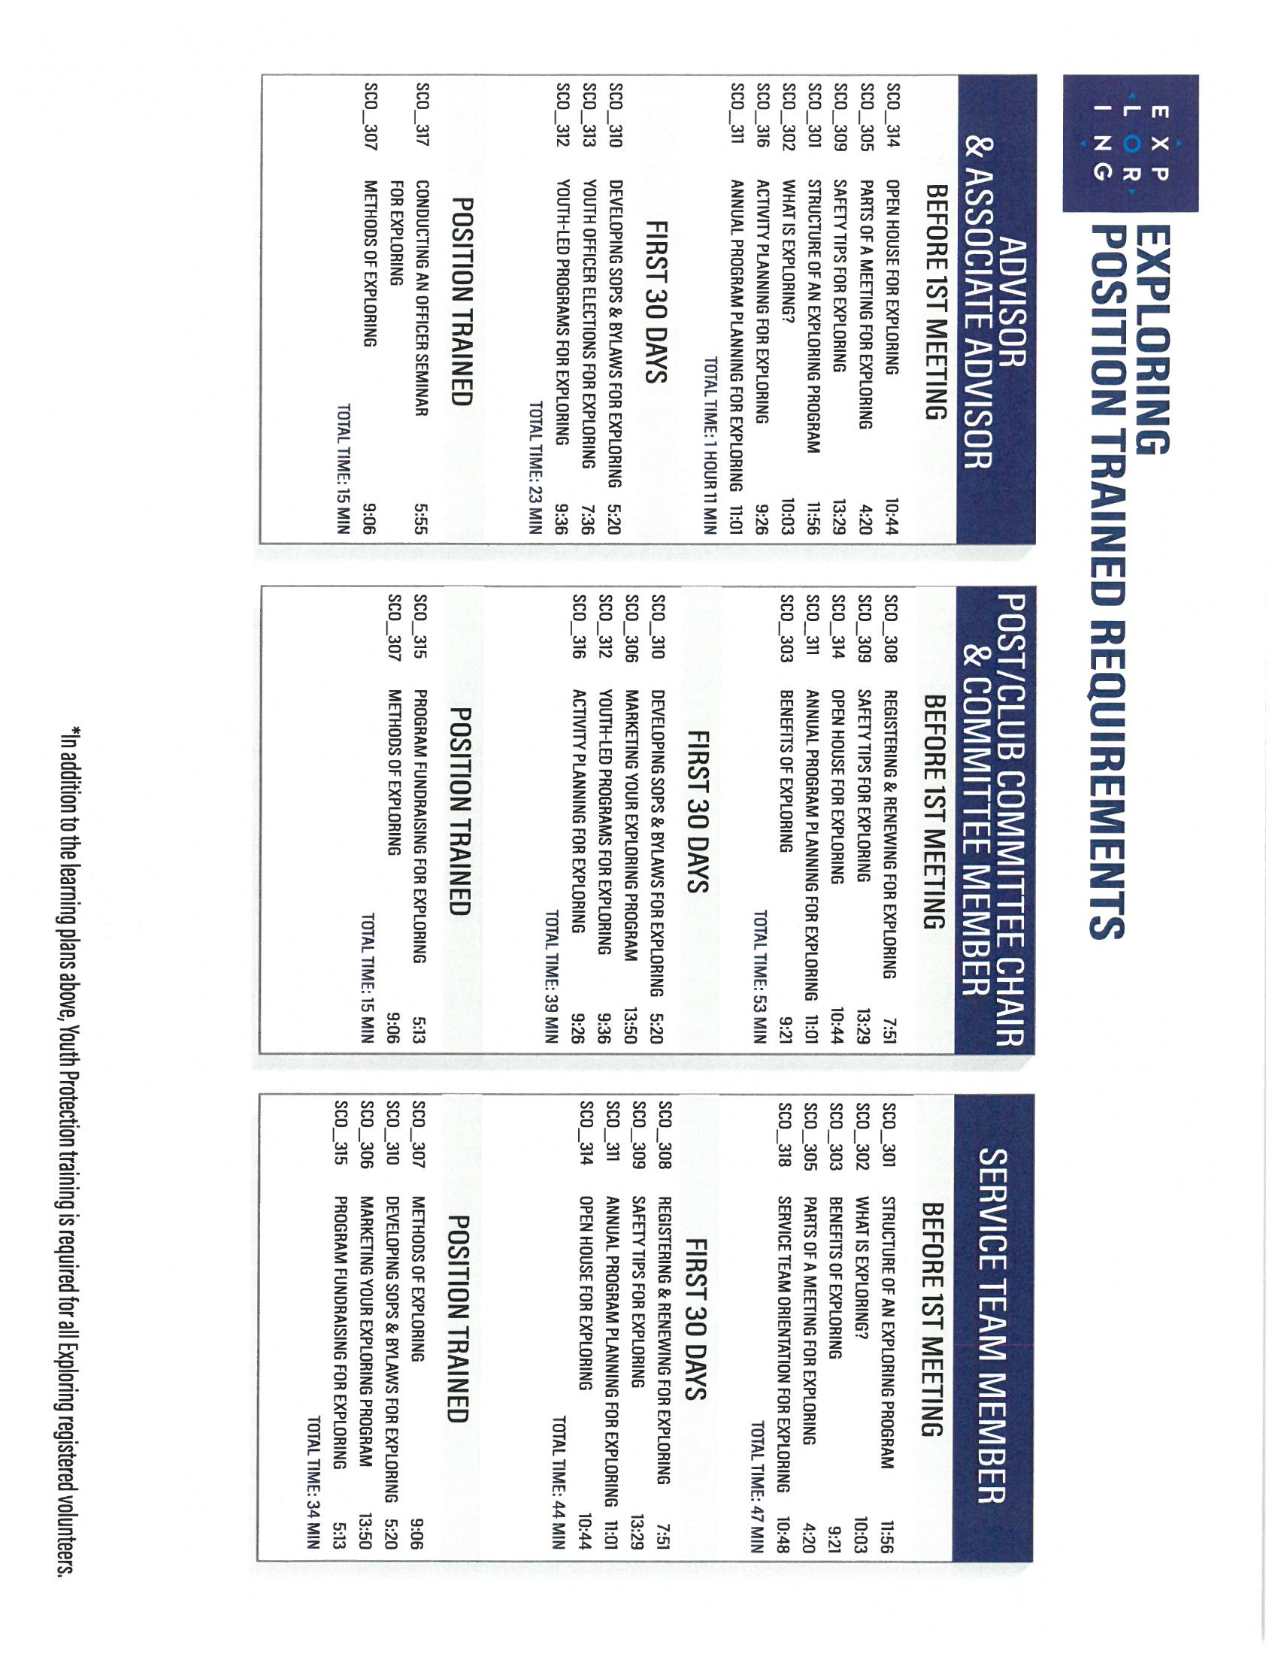
Exploring Position-Specific Training Modules Update Status …
NOW UPDATED AND READY FOR VIEWING

Slide 84

Youth Protection Training
https://my.scouting.org/

Slide 85
Exploring Youth Training Update
https://www.scouting.org/training/youth-protection/venturing/

Slide 86
Resources to help plan the program…
Career Opportunity Worksheet -- www.exploring.org and click on relevant career field icon and scroll to the bottom of the page.
Activity Library (including Life Skills Section) https://www.exploring.org/activity-library/
Organization’s Resources/Employees
  A. Current work curriculum (developed by the company)
  B. Employee’s expertise/knowledge (Use All-in One Program
  Planning Meeting)
Career Achievement Award (Posts) & Career Awareness Award (Clubs)
  http://www.exploring.org/wp-content/uploads/2017/06/Career-Achievement-Award
  May2017.pdf
  http://www.exploring.org/wp-content/uploads/2018/05/Career-Awareness-Award-
  FINAL.pdf
Exploring Guidebook for Leaders http://www.exploring.org/wp-
  content/uploads/2016/10/Exploring-Guidebook-Sept2017.800-10018.pdf
Safety First Guidelines/Guide to Safe Scouting http://www.exploring.org/wp- content/uploads/2016/12/LFL-safety-first-guidelines-3.21.17.pdf
7. Online Exploring Adult Leader Specific Training & Youth Protection Training
https://www.exploring.org/training-safety/

Slide 87



STAY CONNECTED
page | @lflexploring
group | Exploring Success!
group | National Explorer Alumni Association
learningforlifeusa
exploring.org | Stay Connected
exploring@lflmail.org

Slide 88
Questions?

Slide 89


Good News from the Field!

Slide 90
2023 NATIONAL EXPLORING LIVE HOURS
The National Exploring Live Hour is a monthly Zoom video conference that will help engage and equip
Exploring volunteers and professionals to grow, support, and learn more about Exploring. Each month the National Exploring Live Hour will be led by our National Exploring Chair and the National Director of Exploring. The live hours will include sharing best practices and ideas that are happening within our councils, highlighting successful growth campaigns, and inspiring new ideas through various trainings. This will also offer an opportunity for local councils to collaborate with territory and national counterparts to generate innovative solutions to real-life Exploring challenges.
National Exploring Live Hour Schedule
1:00 PM – 2:00 PM Central Standard Time, Monthly
Register for each of the National Exploring Live Hour ZOOM presentations at:
https://events.scouting.org/form/C1DDDF92934F4521/

Slide 91
Exploring at Home (Discuss Best Practices)
Idea Sharing
Questions and Answers from the Field https://drive.google.com/file/d/1Bo7U0iJ8Ti-bmyIFtxGfG0TIt3dB1xX4/view?usp=sharing
After the Live Hour Discussions
(Open Dialogue)

Slide 92
ADDITIONAL SLIDES FOR COUNCIL USE
All slides will be emailed to each
Exploring Live Hour Participant every month

Slide 93


Successful Councils…
Intentionally Providing a Pathway to Exploring Growth and
Strategic Planning In Your Council

Slide 94
OPEN HOUSES
INSERT HERE
COUNCIL/DISTRICT YEARLY MEMBERSHIP PLANS
(Recruitment/Retention Cycle)
Career Interest Surveys

Slide 95

12 Keys To Success

Slide 96

1. Recruit a council Exploring volunteer chair and committee
2. Appoint a Council Exploring Champion
“Staff Advisor”
3. Create a public presence for Exploring
(council website, newsletters, social media)

Slide 97

4. Train key volunteers and staff on the 4
Phases of Post/Club Organization
5. Set specific goals for Career Interest
Surveys or gathering of data from select high schools
6. Set goals to host Open Houses for all
Posts/Clubs (i.e. School Night for
Scouting)

Slide 98
7. Create a campaign to emphasize
Post/Club unit support (through
Service Teams/Commissioners)
8. Integrate Exploring into council activities and events
9. Promote Exploring to all current customers (i.e. “Scouts BSA”)

Slide 99
10. Host a council community cultivation event, focusing on a specific career.
11. Involve the Council Executive Board to help open doors within the community and to help create a list of businesses to match the
Career Interest Survey results.
12. Ensure that Exploring is included in the
Council Strategic Plan, PDS Goals, and
Board Meetings.

Slide 100

“Action Planning”
The Beginning of your Strategic Plan
The foundation of your plan will begin here

Slide 101
Career Interest Surveys
The # 1
Leading Indicator for Exploring Growth

Slide 102




Slide 103
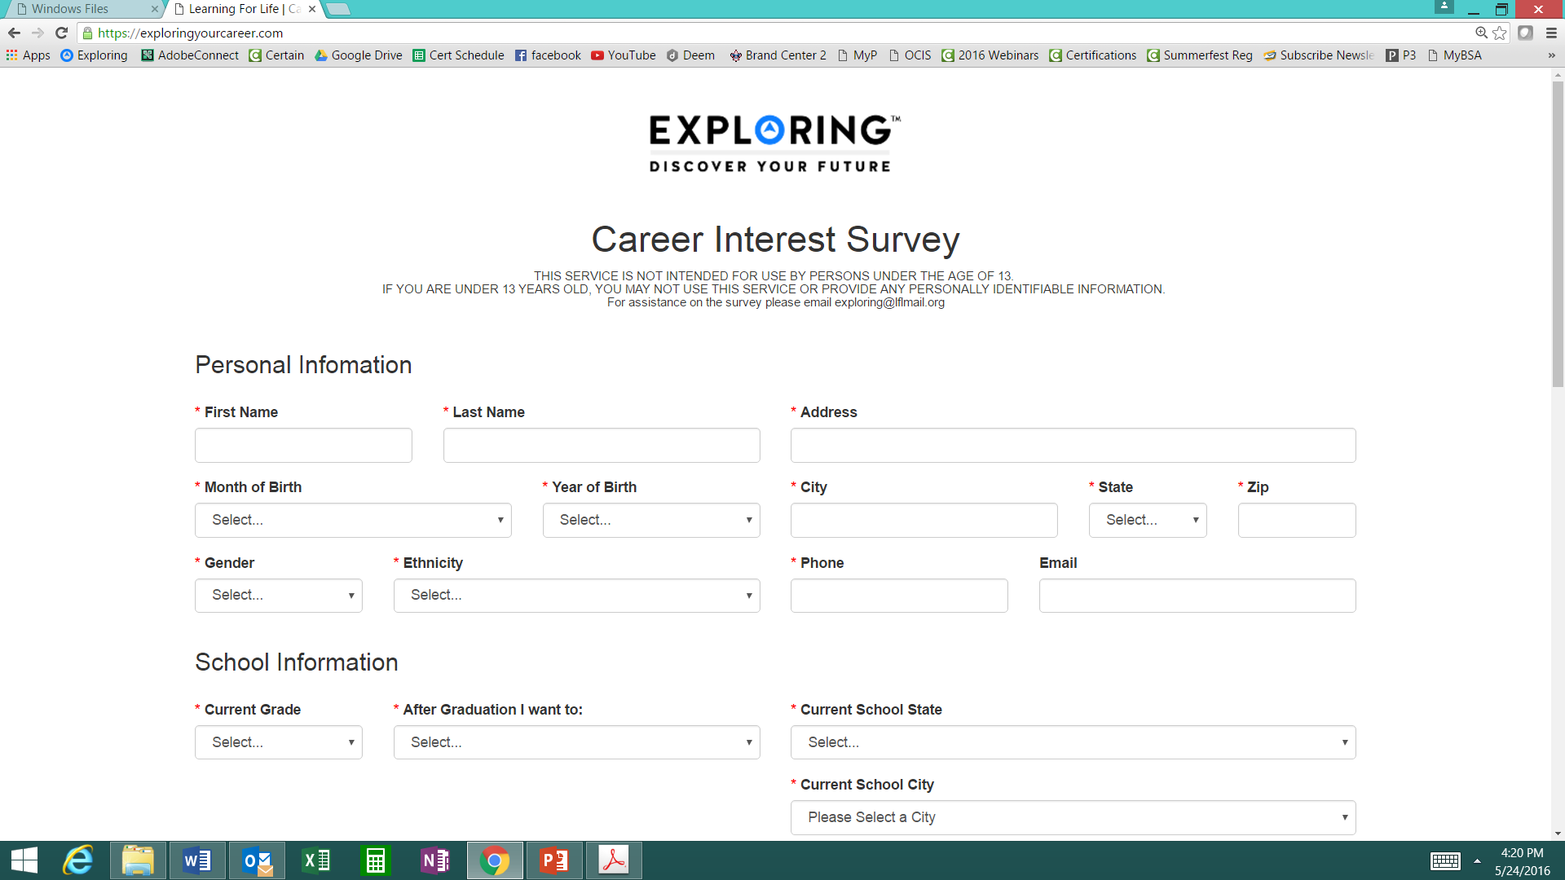
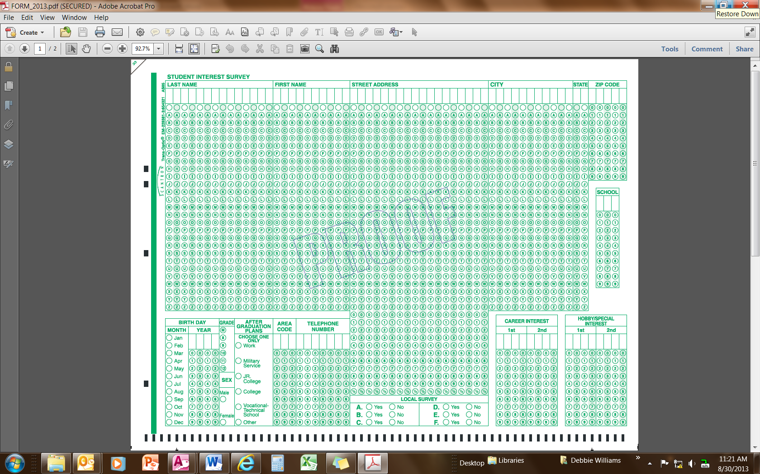
Phase 1 – Research
Career Interest Surveys (two choices)
pa
pa
Online Survey:
www.exploringyourcareer.com
Paper Scantron Survey

Slide 104

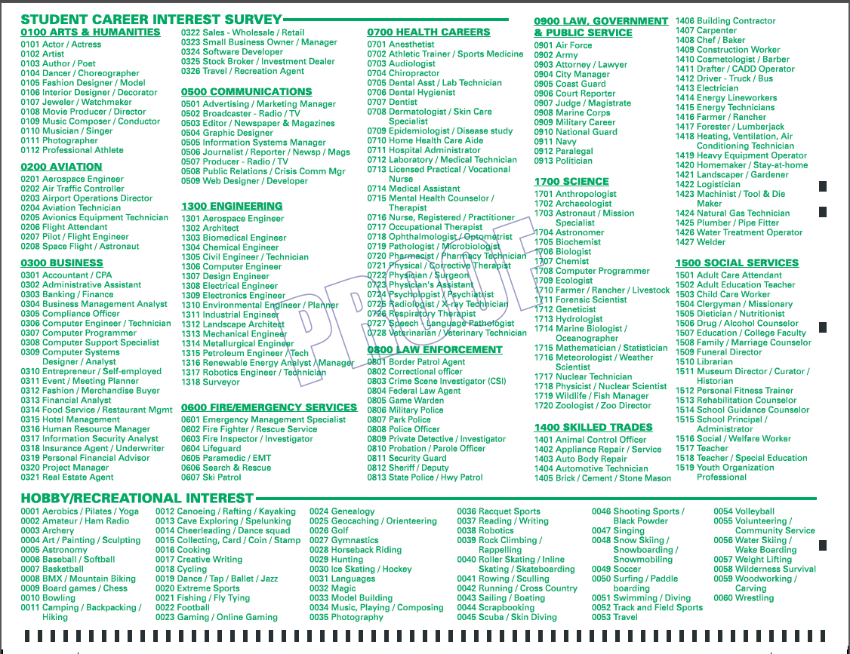
BACK SIDE
FRONT SIDE
Paper Scantron Survey Available through NDC

Slide 105
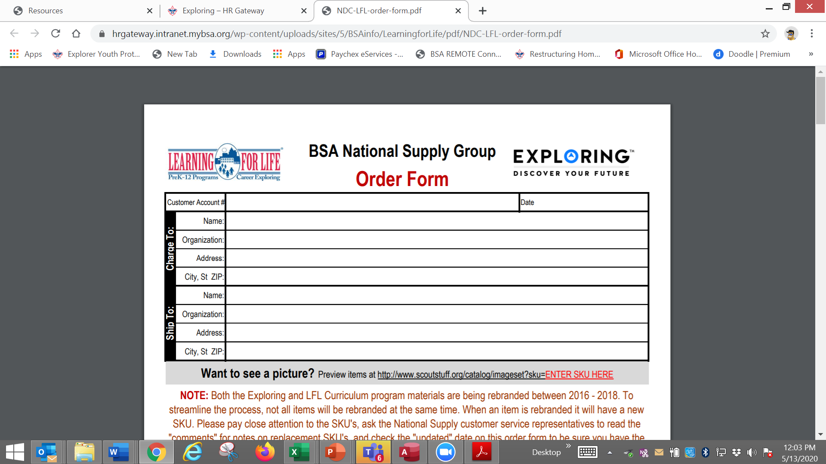

Slide 106
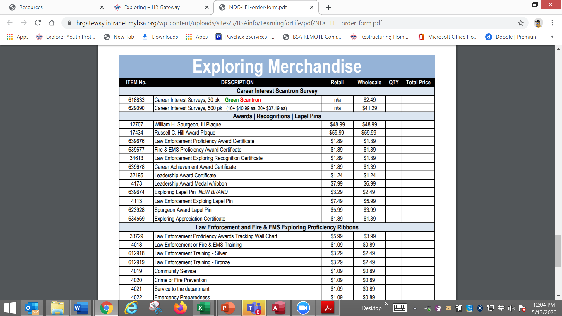

Slide 107
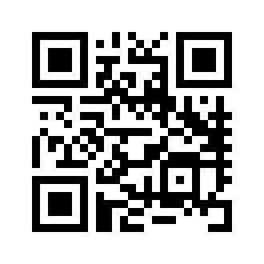
Online Career Interest Survey
www.exploringyourcareer.com
TRY IT NOW!
Use QR code or simply type address in web browser
Notes:
A “QR” or Quick Response code was created to take students directly to the survey site. It is available on posters, post cards, business cards, and book marks.
How do you use this? Email it to all teachers, they can open it from email and project it one screen for students to use their smartphones!

Slide 108
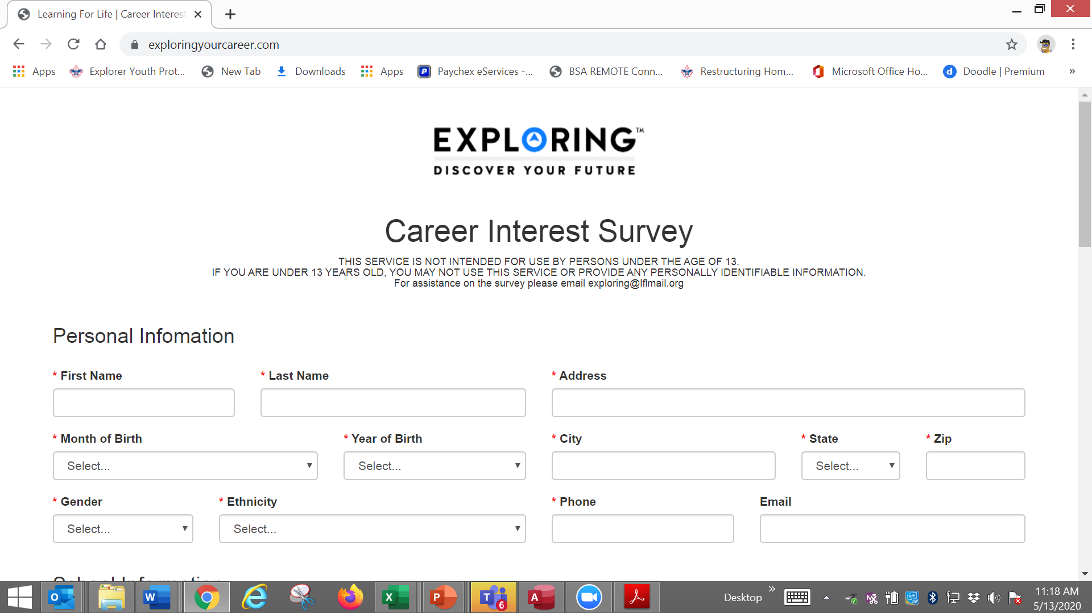

Slide 109
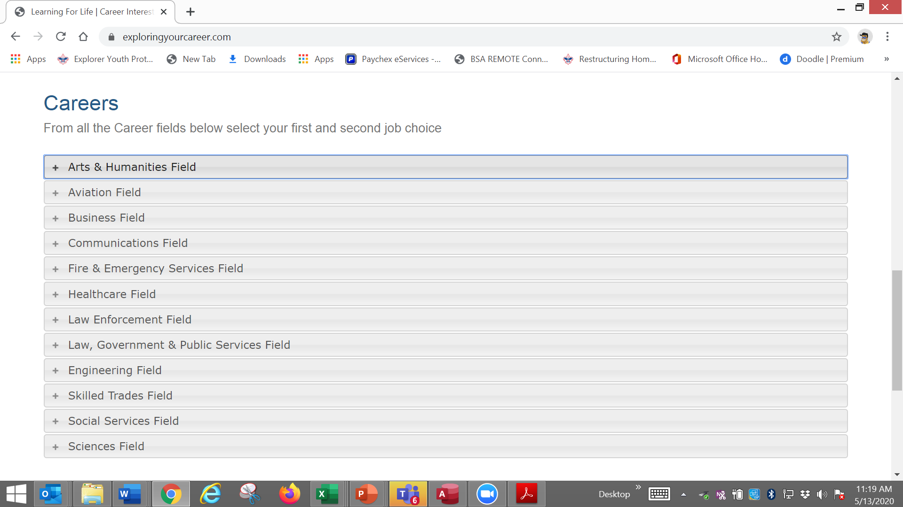

Slide 110
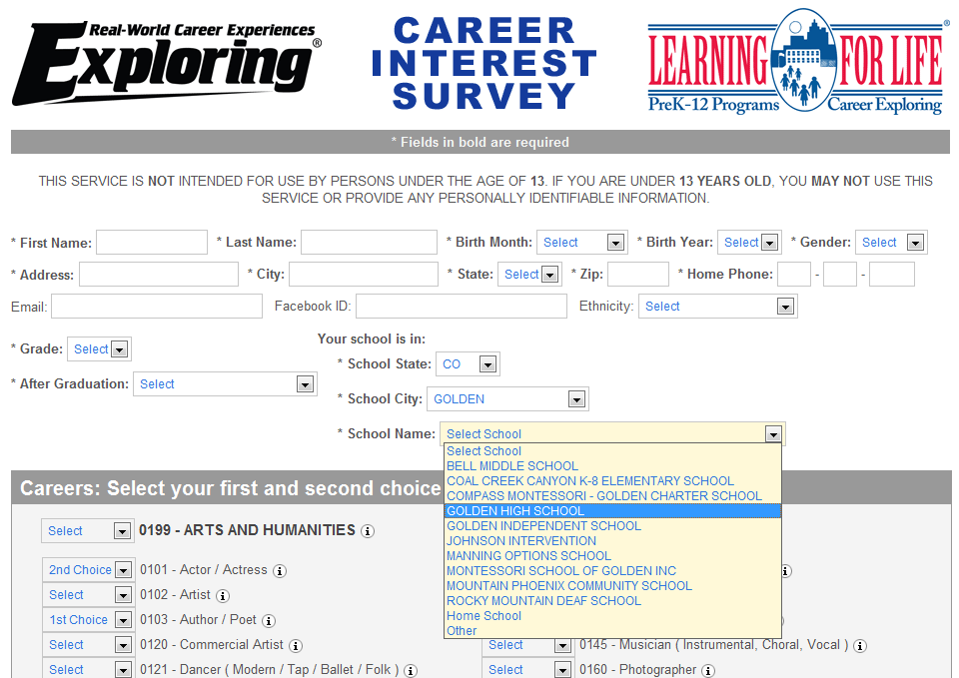
www.exploringyourcareer.org
Two career & hobby choices
School names
pre-loaded
Notes:
REFER TO HANDOUT IN YOUR FOLDER.
This is a screen shot of the new Online Career Interest Survey that was activated on Jan 1, 2012.
The careers & hobbies match the paper version. So schools and administer the survey either on paper or electronically.
The online version can be accessed from any device that can access the Internet – including smart phones.
Results are sent instantly to a secure website where councils can access the results and provide them to schools in the same format as the paper survey.
Instructions for accessing results can be found in the LFL internal site.
Students 13 yrs. and younger cannot legally complete this survey online. If they enter data, the system will not save it.
You can also add schools/colleges to this list if they do not populate when you put in your respective zip code. Simply e-mail us at exploring@lflmail.org and request your specific school to be added, with zip code

Slide 111
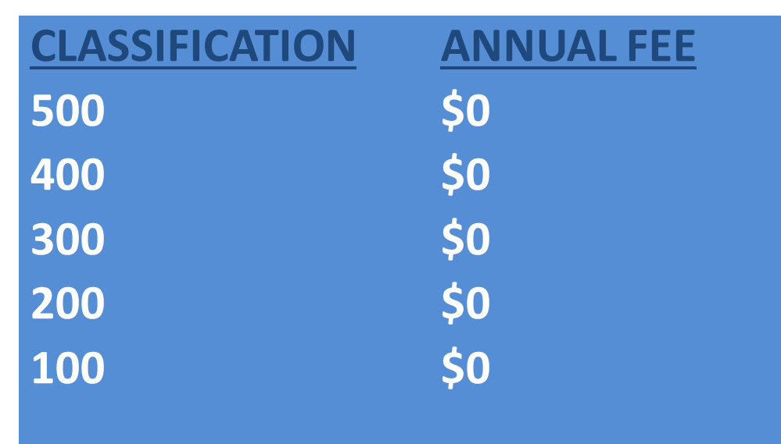
Online Career Interest Survey COSTS
Unlimited schools and unlimited surveys for students 13 years of age and older

Slide 112
REPORTS GENERATED FROM THE SURVEYS

Slide 113
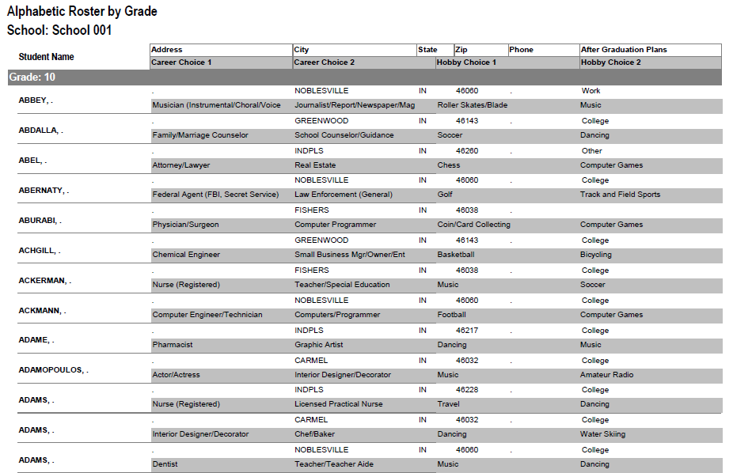
RESULTS REPORT: School
Grade: 10
ABBEY, Susie 123 Main St Noblesville IN 46060 Work
Career 1 Career 2 Hobby 1 Hobby 2
Musician Journalist Roller Skate /Blade Music
113
Notes:
113
No matter the survey format you use, the reports are generated the same way.
**GOOD data to establish credibility at/during your sales call
This is one set of sample results provided at no cost to schools. Very helpful for Guidance Counselors.
All students, by grade, alphabetically. Shows:
Career interests
Hobby interests
Post-high school plans
Other results include all students interested in each career (all the attorneys, architects, dentists, electricians, etc). Helpful for Guidance Counselor planning, career speakers, college days and college fairs.
Be sure to return results to the Guidance Counselor when you say you will – under promise and over deliver. Do not promise results in one week if you cannot do it. Say 2-3 weeks, then they will be very happy if they do receive them in a week or ten days.

Slide 114
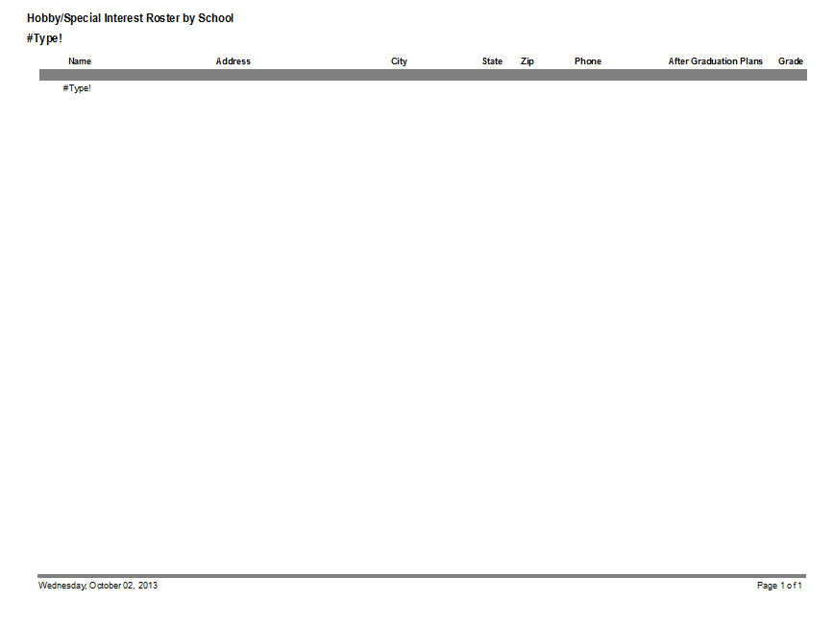
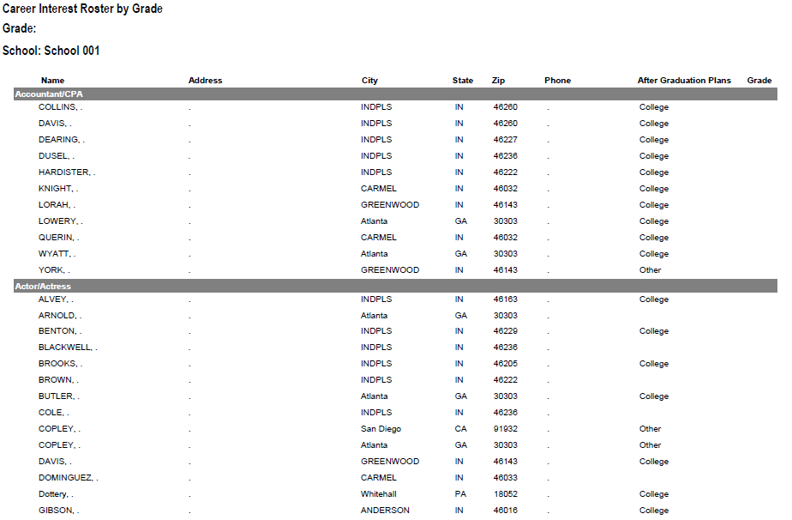
RESULTS REPORT: School
114
Notes:
114
This is another set of sample results provided at no cost to schools. Very helpful for Guidance Counselors.
This report includes all students interested in each career (all the attorneys, architects, dentists, electricians, etc.). Helpful for Guidance Counselor planning and career speakers.
The After Graduation Plans is important to Guidance Counselors
College
Junior college
Military Service
Technical school
Work
Other
Why are these reports help full to the school…to you?

Slide 115
Summary Career Interest Report by Council
Code Career Count
0712 Nurse (Registered) 798
0145 Musician (Instrumental/Choral/Voice) 751
0903 Attorney/Lawyer 733
1625 Teacher/Teacher Aide 678
0300 Business (General) 645
0719 Physician/Surgeon 604
0101 Actor/Actress 600
0130 Fashion Designer/Model/Buyer 579
0721 Psychiatrist/Psychologist 578
0170 Professional Athlete 507
0180 Photographer 461
1305 Architect 437
0725 Veterinarian 429
0102 Artist 427
0718 Physical Corrective Therapist 313
1300 Engineering (General) 208
MOST IMPORTANT TO YOU

Slide 116
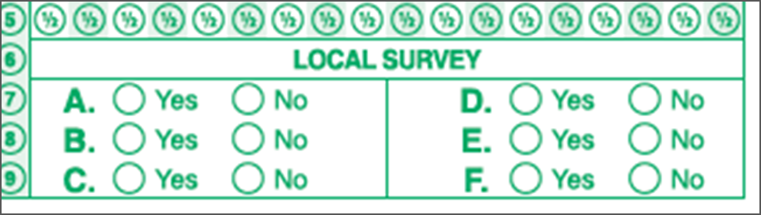
Career Interest Survey Questions
Opportunity for 6 “Yes” or “No” questions
Unique feature of our survey
Anything school officials want to know
  Are you planning to take the SAT / ACT?
  Are drugs a problem in our school?
  Is there enough student parking?

Slide 117
www.exploring.org

Slide 118

Career Interest Survey Guidebook
Be sure you have the most recent version
Download at www.exploring.org
One stop shop for all CIS resources
Table of Contents
  Page 5 | At A Glance
  Page 7 | Overcoming Objections
  Page 44 | Appendix

Slide 119
ALTERNATE METHODS?
1. Use school information already available
2. Ask youth to develop contacts
3. Develop cultivation events
4. Invite Eagle Scouts / Scouts to join
5. Booth at schools open house night and career days /career fairs
6. Annual Exploring open houses for ALL Posts and Clubs
7. Follow up leads from the Exploring Lead
Generator

Slide 120
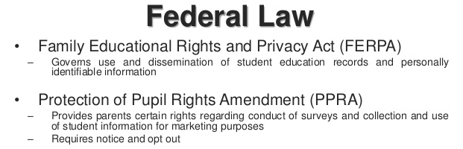
Confidential Information

Slide 121

U.S. Department of Education
Career Interest Survey Letter of Support

Slide 122
BASED ON SURVEY RESULTS
1. Focus on Top 4 students interests
2. Identify companies in those 4 interest areas
3. Identify the path to the CEO
  Council board contacts
  School board/admins
  PAS find
  Nominating committee
  Applications

Slide 123
4 Steps/Phases in Organizing a new Post
1. Research-
Conduct the Career interest surveys
and develop business/community prospects
2. Leadership-
Meeting with the top leadership within the
businesses/community and identifying program
leaders; includes training of leaders
3. Program-
Develop the organization’s meeting/program
themes and prepare for an open house
4. Participation-
Recruiting youth through an organized open house and
involvement of youth in program development

Slide 124
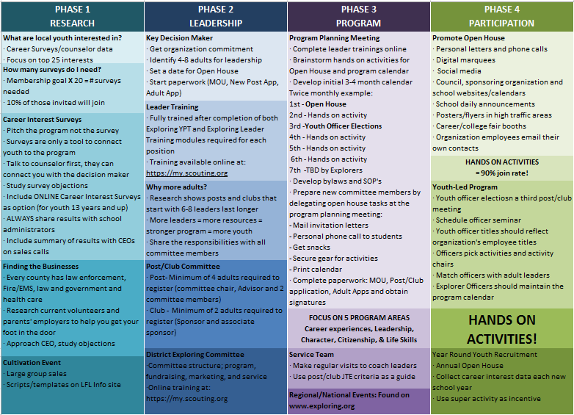

Slide 125
MOST IMPORTANT PART
OF EACH PHASE?
Phase 1 : Career Interest Surveys
Phase 2: Training
Phase 3: All-In-One Program Planning Meeting
Phase 4: Open House

Slide 126
Phase 1 – Research
Career Interest Surveys (two choices)
pa
pa
Online Survey:
www.exploringyourcareer.com
Paper Scantron
Survey Available through NDC

Slide 127
Online Career Interest Survey
www.exploringyourcareer.org
TRY IT NOW!
Use QR code or simply type address in web browser
Notes:
A “QR” or Quick Response code was created to take students directly to the survey site. It is available on posters, post cards, business cards, and book marks.
How do you use this? Email it to all teachers, they can open it from email and project it one screen for students to use their smartphones!

Slide 128
Phase Two: Training

Slide 129
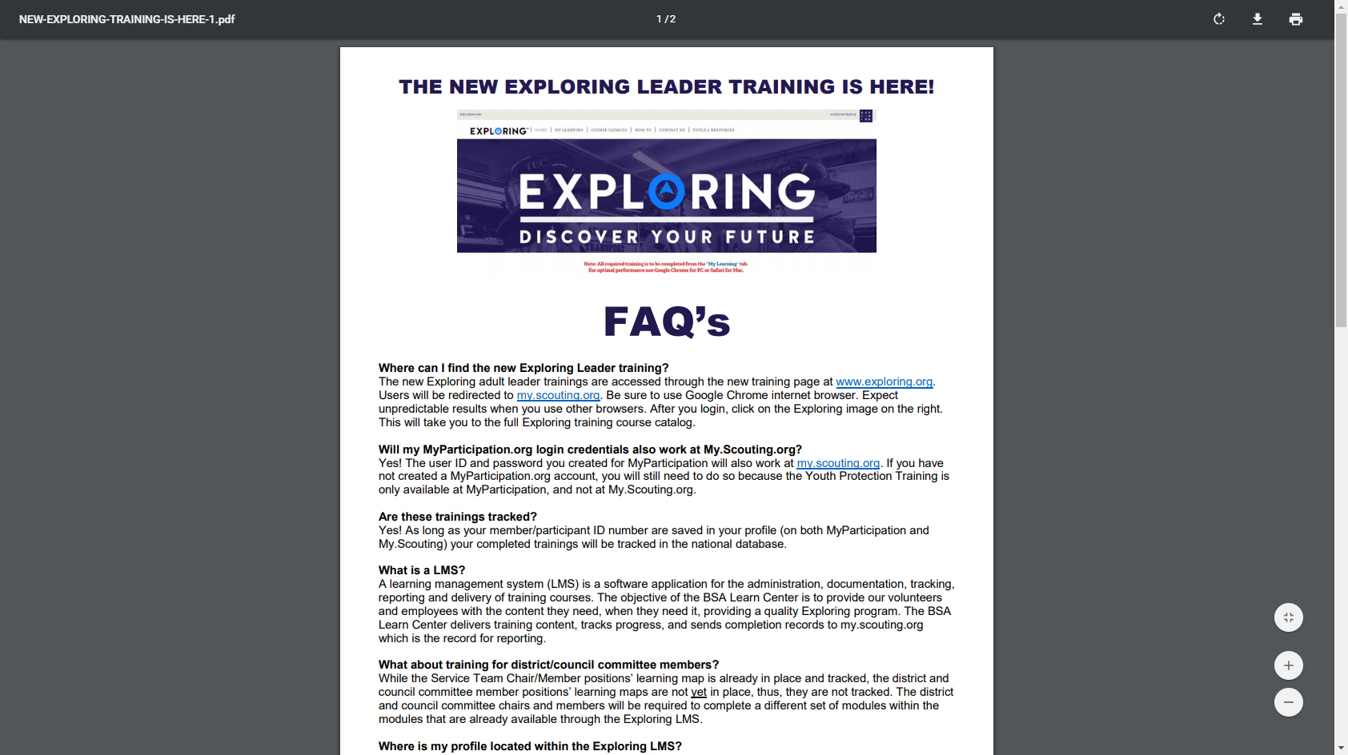

Slide 130

Phase 3 – Program
All-In-One Program Planning Meeting
1) Paperwork
2) Adult Explorer Leader Training
  - Youth Protection for Explorers
  - Adult Explorer Leader Training
3) Open House Planning
  - Brainstorm session
  Why did you choose this career for yourself?
  What are hands on activities that you can do with youth?
  - Develop a 3-4-month calendar (use Activity Library)
  - Choose Open House “hands-on activities”
4) Prepare Post Committee Members for Open House

Slide 131

Phase 3 – Program
Planning the Open House
1) From your BRAINSTORM session…
  - Pick the 4-5 best activities for a quick hands-on
  format at the Open House
2) At the open house…“Go shopping”
  - 4-5 stations (rotations)
  - 4-5 minutes each

Slide 132
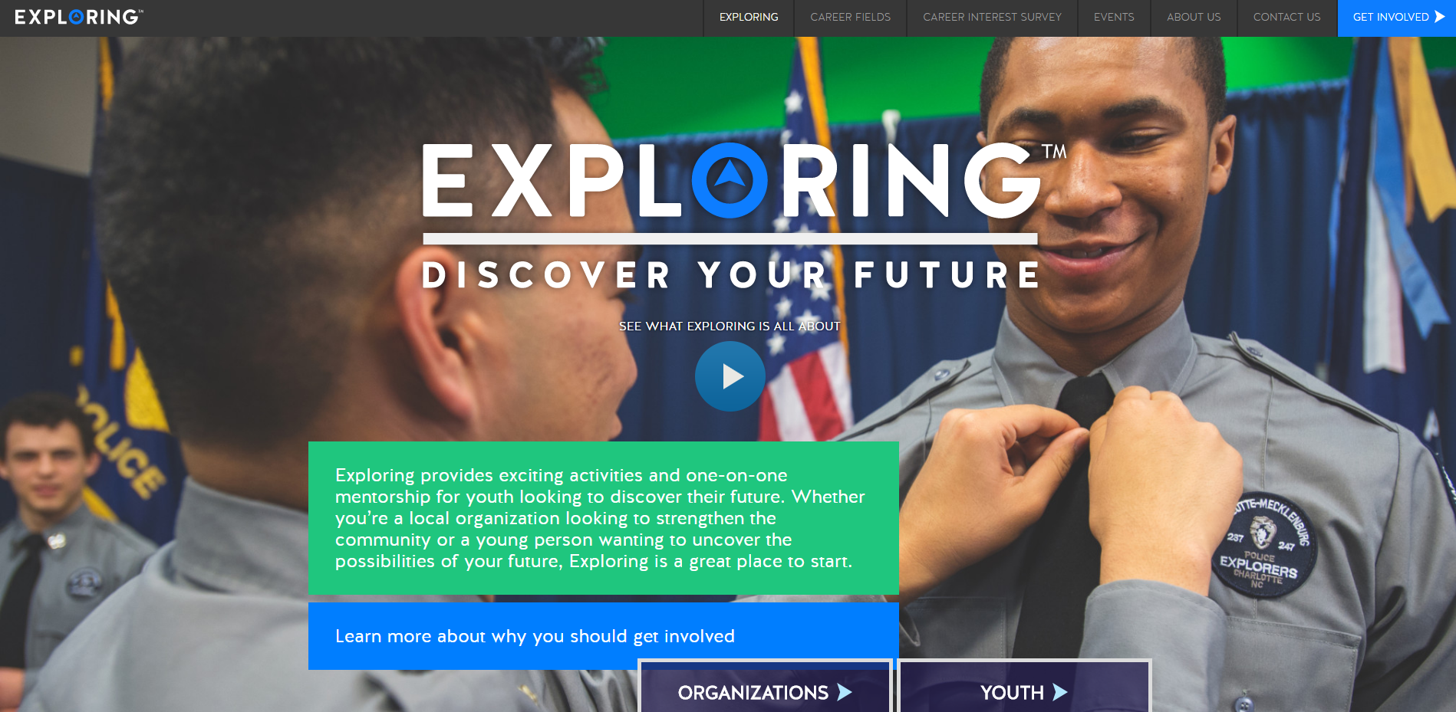

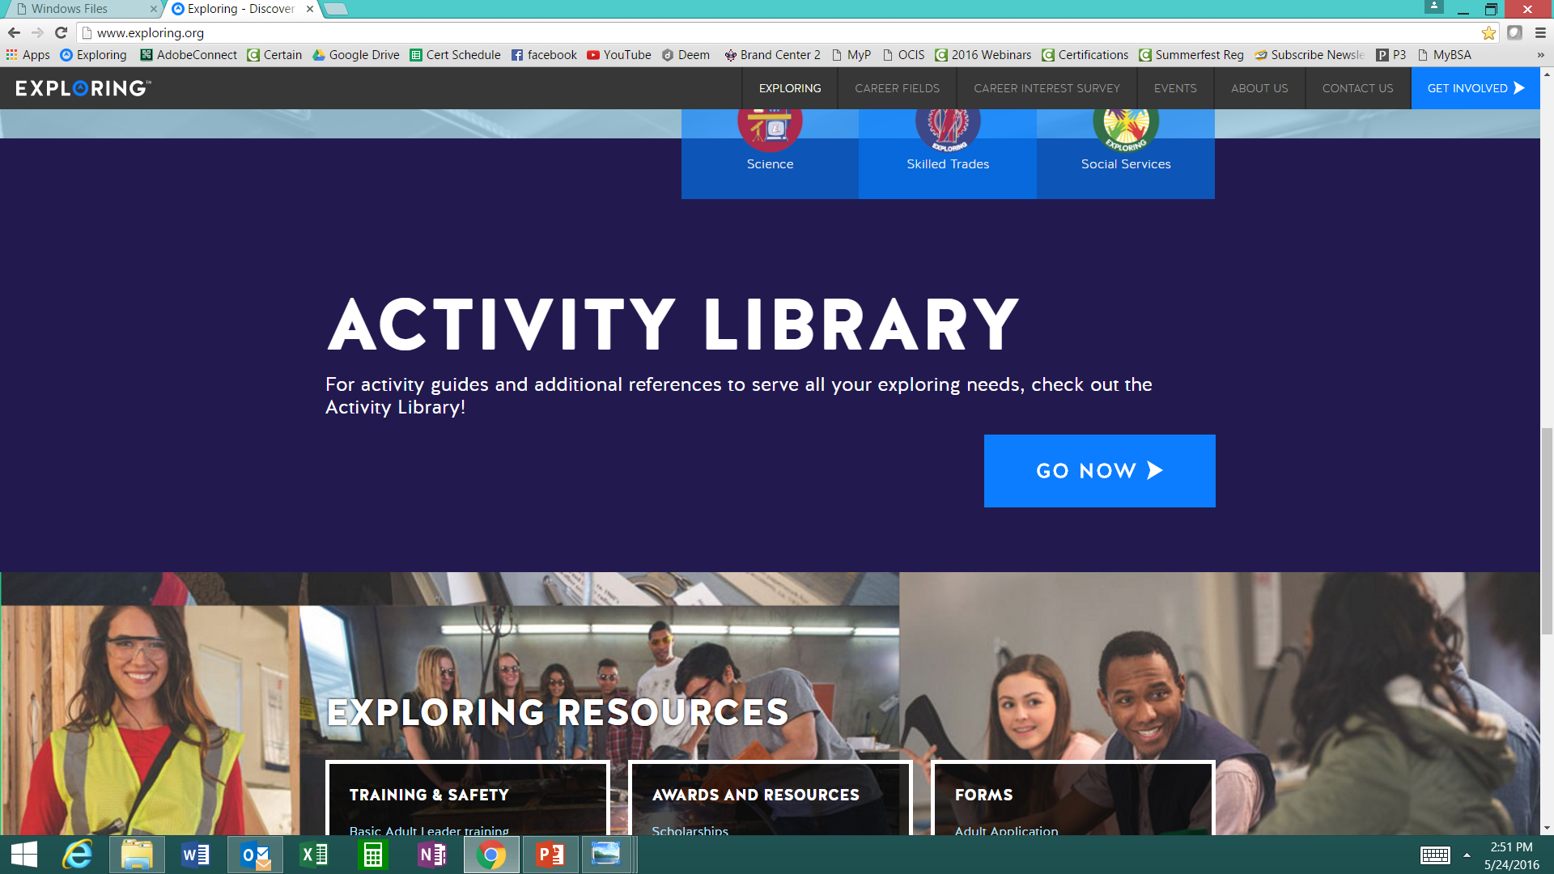

www.exploring.org
Notes:
Program planning is also a service that is provided by the local Boy Scout Council. This Activity Library is an all new supplement to the process. You will find it on www.exploring.org

Slide 133
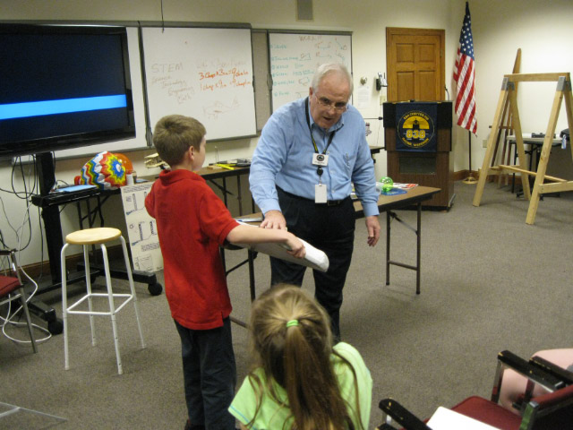
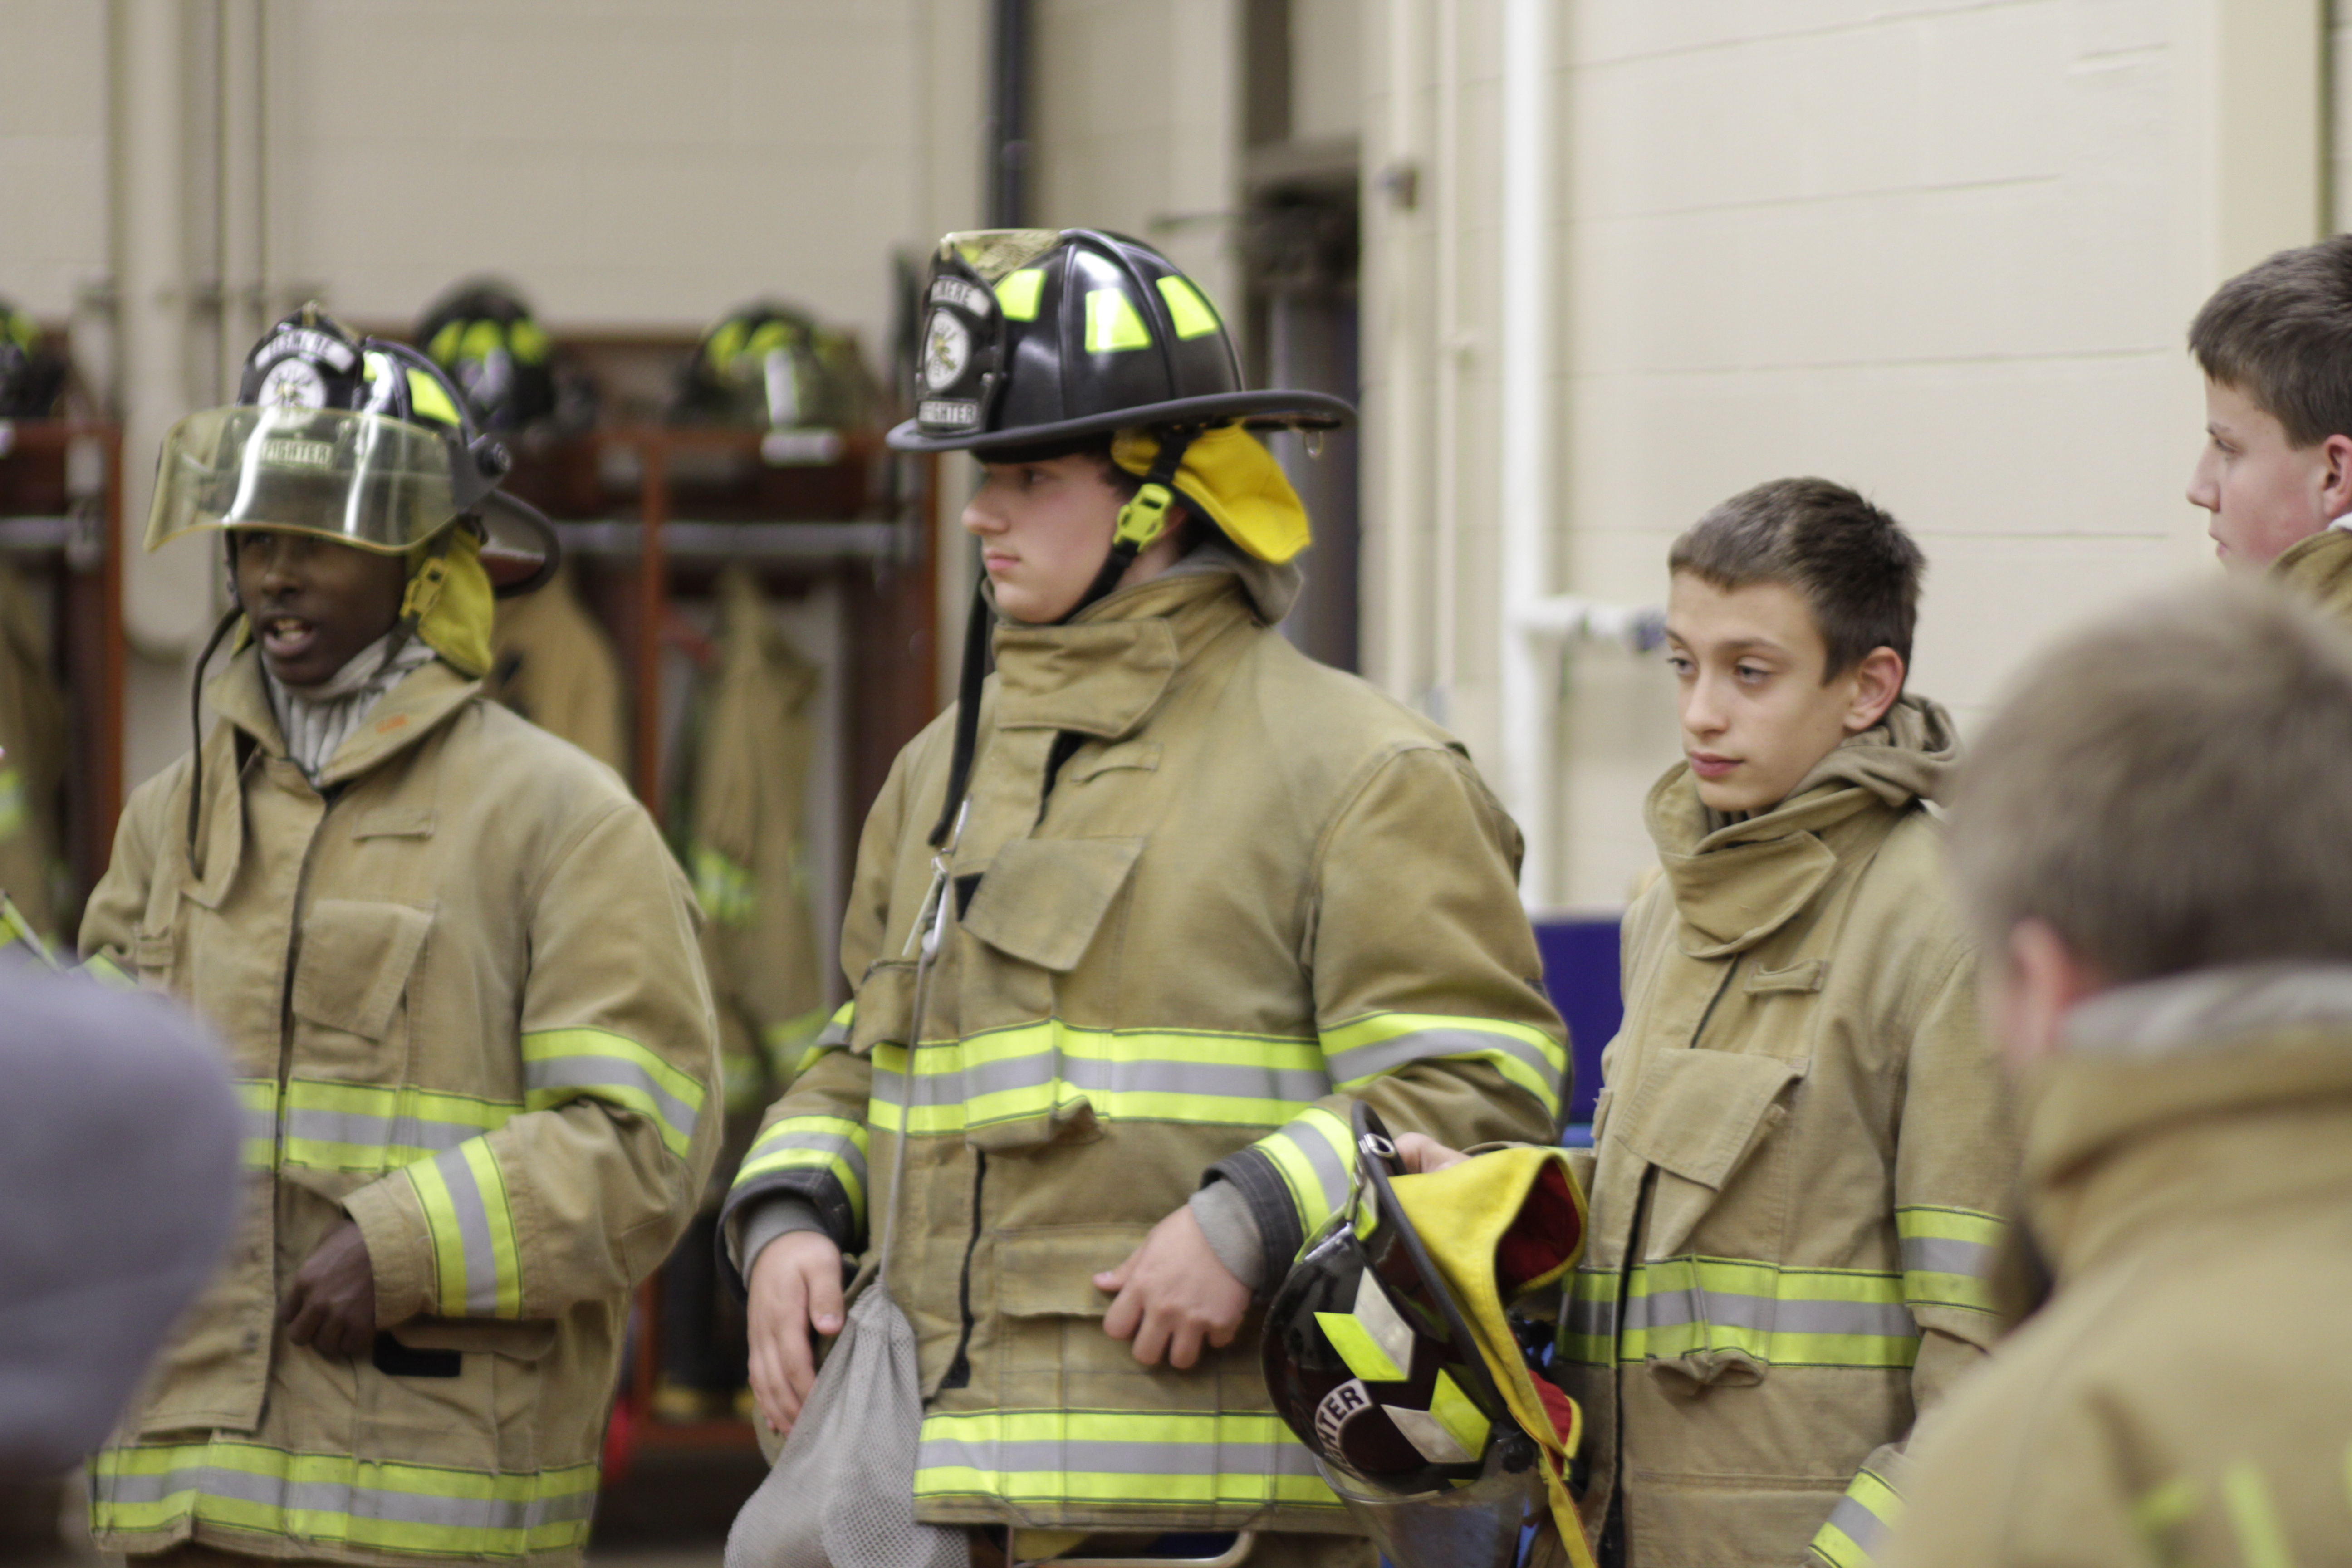
Phase 4 – Participation
SIMPLE OPEN HOUSE AGENDA
OPEN HOUSE AGENDA
Welcome
What is Exploring?
Video
HANDS-ON ACTIVITIES
Activity Interest Survey (customized)
Calendar
ASK TO JOIN
Applications & fees
Snacks

Slide 137


Slide 138
Leads are being generated from Exploring.org and include anyone interested in joining, leading, sponsoring, or
otherwise supporting Exploring in their area.
Scout Executives, Assistant Scout Executives and DFS’s receive weekly lead reports.
Exploring Executives and staff advisors receive immediate notifications of each lead generated.
To make changes to any of these settings, email your request to exploring@lflmail.org.
WHEN YOU RECEIVE AN IMMEDIATE NOTIFICATION EMAIL:
1. In the email, you will see a note to “copy & paste the following URL into your browser to mark lead as contacted”.
By following this directive, you are changing the status of your lead to “contacted”. You will no longer receive email notifications for that particular lead. The lead will begin to show as “contacted” on your SE’s weekly report.
Invite the person to attend an existing post/club meeting to get a feel for the program and connect them to
appropriate Exploring advisors.

Slide 139
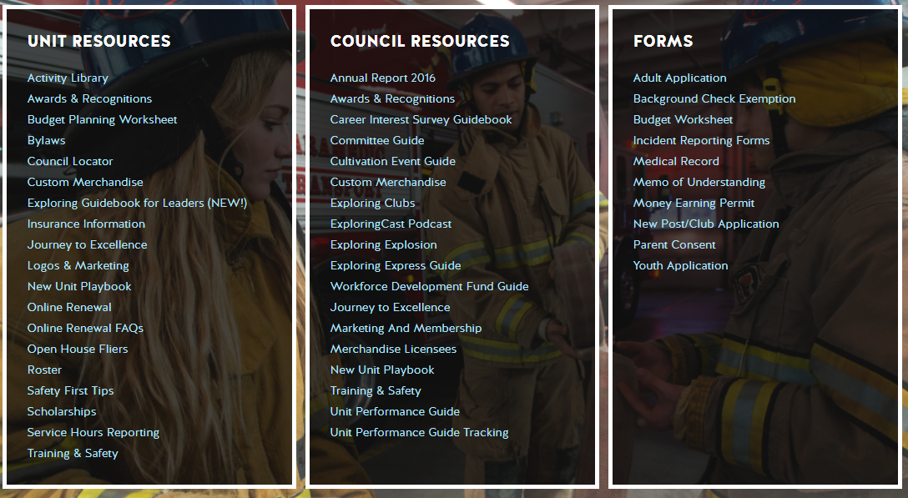
Resources to help you… www.exploring.org

