Slide 1
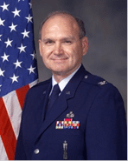

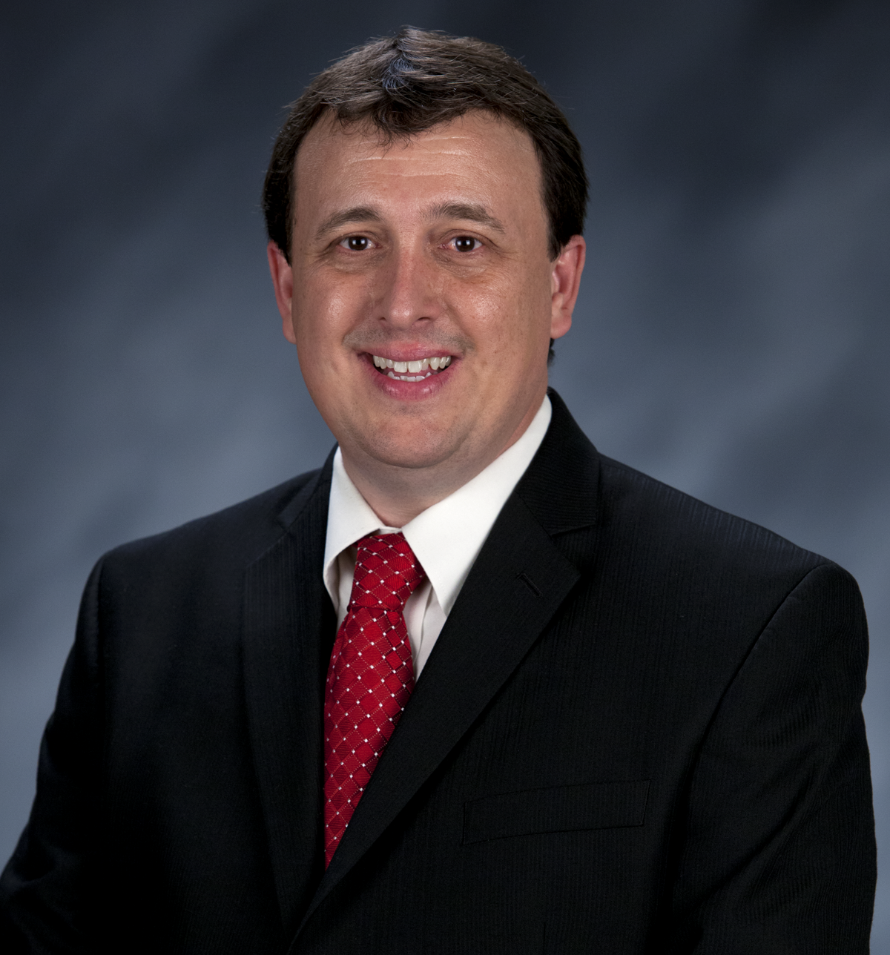
Craig Martin
Vice-Chair,
National Exploring Program Chair
NATIONAL EXPLORING
LIVE HOUR
June 12, 2024
Tim Anderson
National Director
Learning for Life & Exploring
Older Youth Programs

Slide 2

LEARNING FOR LIFE CORPORATE MISSION:
To develop and deliver engaging, research based academic, character, leadership and career focused programs aligned to state and national standards that guide and enable all students to achieve their full potential.
NON-DISCRIMINATION STATEMENT:
Learning for Life programs are designed for all age groups from pre‐kindergarten and not yet age 21. Youth participation is open to any youth in the prescribed age group for that particular program. Adults are selected by the participating organization for Involvement in the program. Color, race, religion, gender, sexual orientation, ethnic background, disability, economic status or citizenship is not criteria for participation by youth or adults.
Notes:
AFFILIATION STATEMENT
Learning for Life is one of the programs that local Boy Scouts of America councils are authorized to deliver, with local executive board approval. Learning for Life is an affiliate of the Boy Scouts of America that is comprised of both a written character education curriculum for PreK – 12th graders and students with special needs, as well as Interactive career Exploring programs for 6th graders thru 20 year olds. Youth participation is open to any youth in the prescribed age group for that particular Program. Adults, 21 years of age and older, are selected by participating organizations for involvement in the Learning for Life programs. Color, race, religion, gender, sexual orientation, ethnic background, disability, economic status or citizenship is not criteria for participation by youth or adults. Youth and adults involved with Learning for Life programs, including Exploring, are registered with Learning for Life as participants. Learning for Life participants are not members of the Boy Scouts of America. Learning for Life, a District of Columbia non‐profit corporation, is a separate 501(c)(3) Corporation, with a Board of Directors that is separate from the Boy Scouts of America. While they have different policies, there are occasions when local Learning for Life and Traditional BSA programs may participate in an event. Both programs will be required to follow the appropriate guidelines, especially regarding safety. Completion of training, registration and annual fees are program specific and not transferable between programs

Slide 3

  Learning for Life Curriculum-Based Programs consists of grade specific, age-oriented, character education lesson plans that are utilized in schools and other educational settings to help instill character and ethical decision making in our youth. The available lesson plans that are offered for Learning for Life Groups include PreK-12 grades, Champions for students with special needs, along with additional digital resources. Learning for Life uses these interactive lessons to help youth make informed decisions while becoming better students and citizens.
  CURRICULUM PROGRAM VISION:
  To provide engaging and relevant PreK‐12 solutions that positively impact academic performance, social & emotional maturity, character development, and career education for all students.
www.learningforlife.org

Slide 4

  Exploring is a co-ed program for youth that are in the 6th grade through 20 years old. Exploring provides opportunities for real-world hands-on career experiences, while helping them “Discover their Future”. The program links youth with mentors and experts with partner businesses and agencies in their communities. Participating in an Exploring Club or Post ensures youth make informed decisions about careers they may or may not be interested in pursuing, while allowing businesses and organizations the opportunity to meet and cultivate future employees.
EXPLORING MISSION:
Deliver character-building experiences and mentorship that allow youth to achieve their full potential in both life and work.
EXPLORING VISION :
Shape the workforce of tomorrow by engaging and mentoring today’s youth in career and life enhancing opportunities.
www.exploring.org

Slide 5

National Learning for Life/Exploring
National Professional Staff Direct Support
Tim Anderson
National Director,
Learning for Life/Exploring
Older Youth Programs
Vacant
Project Coordinator
Shane Calendine
Vice President Council Operations (BSA)
Susan Fitzhugh
Sr. Administrative Assistant
John Mosby
Assistant Chief Scout Executive/EVP
Secretary
Steven Hardy
Treasurer
Lisa Fritschel

Slide 6


New Board Chair for
National LFL / Exploring
Executive Board

Slide 7
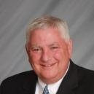
Bernie Lockard’s Background…
Scouting…
Eagle Scout (1972)
Order of the Arrow Vigil Honor
Cubmaster
Pack Committee Chairman
Assistant Scoutmaster
Scoutmaster
Unit Commissioner
Wood Badge Course Director
NYLT Course Director
District Chairman
President, Laurel Highlands Council’s Board of Directors (2013 - 2014)
2019 World Jamboree Scoutmaster
Chair, National Venturing Committee (2020 - 2022)
2023 & 2017 National Jamboree Staff
National Eagle Scout Association Scholarship Committee (2013 - Present)
BSA Recognition…
Award of Merit – 1998
Silver Beaver – 2001
Distinguished Citizen – 2010
Rockefeller Award – 2010
Silver Antelope – 2014
National Outstanding Eagle Scout Award - 2015
National Venturing Leadership Award – 2022
Silver Buffalo - 2024
Personal…
Married to Robyn L. Ashbridge, father of five and grandfather of seven
President, The Lockard Company, Indiana, PA
Graduate of Carnegie-Mellon University, Pittsburgh, PA, with B.S. in Administration and Management Science, Economics, Mathematics (Graduated With Honors)

Slide 8

National Director/President
Tim Anderson (E)
(V) = Volunteer
(E) = Employee/Professional
Executive Board Secretary
Steven Hardy (E)
NATIONAL LEARNING FOR LIFE EXECUTIVE BOARD
Executive Board Treasurer
Lisa Fritschel (E)
(Board Member)
National Exploring Program Chair
Craig Martin (V)
Staff Advisor-Tim Anderson (E)
LFL National Executive Board Chair
Bernie Lockard (V)
---------------------------------------------------------------------------------------------
LFL National Executive Board Nominating Committee Chair
Fred Markham (V)
----------------------------------------------------------------------------------------------
LFL National Immediate Past Executive Board Chair/Governance
Mark Wiesenhahn (V)
-------------------------------------------------------------------------------------------------------------
(Board Member)
Dan Walters (V)
Staff Advisor-Tim Anderson (E)
(Board Member)
National LFL Curriculum Based
Program Chair
Dr. Helen Stiff-Williams (V)
Staff Advisor-Tim Anderson (E)
(Board Member)
National Exploring Program Commissioner
Richard “Dick” Davies (V)
Staff Advisor-Tim Anderson (E)
(Board Member)
National Career Field Development Chair
Bray Barnes (V)
Staff Advisor-Tim Anderson (E)
(Board Member)
National Partnerships/Development Chair
Vacant (V)
Staff Advisor-Tim Anderson (E)
(Board Member)
National Marketing/Recruitment Chair
Jeff Schweiger (V)
Staff Advisor-Tim Anderson (E)

Slide 9

Bruin1967@aol.com
Craig Martin
National Exploring Program Chair
Bruin1967@aol.com

Slide 10
Safety Moment ~
Heat-Related Illness*
* Scouting Safety Moments’ Heat-Related Illness (see https://www.scouting.org/health-and-safety/safety-moments/heat-related-illness/)
)

Slide 11

Heat-Related Illness…
Each year, heat-related illnesses strike the unprepared. Prevention is key! Be prepared by acclimating to the environment for at least seven days before going on an outdoor adventure; drinking plenty of fluids and eating a healthy diet beforehand; and continuing to drink fluids when outdoors on hot or humid days. Be sure to drink only when you’re thirsty to avoid overhydrating. Take extra rest breaks, especially if you are exercising strenuously.

Slide 12
Heat-Related Illness General Info…
The body cools itself primarily through evaporating sweat
This is why it is so important to stay hydrated
But in hot and humid weather, the sweat does not evaporate—it puddles, and sweat that puddles is not cooling
In that case, a person is at greater risk for a heat-related illness, either because of excessive water loss, and increased body temperature, or both
The four most common illnesses are heat syncope, heat cramps, heat exhaustion, and heatstroke

Slide 13
Common Heat-Related Illnesses …
Heat syncope is dizziness or fainting that usually occurs when standing for long periods of time (such as at summertime flag ceremonies) or when suddenly standing up. Being hot and dehydrated increases the risk for syncope
Heat cramps occur when sweating depletes the body’s salt and fluids. In situations of either heat syncope or heat cramps, have the person rest in a cool area and drink water or diluted sports drink. If the person does not feel better within an hour, get medical attention
Heat exhaustion occurs due to an excessive loss of water through excessive sweating. Uncontrolled heat exhaustion is an urgent medical situation; it can progress to heatstroke if not treated. Provide cold water or diluted sports drink. Cool the person—get them out of the heat, remove excess clothing, spray or douse the person with cold water, and fan them. Do not give them salt tablets. Evacuate if the person does not improve within 30 minutes

Slide 14
Common Heat-Related Illnesses continued
Heatstroke is a true medical emergency. Immediate cooling, evacuation and activation of the EMS system is required, as the body is no longer able to cool itself. It is critical to cool the person quickly by any means possible—move the person to a cool, shaded area; remove as much clothing as possible; spray, douse, or immerse them in cold water; place ice packs in the person’s armpits, groin, and sides of the neck. These actions should happen simultaneously, if possible. If the person is unconscious, maintain their airway. Continue to monitor them and prepare for a rapid evacuation. Do not give an unconscious person anything by mouth. Do not use fever reducers like acetaminophen to bring down the temperature. You may stop cooling the person if their mental status improves
Again, the best way to prepare for heat-related illnesses is to prevent the illness

Slide 15
Heat Exhaustion & Stroke Symptoms…
Heat Exhaustion Symptoms ~
Inability to concentrate
Pale or ashen skin
Rapid pulse
Severe thirst
Heavy sweating, skin may be clammy, not hot
Fatigue, weakness, irritability
Nausea, dizziness, headache
Heat Stroke Symptoms ~
Extremely hot-feeling, flushed skin
Altered mental status
Fatigue
Headache, body aches
Nausea, vomiting

Slide 16
Heat-Related Illness Prevention…
Monitor: Know how hot & humid it will be
Acclimate: It takes 7+ days of heat exposure to prepare the body for hot environments
Hydrate: Drink when thirsty, preferably water
Observe: Watch all group members for signs of heat-related illness

Slide 17
Heat-Related Illness Resources…
Scouts BSA Handbook for Boys or Scouts BSA Handbook for Girls
The National Institute for Occupational Safety and Health, “Heat Stress—Heat Related Illness” @ https://www.cdc.gov/niosh/topics/heatstress/heatrelillness.html
Gauer, R. and Meyers, B.K. Heat-Related Illnesses. American Family Physician. 2019;99(8):482-489 @ https://www.aafp.org/pubs/afp/issues/2019/0415/p482.html

Slide 18
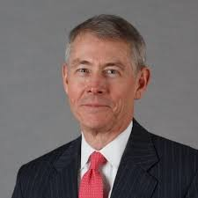
National Exploring Program Commissioner
Richard (Dick) Davies
Richard.davies.nyc@gmail.com
(914) 327-7430
Recent Scouting History
Interim Scout Executive for two years Greater
New York Councils ~ 2021 – 2022
Stepped down as Council Commissioner to take role
Formerly VP – Membership, VP – Scoutreach and Manhattan Borough President
Eagle Scout from Wisconsin
Exploring History
Exploring Chair, National Commissioner Service Team ~ Nov 2022 – TBD
National Exploring Program Commissioner, National LFL Executive Board ~ Nov 2022 -TBD
Area and Northeast Regional Exploring Chair and Board Member ~ 2018 – 2021
National Exploring Committee ~ 1976 – 1979
National Explorer President ~ 1976-77; Youth Member of National Executive Board
Professional Career
Since 2016, angel investor and advisory board member for start-up companies
Consultant to investment management industry
Most of career on business side of investment management industry (business unit management, client and product development) with Alliance Bernstein and Russell investments
Last ten years through 2016 working with largest 401k and other defined contribution plans around the world.

Slide 19

National Exploring Committee & National Resource Associate Advisors (SME’s)
Craig Martin
National Exploring Program Chair,
Learning for Life Executive Board
Bruin1967@aol.com
719-331-6406
Richard (Dick) Davies
National Exploring Program Commissioner,
Learning for Life Executive Board
Exploring Chair,
National Commissioner Service Team
Richard.davies.nyc@gmail.com
914-327-7430
u

Slide 20
National Exploring
Subject Matter Experts (SMEs) and
Exploring National Resource Associate Advisors (RAA)

Slide 21
National Exploring Subject Matter Experts & Exploring National Resource Associate Advisors
In support to our fourteen Council Service Territories* (CSTs), formerly National Service Territories (NSTs) , our National Exploring Program is currently supporting each CST, along with their territory’s councils, with a National Exploring Subject Matter Expert (SME), who serves as that territory’s Exploring National Resource Associate Advisor . As a caveat, we do not presume this role is either formally or informally part of the CST organizational structure but rather a service being made available by the National Exploring Program to each CST and/or their councils. Additionally, we have an Exploring National Resource Advisor dedicated to supporting the California Highway Patrol (CHP) and the councils with CHP Law Enforcement Posts as well as the posts themselves
* In April 2024, CST 2 & 11 were eliminated and their councils moved into adjacent CSTs

Slide 22
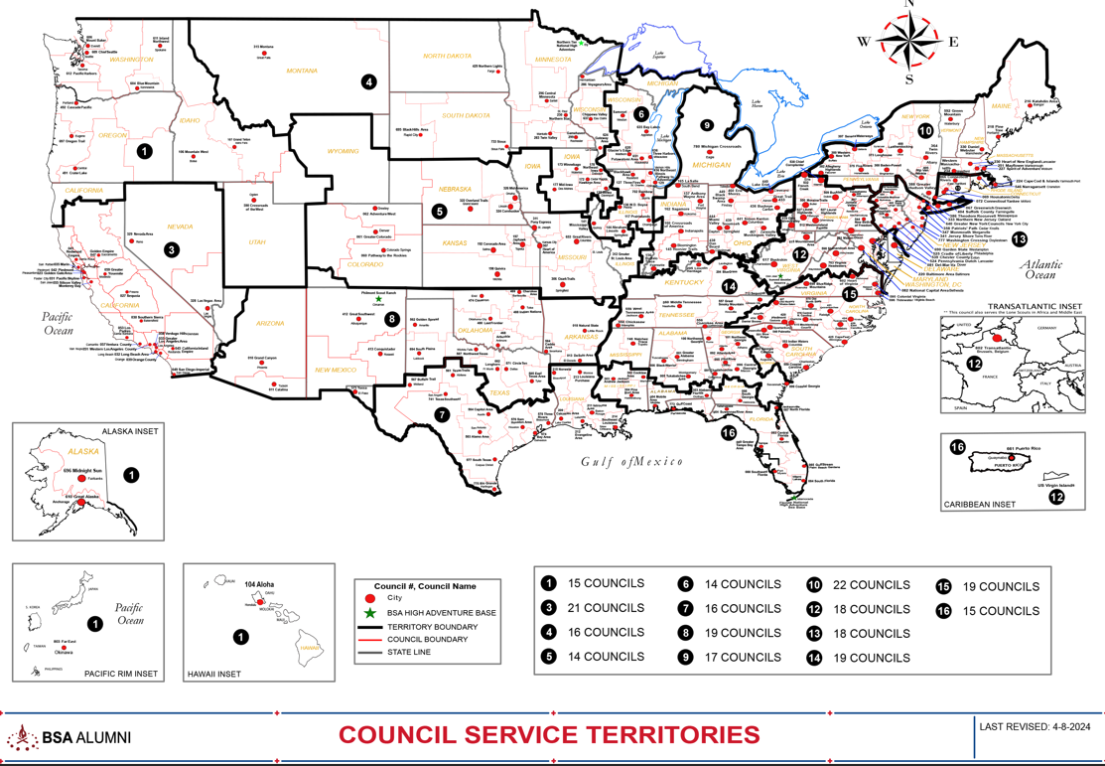

Council Service Territories (CSTs)…
COUNCIL

Slide 23
Current National Exploring SMEs / RAAs Team...
CST 1 ~ Suzie Steiner (Mountain West Council), who is currently an Advisor for an Exploring STEM / Robotics Post, which also encompasses trades such as machining & welding and business careers, and has previously been an assistant district commissioner, assistant & roundtable commissioner and Cub Scout den leader. National Exploring Resource Associate Advisor (RAA) supporting the CST 1 and councils within the territory
suzie@openlabidaho.org
((208) 869-2403
CST 3~ Stuart Mahler (Golden Gate Area Council), who is currently an Assistant Council Commissioner and LFL Council Exploring Chair and Executive Board Member as well as a retired police officer, an advisor in the 1987 Law Enforcement Exploring National Academy, staff member on three National Exploring Law Enforcement Exploring Conferences and Law Enforcement Explorer in his youth. National Exploring Resource Advisor (RAA) supporting the CST 3 and councils within the territory
mdc.stuart@gmail.com
(925) 519-6957
CST 4 & 5 ~ Roger Engelbart (Greater St Louis Area Council), who is currently the Assistant Council Commissioner for Training and the Engineering Chair for the Council Exploring Committee, as well as a retired Boeing Engineer involved in Nondestructive Evaluation. National Exploring Resource Associate Advisor (RAA) supporting the CST 4 & 5 and councils within those two territories
engelbart301@sbcglobal.net
(314) 920-8968

Slide 24
Current National Exploring SMEs / RAAs Team...
CST 6 ~ Richard (Dick) Davies (Glacier's Edge Council) who is the National Exploring Commissioner, Exploring Chair for the National Commissioner Service Team & National Exploring Program Committee Vice-Chair, as well as VP - Development in Glacier's Edge Council (Madison, WI), Greater New York Councils Executive Board Member, former Interim Scout Executive for the Greater New York Councils (2021 & 2022), past Northeast Region Exploring Chair and Board Member, and, in his youth, National Explorer President (1976-77) & Youth Member of National Executive Board. National Exploring Resource Associate Advisor (RAA) supporting the CST 6 and councils within the territory
richard.davies.nyc@gmail.com
(914) 327-7430
CST 7 ~ Don Decker (Bay Area Council) - Eagle Scout, Woodbadge staff member, retired BSA Professional Scouter, Business and Banking Explorer as a youth, and currently a full time Agriculture Specialist, US Customs and Border Protection Agency. National Exploring Resource Associate Advisor (RAA) supporting the CST 7 and councils within the territory
donedecker@gmail.com
( 832) 266-7145
CST 8 ~ Craig Martin (Pathway to the Rockies Council), who is the National Exploring Program Committee Chair as well as a retired Senior Systems Engineer supporting Department of Defense satellite programs and a retired USAF Colonel with extensive experience building, testing, launching & operating US Air Force satellites and testing air-to-air & air-to-ground missile systems. National Exploring Resource Associate Advisor (RAA) supporting the CST 8 and councils within the territory
bruin1967@aol.com
(719) 331-6406

Slide 25
Current National Exploring SMEs / RAAs Team...
CST 9 ~ Richard (Rick) Belford, Jr. (Western Massachusetts Council), who is currently the Vice President of Membership, Executive Board member, and Exploring Service Team member. Also a former Associate Advisor and Committee Member for two Posts and a former Scouting Professional/District Executive. Retired DOD/Federal employee and retired USAF Chief Master Sergeant. National Exploring Resource Associate Advisor (RAA) supporting the CST 9 and councils within the territory
rebwme234@gmail.com
(860) 749-2028
CST 10 ~ Joseph (Joe) Marinelli (Seneca Waterways Council), who is the Council Executive Committee’s & Board’s former Vice President of Exploring, past President of the Finger Lakes Council and Executive Director, Finger Lakes STEM Hub as well as a retired Regional Supervising Superintendent & BOCES (service agency) CEO for 25 school districts in upstate New York. National Exploring Resource Associate Advisor (RAA) ) supporting the CST 10 and councils within the territory
josephjmarinelli@aol.com
(585) 704-4659
CST 12 ~ John Brady (Del-Mar-Va Council) who is currently a member on the Council Executive Board, District Vice Chair and Sea Scout Ship 198 Committee Member as well as a former Attorney/Labor Relations Specialist for the State of Delaware & a former Scouting Professional District Executive. National Exploring Resource Associate Advisor (RAA) supporting the CST 12 & 14 and councils within those two territories
jfbradygroup@gmail.com
(302) 381-8728

Slide 26
Current National Exploring SMEs / RAAs Team...
CST 13 ~ Linda Hassler (Monmouth Council) who is currently a member of her Monmouth Council Board of Directors and Troop 140 Committee Member as well as an Assistant Professor at Rutgers’ School of Nursing, former Northeast Region Area 5 Exploring Chair, former Exploring Post Advisor and a Tennis Explorer in her youth. National Exploring Resource Associate Advisor (RAA) supporting the CST 13 and councils within the territory
Lindajhassler@gmail.com
(732) 687-7208
CST 14 ~ John Brady
CST 15 & 16 ~ Kenneth (Ken) Leedham (Gulf Stream Council) who is currently a District Commissioners, Exploring service team member, associate post advisor, merit badge counselor and Wood Badge staff member as well as a full-time police officer and Law Enforcement Explorer in his youth. National Exploring Resource Associate Advisor (RAA) supporting the CST 15 & 16 and councils within those two territories
treasurecoastscouting@gmail.com
(772) 370-2800
CHP ~ Rick TerBorch (Los Padres Council), who is the former National Service Territory (NST) 3 Commissioner, Assistant Council Commissioner and Council Executive Board Member as well as a retired Chief of Police in Arroyo Grande, CA, past Los Padres Council President & Council Commissioner, past National Law Enforcement Exploring Committee Member, Exploring Advisor and over 35+ years in Law Enforcement Exploring. National Exploring Resource Associate Advisor (RAA) supporting the California Highway Patrol (CHP) and the councils with CHP Law Enforcement Posts.
rterborch@earthlink.net
(805) 441-1721

Slide 27
Current National Exploring SMEs / RAAs Team...
Additionally, any of these National Exploring RAAs are available to any of the CSTs and their councils on the following Exploring Career Fields
Aviation ~ Rick Belford & Roger Engelbart
Business ~ Rick Belford (Contracting & Procurement)
Communications ~ Rick Belford (Broadcasting & Public Relations) and John Brady (Broadcasting & News Reporter)
Engineering & Technology ~ Roger Engelbart, Craig Martin and Suzie Steiner (Robotics)
Health Care ~ Linda Hassler
Law & Government ~ John Brady (Law Careers) and Craig Martin & Rick Belford (Military Careers)
Law Enforcement ~ Ken Leedham, Stuart Mahler & Rick Terborch
Skilled Trades ~ Joe Marinelli & Suzie Steiner
Social Services ~ Joe Marinelli (Education), Linda Hassler (College Professor), Rick Belford & John Brady (Non-Profit / Not-For-Profit Management) and Suzie Steiner (STEM)
Other Career Fields ~ National Exploring RAA, assisting your CST, will find the best individual to assist you for other Exploring Career Fields

Slide 28
National Exploring Program Committee

Slide 29
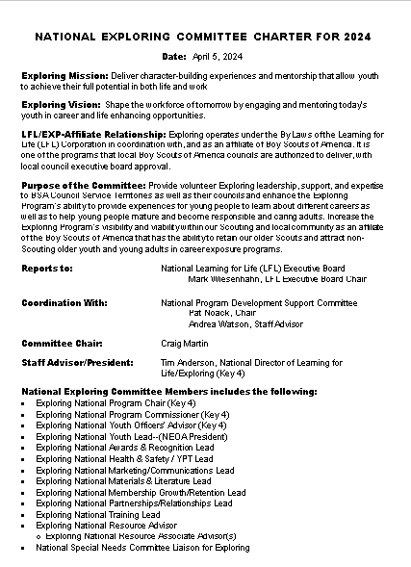
New National Exploring Committee Charter for 2024-2025
(Page 1)

Slide 30
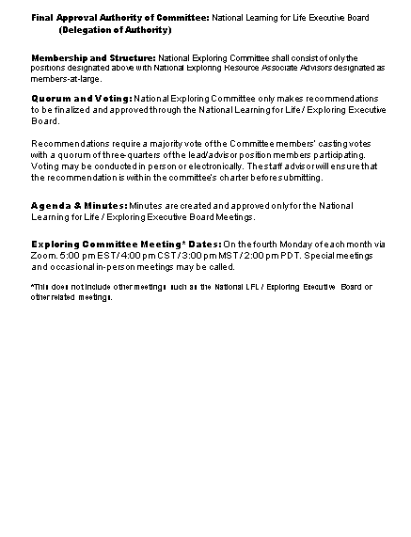
New National Exploring Committee Charter for 2024-2025
(Page 2)

Slide 31
Nat’l Exploring Committee Members…
National Exploring Program Chair Craig Martin
National Exploring Program Commissioner Richard (Dick) Davies
National Exploring Membership Growth / Retention Chair Jeffrey (Jeff) Schweiger
National Exploring Awards & Recognition Chair Richard (Rick) Belford
National Exploring Training Chair Roger Engelbart
National Exploring Health & Safety / YPT Chair Linda Hassler
National Exploring Marketing / Communications Chair (Website / Social Media) TBD *
National Exploring Materials & Literature Chair TBD *
National Exploring Youth officer Advisor TBD *
National Exploring Youth Chair TBD
National Exploring Partnerships / Relationships Chair TBD *
National Exploring Resource Advisor Stuart Mahler
National Special Needs Committee Liaison for Exploring Steven Kappel, MD
National Exploring Members-at-Large (National Exploring Resource Associate Advisors)
  National Exploring Subject Matter Expert John Brady
  National Exploring Subject Matter Expert Don Deeker
  National Exploring Subject Matter Expert Kenneth (Ken) Leedham
  National Exploring Subject Matter Expert Joseph (Joe) Marinelli
  National Exploring Subject Matter Expert Suzie Steiner
  National Exploring Subject Matter Expert Rick TerBorch
* Note: Welcome recommendations from our Exploring community

Slide 32
Topic(s) of the Month
Career Interest Surveys
Open Houses

Slide 33
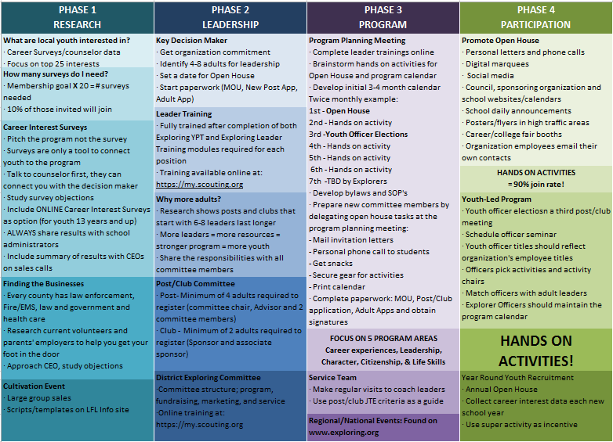

Slide 34
MOST IMPORTANT PART
OF EACH PHASE?
Phase 1 : Career Interest Surveys
Phase 2: Training
Phase 3: All-In-One Program Planning Meeting
Phase 4: Open House

Slide 35
Career Interest Surveys
The # 1
Leading Indicator for Exploring Growth

Slide 37
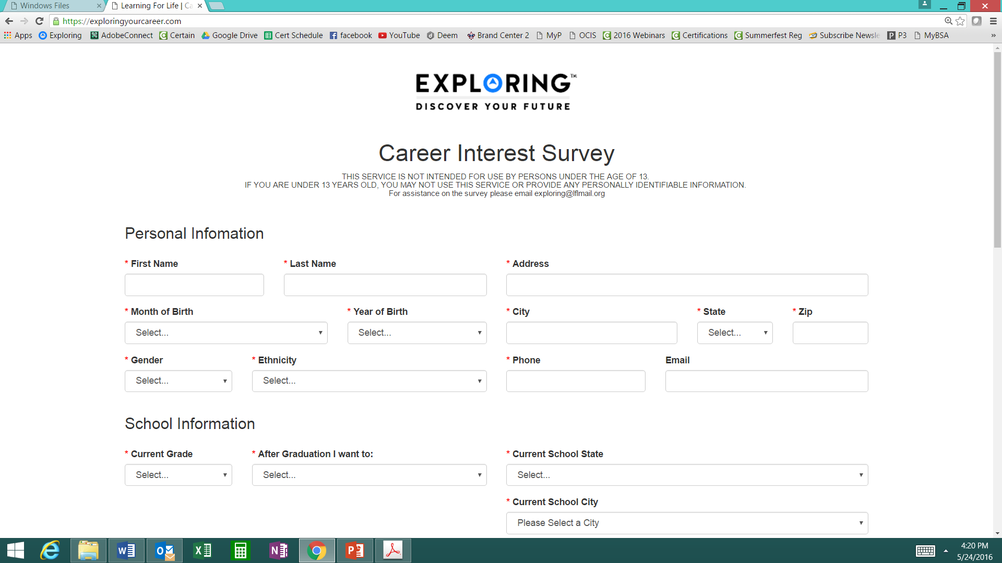
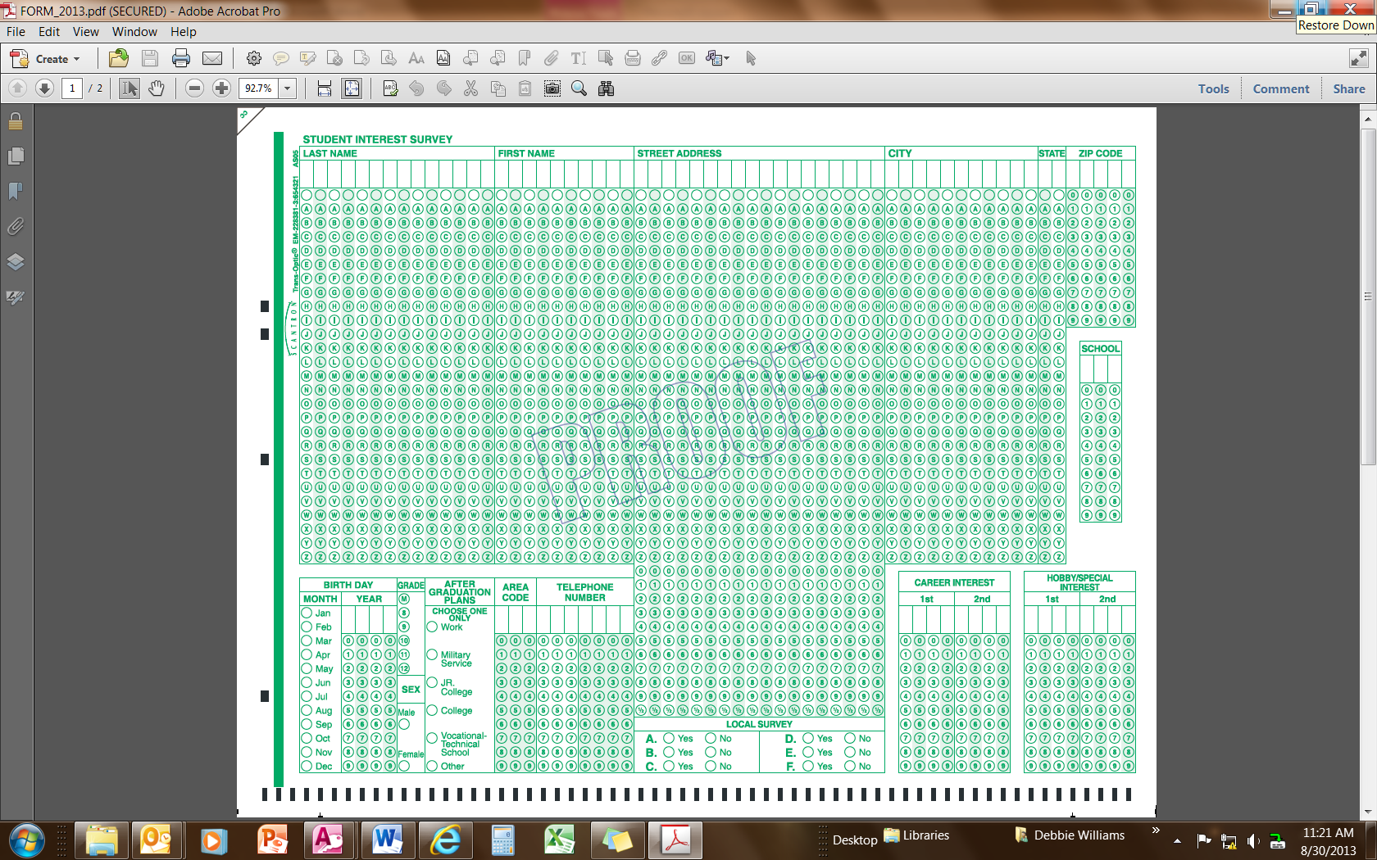
Phase 1 – Research
Career Interest Surveys (two choices)
pa
pa
Online Survey:
www.exploringyourcareer.com
Paper Scantron Survey

Slide 38
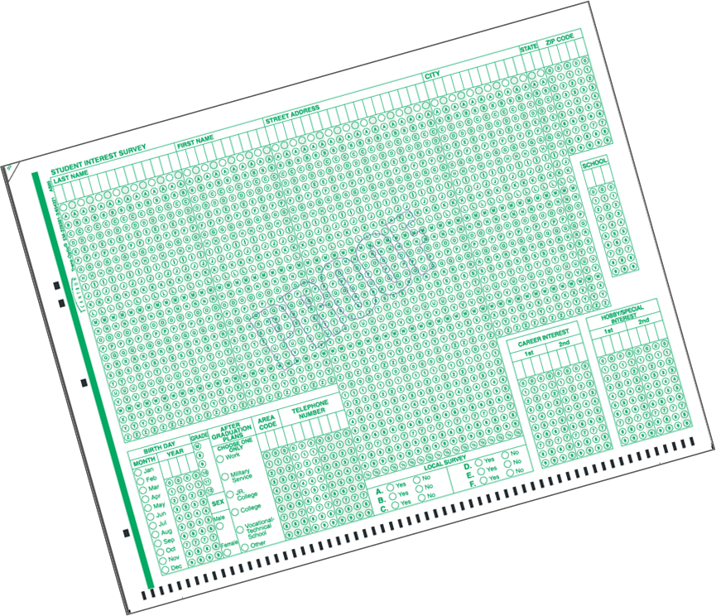

BACK SIDE
FRONT SIDE
Paper Scantron Survey Available through NDC

Slide 39
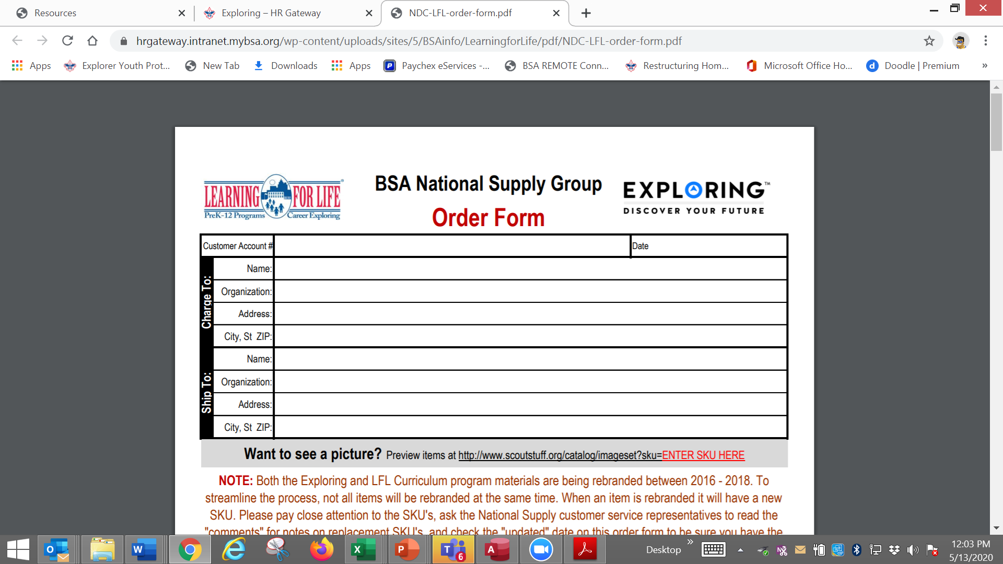

Slide 40
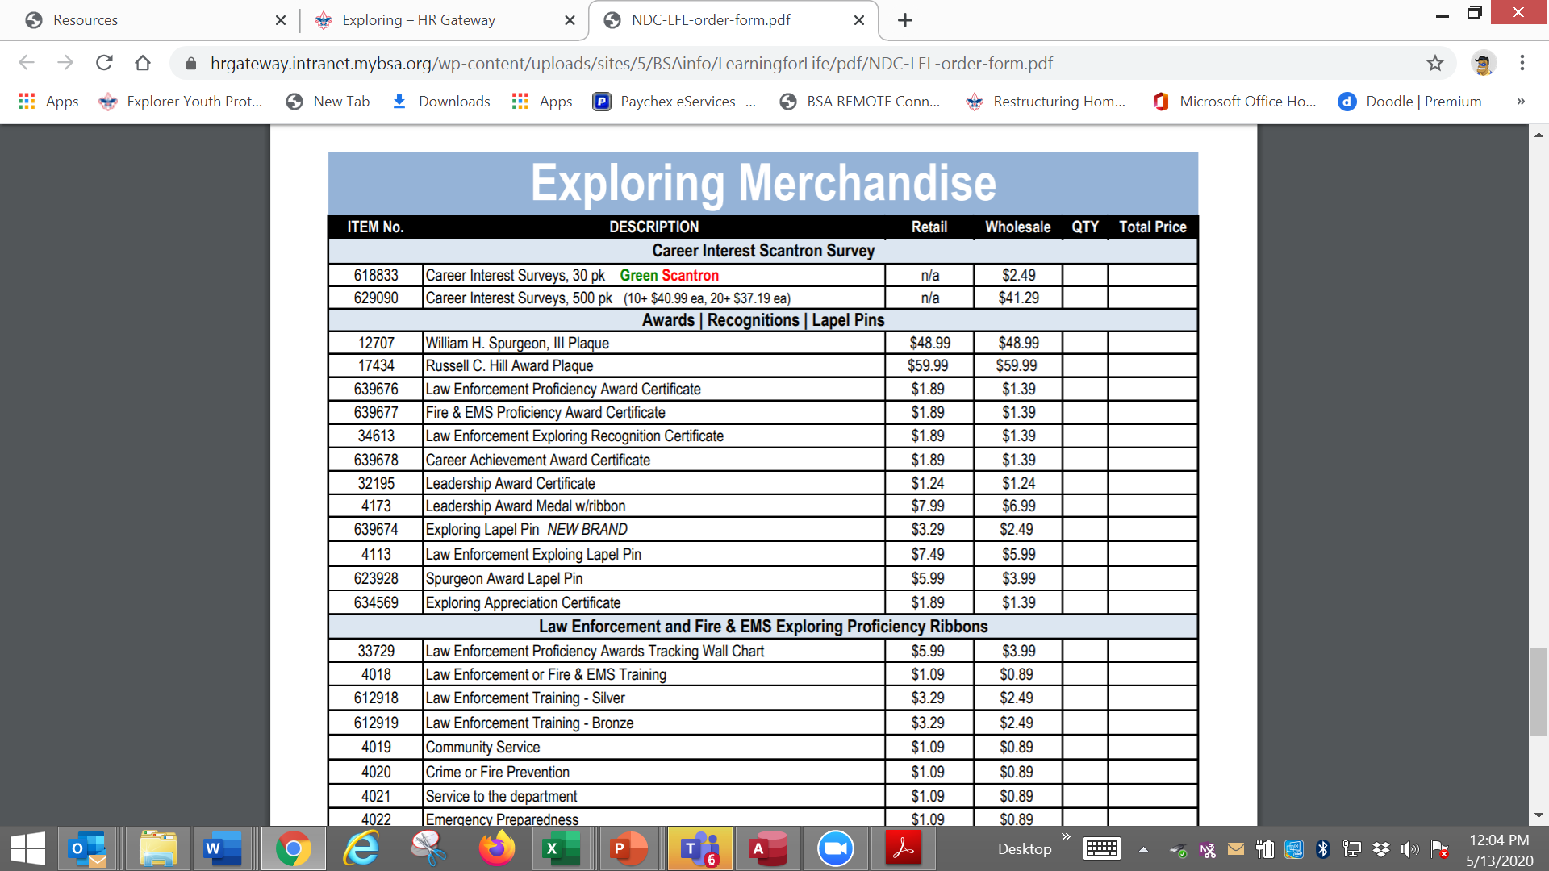

Slide 41

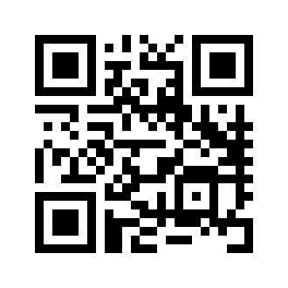
Online Career Interest Survey
www.exploringyourcareer.com
TRY IT NOW!
Use QR code or simply type address in web browser
Notes:
A “QR” or Quick Response code was created to take students directly to the survey site. It is available on posters, post cards, business cards, and book marks.
How do you use this? Email it to all teachers, they can open it from email and project it one screen for students to use their smartphones!

Slide 42
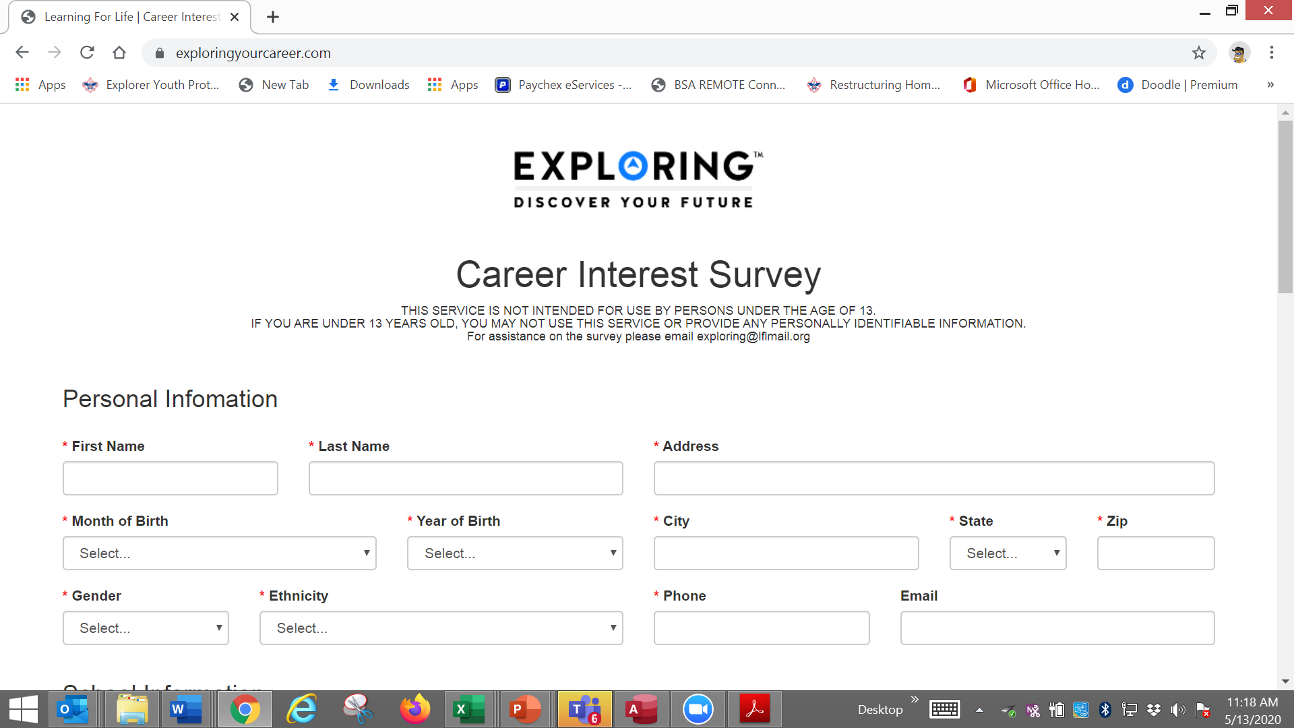

Slide 43
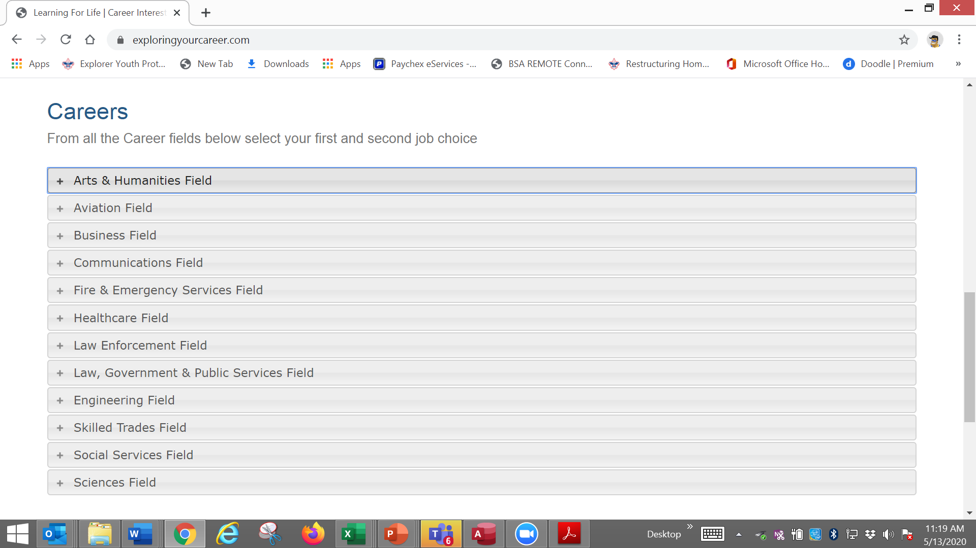

Slide 44
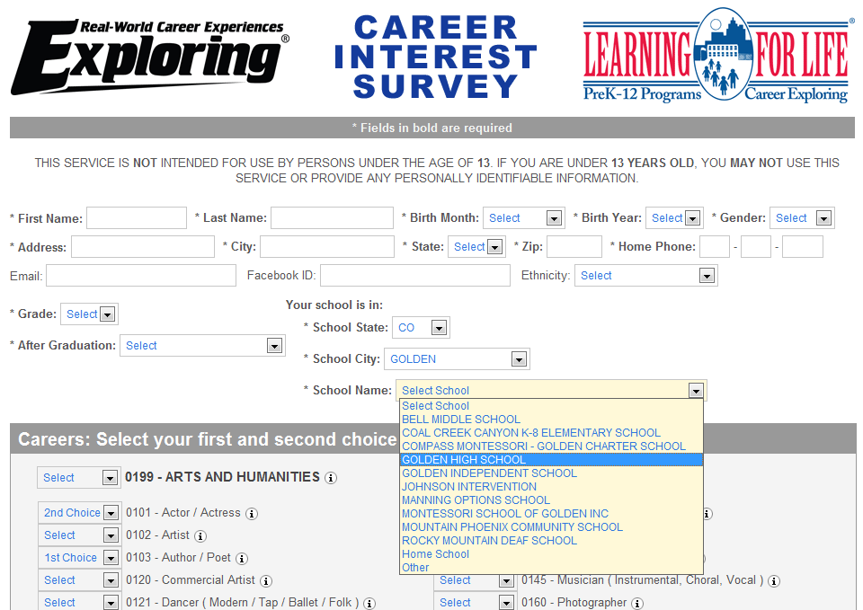
www.exploringyourcareer.org
Two career & hobby choices
School names
pre-loaded
Notes:
REFER TO HANDOUT IN YOUR FOLDER.
This is a screen shot of the new Online Career Interest Survey that was activated on Jan 1, 2012.
The careers & hobbies match the paper version. So schools and administer the survey either on paper or electronically.
The online version can be accessed from any device that can access the Internet – including smart phones.
Results are sent instantly to a secure website where councils can access the results and provide them to schools in the same format as the paper survey.
Instructions for accessing results can be found in the LFL internal site.
Students 13 yrs. and younger cannot legally complete this survey online. If they enter data, the system will not save it.
You can also add schools/colleges to this list if they do not populate when you put in your respective zip code. Simply e-mail us at exploring@lflmail.org and request your specific school to be added, with zip code

Slide 45
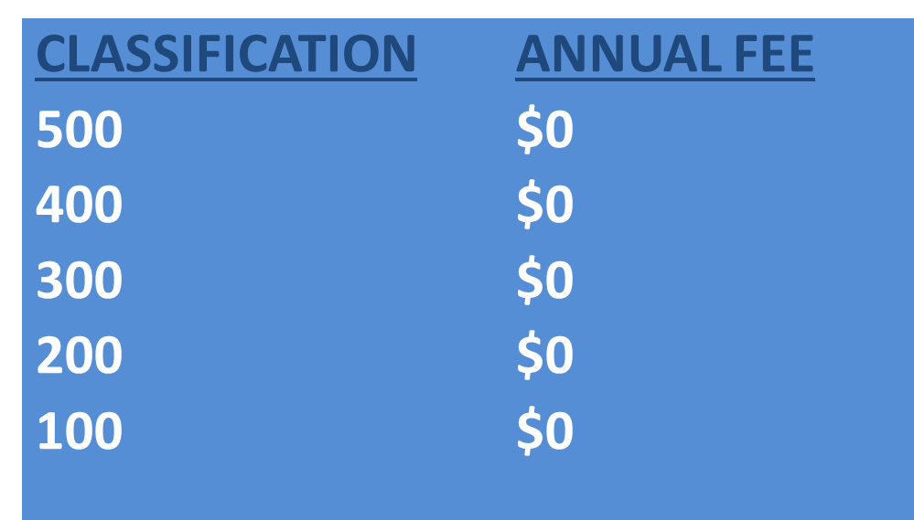
Online Career Interest Survey COSTS
Unlimited schools and unlimited surveys for students 13 years of age and older

Slide 46
REPORTS GENERATED FROM THE SURVEYS

Slide 47
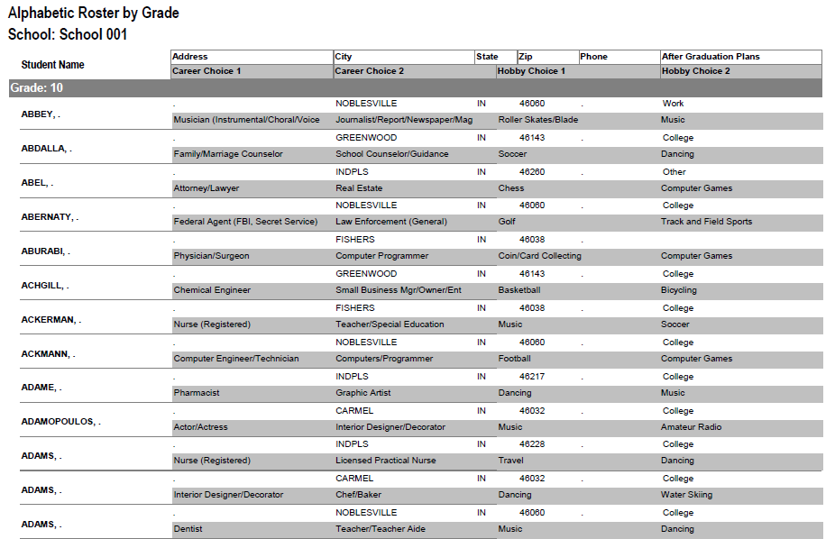
RESULTS REPORT: School
Grade: 10
ABBEY, Susie 123 Main St Noblesville IN 46060 Work
Career 1 Career 2 Hobby 1 Hobby 2
Musician Journalist Roller Skate /Blade Music
47
Notes:
47
No matter the survey format you use, the reports are generated the same way.
**GOOD data to establish credibility at/during your sales call
This is one set of sample results provided at no cost to schools. Very helpful for Guidance Counselors.
All students, by grade, alphabetically. Shows:
Career interests
Hobby interests
Post-high school plans
Other results include all students interested in each career (all the attorneys, architects, dentists, electricians, etc). Helpful for Guidance Counselor planning, career speakers, college days and college fairs.
Be sure to return results to the Guidance Counselor when you say you will – under promise and over deliver. Do not promise results in one week if you cannot do it. Say 2-3 weeks, then they will be very happy if they do receive them in a week or ten days.

Slide 48

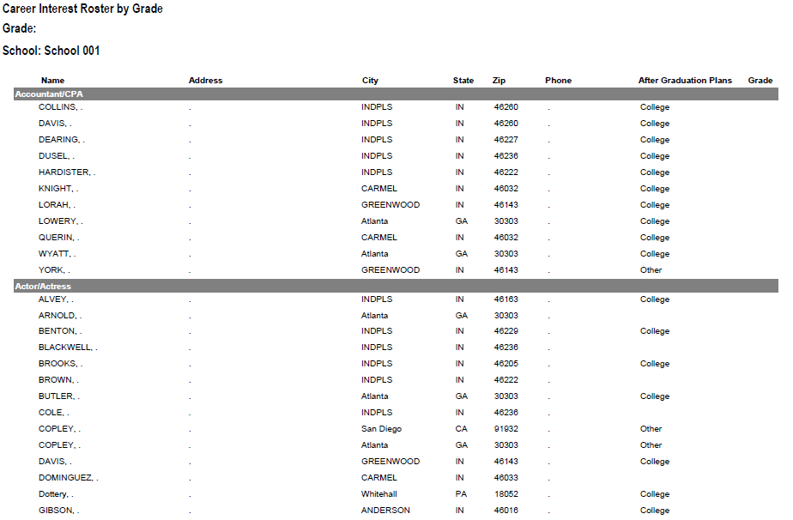
RESULTS REPORT: School
48
Notes:
48
This is another set of sample results provided at no cost to schools. Very helpful for Guidance Counselors.
This report includes all students interested in each career (all the attorneys, architects, dentists, electricians, etc.). Helpful for Guidance Counselor planning and career speakers.
The After Graduation Plans is important to Guidance Counselors
College
Junior college
Military Service
Technical school
Work
Other
Why are these reports help full to the school…to you?

Slide 49
Summary Career Interest Report by Council
Code Career Count
0712 Nurse (Registered) 798
0145 Musician (Instrumental/Choral/Voice) 751
0903 Attorney/Lawyer 733
1625 Teacher/Teacher Aide 678
0300 Business (General) 645
0719 Physician/Surgeon 604
0101 Actor/Actress 600
0130 Fashion Designer/Model/Buyer 579
0721 Psychiatrist/Psychologist 578
0170 Professional Athlete 507
0180 Photographer 461
1305 Architect 437
0725 Veterinarian 429
0102 Artist 427
0718 Physical Corrective Therapist 313
1300 Engineering (General) 208
MOST IMPORTANT TO YOU

Slide 50

Career Interest Survey Questions
Opportunity for 6 “Yes” or “No” questions
Unique feature of our survey
Anything school officials want to know
  Are you planning to take the SAT / ACT?
  Are drugs a problem in our school?
  Is there enough student parking?

Slide 51
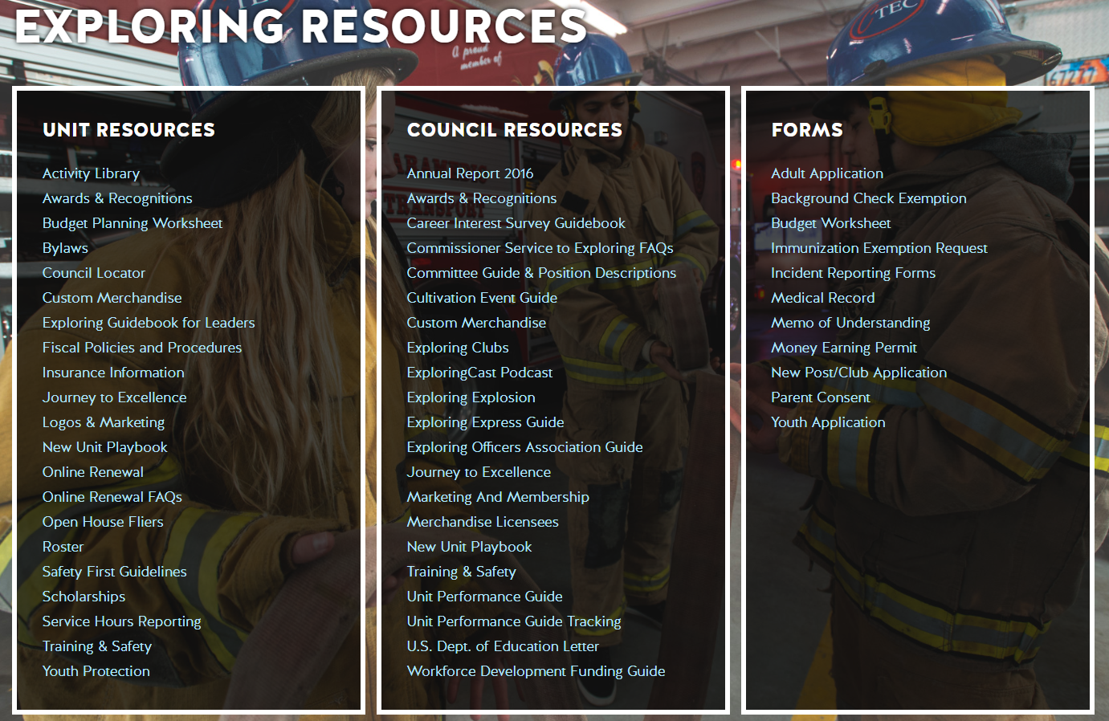
www.exploring.org

Slide 52

Career Interest Survey Guidebook
Be sure you have the most recent version
Download at www.exploring.org
One stop shop for all CIS resources
Table of Contents
  Page 5 | At A Glance
  Page 7 | Overcoming Objections
  Page 44 | Appendix

Slide 53
ALTERNATE METHODS?
1. Use school information already available
2. Ask youth to develop contacts
3. Develop cultivation events
4. Invite Eagle Scouts / Scouts to join
5. Booth at schools open house night and career days /career fairs
6. Annual Exploring open houses for ALL Posts and Clubs
7. Follow up leads from the Exploring Lead
Generator

Slide 54


Slide 55
Leads are being generated from Exploring.org and include anyone interested in joining, leading, sponsoring, or
otherwise supporting Exploring in their area.
Scout Executives, Assistant Scout Executives and DFS’s receive weekly lead reports.
Exploring Executives and staff advisors receive immediate notifications of each lead generated.
To make changes to any of these settings, email your request to exploring@lflmail.org.
WHEN YOU RECEIVE AN IMMEDIATE NOTIFICATION EMAIL:
1. In the email, you will see a note to “copy & paste the following URL into your browser to mark lead as contacted”.
By following this directive, you are changing the status of your lead to “contacted”. You will no longer receive email notifications for that particular lead. The lead will begin to show as “contacted” on your SE’s weekly report.
Invite the person to attend an existing post/club meeting to get a feel for the program and connect them to
appropriate Exploring advisors.

Slide 56
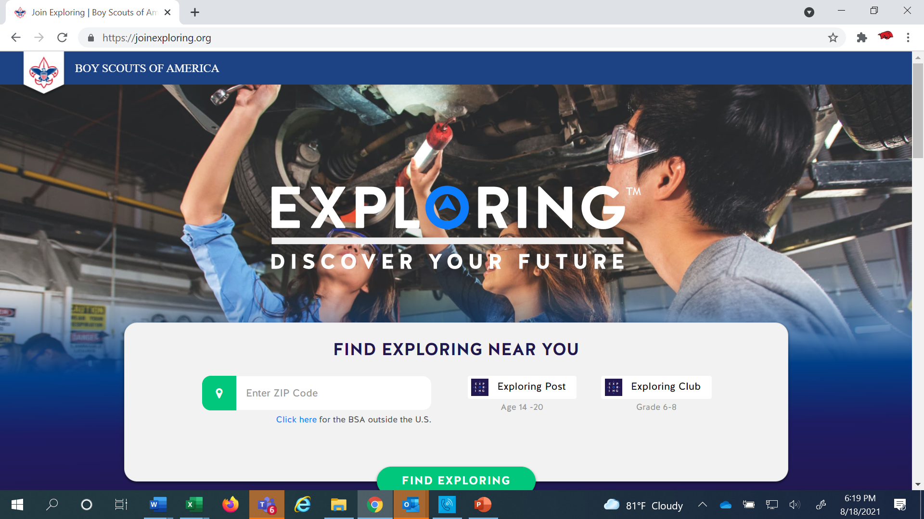
www.joinexploring.org

Slide 58
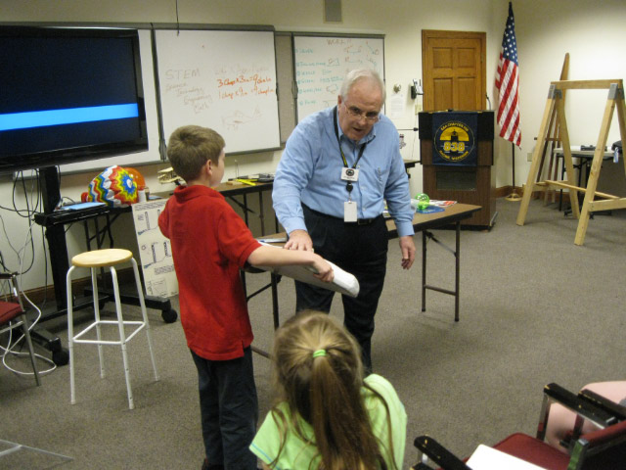
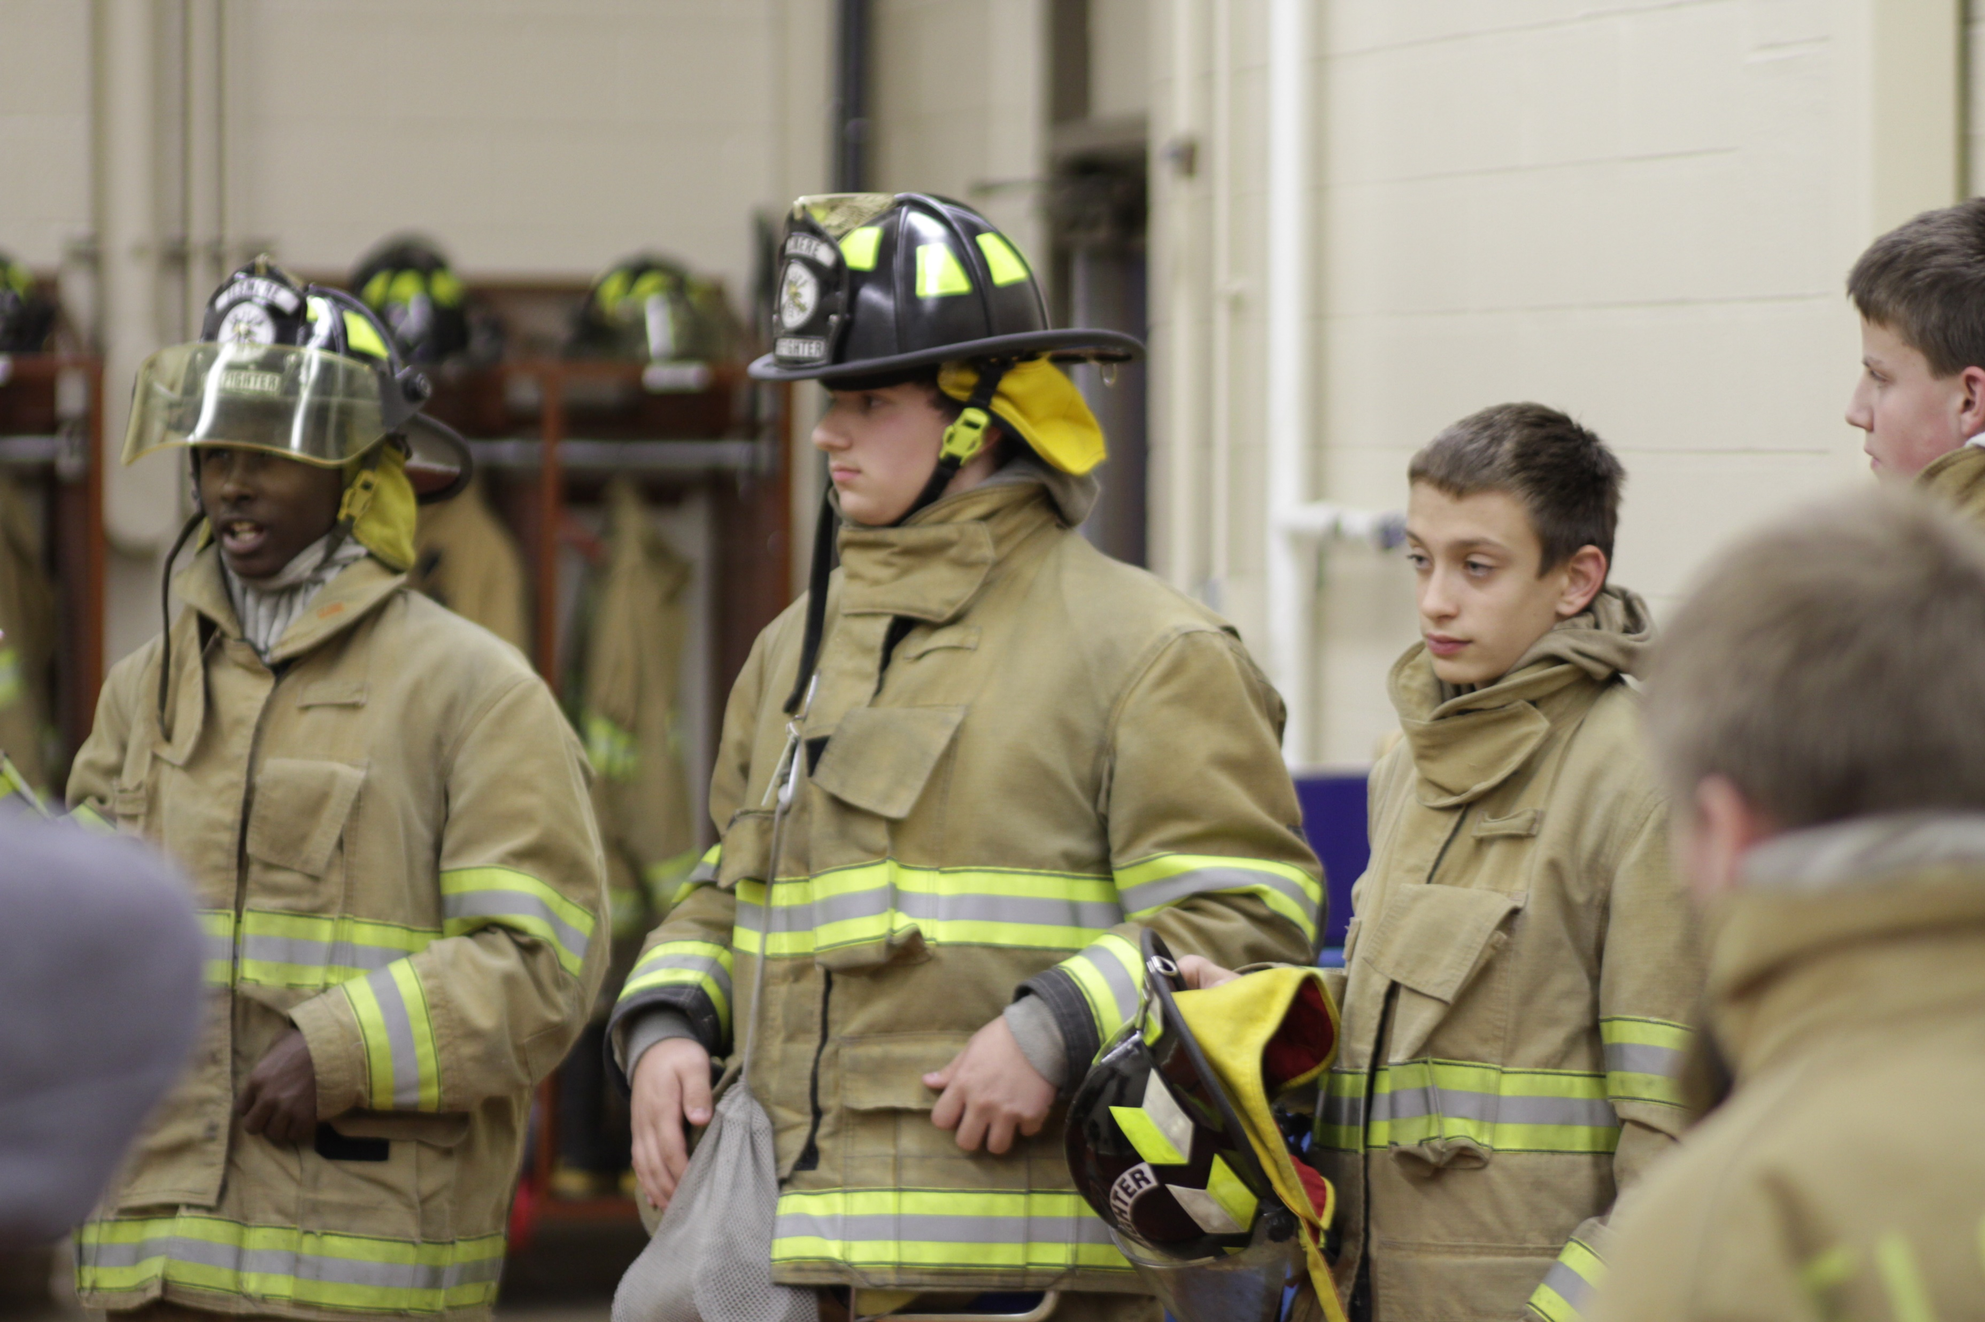
Phase 4 – Participation
SIMPLE OPEN HOUSE AGENDA
OPEN HOUSE AGENDA
Welcome
What is Exploring?
Video
HANDS-ON ACTIVITIES
Activity Interest Survey (customized)
Calendar
ASK TO JOIN
Applications & fees
Snacks

Slide 59
Barriers to Abuse Update
As part of our ongoing commitment to abuse prevention, the Boy Scouts of America, to include Exploring, is updating the adult supervision requirements for overnight activities
This update enhances the minimum “two deep leadership” requirements by additionally requiring every adult present on overnight activities to be a registered member of the Boy Scouts of America or Exploring
These adults must submit an adult application and registration fee, undergo a criminal background check, a volunteer screening database check and must complete mandatory Youth Protection training.
A limited exception for parents and legal guardians of Cub Scout youth attending overnight with their children is planned due to the family centric nature of Cub Scouting
All Cub Scout Packs, Scouts BSA Troops, Venturing Crews, Sea Scouting Ships, Exploring Posts, council, and district overnight programs will be required to comply with this update by September 1, 2023. We encourage early adoption prior to the effective date
This updated Barrier to Abuse will be referenced as part of the Guide to Safe Scouting, Exploring’s Safety First Guidelines, Youth Protection and Adult Leadership section, Scouting’s Barriers to Abuse. Youth Protection and Barriers to Abuse FAQ’s will be expanded to include additional FAQ’s as they are developed

Slide 60
National Exploring
Volunteer of the Month
The National Volunteer of the Month will be recognized on www.exploring.org
and will receive a certificate and polo shirt from the National Exploring Team!
Nominees should be submitted using the link below
http://bit.ly/ExpVolMonth

Slide 61
Example Nomination Write-Up
George Denise completed his Exploring Fast Start training on 1/01/2011 and his most recent position is Service Team Chair for my district since February 2018. He has been involved with every aspect from FOS and volunteer recruitment to membership, product sales, program and unit service. George helped Exploring District achieved significant growth in our FOS campaign and 5% membership growth last year. We are at 61% of our FOS goal for the year, second highest percentage in our council. As we shelter-in-place, he secured a dynamic guest speaker for our Science Night and saved us $650 in shipping cost in our Make A Mask Challenge. His efforts made it possible for us to donate thousands of pieces of protective medical gear to 7 medical facilities in 2 counties. He supported a 15 year old Scout in the Medical Explorer program whom has wanted to make a difference. What started as a local mask-making challenge turned into a multi-city effort through connections of Scouting friends in Dallas, TX and Orange County, CA to Santa Clara county .

Slide 62



STAY CONNECTED
page | @lflexploring
group | Exploring Success!
group | National Explorer Alumni Association
learningforlifeusa
exploring.org | Stay Connected
exploring@lflmail.org

Slide 63
Questions?

Slide 64

2024 NATIONAL EXPLORING LIVE HOURS
The National Exploring Live Hour is a monthly Zoom video conference that will help engage and equip
Exploring volunteers and professionals to grow, support, and learn more about Exploring. Each month the National Exploring Live Hour will be led by our National Exploring Chair and the National Director of Exploring. The live hours will include sharing best practices and ideas that are happening within our councils, highlighting successful growth campaigns, and inspiring new ideas through various trainings. This will also offer an opportunity for local councils to collaborate with territory and national counterparts to generate innovative solutions to real-life Exploring challenges.
National Exploring Live Hour Schedule
1:00 PM – 2:00 PM Central Standard Time, Monthly
Register for each of the National Exploring Live Hour ZOOM presentations at:
https://reservations.scouting.org/profile/form/index.cfm?PKformID=0x144800abcd

Slide 65
Exploring at Home (Discuss Best Practices)
Idea Sharing
Questions and Answers from the Field https://drive.google.com/file/d/1Bo7U0iJ8Ti-bmyIFtxGfG0TIt3dB1xX4/view?usp=sharing
After the Live Hour Discussions
(Open Dialogue)

Slide 66


Good News from the Field!

Slide 67
v
END OF JUNE ELH PRESENTATION SLIDES
All Other Slides Below are Informational

Slide 68
v
EXPLORING UPDATES
REMINDERS
Tim Anderson
National Director
Learning for Life & Exploring
National Director Older Youth Programs

Slide 69

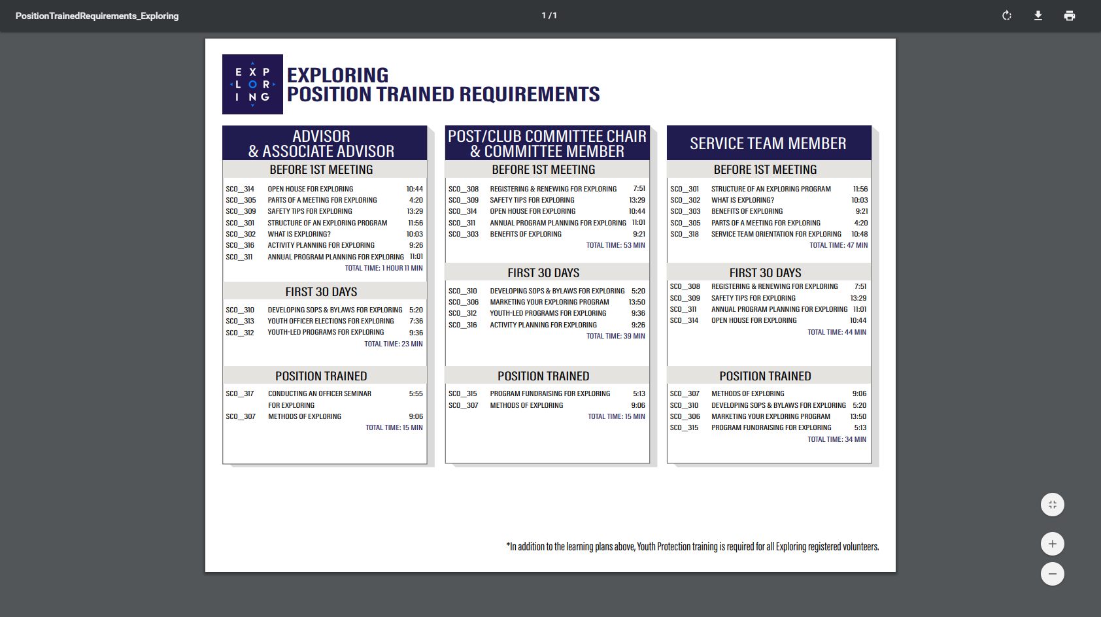
EXPLORING PARTICIPANT POLICY
“EP” (18 THROUGH 20 YR OLD EXPLORERS)
Effective August 1, 2020, all applicants 18 through 20 years old must complete and submit an adult application, consent to a criminal background check, and successfully complete Youth Protection training.
However, an 18- through 20-year-old will still be considered an Adult Exploring Participant in the post and will not be considered an adult leader. Therefore, an “EP” will not be allowed to fulfill adult leadership roles pertaining to Two-Adult Leadership and other requirements that require leadership to be at least 21 years of age.
All Exploring Participants “EP” will continue to count as youth within your youth membership reports.
Visit the link below for an infographic as well as a Q & A to assist you in implementing this important new policy. http://filestore.scouting.org/filestore/se-packet/2020-08-10/Exploring-Participant-Policy-FINAL-2.pdf

Slide 70
EXPLORING REGISTRATION FEES
Effective August 1, 2023, Exploring fee updates:
- Exploring Youth $50.00
- Exploring Adult Participants (18-20) $50.00
- Exploring Adults $50.00
- Exploring Post/Club Annual Renewal Fee $100.00
- There is no additional “Joining Fee” for Exploring
The updated membership fees will take effect August 1, 2023, for new members in the 2023-2024 program year.
The national membership fee helps cover the cost of essential services, including program resources, liability insurance for those participating in approved Scouting activities, criminal background checks, youth protection, and the development of intellectual property for national, council, and unit programs. As we move forward, we will continue to look at the membership fee structure and how we deliver the Scouting program for future generations.

Slide 71
NEWLY UPDATED EXPLORING APPLICATIONS
The newly updated Exploring applications are available now for download online at www.exploring.org
New Post/Club Application (SKU# 655197)
Youth Application (SKU# 634698)
Adult Application (SKU# 634699)
-Includes the new 18-20 Exploring Participant (EP) Code, which will became mandatory beginning August 1st, 2020.
*New applications are available at the National Distribution Center .

Slide 72

Newest Technology for Exploring
BeAnExplorer “Equivalent”
“joinexploring.org”
“joinexploring.com”
Scoutbook for Exploring
Online Registration
Online Renewal

Slide 73

*Exploring Leadership Experience
*Coming soon for Exploring youth
Resume Builder that will help recognize Explorers
This online, mentor assisted, self-paced and guided experience will allow our Explorers to…
Have an opportunity to discover their inner leadership potential
Gain practical leadership experience – participate in a capstone project
Work with a mentor to gain professional leadership experience
Be recognized with a Nationally Certified Leadership Experience Certificate that will help improve their resume and recognize their overall Exploring Experience.

Slide 74
ONLINE
REGISTRATION
FOR EXPLORING

Slide 75
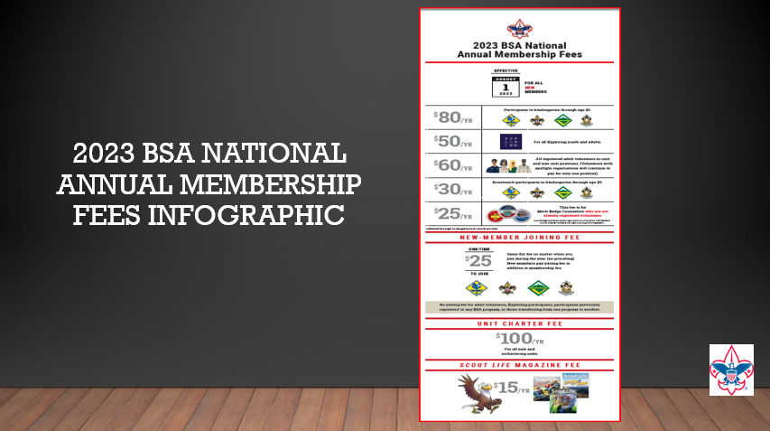

Slide 76
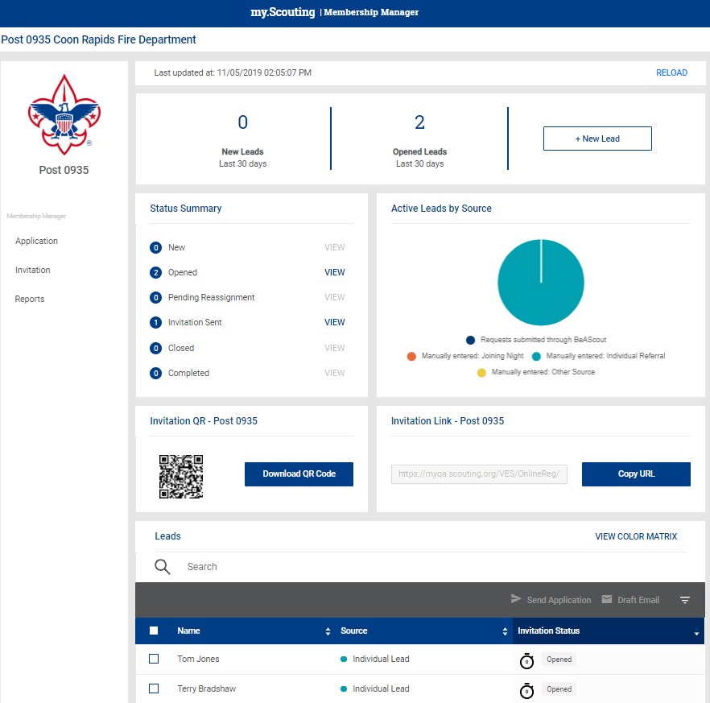
Invitation Manager
There is no BeAnExplorer…yet ☺

Slide 77
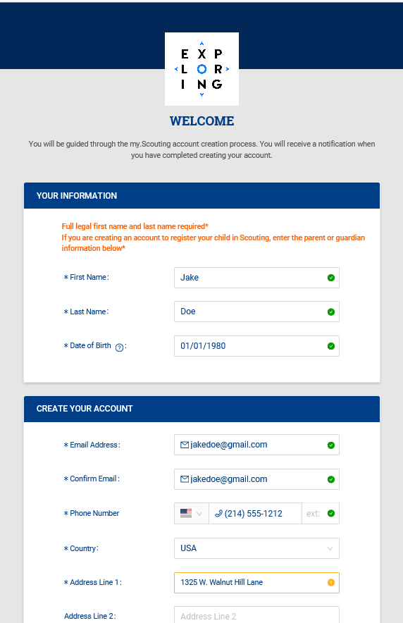
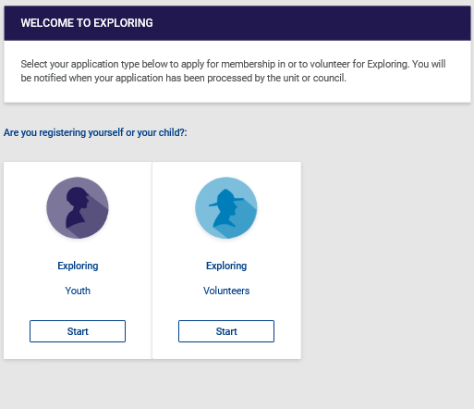
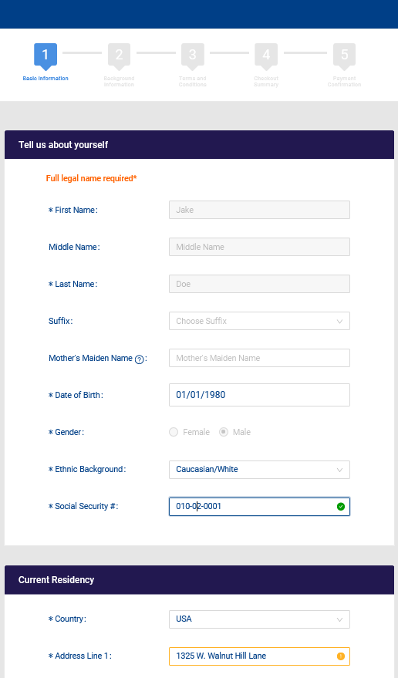
Create Account & Complete Application

Slide 78
ONLINE
RENEWAL/
“RECHARTERING”
FOR EXPLORING

Slide 79
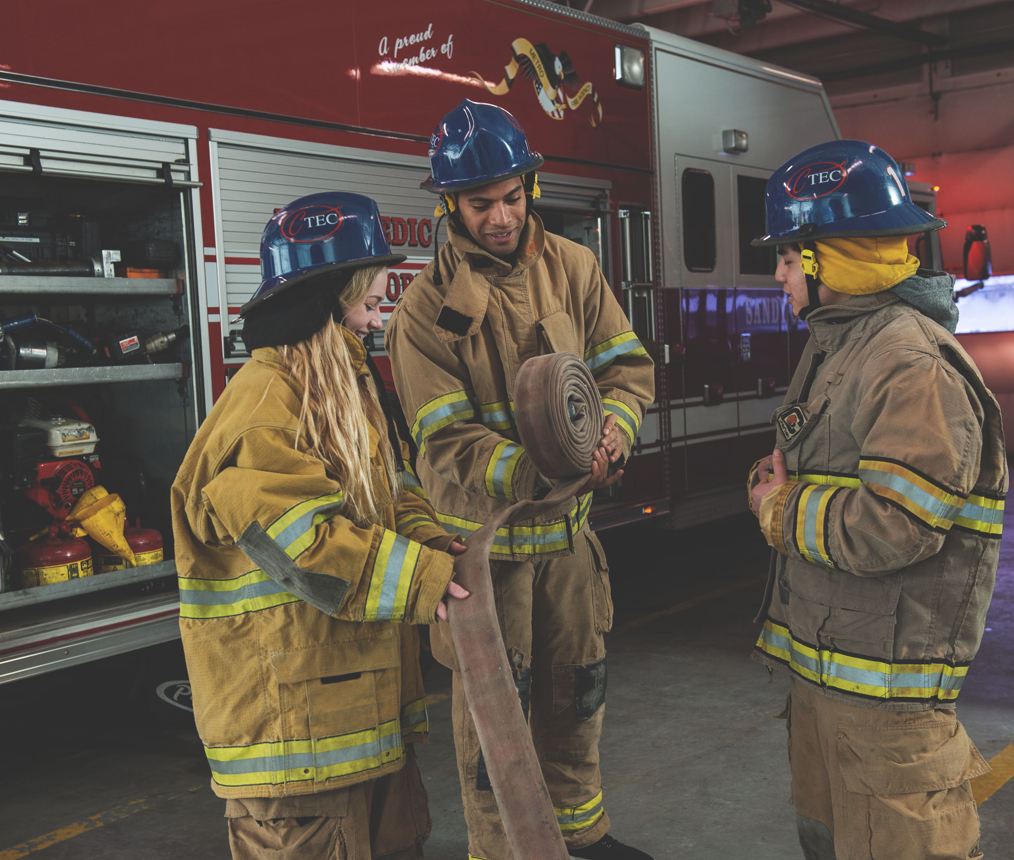
UNIT
“RENEWAL”
Aug 2023 – Feb 2024 Recharters

Slide 80
https://www.scouting.org/commissioners/internet-rechartering/
Information included is:
Training Video
FAQ’s
User Guides
Internet Recharter Guidelines
Summary of Enhancements
Recharter Demo Tool
New Online Rechartering/Renewal System
https://advancements.scouting.org/login
Manager of Shared Services
Member Data Outsourcing Solutions

Slide 81

BSA New Renewal System Overview

Slide 82
Registrar Tools and Online Registration – Scheduled Updates
Unit Renewal (new method)– Mid February
Auto Renewal Membership – Mid-February
Change in Adult Workflow / CBC requirement - Early March
Final Auto Renewal Implementation – Early March
New Fee Structure – April 1st
Council Service Territory Changes – April 1st
New Cub Scout Program integrated into Scoutbook+ - June 1st

Slide 83
Criminal Background Check Workflow Change
… during this process, you are not eligible to meet with youth …
March 2024 Implementation
  There will be a 3-5 day delay (or more) in acceptance as an Adult Leader
Major Impact
  Rechartering Units
  Camp Leaders
  New Units

Slide 84
Auto Renewal Membership / Units
For all Youth and Adult members in the BSA
All Membership Terms are for 12 months
New Membership Renewal will only have a one-month lapse
New Unit Renewal will only have a one-month lapse
Parent/Guardian e-mails are needed
Parents can Opt-Out and Units can Opt-out the member too
A one-time data sync will be done in March to align all Multiple and Functional Registrations to the Primary (paid) expiry date

Slide 85
Unit Recharter BEFORE March 1, 2024
>> NO CHANGES <<
Unit Renewal AFTER March 1, 2024
>> Auto-Renewal Process <<
Youth and adult leader membership fees will be separated from the unit charter.
Login at https://advancements.scouting.org/
Unit Leader, Unit committee chair,
chartered organization representative, or designee
Auto-Renewal
Manual Renewal
Unit Paid Renewals
Auto-Renewal
Individual membership renewal and fees are paid automatically by the individual
Manual Renewal
Individual membership renewal and fees are paid to the unit or local council office.
Unit Paid Renewals
Individual membership renewal and fees are paid by the unit
Click on re-charter located on the lower right menu.
Enter 12-month term
Login at My.Scouting.org and go to Organization Manager
(Unit Leader, committee chair, chartered organization representative,
or designee have access)
Edit Roster
Click on “Unit Renewal "on the menu.
Invite New Members
Update Adult Leader Positions
Remove Members
Validate Information
Make changes to Leadership if needed in Position Manager – Have leaders take YPT if needed
Validate Information
E-Sign the Page
Pay and Submit
Pay and Submit

Slide 86
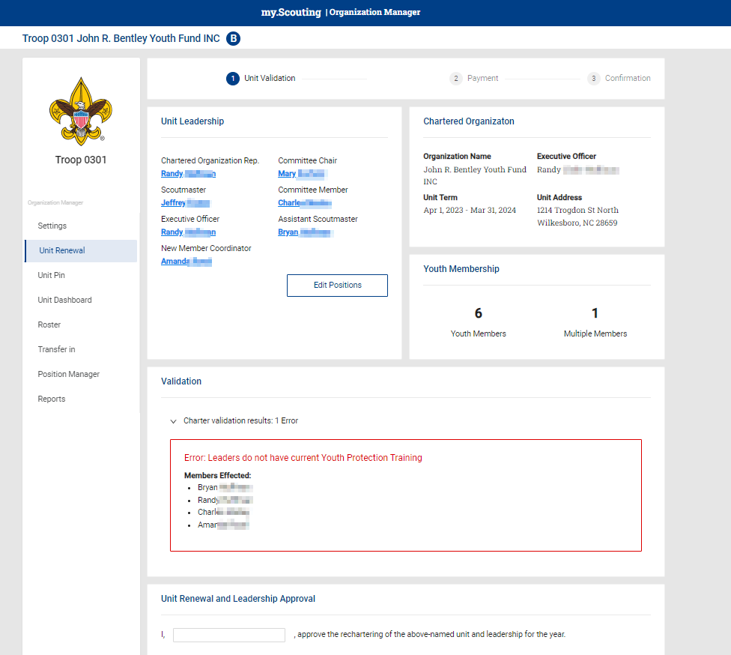
Auto Renewal Membership – Unit Renewals

Slide 87
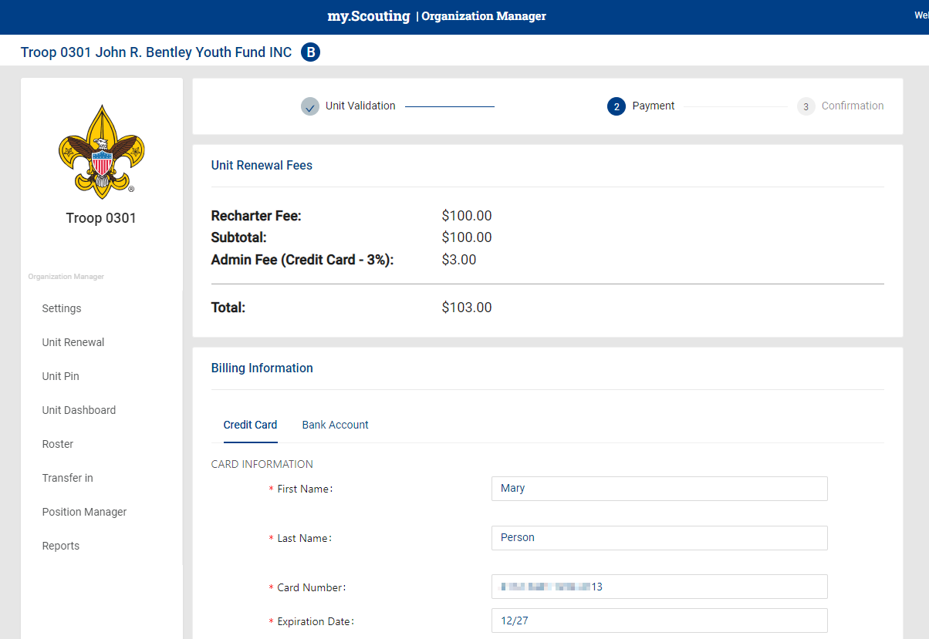
Auto Renewal Membership – Unit Renewals

Slide 88
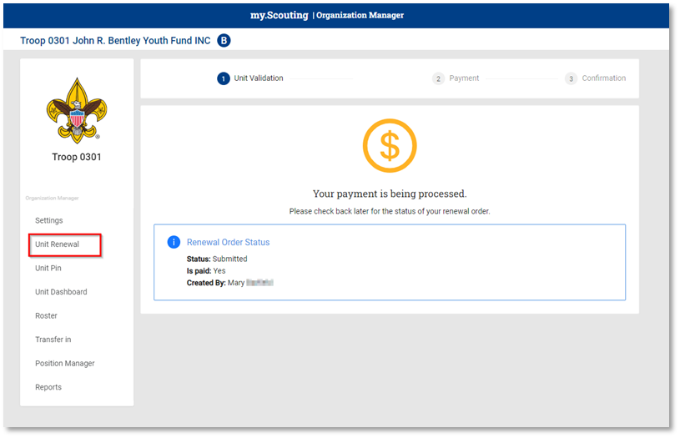
Auto Renewal Membership – Unit Renewals

Slide 89





Auto-Renewal Membership
For all youth and adult
members of the BSA
Note: All registrations are for 12 months. For example, if your current registration expires on 12/31/2023, your renewed membership will start on 1/1/2024
and run through the entire calendar year until 12/31/2024. Membership renewal can be completed by either the individual, the family or the unit.
Auto Renewal Membership
Family/Self Pay
Auto Renewal Membership
Unit Pay
An email notification and a renewal link will be sent 60 days before membership expires.
The link provided in the email will direct individuals to a renewal form on My.Scouting
If registered in multiple positions, select the primary position. Renewing the primary position will automatically renew multiple positions.
The individual pays with a credit card and submits the renewal.
The unit will approve the membership renewal.
In Organization Manager, the unit selects the
Unit Pay option.
Unit Key 3s are notified each month about which members are due to renew that month.
Using the Roster tab, the unit selects which members they are renewing.
The unit can choose not to renew a member
(opt-out). The unit can also change the Scout’s Life subscription settings for each person.
The unit pays with a credit card or establishes a securely stored electronic fund transfer payment (ACH) and submits the renewal.

Slide 90
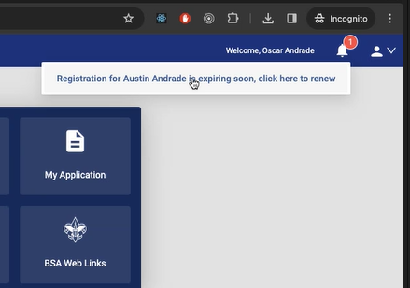
Auto Renewal Membership – Family / Self Pay

Slide 91
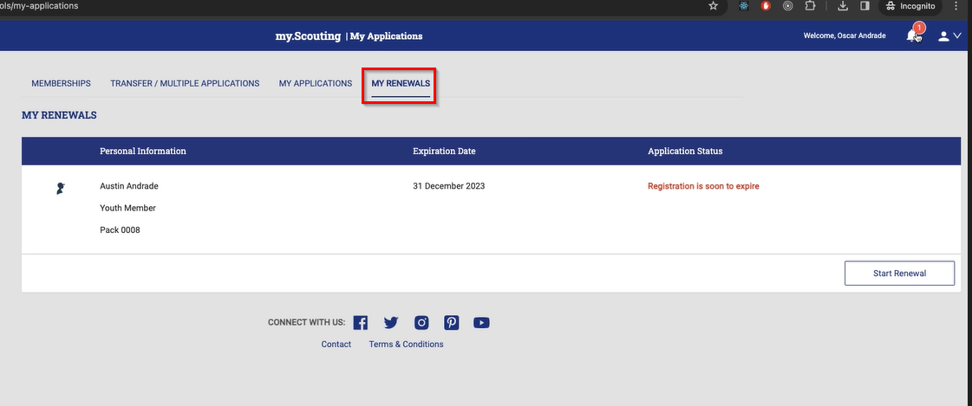
Auto Renewal Membership – Family / Self Pay

Slide 92
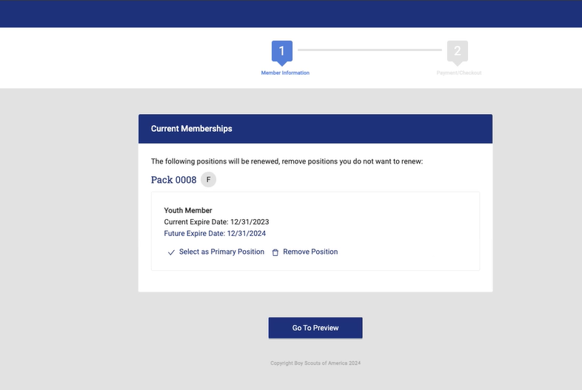
Auto Renewal Membership – Family / Self Pay

Slide 93
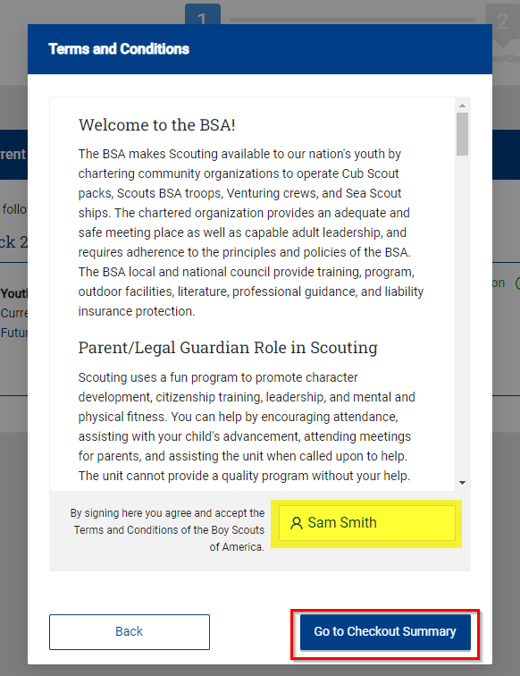
Auto Renewal Membership – Family / Self Pay

Slide 94
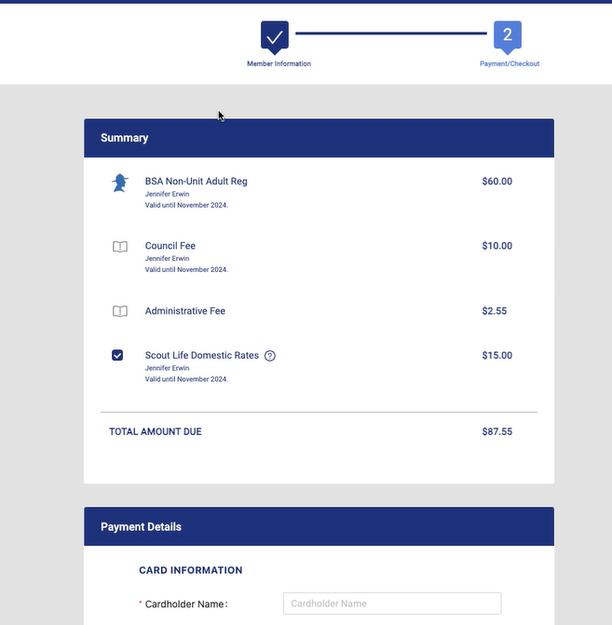
Auto Renewal Membership – Family / Self Pay

Slide 95
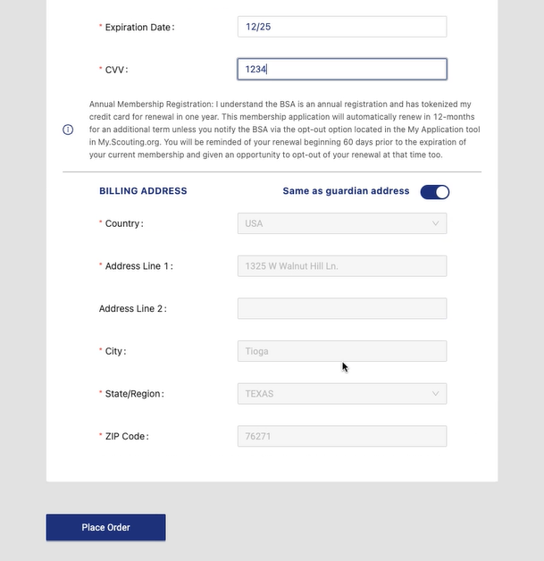
Auto Renewal Membership – Family / Self Pay

Slide 96
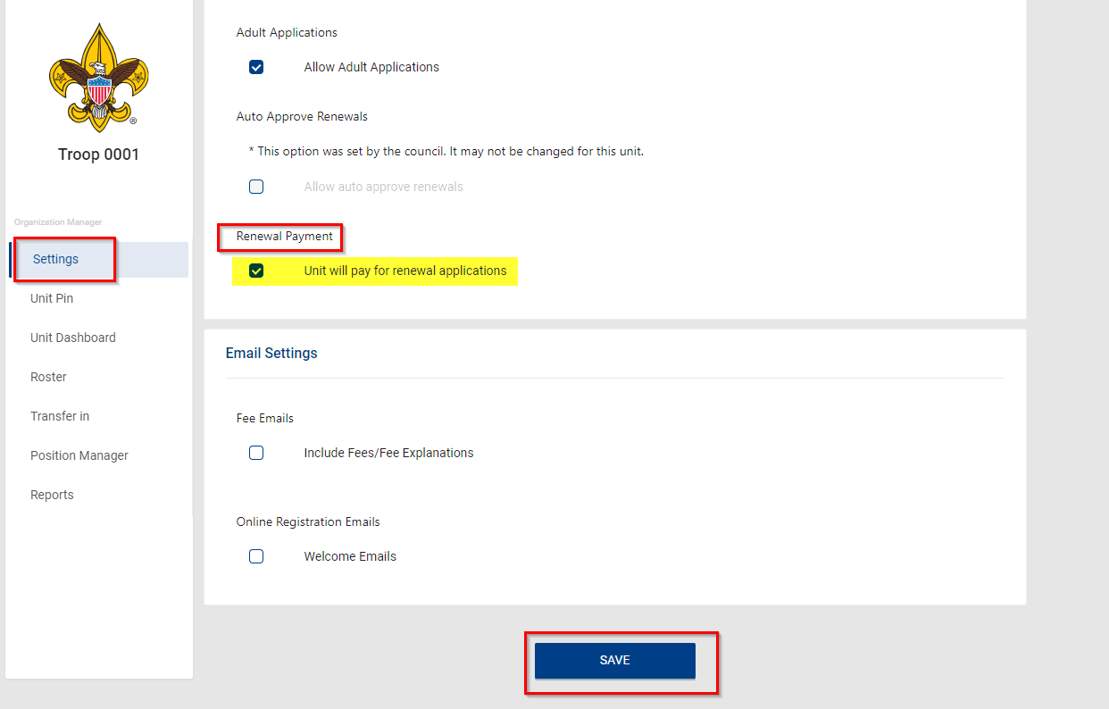
Auto Renewal Membership – Unit Pay

Slide 97
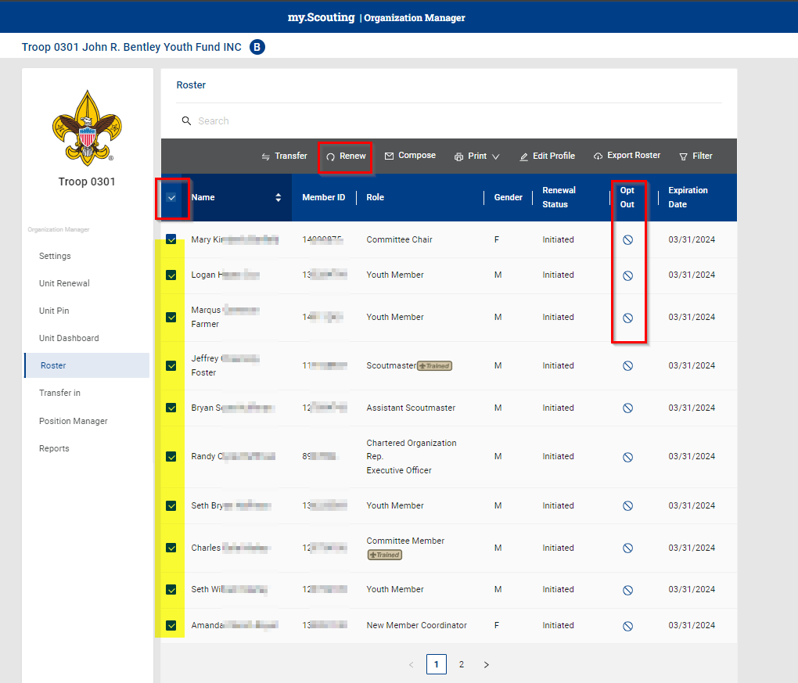
Auto Renewal Membership – Unit Pay

Slide 98
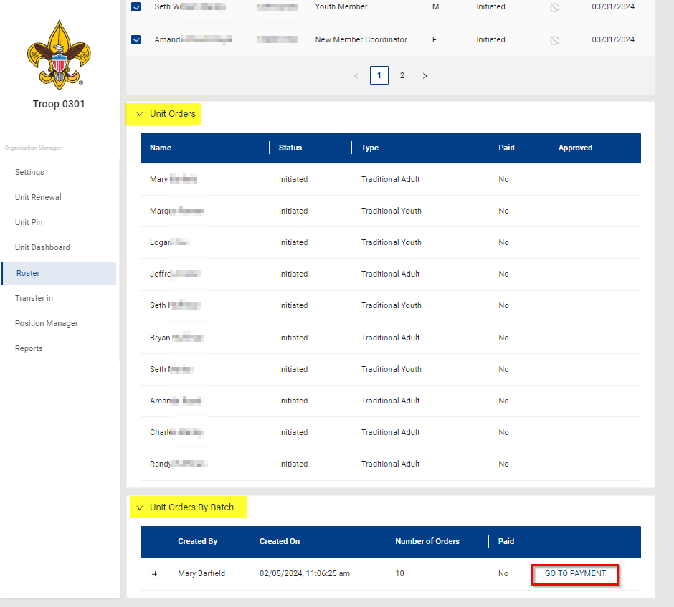
Auto Renewal Membership – Unit Pay

Slide 99
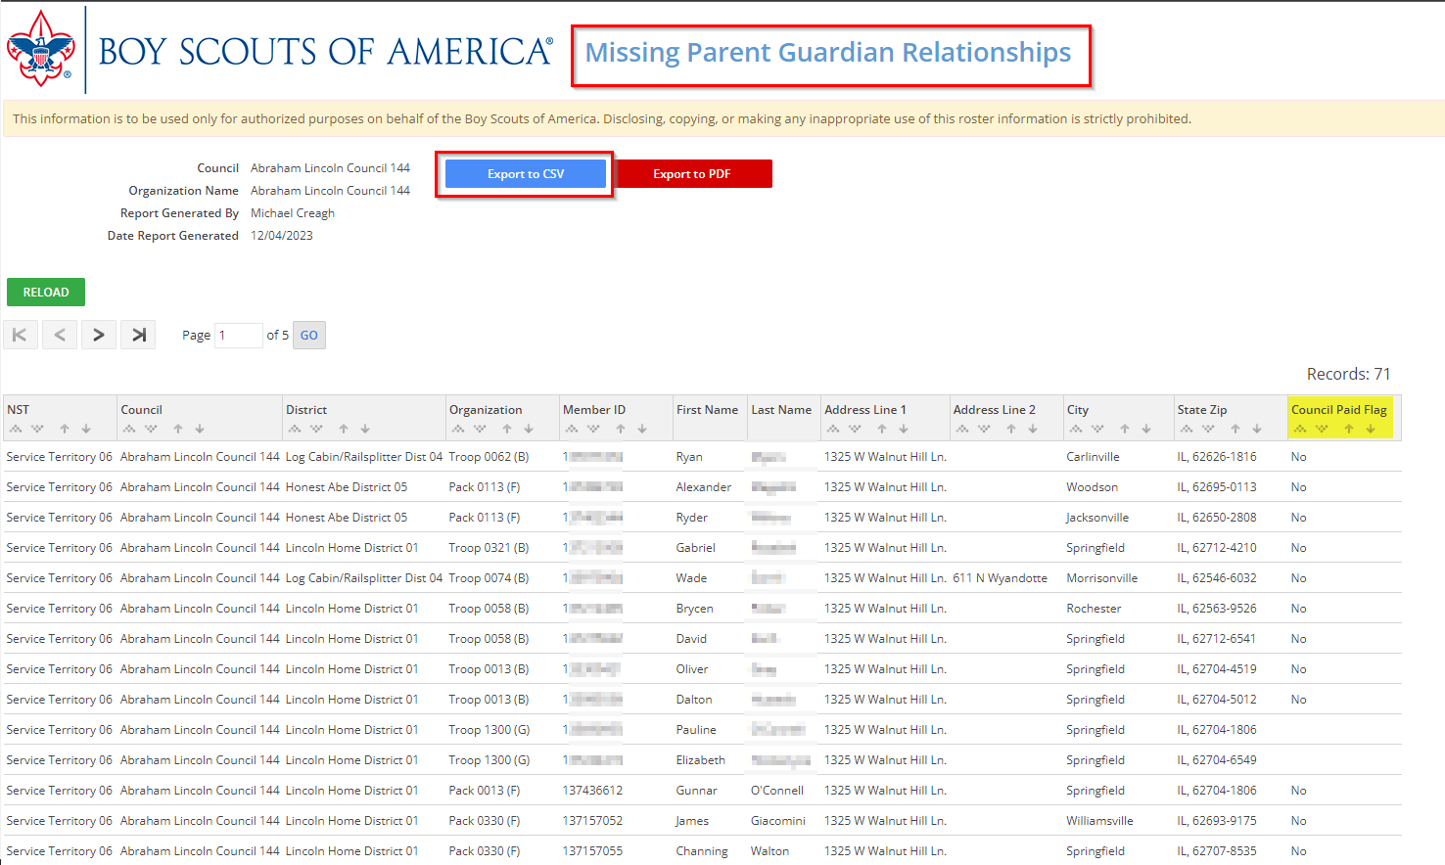
Auto Renewal Membership – Missing Parent Guardian Relationship

Slide 100
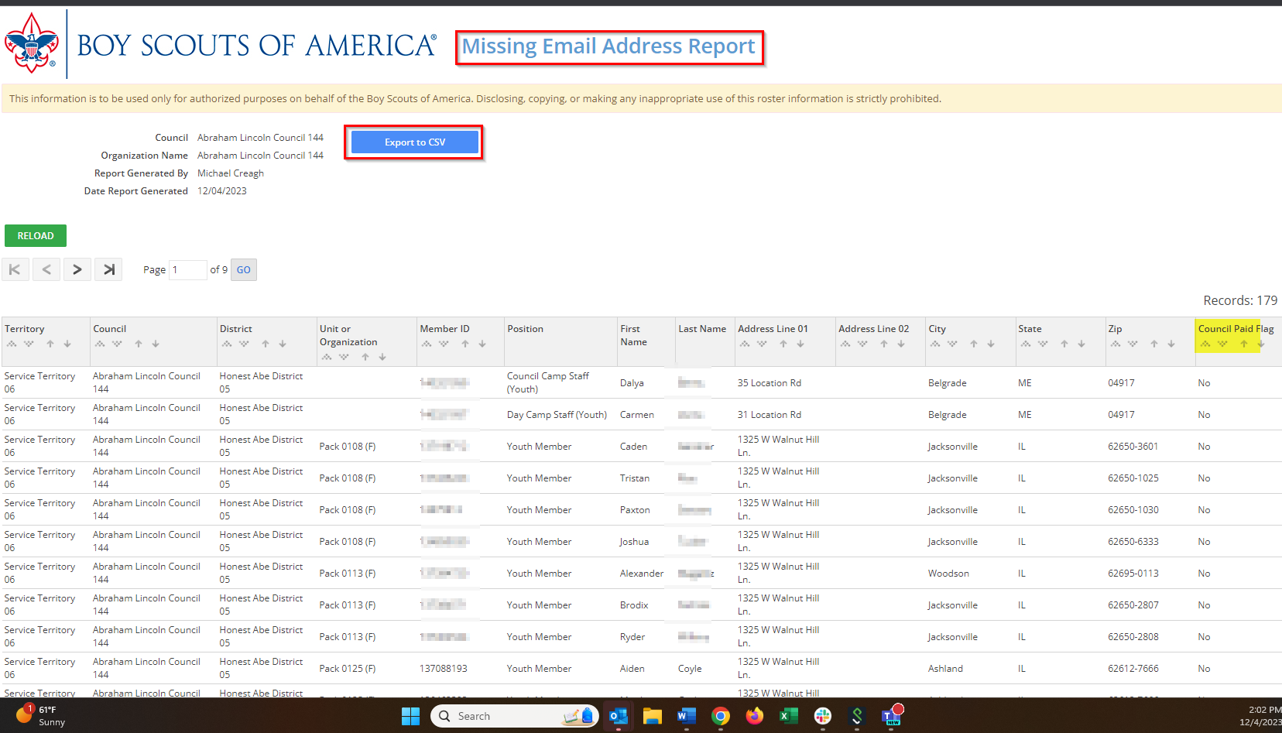
Auto Renewal Membership – Missing Email Address Report

Slide 101
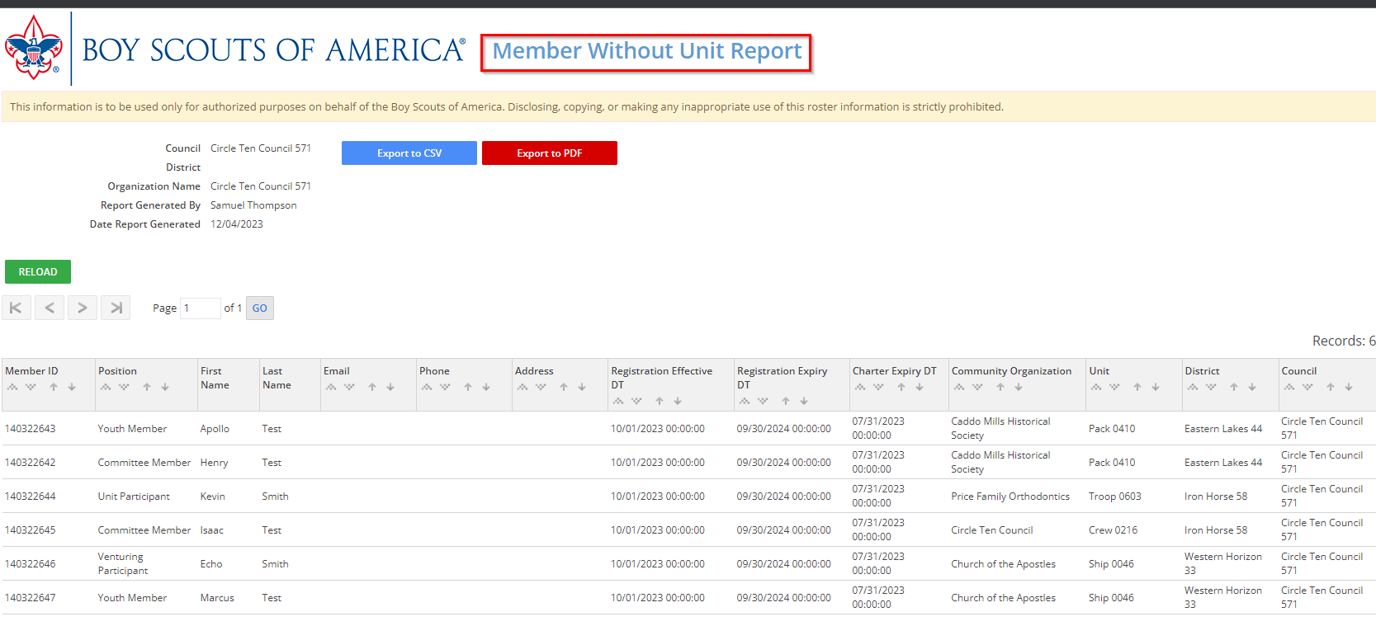
Auto Renewal Membership – Member without Unit Report

Slide 102
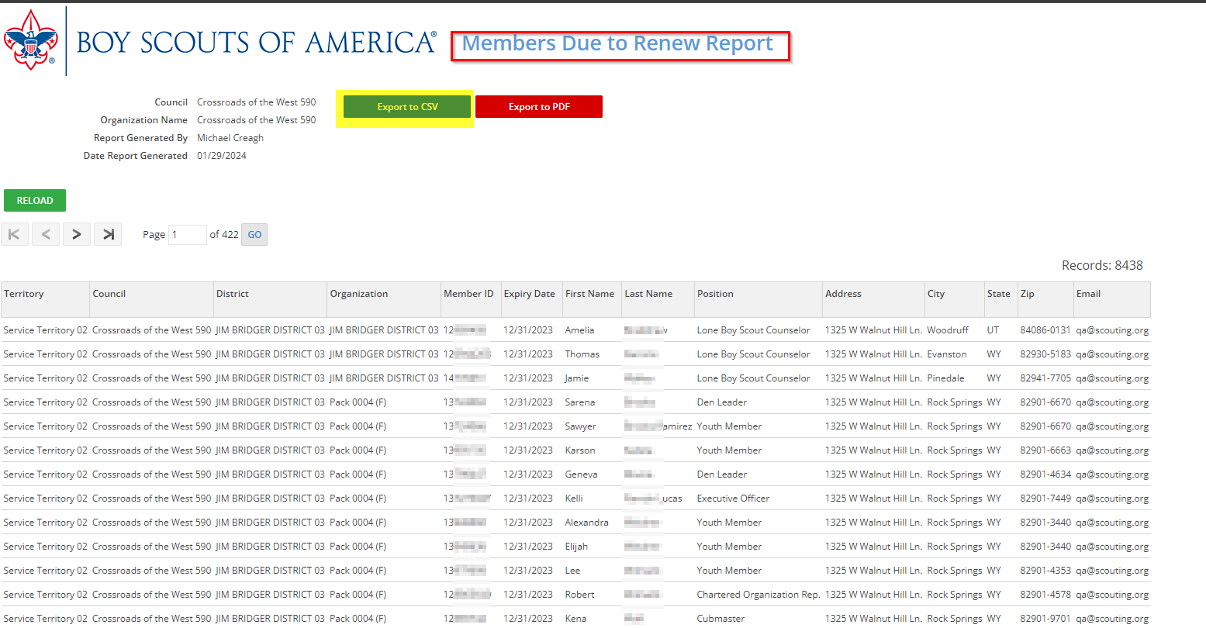
Auto Renewal Membership – Members Due to Renew Report

Slide 103
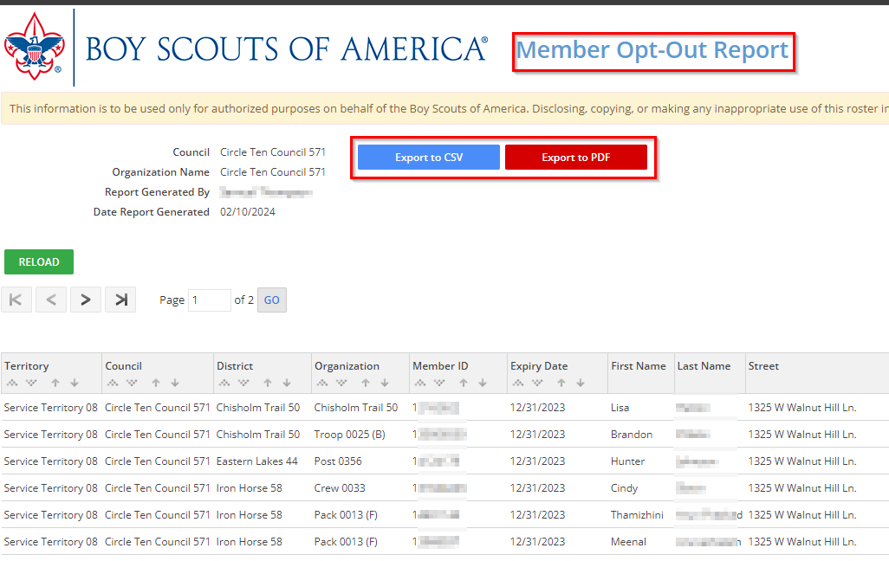
Auto Renewal Membership – Members Opt-Out Report

Slide 104
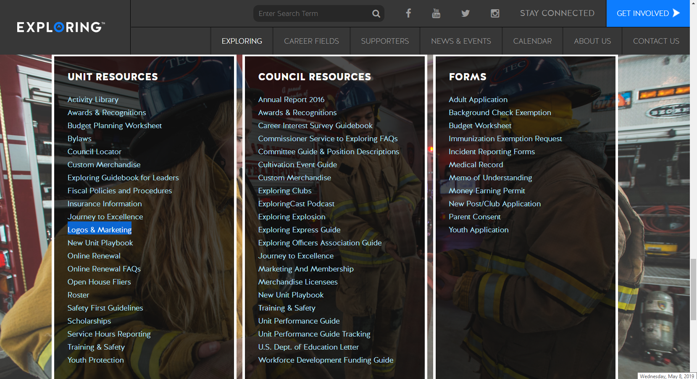

Slide 105
Exploring in comparison to Traditional Scouting
 | SCOUTS BSA | VENTURING | SEA SCOUTS | EXPLORING
UNIT | Troop | Crew | Ship | Club/Post
LEADER | Scoutmaster | Advisor | Skipper | Sponsor/Advisor
YOUTH LEADER | Senior Patrol Leader | President | Boatswain | President or Agency Nomenclature
YOUTH PARTICIPANT | Scout | Venturer | Sea Scout | Participant or Explorer
RE-REGISTRATION | Charter Renewal | Charter Renewal | Charter Renewal | MOU Renewal
SPONSOR | Chartered Org | Chartered Org | Charter Org | Participating Org
SPONSORING AGREEMENT | Charter | Charter | Charter | Memorandum of Understanding (MOU)
UNIT SERVICE | Commissioner | Commissioner | Commissioner | Service Team
YOUTH RUN | Yes | Yes | Yes | Yes
AGE SPAN | 11-18 | 13-20 | 13 - 20 | 11-13/14-20
RELIGIOUS DECLARATION | Duty to God | Duty to God | Duty to God | None
UNIFORM | Scouts BSA | Venturing (Unit Selected) | Sea Scouts (Unit Selected) | Club/Post Selected, not required

Slide 106
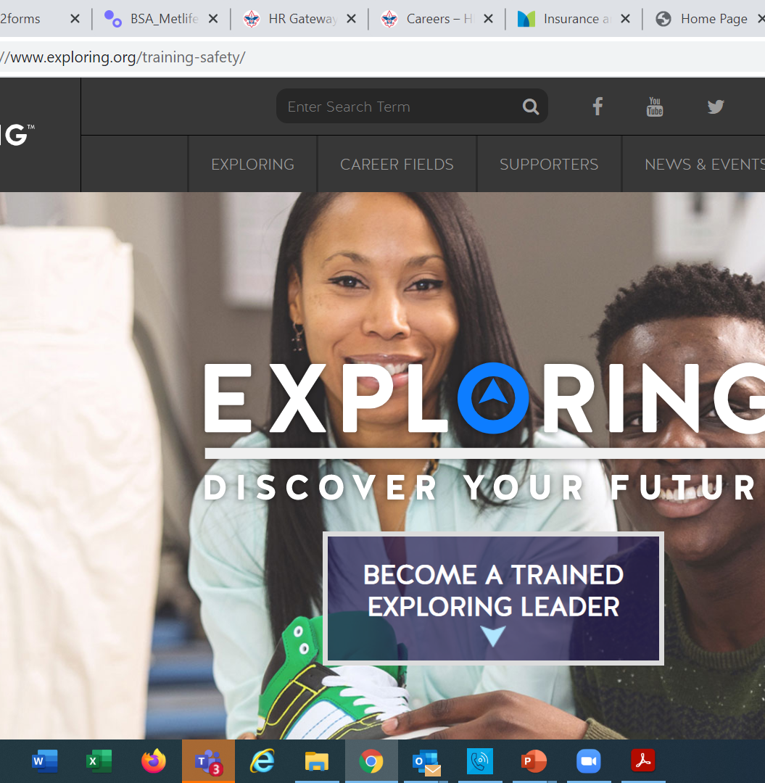
  Exploring Training

Slide 107
Exploring Position-Specific Training Modules
Update Status

Slide 108
Exploring Position-Specific Training Modules Update Status …
The Exploring Leader Training Modules have also been formatted to be experienced through the learning center via computer or smart device.
Login in to https://my.scouting.org/ . If you need to create an account and do not know your member ID number, please contact your local BSA council office/service center
Once you log in, locate the blue box on the right side of your screen labeled “Click here to access Exploring Training”
After logging in, you may also click “Menu” in the top left corner and select “My Training”. Under Training Courses by Program, select “Exploring Adult Training”
You may select between the three available Exploring learning plans (based on position). Anyone is welcome to complete the trainings
NOTE: In addition, the “Servicing Exploring Units Module for Commissioners” has been updated within the Learn Center.
We would like to sincerely thank the many Exploring professionals and volunteers that helped make this important update happen!

Slide 109

Exploring Position-Specific Training Modules Update Status …
NOW UPDATED AND READY FOR VIEWING

Slide 112
Youth Protection Training
https://my.scouting.org/

Slide 113
Exploring Youth Training Update
https://www.scouting.org/training/youth-protection/venturing/

Slide 114
Important resources to help plan the program…
Career Opportunity Worksheet -- www.exploring.org and click on relevant career field icon and scroll to the bottom of the page.
Activity Library (including Life Skills Section) https://www.exploring.org/activity-library/
Organization’s Resources/Employees
  A. Current work curriculum (developed by the company)
  B. Employee’s expertise/knowledge (Use All-in One Program Planning Meeting-found in the Exploring Guidebook for Leaders)
Career Achievement Award (Posts) & Career Awareness Award (Clubs)
  http://www.exploring.org/wp-content/uploads/2017/06/Career-Achievement-Award-May2017.pdf
  http://www.exploring.org/wp-content/uploads/2018/05/Career-Awareness-Award-FINAL.pdf
Exploring Guidebook for Leaders https://www.exploring.org/wp-content/uploads/2016/10/Exploring-Guidebook-Sept2017.800-10018.pdf
Safety First Guidelines/Guide to Safe Scouting (Guide is being Updated—Please follow all CURRENT YPT Policies)
https://www.exploring.org/wp-content/uploads/2021/08/LFL-safety-first-guidelines-3.21.17_8.pdf
7. Online Exploring Adult Leader Specific Training & Youth Protection Training
https://www.exploring.org/training-safety/ or www.myscouting.org
8. Unit Performance Guide (Chapter 5- Exploring) –Details about organizing a new Post/Club
http://www.exploring.org/wp-content/uploads/2021/04/522-02516_UPG.compressed.pdf
Also visit www.exploringexplosion.org and scroll to the bottom of the website to find additional resources…

Slide 115
ADDITIONAL SLIDES FOR COUNCIL USE
All slides will be emailed to each
Exploring Live Hour Participant every month

Slide 116


Successful Councils…
Intentionally Providing a Pathway to Exploring Growth and
Strategic Planning In Your Council

Slide 117
OPEN HOUSES
INSERT HERE
COUNCIL/DISTRICT YEARLY MEMBERSHIP PLANS
(Recruitment/Retention Cycle)
Career Interest Surveys

Slide 118

12 Keys To Success

Slide 119

1. Recruit a council Exploring volunteer chair and committee
2. Appoint a Council Exploring Champion
“Staff Advisor”
3. Create a public presence for Exploring
(council website, newsletters, social media)

Slide 120

4. Train key volunteers and staff on the 4
Phases of Post/Club Organization
5. Set specific goals for Career Interest
Surveys or gathering of data from select high schools
6. Set goals to host Open Houses for all
Posts/Clubs (i.e. School Night for
Scouting)

Slide 121
7. Create a campaign to emphasize
Post/Club unit support (through
Service Teams/Commissioners)
8. Integrate Exploring into council activities and events
9. Promote Exploring to all current customers (i.e. “Scouts BSA”)

Slide 122
10. Host a council community cultivation event, focusing on a specific career.
11. Involve the Council Executive Board to help open doors within the community and to help create a list of businesses to match the
Career Interest Survey results.
12. Ensure that Exploring is included in the
Council Strategic Plan, PDS Goals, and
Board Meetings.

Slide 123

“Action Planning”
The Beginning of your Strategic Plan
The foundation of your plan will begin here

Slide 124
Starting a New Post/Club
“The Four Phases”

Slide 125
REGISTRATION BASICS
YOUTH
POST: ___ and have completed eighth grade OR 15 years of age but not yet ___ years old
CLUB: 6th-8th graders who have completed the ____ grade and are at least 10 years old but have not completed the eighth grade and are not yet ____ years old.
ADULTS
___ years age or older
POST: Min of 4 adults
  ______________ (CC)
  2 ____________ (MC)
  _______________ (EA)
CLUB: 2 adults _______________ (ES)
_______________ (AS)
PAPERWORK
New Post/Club ____________
4 _________ Apps
5 _________ Apps
Annual ______________
of Understanding
$____ General Liability Insurance Fee
$____ per person registration fee
14
21
Application
21
Adult
Committee Chair
2 Committee Members
Youth
5th
Advisor
Memorandum
Sponsor
100
15
Assoc Sponsor
50
Exploring Youth Participants “EP’s” ages 18-20 must complete an
Exploring ________ Application & Successfully Complete YPT.
Adult

Slide 127
4 Steps/Phases in Organizing a new Post
1. Research-
Conduct the Career interest surveys
and develop business/community prospects
2. Leadership-
Meeting with the top leadership within the
businesses/community and identifying program
leaders; includes training of leaders
3. Program-
Develop the organization’s meeting/program
themes and prepare for an open house
4. Participation-
Recruiting youth through an organized open house and
involvement of youth in program development

Slide 128
MOST IMPORTANT PART
OF EACH PHASE?
Phase 1 : Career Interest Surveys
Phase 2: Training
Phase 3: All-In-One Program Planning Meeting
Phase 4: Open House

Slide 129
Career Interest Surveys
The # 1
Leading Indicator for Exploring Growth

Slide 131
Phase 1 – Research
Career Interest Surveys (two choices)
pa
pa
Online Survey:
www.exploringyourcareer.com
Paper Scantron Survey

Slide 132
BACK SIDE
FRONT SIDE
Paper Scantron Survey Available through NDC

Slide 135
Online Career Interest Survey
www.exploringyourcareer.com
TRY IT NOW!
Use QR code or simply type address in web browser
Notes:
A “QR” or Quick Response code was created to take students directly to the survey site. It is available on posters, post cards, business cards, and book marks.
How do you use this? Email it to all teachers, they can open it from email and project it one screen for students to use their smartphones!

Slide 138
www.exploringyourcareer.org
Two career & hobby choices
School names
pre-loaded
Notes:
REFER TO HANDOUT IN YOUR FOLDER.
This is a screen shot of the new Online Career Interest Survey that was activated on Jan 1, 2012.
The careers & hobbies match the paper version. So schools and administer the survey either on paper or electronically.
The online version can be accessed from any device that can access the Internet – including smart phones.
Results are sent instantly to a secure website where councils can access the results and provide them to schools in the same format as the paper survey.
Instructions for accessing results can be found in the LFL internal site.
Students 13 yrs. and younger cannot legally complete this survey online. If they enter data, the system will not save it.
You can also add schools/colleges to this list if they do not populate when you put in your respective zip code. Simply e-mail us at exploring@lflmail.org and request your specific school to be added, with zip code

Slide 139
Online Career Interest Survey COSTS
Unlimited schools and unlimited surveys for students 13 years of age and older

Slide 140
REPORTS GENERATED FROM THE SURVEYS

Slide 141
RESULTS REPORT: School
Grade: 10
ABBEY, Susie 123 Main St Noblesville IN 46060 Work
Career 1 Career 2 Hobby 1 Hobby 2
Musician Journalist Roller Skate /Blade Music
141
Notes:
141
No matter the survey format you use, the reports are generated the same way.
**GOOD data to establish credibility at/during your sales call
This is one set of sample results provided at no cost to schools. Very helpful for Guidance Counselors.
All students, by grade, alphabetically. Shows:
Career interests
Hobby interests
Post-high school plans
Other results include all students interested in each career (all the attorneys, architects, dentists, electricians, etc). Helpful for Guidance Counselor planning, career speakers, college days and college fairs.
Be sure to return results to the Guidance Counselor when you say you will – under promise and over deliver. Do not promise results in one week if you cannot do it. Say 2-3 weeks, then they will be very happy if they do receive them in a week or ten days.

Slide 142
RESULTS REPORT: School
142
Notes:
142
This is another set of sample results provided at no cost to schools. Very helpful for Guidance Counselors.
This report includes all students interested in each career (all the attorneys, architects, dentists, electricians, etc.). Helpful for Guidance Counselor planning and career speakers.
The After Graduation Plans is important to Guidance Counselors
College
Junior college
Military Service
Technical school
Work
Other
Why are these reports help full to the school…to you?

Slide 143
Summary Career Interest Report by Council
Code Career Count
0712 Nurse (Registered) 798
0145 Musician (Instrumental/Choral/Voice) 751
0903 Attorney/Lawyer 733
1625 Teacher/Teacher Aide 678
0300 Business (General) 645
0719 Physician/Surgeon 604
0101 Actor/Actress 600
0130 Fashion Designer/Model/Buyer 579
0721 Psychiatrist/Psychologist 578
0170 Professional Athlete 507
0180 Photographer 461
1305 Architect 437
0725 Veterinarian 429
0102 Artist 427
0718 Physical Corrective Therapist 313
1300 Engineering (General) 208
MOST IMPORTANT TO YOU

Slide 144
Career Interest Survey Questions
Opportunity for 6 “Yes” or “No” questions
Unique feature of our survey
Anything school officials want to know
  Are you planning to take the SAT / ACT?
  Are drugs a problem in our school?
  Is there enough student parking?

Slide 145
www.exploring.org

Slide 146
Career Interest Survey Guidebook
Be sure you have the most recent version
Download at www.exploring.org
One stop shop for all CIS resources
Table of Contents
  Page 5 | At A Glance
  Page 7 | Overcoming Objections
  Page 44 | Appendix

Slide 147
ALTERNATE METHODS?
1. Use school information already available
2. Ask youth to develop contacts
3. Develop cultivation events
4. Invite Eagle Scouts / Scouts to join
5. Booth at schools open house night and career days /career fairs
6. Annual Exploring open houses for ALL Posts and Clubs
7. Follow up leads from the Exploring Lead
Generator

Slide 148
BASED ON SURVEY RESULTS
1. Focus on Top 4 students interests
2. Identify companies in those 4 interest areas
3. Identify the path to the CEO
  Council board contacts
  School board/admins
  PAS find
  Nominating committee
  Applications

Slide 149
Career Interest Survey Guidebook
Be sure you have the most recent version
Download at www.exploring.org
One stop shop for all CIS resources
Table of Contents
  Page 5 | At A Glance
  Page 7 | Overcoming Objections
  Page 44 | Appendix

Slide 151
Leads are being generated from Exploring.org and include anyone interested in joining, leading, sponsoring, or
otherwise supporting Exploring in their area.
Scout Executives, Assistant Scout Executives and DFS’s receive weekly lead reports.
Exploring Executives and staff advisors receive immediate notifications of each lead generated.
To make changes to any of these settings, email your request to exploring@lflmail.org.
WHEN YOU RECEIVE AN IMMEDIATE NOTIFICATION EMAIL:
1. In the email, you will see a note to “copy & paste the following URL into your browser to mark lead as contacted”.
By following this directive, you are changing the status of your lead to “contacted”. You will no longer receive email notifications for that particular lead. The lead will begin to show as “contacted” on your SE’s weekly report.
Invite the person to attend an existing post/club meeting to get a feel for the program and connect them to
appropriate Exploring advisors.

Slide 152
www.joinexploring.org

Slide 154

Phase 2 - Leadership
CEO’s Police/Fire Chiefs Administrators
Industry Experts Retirees Community Leaders

Slide 155

Moving forward with the CEO
1) Get organization’s commitment
2) Identify 6-8 adults
- CEO invites them
- You provide guidance
3) Set 2 dates for:
  - All-In-One program planning
  meeting
  - Open House
4) Start Paperwork
  - New Club/Post Application
  - MOU, Adult Application

Slide 156
  Exploring Training

Slide 158
Phase Two: Training

Slide 160
Important resources to help plan the program…
Career Opportunity Worksheet -- www.exploring.org and click on relevant career field icon and scroll to the bottom of the page.
Activity Library (including Life Skills Section) https://www.exploring.org/activity-library/
Organization’s Resources/Employees
  A. Current work curriculum (developed by the company)
  B. Employee’s expertise/knowledge (Use All-in One Program Planning Meeting-found in the Exploring Guidebook for Leaders)
Career Achievement Award (Posts) & Career Awareness Award (Clubs)
  http://www.exploring.org/wp-content/uploads/2017/06/Career-Achievement-Award-May2017.pdf
  http://www.exploring.org/wp-content/uploads/2018/05/Career-Awareness-Award-FINAL.pdf
Exploring Guidebook for Leaders https://www.exploring.org/wp-content/uploads/2016/10/Exploring-Guidebook-Sept2017.800-10018.pdf
Safety First Guidelines/Guide to Safe Scouting (Guide is being Updated—Please follow all CURRENT YPT Policies)
https://www.exploring.org/wp-content/uploads/2021/08/LFL-safety-first-guidelines-3.21.17_8.pdf
7. Online Exploring Adult Leader Specific Training & Youth Protection Training
https://www.exploring.org/training-safety/ or www.myscouting.org
8. Unit Performance Guide (Chapter 5- Exploring) –Details about organizing a new Post/Club
http://www.exploring.org/wp-content/uploads/2021/04/522-02516_UPG.compressed.pdf
Also visit www.exploringexplosion.org and scroll to the bottom of the website to find additional resources…

Slide 161

Phase 3 – Program
All-In-One Program Planning Meeting
1) Paperwork
2) Adult Explorer Leader Training
  - Youth Protection for Explorers
  - Adult Explorer Leader Training
3) Open House Planning
  - Brainstorm session
  Why did you choose this career for yourself?
  What are hands on activities that you can do with youth?
  - Develop a 3-4-month calendar (use Activity Library)
  - Choose Open House “hands-on activities”
4) Prepare Post Committee Members for Open House

Slide 162


SAMPLE PROGRAM CALENDARS
The frequency of your meetings and length of your program each year is up to you. For example, this could be a 12 month or 12 week program.
ENGINEERING & TECH
MONTHLY MEETINGS YEAR-ROUND
September
Open House
October
Chemical engineering
November
Youth Officer Elections
December
Holiday Play – open house
January
Industrial Technology
February
Electrical engineering
March
Computer science
April
Fluid power technology
May
Ethics in engineering
June
Visit with engineering firm
July
Civil engineering
August
Mechanical engineering
Notes:
PRESENTER NOTES:
BE SURE TO DELETE THE CALENDARS/SLIDES THAT ARE NOT RELEVANT TO THE CAREER INDUSTRY TO WHICH YOU’RE PRESENTING.
Remind the audience that they have flexibility is setting the schedule for their own program. Here are some options:
Year round – may or may not include summer
Weekly
Monthly
3 months at a time, different group of youth each time, 3 times per year
Weeknights or weekends

Slide 163

Phase 3 – Program
Planning the Open House
1) From your BRAINSTORM session…
  - Pick the 4-5 best activities for a quick hands-on
  format at the Open House
2) At the open house…“Go shopping”
  - 4-5 stations (rotations)
  - 4-5 minutes each

Slide 164




www.exploring.org
Notes:
Program planning is also a service that is provided by the local Boy Scout Council. This Activity Library is an all new supplement to the process. You will find it on www.exploring.org

Slide 166
Phase 4 – Participation
SIMPLE OPEN HOUSE AGENDA
OPEN HOUSE AGENDA
Welcome
What is Exploring?
Video
HANDS-ON ACTIVITIES
Activity Interest Survey (customized)
Calendar
ASK TO JOIN
Applications & fees
Snacks

Slide 167

Resources to help you… www.exploring.org

