Slide 1

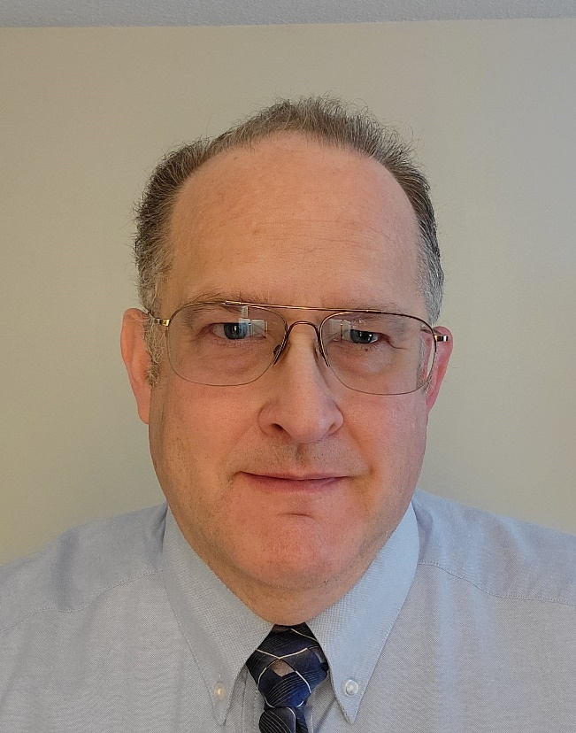
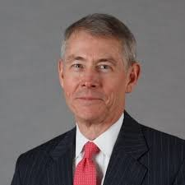
Bruin1967@aol.com
www.exploring.org
2024 BSA NAM
Elective Session 1
Exploring ~
Creating Membership
Growth
Jeff Schweiger
National Exploring
Membership Growth &
Retention Lead
Scouter.jeff@earthlink.net
exploringmarketing@scouting.org
Richard “Dick” Davies
National Exploring
Program Commissioner
Richard.davies.nyc@gmail.com

Slide 2
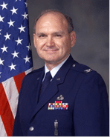
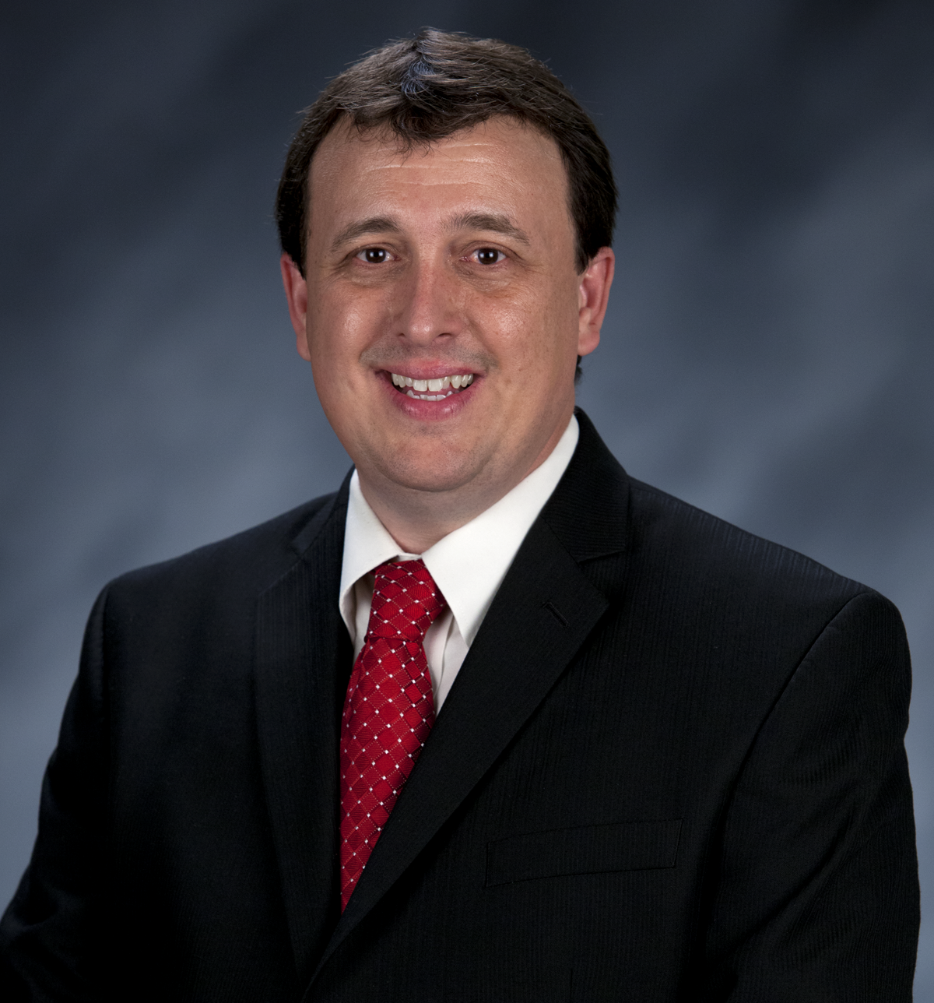
Bruin1967@aol.com
www.exploring.org
2024 BSA NAM
Elective Session 1
Exploring ~
Creating Membership
Growth
Craig Martin
National Exploring
Program Chair
Bruin1967@aol.com
Tim Anderson
National Director
Learning for Life / Exploring &
Older Youth Programs
Tim.Anderson@lflmail.org
Tim.Anderson@scouting.org

Slide 3


What is Exploring?
A career education program for young men and women
  Helps them make more informed decisions about future careers
Exploring serves two different age groups, both coed.
Exploring Clubs serve middle schoolers, aged 10 – 13, in sixth through eighth grades. Exploring Posts serve older youth 14 – 20 years old.
The program model is the same for both age groups:
  Hands-on and interactive character and career activities are facilitated by trained business leaders in your local community.

Slide 4
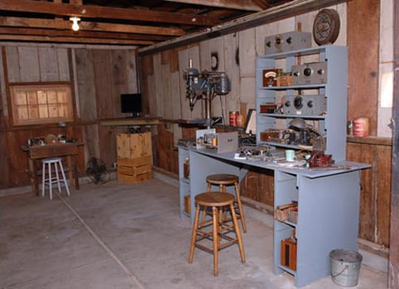

The Importance of an Origin Story
Hewlett-Packard (Palo Alto, California)

Slide 5

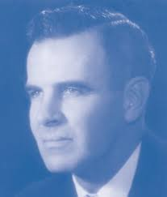
BSA and Exploring Origin Stories?
William D. Boyce
William H. Spurgeon III

Slide 6
Where Did Contemporary Exploring Come From?
Interesting Parallels With Family Scouting
B.S.A. Research on Serving Teenage Boys
  University of Michigan (1955)
  Study update by Daniel Yankelovich (Mid 1960s)
Findings The Same In Both Studies
  Outdoors was not the primary appeal; uniforms not cool
  Over 80% not getting enough guidance on careers
  Wanted to participate in activities with girls!
“Experimentation” in Orange County, California
  Career program focus within ”Explorer Scout” programs
  Surreptitiously registering young women
  Led by National Executive Board member Bill Spurgeon
After Two Year Pilot: Co-ed April 1971

Slide 7
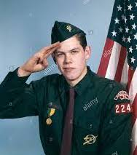
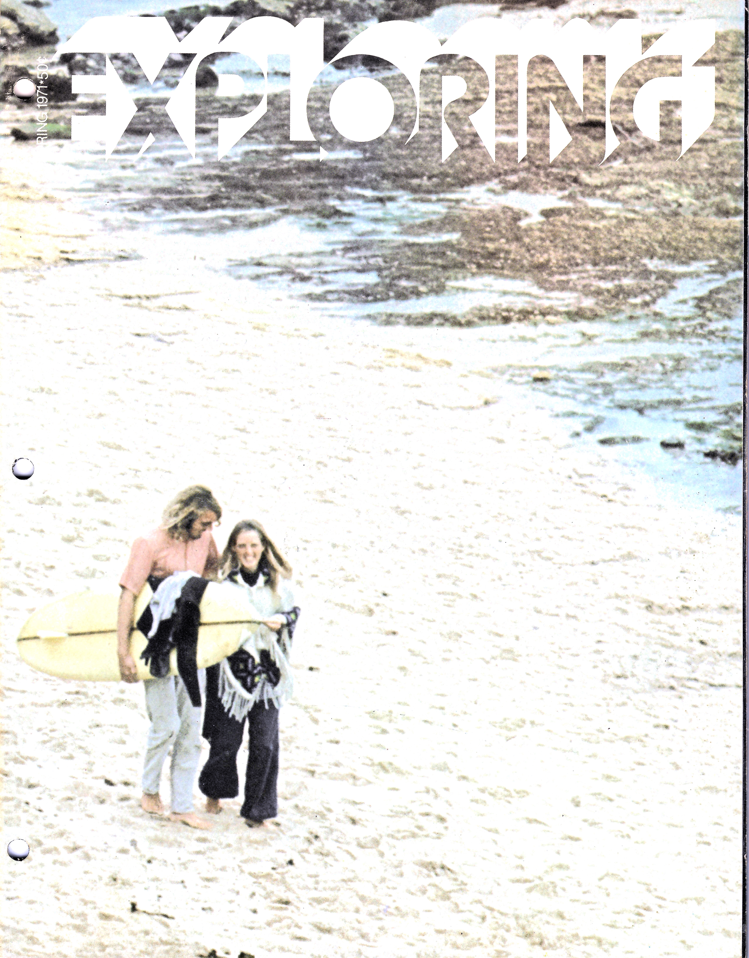
Birth of Contemporary Exploring
1960s
1971 and Beyond

Slide 8
What Happened To Exploring?
1980’s 17 Career and Traditional Program Clusters
Curriculum-based Learning for Life Program started (1991)
Venturing Split Off In 1998; Remained Traditional B.S.A.
Exploring Joined Learning for Life, an Affiliate of the B.S.A.
  12 Career Exploring Fields
  Separate 501(c)3 non-profit formed in 1992
  Original mission of running in-school programs
  Curriculum based
  No Duty to God requirement
Why the Change?
  Membership standards challenging for Exploring
  Protect ”Duty to God” requirement in traditional programs
For A Period, Not Counted as Membership (“below the line”)
  Fully counts now!!

Slide 9












Twelve Career Fields

Slide 10
Leading Career Specialties
November 2023 (28,312 Members)
Explorer Clubs
All Other Specialties
Aviation
Business
Law Enforcement
Law & Government
Science/Engineering
Fire/EMS
Career Education
General Interest
Health Care

Slide 11

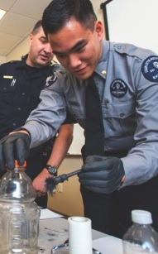



PROGRAMS ARE BASED ON
5 AREAS OF EMPHASIS
CAREER
OPPORTUNITIES
LEADERSHIP
EXPERIENCE
LIFE SKILLS
CITIZENSHIP
CHARACTER
EDUCATION

Slide 12
Exploring’s Value Proposition
Something for Everyone
Youth: Try On Your Future, Lead Others, Fun
Parents: Career For My Child
Sponsors: Build New Employee Pipeline/Give Back
Schools: Career & Technical Education (CTE)
Partners: Workforce Development
Councils: New Membership, Volunteers and Funds
Community: Help for Underserved Diverse Neighborhoods

Slide 13
Exploring: Consistent with B.S.A. Mission/Vision
Mission Statement
The mission of the Boy Scouts of America is to prepare young people to make ethical and moral choices over their lifetimes by instilling in them the values of the Scout Oath and Law.
Vision Statement
The Boy Scouts of America will prepare every eligible youth in America to become a responsible, participating citizen and leader who is guided by the Scout Oath and Law.
Exploring’s Mission: Deliver character-building
experiences and mentorship
that allow youth to achieve their full potential
in both life and work.

Slide 14
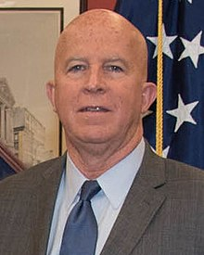
NYPD Police Commissioner on Exploring
Hundreds of New York City Cops Started in Exploring
“Now it would be nice if some of these Explorers go on to become New York City cops or join another agency, but that’s not really the point, is it? The important thing is that these young people become better citizens and leaders in their communities.”
James O’Neill

Slide 15
How Is The Exploring Experience?
Highest Net Promoter Score

Slide 16
Exploring is very different from Our Traditional B.S.A. Young Adult Programs
 | Venturing and Sea Scouts | Exploring
Mission | Leadership and Character Development
Target Age | 14-20
Recruiting Hook | Outdoors | Careers
Chartered Partners and Sponsors | Religious and Civic Organizations | Businesses and Public Agencies
Advancement | Yes | Certificate Program
Scout-Like Uniform | Yes | Post Identity Attire
Scout Oath & Law | Yes | No
Order of the Arrow | Yes | No

Slide 17
Issues With Exploring
Based on Conversations Around the Country
Not Everyone is Promoting Exploring
It Looks and Feels Different Than Traditional Programs
Not Part of our Mission
There Are No Manuals (But A Program Library)
Our Professionals Have No Experience
We Have Higher Priorities (Family Membership/Survival)
Exploring Doesn’t Fit Our Revenue Model
  Don’t Use Camps/Sell Popcorn/Do FOS/Buy Uniforms

Slide 18
Exploring: Additive to Traditional Programs
Benefits to Local Councils
New Sources of Membership Growth
  New entry point in addition to Cubs
New Source of Senior Volunteer Recruitment
  Business and civic leaders with no Scouting history
  Candidates specifically interested in high school age youth
New Sources of Foundation and Corporate Giving
  Workforce readiness a hot topic for foundations
  Funders looking for “return on investment”
School Access and Cooperation
Outreach to Economically Challenged and Underserved Diverse Communities

Slide 19

CONGRATULATIONS
New National Membership Growth Record
22 Consecutive Months of Growth
In Membership and Units
*Growth Streak Began In April 2022
through January 2024

Slide 20
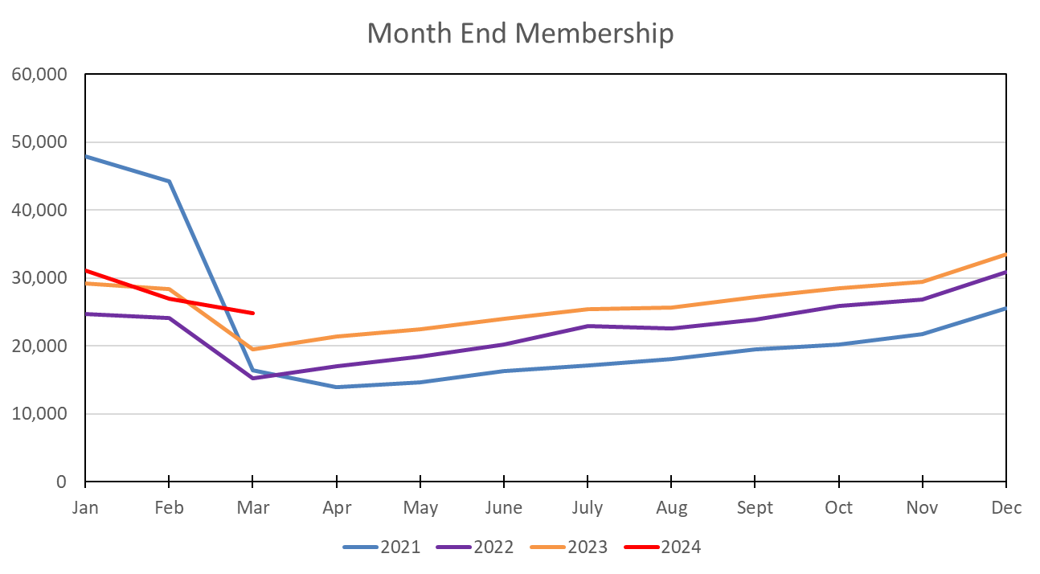
22 Straight Months of Exploring Membership Growth
Beginning April 2022 – Ended in February

Slide 21
COVID Hurt All Our Programs
Exploring Rebounded in Both Youth and Units in 2022-23

Slide 22
One-Third of Councils Lost Exploring Membership
2023 Yearend Results
 | # Councils | Explorers
Councils + 100 Members | 15 | 2,972
Other Positive Councils | 113 | 2,888
Total Positive | 128 | 5,860
Councils No change | 34 | - -
Councils –100 Members | 5 | -1,794
Other Negative Councils | 76 | -1,489
Total Negative | 81 | -3,283
Total All Councils | 243 | 2,577

Slide 23
All Star Exploring Councils – 2023
Exploring Growth and Intensity > 10% Council Membership
Council | Council Membership |  | Exploring Membership
HQ City | Total | % Growth | Total | Incr | % Grow | % Expl
New York NY | 8,751 | 6.9% | 2,657 | 365 | 15.9% | 30.4%
San Angelo TX | 524 | 0.8% | 132 | 56 | 73.7% | 25.2%
Fresno CA | 1,324 | 2.8% | 235 | 56 | 31.3% | 17.7%
Harlingen TX | 825 | 4.2% | 143 | 36 | 33.6% | 17.3%
Montgomery AL | 1,923 | 4.7% | 320 | 188 | 142.4% | 16.6%
Yarmouth Port MA | 894 | 4.8% | 146 | 116 | 386.7% | 16.3%
Columbia SC | 3,696 | 6.0% | 547 | 70 | 14.7% | 14.8%
San Juan PR | 3,727 | 4.3% | 543 | 55 | 11.3% | 14.6%
Fairbanks AK | 393 | 5.6% | 56 | 2 | 3.7% | 14.2%
Lansing MI | 26,442 | -2.6% | 3,494 | 636 | 22.3% | 13.2%
Westfield MA | 1,822 | 9.2% | 222 | 136 | 158.1% | 12.2%
Lafayette LA | 1,068 | 8.1% | 123 | 39 | 46.4% | 11.5%

Slide 24
BSA Doing a Poor Job of Serving Older Youth
2% Market Share Standard for Local Councils (Yearend 2023)
Goal
Market Share

Slide 25
Traits of Successful Exploring Councils
Exploring is Different and Requires Specialized Attention
Board Support: Goals and Strategy for Exploring
Volunteer Structure and Executive Board Presence
  Committee Chair/Vice President
  Active committee
  Youth leadership (Explorer Officers Association)
Assigned Professional Responsibility
  Larger Councils: Full time Exploring Executive(s)
  Smaller Councils: Accountable field-serving executive
Dedicated Exploring Division (If Large Enough)
9-Month Hands-On Youth-Led Programs

Slide 26
Exploring Complements Scouting for Older Scouts
Scouting and Exploring are NOT mutually exclusive
Addresses need for career information/experience
  Wanted and needed by older youth and young adults
  Association with other youth with similar career interests
  Gives opportunity for hands-on experience in career areas with adults working in those areas
Exploring Emphasis Areas and Methods reinforce the Aims and Methods of Scouting

Slide 27
Exploring Impact on Membership Goals
Scouting and Exploring are separate programs with separate National organizations
  Cannot multiple between the programs
  Separate paid membership
  Same member in both programs counts in both programs (i.e., counts twice in membership statistics)
Appeals to youth and young adults that are not otherwise involved with Scouting
  Underserved diverse communities
  Allows us to serve these additional members

Slide 28
Council Support Steps for Growing Exploring
Recruit a council Exploring volunteer chair and committee
Appoint a council Exploring champion “staff advisor”
Ensure that Exploring is included in the council strategic plan, PDS goals, and council board meetings.
Promote Exploring to all current customers (i.e. “Scouts BSA”)
Integrate Exploring into council activities and events
Provide regular unit service to Exploring units
Train key volunteers and staff on the 4 Phases of Post/Club Organization

Slide 29

4 Steps/Phases In Organizing A New Post
1. Research-
Determine the career interests of potential participants
and develop business/community prospects
2. Leadership-
Meeting with the top leadership within the
businesses/community and identifying program
leaders; includes training of leaders
3. Program-
Develop the organization’s meeting/program
themes and prepare for an open house
4. Participation-
Recruiting youth through an organized open house and
involvement of youth in program development

Slide 30
What Are Metrics of a Healthy Post?
Key Leaders Trained (Advisor and Committee Chair)
At Least 7 Members
Membership Growth or 15 Explorers
Solid Retention
Elected and Trained Post Officers
Annual Post “Super Activity”

Slide 31
National Coordinated Partnerships
California Highway Patrol (CHP). The CHP Explorer Program has Posts throughout California. Contact National Exploring Committee representative Rick TerBorch, rterborch@earthlink.net, (805) 441-1721 for more information
The US Forest Service (USFS) is interested in creating additional Posts throughout the country. Contact National Exploring Committee representative Stuart Mahler, mdc.stuart@gmail.com, (925) 519-6957 for more information
US Department of Homeland Security, Customs and Border Protection (CBP) has Posts throughout the country. Contact Jeff Schweiger, scouter.jeff@earthlink.net or exploringmarketing@scouting.org, (703) 472-0669 for more information

Slide 32
New Exploring Developments
Coming Soon
American Airlines
Leadership Certificate For Individual Explorers
National Youth Delegate Conference
Restructured Volunteer Specialty Program Committees
Adult Recognition Programs
Enhanced Commissioner Program Pages
  https://www.scouting.org/commissioners/exploring-for-commissioners/

Slide 33
Monthly Training for Professionals & Volunteers
2024 NATIONAL EXPLORING LIVE HOURS
The National Exploring Live Hour is a monthly Zoom video conference that will help engage and equip
Exploring volunteers and professionals to grow, support, and learn more about Exploring. Each month the National Exploring Live Hour will be led by our National Exploring Chair and the National Director of Exploring. The live hours will include sharing best practices and ideas that are happening within our councils, highlighting successful growth campaigns, and inspiring new ideas through various trainings. This will also offer an opportunity for local councils to collaborate with territory and national counterparts to generate innovative solutions to real-life Exploring challenges.
National Exploring Live Hour Schedule
1:00 PM – 2:00 PM Central Standard Time, Monthly
https://reservations.scouting.org/profile/144800

Slide 34
National Exploring Subject Matter Experts
National Exploring Subject Matter Experts (SMEs), also known as Exploring Resource Associate Advisors (RAAs) have been assigned to support the Council Service Territories
Not part of the CST organizational structure but rather a service being made available by the National Exploring Program to each CST and their councils
Additionally, a National Exploring RAA has been dedicated to support the California Highway Patrol (CHP) Exploring Program

Slide 35
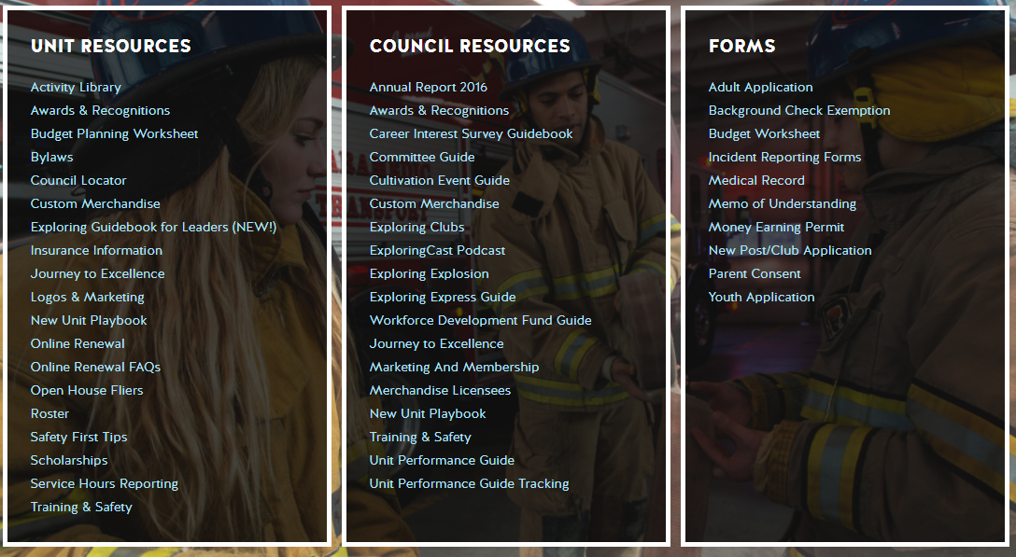
Resources to help you… www.exploring.org

Slide 36

Back-Up Slides

Slide 37
A Little History
1940’s Sea Scouting, Exploring & Air Scouts
1950’s Youth automatically an Explorer at age 14
1960’s Career Exploring introduced
1970‘s Women joined Exploring as adult leaders and youth Members. National Youth Officers
1980’s 17 Career and Traditional Program Clusters
1991 Curriculum-based Learning for Life Program started
1998 12 Career Exploring Fields Move to LFL.
Venturing started with 5 traditional fields
2013 Exploring Club program started ages 10-13

Slide 38

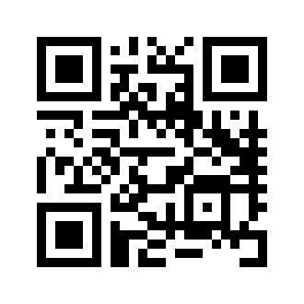
www.exploringyourcareer.com
Online Career Interest Survey for youth who are at least 13 years of age or older
TRY IT NOW!
Use QR code or simply type address in web browser

Slide 39
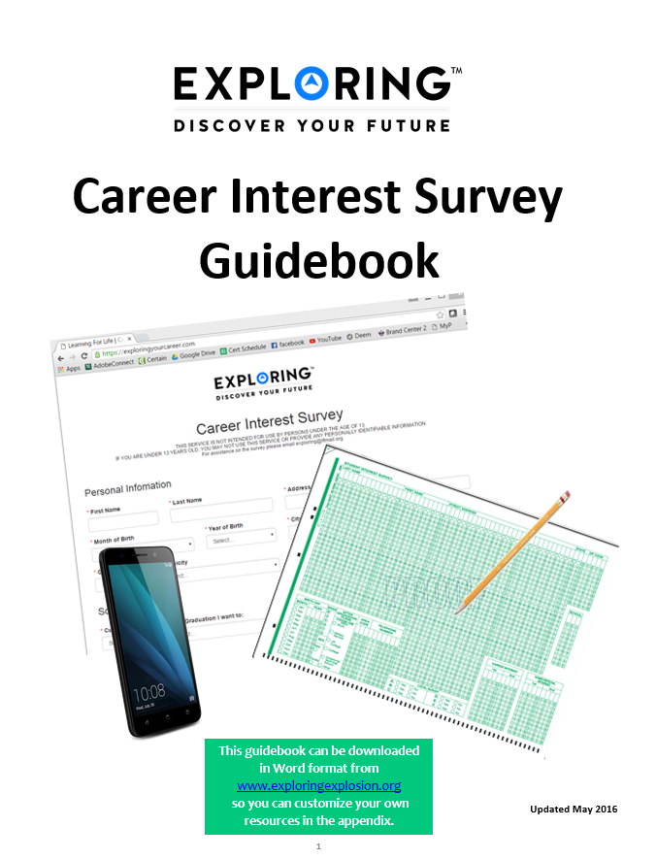

Career Interest Survey Guidebook
Be sure you have the most recent version
Download at www.exploring.org
One stop shop for all CIS resources
Table of Contents
  Page 5 | At A Glance
  Page 7 | Overcoming Objections
  Page 44 | Appendix

Slide 40
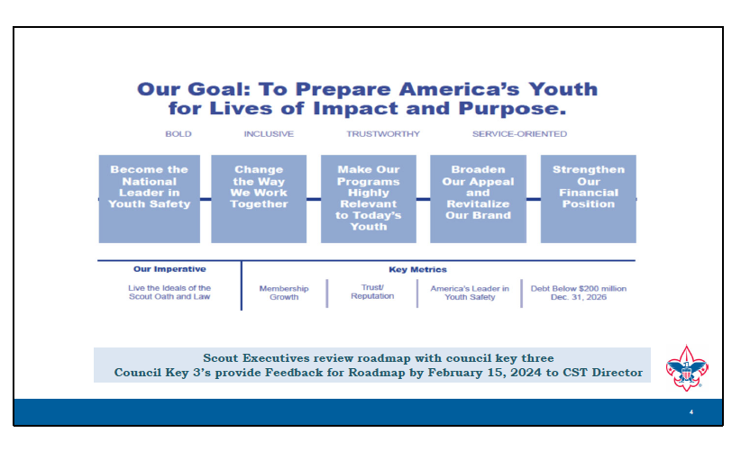

Slide 41
THE EXPLORING VALUE PROPOSITION
Everyone Cares About Careers
Potential Unit Leaders Are Career Program Ready
Exploring Sells Itself
BUILDING NEW RELATIONSHIPS
Recruiting Top CEOs (Council Board)
Partnering With Top Businesses
Creating New Funding Sources

Slide 42
Exploring Membership Quite Stable (Pre-COVID)
Our Third Largest Program (With Limited Support)
Total BSA Youth Membership
Co-Ed Young Adult Programs

Slide 43
Exploring Nomenclature Comparison
 | SCOUTS BSA | VENTURING | SEA SCOUTS | EXPLORING
UNIT | Troop | Crew | Ship | Club/Post
LEADER | Scoutmaster | Advisor | Skipper | Sponsor/Advisor
YOUTH LEADER | Senior Patrol Leader | President | Boatswain | President or Agency Nomenclature
YOUTH PARTICIPANT | Scout | Venturer | Sea Scout | Participant or Explorer
RE-REGISTRATION | Charter Renewal | Charter Renewal | Charter Renewal | MOU Renewal
SPONSOR | Chartered Org | Chartered Org | Charter Org | Participating Org
SPONSORING AGREEMENT | Charter | Charter | Charter | Memorandum of Understanding (MOU)
UNIT SERVICE | Commissioner | Commissioner | Commissioner | Service Team
YOUTH RUN | Yes | Yes | Yes | Yes
AGE SPAN | 11-18 | 13-20 | 13 - 20 | 11-13/14-20
RELIGIOUS DECLARATION | Duty to God | Duty to God | Duty to God | None
UNIFORM | Scouts BSA | Venturing (Unit Selected) | Sea Scouts (Unit Selected) | Club/Post Selected, not required

Slide 44


12 Keys To Success
Successful Councils
Providing a Pathway to Exploring Growth and
Strategic Planning In Your Council

Slide 45

1. Recruit a council Exploring volunteer chair and committee
2. Appoint a council Exploring champion
“staff advisor”
3. Create a public presence for Exploring on the council website, newsletters, & social media
4. Train key volunteers and staff on the 4
Phases of Post/Club Organization

Slide 46

5. Set specific goals for Career Interest
Surveys or gathering of data from select high schools
6. Set goals to host open houses for all
Posts/Clubs
7. Create a campaign to emphasize Post/Club unit support through Service Teams or
Commissioners
8. Integrate Exploring into council activities and events

Slide 47

9. Promote Exploring to all current customers (i.e. “Scouts BSA”)
10. Host a council community cultivation event, focusing on a specific career.
11. Recruit Council Executive Board to help open doors within the community and to help create a list of businesses to match the
Career Interest Survey results.
12. Ensure that Exploring is included in the council strategic plan, PDS goals, and council board meetings.

Slide 48
Exploring Clubs
2013 Response to DOE Guidance on Early Career Education
What Are They?
What’s The Program?
6-th – 8th Graders
Sponsors Provide Program
Schools/PTAs
Civic Organizations
Businesses/Agencies
Leaders Register and Train
Safety First/YPT Policies Apply
Some Activities Prohibited
Structure
Standalone Clubs
Attached to Explorer Post
  Explorers Act as Mentors
Donations May Fund Registration
ScoutReach Similarities
May Focus On At-Risk Youth
Multi-Career or Single Specialty
Like Posts: Hands-On Interactive
Typically After-School
Classroom Setting + Field Trip
Lesson Plans Available 6th & 7th
May Include Soft Skills
Interviewing, Presentation
Resume Writing
Single Specialty Examples
Law Enforcement/Fire & EMS
Engineering
Robotics
Circus/Dance & Theater

Slide 49
OPEN HOUSES
INSERT HERE
COUNCIL/DISTRICT YEARLY MEMBERSHIP PLANS
(Recruitment/Retention Cycle)
Career Interest Surveys
MOST IMPORTANT

Slide 50
US Department of Agriculture Forest Service
(USDAFS)
The US Department of Agriculture-Forest Service (USDAFS) is interested in creating additional Posts throughout the country. This is an excellent opportunity to continue to grow Exploring within your council.
If your council has a National Forest within its boundaries, please contact Stuart Mahler, National Exploring Subject Matter Expert & National Exploring Resource Advisor, who is also representing the National Exploring Program Committee as our primary POC with the USDAFS representatives. Stuart may be contacted at:
(925) 519-6957 or mdc.stuart@gmail.com

Slide 51
National Exploring Subject Matter Experts / Exploring Resource Associate Advisors
In support to our fourteen Council Service Territories (CSTs), formerly National Service Territories (NSTs), our National Exploring Program is currently supporting each CST, along with their territory’s councils, with a National Exploring Subject Matter Expert (SME), who serves as that territory’s National Exploring Resource Associate Advisor (RAA). As a caveat, we do not presume this role is either formally or informally part of the CST organizational structure but rather a service being made available by the National Exploring Program to each CST and their councils. Additionally, we have an National Exploring RAA dedicated to supporting the California Highway Patrol (CHP) and the councils with CHP Law Enforcement Posts as well as the posts themselves

Slide 52
Current National Exploring SMEs / RAAs Team...
CST 1 ~ Suzie Steiner (Mountain West Council), who is currently an Advisor for an Exploring STEM / Robotics Post, which also encompasses trades such as machining & welding and business careers, and has previously been an assistant district commissioner, assistant & roundtable commissioner and Cub Scout den leader. National Exploring Resource Associate Advisor (RAA) supporting the CST 1 and councils within the territory
suzie@openlabidaho.org
((208) 869-2403
CST 3~ Stuart Mahler (Golden Gate Area Council), who is currently an Assistant Council Commissioner and LFL Council Exploring Chair and Executive Board Member as well as a retired police officer, an advisor in the 1987 Law Enforcement Exploring National Academy, staff member on three National Exploring Law Enforcement Exploring Conferences and Law Enforcement Explorer in his youth. National Exploring Resource Advisor (RAA) supporting the CST 3 and councils within those two territories
mdc.stuart@gmail.com
(925) 519-6957
CST 4 & 5 ~ Roger Engelbart (Greater St Louis Area Council), who is currently the Assistant Council Commissioner for Training and the Engineering Chair for the Council Exploring Committee, as well as a retired Boeing Engineer involved in Nondestructive Evaluation. National Exploring Resource Associate Advisor (RAA) supporting the CST 4 & 5 and councils within those two territories
engelbart301@sbcglobal.net
(314) 920-8968

Slide 53
Current National Exploring SMEs / ERAs Team...
CST 6 ~ Richard (Dick) Davies (Glacier's Edge Council) who is the National Exploring Commissioner, Exploring Chair for the National Commissioner Service Team & National Exploring Program Committee Vice-Chair, as well as VP - Development in Glacier's Edge Council (Madison, WI), Greater New York Councils Executive Board Member, former Interim Scout Executive for the Greater New York Councils (2021 & 2022), past Northeast Region Exploring Chair and Board Member, and, in his youth, National Explorer President (1976-77) & Youth Member of National Executive Board. National Exploring Resource Associate Advisor (RAA) supporting the CST 6 and councils within the territory
richard.davies.nyc@gmail.com
(914) 327-7430
CST 7 ~ Don Decker (Bay Area Council) - Eagle Scout, Woodbadge staff member, retired BSA Professional Scouter, Business and Banking Explorer as a youth, and currently a full time Agriculture Specialist, US Customs and Border Protection Agency. National Exploring Resource Associate Advisor (RAA) supporting the CST 7 and councils within the territory
donedecker@gmail.com
( 832) 266-7145
CST 8 ~ Craig Martin (Pathway to the Rockies Council), who is the National Exploring Program Committee Chair as well as a retired Senior Systems Engineer supporting Department of Defense satellite programs and a retired USAF Colonel with extensive experience building, testing, launching & operating US Air Force satellites and testing air-to-air & air-to-ground missile systems. National Exploring Resource Associate Advisor (RAA) supporting the CST 8 and councils within the territory
bruin1967@aol.com
(719) 331-6406

Slide 54
Current National Exploring SMEs / ERAs Team...
CST 9 ~ Richard (Rick) Belford, Jr. (Western Massachusetts Council), who is currently the Vice President of Membership, Executive Board member, and Exploring Service Team member. Also a former Associate Advisor and Committee Member for two Posts and a former Scouting Professional/District Executive. Retired DOD/Federal employee and retired USAF Chief Master Sergeant. National Exploring Resource Associate Advisor (RAA) supporting the CST 9 & 11 and councils within those two territories
rebwme234@gmail.com
(860) 749-2028
CST 10 ~ Joseph (Joe) Marinelli (Seneca Waterways Council), who is the Council Executive Committee’s & Board’s former Vice President of Exploring, past President of the Finger Lakes Council and Executive Director, Finger Lakes STEM Hub as well as a retired Regional Supervising Superintendent & BOCES (service agency) CEO for 25 school districts in upstate New York. National Exploring Resource Associate Advisor (RAA) ) supporting the CST 10 and councils within the territory
josephjmarinelli@aol.com
(585) 704-4659
CST 12 ~ John Brady (Del-Mar-Va Council) who is currently a member on the Council Executive Board, District Vice Chair and Sea Scout Ship 198 Committee Member as well as a former Attorney/Labor Relations Specialist for the State of Delaware & a former Scouting Professional District Executive. National Exploring Resource Associate Advisor (RAA) supporting the CST 12 & 14 and councils within those two territories
jfbradygroup@gmail.com
(302) 271-4700

Slide 55
Current National Exploring SMEs / ERAs Team...
CST 13 ~ Linda Hassler (Monmouth Council) who is currently a member of her Monmouth Council Board of Directors and Troop 140 Committee Member as well as an Assistant Professor at Rutgers’ School of Nursing, former Northeast Region Area 5 Exploring Chair, former Exploring Post Advisor and a Tennis Explorer in her youth. National Exploring Resource Associate Advisor (RAA) supporting the CST 13 and councils within the territory
Lindajhassler@gmail.com
(732) 687-7208
CST 14 ~ John Brady
CST 15 & 16 ~ Kenneth (Ken) Leedham (Gulf Stream Council) who is currently a District Commissioners, Exploring service team member, associate post advisor, merit badge counselor and Wood Badge staff member as well as a full-time police officer and Law Enforcement Explorer in his youth. National Exploring Resource Associate Advisor (RAA) supporting the CST 15 & 16 and councils within those two territories
treasurecoastscouting@gmail.com
(772) 370-2800
CHP ~ Rick TerBorch (Los Padres Council), who is the former National Service Territory (NST) 3 Commissioner, Assistant Council Commissioner and Council Executive Board Member as well as a retired Chief of Police in Arroyo Grande, CA, past Los Padres Council President & Council Commissioner, past National Law Enforcement Exploring Committee Member, Exploring Advisor and over 35+ years in Law Enforcement Exploring. National Exploring Resource Associate Advisor (RAA) supporting the California Highway Patrol (CHP) and the councils with CHP Law Enforcement Posts.
rterborch@earthlink.net
(805) 441-1721

Slide 56


