Slide 1
Engaging Social and Digital Media

Slide 2
Darin Kinn
Director, Marketing & Brand
Scouting America
darin.kinn@scouting.org

Slide 3
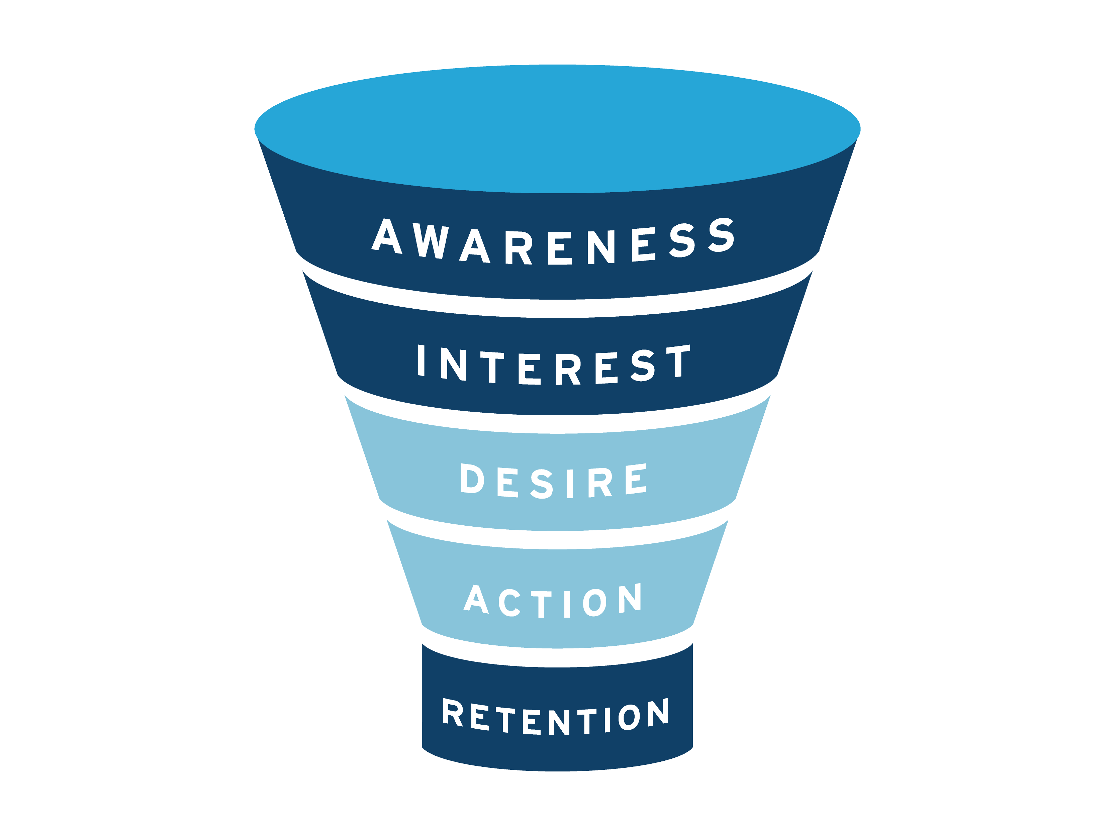
The Funnel
Paid Social
Paid Search
Nurture
PR/Earned Media
Email Lead Gen Campaigns
#AdventureOn! Campaign Assets
Activate
BeAScout Lead Activation
Geofencing
JOIN
Fliers, Posters, Yard Signs
ScoutingWire
Retain
Newsletters
Emails/Websites

Slide 4
The Funnel
Paid Social
Paid Search
Nurture
PR/Earned Media
Email Lead Gen Campaigns
#AdventureOn! Campaign Assets
Activate
BeAScout Lead Activation
Geofencing
JOIN
Fliers, Posters, Yard Signs
ScoutingWire
Retain
Newsletters
Emails/Websites

Slide 5
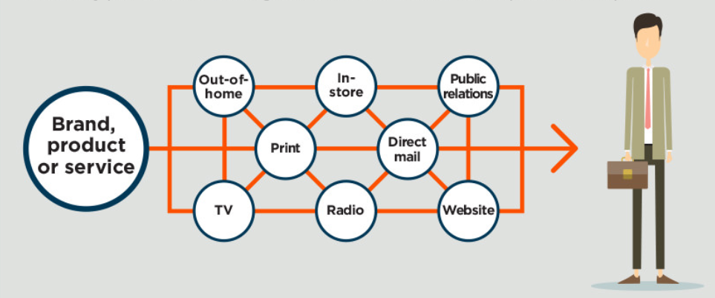
The Good Old Days….

Slide 6
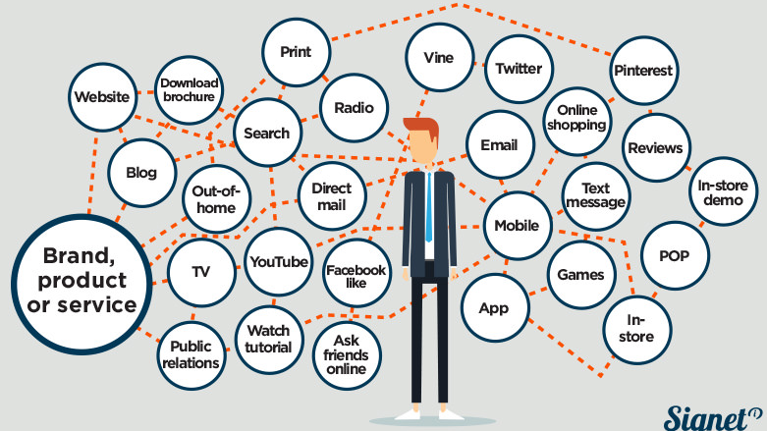
Scout Nights
PR
Fliers
Instagram
Facebook Events
Scout Talks

Slide 7
Scout Nights
PR
Fliers
Still the good old days…
Instagram
Facebook Events
Scout Talks

Slide 8
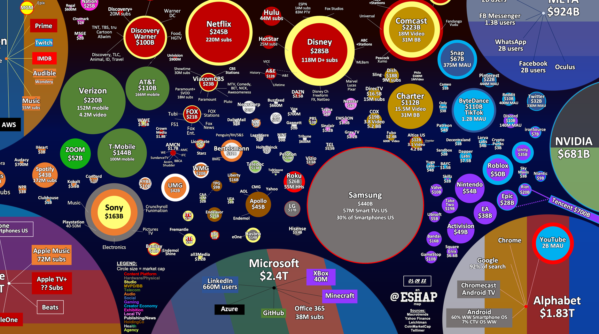

Slide 9
10,000+ Media messages daily

Slide 10
How do you reach families today?
With all the complexity…

Slide 11
Social Media!
1
It’s where we are…
2
It is an efficient use of resources

Slide 12
Social Stats
Facebook
TikTok
Twitter
Instagram
YouTube
2 Hrs
27 Mins
159x
The Daily Number of Times US Adults Check Their Phones
Daily Time Spent on Social Media by US Adults
2023, Psychology Today
2023, Data Reportal, Hootsuite
Top Social Media Platforms, US Adults 18+
2023, Statista

Slide 13
We get it!
Social is important…
How do we best
invest our time??

Slide 14
5
5 Common Elements of Successful Social Media Strategies

Slide 15
Common Elements…
1
A Plan: Clearly defined goals & audiences
Sounds basic - In Exploring we do plans for meeting content, activities, special events… but do we apply that same rigor to social campaigns?
Include things like:
Target audiences
Timing – Start/End & How often you’ll post
Messages / Talking Points
The channels you’ll use
Budget
Success metrics

Slide 16
Common Elements…
Consistent Posting
2
Consistent posting is critical…
We’re all guilty of getting busy and occasionally letting our posting lag
Nothing sends up red flag like an inactive channel
Schedule posts during busy times
Post 3-4 times per week on FB…more on Twitter and TikTok

Slide 17
Common Elements…
3
Engaging Content
People want to be informed, inspired, educated, and entertained
Rotate through those categories regularly…don’t get stuck
Success stories always perform well
Encourage comment and interaction
Respond to comments and messages

Slide 18
Common Elements…
Resources Identified
4
Resources identified UP-FRONT
Are you an army of 1… or do you have people you can call upon to assist?
Don’t forget stakeholders
Think through the funding or tools you’ll need to execute your plan and have those in place

Slide 19
Common Elements…
5
Regular Assessment
If you’ve identified success metrics in your plan, you’ll know what to measure
Check in on your campaigns and channels as they are going… are you achieving the measurements you need to achieve?
If not…make adjustments mid-stream…

Slide 20
Watchouts
Waiting until the end of the campaign to review
Winging It
Mismatching audiences & messaging
Lack of stakeholder buy-in

Slide 21
What if I’m just Getting Started?…
Start with Facebook, then branch out
Consistent Posting: 2-3x per week
Map out your year – big events

Slide 22
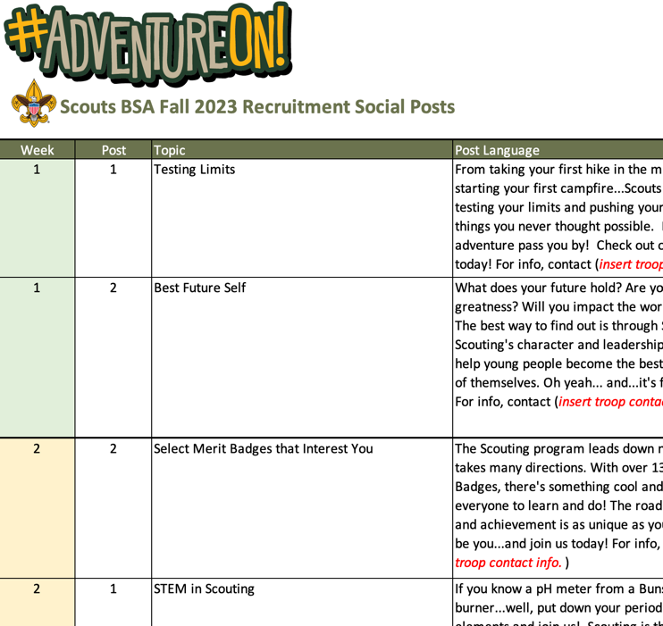
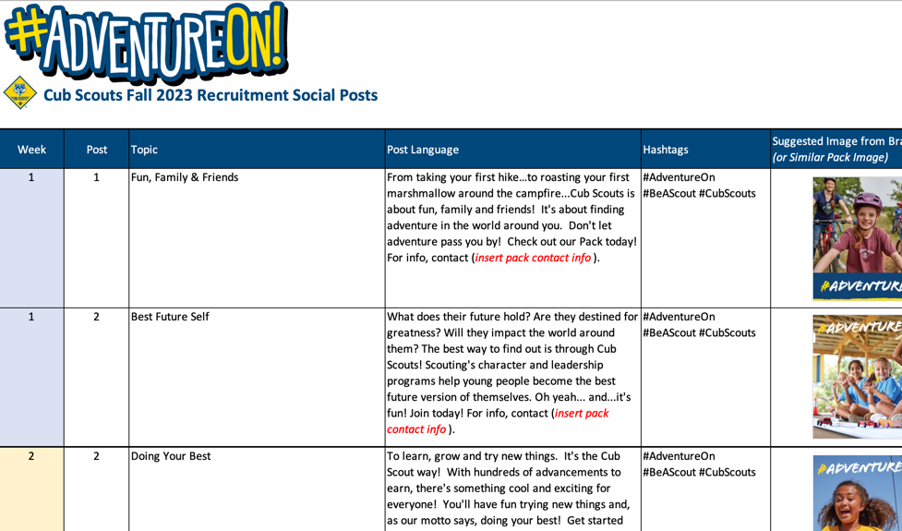
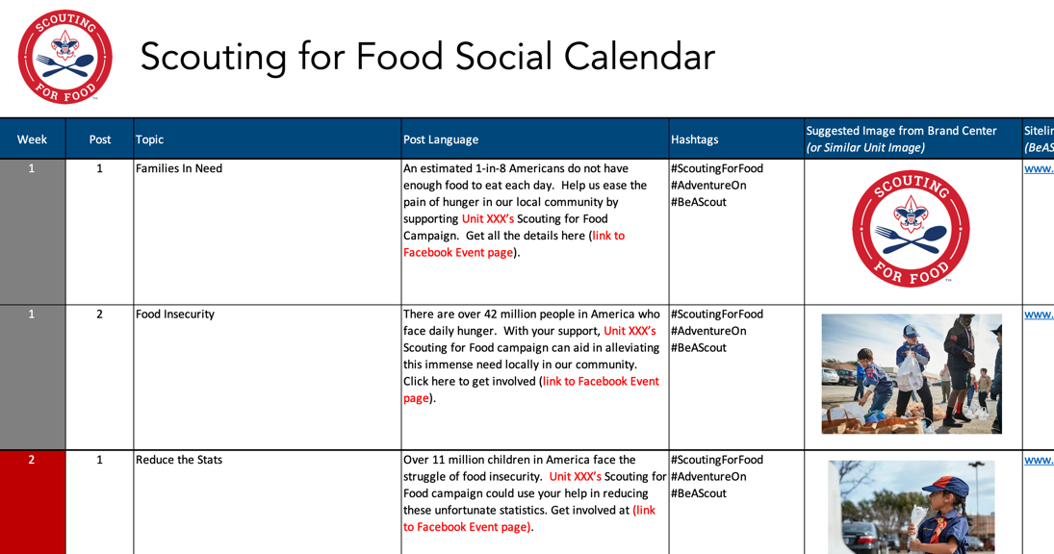
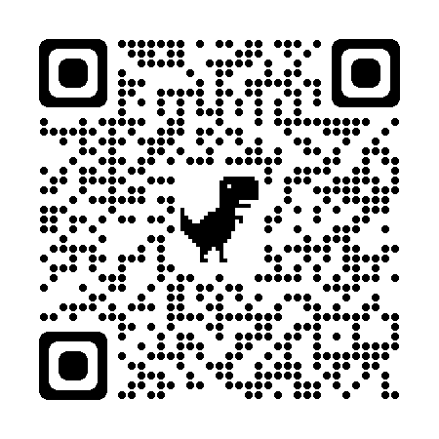
Calendar examples…

Slide 23
Engaging Social and Digital Media

