Slide 1
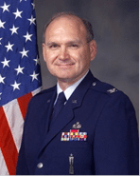

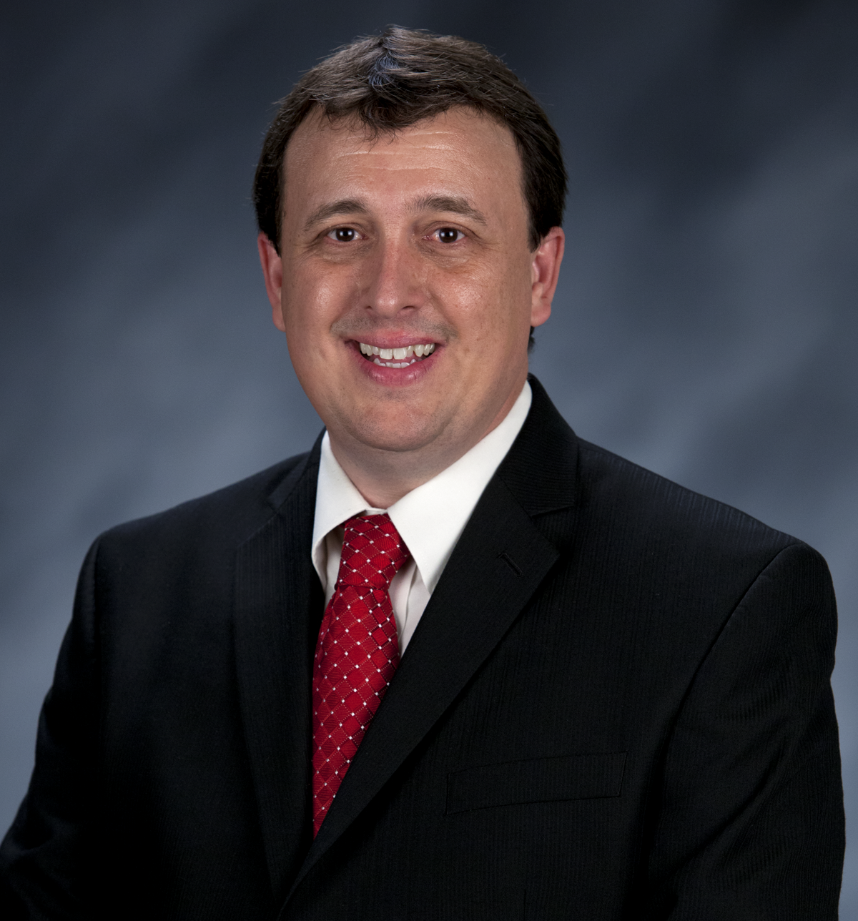
Craig Martin
Vice-Chair,
National Exploring Program Chair
NATIONAL EXPLORING
LIVE HOUR
September 11, 2024
Tim Anderson
National Director
Learning for Life & Exploring
Older Youth Programs

Slide 2

LEARNING FOR LIFE CORPORATE MISSION:
To develop and deliver engaging, research based academic, character, leadership and career focused programs aligned to state and national standards that guide and enable all students to achieve their full potential.
NON-DISCRIMINATION STATEMENT:
Learning for Life programs are designed for all age groups from pre‐kindergarten and not yet age 21. Youth participation is open to any youth in the prescribed age group for that particular program. Adults are selected by the participating organization for Involvement in the program. Color, race, religion, gender, sexual orientation, ethnic background, disability, economic status or citizenship is not criteria for participation by youth or adults.
Notes:
AFFILIATION STATEMENT
Learning for Life is one of the programs that local Boy Scouts of America councils are authorized to deliver, with local executive board approval. Learning for Life is an affiliate of the Boy Scouts of America that is comprised of both a written character education curriculum for PreK – 12th graders and students with special needs, as well as Interactive career Exploring programs for 6th graders thru 20 year olds. Youth participation is open to any youth in the prescribed age group for that particular Program. Adults, 21 years of age and older, are selected by participating organizations for involvement in the Learning for Life programs. Color, race, religion, gender, sexual orientation, ethnic background, disability, economic status or citizenship is not criteria for participation by youth or adults. Youth and adults involved with Learning for Life programs, including Exploring, are registered with Learning for Life as participants. Learning for Life participants are not members of the Boy Scouts of America. Learning for Life, a District of Columbia non‐profit corporation, is a separate 501(c)(3) Corporation, with a Board of Directors that is separate from the Boy Scouts of America. While they have different policies, there are occasions when local Learning for Life and Traditional BSA programs may participate in an event. Both programs will be required to follow the appropriate guidelines, especially regarding safety. Completion of training, registration and annual fees are program specific and not transferable between programs

Slide 3

  Learning for Life Curriculum-Based Programs consists of grade specific, age-oriented, character education lesson plans that are utilized in schools and other educational settings to help instill character and ethical decision making in our youth. The available lesson plans that are offered for Learning for Life Groups include PreK-12 grades, Champions for students with special needs, along with additional digital resources. Learning for Life uses these interactive lessons to help youth make informed decisions while becoming better students and citizens.
  CURRICULUM PROGRAM VISION:
  To provide engaging and relevant PreK‐12 solutions that positively impact academic performance, social & emotional maturity, character development, and career education for all students.
www.learningforlife.org

Slide 4

  Exploring is a co-ed program for youth that are in the 6th grade through 20 years old. Exploring provides opportunities for real-world hands-on career experiences, while helping them “Discover their Future”. The program links youth with mentors and experts with partner businesses and agencies in their communities. Participating in an Exploring Club or Post ensures youth make informed decisions about careers they may or may not be interested in pursuing, while allowing businesses and organizations the opportunity to meet and cultivate future employees.
EXPLORING MISSION:
Deliver character-building experiences and mentorship that allow youth to achieve their full potential in both life and work.
EXPLORING VISION :
Shape the workforce of tomorrow by engaging and mentoring today’s youth in career and life enhancing opportunities.
www.exploring.org

Slide 5

National Learning for Life/Exploring
National Professional Staff Direct Support
Tim Anderson
National Director,
Learning for Life/Exploring
Older Youth Programs
Vacant
Project Coordinator
John Mosby
Asst. Chief Scout Executive & EVP
(BSA)
Shane Calendine
Vice President Council Operations (BSA)
Susan Fitzhugh
Sr. Administrative Assistant

Slide 6

National Director/President
Tim Anderson (E)
(V) = Volunteer
(E) = Employee/Professional
LFL Executive Board Secretary
Steven Hardy (E)
NATIONAL LEARNING FOR LIFE
EXECUTIVE BOARD
LFL Executive Board Treasurer
Lisa Fritschel (E)
National Learning for Life Executive Board Chair
(Board Member)
Bernard “Bernie” Lockard (V)
----------------------------------------------------------------------------------------------
National Learning for Life
Immediate Past Executive Board Chair/Governance
(Board Member)
Mark Wiesenhahn (V)
(Board Member)
National
Exploring Program Chair
Craig Martin (V)
(Board Member)
National Learning for Life Curriculum Based Program Chair
Dr. Helen Stiff-Williams (V)
(Board Member)
National
Exploring Program Commissioner
Richard “Dick” Davies (V)
(Board Member)
National Membership & Retention Chair
Vacant (V)
(Board Member)
National
Fundraising & Development Chair
Vacant (V)
(Board Member)
National
Partnerships & Relationships Chair
Vacant (V)
(Board Member)
National
Marketing & Technology Chair
Jeff Schweiger

Slide 7

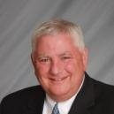

National Learning for Life Executive Board Chair
Bernie Lockard
Scouting…
Eagle Scout (1972)
Order of the Arrow Vigil Honor
Cubmaster
Pack Committee Chairman
Assistant Scoutmaster
Scoutmaster
Unit Commissioner
Wood Badge Course Director
NYLT Course Director
District Chairman
President, Laurel Highlands Council’s Board of Directors (2013 - 2014)
2019 World Jamboree Scoutmaster
Chair, National Venturing Committee (2020 - 2022)
2023 & 2017 National Jamboree Staff
National Eagle Scout Association Scholarship Committee (2013 - Present)
BSA Recognition…
Award of Merit – 1998
Silver Beaver – 2001
Distinguished Citizen – 2010
Rockefeller Award – 2010
Silver Antelope – 2014
National Outstanding Eagle Scout Award - 2015
National Venturing Leadership Award – 2022
Silver Buffalo - 2024
Personal…
Married to Robyn L. Ashbridge, father of five and grandfather of seven
President, The Lockard Company, Indiana, PA
Graduate of Carnegie-Mellon University, Pittsburgh, PA, with B.S. in Administration and Management Science, Economics, Mathematics (Graduated With Honors)

Slide 8
Safety Moment ~
All-Terrain Vehicle Safety*
* Scouting America Safety Moments ~ https://www.scouting.org/health-and-safety/safety-moments/all-terrain-vehicles/ and OTHROINFO ~ https://orthoinfo.aaos.org/en/staying-healthy/all-terrain-vehicle-safety/
)

Slide 9

ATV Safety…
All-terrain vehicles (ATVs) are defined as “motorized recreational cycles with three or four large, soft tires, designed for off-road use on a variety of terrains.” While all-terrain vehicles—including ATVs, utility task vehicles (UTVs), and side-by-sides—are fun and exciting to navigate through a forest course, they are also under the watchful eye of the Consumer Product Safety Commission and have a reputation of scarring the environment.

Slide 10
ATV General Info…
With the exception of Scouting America council-run ATV programs, ATVs, UTVs, and side-by-sides are banned from program use, a restriction that includes their use within units
ATV programs have been used in Scouting America’ s council-run programs following National Camp Accreditation Program (NCAP) standards for some time now. When an approved program is offered, the camp provides a safe introductory program into all-terrain vehicle use and operation following the safety training program of the ATV Safety Institute (ASI)
  The course or program must follow the ASI’s RiderCourse program in its entirety. No deviation is permitted from the course outline. Go online at atvsafety.org to review the section they have for parents. It details what you may want to know about riding ATVs safely
  In the camp program, a qualified staff member will be present at all times that participants are riding. Unsupervised riding is not allowed. Manufacturer restrictions on the age, weight, and height of riders shall be followed, with no exceptions
  Parents and/or guardians must complete a permission slip, inclusive of hold-harmless language, prior to beginning the program
  The ATVs may not carry passengers except for the designated rider, and the ATV may not be used to pull anyone or anything
  Should your council use ATVs, please understand the speed limits and trail conditions at which they are meant to operate, keep your limbs inside of the ATV, and maintain the use of all necessary personal protective equipment (PPE) while riding
The ATVs are council-owned and used for program. The ATVs may not be leased to third parties during the off-season. Personal ATVs are not authorized for use
NCAP standards allow for a fun time on ATVs while keeping Scouts & Explorers safe

Slide 11
ATV Safety Tips
To help reduce the numbers of injuries and deaths, particularly among young people, the American Academy of Orthopedic Surgeons( AAOS)—along with the Orthopedic Trauma Association and the Pediatric Orthopedic Society of North America—recommends that:
All ATV operators should be licensed and undergo a hands-on training course. Both children and adults should be able to demonstrate competence in handling the vehicle and knowledge of the potential safety hazards
ATVs should never be driven by a child younger than the age of 12. Younger children do not have adequate physical size and strength to control these vehicles. Nor do they have the motor skills, coordination, and judgment needed to operate a vehicle safely
Children between the ages of 12 and 16 should have limitations on their use of ATVs. They should be supervised by a responsible adult. Children under 16 years of age should only operate age-appropriate models that have an engine size of 90 cc or less
Operators should always wear protective gear. Helmets are especially important in reducing the risk of head injury. Wearing protective gloves, goggles, heavy boots, and long pants can also help reduce injuries
ATVs should only be used during daylight hours. In the varied terrain in which ATVs are most commonly used, good visibility is required. Riding after dark is especially dangerous. The lights attached to an ATV cannot provide enough properly directed illumination when the vehicle is bouncing or turning
Only one person should ride a vehicle intended for single person use. Adding a passenger increases the likelihood that the ATV will tip or turn over
Do not operate an ATV if you have taken drugs or alcohol. A large number of ATV-related fatalities involve alcohol use

Slide 12
ATV Safety Resources…
ATV Safety Program = https://www.scouting.org/outdoor-programs/atv-safety-program/
ATV Safety Institute—For Parents = https://atvsafety.org/
ATV Safety Institute—RiderCourse = https://atvsafety.org/atv-ridercourse/
National Camp Standards = https://www.scouting.org/outdoor-programs/camp-accreditation/
  PS-205: All-Terrain Vehicle Programs
  SQ-412: Other Program Staff Qualification
All-Terrain Vehicle Safety = https://orthoinfo.aaos.org/en/staying-healthy/all-terrain-vehicle-safety/

Slide 13
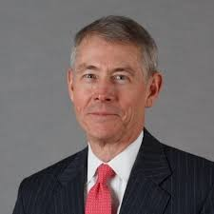
National Exploring Program Commissioner
Richard (Dick) Davies
Richard.davies.nyc@gmail.com
(914) 327-7430
Recent Scouting History
Interim Scout Executive for two years Greater
New York Councils ~ 2021 – 2022
Stepped down as Council Commissioner to take role
Formerly VP – Membership, VP – Scoutreach and Manhattan Borough President
Eagle Scout from Wisconsin
Exploring History
Exploring Chair, National Commissioner Service Team ~ Nov 2022 – TBD
National Exploring Program Commissioner, National LFL Executive Board ~ Nov 2022 -TBD
Area and Northeast Regional Exploring Chair and Board Member ~ 2018 – 2021
National Exploring Committee ~ 1976 – 1979
National Explorer President ~ 1976-77; Youth Member of National Executive Board
Professional Career
Since 2016, angel investor and advisory board member for start-up companies
Consultant to investment management industry
Most of career on business side of investment management industry (business unit management, client and product development) with Alliance Bernstein and Russell investments
Last ten years through 2016 working with largest 401k and other defined contribution plans around the world.

Slide 14


Bruin1967@aol.com
Craig Martin
National Exploring Program Chair
Bruin1967@aol.com

Slide 15

National Exploring Committee & National Resource Associate Advisors (SME’s)
Craig Martin
National Exploring Program Chair,
Learning for Life Executive Board
Bruin1967@aol.com
719-331-6406
Richard (Dick) Davies
National Exploring Program Commissioner,
Learning for Life Executive Board
Exploring Chair,
National Commissioner Service Team
Richard.davies.nyc@gmail.com
914-327-7430
u

Slide 16
Current Exploring Participation Status

Slide 17
Exploring Membership Growth Opportunity…
As of… | Units |  | Youth Membership |  | Adult Membership
 | Clubs | Posts | Clubs | Posts | Clubs | Posts
31 Jan 2020 * | 395 | 4,055 | 14,903 | 80,474 | 704 | 19,095
21 Aug 2024 | 183 | 1,529 | 4,382 | 24,660 | 847 | 10,033
Opportunity | 212 | 2,526 | 10,521 | 55,814 | 143+ | 9,062
* Just before the COVID-19 Pandemic shut-down all in-person meetings
Negative downward trend since 21 August 2024

Slide 18
Exploring Participants as of 21 August 2024
Clubs/Posts = 1,712 (+78) Youth = 29,042 (+2845) Adults = 10,880 (+506)
Career Area Units Youth Adults
Arts & Humanities 5 168 (+93) 52
Aviation 42 (+2) 652 (+38) 324 (+2)
Business 11 (-1) 483 (+38) 56 (-5)
Education 34 (+1) 1,230 (+5) 187 (+3)
Communications 5 106 (+2) 33 (-1)
Engineering & Technology 24 (+1) 592 (+28) 159 (+7)
Explorer Clubs 183 (+10) 4,382 (+290) 847 (+46)
Fire/Emergency Services 452 (+17) 5,383 (+341) 3,020 (+128)
General Interest 64 (+4) 1,963 (+134) 396 (+26)
Health Care 53 (+1) 1,516 (+100) 289 (+3)
Law Enforcement 650 (+29) 7,506 (+825) 4,249 (+188)
Law / Gov’t / Public Service 70 (+9) 2,441 (+899) 460 (+70)
Science 18 1,136 (-1) 92 (+1)
Skilled Trades 17 (+1) 220 (+31) 135 (+6)
Social Services 4 109 30
STEM 7 (+1) 301 (+64) 69 (+47)
No Special Interest Selected 72 (+4) 816 (+258) 464 (+27)
NOTE: Numbers in parentheses are changes since 17 June 2024 (Jeff Schweiger, National Exploring Membership & Retention Lead, discovered that previous reports had under-counted clubs & over-counted posts because currently 105 clubs do not reflect “0999” special interest code (SIC) which will require each of these clubs’ council registrar to correct)

Slide 19
National Exploring Program Committee

Slide 20
Nat’l Exploring Committee Members…
National Exploring Program Chair Craig Martin
National Exploring Program Commissioner Richard (Dick) Davies
National Exploring Membership Growth / Retention Lead Jeffrey (Jeff) Schweiger
National Exploring Awards & Recognition Lead Richard (Rick) Belford
National Exploring Training Lead Roger Engelbart
National Exploring Health & Safety / YPT Lead Linda Hassler
National Exploring Marketing / Communications Lead (Website / Social Media) TBD *
National Exploring Materials & Literature Lead Timothy (Tim) Buckles
National Exploring Career Fields Development Lead TBD *
National Exploring Youth Officer Advisor TBD *
National Exploring Youth Chair TBD
National Exploring Partnerships / Relationships Lead TBD *
National Exploring Resource Advisor Stuart Mahler
National Special Needs Committee Liaison for Exploring TBD
National Exploring Members-at-Large (National Exploring Resource Associate Advisors)
  National Exploring Subject Matter Expert John Brady
  National Exploring Subject Matter Expert Don Deeker
  National Exploring Subject Matter Expert Kenneth (Ken) Leedham
  National Exploring Subject Matter Expert Joseph (Joe) Marinelli
  National Exploring Subject Matter Expert Suzie Steiner
  National Exploring Subject Matter Expert Rick TerBorch
* Note: Welcome recommendations from National Exploring Live Hour Participants

Slide 21
New Materials & Literature Lead for
National Exploring Committee

Slide 22
National Exploring Committee’s Materials & Literature Lead Timothy (Tim) Buckles…
Occupation: Retired Graphics Designer & Educator
Resident Location: Ramona CA
  Mobile Phone: (619) 944-1803
  Email: timbuckles@yahoo.com
Home Council: San Diego – Imperial Council
  Assistant Council Commissioner for Exploring
Brief Bio:
  Extensive experience creating print materials and multimedia presentations
  Owned a design studio for 30 years
  Taught (part time) design and digital illustration at several colleges & universities
  Eventually took a full-time teaching position that brought him to San Diego
  Has been creating print pieces for his Council using the Marketing Collateral available on the Scouting Wire web site
  Education:
    Bachelor’s Degree in Art with Specialization in Design from UCLA
    Master’s Degree in Education from California State University (CSU) - Chico

Slide 23
National Exploring Subject Matter Experts & Exploring Resource Associate Advisors
In support to our fourteen Council Service Territories* (CSTs), formerly National Service Territories (NSTs) , our National Exploring Program is currently supporting each CST, along with their territory’s councils, with a National Exploring Subject Matter Expert (SME), who serves as that territory’s National Exploring Resource Associate Advisor (RAA). As a caveat, we do not presume this role is either formally or informally part of the CST organizational structure but rather a service being made available by the National Exploring Program to each CST and/or their councils. Additionally, we have an National Exploring RAA dedicated to supporting the California Highway Patrol (CHP) and the councils with CHP Law Enforcement Posts as well as the posts themselves
* In April 2024, CST 2 & 11 were eliminated and their councils moved into adjacent CSTs

Slide 24
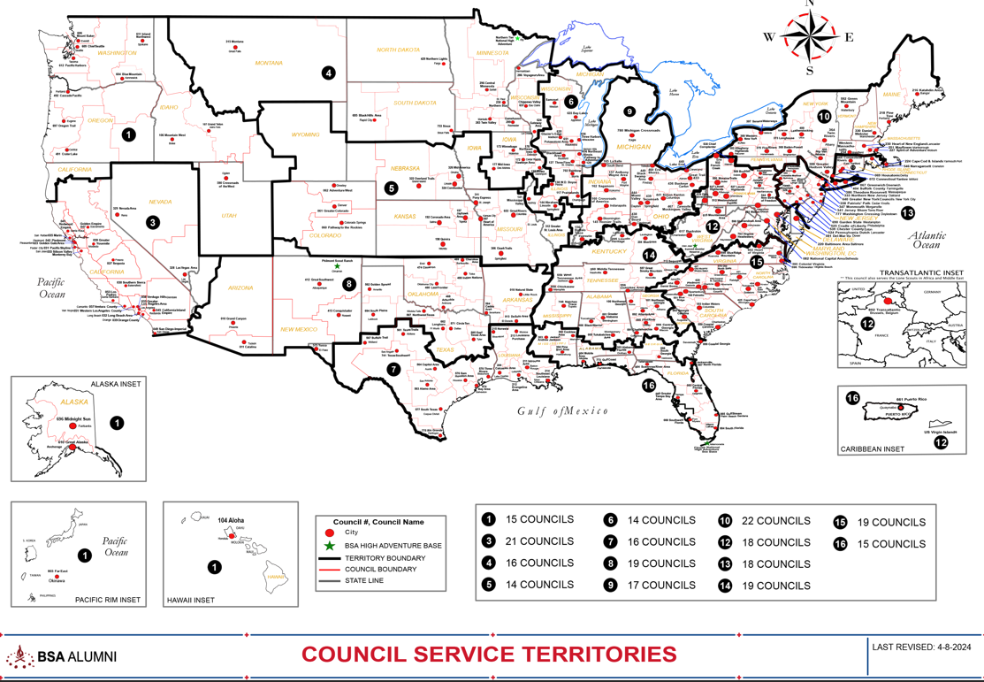
Council Service Territories (CSTs)…
COUNCIL

Slide 25
Current National Exploring SMEs / RAAs Team...
CST 1 ~ Suzie Steiner (Mountain West Council), who is currently an Advisor for an Exploring STEM / Robotics Post, which also encompasses trades such as machining & welding and business careers, and has previously been an assistant district commissioner, assistant & roundtable commissioner and Cub Scout den leader. National Exploring Resource Associate Advisor (RAA) supporting the CST 1 and councils within the territory
suzie@openlabidaho.org
((208) 869-2403
CST 3~ Stuart Mahler (Golden Gate Area Council), who is currently an Assistant Council Commissioner and LFL Council Exploring Chair and Executive Board Member as well as a retired police officer, an advisor in the 1987 Law Enforcement Exploring National Academy, staff member on three National Exploring Law Enforcement Exploring Conferences and Law Enforcement Explorer in his youth. National Exploring Resource Advisor (RAA) supporting the CST 3 and councils within the territory
mdc.stuart@gmail.com
(925) 519-6957
CST 4 & 5 ~ Roger Engelbart (Greater St Louis Area Council), who is currently the Assistant Council Commissioner for Training and the Engineering Chair for the Council Exploring Committee, as well as a retired Boeing Engineer involved in Nondestructive Evaluation. National Exploring Resource Associate Advisor (RAA) supporting the CST 4 & 5 and councils within those two territories
engelbart301@sbcglobal.net
(314) 920-8968

Slide 26
Current National Exploring SMEs / ERAs Team...
CST 6 ~ Richard (Dick) Davies (Glacier's Edge Council) who is the National Exploring Commissioner, Exploring Chair for the National Commissioner Service Team & National Exploring Program Committee Vice-Chair, as well as VP - Development in Glacier's Edge Council (Madison, WI), Greater New York Councils Executive Board Member, former Interim Scout Executive for the Greater New York Councils (2021 & 2022), past Northeast Region Exploring Chair and Board Member, and, in his youth, National Explorer President (1976-77) & Youth Member of National Executive Board. National Exploring Resource Associate Advisor (RAA) supporting the CST 6 and councils within the territory
richard.davies.nyc@gmail.com
(914) 327-7430
CST 7 ~ Don Decker (Bay Area Council) - Eagle Scout, Woodbadge staff member, retired BSA Professional Scouter, Business and Banking Explorer as a youth, and currently a full time Agriculture Specialist, US Customs and Border Protection Agency. National Exploring Resource Associate Advisor (RAA) supporting the CST 7 and councils within the territory
donedecker@gmail.com
( 832) 266-7145
CST 8 ~ Craig Martin (Pathway to the Rockies Council), who is the National Exploring Program Committee Chair as well as a retired Senior Systems Engineer supporting Department of Defense satellite programs and a retired USAF Colonel with extensive experience building, testing, launching & operating US Air Force satellites and testing air-to-air & air-to-ground missile systems. National Exploring Resource Associate Advisor (RAA) supporting the CST 8 and councils within the territory
bruin1967@aol.com
(719) 331-6406

Slide 27
Current National Exploring SMEs / ERAs Team...
CST 9 ~ Richard (Rick) Belford, Jr. (Western Massachusetts Council), who is currently the Vice President of Membership, Executive Board member, and Exploring Service Team member. Also a former Associate Advisor and Committee Member for two Posts and a former Scouting Professional/District Executive. Retired DOD/Federal employee and retired USAF Chief Master Sergeant. National Exploring Resource Associate Advisor (RAA) supporting the CST 9 and councils within the territory
rebwme234@gmail.com
(860) 402-4836
CST 10 ~ Joseph (Joe) Marinelli (Seneca Waterways Council), who is the Council Executive Committee’s & Board’s former Vice President of Exploring, past President of the Finger Lakes Council and Executive Director, Finger Lakes STEM Hub as well as a retired Regional Supervising Superintendent & BOCES (service agency) CEO for 25 school districts in upstate New York. National Exploring Resource Associate Advisor (RAA) ) supporting the CST 10 and councils within the territory
josephjmarinelli@aol.com
(585) 704-4659
CST 12 ~ John Brady (Del-Mar-Va Council) who is currently a member on the Council Executive Board, District Vice Chair and Sea Scout Ship 198 Committee Member as well as a former Attorney/Labor Relations Specialist for the State of Delaware & a former Scouting Professional District Executive. National Exploring Resource Associate Advisor (RAA) supporting the CST 12 & 14 and councils within those two territories
jfbradygroup@gmail.com
(302) 381-8728

Slide 28
Current National Exploring SMEs / ERAs Team...
CST 13 ~ Linda Hassler (Monmouth Council) who is currently a member of her Monmouth Council Board of Directors and Troop 140 Committee Member as well as an Assistant Professor at Rutgers’ School of Nursing, former Northeast Region Area 5 Exploring Chair, former Exploring Post Advisor and a Tennis Explorer in her youth. National Exploring Resource Associate Advisor (RAA) supporting the CST 13 and councils within the territory
Lindajhassler@gmail.com
(732) 687-7208
CST 14 ~ John Brady
CST 15 & 16 ~ Kenneth (Ken) Leedham (Gulf Stream Council) who is currently a District Commissioners, Exploring service team member, associate post advisor, merit badge counselor and Wood Badge staff member as well as a full-time police officer and Law Enforcement Explorer in his youth. National Exploring Resource Associate Advisor (RAA) supporting the CST 15 & 16 and councils within those two territories
treasurecoastscouting@gmail.com
(772) 370-2800
CHP ~ Rick TerBorch (Los Padres Council), who is the former National Service Territory (NST) 3 Commissioner, Assistant Council Commissioner and Council Executive Board Member as well as a retired Chief of Police in Arroyo Grande, CA, past Los Padres Council President & Council Commissioner, past National Law Enforcement Exploring Committee Member, Exploring Advisor and over 35+ years in Law Enforcement Exploring. National Exploring Resource Associate Advisor (RAA) supporting the California Highway Patrol (CHP) and the councils with CHP Law Enforcement Posts.
rterborch@earthlink.net
(805) 441-1721

Slide 29
Current National Exploring SMEs / RAAs Team...
Additionally, any of these National Exploring RAAs are available to any of the CSTs and their councils on the following Exploring Career Fields
Aviation ~ Rick Belford & Roger Engelbart
Business ~ Rick Belford (Contracting & Procurement)
Communications ~ Rick Belford (Broadcasting & Public Relations) and John Brady (Broadcasting & News Reporter)
Engineering & Technology ~ Roger Engelbart, Craig Martin and Suzie Steiner (Robotics)
Health Care ~ Linda Hassler
Law & Government ~ John Brady (Law Careers) and Craig Martin & Rick Belford (Military Careers)
Law Enforcement ~ Ken Leedham, Stuart Mahler & Rick Terborch
Skilled Trades ~ Joe Marinelli & Suzie Steiner
Social Services ~ Joe Marinelli (Education), Linda Hassler (College Professor), Rick Belford & John Brady (Non-Profit / Not-For-Profit Management) and Suzie Steiner (STEM)
Other Career Fields ~ National Exploring RAA, assisting your CST, will find the best individual to assist you for other Exploring Career Fields

Slide 30
National Exploring Program Priorities Mapped to
BSA Roadmap (2024-2025)

Slide 31

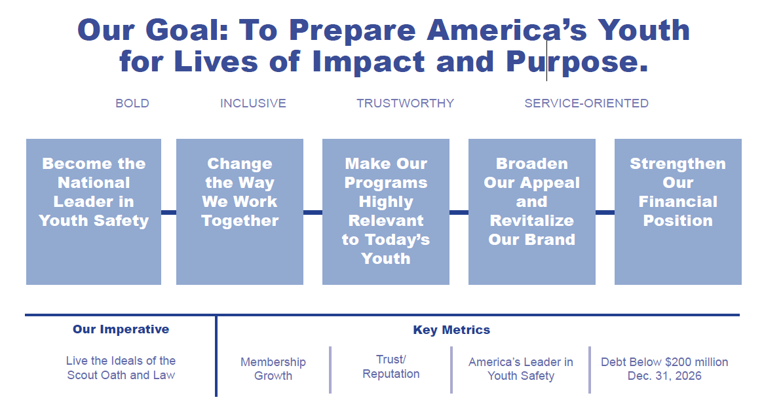
Notes:
.This is the Scouting Forward Roadmap developed by the National Board to set the direction they see for the BSA

Slide 32
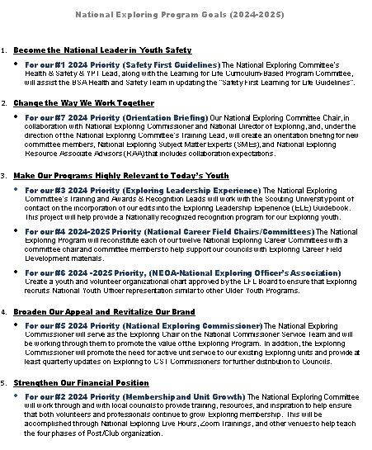
National Exploring Priorities mapped to BSA Roadmap

Slide 33
National Exploring Priorities mapped to BSA Roadmap
Become the National Leader in Youth Safety
For our #1 2024 Priority (Safety First Guidelines [see slide 38]), the National Exploring Committee’s Health & Safety & YPT Lead, along with the Learning for Life Curriculum-Based Program Committee representative, will assist the BSA Health and Safety Team in updating the “Safety First Learning for Life Guidelines”
  On 18 June 2024, Tim Anderson conducted a kick-off Zoom with Linda Hassler & her review team
  On 14 August 2024, Tim Anderson held way-ahead discussion with Linda Hassler & Craig Martin where we decided to meet weekly to review each page in the guidelines for required updates and once we’ve reviewed the entire guidelines would share recommended updates with Linda’s review team for their review and comments
  On 29 August 2024, Tim, Linda & Craig will start weekly guidelines updates review
Change the Way We Work Together
For our #7 2024 Priority (Orientation Briefing), our National Exploring Committee Chair, in collaboration with National Exploring Commissioner and National Director of Exploring, and, under the direction of the National Exploring Committee’s Training Lead, will create an orientation briefing for new committee members, National Exploring Subject Matter Experts (SMEs), and National Exploring Resource Associate Advisors (RAA) that includes collaboration expectations

Slide 34
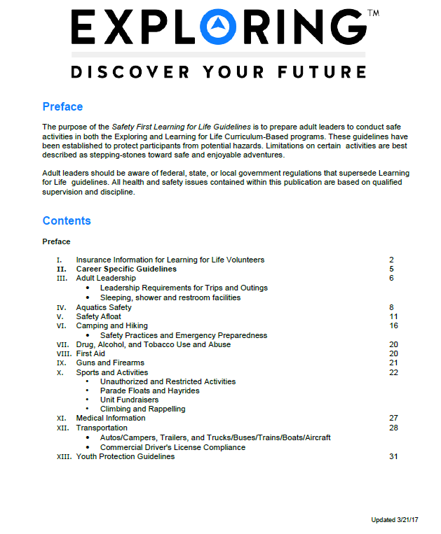
Exploring
Safety First Guidelines

Slide 35
National Exploring Priorities mapped to BSA Roadmap
Make Our Programs Highly Relevant to Today’s Youth
For our #3 2024 Priority (Exploring Leadership Experience), the National Exploring Committee’s Training and Awards & Recognition Leads will work with the Scouting University point of contact on the incorporation of our edits into the Exploring Leadership Experience (ELE) Guidebook. This project will help provide a Nationally recognized recognition program for our Exploring youth
  On 18 June 2024 & 20 August 2024, Tim Anderson met with Rick Belford, Roger Engelbart & Craig Martin to discuss the way-ahead on updating the Guidebook and develop a Statement of Work (see slides 40 & 41) for working with Scouting U
  On 4 September 2024, Guidebook Update Review with Tim Anderson
For our #4 2024-2025 Priority (National Career Field Chairs/Committees), the National Exploring Program will reconstitute each of our twelve National Exploring Career Committees with a committee chair and committee members to help support our councils with Exploring Career Field Development materials
  On Monday (May 20, 2024), held Zoom meeting to discuss reconstituting National Aviation Exploring Career Committee with five potential committee members
  Recruited Chief Roger Stearns, Texas A&M – San Antonio Police Department as first member of the National Law Enforcement Exploring Career Committee
  See slides 42 & 43 for proposed responsibilities for each of this Exploring Career Committee

Slide 36
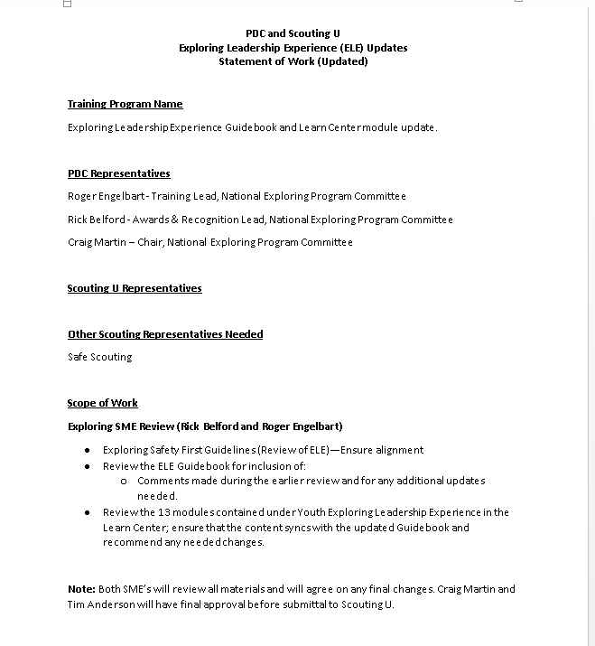
Exploring Leadership Experience Guidebook Update SOW

Slide 37
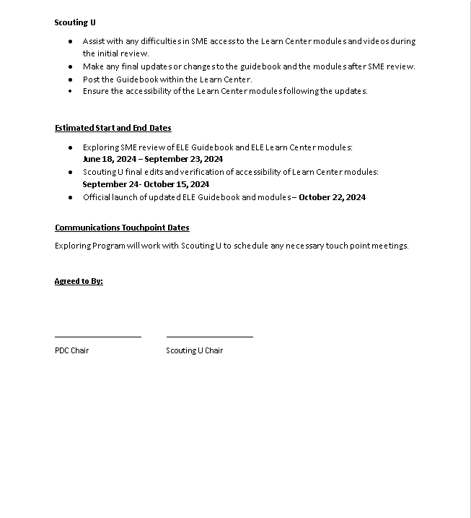
Exploring Leadership Experience Guidebook Update SOW

Slide 38
Proposed Exploring Career Committee Responsibilities
National Exploring Program needs to reconstitute each of the twelve National Exploring Career Committees with committee chair and committees member who will …
Be responsible for the material related to their career field within the Exploring Home Page’s Activity Library
Periodically (at least annually) review their career field materials to insure that it is up-to-date and inform the National Director of Exploring and National Exploring Program Chair the results of their review
Update (as required) their out-of-date career field materials and alert the National Director of Exploring and National Exploring Program Chair when update has been accomplish and on the Exploring Homepage
Add new career material, as appropriate, to assist club sponsors & post advisors in delivering career unique experiences & activities for their explorers, and alert the National Director of Exploring and National Exploring Program Chair when this new material has been inserted into their career field area on the Exploring Homepage
Meet quarterly with the National Exploring Program Committee to inform them of their career committee's current activities and future plans
  Work to increase the total number of Explorers participating in the career field and establish or increase the funding for Exploring scholarships within the career field

Slide 39
Proposed Exploring Career Committee Responsibilities continued
National Exploring Program needs to reconstitute each of the twelve National Exploring Career Committees with committee chair and committees member who will …
Gather and provide useful data specific to the career field for targeted geographic areas. This data would be designed to help councils identify and establish potential membership growth campaigns. It will also encourage the offering of the Exploring program in job markets that have predicted future shortfalls for employees within a particular career
Become an active promoter of Exploring within your area of influence, while also helping to promote national campaigns and events, such as Exploring Explosion (www.exploringexplosion.org). These efforts should result in growth in number of registered Explorers within the career field
If possible, secure financial resources from industry groups & national career associations to market and support the career field specialties
Generate real proactive promotion from industry & national career associations players to support the formation new Exploring clubs & posts
As appropriate, support national and/or territorial events in their career specialties

Slide 40
National Exploring Priorities mapped to BSA Roadmap
Make Our Programs Highly Relevant to Today’s Youth
(continued)
For our #6 2024 -2025 Priority (NEOA-National Exploring Officer’s Association), create a youth and volunteer organizational chart approved by the LFL Board to ensure that Exploring recruits National Youth Officer representation similar to other Older Youth Programs.
Broaden Our Appeal and Revitalize Our Brand
For our #5 2024 Priority (National Exploring Commissioner) ,the National Exploring Commissioner will serve as the Exploring Chair on the National Commissioner Service Team and will be working through them to promote the value of the Exploring Program. In addition, the Exploring Commissioner will promote the need for active unit service to our existing Exploring units and provide at least quarterly updates on Exploring to CST Commissioners for further distribution to Councils.
  When Exploring Journey to Excellence sunsets on 31 December 2024, National Exploring Commissioner Dick Davies proposed “Quality Guidelines for Sustainable Effective Explorer Posts” to replace it (see slides 45 & 46)

Slide 41
Proposed Exploring Post Metrics from National Exploring Program Commissioner Dick Davies
Quality Guidelines Leading to Sustainable Effective Explorer Posts
Experienced Exploring volunteers examined characteristics of Posts which maintain successful programs over a period of years while attracting and retaining youth for meaningful multi-year experiences. The following are the first three of five metrics:
Trained Adult Leaders – Training would be desirable for all adult leaders but at a minimum, the Post Advisor and Committee Chair should complete online training on the basics of running an Explorer Post, including critical youth protection policies. It’s easy to appreciate why adult leadership would benefit from an introductory orientation to Exploring.
Minimum Membership of 7 – Posts which start with or can’t sustain membership of at least 7 are unlikely to survive to the next year and may lack the critical mass to run exciting, captivating programs. Several Post members are likely to drift away for various reasons during the year and may not show up for additional years in their Post.
Growing Membership (or at Least Maintain 15 Members) – Growing youth membership is a sign of a healthy Post especially for Posts below 15 in size. At that point, sponsor program resources may be maxed out. Importantly the Post has likely reached the scale to survive natural attrition.

Slide 42
Proposed Exploring Post Metrics from National Exploring Program Commissioner Dick Davies continued
Quality Guidelines Leading to Sustainable Effective Explorer Posts
Experienced Exploring volunteers examined characteristics of Posts which maintain successful programs over a period of years while attracting and retaining youth for meaningful multi-year experiences. The following are the last two of five metrics:
Trained Youth Leaders – Exploring is a hands-on youth led program with the mentorship and program support of adult advisors. Leadership development is an important element of emphasis of the program. The election of youth officers (or their appointment in the case of some public safety agencies) is an important method of Exploring. It motivates youth to stay involved for multiple years as they move up in the Post and learn important life skills leading teams.
Annual Superactivity – A Superactivity is the program highlight in a Post’s annual activity calendar. It involves special planning and coordination and may involve travel and possibly overnight stays. Examples include a special tour of a major career-oriented site or participation in another Council’s Exploring event or competition. A special event of this type makes it more likely the Explorer will return to the Post in the new school year. A Superactivity is important in improving youth retention.
NATIONAL EXPLORING COMMITTEE HAS ENDORSED THESE METRIC AS WRITTEN

Slide 43
National Exploring Priorities mapped to BSA Roadmap
Strengthen Our Financial Position
For our #2 2024 Priority (Membership and Unit Growth), the National Exploring Committee will work through and with local councils to provide training, resources, and inspiration to help ensure that both volunteers and professionals continue to grow Exploring membership. This will be accomplished through National Exploring Live Hours, Zoom Trainings and other venues to help teach the four phases of Post/Club organization

Slide 44
Topic(s) of the Month
              ONLINE REGISTRATION/RENEWAL
      Michael Creagh
      Manager Applications • Information Technology

Slide 45

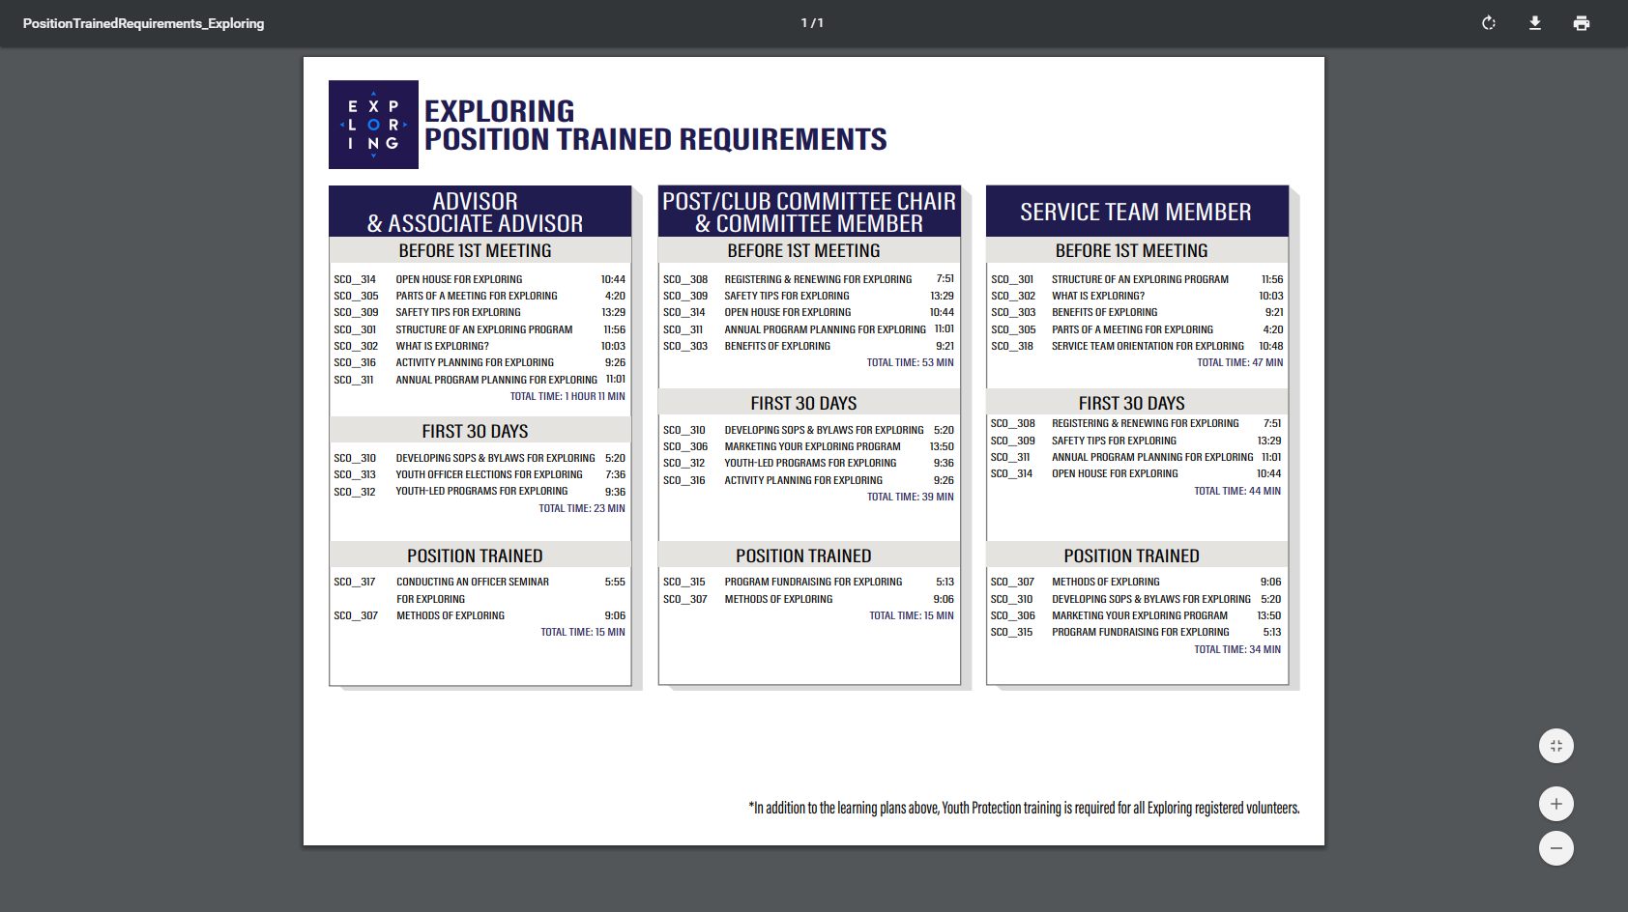
ONLINE
REGISTRATION
FOR EXPLORING

Slide 46
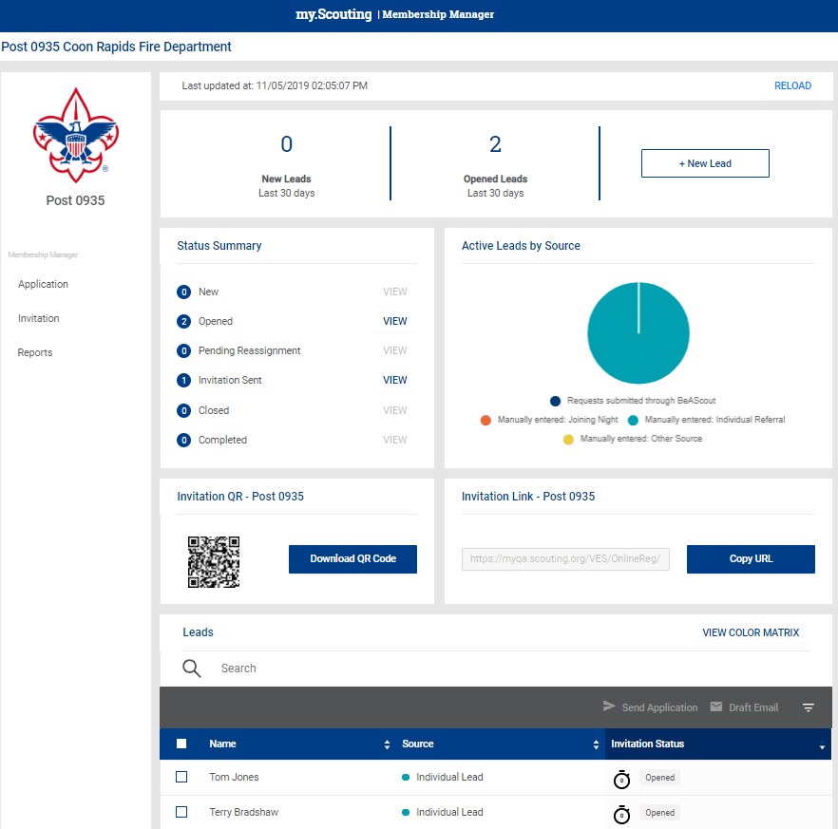
Invitation Manager

Slide 47
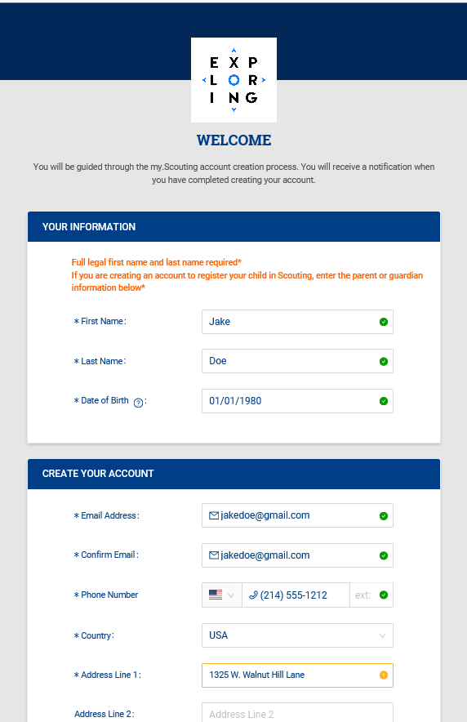
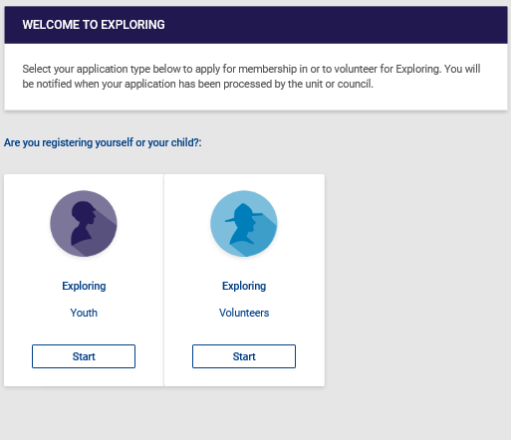
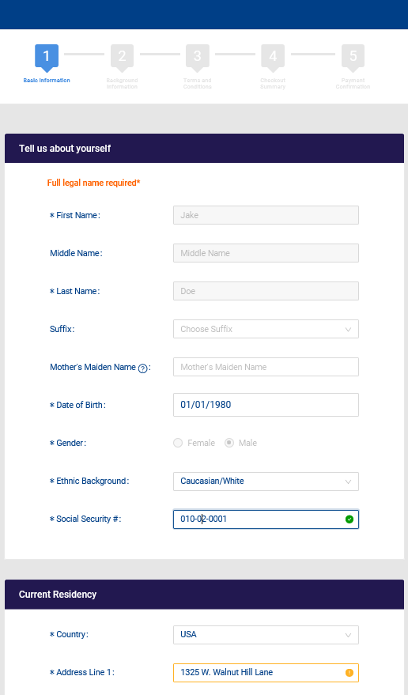
Create Account & Complete Application

Slide 48
Membership and Unit
Online Renewal
FOR EXPLORING

Slide 49
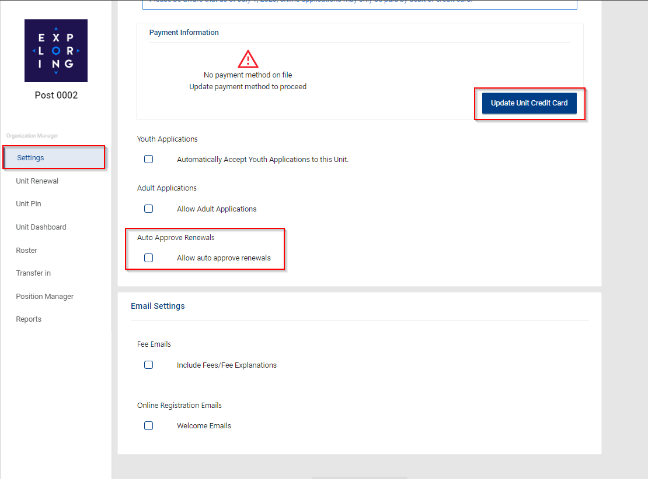
Organization Manager

Slide 50
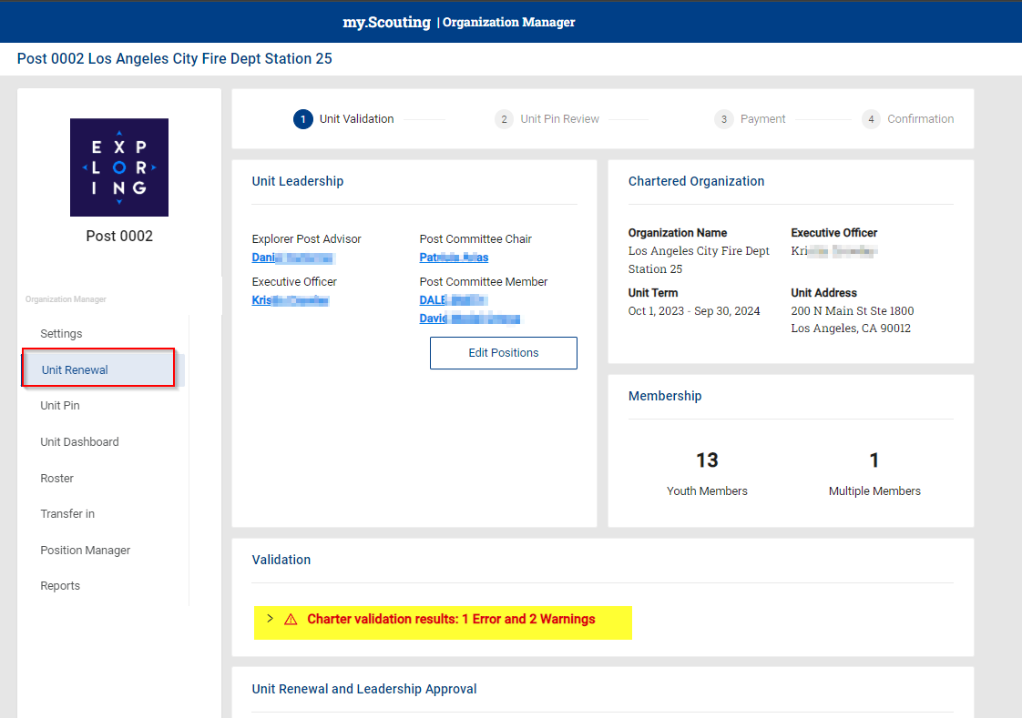
Unit Renewal - Post View

Slide 51
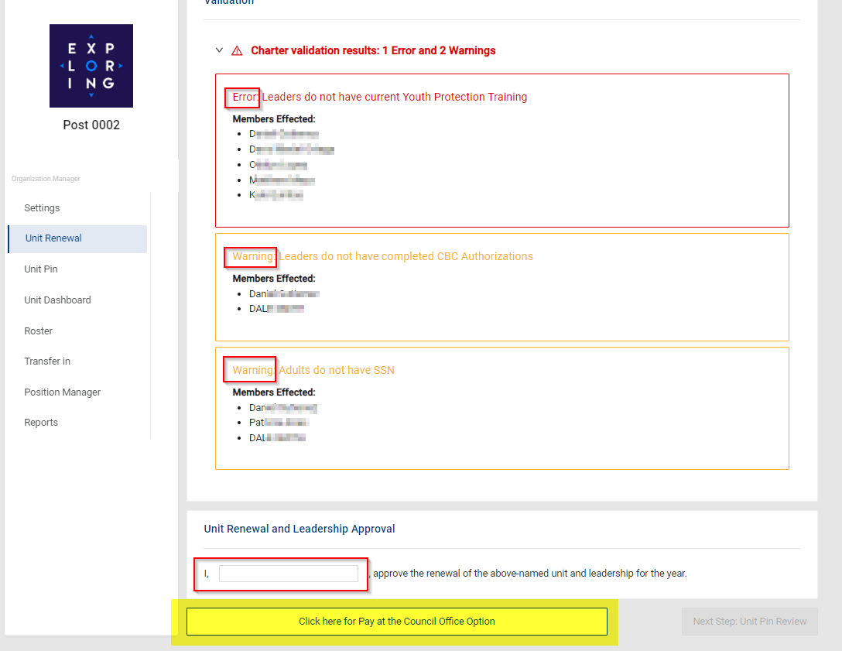
Unit Renewal - Post View

Slide 52
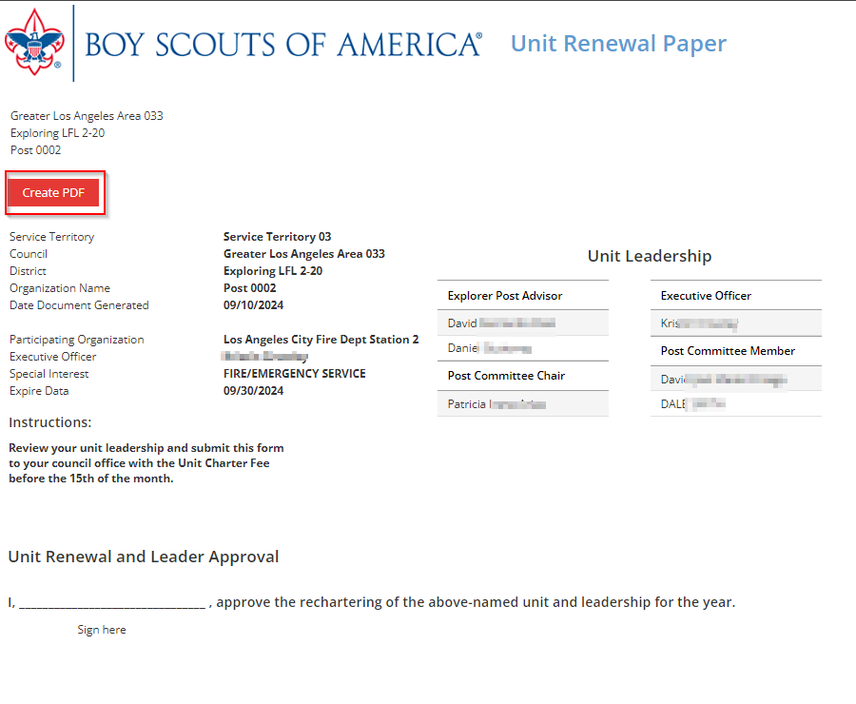
Unit Renewal - Post View

Slide 53
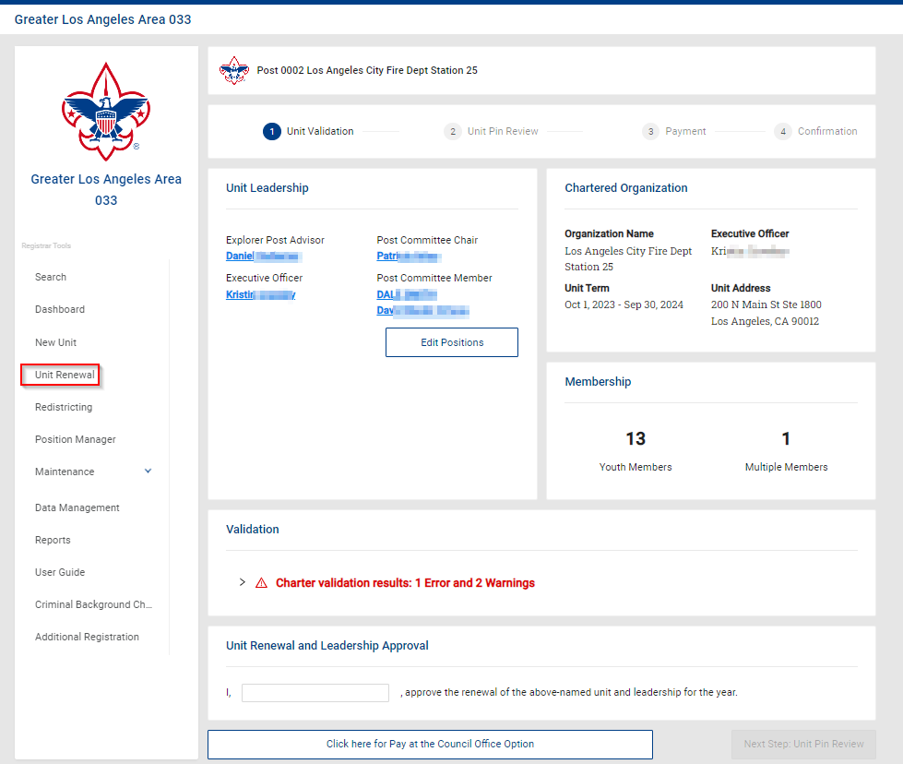
Unit Renewal - Council View

Slide 54
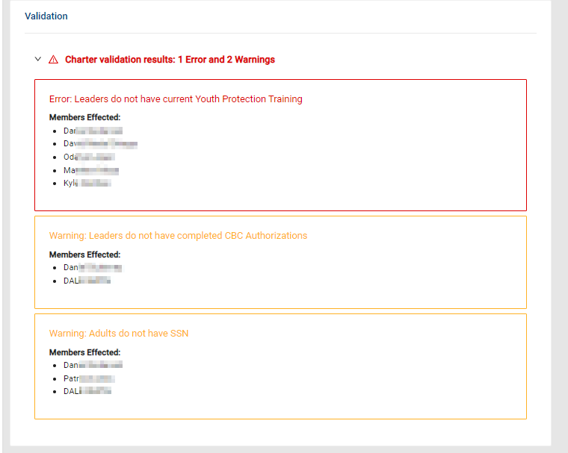
Unit Renewal - Council View

Slide 55
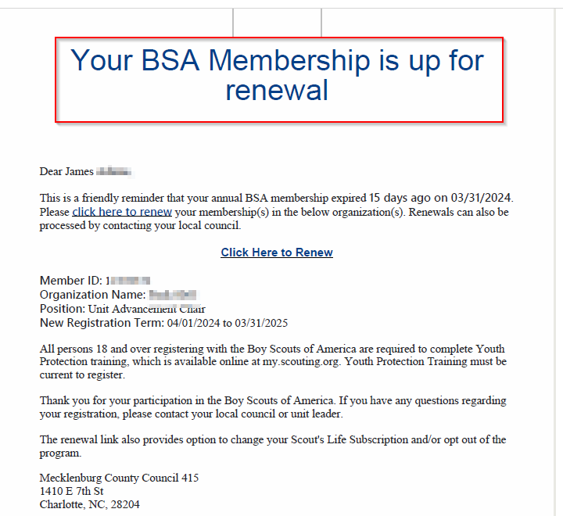
Member Renewal – Member/Parent

Slide 56
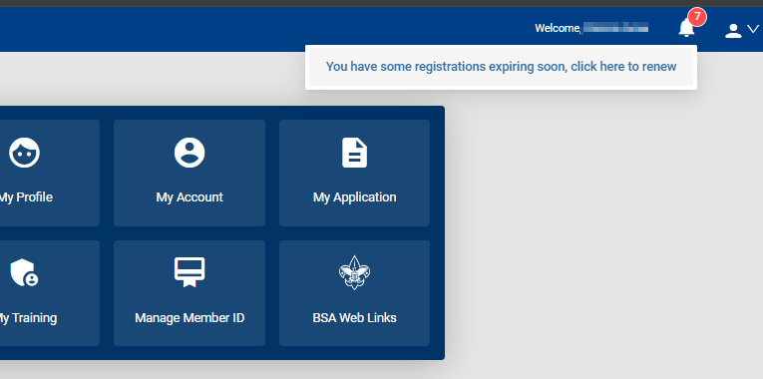
Member Renewal – Member/Parent

Slide 57
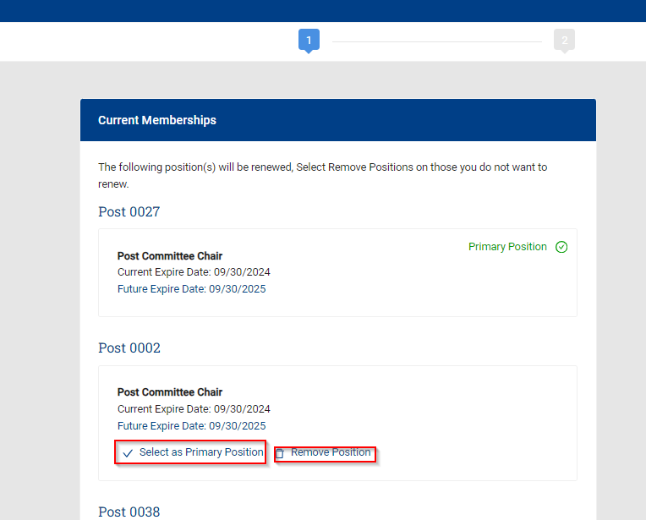
Member Renewal – Member/Parent

Slide 58
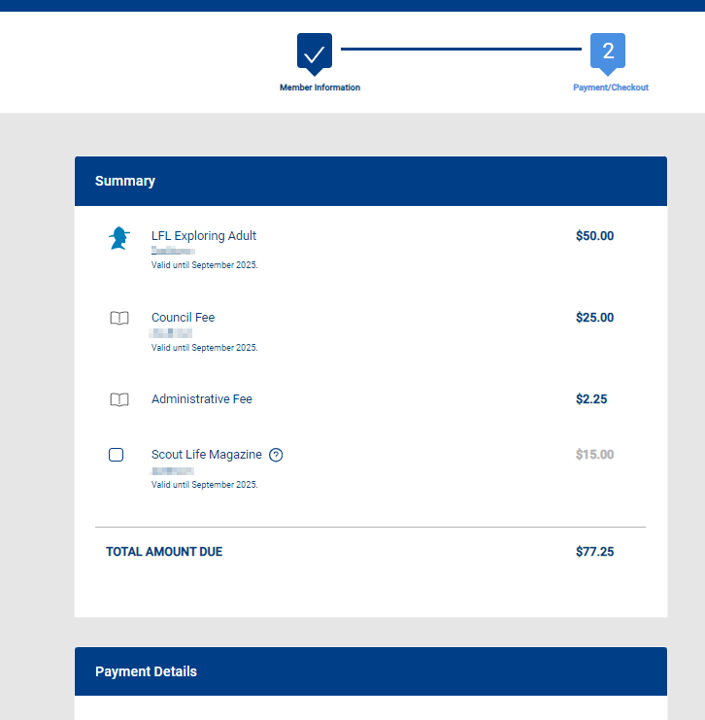
Member Renewal – Member/Parent

Slide 59
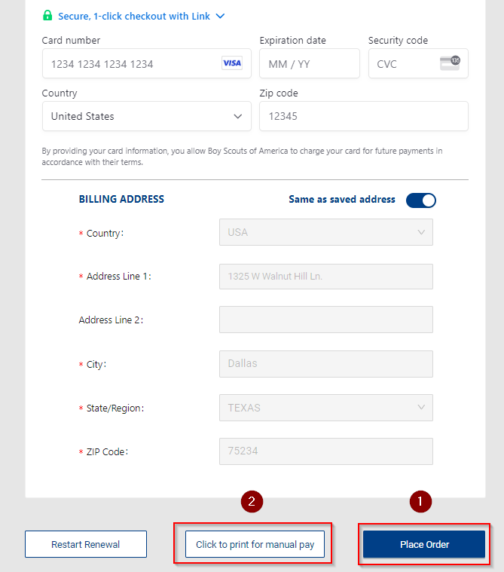
Member Renewal – Member/Parent

Slide 60
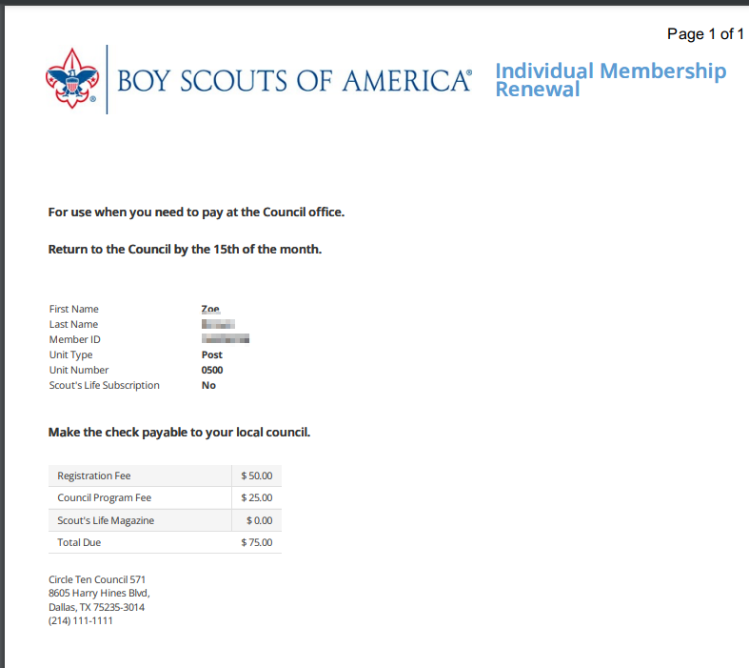
Member Renewal – Member/Parent

Slide 61
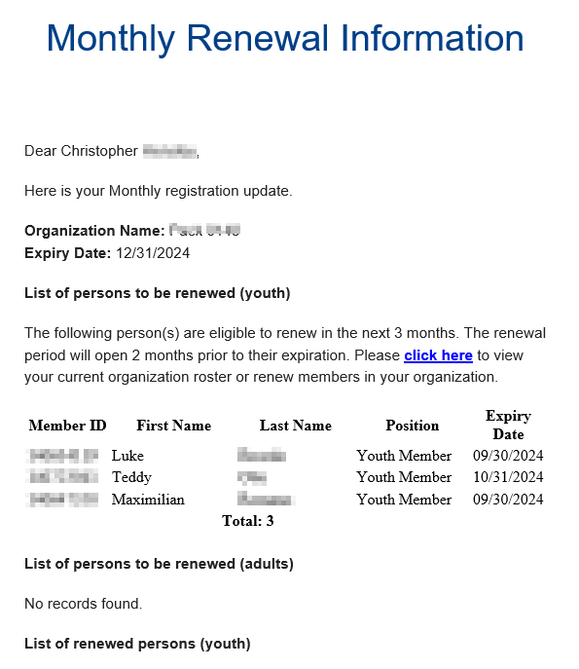
Member Renewal – Unit Pay

Slide 62
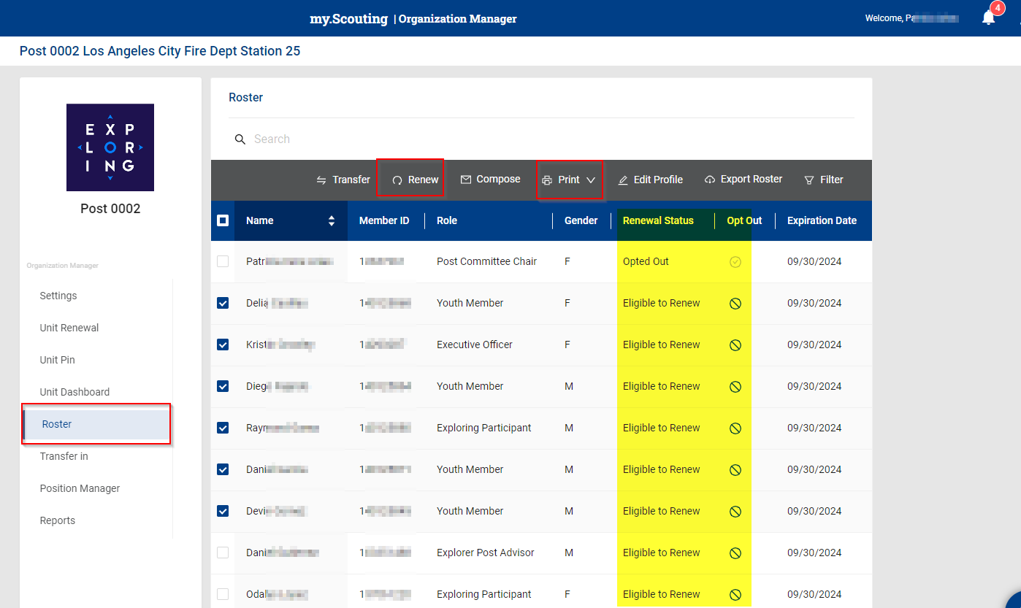
Member Renewal – Unit Pay

Slide 63
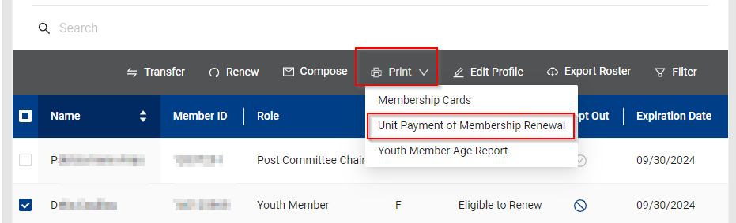
Member Renewal – Unit Pay

Slide 64
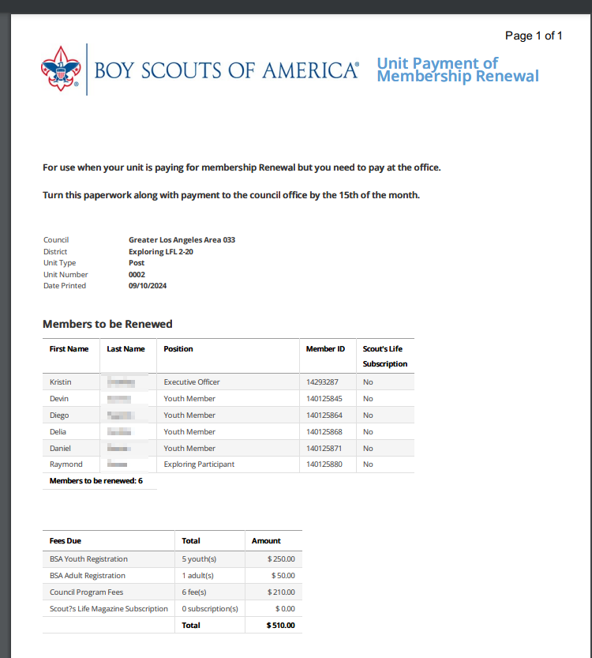
Member Renewal – Unit Pay

Slide 65
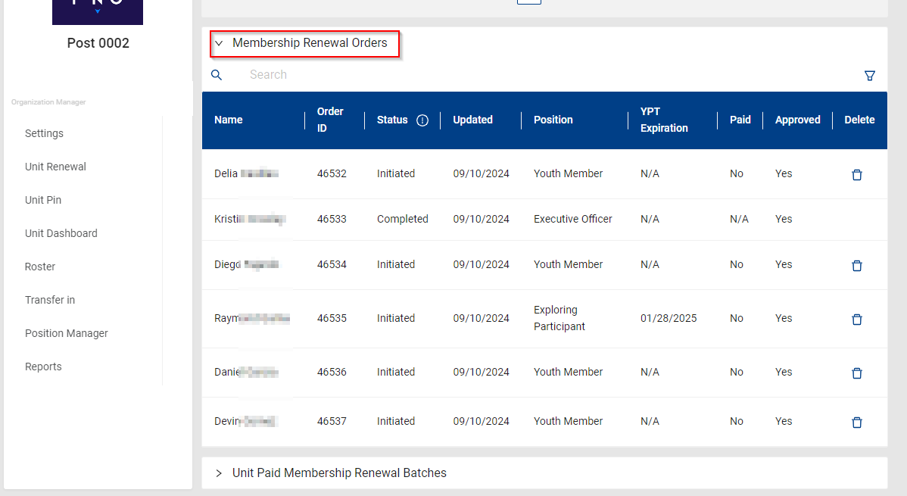
Member Renewal – Unit Pay

Slide 66
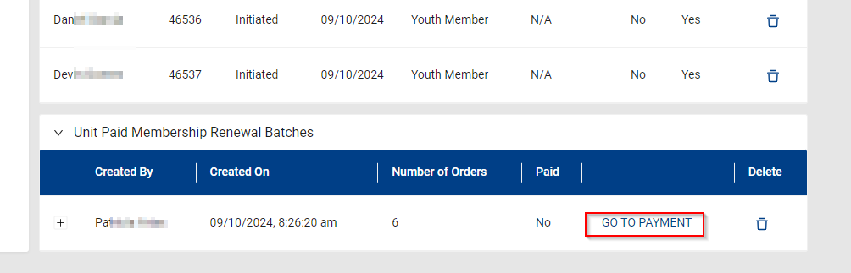
Member Renewal – Unit Pay

Slide 67
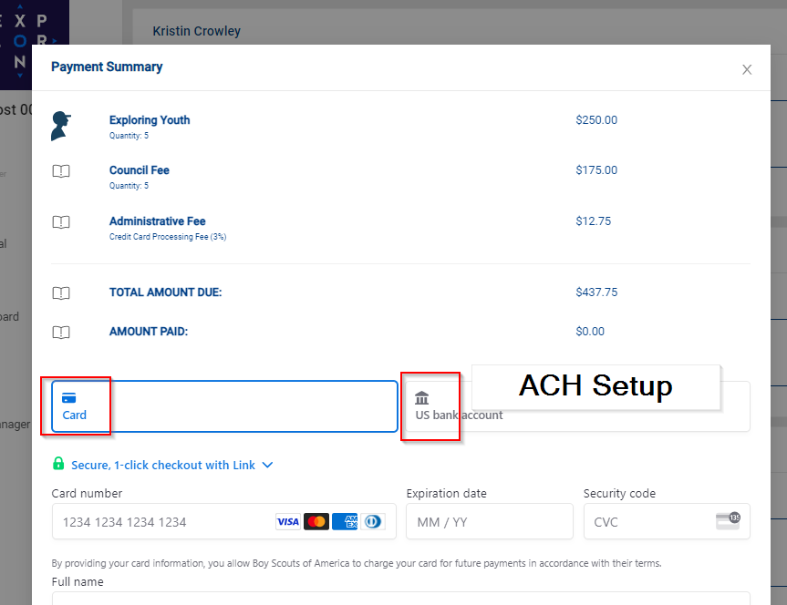
Member Renewal – Unit Pay

Slide 68
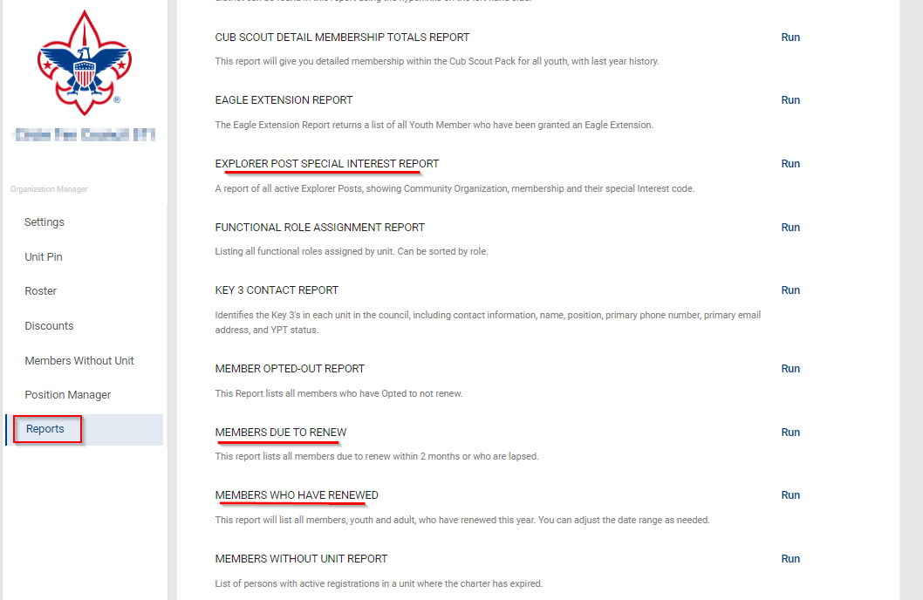
Renewal Membership – Reports

Slide 69
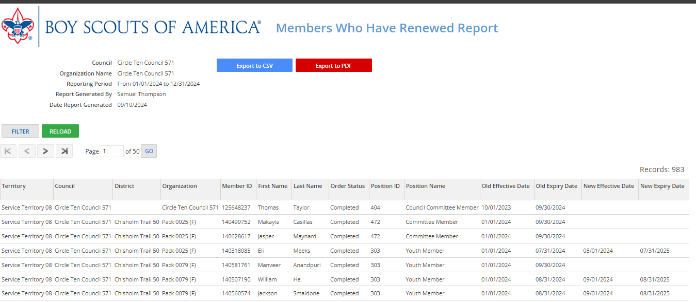
Renewal Membership – Members Who have Renewed

Slide 70
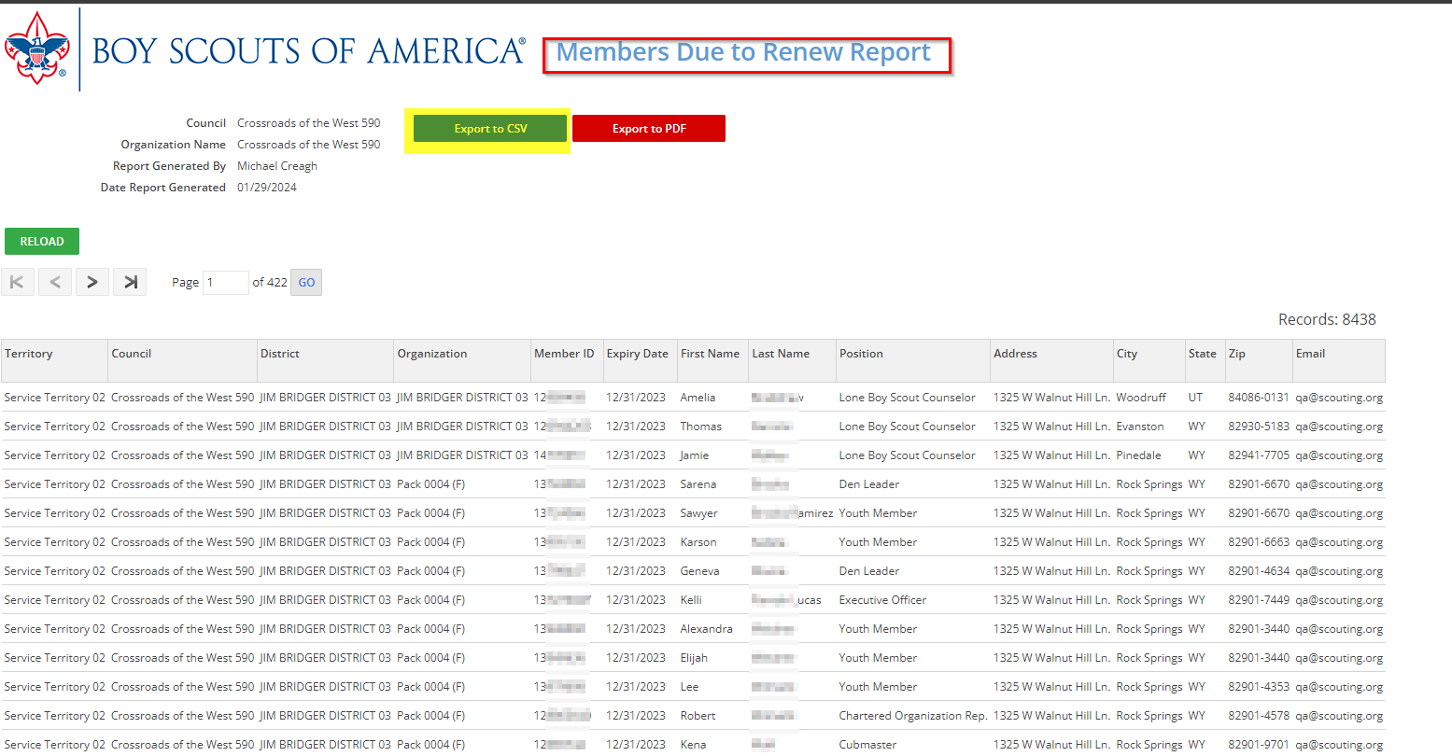
Renewal Membership – Members Due to Renew Report

Slide 71
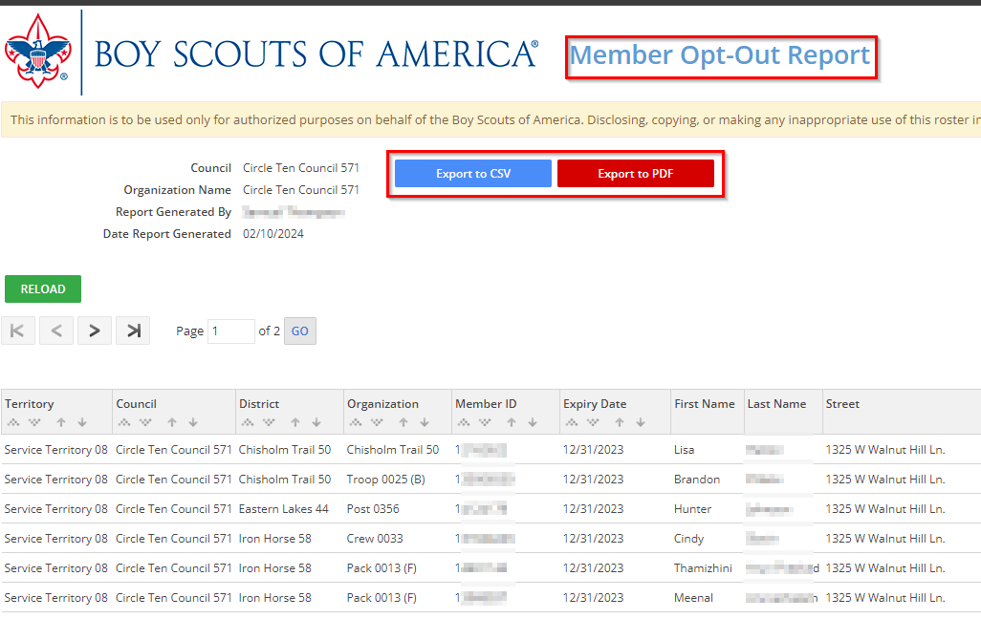
Auto Renewal Membership – Members Opt-Out Report

Slide 72
Auto Renewal Membership – Members Opt-Out Report

Slide 73
https://www.scouting.org/resources/unit-and-membership-renewal
Information included is:
Training Video
FAQ’s
User Guides
Internet Recharter Guidelines
Summary of Enhancements
Recharter Demo Tool
Help and FAQ’s
Manager of Shared Services
Member Data Outsourcing Solutions

Slide 74
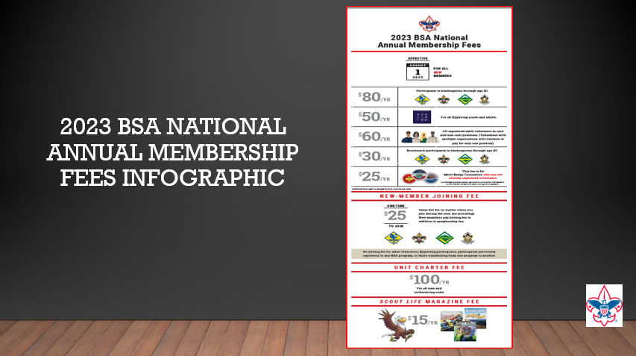

Slide 75
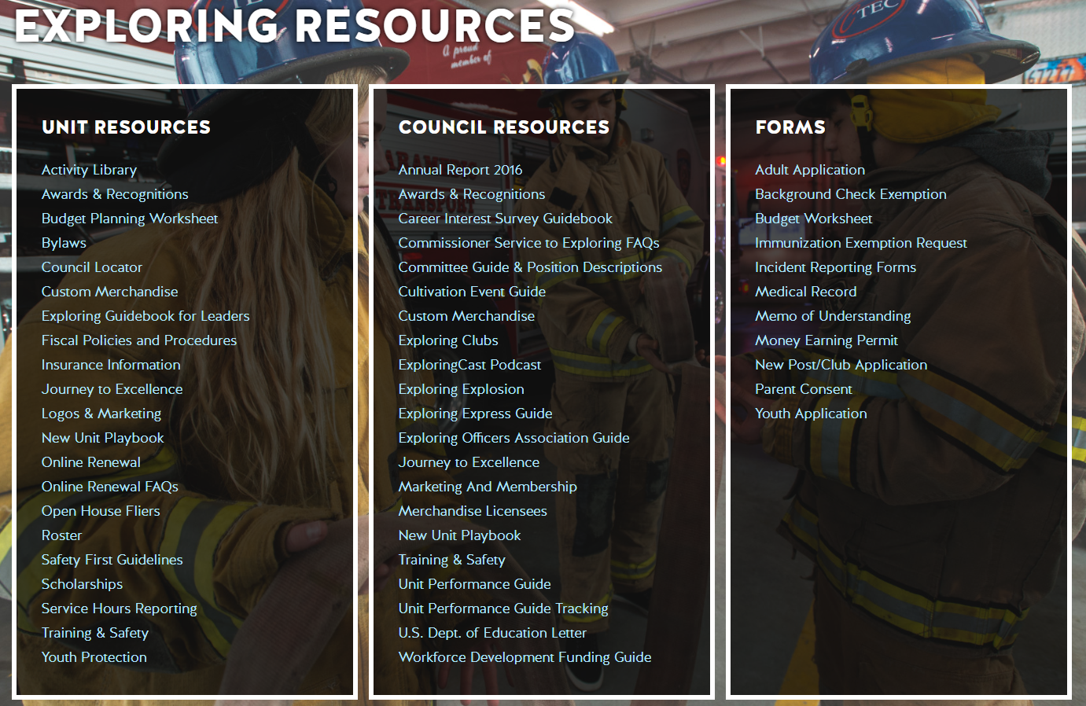
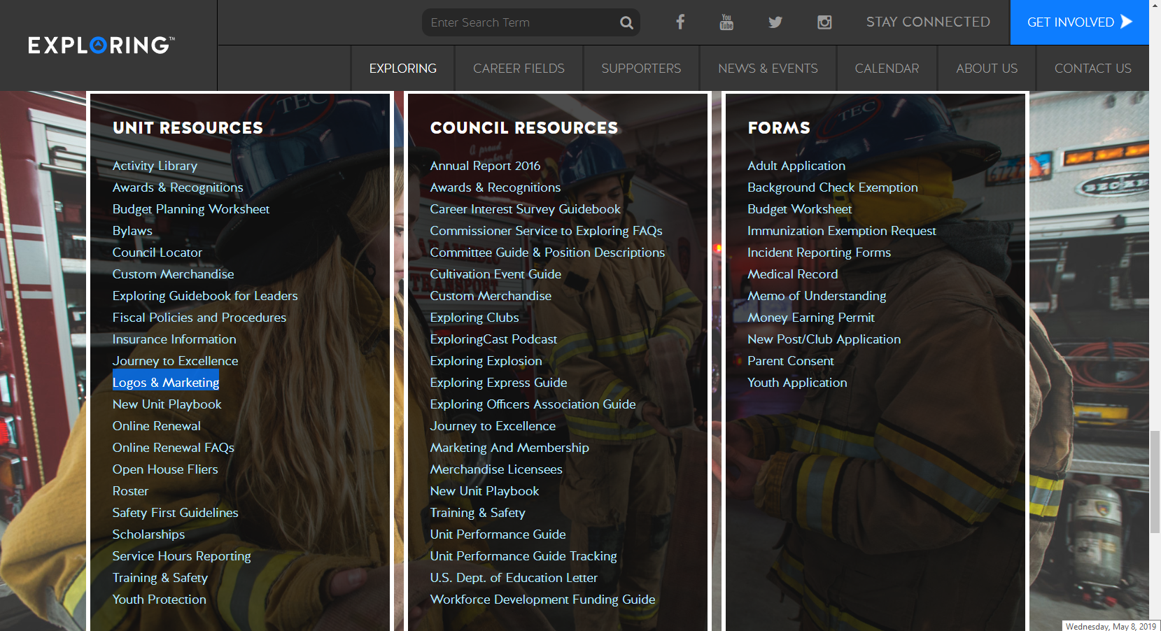

Slide 76

Exploring Youth Training Update
https://www.scouting.org/training/youth-protection/venturing/

Slide 77


Slide 78
Leads are being generated from Exploring.org and include anyone interested in joining, leading, sponsoring, or
otherwise supporting Exploring in their area.
Scout Executives, Assistant Scout Executives and DFS’s receive weekly lead reports.
Exploring Executives and staff advisors receive immediate notifications of each lead generated.
To make changes to any of these settings, email your request to exploring@lflmail.org.
WHEN YOU RECEIVE AN IMMEDIATE NOTIFICATION EMAIL:
1. In the email, you will see a note to “copy & paste the following URL into your browser to mark lead as contacted”.
By following this directive, you are changing the status of your lead to “contacted”. You will no longer receive email notifications for that particular lead. The lead will begin to show as “contacted” on your SE’s weekly report.
Invite the person to attend an existing post/club meeting to get a feel for the program and connect them to
appropriate Exploring advisors.

Slide 79
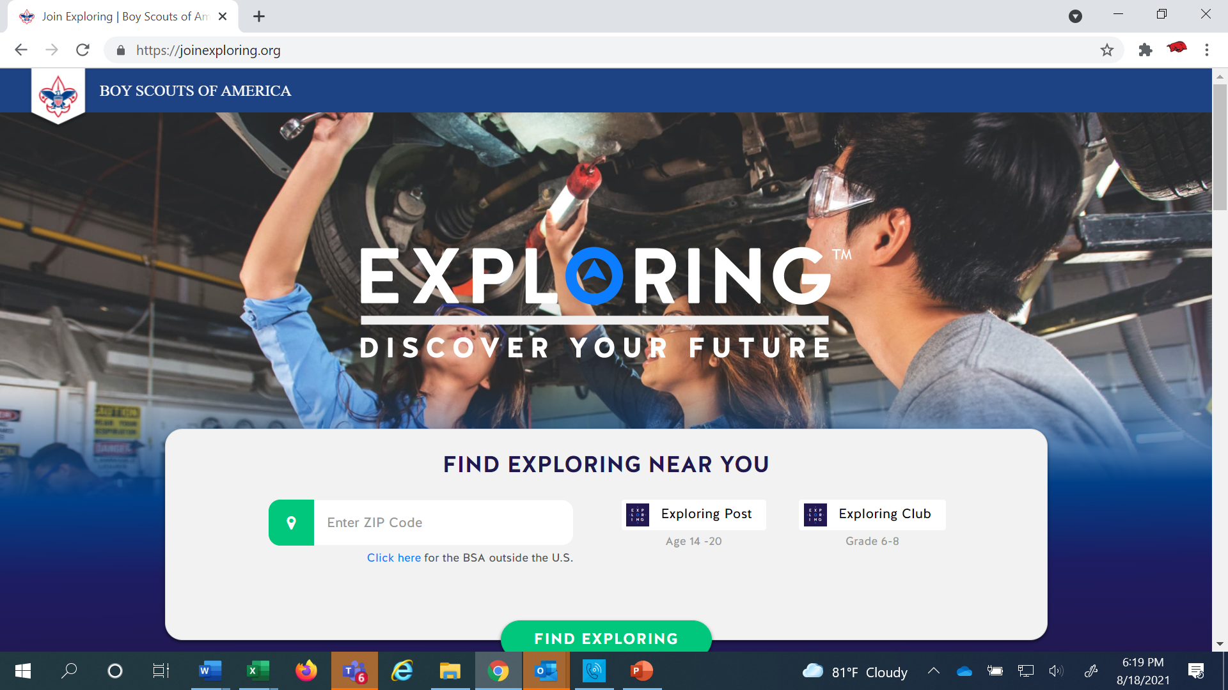
www.joinexploring.org

Slide 80
Barriers to Abuse Update
As part of our ongoing commitment to abuse prevention, the Boy Scouts of America, to include Exploring, is updating the adult supervision requirements for overnight activities
This update enhances the minimum “two deep leadership” requirements by additionally requiring every adult present on overnight activities to be a registered member of the Boy Scouts of America or Exploring
These adults must submit an adult application and registration fee, undergo a criminal background check, a volunteer screening database check and must complete mandatory Youth Protection training.
A limited exception for parents and legal guardians of Cub Scout youth attending overnight with their children is planned due to the family centric nature of Cub Scouting
All Cub Scout Packs, Scouts BSA Troops, Venturing Crews, Sea Scouting Ships, Exploring Posts, council, and district overnight programs will be required to comply with this update by September 1, 2023. We encourage early adoption prior to the effective date
This updated Barrier to Abuse will be referenced as part of the Guide to Safe Scouting, Exploring’s Safety First Guidelines, Youth Protection and Adult Leadership section, Scouting’s Barriers to Abuse. Youth Protection and Barriers to Abuse FAQ’s will be expanded to include additional FAQ’s as they are developed

Slide 81

National Exploring
Volunteer of the Month
The National Volunteer of the Month will be recognized on www.exploring.org
and will receive a certificate and polo shirt from the National Exploring Team!
Nominees should be submitted using the link below
http://bit.ly/ExpVolMonth

Slide 82
2019 National Exploring Volunteer(s) of the Month
April / Mickey Boylan / Old North State Council, Greensboro, NC
May / Daniel Sherwin / Longhorn Council, Ft. Worth, TX
June / Chief James Pushee / Daniel Webster Council, Manchester, NH
July / Scott Hart / Circle Ten Council, Dallas, TX
August / Dick Davies / Greater New York Council, New York, NY
September / Sgt. Jose Diaz / Connecticut Rivers Council, East Hartford, CT
October/ Asst. Chief Martin Birkenfeld / Golden Spread Council, Amarillo, TX
November/ Craig Martin/Pikes Peak Council/Colorado Springs, CO

Slide 83
2020 National Exploring Volunteer(s) of the Month
April / Paul Vanderplow / ATF
May / Chief Ron Pray / Golden Spread Council
June / Dawn Gowen / Costal Georgia Council
July /Fred Markham/ Caddo Area Council
August /Dan Walters/ Golden Gate Area Council
September/George Denise/ Silicon Valley Monterey Bay Council
October/Amanda Clay/ Atlanta Area Council
November/LT. Darla Gray / Greater St. Louis Area Council
December/Sgt Erin Lunsford/Silicon Valley Monterey Bay Council

Slide 84
2021 National Exploring Volunteer(s) of the Month
June / Mike Goldstein / Northern Star Council
July / John Barrett / Circle Ten Council
August / Anthony Jackson / Michigan Crossroads Council
September/ Captain Ryan Ira / Silicon Valley Monterey Bay Council
October/ Eirinn Rickard / Greenwich Council
November/ Mark Wiesenhahn/ National LFL/Exploring Board Chair

Slide 85
2022 National Exploring Volunteer(s) of the Month
May / Wiley “Skeet” Gibble / Cherokee Area Council
June / DuWayne “Duwey” Dixon / Northern Star Council
July / Ronda Williams / Great Trail Council
August / Jeff Schweiger / National Capital Area Council
October / Daric Parent / Circle Ten Council
November/ Sergeant Leonardo Gonzalez /Silicon Valley Monterrey Bay Council
December/ Heather MacInnes/ Western Massachusetts Council

Slide 86
2023 National Exploring Volunteer(s) of the Month
May / Stuart Mahler / Golden Gate Area Council
June / Richard “Rick” Belford Jr. / Western Massachusetts Council
November/ Roger Engelbart/Greater St Louis Area Council

Slide 87
2024 National Exploring Volunteer(s) of the Month
September / / Council

Slide 88
National Exploring Volunteer of the Month
September 2024
Kenneth A. White
Western Massachusetts Council #234

Slide 89
Example Nomination Write-Up
George Denise completed his Exploring Fast Start training on 1/01/2011 and his most recent position is Service Team Chair for my district since February 2018. He has been involved with every aspect from FOS and volunteer recruitment to membership, product sales, program and unit service. George helped Exploring District achieved significant growth in our FOS campaign and 5% membership growth last year. We are at 61% of our FOS goal for the year, second highest percentage in our council. As we shelter-in-place, he secured a dynamic guest speaker for our Science Night and saved us $650 in shipping cost in our Make A Mask Challenge. His efforts made it possible for us to donate thousands of pieces of protective medical gear to 7 medical facilities in 2 counties. He supported a 15 year old Scout in the Medical Explorer program whom has wanted to make a difference. What started as a local mask-making challenge turned into a multi-city effort through connections of Scouting friends in Dallas, TX and Orange County, CA to Santa Clara county .

Slide 90
National Exploring
Volunteer of the Month
The National Volunteer of the Month will be recognized on www.exploring.org
and will receive a certificate and polo shirt from the National Exploring Team!
Nominees should be submitted using the link below
http://bit.ly/ExpVolMonth

Slide 91
Example Nomination Write-Up
George Denise completed his Exploring Fast Start training on 1/01/2011 and his most recent position is Service Team Chair for my district since February 2018. He has been involved with every aspect from FOS and volunteer recruitment to membership, product sales, program and unit service. George helped Exploring District achieved significant growth in our FOS campaign and 5% membership growth last year. We are at 61% of our FOS goal for the year, second highest percentage in our council. As we shelter-in-place, he secured a dynamic guest speaker for our Science Night and saved us $650 in shipping cost in our Make A Mask Challenge. His efforts made it possible for us to donate thousands of pieces of protective medical gear to 7 medical facilities in 2 counties. He supported a 15 year old Scout in the Medical Explorer program whom has wanted to make a difference. What started as a local mask-making challenge turned into a multi-city effort through connections of Scouting friends in Dallas, TX and Orange County, CA to Santa Clara county .

Slide 92



STAY CONNECTED
page | @lflexploring
group | Exploring Success!
group | National Explorer Alumni Association
learningforlifeusa
exploring.org | Stay Connected
exploring@lflmail.org

Slide 93
Questions?

Slide 94

2024 NATIONAL EXPLORING LIVE HOURS
The National Exploring Live Hour is a monthly Zoom video conference that will help engage and equip
Exploring volunteers and professionals to grow, support, and learn more about Exploring. Each month the National Exploring Live Hour will be led by our National Exploring Chair and the National Director of Exploring. The live hours will include sharing best practices and ideas that are happening within our councils, highlighting successful growth campaigns, and inspiring new ideas through various trainings. This will also offer an opportunity for local councils to collaborate with territory and national counterparts to generate innovative solutions to real-life Exploring challenges.
National Exploring Live Hour Schedule
1:00 PM – 2:00 PM Central Standard Time, Monthly
Register for each of the National Exploring Live Hour ZOOM presentations at:
https://reservations.scouting.org/profile/form/index.cfm?PKformID=0x144800abcd

Slide 95
Exploring at Home (Discuss Best Practices)
Idea Sharing
Questions and Answers from the Field https://drive.google.com/file/d/1Bo7U0iJ8Ti-bmyIFtxGfG0TIt3dB1xX4/view?usp=sharing
After the Live Hour Discussions
(Open Dialogue)

Slide 96


Good News from the Field!

Slide 97
v
END OF SEPTEMBER
EXPLORING LIVE HOUR
PRESENTATION SLIDES
All Other Slides Below are Informational

Slide 98
v
EXPLORING UPDATES
REMINDERS
Tim Anderson
National Director
Learning for Life & Exploring
National Director Older Youth Programs

Slide 99
EXPLORING PARTICIPANT POLICY
“EP” (18 THROUGH 20 YR OLD EXPLORERS)
Effective August 1, 2020, all applicants 18 through 20 years old must complete and submit an adult application, consent to a criminal background check, and successfully complete Youth Protection training.
However, an 18- through 20-year-old will still be considered an Adult Exploring Participant in the post and will not be considered an adult leader. Therefore, an “EP” will not be allowed to fulfill adult leadership roles pertaining to Two-Adult Leadership and other requirements that require leadership to be at least 21 years of age.
All Exploring Participants “EP” will continue to count as youth within your youth membership reports.
Visit the link below for an infographic as well as a Q & A to assist you in implementing this important new policy. http://filestore.scouting.org/filestore/se-packet/2020-08-10/Exploring-Participant-Policy-FINAL-2.pdf

Slide 100
EXPLORING REGISTRATION FEES
Effective August 1, 2023, Exploring fee updates:
- Exploring Youth $50.00
- Exploring Adult Participants (18-20) $50.00
- Exploring Adults $50.00
- Exploring Post/Club Annual Renewal Fee $100.00
- There is no additional “Joining Fee” for Exploring
The updated membership fees will take effect August 1, 2023, for new members in the 2023-2024 program year.
The national membership fee helps cover the cost of essential services, including program resources, liability insurance for those participating in approved Scouting activities, criminal background checks, youth protection, and the development of intellectual property for national, council, and unit programs. As we move forward, we will continue to look at the membership fee structure and how we deliver the Scouting program for future generations.

Slide 101
NEWLY UPDATED EXPLORING APPLICATIONS
The newly updated Exploring applications are available now for download online at www.exploring.org
New Post/Club Application (SKU# 655197)
Youth Application (SKU# 634698)
Adult Application (SKU# 634699)
-Includes the new 18-20 Exploring Participant (EP) Code, which will became mandatory beginning August 1st, 2020.
*New applications are available at the National Distribution Center .

Slide 102

Newest Technology for Exploring
BeAnExplorer “Equivalent”
“joinexploring.org”
“joinexploring.com”
Scoutbook for Exploring
Online Registration
Online Renewal

Slide 103

*Exploring Leadership Experience
*Coming soon for Exploring youth
Resume Builder that will help recognize Explorers
This online, mentor assisted, self-paced and guided experience will allow our Explorers to…
Have an opportunity to discover their inner leadership potential
Gain practical leadership experience – participate in a capstone project
Work with a mentor to gain professional leadership experience
Be recognized with a Nationally Certified Leadership Experience Certificate that will help improve their resume and recognize their overall Exploring Experience.

Slide 104
Exploring in comparison to Traditional Scouting
 | SCOUTS BSA | VENTURING | SEA SCOUTS | EXPLORING
UNIT | Troop | Crew | Ship | Club/Post
LEADER | Scoutmaster | Advisor | Skipper | Sponsor/Advisor
YOUTH LEADER | Senior Patrol Leader | President | Boatswain | President or Agency Nomenclature
YOUTH PARTICIPANT | Scout | Venturer | Sea Scout | Participant or Explorer
RE-REGISTRATION | Charter Renewal | Charter Renewal | Charter Renewal | MOU Renewal
SPONSOR | Chartered Org | Chartered Org | Charter Org | Participating Org
SPONSORING AGREEMENT | Charter | Charter | Charter | Memorandum of Understanding (MOU)
UNIT SERVICE | Commissioner | Commissioner | Commissioner | Service Team
YOUTH RUN | Yes | Yes | Yes | Yes
AGE SPAN | 11-18 | 13-20 | 13 - 20 | 11-13/14-20
RELIGIOUS DECLARATION | Duty to God | Duty to God | Duty to God | None
UNIFORM | Scouts BSA | Venturing (Unit Selected) | Sea Scouts (Unit Selected) | Club/Post Selected, not required

Slide 105
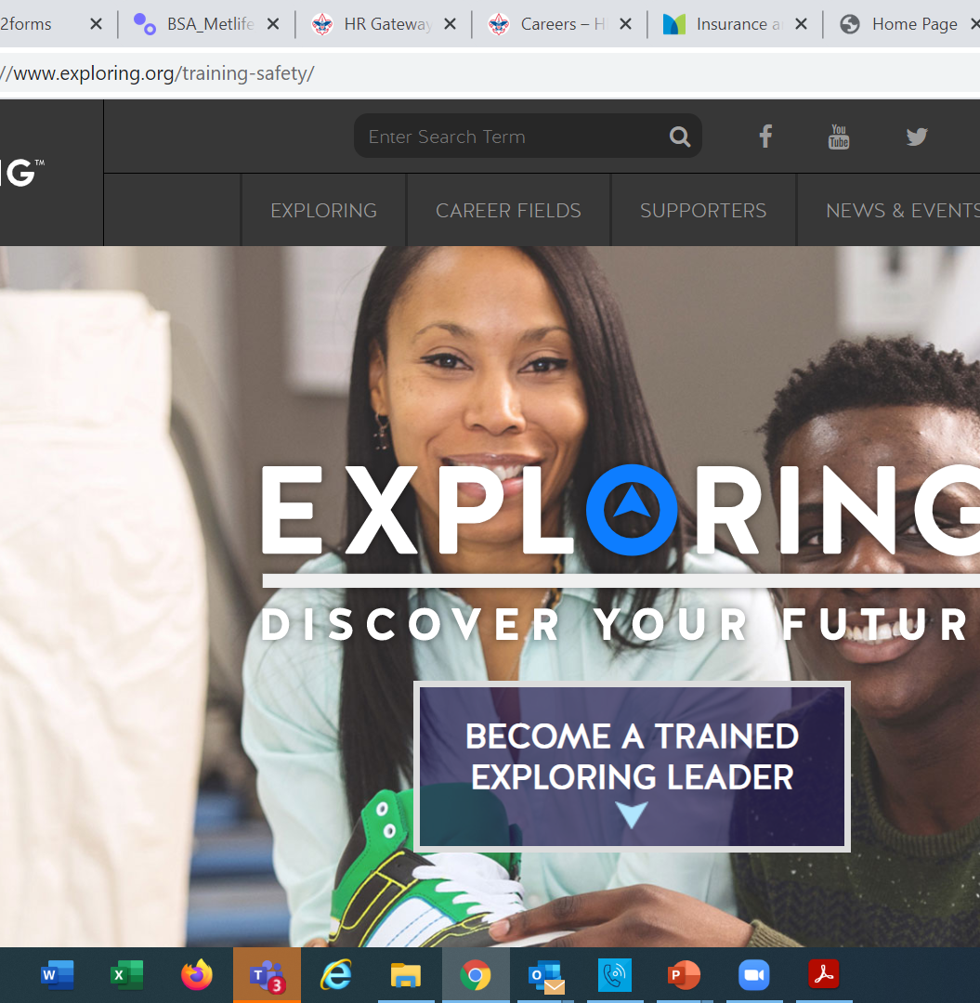
  Exploring Training

Slide 106
Exploring Position-Specific Training Modules
Update Status

Slide 107
Exploring Position-Specific Training Modules Update Status …
The Exploring Leader Training Modules have also been formatted to be experienced through the learning center via computer or smart device.
Login in to https://my.scouting.org/ . If you need to create an account and do not know your member ID number, please contact your local BSA council office/service center
Once you log in, locate the blue box on the right side of your screen labeled “Click here to access Exploring Training”
After logging in, you may also click “Menu” in the top left corner and select “My Training”. Under Training Courses by Program, select “Exploring Adult Training”
You may select between the three available Exploring learning plans (based on position). Anyone is welcome to complete the trainings
NOTE: In addition, the “Servicing Exploring Units Module for Commissioners” has been updated within the Learn Center.
We would like to sincerely thank the many Exploring professionals and volunteers that helped make this important update happen!

Slide 108
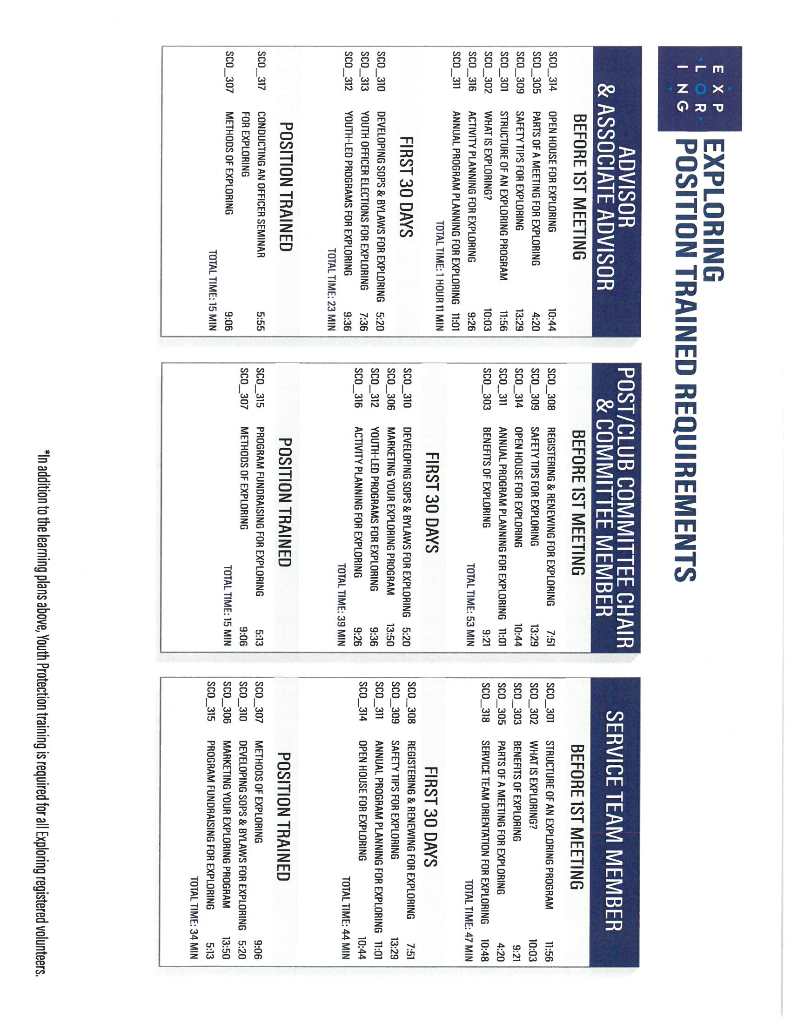
Exploring Position-Specific Training Modules Update Status …
NOW UPDATED AND READY FOR VIEWING

Slide 111
Youth Protection Training
https://my.scouting.org/

Slide 112
Exploring Youth Training Update
https://www.scouting.org/training/youth-protection/venturing/

Slide 113
Important resources to help plan the program…
Career Opportunity Worksheet -- www.exploring.org and click on relevant career field icon and scroll to the bottom of the page.
Activity Library (including Life Skills Section) https://www.exploring.org/activity-library/
Organization’s Resources/Employees
  A. Current work curriculum (developed by the company)
  B. Employee’s expertise/knowledge (Use All-in One Program Planning Meeting-found in the Exploring Guidebook for Leaders)
Career Achievement Award (Posts) & Career Awareness Award (Clubs)
  http://www.exploring.org/wp-content/uploads/2017/06/Career-Achievement-Award-May2017.pdf
  http://www.exploring.org/wp-content/uploads/2018/05/Career-Awareness-Award-FINAL.pdf
Exploring Guidebook for Leaders https://www.exploring.org/wp-content/uploads/2016/10/Exploring-Guidebook-Sept2017.800-10018.pdf
Safety First Guidelines/Guide to Safe Scouting (Guide is being Updated—Please follow all CURRENT YPT Policies)
https://www.exploring.org/wp-content/uploads/2021/08/LFL-safety-first-guidelines-3.21.17_8.pdf
7. Online Exploring Adult Leader Specific Training & Youth Protection Training
https://www.exploring.org/training-safety/ or www.myscouting.org
8. Unit Performance Guide (Chapter 5- Exploring) –Details about organizing a new Post/Club
http://www.exploring.org/wp-content/uploads/2021/04/522-02516_UPG.compressed.pdf
Also visit www.exploringexplosion.org and scroll to the bottom of the website to find additional resources…

Slide 114
ADDITIONAL SLIDES FOR COUNCIL USE
All slides will be emailed to each
Exploring Live Hour Participant every month

Slide 115


Successful Councils…
Intentionally Providing a Pathway to Exploring Growth and
Strategic Planning In Your Council

Slide 116
OPEN HOUSES
INSERT HERE
COUNCIL/DISTRICT YEARLY MEMBERSHIP PLANS
(Recruitment/Retention Cycle)
Career Interest Surveys

Slide 117

12 Keys To Success

Slide 118

1. Recruit a council Exploring volunteer chair and committee
2. Appoint a Council Exploring Champion
“Staff Advisor”
3. Create a public presence for Exploring
(council website, newsletters, social media)

Slide 119

4. Train key volunteers and staff on the 4
Phases of Post/Club Organization
5. Set specific goals for Career Interest
Surveys or gathering of data from select high schools
6. Set goals to host Open Houses for all
Posts/Clubs (i.e. School Night for
Scouting)

Slide 120
7. Create a campaign to emphasize
Post/Club unit support (through
Service Teams/Commissioners)
8. Integrate Exploring into council activities and events
9. Promote Exploring to all current customers (i.e. “Scouts BSA”)

Slide 121
10. Host a council community cultivation event, focusing on a specific career.
11. Involve the Council Executive Board to help open doors within the community and to help create a list of businesses to match the
Career Interest Survey results.
12. Ensure that Exploring is included in the
Council Strategic Plan, PDS Goals, and
Board Meetings.

Slide 122

“Action Planning”
The Beginning of your Strategic Plan
The foundation of your plan will begin here

Slide 123
Starting a New Post/Club
“The Four Phases”

Slide 124
REGISTRATION BASICS
YOUTH
POST: ___ and have completed eighth grade OR 15 years of age but not yet ___ years old
CLUB: 6th-8th graders who have completed the ____ grade and are at least 10 years old but have not completed the eighth grade and are not yet ____ years old.
ADULTS
___ years age or older
POST: Min of 4 adults
  ______________ (CC)
  2 ____________ (MC)
  _______________ (EA)
CLUB: 2 adults _______________ (ES)
_______________ (AS)
PAPERWORK
New Post/Club ____________
4 _________ Apps
5 _________ Apps
Annual ______________
of Understanding
$____ General Liability Insurance Fee
$____ per person registration fee
14
21
Application
21
Adult
Committee Chair
2 Committee Members
Youth
5th
Advisor
Memorandum
Sponsor
100
15
Assoc Sponsor
50
Exploring Youth Participants “EP’s” ages 18-20 must complete an
Exploring ________ Application & Successfully Complete YPT.
Adult

Slide 125
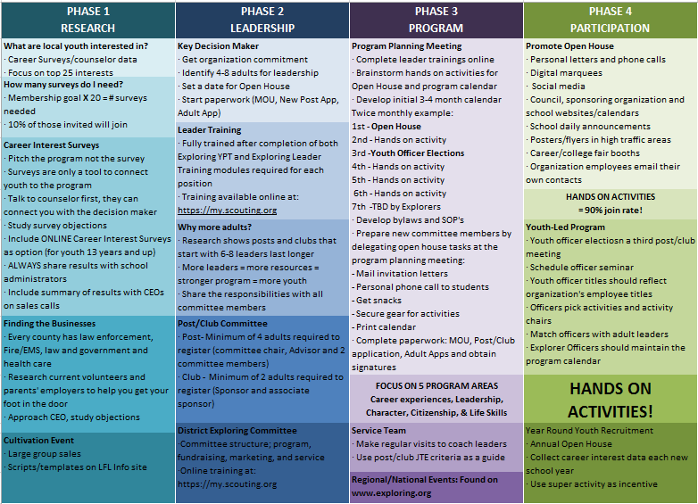

Slide 126
4 Steps/Phases in Organizing a new Post
1. Research-
Conduct the Career interest surveys
and develop business/community prospects
2. Leadership-
Meeting with the top leadership within the
businesses/community and identifying program
leaders; includes training of leaders
3. Program-
Develop the organization’s meeting/program
themes and prepare for an open house
4. Participation-
Recruiting youth through an organized open house and
involvement of youth in program development

Slide 127
MOST IMPORTANT PART
OF EACH PHASE?
Phase 1 : Career Interest Surveys
Phase 2: Training
Phase 3: All-In-One Program Planning Meeting
Phase 4: Open House

Slide 128
Career Interest Surveys
The # 1
Leading Indicator for Exploring Growth

Slide 130
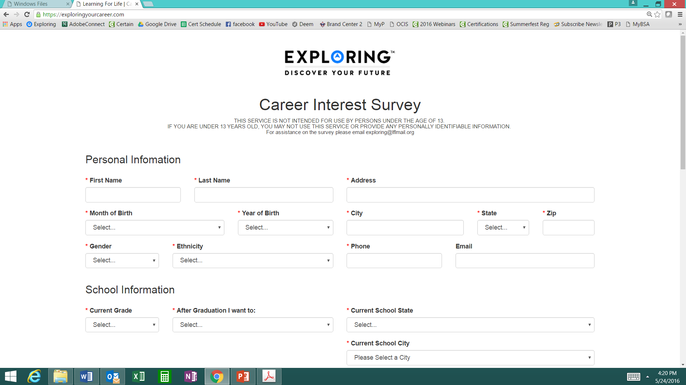
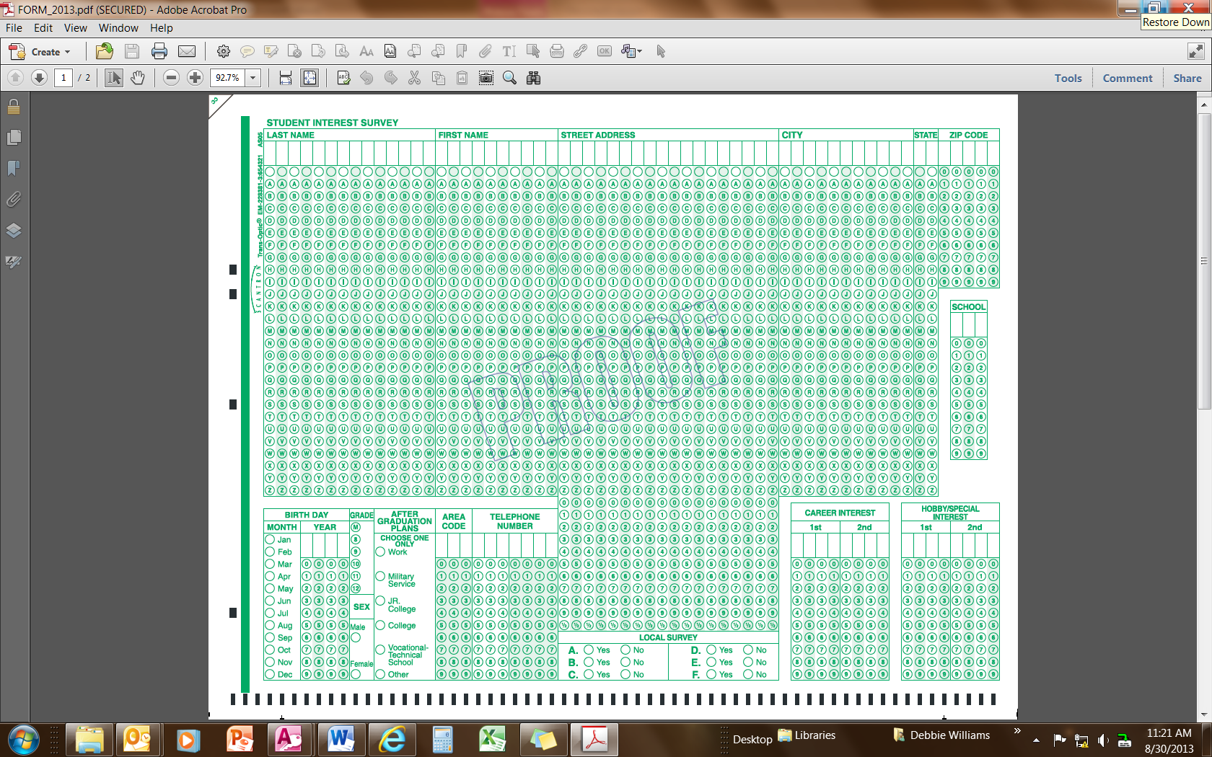
Phase 1 – Research
Career Interest Surveys (two choices)
pa
pa
Online Survey:
www.exploringyourcareer.com
Paper Scantron Survey

Slide 131
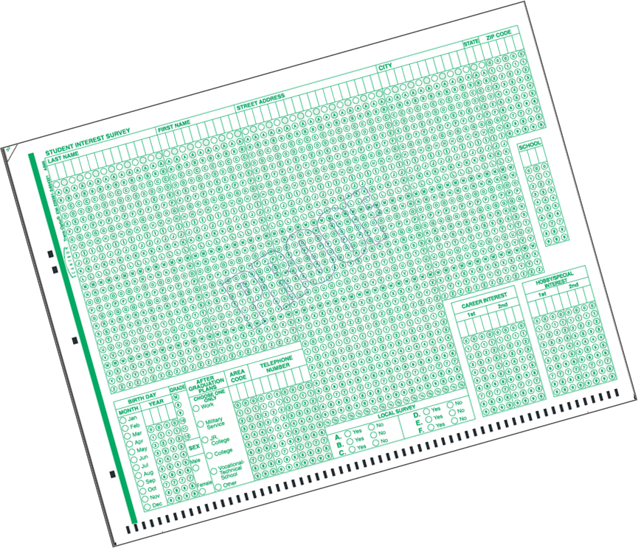
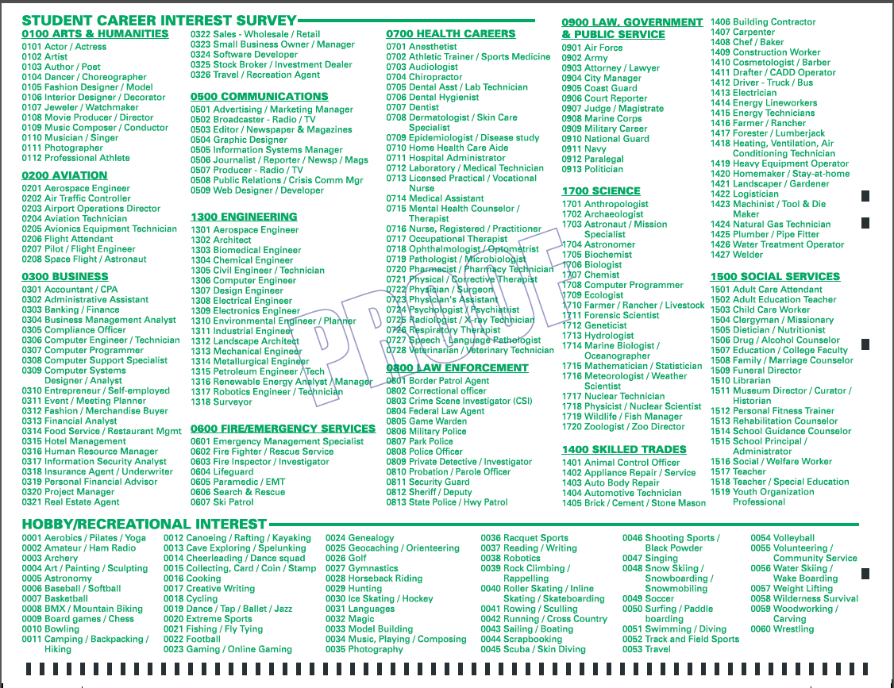
BACK SIDE
FRONT SIDE
Paper Scantron Survey Available through NDC

Slide 132
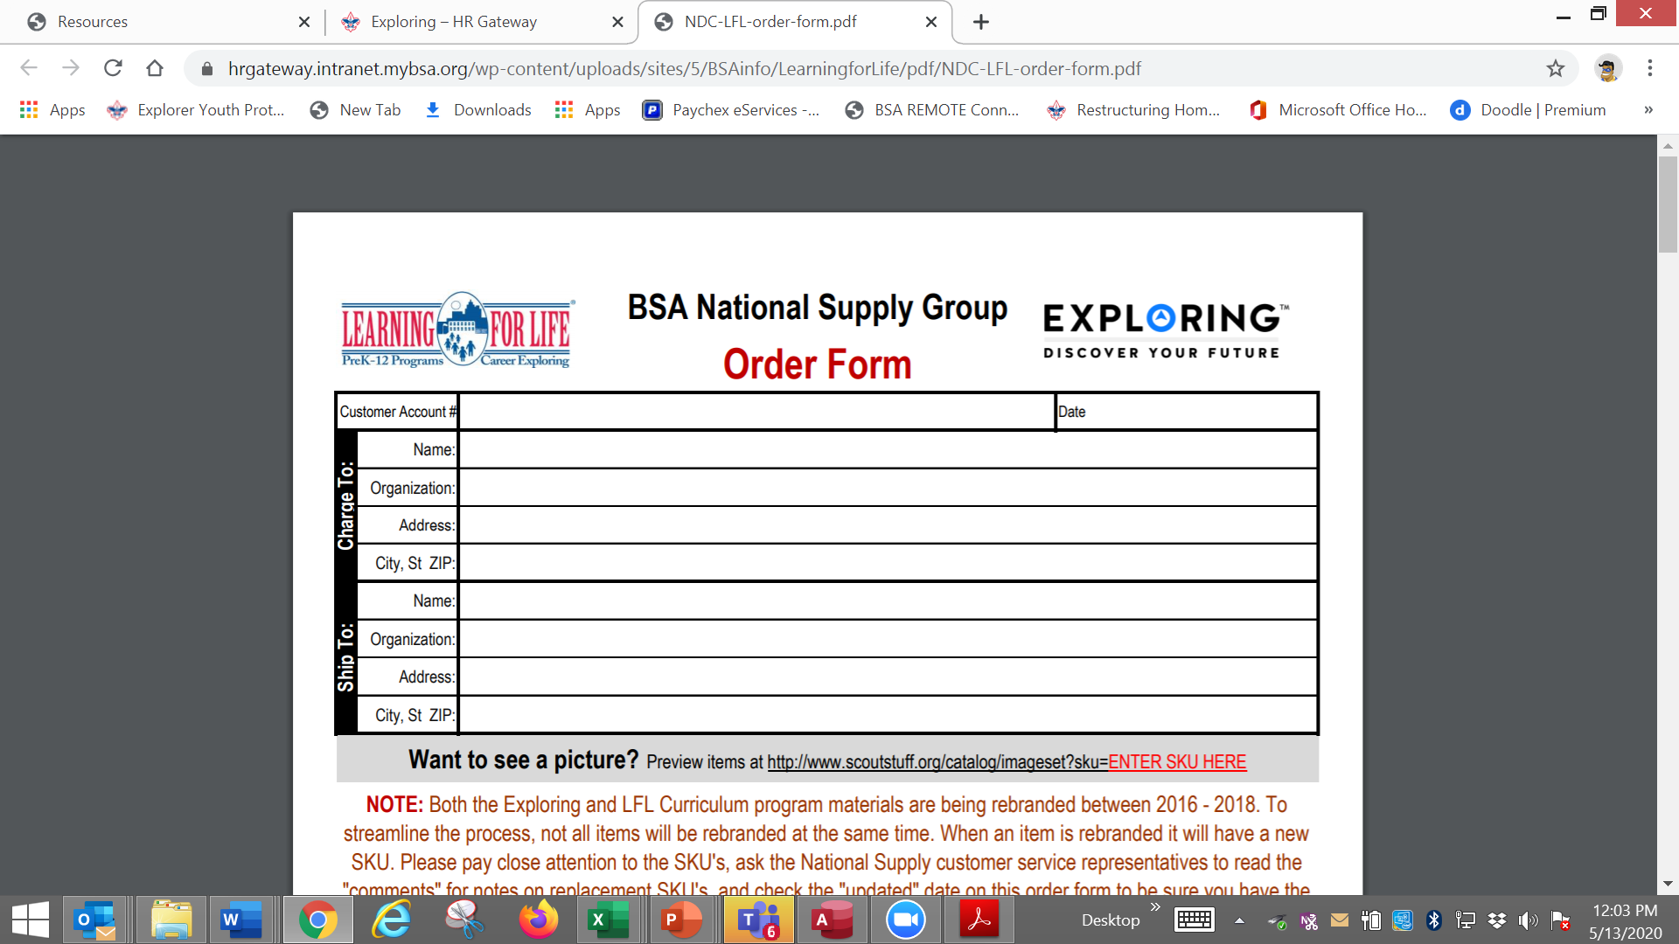

Slide 133


Slide 134

Online Career Interest Survey
www.exploringyourcareer.com
TRY IT NOW!
Use QR code or simply type address in web browser
Notes:
A “QR” or Quick Response code was created to take students directly to the survey site. It is available on posters, post cards, business cards, and book marks.
How do you use this? Email it to all teachers, they can open it from email and project it one screen for students to use their smartphones!

Slide 135


Slide 136


Slide 137

www.exploringyourcareer.org
Two career & hobby choices
School names
pre-loaded
Notes:
REFER TO HANDOUT IN YOUR FOLDER.
This is a screen shot of the new Online Career Interest Survey that was activated on Jan 1, 2012.
The careers & hobbies match the paper version. So schools and administer the survey either on paper or electronically.
The online version can be accessed from any device that can access the Internet – including smart phones.
Results are sent instantly to a secure website where councils can access the results and provide them to schools in the same format as the paper survey.
Instructions for accessing results can be found in the LFL internal site.
Students 13 yrs. and younger cannot legally complete this survey online. If they enter data, the system will not save it.
You can also add schools/colleges to this list if they do not populate when you put in your respective zip code. Simply e-mail us at exploring@lflmail.org and request your specific school to be added, with zip code

Slide 138

Online Career Interest Survey COSTS
Unlimited schools and unlimited surveys for students 13 years of age and older

Slide 139
REPORTS GENERATED FROM THE SURVEYS

Slide 140

RESULTS REPORT: School
Grade: 10
ABBEY, Susie 123 Main St Noblesville IN 46060 Work
Career 1 Career 2 Hobby 1 Hobby 2
Musician Journalist Roller Skate /Blade Music
140
Notes:
140
No matter the survey format you use, the reports are generated the same way.
**GOOD data to establish credibility at/during your sales call
This is one set of sample results provided at no cost to schools. Very helpful for Guidance Counselors.
All students, by grade, alphabetically. Shows:
Career interests
Hobby interests
Post-high school plans
Other results include all students interested in each career (all the attorneys, architects, dentists, electricians, etc). Helpful for Guidance Counselor planning, career speakers, college days and college fairs.
Be sure to return results to the Guidance Counselor when you say you will – under promise and over deliver. Do not promise results in one week if you cannot do it. Say 2-3 weeks, then they will be very happy if they do receive them in a week or ten days.

Slide 141


RESULTS REPORT: School
141
Notes:
141
This is another set of sample results provided at no cost to schools. Very helpful for Guidance Counselors.
This report includes all students interested in each career (all the attorneys, architects, dentists, electricians, etc.). Helpful for Guidance Counselor planning and career speakers.
The After Graduation Plans is important to Guidance Counselors
College
Junior college
Military Service
Technical school
Work
Other
Why are these reports help full to the school…to you?

Slide 142
Summary Career Interest Report by Council
Code Career Count
0712 Nurse (Registered) 798
0145 Musician (Instrumental/Choral/Voice) 751
0903 Attorney/Lawyer 733
1625 Teacher/Teacher Aide 678
0300 Business (General) 645
0719 Physician/Surgeon 604
0101 Actor/Actress 600
0130 Fashion Designer/Model/Buyer 579
0721 Psychiatrist/Psychologist 578
0170 Professional Athlete 507
0180 Photographer 461
1305 Architect 437
0725 Veterinarian 429
0102 Artist 427
0718 Physical Corrective Therapist 313
1300 Engineering (General) 208
MOST IMPORTANT TO YOU

Slide 143

Career Interest Survey Questions
Opportunity for 6 “Yes” or “No” questions
Unique feature of our survey
Anything school officials want to know
  Are you planning to take the SAT / ACT?
  Are drugs a problem in our school?
  Is there enough student parking?

Slide 144
www.exploring.org

Slide 145

Career Interest Survey Guidebook
Be sure you have the most recent version
Download at www.exploring.org
One stop shop for all CIS resources
Table of Contents
  Page 5 | At A Glance
  Page 7 | Overcoming Objections
  Page 44 | Appendix

Slide 146
ALTERNATE METHODS?
1. Use school information already available
2. Ask youth to develop contacts
3. Develop cultivation events
4. Invite Eagle Scouts / Scouts to join
5. Booth at schools open house night and career days /career fairs
6. Annual Exploring open houses for ALL Posts and Clubs
7. Follow up leads from the Exploring Lead
Generator

Slide 147
BASED ON SURVEY RESULTS
1. Focus on Top 4 students interests
2. Identify companies in those 4 interest areas
3. Identify the path to the CEO
  Council board contacts
  School board/admins
  PAS find
  Nominating committee
  Applications

Slide 148
Career Interest Survey Guidebook
Be sure you have the most recent version
Download at www.exploring.org
One stop shop for all CIS resources
Table of Contents
  Page 5 | At A Glance
  Page 7 | Overcoming Objections
  Page 44 | Appendix

Slide 150
Leads are being generated from Exploring.org and include anyone interested in joining, leading, sponsoring, or
otherwise supporting Exploring in their area.
Scout Executives, Assistant Scout Executives and DFS’s receive weekly lead reports.
Exploring Executives and staff advisors receive immediate notifications of each lead generated.
To make changes to any of these settings, email your request to exploring@lflmail.org.
WHEN YOU RECEIVE AN IMMEDIATE NOTIFICATION EMAIL:
1. In the email, you will see a note to “copy & paste the following URL into your browser to mark lead as contacted”.
By following this directive, you are changing the status of your lead to “contacted”. You will no longer receive email notifications for that particular lead. The lead will begin to show as “contacted” on your SE’s weekly report.
Invite the person to attend an existing post/club meeting to get a feel for the program and connect them to
appropriate Exploring advisors.

Slide 151
www.joinexploring.org

Slide 153

Phase 2 - Leadership
CEO’s Police/Fire Chiefs Administrators
Industry Experts Retirees Community Leaders

Slide 154

Moving forward with the CEO
1) Get organization’s commitment
2) Identify 6-8 adults
- CEO invites them
- You provide guidance
3) Set 2 dates for:
  - All-In-One program planning
  meeting
  - Open House
4) Start Paperwork
  - New Club/Post Application
  - MOU, Adult Application

Slide 155
  Exploring Training

Slide 157
Phase Two: Training

Slide 159
Important resources to help plan the program…
Career Opportunity Worksheet -- www.exploring.org and click on relevant career field icon and scroll to the bottom of the page.
Activity Library (including Life Skills Section) https://www.exploring.org/activity-library/
Organization’s Resources/Employees
  A. Current work curriculum (developed by the company)
  B. Employee’s expertise/knowledge (Use All-in One Program Planning Meeting-found in the Exploring Guidebook for Leaders)
Career Achievement Award (Posts) & Career Awareness Award (Clubs)
  http://www.exploring.org/wp-content/uploads/2017/06/Career-Achievement-Award-May2017.pdf
  http://www.exploring.org/wp-content/uploads/2018/05/Career-Awareness-Award-FINAL.pdf
Exploring Guidebook for Leaders https://www.exploring.org/wp-content/uploads/2016/10/Exploring-Guidebook-Sept2017.800-10018.pdf
Safety First Guidelines/Guide to Safe Scouting (Guide is being Updated—Please follow all CURRENT YPT Policies)
https://www.exploring.org/wp-content/uploads/2021/08/LFL-safety-first-guidelines-3.21.17_8.pdf
7. Online Exploring Adult Leader Specific Training & Youth Protection Training
https://www.exploring.org/training-safety/ or www.myscouting.org
8. Unit Performance Guide (Chapter 5- Exploring) –Details about organizing a new Post/Club
http://www.exploring.org/wp-content/uploads/2021/04/522-02516_UPG.compressed.pdf
Also visit www.exploringexplosion.org and scroll to the bottom of the website to find additional resources…

Slide 160

Phase 3 – Program
All-In-One Program Planning Meeting
1) Paperwork
2) Adult Explorer Leader Training
  - Youth Protection for Explorers
  - Adult Explorer Leader Training
3) Open House Planning
  - Brainstorm session
  Why did you choose this career for yourself?
  What are hands on activities that you can do with youth?
  - Develop a 3-4-month calendar (use Activity Library)
  - Choose Open House “hands-on activities”
4) Prepare Post Committee Members for Open House

Slide 161


SAMPLE PROGRAM CALENDARS
The frequency of your meetings and length of your program each year is up to you. For example, this could be a 12 month or 12 week program.
ENGINEERING & TECH
MONTHLY MEETINGS YEAR-ROUND
September
Open House
October
Chemical engineering
November
Youth Officer Elections
December
Holiday Play – open house
January
Industrial Technology
February
Electrical engineering
March
Computer science
April
Fluid power technology
May
Ethics in engineering
June
Visit with engineering firm
July
Civil engineering
August
Mechanical engineering
Notes:
PRESENTER NOTES:
BE SURE TO DELETE THE CALENDARS/SLIDES THAT ARE NOT RELEVANT TO THE CAREER INDUSTRY TO WHICH YOU’RE PRESENTING.
Remind the audience that they have flexibility is setting the schedule for their own program. Here are some options:
Year round – may or may not include summer
Weekly
Monthly
3 months at a time, different group of youth each time, 3 times per year
Weeknights or weekends

Slide 162

Phase 3 – Program
Planning the Open House
1) From your BRAINSTORM session…
  - Pick the 4-5 best activities for a quick hands-on
  format at the Open House
2) At the open house…“Go shopping”
  - 4-5 stations (rotations)
  - 4-5 minutes each

Slide 163




www.exploring.org
Notes:
Program planning is also a service that is provided by the local Boy Scout Council. This Activity Library is an all new supplement to the process. You will find it on www.exploring.org

Slide 165


Phase 4 – Participation
SIMPLE OPEN HOUSE AGENDA
OPEN HOUSE AGENDA
Welcome
What is Exploring?
Video
HANDS-ON ACTIVITIES
Activity Interest Survey (customized)
Calendar
ASK TO JOIN
Applications & fees
Snacks

Slide 166

Resources to help you… www.exploring.org

