Slide 1
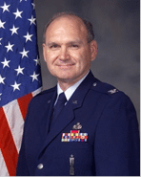

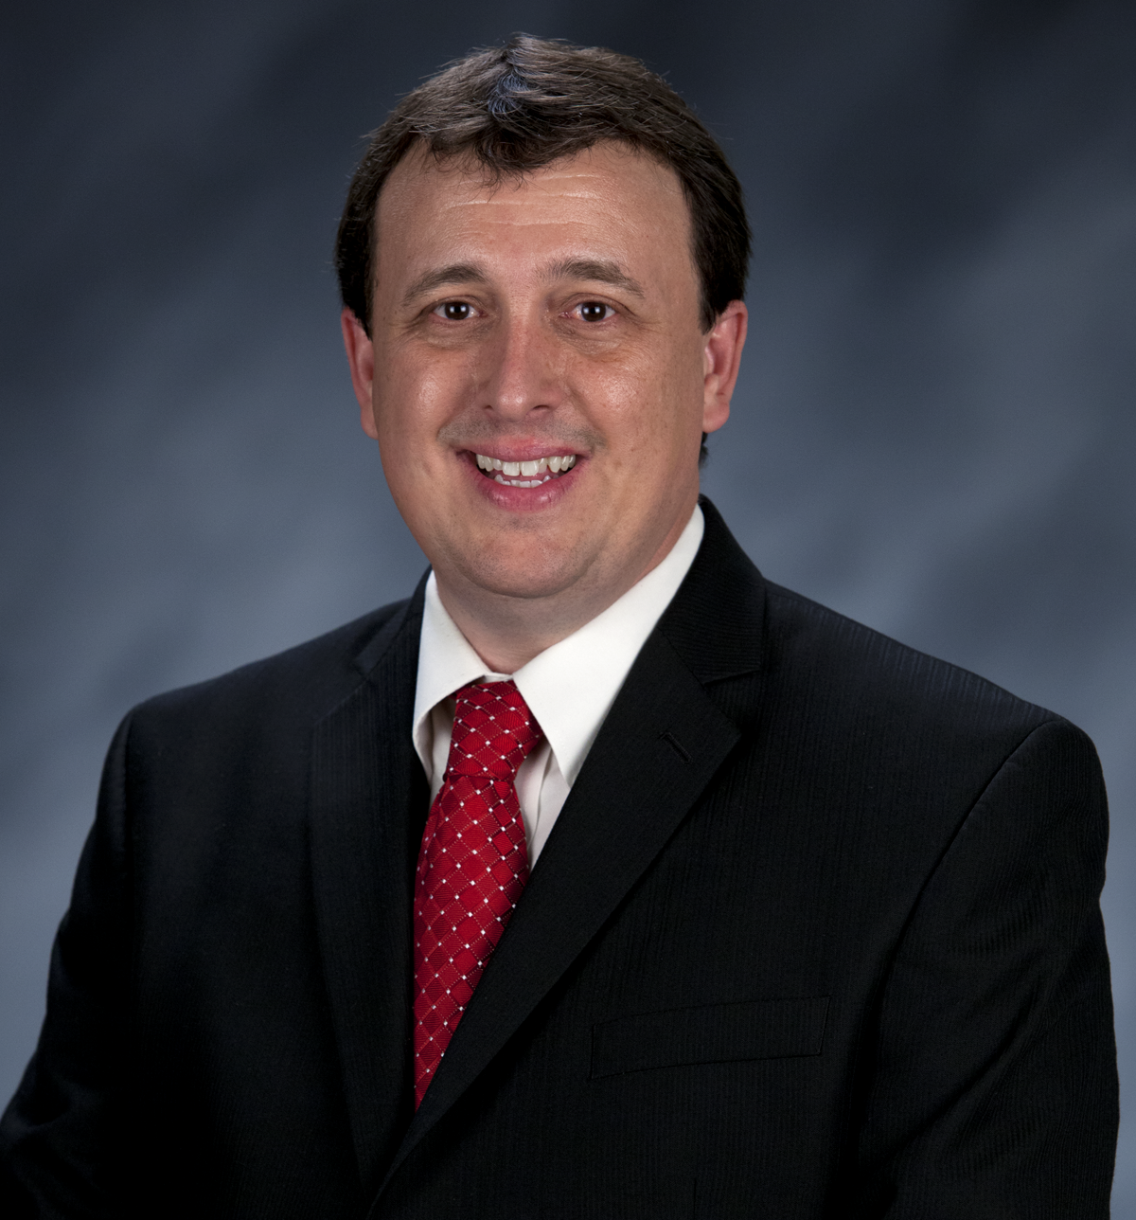
Craig Martin
Vice-Chair,
National Exploring Program Chair
NATIONAL EXPLORING
LIVE HOUR
MAY 7th, 2025
Tim Anderson
National Director
Learning for Life & Exploring
Older Youth Programs

Slide 2

LEARNING FOR LIFE CORPORATE MISSION:
To develop and deliver engaging, research based academic, character, leadership and career focused programs aligned to state and national standards that guide and enable all students to achieve their full potential.
THE CORPORATION
NON-DISCRIMINATION STATEMENT:
Learning for Life programs are designed for all age groups from pre‐kindergarten and not yet age 21. Youth participation is open to any youth in the prescribed age group for that particular program. Adults are selected by the participating organization for Involvement in the program. Color, race, religion, gender, sexual orientation, ethnic background, disability, economic status or citizenship is not criteria for participation by youth or adults.
Notes:
AFFILIATION STATEMENT
Learning for Life is one of the programs that local Boy Scouts of America councils are authorized to deliver, with local executive board approval. Learning for Life is an affiliate of the Boy Scouts of America that is comprised of both a written character education curriculum for PreK – 12th graders and students with special needs, as well as Interactive career Exploring programs for 6th graders thru 20 year olds. Youth participation is open to any youth in the prescribed age group for that particular Program. Adults, 21 years of age and older, are selected by participating organizations for involvement in the Learning for Life programs. Color, race, religion, gender, sexual orientation, ethnic background, disability, economic status or citizenship is not criteria for participation by youth or adults. Youth and adults involved with Learning for Life programs, including Exploring, are registered with Learning for Life as participants. Learning for Life participants are not members of the Boy Scouts of America. Learning for Life, a District of Columbia non‐profit corporation, is a separate 501(c)(3) Corporation, with a Board of Directors that is separate from the Boy Scouts of America. While they have different policies, there are occasions when local Learning for Life and Traditional BSA programs may participate in an event. Both programs will be required to follow the appropriate guidelines, especially regarding safety. Completion of training, registration and annual fees are program specific and not transferable between programs

Slide 3

  Learning for Life Curriculum-Based Programs consists of grade specific, age-oriented, character education lesson plans that are utilized in schools and other educational settings to help instill character and ethical decision making in our youth. The available lesson plans that are offered for Learning for Life Groups include PreK-12 grades, Champions for students with special needs, along with additional digital resources. Learning for Life uses these interactive lessons to help youth make informed decisions while becoming better students and citizens.
  CURRICULUM PROGRAM VISION:
  To provide engaging and relevant PreK‐12 solutions that positively impact academic performance, social & emotional maturity, character development, and career education for all students.
www.learningforlife.org

Slide 4

  Exploring is a co-ed program for youth that are in the 6th grade through 20 years old. Exploring provides opportunities for real-world hands-on career experiences, while helping them “Discover their Future”. The program links youth with mentors and experts with partner businesses and agencies in their communities. Participating in an Exploring Club or Post ensures youth make informed decisions about careers they may or may not be interested in pursuing, while allowing businesses and organizations the opportunity to meet and cultivate future employees.
EXPLORING MISSION:
Deliver character-building experiences and mentorship that allow youth to achieve their full potential in both life and work.
EXPLORING VISION :
Shape the workforce of tomorrow by engaging and mentoring today’s youth in career and life enhancing opportunities.
www.exploring.org

Slide 5
A little about each program
Learning for Life Curriculum-Based Programs consists of grade specific, age-oriented, character education lesson plans that are utilized in schools and other educational settings to help instill character and ethical decision making in our youth. The available lesson plans that are offered for Learning for Life Groups include PreK-12 grades, and Champions for students with special needs. Learning for Life uses these interactive lessons to help youth make informed decisions while becoming better students and citizens.
Exploring is a co-ed program for youth that are in the 6th grade through 20 years old. Exploring provides opportunities for real-world hands-on career experiences, while helping them “Discover their Future”. The program links youth with mentors and experts with partner businesses and agencies in their communities. Participating in an Exploring Club or Post ensures youth make informed decisions about careers they may or may not be interested in pursuing, while allowing businesses and organizations the opportunity to meet and cultivate future employees.

Slide 6

National Learning for Life/Exploring
National Professional Staff Direct Support
Tim Anderson
National Director,
Learning for Life/Exploring
Older Youth Programs
Vacant
Project Coordinator
John Mosby
Asst. Chief Scout Executive & EVP
(BSA)
Susan Fitzhugh
Sr. Administrative Assistant

Slide 7

National Director/President
Tim Anderson (E)
(V) = Volunteer
(E) = Employee/Professional
LFL Executive Board Secretary
Steven Hardy (E)
LFL Executive Board Treasurer
Lisa Fritschel (E)
NATIONAL LEARNING FOR LIFE EXECUTIVE BOARD
(Board Member)
National
Exploring Program Chair
Craig Martin (V)
*National Learning for Life Executive Board Chair*
Bernard “Bernie” Lockard (V)
----------------------------------------------------------------------------------------------
National Learning for Life
Immediate Past Executive Board Chair/Governance
Mark Wiesenhahn (V)
(Board Member)
National Learning for Life Curriculum Based Program Chair
Dr. Helen Stiff-Williams (V)
(Board Member)
National
Exploring Program Commissioner
Richard “Dick” Davies (V)
(Board Member)
National Learning for Life Curriculum
Based Program Commissioner
Vacant (V)
(Board Member)
National LFL/EXP
Fundraising & Development Chair
Vacant (V)
(Board Member)
National LFL/EXP
Membership & Retention Chair
Vacant (V)
(Board Member)
National LFL/EXP
Partnerships & Relationships Chair
Vacant (V)
(Board Member)
National LFL/EXP
Safeguarding Youth/
Health & Safety Chair
Vacant (V)
(Board Member)
National LFL/EXP
Technology/Website Chair
Jeff Schweiger
(Board Member)
National LFL/EXP
Marketing & Social Media Chair
Vacant (V)

Slide 8

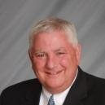

National Learning for Life Executive Board Chair
Bernie Lockard
Scouting…
Eagle Scout (1972)
Order of the Arrow Vigil Honor
Cubmaster
Pack Committee Chairman
Assistant Scoutmaster
Scoutmaster
Unit Commissioner
Wood Badge Course Director
NYLT Course Director
District Chairman
President, Laurel Highlands Council’s Board of Directors (2013 - 2014)
2019 World Jamboree Scoutmaster
Chair, National Venturing Committee (2020 - 2022)
2023 & 2017 National Jamboree Staff
National Eagle Scout Association Scholarship Committee (2013 - Present)
BSA Recognition…
Award of Merit – 1998
Silver Beaver – 2001
Distinguished Citizen – 2010
Rockefeller Award – 2010
Silver Antelope – 2014
National Outstanding Eagle Scout Award - 2015
National Venturing Leadership Award – 2022
Silver Buffalo - 2024
Personal…
Married to Robyn L. Ashbridge, father of five and grandfather of seven
President, The Lockard Company, Indiana, PA
Graduate of Carnegie-Mellon University, Pittsburgh, PA, with B.S. in Administration and Management Science, Economics, Mathematics (Graduated With Honors)

Slide 9
National Exploring Program Chair
Craig Martin
bruin1967@aol.com
(719) 331-6406
Recent Scouting History
Unit Commissioner & Exploring Service Team Member, Pathway to the
Rockies Council ~ 2013 - Present
Council Commissioner, Pikes Peak Council (now Pathway to the Rockies Council) ~ 2009 – 2012
Exploring History
National Exploring Program Chair, National LFL Executive Board ~ 2022 - Present
National Exploring Program Committee Chair ~ 2022 - Present
Exploring Chair, National Commissioner Service Team, ~ 2019 – 2022
National Exploring Service Team Chair, National LFL Executive Board ~ 2018 – 2022
Exploring Committee Chair, BSA Western Region (Area 2) – 2012- 2020
Non-Military Professional Career
Deputy Chief Engineer, GPS Systems Engineering & Integration Program, TASC Inc. ~ 2015-2016
Program Manager and Senior System Engineer, TASC Inc. ~ 1998 – 2015
Military Career
Colonel, United States Air Force ~ Retired in 1998 after 30-year Career in USAF Space & Missile and Research & Development Programs

Slide 10
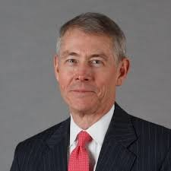
National Exploring Program Commissioner
Richard (Dick) Davies
Richard.davies.nyc@gmail.com
(914) 327-7430
Recent Scouting History
Interim Scout Executive for two years Greater
New York Councils ~ 2021 – 2022
Stepped down as Council Commissioner to take role
Formerly VP – Membership, VP – Scoutreach and Manhattan Borough President
Eagle Scout from Wisconsin
Exploring History
Exploring Chair, National Commissioner Service Team ~ Nov 2022 – TBD
National Exploring Program Commissioner, National LFL Executive Board ~ Nov 2022 -TBD
Area and Northeast Regional Exploring Chair and Board Member ~ 2018 – 2021
National Exploring Committee ~ 1976 – 1979
National Explorer President ~ 1976-77; Youth Member of National Executive Board
Professional Career
Since 2016, angel investor and advisory board member for start-up companies
Consultant to investment management industry
Most of career on business side of investment management industry (business unit management, client and product development) with Alliance Bernstein and Russell investments
Last ten years through 2016 working with largest 401k and other defined contribution plans around the world.

Slide 11
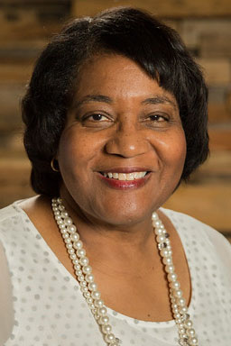
Helen Stiff-Williams, Ed. D.
Consultant and Adjunct Professor
National Learning for Life Curriculum-Based Program Chair
PROFESSIONAL POSITIONS HELD
Consultant, National Teacher Training, July 2021- present
Adjunct Professor, Regent University, July 2021- present
Organizational Leadership Coach, July 2021- present
Professor of Teacher Education and Interdisciplinary Studies
College of Arts and Sciences, Regent University, 2019-2021
Professor of Education
School of Education, Regent University, Virginia Beach, VA, 1998 - 2019
Director
  Center for Character Education and Civic Development, 2006- 2012
Chairman and Professor of Education
Department of Education, Hampton University, Hampton, VA, 1995 -1998
Adjunct Faculty and Educational Consultant
  Division of Continuing Education, University of Virginia, 1994 - 2000
Division Chief
Virginia Department of Education, Richmond, VA, 1990 - 94
Assistant Superintendent
  King George County Public Schools, Central Administration, King
George, VA
Middle School Principal
Charlottesville City Schools, Buford Middle School, Charlottesville, VA
Elementary Principal
Cumberland County Schools, Cumberland, VA
Adjunct Faculty Member
Longwood College, Department of Education, Farmville, VA
Assistant High School Principal
  Prince Edward County Public Schools, Farmville, VA
Assistant Elementary Principal
Prince Edward County Public Schools, Farmville, VA
EDUCATION:
University of Virginia, Charlottesville, VA, Doctorate of Education, Administration,
Supervision, and Curriculum
Longwood University, Farmville, VA, Master of Science, Supervision
Hampton University, (formerly known as Hampton Institute) Hampton, VA, Bachelor of
Science with High Honors, History Education.

Slide 12


National Exploring
Live Hour
7 May 2025
Craig Martin
National Exploring Program Chair,
Learning for Life Executive Board
Bruin1967@aol.com
719-331-6406
u

Slide 13
Safety Moment ~
Distracted Driving*
* Source: Safety Moment Presentation by Dan Segersin (Chair, National Outdoor Programs & Properties Committee) @ 15 April 2025 Scouting America’s National Program Development Committee Meeting
)

Slide 14


Slide 15

Distracted Driving…

Slide 16
Distracted Driving…
SUMMARY: Distracted driving is considered “any activity that diverts the driver’s attention away from driving,” according to the National Highway Transportation Safety Administration.
The distractions can include a wide range of a driver’s or passenger’s personal actions or activities while in a vehicle.
Even if a driver is only trying to keep passengers in their seats while the vehicle is in motion, that is a distraction.
GENERAL INFORMATION: Distracted driving can have deadly consequences.
Each year over 3,000 people died in crashes involving a distracted driver according to the National Highway Traffic Safety Administration.

Slide 17
Distracted Driving…
SUMMARY: Distracted driving is considered “any activity that diverts the driver’s attention away from driving,” according to the National Highway Transportation Safety Administration.
The distractions can include a wide range of a driver’s or passenger’s personal actions or activities while in a vehicle.
Even if a driver is only trying to keep passengers in their seats while the vehicle is in motion, that is a distraction.
GENERAL INFORMATION: Distracted driving can have deadly consequences.
Each year over 3,000 people died in crashes involving a distracted driver according to the National Highway Traffic Safety Administration.

Slide 18
What’s New for Exploring in 2025

Slide 19
Scouting America’s New Program Initiatives*…
Exploring
Increased resources for Councils
Expand Posts into National Trade Partners
Drone Post Career Awareness
* Presented at 15 April 2025 National Program Development Committee Meeting

Slide 20

Scouting America’s New Program Initiatives*…
Outdoor Club
Targeted for high school youth
Include Scouting’s outdoor & fun elements
Contains Scouting’s leadership & character development
Leaves out the uniform and other components that are specific to Scouts BSA
Leaves out advancement & rank
Housed within Learning for Life
* Presented at 15 April 2025 National Program Development Committee Meeting

Slide 21
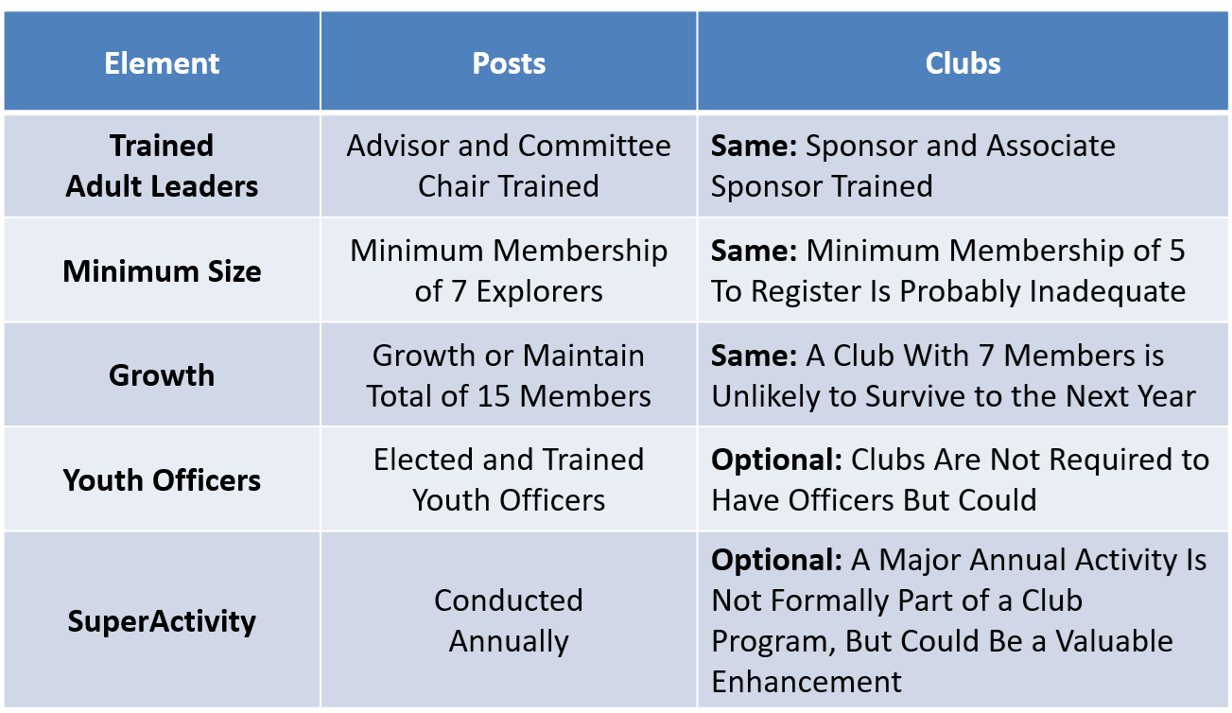
Exploring Quality Guidelines Replacing JTE for Posts & Clubs
Objective: Quality Sustainable Programs

Slide 22
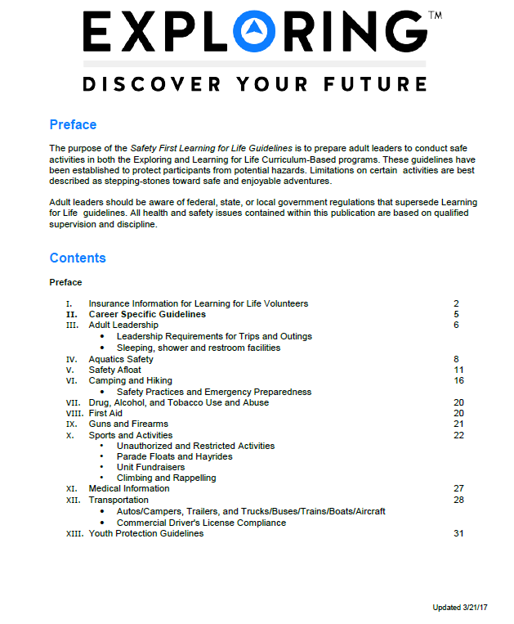
Exploring Safety First Guidelines
National Exploring Committee’s Health & Safety & YPT Lead’s Team has been updating the “Exploring Safety First Guidelines” and has now passed their proposed revision to the BSA Health and Safety Team for their review and comments
Expect the updated “Exploring Safety First Guidelines” release in Summer of 2025

Slide 23
Exploring Leadership Experience*
* Coming soon for Exploring participants with expected roll-out in late Summer 2025
Resume Builder that will help recognize Explorers
This online, mentor assisted, self-paced and guided experience will allow our Explorers to…
Have an opportunity to discover their inner leadership potential
Gain practical leadership experience – participate in a capstone project
Work with a mentor to gain professional leadership experience
Be recognized with a Nationally Certified Leadership Experience Certificate that will help improve their resume and recognize their overall Exploring Experience.

Slide 24
Exploring Service Corps Participation at 2026 National Jamboree
Here our thoughts for Exploring Service Corps Participation at 2026 National Jamboree which should be patterned after the 2023 National Jamboree participation...
Exploring Youth / Young Adults and their Advisors only pay half price for attendance
Exploring attendees spend 50% of their time providing service and 50% of their time participating in National Jamboree as normal participants
Wall Tents with cots are provided to Exploring attendees
All Exploring attendees are billet in same area or subcamp...possibly where the rest of the Jamboree staff is billet
Exploring attendees eat all their meals in the dining hall like the other Jamboree staff
Have I missed any other participation requirements?

Slide 25
2025
Scouting America’s
Organizational Goals

Slide 26
2025 Scouting America's Organizational Goals
On 29 January 2025, Roger Krone, Chief Scout Executive / President & CEO of Scouting America, announced Scouting America’s 2025 Organizational Goals which is focused on four key areas: Safeguarding Youth, Membership Growth, Customer Satisfaction and Financial Health…
Goal 1: Safeguarding Youth
Target: 0 (Zero) Serious Incidents
Our commitment to safeguarding youth is absolute and remains our top priority. At the same time, we recognize that any activity inside or outside of Scouting involves risk. We aim to continually enhance our highly effective preventive strategies to mitigate the risk of harm or abuse. This goal underscores our dedication to creating a safe environment for youth to thrive in Scouting. We must have a zero-tolerance culture where serious incidents are concerned.
Goal 2: Membership Growth
Membership Target: 2024 Actual 2025 Target
1,030,862 1,075,000
We are dedicated to serving an ever-expanding number of youth with programs that prepare them for lives of purpose and impact. We will do this by starting new units in communities across the nation and by reaching today’s parents in new and innovative ways. Our goal is to reach 1,075,000 members by the end of 2025. By aligning local and national efforts and by offering fun and exciting programs, we will help the next generation of young people to be Prepared For Life.

Slide 27
2025 Scouting America's Organizational Goals continued
Goal 3: Satisfaction Index (VOS)
Satisfaction Score: 2024 Actual 2025 Target
43.3% 46.0%
Customer satisfaction is at the heart of our mission. We believe volunteers who view our programs in a positive light will be more enthusiastic about delivering them. Our Voice of the Scout (VOS) survey measures the sentiment of our unit leaders and members. We aim to achieve a satisfaction index of 46.0%. This reflects our commitment to delivering an outstanding experience and value to youth, families and leaders.
Goal 4: Financial Health (Debt Reduction)
Debt Reduction Target: 2024 Actual 2025 Target
$360,000,000 $317,000,000
Improving the collective financial health of local councils and the National Service Center is crucial to our future. At the National Service Center, we are focused on reducing debt to $317M by the end of 2025 on our way to debt below $200M by the end of 2026. This will strengthen our financial position and enable us to accelerate investments in driving membership and enhancing programs while keeping fees low.

Slide 28
2025 National Exploring Program Priorities Mapped to Scouting America’s 2025 Organizational Goals

Slide 29
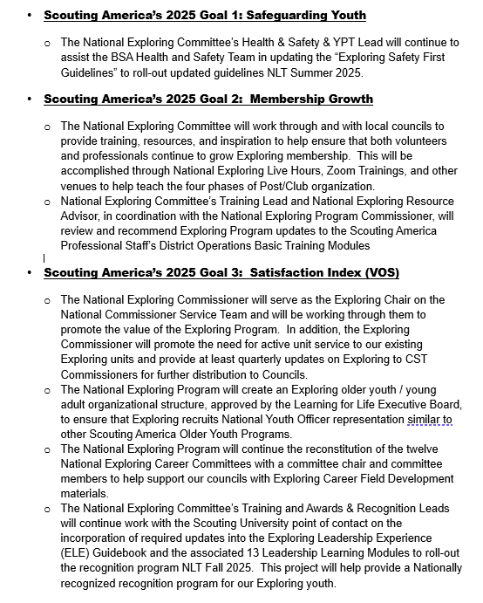
2025
National Exploring Priorities mapped to
Scouting America’s 2025 Organizational Goals

Slide 30
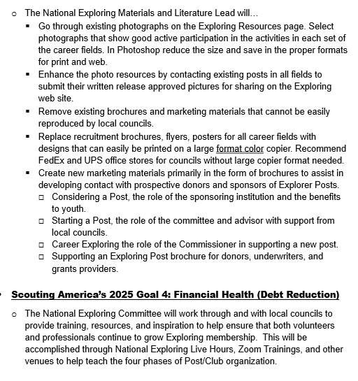
2025
National Exploring Priorities mapped to
Scouting America’s 2025 Organizational Goals continued

Slide 31
National Exploring Program Committee

Slide 32
Nat’l Exploring Committee Members…
National Exploring Program Chair Craig Martin
National Exploring Program Commissioner Richard (Dick) Davies
National Exploring Membership Growth / Retention Lead Jeffrey (Jeff) Schweiger
National Exploring Awards & Recognition Lead Richard (Rick) Belford
National Exploring Training Lead Roger Engelbart
National Exploring Health & Safety / YPT Lead Linda Hassler
National Exploring Marketing / Communications Lead (Website / Social Media) TBD *
National Exploring Materials & Literature Lead Timothy (Tim) Buckles
National Exploring Career Fields Development Lead TBD *
National Exploring Youth Officer Advisor TBD *
National Exploring Youth Chair TBD
National Exploring Partnerships / Relationships Lead TBD *
National Exploring Resource Advisor Stuart Mahler
National Special Needs Committee Liaison for Exploring Britt Flather
National Exploring Members-at-Large (National Exploring Resource Associate Advisors)
  National Exploring Subject Matter Expert John Brady
  National Exploring Subject Matter Expert Don Deeker
  National Exploring Subject Matter Expert Kenneth (Ken) Leedham
  National Exploring Subject Matter Expert Joseph (Joe) Marinelli
  National Exploring Subject Matter Expert Suzie Steiner
  National Exploring Subject Matter Expert Rick TerBorch
* Note: Welcome recommendations from anyone

Slide 33
National Exploring Subject Matter Experts & Exploring Resource Associate Advisors
In support to our fourteen Scouting America Council Service Territories (CSTs), our National Exploring Program is currently supporting each CST, along with their territory’s councils, with a National Exploring Subject Matter Expert (SME), who serves as that territory’s Exploring Resource Associate Advisor (ERAA). As a caveat, we do not presume this role is either formally or informally part of the CST organizational structure but rather a service being made available by the National Exploring Program to each CST and/or their councils. Additionally, we have a National Exploring RAA dedicated to supporting the California Highway Patrol (CHP) and the councils with CHP Law Enforcement Posts as well as the posts themselves

Slide 34
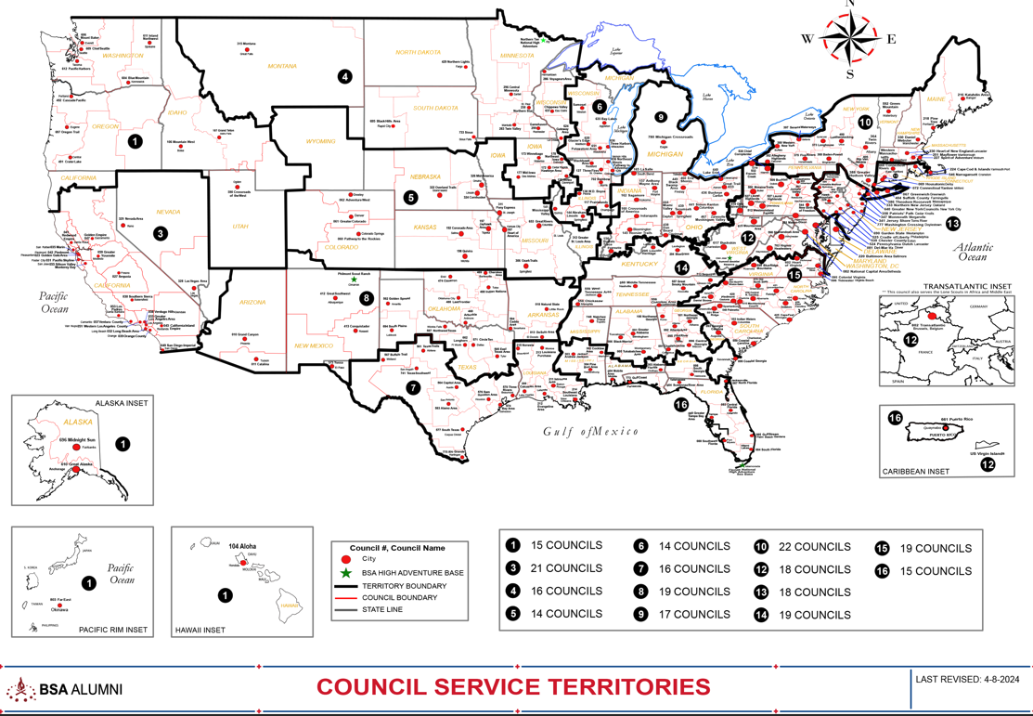
Council Service Territories (CSTs)…
COUNCIL

Slide 35
Current National Exploring SMEs / RAAs Team...
CST 1 ~ Suzie Steiner (Mountain West Council), who is currently an Advisor for an Exploring STEM / Robotics Post, which also encompasses trades such as machining & welding and business careers, and has previously been an assistant district commissioner, assistant & roundtable commissioner and Cub Scout den leader. National Exploring Resource Associate Advisor (RAA) supporting the CST 1 and councils within the territory
suzie@openlabidaho.org
((208) 869-2403
CST 3~ Stuart Mahler (Golden Gate Area Council), who is currently an Assistant Council Commissioner and LFL Council Exploring Chair and Executive Board Member as well as a retired police officer, an advisor in the 1987 Law Enforcement Exploring National Academy, staff member on three National Exploring Law Enforcement Exploring Conferences and Law Enforcement Explorer in his youth. National Exploring Resource Advisor (RAA) supporting the CST 3 and councils within the territory
mdc.stuart@gmail.com
(925) 519-6957
CST 4 & 5 ~ Roger Engelbart (Greater St Louis Area Council), who is currently the Assistant Council Commissioner for Training and the Engineering Chair for the Council Exploring Committee, as well as a retired Boeing Engineer involved in Nondestructive Evaluation. National Exploring Training Lead and National Exploring Resource Associate Advisor (RAA) supporting the CST 4 & 5 and councils within those two territories
engelbart301@sbcglobal.net
(314) 920-8968

Slide 36
Current National Exploring SMEs / ERAs Team...
CST 6 ~ Richard (Dick) Davies (Glacier's Edge Council) who is the National Exploring Commissioner, Exploring Chair for the National Commissioner Service Team & National Exploring Program Committee Vice-Chair, as well as VP - Development in Glacier's Edge Council (Madison, WI), Greater New York Councils Executive Board Member, former Interim Scout Executive for the Greater New York Councils (2021 & 2022), past Northeast Region Exploring Chair and Board Member, and, in his youth, National Explorer President (1976-77) & Youth Member of National Executive Board. National Exploring Resource Associate Advisor (RAA) supporting the CST 6 and councils within the territory
richard.davies.nyc@gmail.com
(914) 327-7430
CST 7 ~ Don Decker (Bay Area Council) - Eagle Scout, Woodbadge staff member, retired BSA Professional Scouter, Business and Banking Explorer as a youth, and currently a full time Agriculture Specialist, US Customs and Border Protection Agency. National Exploring Resource Associate Advisor (RAA) supporting the CST 7 and councils within the territory
donedecker@gmail.com
( 832) 266-7145
CST 8 ~ Craig Martin (Pathway to the Rockies Council), who is the National Exploring Program Committee Chair as well as a retired Senior Systems Engineer supporting Department of Defense satellite programs and a retired USAF Colonel with extensive experience building, testing, launching & operating US Air Force satellites and testing air-to-air & air-to-ground missile systems. National Exploring Resource Associate Advisor (RAA) supporting the CST 8 and councils within the territory
bruin1967@aol.com
(719) 331-6406

Slide 37
Current National Exploring SMEs / ERAs Team...
CST 9 ~ Richard (Rick) Belford (Western Massachusetts Council), who is currently the Vice President of Membership, Executive Board member, and Committee Chair for five units - a Cub Scout Pack, a girl troop, a boy troop, a Sea Scout Ship and an Aviation Explorer Post. Also a former Scouting Professional/District Executive, a retired DOD/Federal employee and a retired USAF Chief Master Sergeant. National Exploring Awards & Recognition Lead and Resource Associate Advisor (RAA) supporting the CST 9 Program Lead and councils within that territory.
o rebwmc234@gmail.com
o (860) 402-4836
CST 10 ~ Joseph (Joe) Marinelli (Seneca Waterways Council), who is the Council Executive Committee’s & Board’s former Vice President of Exploring, past President of the Finger Lakes Council and Executive Director, Finger Lakes STEM Hub as well as a retired Regional Supervising Superintendent & BOCES (service agency) CEO for 25 school districts in upstate New York. National Exploring Resource Associate Advisor (RAA) ) supporting the CST 10 and councils within the territory
josephjmarinelli@aol.com
(585) 704-4659
CST 12 ~ John Brady (Del-Mar-Va Council) who is currently a member on the Council Executive Board, District Vice Chair and Sea Scout Ship 198 Committee Member as well as a former Attorney/Labor Relations Specialist for the State of Delaware & a former Scouting Professional District Executive. National Exploring Resource Associate Advisor (RAA) supporting the CST 12 & 14 and councils within those two territories
jfbradygroup@gmail.com
(302) 381-8728

Slide 38
Current National Exploring SMEs / ERAs Team...
CST 13 ~ Linda Hassler (Monmouth Council) who is currently a member of her Monmouth Council Board of Directors and Troop 140 Committee Member as well as an Assistant Professor at Rutgers’ School of Nursing, former Northeast Region Area 5 Exploring Chair, former Exploring Post Advisor and a Tennis Explorer in her youth. National Exploring Health & Safety / YPT Lead and National Exploring Resource Associate Advisor (RAA) supporting the CST 13 and councils within the territory
Lindajhassler@gmail.com
(732) 687-7208
CST 14 ~ John Brady
CST 15 & 16 ~ Kenneth (Ken) Leedham (Gulf Stream Council) who is currently a District Commissioners, Exploring service team member, associate post advisor, merit badge counselor and Wood Badge staff member as well as a full-time police officer and Law Enforcement Explorer in his youth. National Exploring Resource Associate Advisor (RAA) supporting the CST 15 & 16 and councils within those two territories
treasurecoastscouting@gmail.com
(772) 370-2800
CHP ~ Rick TerBorch (Los Padres Council), who is the former National Service Territory (NST) 3 Commissioner, Assistant Council Commissioner and Council Executive Board Member as well as a retired Chief of Police in Arroyo Grande, CA, past Los Padres Council President & Council Commissioner, past National Law Enforcement Exploring Committee Member, Exploring Advisor and over 35+ years in Law Enforcement Exploring. National Exploring Resource Associate Advisor (RAA) supporting the California Highway Patrol (CHP) and the councils with CHP Law Enforcement Posts.
rterborch@earthlink.net
(805) 441-1721

Slide 39
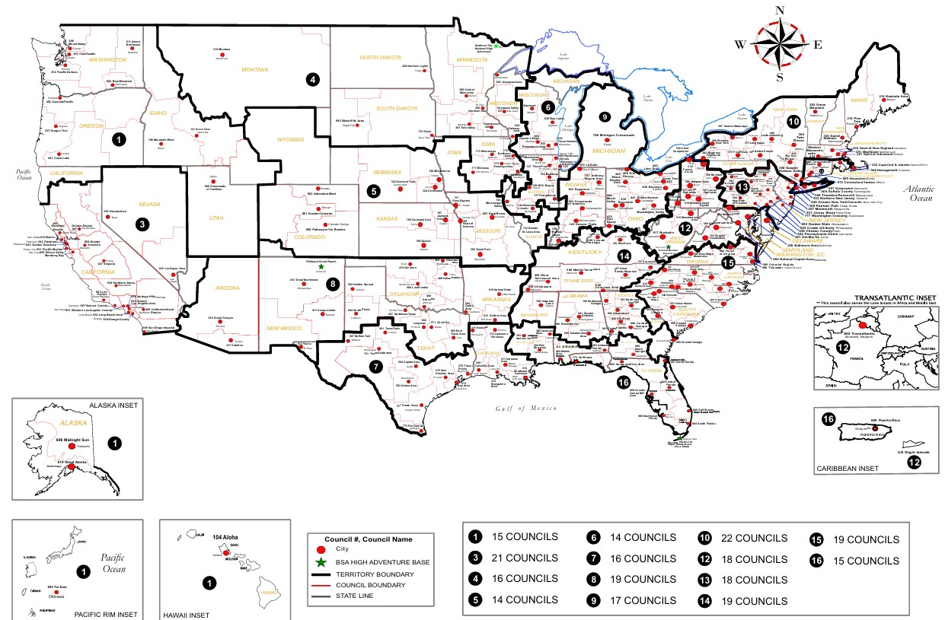

Exploring Associate Resource Advisors
Serve the Entire Country
Find your Council Service Territory & assigned ERAA at
www.exploring.org/about-us

Slide 40

THANK YOU
FOR YOUR
SERVICE TO

Slide 41
Back-Up Slides

Slide 42

What is Exploring?
Hands-on career education program
Helps identify career of interest
Enables informed career decisions
Exploring Program Membership
  Clubs ~ Completion of fifth grade ages 10-14
  Posts ~ Ages 14 & in high school thru age 20
Exploring’s Purpose ~ provide experiences to help young people mature and become responsible and caring adults, and to provide experiences to help young people learn about different careers

Slide 43

12 Exploring Career Fields

Slide 44
Exploring Emphasis Areas ~ How the Program Works
Career Opportunities ~ The opportunity for young adults to interact with business & government agency leaders is an important feature of the Exploring Program
Leadership Experience ~ Since the club or post is run by the Explorers, the training & development of youth officers and / or the post or club leaders is critical
Life Skills ~ Formal & informal social gatherings or activities that cause all participants to interact are a natural part of the club or post program
Citizenship ~ Developing & participating in community service projects is one way the club or post ensures that service is an integral part of its program & activities
Character Education ~ Exploring has developed a series of ethical controversy activities that allow Explorers to investigate & explore several ethical dilemmas. These exercises help develop positive decision-making skills in regard to the ethical & moral decisions they encounter daily

Slide 45
Exploring vs Traditional Scouting
 | SCOUTS BSA | VENTURING | SEA SCOUTS | EXPLORING
UNIT | Troop | Crew | Ship | Club / Post
LEADER | Scoutmaster | Advisor | Skipper | Sponsor / Advisor
YOUTH LEADER | Senior Patrol Leader | President | Boatswain | President or Agency Nomenclature
YOUTH PARTICIPANT | Scout | Venturer | Sea Scout | Participant or Explorer
RE-REGISTRATION | Charter Renewal | Charter Renewal | Charter Renewal | MOU Renewal
SPONSOR | Chartered Org | Chartered Org | Charter Org | Participating Org
SPONSORING AGREEMENT | Charter | Charter | Charter | Memorandum of Understanding (MOU)
UNIT SERVICE | Commissioner | Commissioner | Commissioner | Commissioner / Service Team
YOUTH RUN | Yes | Yes | Yes | Yes
AGE SPAN | 11-18 | 13-20 | 13 - 20 | 11-13 / 14-20
RELIGIOUS DECLARATION | Duty to God | Duty to God | Duty to God | None
UNIFORM | Scouts BSA | Venturing (Unit Selected) | Sea Scouts (Unit Selected) | Club / Post Selected, not required

Slide 46
Exploring: Additive to Traditional Programs
Benefits to Local Councils
New Sources of Membership Growth
  New entry point in addition to Cubs
  Majority of our members have never been in any other Scouting America Program
New Source of Senior Volunteer Recruitment
  Business and civic leaders with no Scouting history
  Candidates specifically interested in high school age youth
New Sources of Foundation and Corporate Giving
  Workforce readiness a hot topic for foundations
  Funders looking for “return on investment”
School Access and Cooperation
Outreach to Economically Challenged and Underserved Diverse Communities (many of these youth have never been in traditional Scouting)

Slide 47
12 Exploring Career Fields

Slide 48
Topic(s) of the Month
4 Phases of Organizing a New Post/Club

Slide 49
REGISTRATION BASICS
YOUTH
POST: ___ and have completed eighth grade OR 15 years of age but not yet ___ years old
CLUB: 6th-8th graders who have completed the ____ grade and are at least 10 years old but have not completed the eighth grade and are not yet ____ years old.
ADULTS
___ years age or older
POST: Min of 4 adults
  ______________ (CC)
  2 ____________ (MC)
  _______________ (EA)
CLUB: 2 adults _______________ (ES)
_______________ (AS)
PAPERWORK
New Post/Club ____________
4 _________ Apps
5 _________ Apps
Annual ______________
of Understanding
$____ General Liability Insurance Fee
$____ per person registration fee
14
21
Application
21
Adult
Committee Chair
2 Committee Members
Youth
5th
Advisor
Memorandum
Sponsor
100
15
Assoc Sponsor
50
Exploring Youth Participants “EP’s” ages 18-20 must complete an
Exploring ________ Application & Successfully Complete YPT.
Adult

Slide 50
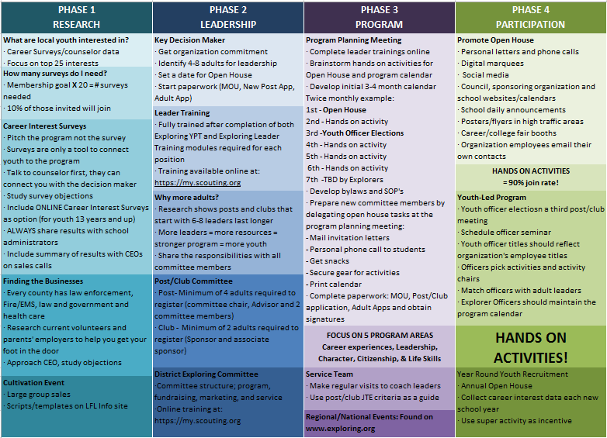

Slide 51
4 Steps/Phases in Organizing a new Post
1. Research-
Conduct the Career interest surveys
and develop business/community prospects
2. Leadership-
Meeting with the top leadership within the
businesses/community and identifying program
leaders; includes training of leaders
3. Program-
Develop the organization’s meeting/program
themes and prepare for an open house
4. Participation-
Recruiting youth through an organized open house and
involvement of youth in program development

Slide 52
MOST IMPORTANT PART
OF EACH PHASE?
Phase 1 : Career Interest Surveys
Phase 2: Training
Phase 3: All-In-One Program Planning Meeting
Phase 4: Open House

Slide 53
Career Interest Surveys
The # 1
Leading Indicator for Exploring Growth

Slide 55
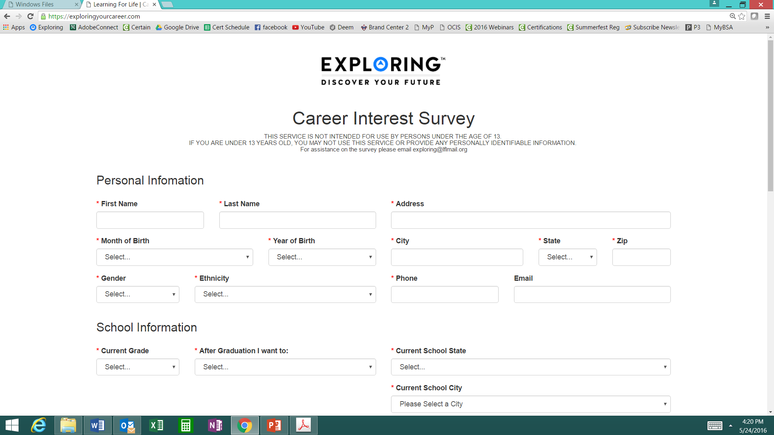
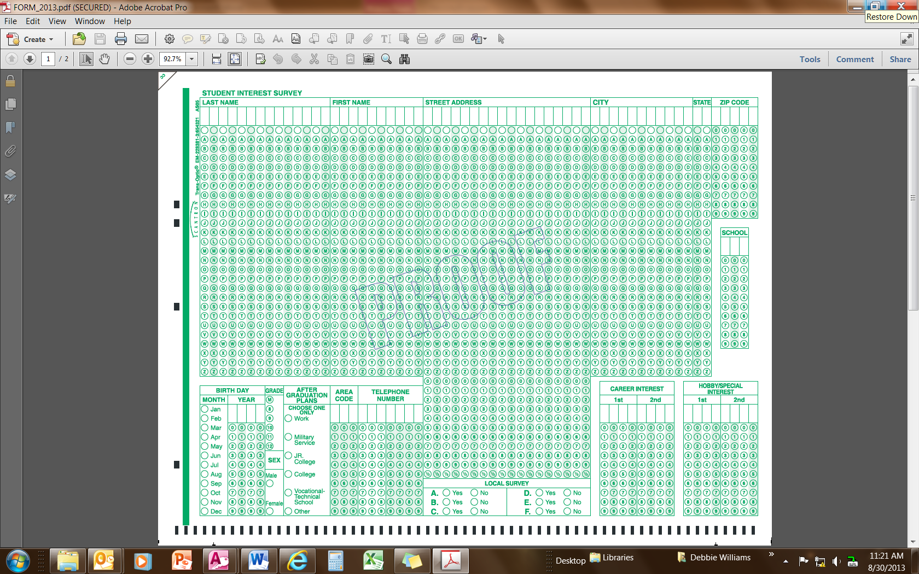
Phase 1 – Research
Career Interest Surveys (two choices)
pa
pa
Online Survey:
www.exploringyourcareer.com
Paper Scantron Survey

Slide 56
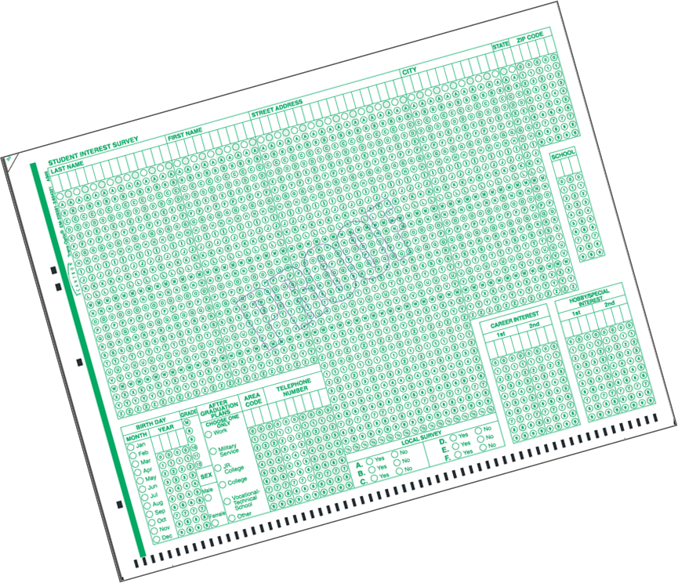
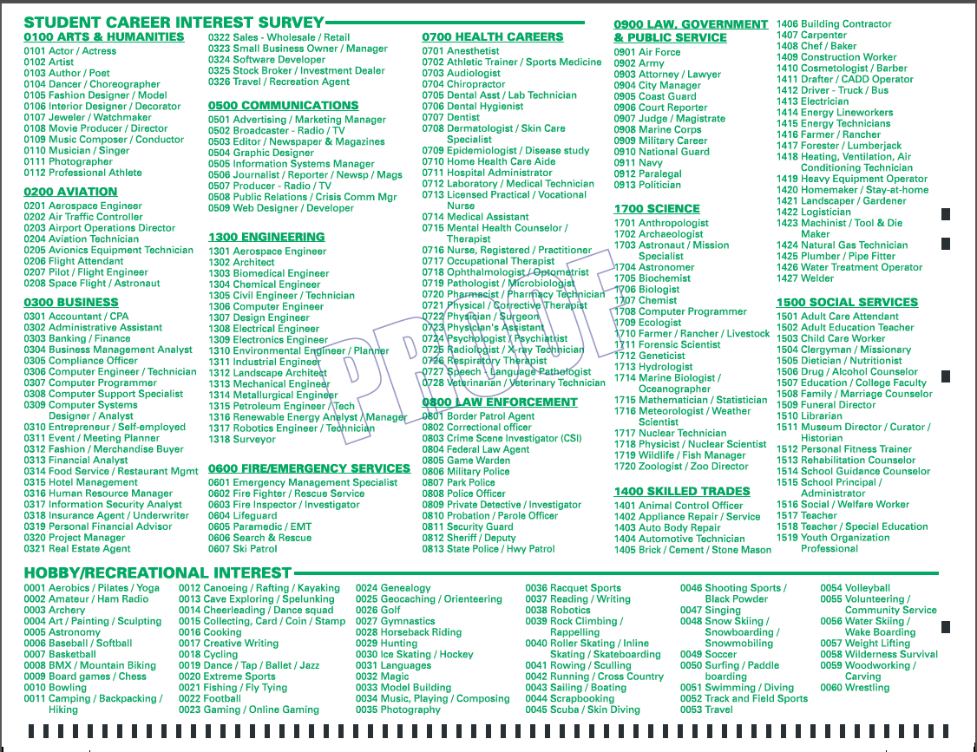
BACK SIDE
FRONT SIDE
Paper Scantron Survey Available through NDC

Slide 57
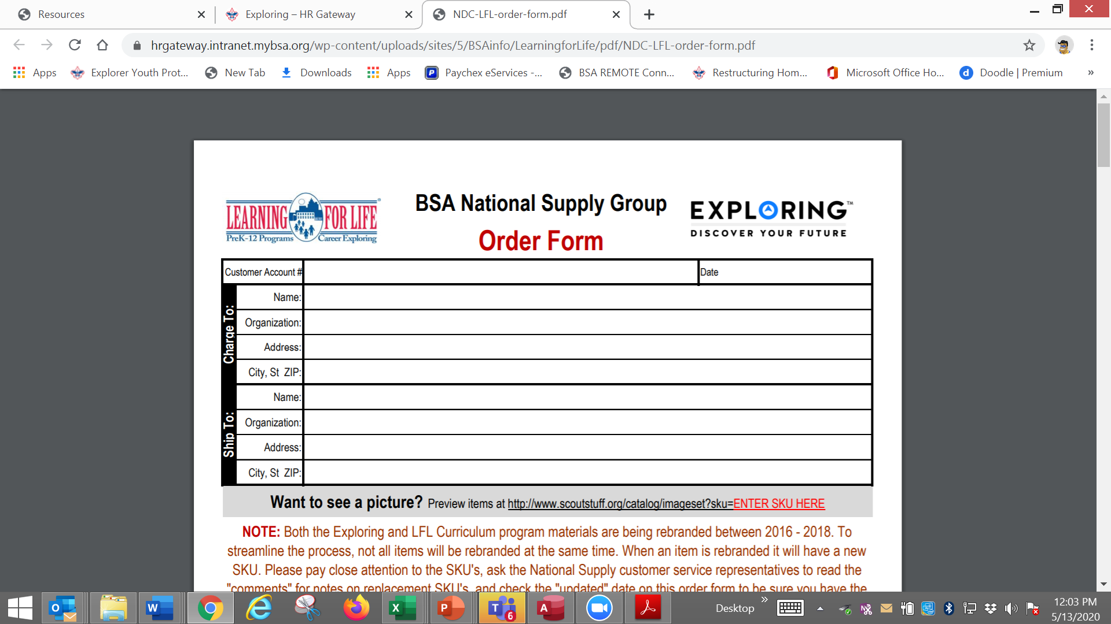

Slide 58
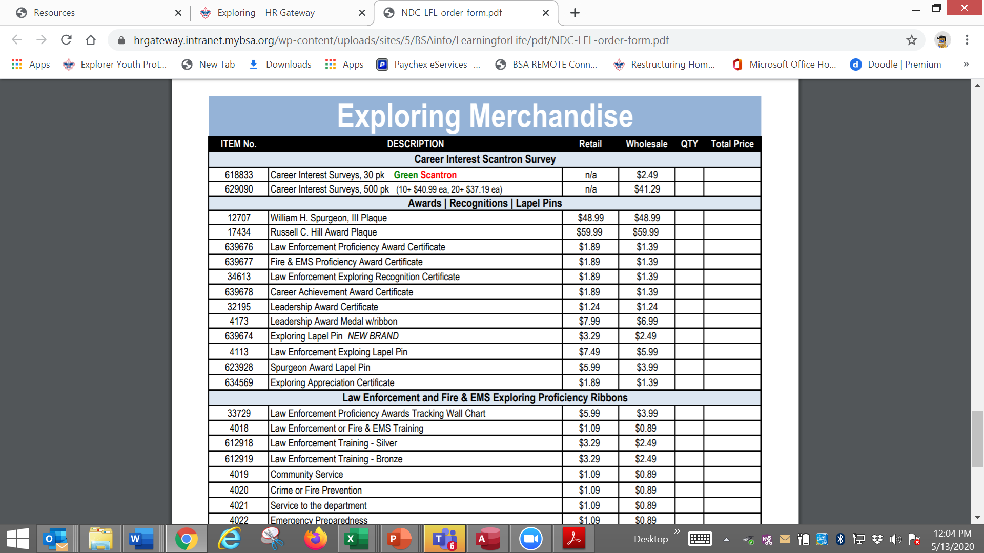

Slide 59

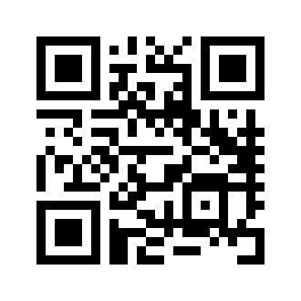
Online Career Interest Survey
www.exploringyourcareer.com
TRY IT NOW!
Use QR code or simply type address in web browser
Notes:
A “QR” or Quick Response code was created to take students directly to the survey site. It is available on posters, post cards, business cards, and book marks.
How do you use this? Email it to all teachers, they can open it from email and project it one screen for students to use their smartphones!

Slide 60
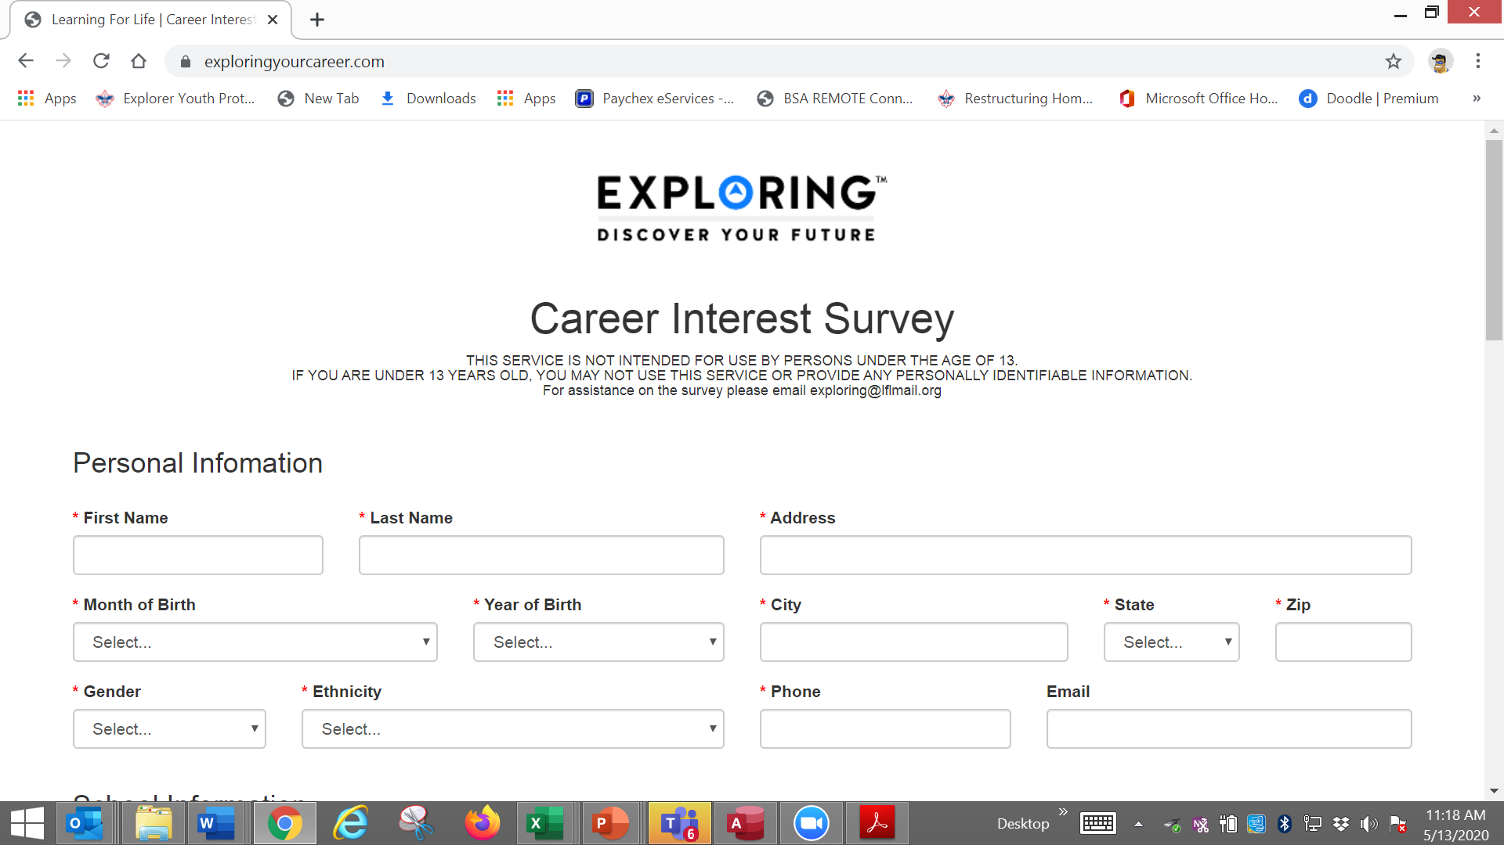

Slide 61
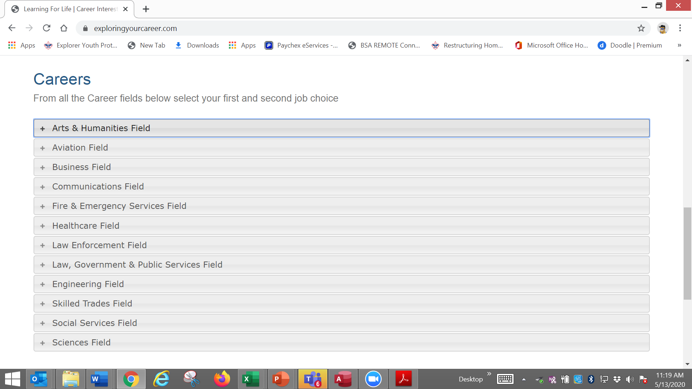

Slide 62
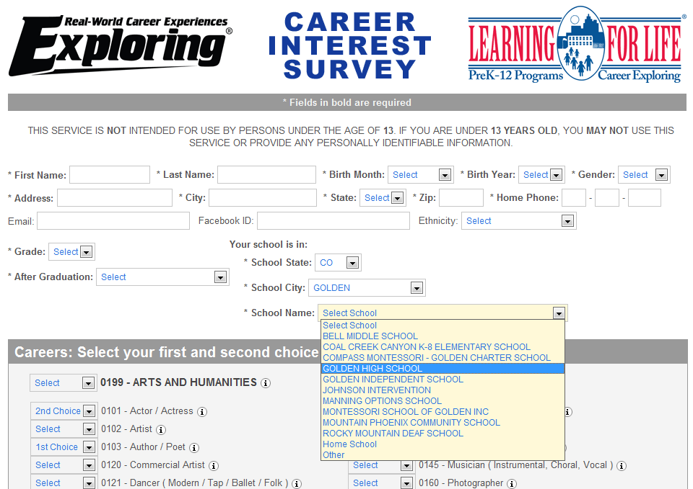
www.exploringyourcareer.org
Two career & hobby choices
School names
pre-loaded
Notes:
REFER TO HANDOUT IN YOUR FOLDER.
This is a screen shot of the new Online Career Interest Survey that was activated on Jan 1, 2012.
The careers & hobbies match the paper version. So schools and administer the survey either on paper or electronically.
The online version can be accessed from any device that can access the Internet – including smart phones.
Results are sent instantly to a secure website where councils can access the results and provide them to schools in the same format as the paper survey.
Instructions for accessing results can be found in the LFL internal site.
Students 13 yrs. and younger cannot legally complete this survey online. If they enter data, the system will not save it.
You can also add schools/colleges to this list if they do not populate when you put in your respective zip code. Simply e-mail us at exploring@lflmail.org and request your specific school to be added, with zip code

Slide 63
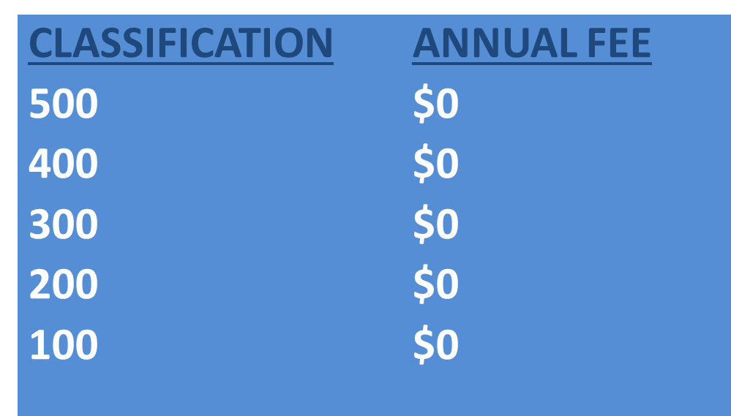
Online Career Interest Survey COSTS
Unlimited schools and unlimited surveys for students 13 years of age and older

Slide 64
REPORTS GENERATED FROM THE SURVEYS

Slide 65
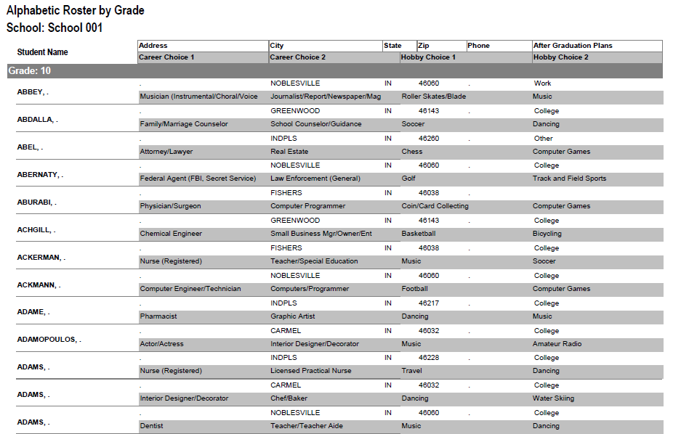
RESULTS REPORT: School
Grade: 10
ABBEY, Susie 123 Main St Noblesville IN 46060 Work
Career 1 Career 2 Hobby 1 Hobby 2
Musician Journalist Roller Skate /Blade Music
65
Notes:
65
No matter the survey format you use, the reports are generated the same way.
**GOOD data to establish credibility at/during your sales call
This is one set of sample results provided at no cost to schools. Very helpful for Guidance Counselors.
All students, by grade, alphabetically. Shows:
Career interests
Hobby interests
Post-high school plans
Other results include all students interested in each career (all the attorneys, architects, dentists, electricians, etc). Helpful for Guidance Counselor planning, career speakers, college days and college fairs.
Be sure to return results to the Guidance Counselor when you say you will – under promise and over deliver. Do not promise results in one week if you cannot do it. Say 2-3 weeks, then they will be very happy if they do receive them in a week or ten days.

Slide 66

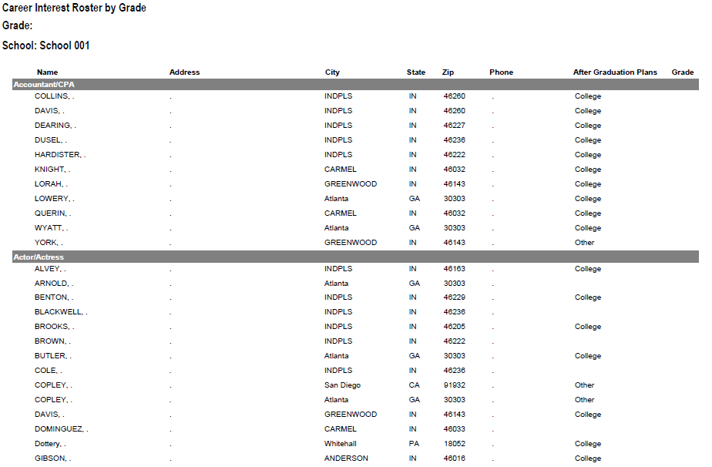
RESULTS REPORT: School
66
Notes:
66
This is another set of sample results provided at no cost to schools. Very helpful for Guidance Counselors.
This report includes all students interested in each career (all the attorneys, architects, dentists, electricians, etc.). Helpful for Guidance Counselor planning and career speakers.
The After Graduation Plans is important to Guidance Counselors
College
Junior college
Military Service
Technical school
Work
Other
Why are these reports help full to the school…to you?

Slide 67
Summary Career Interest Report by Council
Code Career Count
0712 Nurse (Registered) 798
0145 Musician (Instrumental/Choral/Voice) 751
0903 Attorney/Lawyer 733
1625 Teacher/Teacher Aide 678
0300 Business (General) 645
0719 Physician/Surgeon 604
0101 Actor/Actress 600
0130 Fashion Designer/Model/Buyer 579
0721 Psychiatrist/Psychologist 578
0170 Professional Athlete 507
0180 Photographer 461
1305 Architect 437
0725 Veterinarian 429
0102 Artist 427
0718 Physical Corrective Therapist 313
1300 Engineering (General) 208
MOST IMPORTANT TO YOU

Slide 68
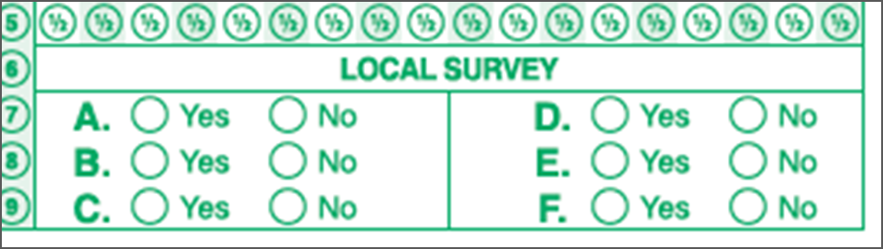
Career Interest Survey Questions
Opportunity for 6 “Yes” or “No” questions
Unique feature of our survey
Anything school officials want to know
  Are you planning to take the SAT / ACT?
  Are drugs a problem in our school?
  Is there enough student parking?

Slide 69
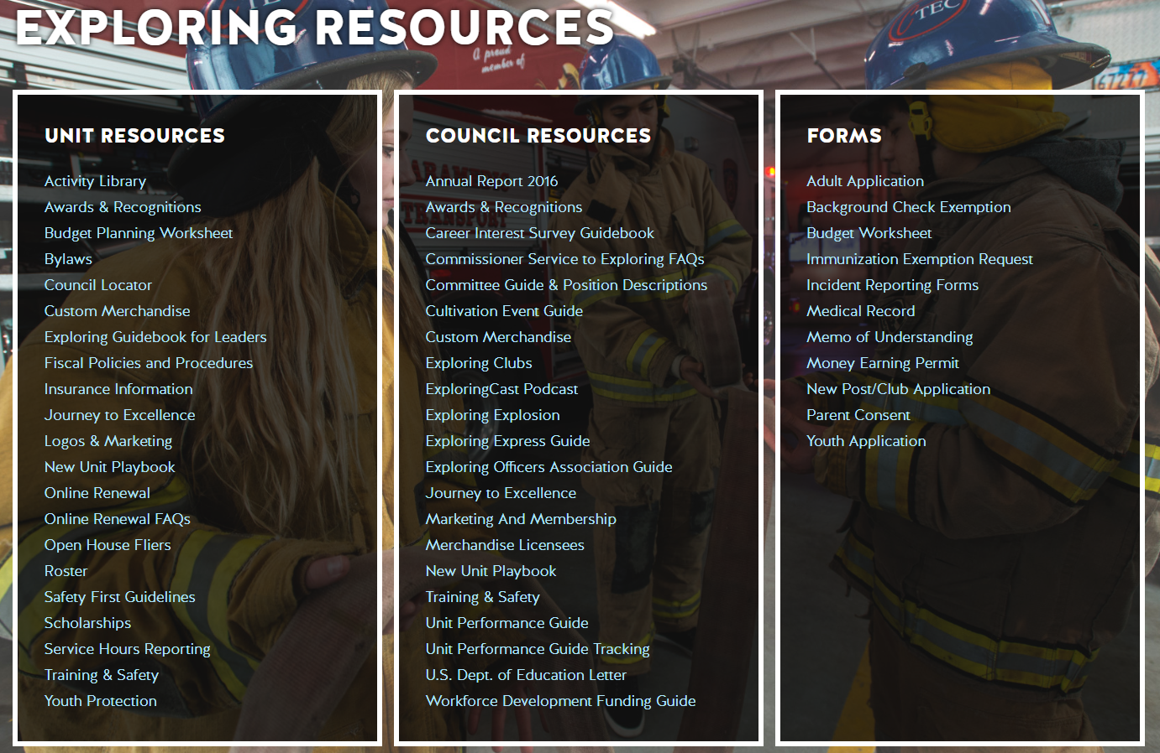
www.exploring.org

Slide 70

Career Interest Survey Guidebook
Be sure you have the most recent version
Download at www.exploring.org
One stop shop for all CIS resources
Table of Contents
  Page 5 | At A Glance
  Page 7 | Overcoming Objections
  Page 44 | Appendix

Slide 71
ALTERNATE METHODS?
1. Use school information already available
2. Ask youth to develop contacts
3. Develop cultivation events
4. Invite Eagle Scouts / Scouts to join
5. Booth at schools open house night and career days /career fairs
6. Annual Exploring open houses for ALL Posts and Clubs
7. Follow up leads from the Exploring Lead
Generator

Slide 72
BASED ON SURVEY RESULTS
1. Focus on Top 4 students interests
2. Identify companies in those 4 interest areas
3. Identify the path to the CEO
  Council board contacts
  School board/admins
  PAS find
  Nominating committee
  Applications

Slide 73
Career Interest Survey Guidebook
Be sure you have the most recent version
Download at www.exploring.org
One stop shop for all CIS resources
Table of Contents
  Page 5 | At A Glance
  Page 7 | Overcoming Objections
  Page 44 | Appendix

Slide 74


Slide 75
Leads are being generated from Exploring.org and include anyone interested in joining, leading, sponsoring, or
otherwise supporting Exploring in their area.
Scout Executives, Assistant Scout Executives and DFS’s receive weekly lead reports.
Exploring Executives and staff advisors receive immediate notifications of each lead generated.
To make changes to any of these settings, email your request to exploring@lflmail.org.
WHEN YOU RECEIVE AN IMMEDIATE NOTIFICATION EMAIL:
1. In the email, you will see a note to “copy & paste the following URL into your browser to mark lead as contacted”.
By following this directive, you are changing the status of your lead to “contacted”. You will no longer receive email notifications for that particular lead. The lead will begin to show as “contacted” on your SE’s weekly report.
Invite the person to attend an existing post/club meeting to get a feel for the program and connect them to
appropriate Exploring advisors.

Slide 76
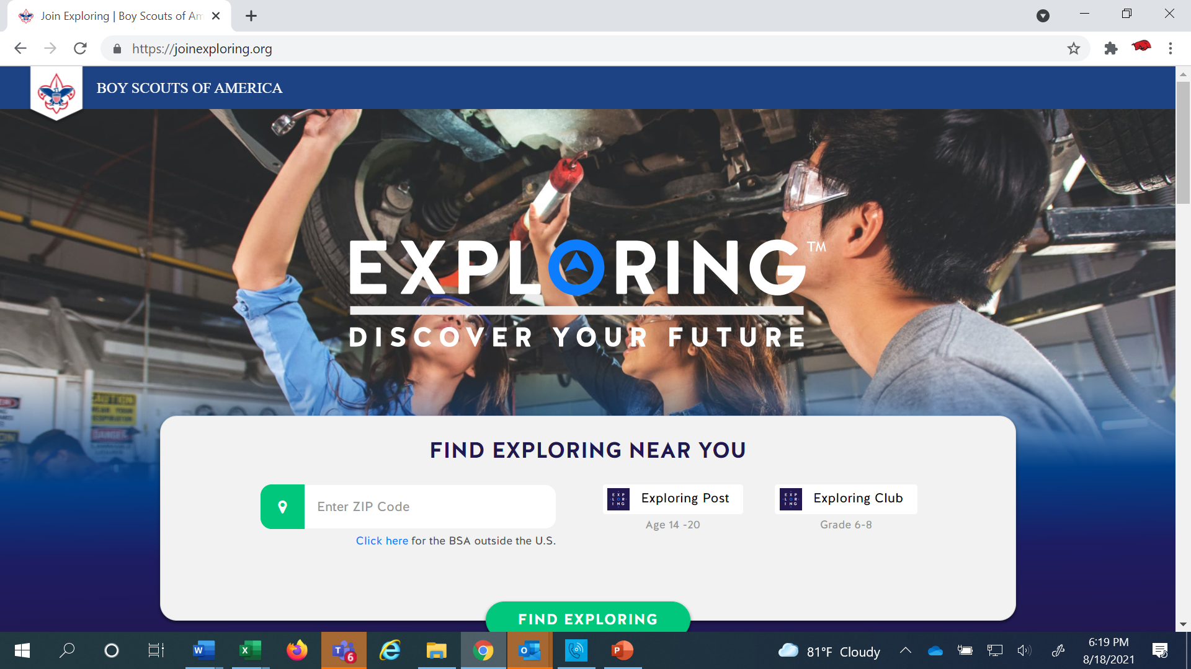
www.joinexploring.org

Slide 78

Phase 2 - Leadership
CEO’s Police/Fire Chiefs Administrators
Industry Experts Retirees Community Leaders

Slide 79

Moving forward with the CEO
1) Get organization’s commitment
2) Identify 6-8 adults
- CEO invites them
- You provide guidance
3) Set 2 dates for:
  - All-In-One program planning
  meeting
  - Open House
4) Start Paperwork
  - New Club/Post Application
  - MOU, Adult Application

Slide 80
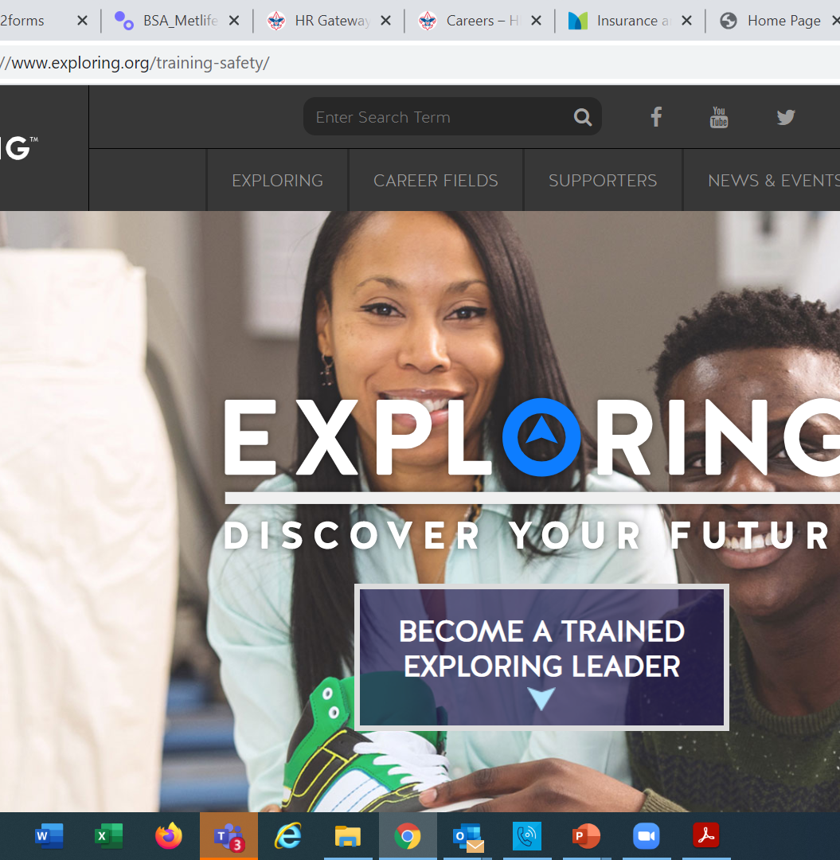
  Exploring Training

Slide 81
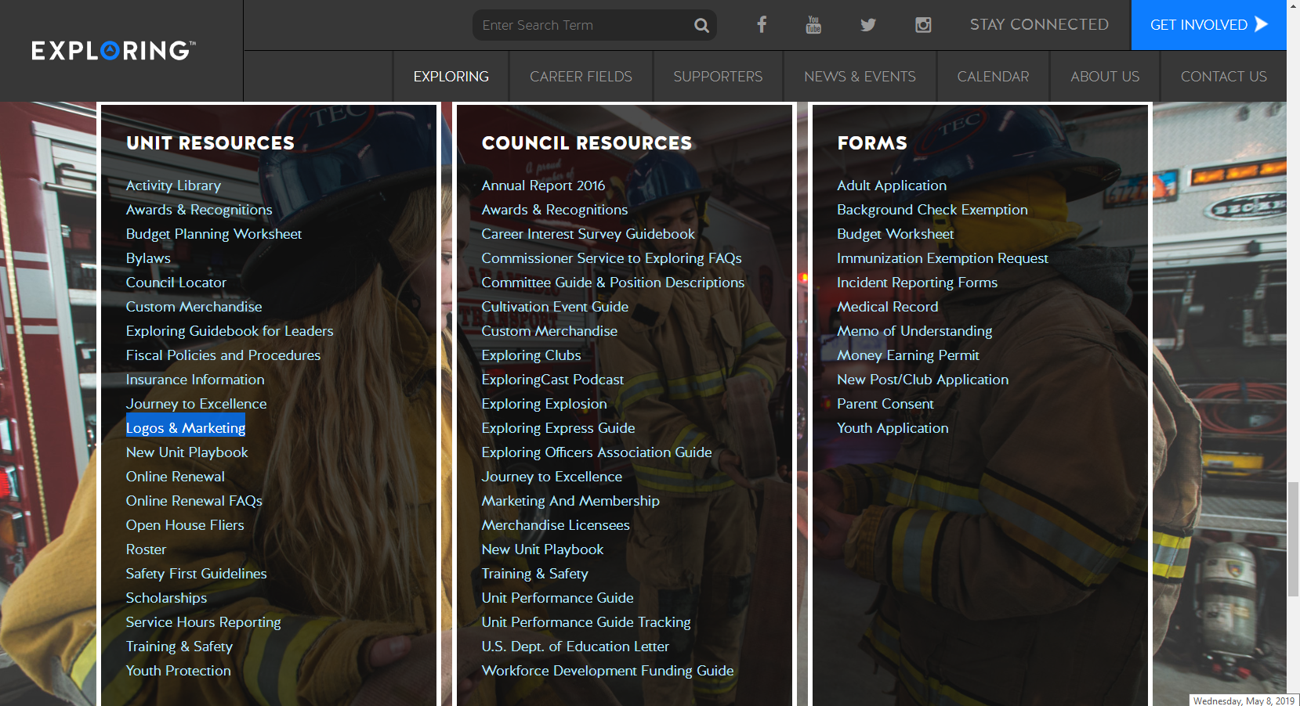

Slide 82
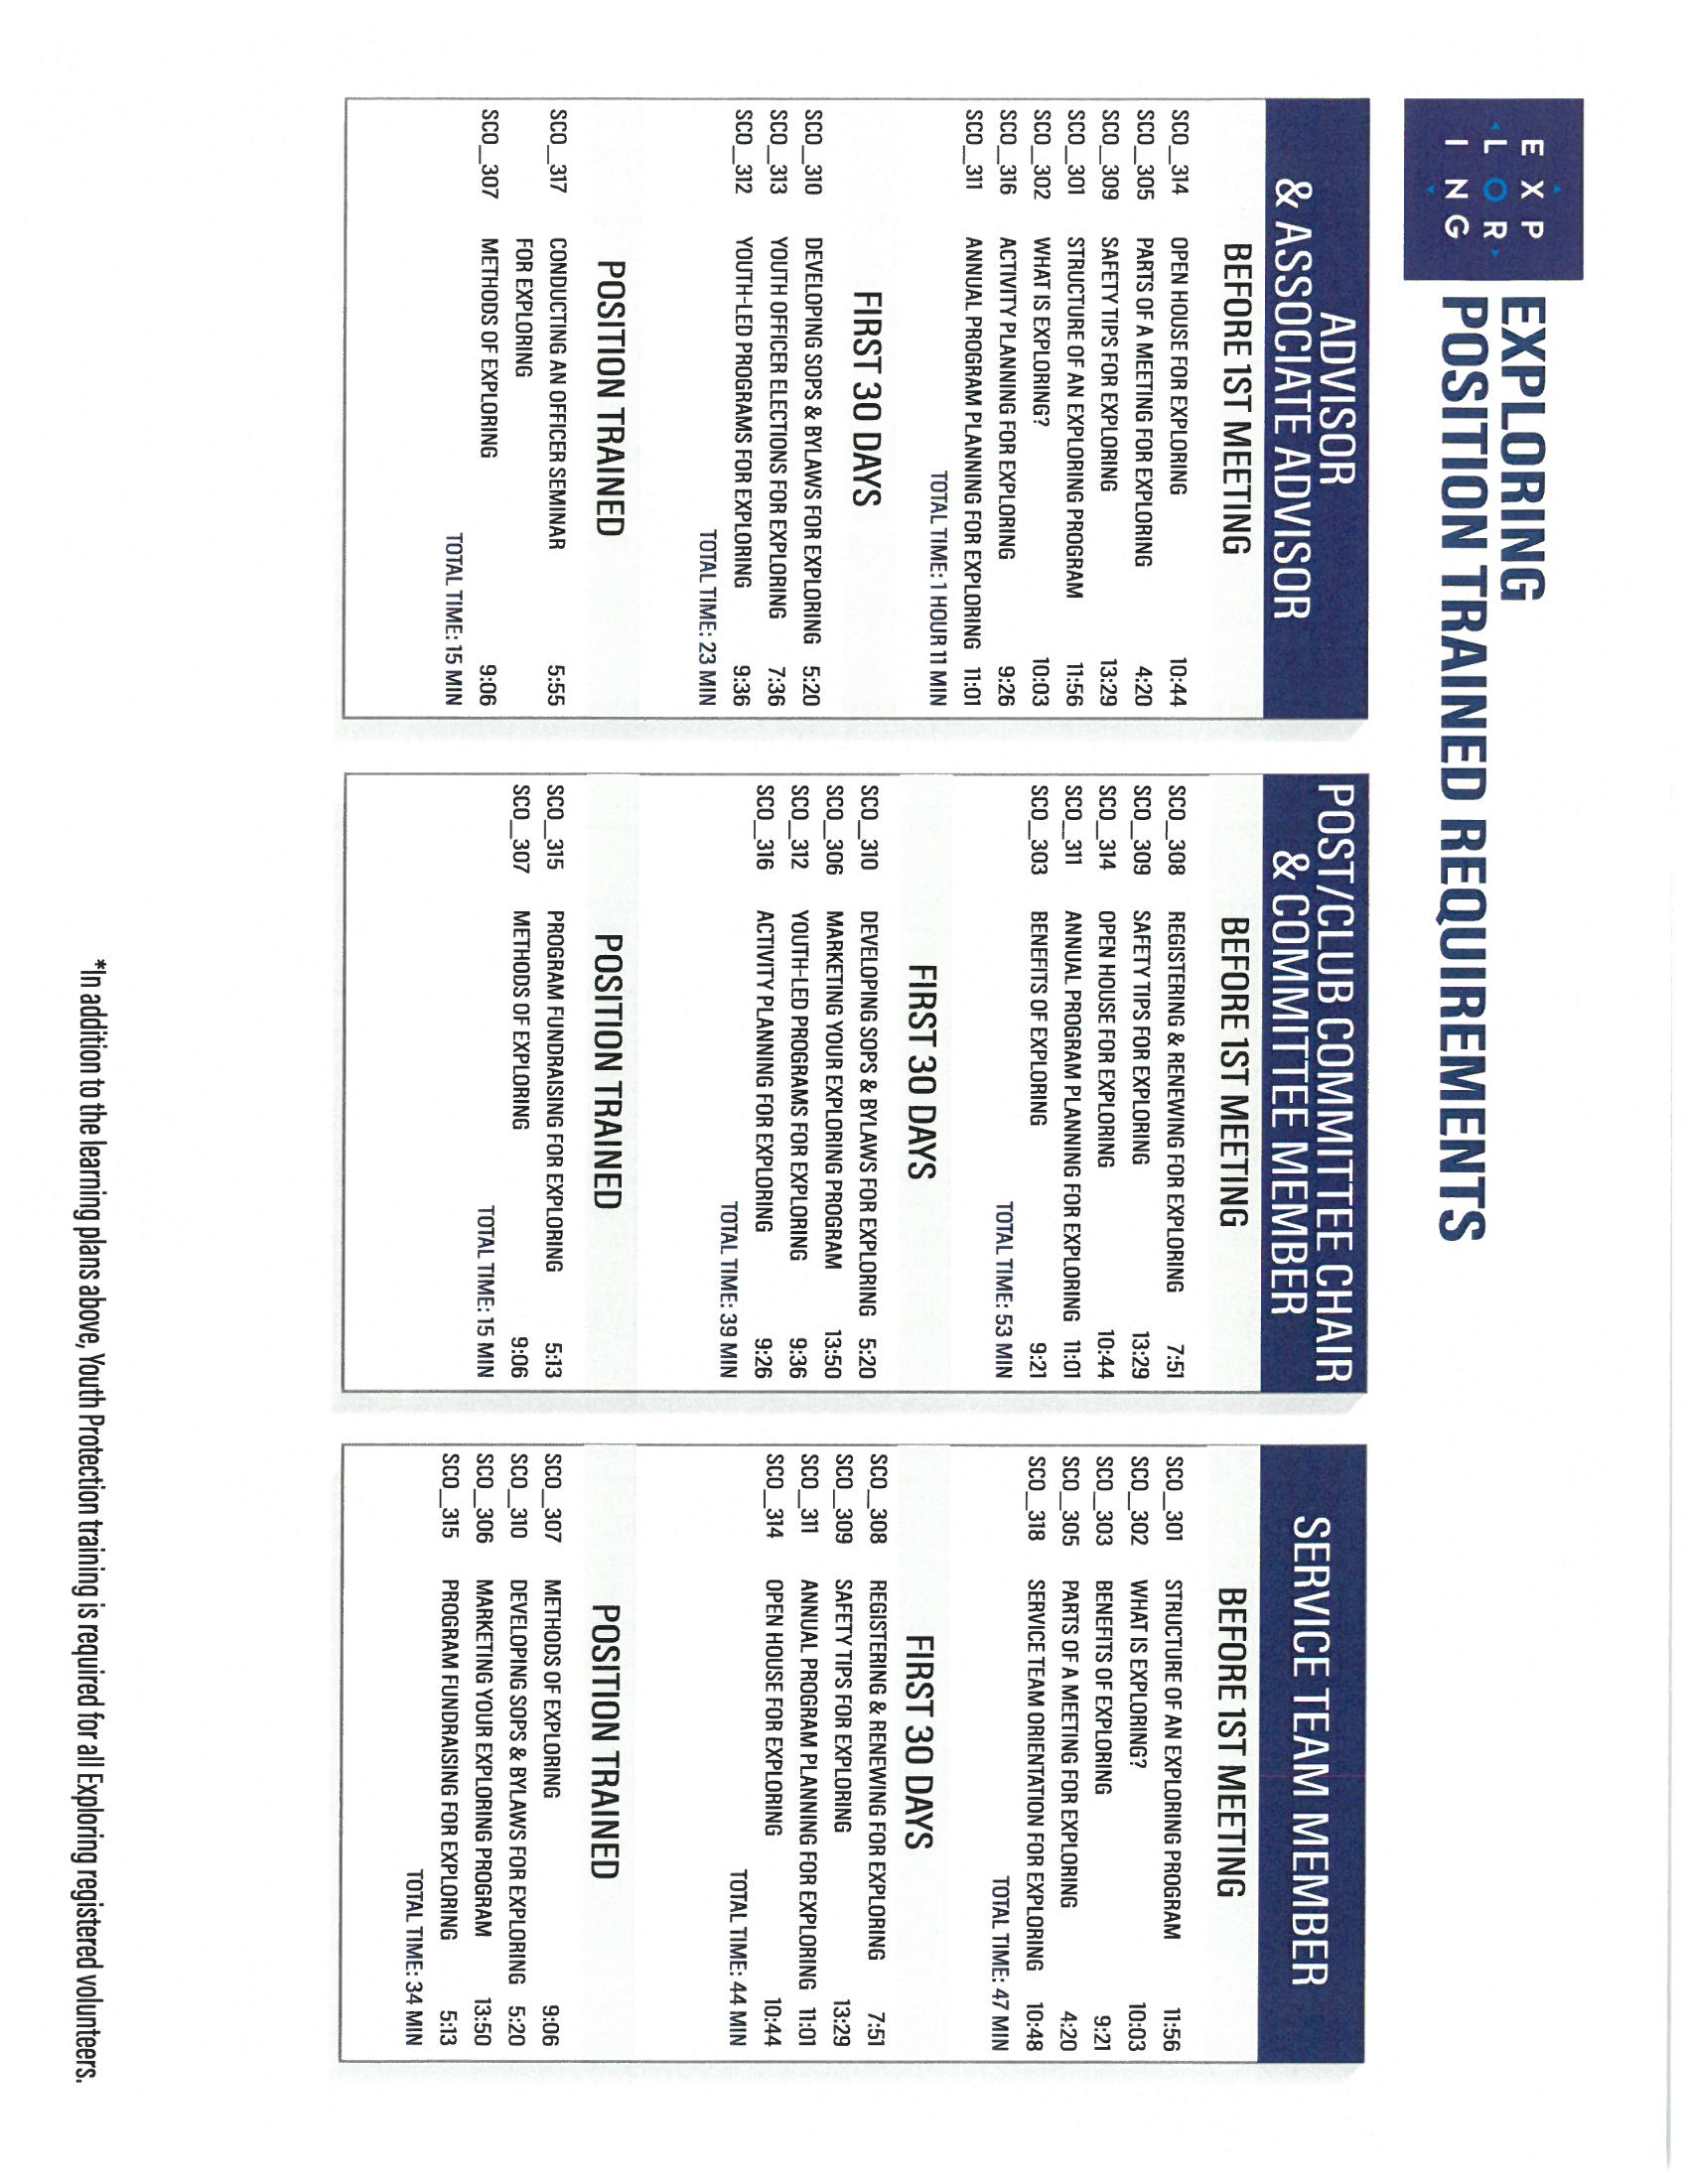
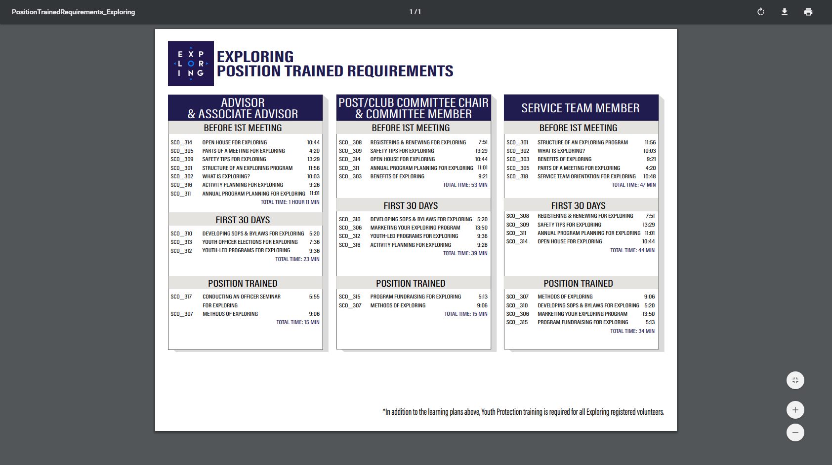
Phase Two: Training

Slide 84
Important resources to help plan the program…
Career Opportunity Worksheet -- www.exploring.org and click on relevant career field icon and scroll to the bottom of the page.
Activity Library (including Life Skills Section) https://www.exploring.org/activity-library/
Organization’s Resources/Employees
  A. Current work curriculum (developed by the company)
  B. Employee’s expertise/knowledge (Use All-in One Program Planning Meeting-found in the Exploring Guidebook for Leaders)
Career Achievement Award (Posts) & Career Awareness Award (Clubs)
  http://www.exploring.org/wp-content/uploads/2017/06/Career-Achievement-Award-May2017.pdf
  http://www.exploring.org/wp-content/uploads/2018/05/Career-Awareness-Award-FINAL.pdf
Exploring Guidebook for Leaders https://www.exploring.org/wp-content/uploads/2016/10/Exploring-Guidebook-Sept2017.800-10018.pdf
Safety First Guidelines/Guide to Safe Scouting (Guide is being Updated—Please follow all CURRENT YPT Policies)
https://www.exploring.org/wp-content/uploads/2021/08/LFL-safety-first-guidelines-3.21.17_8.pdf
7. Online Exploring Adult Leader Specific Training & Youth Protection Training
https://www.exploring.org/training-safety/ or www.myscouting.org
8. Unit Performance Guide (Chapter 5- Exploring) –Details about organizing a new Post/Club
http://www.exploring.org/wp-content/uploads/2021/04/522-02516_UPG.compressed.pdf
Also visit www.exploringexplosion.org and scroll to the bottom of the website to find additional resources…

Slide 85

Phase 3 – Program
All-In-One Program Planning Meeting
1) Paperwork
2) Adult Explorer Leader Training
  - Youth Protection for Explorers
  - Adult Explorer Leader Training
3) Open House Planning
  - Brainstorm session
  Why did you choose this career for yourself?
  What are hands on activities that you can do with youth?
  - Develop a 3-4-month calendar (use Activity Library)
  - Choose Open House “hands-on activities”
4) Prepare Post Committee Members for Open House

Slide 86


SAMPLE PROGRAM CALENDARS
The frequency of your meetings and length of your program each year is up to you. For example, this could be a 12 month or 12 week program.
ENGINEERING & TECH
MONTHLY MEETINGS YEAR-ROUND
September
Open House
October
Chemical engineering
November
Youth Officer Elections
December
Holiday Play – open house
January
Industrial Technology
February
Electrical engineering
March
Computer science
April
Fluid power technology
May
Ethics in engineering
June
Visit with engineering firm
July
Civil engineering
August
Mechanical engineering
Notes:
PRESENTER NOTES:
BE SURE TO DELETE THE CALENDARS/SLIDES THAT ARE NOT RELEVANT TO THE CAREER INDUSTRY TO WHICH YOU’RE PRESENTING.
Remind the audience that they have flexibility is setting the schedule for their own program. Here are some options:
Year round – may or may not include summer
Weekly
Monthly
3 months at a time, different group of youth each time, 3 times per year
Weeknights or weekends

Slide 87

Phase 3 – Program
Planning the Open House
1) From your BRAINSTORM session…
  - Pick the 4-5 best activities for a quick hands-on
  format at the Open House
2) At the open house…“Go shopping”
  - 4-5 stations (rotations)
  - 4-5 minutes each

Slide 88
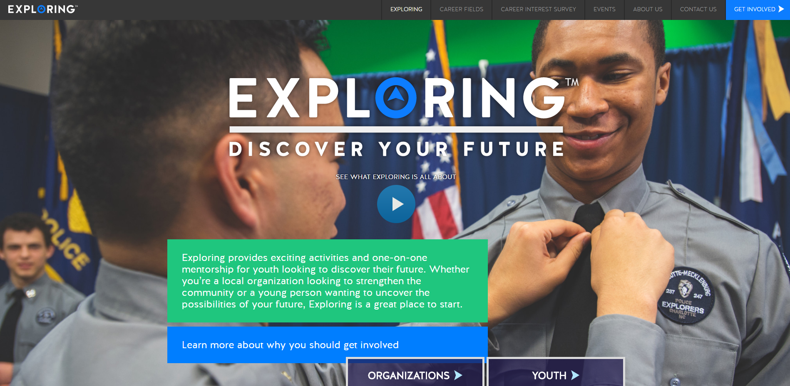

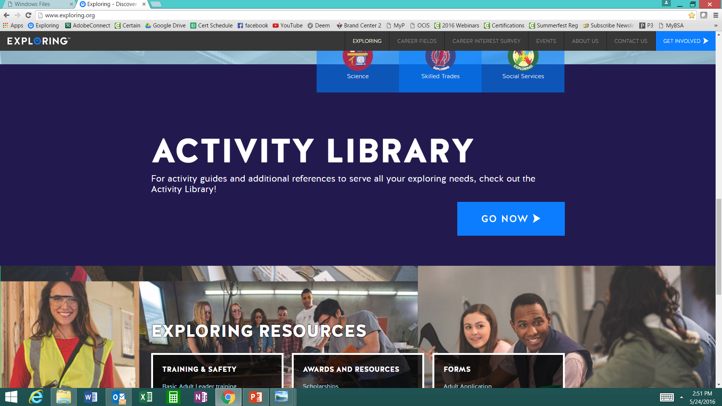

www.exploring.org
Notes:
Program planning is also a service that is provided by the local Boy Scout Council. This Activity Library is an all new supplement to the process. You will find it on www.exploring.org

Slide 90
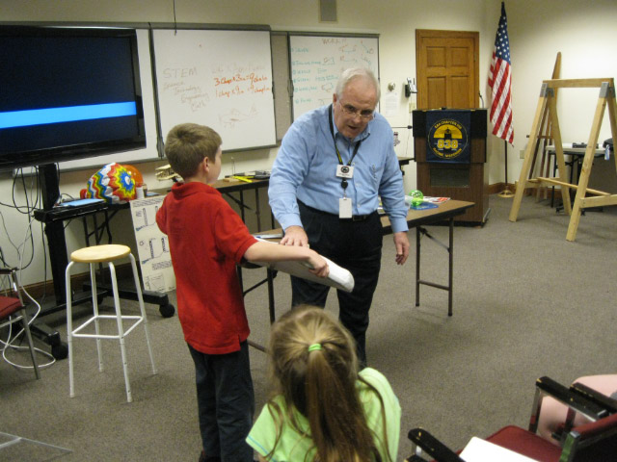
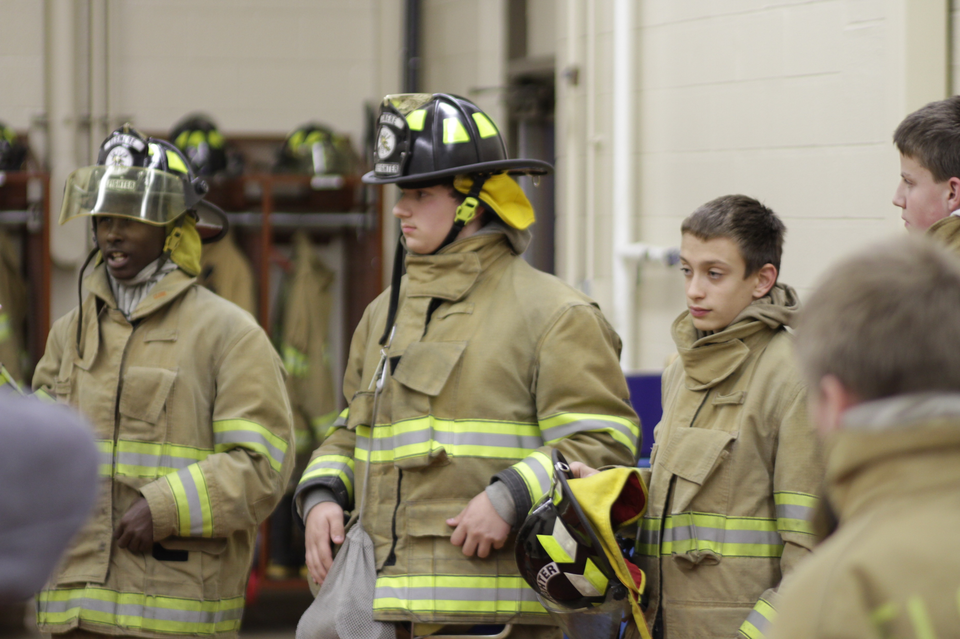
Phase 4 – Participation
SIMPLE OPEN HOUSE AGENDA
OPEN HOUSE AGENDA
Welcome
What is Exploring?
Video
HANDS-ON ACTIVITIES
Activity Interest Survey (customized)
Calendar
ASK TO JOIN
Applications & fees
Snacks

Slide 91
Journey to Excellence
(JTE) unit recognition program to be retired
Effective December 31, 2024, the Journey to Excellence unit recognition program will be retired. Moving forward, metrics for Scouting and Exploring unit success will be seamlessly integrated into unit leader support materials and resources. These metrics will be consistent with those used by the Commissioner corps to support Scouting and Exploring units. This new approach aims to provide a consistent and more streamlined and effective method for evaluating and enhancing unit performance. Feedback from unit leaders and survey results played a crucial role in making this decision. We believe this transition will better support our unit leaders and ultimately improve the experience for all participants as we continue to develop and deliver relevant programs. Units can continue to purchase 2024 Journey to Excellence recognition items through December 31, 2025.

Slide 92

Exploring Youth Training Update
https://www.scouting.org/training/youth-protection/venturing/

Slide 94
Leads are being generated from Exploring.org and include anyone interested in joining, leading, sponsoring, or
otherwise supporting Exploring in their area.
Scout Executives, Assistant Scout Executives and DFS’s receive weekly lead reports.
Exploring Executives and staff advisors receive immediate notifications of each lead generated.
To make changes to any of these settings, email your request to exploring@lflmail.org.
WHEN YOU RECEIVE AN IMMEDIATE NOTIFICATION EMAIL:
1. In the email, you will see a note to “copy & paste the following URL into your browser to mark lead as contacted”.
By following this directive, you are changing the status of your lead to “contacted”. You will no longer receive email notifications for that particular lead. The lead will begin to show as “contacted” on your SE’s weekly report.
Invite the person to attend an existing post/club meeting to get a feel for the program and connect them to
appropriate Exploring advisors.

Slide 95
www.joinexploring.org

Slide 96
Barriers to Abuse Update
As part of our ongoing commitment to abuse prevention, the Boy Scouts of America, to include Exploring, is updating the adult supervision requirements for overnight activities
This update enhances the minimum “two deep leadership” requirements by additionally requiring every adult present on overnight activities to be a registered member of the Boy Scouts of America or Exploring
These adults must submit an adult application and registration fee, undergo a criminal background check, a volunteer screening database check and must complete mandatory Youth Protection training.
A limited exception for parents and legal guardians of Cub Scout youth attending overnight with their children is planned due to the family centric nature of Cub Scouting
All Cub Scout Packs, Scouts BSA Troops, Venturing Crews, Sea Scouting Ships, Exploring Posts, council, and district overnight programs will be required to comply with this update by September 1, 2023. We encourage early adoption prior to the effective date
This updated Barrier to Abuse will be referenced as part of the Guide to Safe Scouting, Exploring’s Safety First Guidelines, Youth Protection and Adult Leadership section, Scouting’s Barriers to Abuse. Youth Protection and Barriers to Abuse FAQ’s will be expanded to include additional FAQ’s as they are developed

Slide 97
National Exploring
Volunteer of the Month
The National Volunteer of the Month will be recognized on www.exploring.org
and will receive a certificate and polo shirt from the National Exploring Team!
Nominees should be submitted using the link below
http://bit.ly/ExpVolMonth

Slide 98
Example Nomination Write-Up
George Denise completed his Exploring Fast Start training on 1/01/2011 and his most recent position is Service Team Chair for my district since February 2018. He has been involved with every aspect from FOS and volunteer recruitment to membership, product sales, program and unit service. George helped Exploring District achieved significant growth in our FOS campaign and 5% membership growth last year. We are at 61% of our FOS goal for the year, second highest percentage in our council. As we shelter-in-place, he secured a dynamic guest speaker for our Science Night and saved us $650 in shipping cost in our Make A Mask Challenge. His efforts made it possible for us to donate thousands of pieces of protective medical gear to 7 medical facilities in 2 counties. He supported a 15 year old Scout in the Medical Explorer program whom has wanted to make a difference. What started as a local mask-making challenge turned into a multi-city effort through connections of Scouting friends in Dallas, TX and Orange County, CA to Santa Clara county .

Slide 99



STAY CONNECTED
page | @lflexploring
group | Exploring Success!
group | National Explorer Alumni Association
learningforlifeusa
exploring.org | Stay Connected
exploring@lflmail.org

Slide 100
Questions?

Slide 101

2025 NATIONAL EXPLORING LIVE HOURS
The National Exploring Live Hour is a monthly Zoom video conference that will help engage and equip
Exploring volunteers and professionals to grow, support, and learn more about Exploring. Each month the National Exploring Live Hour will be led by our National Exploring Chair and the National Director of Exploring. The live hours will include sharing best practices and ideas that are happening within our councils, highlighting successful growth campaigns, and inspiring new ideas through various trainings. This will also offer an opportunity for local councils to collaborate with territory and national counterparts to generate innovative solutions to real-life Exploring challenges.
National Exploring Live Hour Schedule
1:00 PM – 2:00 PM Central Standard Time, Monthly
Register for each of the National Exploring Live Hour ZOOM presentations at:
https://reservations.scouting.org/profile/form/index.cfm?PKformID=0x156865abcd

Slide 102
Exploring at Home (Discuss Best Practices)
Idea Sharing
Questions and Answers from the Field https://drive.google.com/file/d/1Bo7U0iJ8Ti-bmyIFtxGfG0TIt3dB1xX4/view?usp=sharing
After the Live Hour Discussions
(Open Dialogue)

Slide 103


Good News from the Field!

Slide 104
v
END OF MAY 2025
EXPLORING LIVE HOUR
PRESENTATION SLIDES
All Other Slides Below are Informational

Slide 105
v
EXPLORING UPDATES
REMINDERS
Tim Anderson
National Director
Learning for Life & Exploring
National Director Older Youth Programs

Slide 106

EXPLORING PARTICIPANT POLICY
“EP” (18 THROUGH 20 YR OLD EXPLORERS)
Effective August 1, 2020, all applicants 18 through 20 years old must complete and submit an adult application, consent to a criminal background check, and successfully complete Youth Protection training.
However, an 18- through 20-year-old will still be considered an Adult Exploring Participant in the post and will not be considered an adult leader. Therefore, an “EP” will not be allowed to fulfill adult leadership roles pertaining to Two-Adult Leadership and other requirements that require leadership to be at least 21 years of age.
All Exploring Participants “EP” will continue to count as youth within your youth membership reports.
Visit the link below for an infographic as well as a Q & A to assist you in implementing this important new policy. http://filestore.scouting.org/filestore/se-packet/2020-08-10/Exploring-Participant-Policy-FINAL-2.pdf

Slide 107
EXPLORING REGISTRATION FEES
Effective August 1, 2023, Exploring fee updates:
- Exploring Youth $50.00
- Exploring Adult Participants (18-20) $50.00
- Exploring Adults $50.00
- Exploring Post/Club Annual Renewal Fee $100.00
- There is no additional “Joining Fee” for Exploring
The updated membership fees will take effect August 1, 2023, for new members in the 2023-2024 program year.
The national membership fee helps cover the cost of essential services, including program resources, liability insurance for those participating in approved Scouting activities, criminal background checks, youth protection, and the development of intellectual property for national, council, and unit programs. As we move forward, we will continue to look at the membership fee structure and how we deliver the Scouting program for future generations.

Slide 108
NEWLY UPDATED EXPLORING APPLICATIONS
The newly updated Exploring applications are available now for download online at www.exploring.org
New Post/Club Application (SKU# 655197)
Youth Application (SKU# 634698)
Adult Application (SKU# 634699)
-Includes the new 18-20 Exploring Participant (EP) Code, which will became mandatory beginning August 1st, 2020.
*New applications are available at the National Distribution Center .

Slide 109

Newest Technology for Exploring
BeAnExplorer “Equivalent”
“joinexploring.org”
“joinexploring.com”
Scoutbook for Exploring
Online Registration
Online Renewal

Slide 110

*Exploring Leadership Experience
*Coming soon for Exploring youth
Resume Builder that will help recognize Explorers
This online, mentor assisted, self-paced and guided experience will allow our Explorers to…
Have an opportunity to discover their inner leadership potential
Gain practical leadership experience – participate in a capstone project
Work with a mentor to gain professional leadership experience
Be recognized with a Nationally Certified Leadership Experience Certificate that will help improve their resume and recognize their overall Exploring Experience.

Slide 111
Exploring in comparison to Traditional Scouting
 | SCOUTS BSA | VENTURING | SEA SCOUTS | EXPLORING
UNIT | Troop | Crew | Ship | Club/Post
LEADER | Scoutmaster | Advisor | Skipper | Sponsor/Advisor
YOUTH LEADER | Senior Patrol Leader | President | Boatswain | President or Agency Nomenclature
YOUTH PARTICIPANT | Scout | Venturer | Sea Scout | Participant or Explorer
RE-REGISTRATION | Charter Renewal | Charter Renewal | Charter Renewal | MOU Renewal
SPONSOR | Chartered Org | Chartered Org | Charter Org | Participating Org
SPONSORING AGREEMENT | Charter | Charter | Charter | Memorandum of Understanding (MOU)
UNIT SERVICE | Commissioner | Commissioner | Commissioner | Service Team
YOUTH RUN | Yes | Yes | Yes | Yes
AGE SPAN | 11-18 | 13-20 | 13 - 20 | 11-13/14-20
RELIGIOUS DECLARATION | Duty to God | Duty to God | Duty to God | None
UNIFORM | Scouts BSA | Venturing (Unit Selected) | Sea Scouts (Unit Selected) | Club/Post Selected, not required

Slide 112
  Exploring Training

Slide 113
Exploring Position-Specific Training Modules
Update Status

Slide 114
Exploring Position-Specific Training Modules Update Status …
The Exploring Leader Training Modules have also been formatted to be experienced through the learning center via computer or smart device.
Login in to https://my.scouting.org/ . If you need to create an account and do not know your member ID number, please contact your local BSA council office/service center
Once you log in, locate the blue box on the right side of your screen labeled “Click here to access Exploring Training”
After logging in, you may also click “Menu” in the top left corner and select “My Training”. Under Training Courses by Program, select “Exploring Adult Training”
You may select between the three available Exploring learning plans (based on position). Anyone is welcome to complete the trainings
NOTE: In addition, the “Servicing Exploring Units Module for Commissioners” has been updated within the Learn Center.
We would like to sincerely thank the many Exploring professionals and volunteers that helped make this important update happen!

Slide 115
Exploring Position-Specific Training Modules Update Status …
NOW UPDATED AND READY FOR VIEWING

Slide 118
Youth Protection Training
https://my.scouting.org/

Slide 119
Exploring Youth Training Update
https://www.scouting.org/training/youth-protection/venturing/

Slide 120
Important resources to help plan the program…
Career Opportunity Worksheet -- www.exploring.org and click on relevant career field icon and scroll to the bottom of the page.
Activity Library (including Life Skills Section) https://www.exploring.org/activity-library/
Organization’s Resources/Employees
  A. Current work curriculum (developed by the company)
  B. Employee’s expertise/knowledge (Use All-in One Program Planning Meeting-found in the Exploring Guidebook for Leaders)
Career Achievement Award (Posts) & Career Awareness Award (Clubs)
  http://www.exploring.org/wp-content/uploads/2017/06/Career-Achievement-Award-May2017.pdf
  http://www.exploring.org/wp-content/uploads/2018/05/Career-Awareness-Award-FINAL.pdf
Exploring Guidebook for Leaders https://www.exploring.org/wp-content/uploads/2016/10/Exploring-Guidebook-Sept2017.800-10018.pdf
Safety First Guidelines/Guide to Safe Scouting (Guide is being Updated—Please follow all CURRENT YPT Policies)
https://www.exploring.org/wp-content/uploads/2021/08/LFL-safety-first-guidelines-3.21.17_8.pdf
7. Online Exploring Adult Leader Specific Training & Youth Protection Training
https://www.exploring.org/training-safety/ or www.myscouting.org
8. Unit Performance Guide (Chapter 5- Exploring) –Details about organizing a new Post/Club
http://www.exploring.org/wp-content/uploads/2021/04/522-02516_UPG.compressed.pdf
Also visit www.exploringexplosion.org and scroll to the bottom of the website to find additional resources…

Slide 121
ADDITIONAL SLIDES FOR COUNCIL USE
All slides will be emailed to each
Exploring Live Hour Participant every month

Slide 122


Successful Councils…
Intentionally Providing a Pathway to Exploring Growth and
Strategic Planning In Your Council

Slide 123

“Action Planning”
The Beginning of your Strategic Plan
The foundation of your plan will begin here

Slide 124
OPEN HOUSES
INSERT HERE
COUNCIL/DISTRICT YEARLY MEMBERSHIP PLANS
(Recruitment/Retention Cycle)
Career Interest Surveys

Slide 125

12 Keys To Success

Slide 126

1. Recruit a council Exploring volunteer chair and committee
2. Appoint a Council Exploring Champion
“Staff Advisor”
3. Create a public presence for Exploring
(council website, newsletters, social media)

Slide 127

4. Train key volunteers and staff on the 4
Phases of Post/Club Organization
5. Set specific goals for Career Interest
Surveys or gathering of data from select high schools
6. Set goals to host Open Houses for all
Posts/Clubs (i.e. School Night for
Scouting)

Slide 128
7. Create a campaign to emphasize
Post/Club unit support (through
Service Teams/Commissioners)
8. Integrate Exploring into council activities and events
9. Promote Exploring to all current customers (i.e. “Scouts BSA”)

Slide 129
10. Host a council community cultivation event, focusing on a specific career.
11. Involve the Council Executive Board to help open doors within the community and to help create a list of businesses to match the
Career Interest Survey results.
12. Ensure that Exploring is included in the
Council Strategic Plan, PDS Goals, and
Board Meetings.

Slide 130
Starting a New Post/Club
“The Four Phases”

Slide 131
REGISTRATION BASICS
YOUTH
POST: ___ and have completed eighth grade OR 15 years of age but not yet ___ years old
CLUB: 6th-8th graders who have completed the ____ grade and are at least 10 years old but have not completed the eighth grade and are not yet ____ years old.
ADULTS
___ years age or older
POST: Min of 4 adults
  ______________ (CC)
  2 ____________ (MC)
  _______________ (EA)
CLUB: 2 adults _______________ (ES)
_______________ (AS)
PAPERWORK
New Post/Club ____________
4 _________ Apps
5 _________ Apps
Annual ______________
of Understanding
$____ General Liability Insurance Fee
$____ per person registration fee
14
21
Application
21
Adult
Committee Chair
2 Committee Members
Youth
5th
Advisor
Memorandum
Sponsor
100
15
Assoc Sponsor
50
Exploring Youth Participants “EP’s” ages 18-20 must complete an
Exploring ________ Application & Successfully Complete YPT.
Adult

Slide 133
4 Steps/Phases in Organizing a new Post
1. Research-
Conduct the Career interest surveys
and develop business/community prospects
2. Leadership-
Meeting with the top leadership within the
businesses/community and identifying program
leaders; includes training of leaders
3. Program-
Develop the organization’s meeting/program
themes and prepare for an open house
4. Participation-
Recruiting youth through an organized open house and
involvement of youth in program development

Slide 134
MOST IMPORTANT PART
OF EACH PHASE?
Phase 1 : Career Interest Surveys
Phase 2: Training
Phase 3: All-In-One Program Planning Meeting
Phase 4: Open House

Slide 135
Career Interest Surveys
The # 1
Leading Indicator for Exploring Growth

Slide 137
Phase 1 – Research
Career Interest Surveys (two choices)
pa
pa
Online Survey:
www.exploringyourcareer.com
Paper Scantron Survey

Slide 138
BACK SIDE
FRONT SIDE
Paper Scantron Survey Available through NDC

Slide 141
Online Career Interest Survey
www.exploringyourcareer.com
TRY IT NOW!
Use QR code or simply type address in web browser
Notes:
A “QR” or Quick Response code was created to take students directly to the survey site. It is available on posters, post cards, business cards, and book marks.
How do you use this? Email it to all teachers, they can open it from email and project it one screen for students to use their smartphones!

Slide 144
www.exploringyourcareer.org
Two career & hobby choices
School names
pre-loaded
Notes:
REFER TO HANDOUT IN YOUR FOLDER.
This is a screen shot of the new Online Career Interest Survey that was activated on Jan 1, 2012.
The careers & hobbies match the paper version. So schools and administer the survey either on paper or electronically.
The online version can be accessed from any device that can access the Internet – including smart phones.
Results are sent instantly to a secure website where councils can access the results and provide them to schools in the same format as the paper survey.
Instructions for accessing results can be found in the LFL internal site.
Students 13 yrs. and younger cannot legally complete this survey online. If they enter data, the system will not save it.
You can also add schools/colleges to this list if they do not populate when you put in your respective zip code. Simply e-mail us at exploring@lflmail.org and request your specific school to be added, with zip code

Slide 145
Online Career Interest Survey COSTS
Unlimited schools and unlimited surveys for students 13 years of age and older

Slide 146
REPORTS GENERATED FROM THE SURVEYS

Slide 147
RESULTS REPORT: School
Grade: 10
ABBEY, Susie 123 Main St Noblesville IN 46060 Work
Career 1 Career 2 Hobby 1 Hobby 2
Musician Journalist Roller Skate /Blade Music
147
Notes:
147
No matter the survey format you use, the reports are generated the same way.
**GOOD data to establish credibility at/during your sales call
This is one set of sample results provided at no cost to schools. Very helpful for Guidance Counselors.
All students, by grade, alphabetically. Shows:
Career interests
Hobby interests
Post-high school plans
Other results include all students interested in each career (all the attorneys, architects, dentists, electricians, etc). Helpful for Guidance Counselor planning, career speakers, college days and college fairs.
Be sure to return results to the Guidance Counselor when you say you will – under promise and over deliver. Do not promise results in one week if you cannot do it. Say 2-3 weeks, then they will be very happy if they do receive them in a week or ten days.

Slide 148
RESULTS REPORT: School
148
Notes:
148
This is another set of sample results provided at no cost to schools. Very helpful for Guidance Counselors.
This report includes all students interested in each career (all the attorneys, architects, dentists, electricians, etc.). Helpful for Guidance Counselor planning and career speakers.
The After Graduation Plans is important to Guidance Counselors
College
Junior college
Military Service
Technical school
Work
Other
Why are these reports help full to the school…to you?

Slide 149
Summary Career Interest Report by Council
Code Career Count
0712 Nurse (Registered) 798
0145 Musician (Instrumental/Choral/Voice) 751
0903 Attorney/Lawyer 733
1625 Teacher/Teacher Aide 678
0300 Business (General) 645
0719 Physician/Surgeon 604
0101 Actor/Actress 600
0130 Fashion Designer/Model/Buyer 579
0721 Psychiatrist/Psychologist 578
0170 Professional Athlete 507
0180 Photographer 461
1305 Architect 437
0725 Veterinarian 429
0102 Artist 427
0718 Physical Corrective Therapist 313
1300 Engineering (General) 208
MOST IMPORTANT TO YOU

Slide 150
Career Interest Survey Questions
Opportunity for 6 “Yes” or “No” questions
Unique feature of our survey
Anything school officials want to know
  Are you planning to take the SAT / ACT?
  Are drugs a problem in our school?
  Is there enough student parking?

Slide 151
www.exploring.org

Slide 152
Career Interest Survey Guidebook
Be sure you have the most recent version
Download at www.exploring.org
One stop shop for all CIS resources
Table of Contents
  Page 5 | At A Glance
  Page 7 | Overcoming Objections
  Page 44 | Appendix

Slide 153
ALTERNATE METHODS?
1. Use school information already available
2. Ask youth to develop contacts
3. Develop cultivation events
4. Invite Eagle Scouts / Scouts to join
5. Booth at schools open house night and career days /career fairs
6. Annual Exploring open houses for ALL Posts and Clubs
7. Follow up leads from the Exploring Lead
Generator

Slide 154
BASED ON SURVEY RESULTS
1. Focus on Top 4 students interests
2. Identify companies in those 4 interest areas
3. Identify the path to the CEO
  Council board contacts
  School board/admins
  PAS find
  Nominating committee
  Applications

Slide 155
Career Interest Survey Guidebook
Be sure you have the most recent version
Download at www.exploring.org
One stop shop for all CIS resources
Table of Contents
  Page 5 | At A Glance
  Page 7 | Overcoming Objections
  Page 44 | Appendix

Slide 157
Leads are being generated from Exploring.org and include anyone interested in joining, leading, sponsoring, or
otherwise supporting Exploring in their area.
Scout Executives, Assistant Scout Executives and DFS’s receive weekly lead reports.
Exploring Executives and staff advisors receive immediate notifications of each lead generated.
To make changes to any of these settings, email your request to exploring@lflmail.org.
WHEN YOU RECEIVE AN IMMEDIATE NOTIFICATION EMAIL:
1. In the email, you will see a note to “copy & paste the following URL into your browser to mark lead as contacted”.
By following this directive, you are changing the status of your lead to “contacted”. You will no longer receive email notifications for that particular lead. The lead will begin to show as “contacted” on your SE’s weekly report.
Invite the person to attend an existing post/club meeting to get a feel for the program and connect them to
appropriate Exploring advisors.

Slide 158
www.joinexploring.org

Slide 160
Phase 2 - Leadership
CEO’s Police/Fire Chiefs Administrators
Industry Experts Retirees Community Leaders

Slide 161
Moving forward with the CEO
1) Get organization’s commitment
2) Identify 6-8 adults
- CEO invites them
- You provide guidance
3) Set 2 dates for:
  - All-In-One program planning
  meeting
  - Open House
4) Start Paperwork
  - New Club/Post Application
  - MOU, Adult Application

Slide 162
  Exploring Training

Slide 164
Phase Two: Training

Slide 166
Important resources to help plan the program…
Career Opportunity Worksheet -- www.exploring.org and click on relevant career field icon and scroll to the bottom of the page.
Activity Library (including Life Skills Section) https://www.exploring.org/activity-library/
Organization’s Resources/Employees
  A. Current work curriculum (developed by the company)
  B. Employee’s expertise/knowledge (Use All-in One Program Planning Meeting-found in the Exploring Guidebook for Leaders)
Career Achievement Award (Posts) & Career Awareness Award (Clubs)
  http://www.exploring.org/wp-content/uploads/2017/06/Career-Achievement-Award-May2017.pdf
  http://www.exploring.org/wp-content/uploads/2018/05/Career-Awareness-Award-FINAL.pdf
Exploring Guidebook for Leaders https://www.exploring.org/wp-content/uploads/2016/10/Exploring-Guidebook-Sept2017.800-10018.pdf
Safety First Guidelines/Guide to Safe Scouting (Guide is being Updated—Please follow all CURRENT YPT Policies)
https://www.exploring.org/wp-content/uploads/2021/08/LFL-safety-first-guidelines-3.21.17_8.pdf
7. Online Exploring Adult Leader Specific Training & Youth Protection Training
https://www.exploring.org/training-safety/ or www.myscouting.org
8. Unit Performance Guide (Chapter 5- Exploring) –Details about organizing a new Post/Club
http://www.exploring.org/wp-content/uploads/2021/04/522-02516_UPG.compressed.pdf
Also visit www.exploringexplosion.org and scroll to the bottom of the website to find additional resources…

Slide 167
Phase 3 – Program
All-In-One Program Planning Meeting
1) Paperwork
2) Adult Explorer Leader Training
  - Youth Protection for Explorers
  - Adult Explorer Leader Training
3) Open House Planning
  - Brainstorm session
  Why did you choose this career for yourself?
  What are hands on activities that you can do with youth?
  - Develop a 3-4-month calendar (use Activity Library)
  - Choose Open House “hands-on activities”
4) Prepare Post Committee Members for Open House

Slide 168
SAMPLE PROGRAM CALENDARS
The frequency of your meetings and length of your program each year is up to you. For example, this could be a 12 month or 12 week program.
ENGINEERING & TECH
MONTHLY MEETINGS YEAR-ROUND
September
Open House
October
Chemical engineering
November
Youth Officer Elections
December
Holiday Play – open house
January
Industrial Technology
February
Electrical engineering
March
Computer science
April
Fluid power technology
May
Ethics in engineering
June
Visit with engineering firm
July
Civil engineering
August
Mechanical engineering
Notes:
PRESENTER NOTES:
BE SURE TO DELETE THE CALENDARS/SLIDES THAT ARE NOT RELEVANT TO THE CAREER INDUSTRY TO WHICH YOU’RE PRESENTING.
Remind the audience that they have flexibility is setting the schedule for their own program. Here are some options:
Year round – may or may not include summer
Weekly
Monthly
3 months at a time, different group of youth each time, 3 times per year
Weeknights or weekends

Slide 169
Phase 3 – Program
Planning the Open House
1) From your BRAINSTORM session…
  - Pick the 4-5 best activities for a quick hands-on
  format at the Open House
2) At the open house…“Go shopping”
  - 4-5 stations (rotations)
  - 4-5 minutes each

Slide 170
www.exploring.org
Notes:
Program planning is also a service that is provided by the local Boy Scout Council. This Activity Library is an all new supplement to the process. You will find it on www.exploring.org

Slide 172
Phase 4 – Participation
SIMPLE OPEN HOUSE AGENDA
OPEN HOUSE AGENDA
Welcome
What is Exploring?
Video
HANDS-ON ACTIVITIES
Activity Interest Survey (customized)
Calendar
ASK TO JOIN
Applications & fees
Snacks

Slide 173
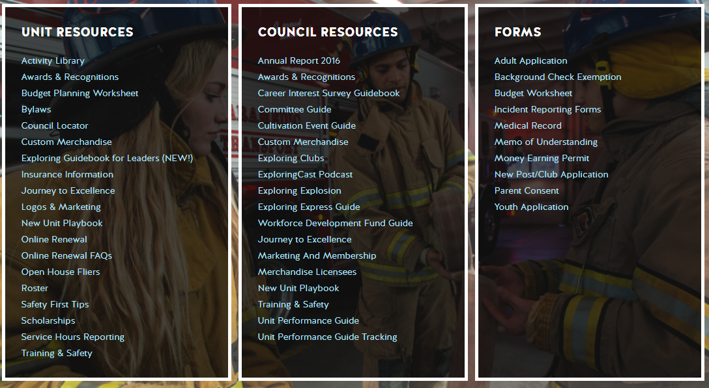
Resources to help you… www.exploring.org

Slide 174
ONLINE
REGISTRATION
FOR EXPLORING

Slide 175
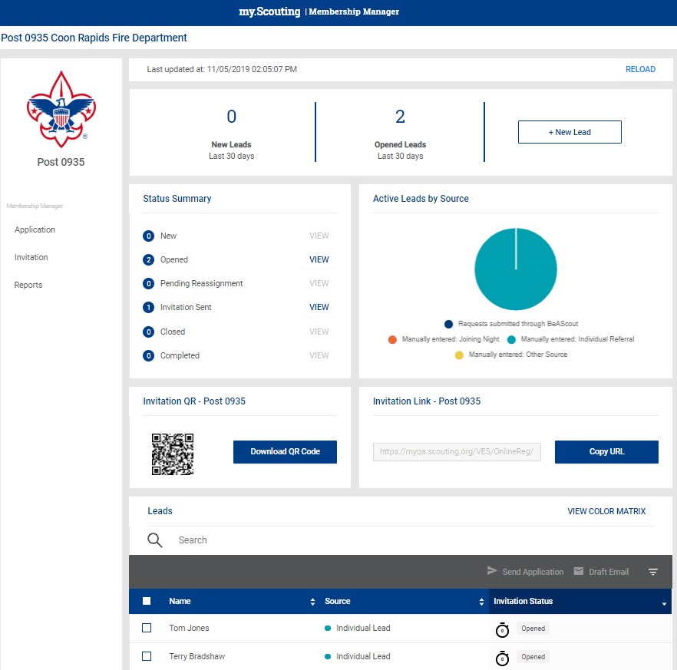
Invitation Manager

Slide 176
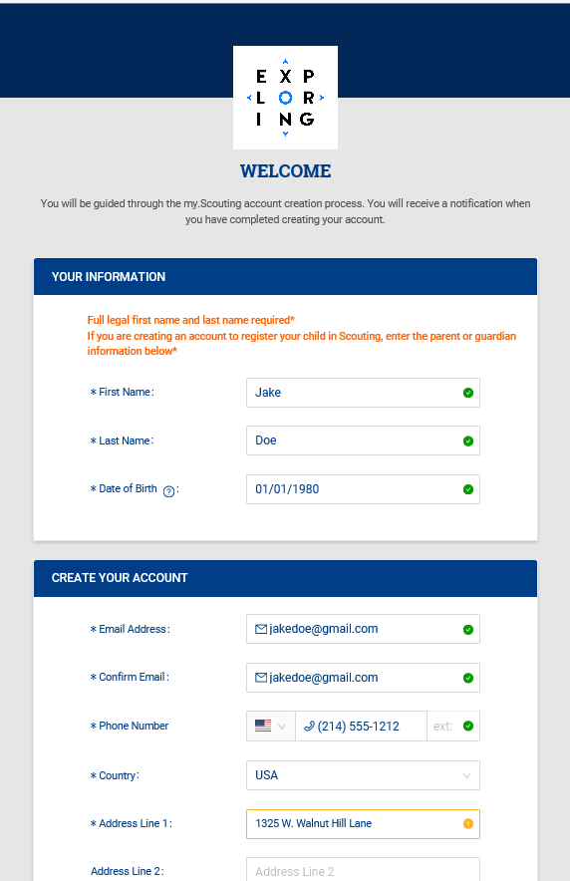
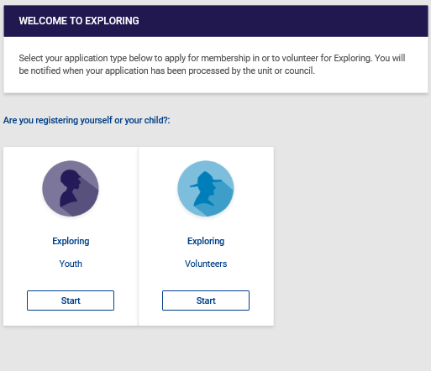
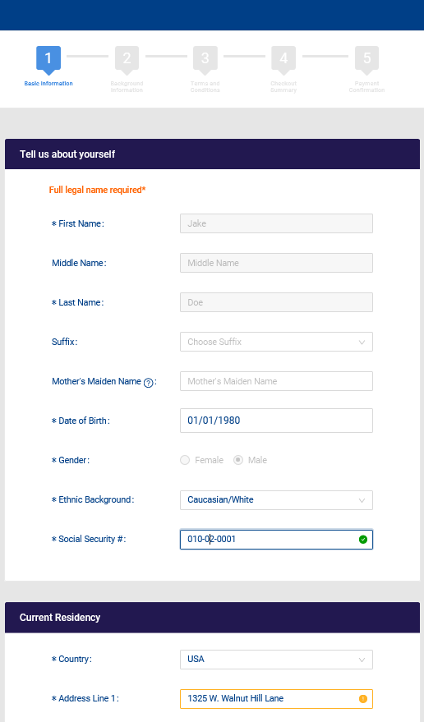
Create Account & Complete Application

Slide 177
Membership and Unit
Online Renewal
FOR EXPLORING

Slide 178
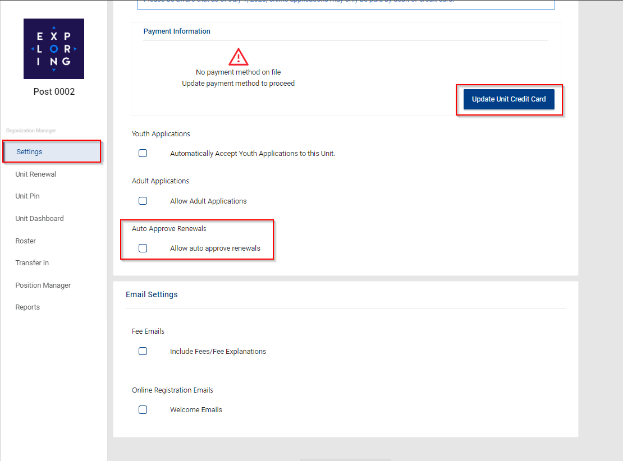
Organization Manager

Slide 179
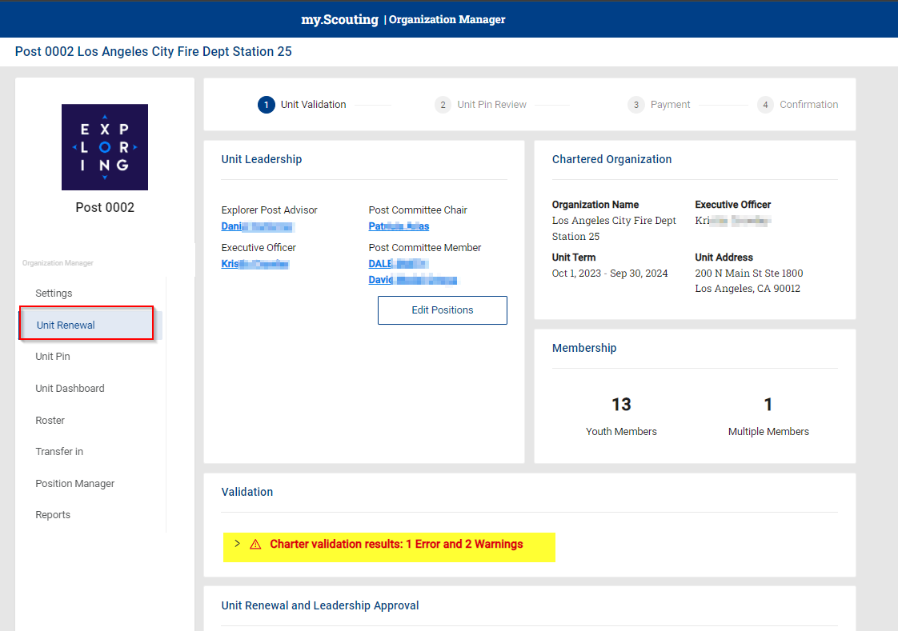
Unit Renewal - Post View

Slide 180
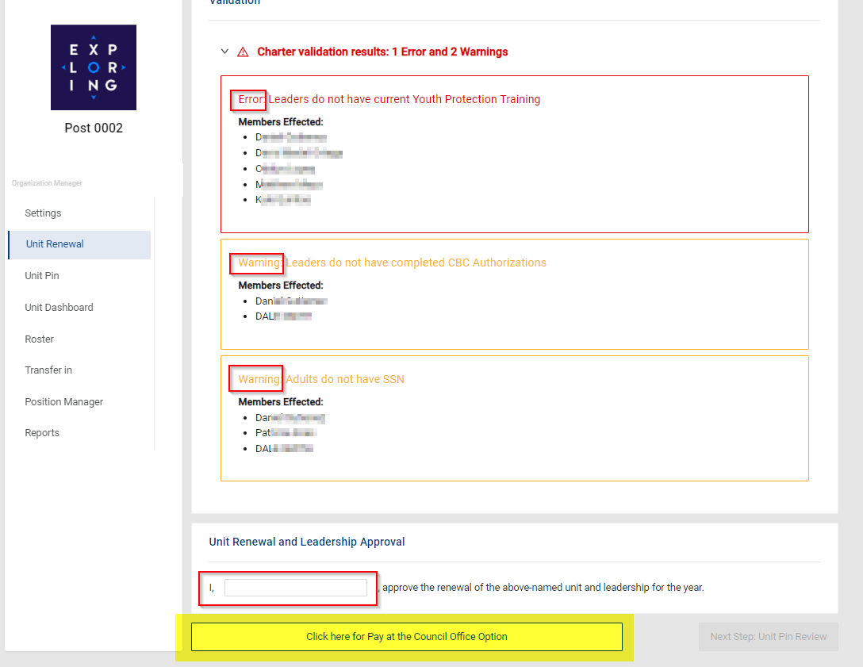
Unit Renewal - Post View

Slide 181
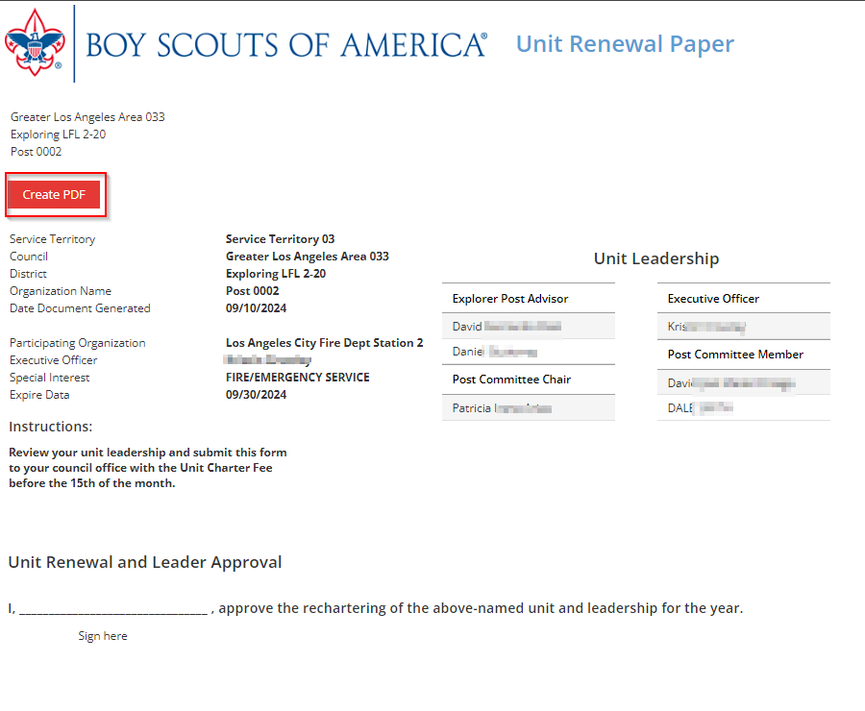
Unit Renewal - Post View

Slide 182
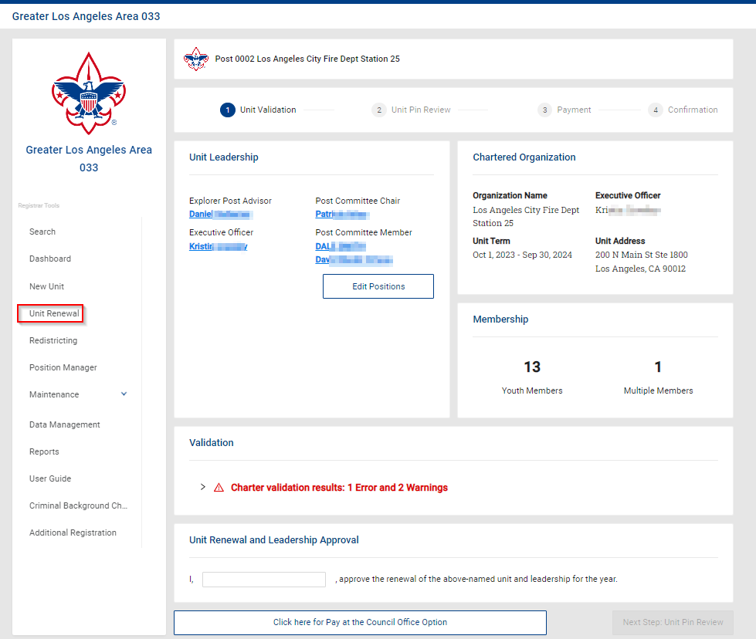
Unit Renewal - Council View

Slide 183
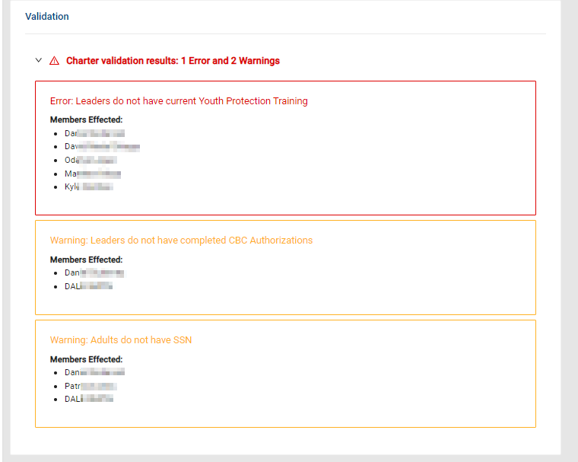
Unit Renewal - Council View

Slide 184
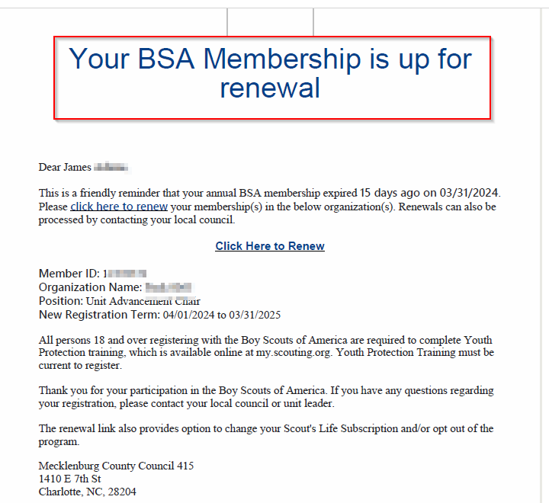
Member Renewal – Member/Parent

Slide 185
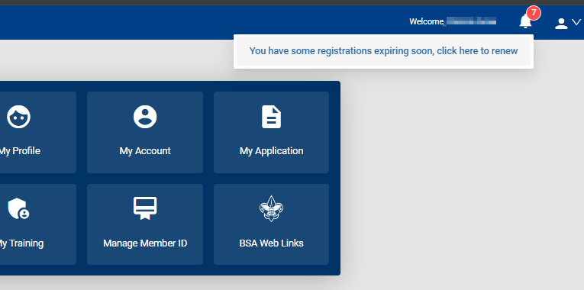
Member Renewal – Member/Parent

Slide 186
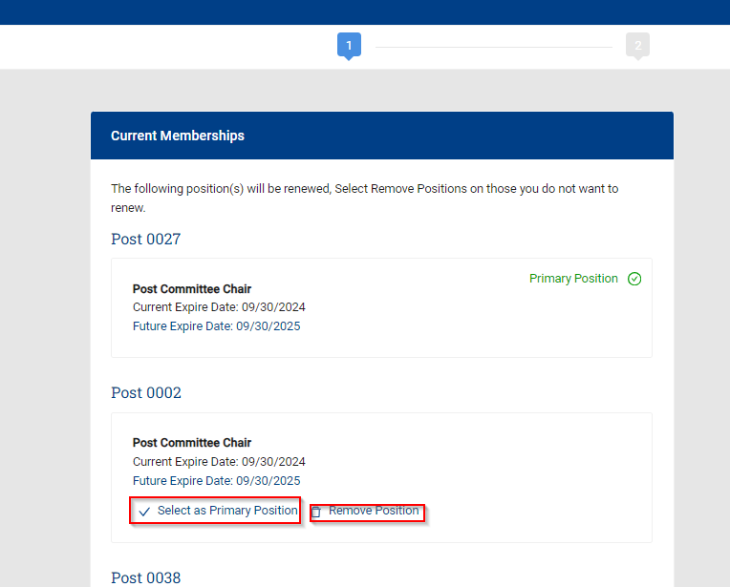
Member Renewal – Member/Parent

Slide 187

Member Renewal – Member/Parent

Slide 188

Member Renewal – Member/Parent

Slide 189

Member Renewal – Member/Parent

Slide 190

Member Renewal – Unit Pay

Slide 191

Member Renewal – Unit Pay

Slide 192

Member Renewal – Unit Pay

Slide 193

Member Renewal – Unit Pay

Slide 194

Member Renewal – Unit Pay

Slide 195

Member Renewal – Unit Pay

Slide 196

Member Renewal – Unit Pay

Slide 197

Renewal Membership – Reports

Slide 198

Renewal Membership – Members Who have Renewed

Slide 199

Renewal Membership – Members Due to Renew Report

Slide 200

Auto Renewal Membership – Members Opt-Out Report

Slide 201
Auto Renewal Membership – Members Opt-Out Report

Slide 202
https://www.scouting.org/resources/unit-and-membership-renewal
Information included is:
Training Video
FAQ’s
User Guides
Internet Recharter Guidelines
Summary of Enhancements
Recharter Demo Tool
Help and FAQ’s
Manager of Shared Services
Member Data Outsourcing Solutions

Slide 203


