Slide 1


Notes:
TW: Let's talk about the business first. There's a widely accepted maxim in business that says it costs 5x more to get a new customer than to retain a customer you already have. Is that true in Scouting? Probably it's not too far off. We spend a lot of effort trying to attract new Cub Scouts (and I don't think anyone would agree that this isn't necessary), and we at least sort of have a plan for short term retention as we try to attract them into a Scouts BSA troop, but we have no plan at all to retain them after that - yet, we have the tools to do it if we chose.

Slide 2
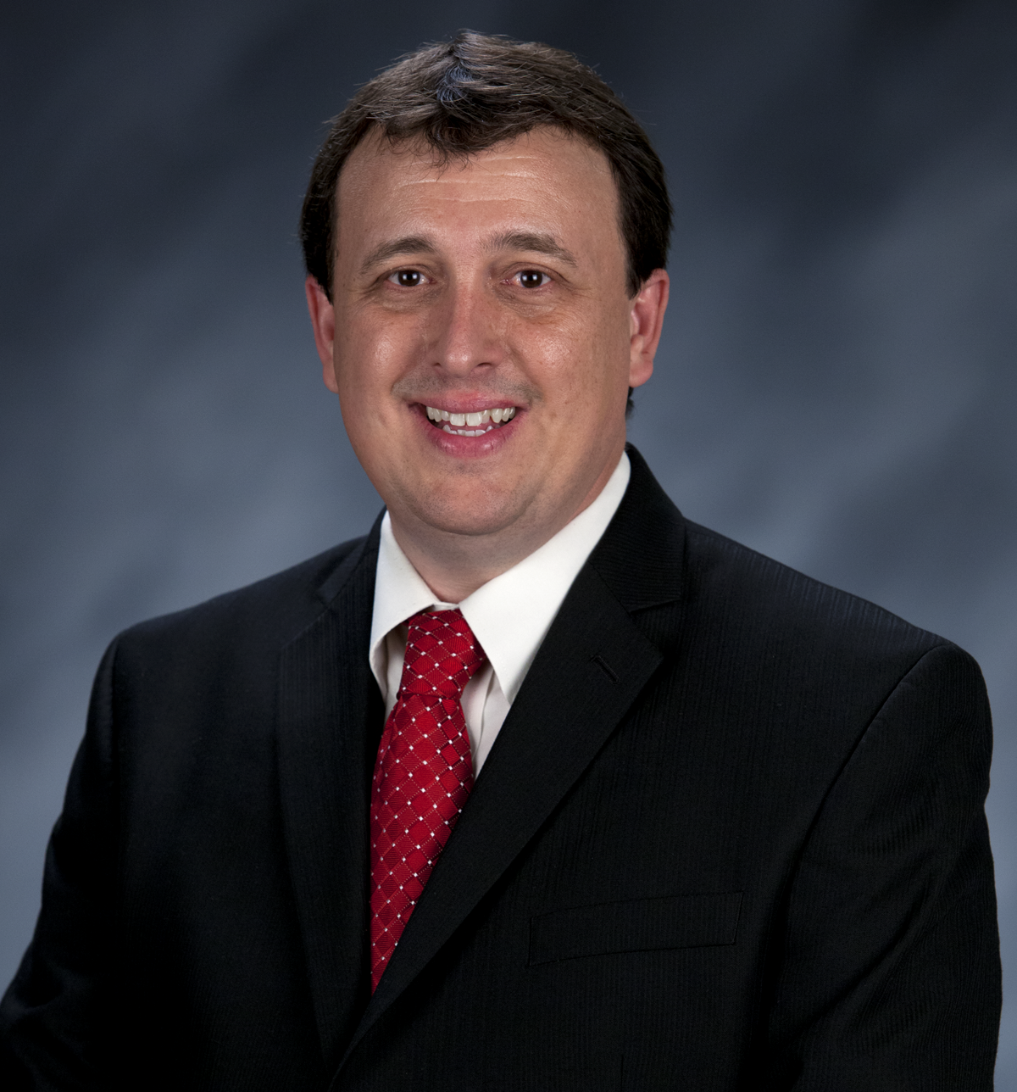

Tim Anderson
National Director
Learning for Life / Exploring &
Older Youth Programs
Notes:
TW: Let's talk about the business first. There's a widely accepted maxim in business that says it costs 5x more to get a new customer than to retain a customer you already have. Is that true in Scouting? Probably it's not too far off. We spend a lot of effort trying to attract new Cub Scouts (and I don't think anyone would agree that this isn't necessary), and we at least sort of have a plan for short term retention as we try to attract them into a Scouts BSA troop, but we have no plan at all to retain them after that - yet, we have the tools to do it if we chose.

Slide 3


Safety Moment
)

Slide 4
Exploring Safety First Guidelines Update
Learning for Life, Exploring, and Scouting America are updating the standard regarding Ride-Alongs for all programs, including but not limited to Law Enforcement Exploring. When youth under 18 years of age participate in Ride-Alongs, all parties involved must adhere to all current Safeguarding Youth policies and guidelines (formerly known as Youth Protection) for all participants.
This includes ensuring that at least two registered adult leaders, each 21 years of age or older and trained in Safeguarding Youth or Youth Protection, are present for the Ride-Along. If the Ride-Along includes a female youth participant, at least one of the registered adult leaders participating in the Ride-Along must also be female.
This standard is mandatory and takes effect on June 30, 2025; however, it should be implemented as soon as possible. While we acknowledge that this change may pose challenges in certain Ride-Along scenarios, it must be strictly enforced to guarantee the safety of both our youth participants and adult leaders.
We will update other documents that refer to Ride-Alongs soon. In the meantime, please ensure that your units participating in Ride-Alongs are notified about the standard and its effective date.
Additionally, remind the Participating Organization to verify that all adults, including young adult participants (aged 18-20), are current with their Youth Protection Training or promptly complete the Safeguarding Youth training.
You may access the training at: https://www.scouting.org/training/youth-protection/

Slide 5

Exploring Membership
3 Years of Growth !!!!

Slide 6



www.exploring.org
VENTURING
www.venturing.org
SEA SCOUTING
Older Youth Programs
www.seascout.org
www.scouting.org
Notes:
BERNIE: The title of this session is "Retention". So why should we care about that topic?
Well, there are two important reasons - one is about the business, one is about our mission.

Slide 7
Venturing
Retention ….
It is about your son or daughter’s
Future….
Preparing them with great
Character, Friends, and a Career
Sea Scouting
Notes:
BERNIE: The title of this session is "Retention". So why should we care about that topic?
Well, there are two important reasons - one is about the business, one is about our mission.

Slide 8
SEA SCOUTING
VENTURING
Scouts BSA Tenure
The average tenure of a Scouts BSA member is 29.0 months
We lose 50% of Scouts BSA youth between the ages of 13-15
However, if they join Venturing, Sea Scouting, or even Exploring…
Instead of dropping out of Scouting, they stay in an additional 16.5 months
Notes:
BERNIE: Does that mean that a 14 year old Eagle Scout is not a successful outcome for BSA? Absolutely not. But it does mean that we have more to give to that Scout, if we can figure out how to get them to stay, and that if they leave the program at that point, we've missed both a business opportunity in several more years of membership, and a mission opportunity in several more years of learning to make more and more sophisticated ethical and moral choices.
To stop missing those opportunities, we as an organization have to consciously choose that we value these, and if so, then we need to start using effectively using the programs we already have to serve them.
We also have to (re)develop a culture in which the transition from Scouts BSA to a young adult program is as natural as a Webelos crossover. We have to get Scoutmasters to understand that this is the next step for their Scouts, just as their troop was once the next step for them.

Slide 9
SEA SCOUTING
VENTURING
The Continuum of Scouting
Notes:
BERNIE: Does that mean that a 14 year old Eagle Scout is not a successful outcome for BSA? Absolutely not. But it does mean that we have more to give to that Scout, if we can figure out how to get them to stay, and that if they leave the program at that point, we've missed both a business opportunity in several more years of membership, and a mission opportunity in several more years of learning to make more and more sophisticated ethical and moral choices.
To stop missing those opportunities, we as an organization have to consciously choose that we value these, and if so, then we need to start using effectively using the programs we already have to serve them.
We also have to (re)develop a culture in which the transition from Scouts BSA to a young adult program is as natural as a Webelos crossover. We have to get Scoutmasters to understand that this is the next step for their Scouts, just as their troop was once the next step for them.

Slide 10

Discover
Your
Future
Notes:
PREPARING FOR THE PRESENTATION:
NOTE: This presentation addresses “WHY” a business leader should start a post or club, not “HOW” to start a new post or club.
1. Present this PowerPoint in combination with the Exploring Sales Kit, available as a BIN item (free to councils) from National Supply: 800-323-0732. Also, print the current year’s JTE post/club scorecard from www.scouting.org/jte and insert in the pocket folder inside the back cover of the sales kit.
2. If you are playing a video (slide 2)…you may need an internet connection if you are swapping with a different video from the LFL/Exploring YouTube channel www.youtube.com/learningforlifeusa.
3. Delete the program calendar slides (slide 14 - ##) that are not relevant to the career industry to which you are presenting.
4. If this is a large group sales scenario, be sure to refer to the Cultivation Event guidebook (download from exploring.org – council resources) for scripts, backdating calendar and more.
5. Consider swapping the photo on slide 1 with a photo relevant to the career field you’re presenting to. Select other photos from the Exploring brand center at http://scoutingwire.org/bsa-brand-center/exploring/.

Slide 11
https://www.exploring.org/
Notes:
BERNIE: Does that mean that a 14 year old Eagle Scout is not a successful outcome for BSA? Absolutely not. But it does mean that we have more to give to that Scout, if we can figure out how to get them to stay, and that if they leave the program at that point, we've missed both a business opportunity in several more years of membership, and a mission opportunity in several more years of learning to make more and more sophisticated ethical and moral choices.
To stop missing those opportunities, we as an organization have to consciously choose that we value these, and if so, then we need to start using effectively using the programs we already have to serve them.
We also have to (re)develop a culture in which the transition from Scouts BSA to a young adult program is as natural as a Webelos crossover. We have to get Scoutmasters to understand that this is the next step for their Scouts, just as their troop was once the next step for them.

Slide 12
Everything we do… is all about…
RELATIONSHIPS
People want and need to know the “WHY” before they hear and learn the “HOW”.

Slide 13
More Videos on Youtube…
Testimonials
Law Enforcement, Denise & Keith - Mom & Explorer (youtube.com)
Exploring LFL - YouTube
Science Exploring according to Dave (youtube.com)
EMS Exploring According to Savanah (youtube.com)
Great Promotional Videos
https://youtu.be/1UtPFB0BHOA
https://youtu.be/p5GFYmWiyic
Notes:
BERNIE: Does that mean that a 14 year old Eagle Scout is not a successful outcome for BSA? Absolutely not. But it does mean that we have more to give to that Scout, if we can figure out how to get them to stay, and that if they leave the program at that point, we've missed both a business opportunity in several more years of membership, and a mission opportunity in several more years of learning to make more and more sophisticated ethical and moral choices.
To stop missing those opportunities, we as an organization have to consciously choose that we value these, and if so, then we need to start using effectively using the programs we already have to serve them.
We also have to (re)develop a culture in which the transition from Scouts BSA to a young adult program is as natural as a Webelos crossover. We have to get Scoutmasters to understand that this is the next step for their Scouts, just as their troop was once the next step for them.

Slide 14
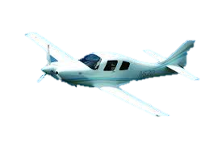

How did you land in your Career?
Story
Notes:
Analogy:--Relating the Plane (Pilot) to a Youth finding a career.
Notice…That Plane didn’t seem to have a very direct path did it? (Show the path of the plane again “flying”)…terrible landing, huh?
What if you got on a plane and the Pilot made an announcement saying …I am really not sure where we are going, and I am not sure when we will get there or where we will land, but we are just going to take off and see what happens. Enjoy your flight! It will be an adventure.
How would that make you feel? Does that even sound like a good plan? Would you stay on that Plane? That sound kind of ridiculous, right? I don’t know about you, but I would definitely ask to get off that flight☺…and look for another one with a flight plan that fit my itinerary and knew where it was going to land before it took off.
So, what if you ask your son/grandson, daughter/granddaughter about his/her Career Plans…. and they said. You know, I am really not sure what I want to do. I think MAYBE I will just go to college for a while and see what happens.
Joke: Maybe with an open check book…drop classes and wonder in the “college wilderness” for a while. After ,all, once a class is dropped ….it only costs a few hundred dollars for that book that is now worthless (unsalable).
Shouldn’t we help them? Maybe give them a “Career Flight Plan” to land in a career that will make them happy, productive, citizens?....or should we just let them take off and land wherever they may happen to land (by luck, asking a friend, or just falling into the first line of work that they try)?

Slide 15


YOUR LIFE SPAN
“Ages 18-65” Work for Est. 47 years
Birth
“Job”, “Work”, “Career”
0years old
99years old
18
50
65
Start Working
Retire
Mid Life
Notes:
Explain that this slide is a representation of a life Span…of someone we know and care about. Maybe your own son/daughter, maybe a next door neighbor, or even a kid in the neighborhood or local school that you don’t even know.
Notice the time line starts at Birth (0) and in this case life ends at (99) …I am being real generous, giving this lucky person 99 awesome years to exist.
Keep CLICKING UNTIL THE “Star” labeled “65” appears on the screen.
What do you think the Star with the “18” represents? That is right, it represents when we hope this youth will probably be ask to go to work…get a job. At least that is what most of us intended for our kids to do, right☺?
CLICK to allow the “Job, Work, Career” box to drop into the slide.
Notice that we are portraying that this youth will work from approximately 18 until hopefully he/she is able to retire at an age of 65. That is what we all want to do, right ? ☺
CLICK and allow the “Ages 18-65” Work for Est 47 years” fall down.
Think about that…Isn't that a really long time? 47 Years!!!! And that is assuming again that work starts at 18 and ends at 65. As you know it could start earlier and end much later for many people. Now, think about this in terms of a young person or any of our young people in America that we all care about.
Shouldn’t we help to ensure that they have a plan to land in the right career, or at least help them eliminate careers that are not compatible with them? If they are going to work for a minimum of 47 years, it would be nice if they were actually happy and successful, right?
Well, here is where Exploring comes in…
CLICK and allow the Plane to fly in with the Exploring Logo.
Now, that plane landing looked like it was well designed by a capable pilot didn’t it?...much better than the flight we witnessed earlier, huh?
That is exactly what Exploring does….It gives our young people a “Career Flight Plan”. It allows them to land it a career that is designed for them.

Slide 16
What is your
Exploring story?
FIND ONE

Slide 17
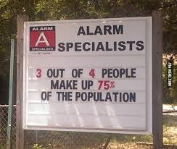
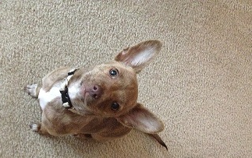
Alarming Statistics
HUH?
What are your local statistics…and why should you care?

Slide 18
OPEN HOUSES
INSERT HERE
COUNCIL/DISTRICT YEARLY MEMBERSHIP PLANS
(Recruitment/Retention Cycle)
Career Interest Surveys

Slide 19
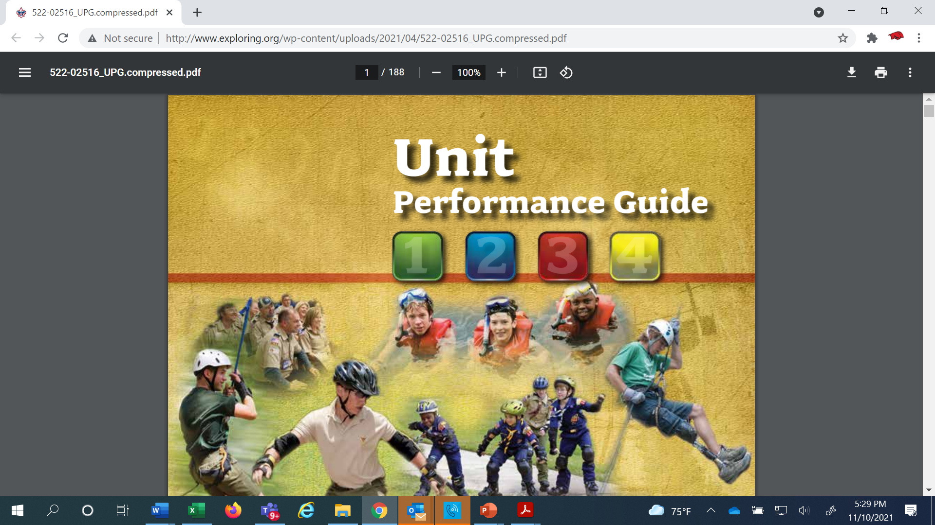
http://www.exploring.org/wp-content/uploads/2021/04/522-02516_UPG.compressed.pdf
All of the details…
UPG Chapter 5
beginning on page 125 (Exploring )
Notes:
PREPARING FOR THE PRESENTATION:
NOTE: This presentation addresses “WHY” a business leader should start a post or club, not “HOW” to start a new post or club.
1. Present this PowerPoint in combination with the Exploring Sales Kit, available as a BIN item (free to councils) from National Supply: 800-323-0732. Also, print the current year’s JTE post/club scorecard from www.scouting.org/jte and insert in the pocket folder inside the back cover of the sales kit.
2. If you are playing a video (slide 2)…you may need an internet connection if you are swapping with a different video from the LFL/Exploring YouTube channel www.youtube.com/learningforlifeusa.
3. Delete the program calendar slides (slide 14 - ##) that are not relevant to the career industry to which you are presenting.
4. If this is a large group sales scenario, be sure to refer to the Cultivation Event guidebook (download from exploring.org – council resources) for scripts, backdating calendar and more.
5. Consider swapping the photo on slide 1 with a photo relevant to the career field you’re presenting to. Select other photos from the Exploring brand center at http://scoutingwire.org/bsa-brand-center/exploring/.

Slide 20

What is Exploring?
A career education program for young men and women
Helps students make
more informed decisions
about future careers
Hands on Interactive Career education program

Slide 21

What is Exploring?
Not ONLY
Not ONLY
JOB
SHADOWING
WHAT IT SHOULD BE…
HANDS ON/ INTERACTIVE!

Slide 22

LEARNING FOR LIFE CORPORATE MISSION:
To develop and deliver engaging, research based academic, character, leadership and career focused programs aligned to state and national standards that guide and enable all students to achieve their full potential.
THE CORPORATION
NON-DISCRIMINATION STATEMENT:
Learning for Life programs are designed for all age groups from pre‐kindergarten and not yet age 21. Youth participation is open to any youth in the prescribed age group for that particular program. Adults are selected by the participating organization for Involvement in the program. Color, race, religion, gender, sexual orientation, ethnic background, disability, economic status or citizenship is not criteria for participation by youth or adults.
Notes:
AFFILIATION STATEMENT
Learning for Life is one of the programs that local Boy Scouts of America councils are authorized to deliver, with local executive board approval. Learning for Life is an affiliate of the Boy Scouts of America that is comprised of both a written character education curriculum for PreK – 12th graders and students with special needs, as well as Interactive career Exploring programs for 6th graders thru 20 year olds. Youth participation is open to any youth in the prescribed age group for that particular Program. Adults, 21 years of age and older, are selected by participating organizations for involvement in the Learning for Life programs. Color, race, religion, gender, sexual orientation, ethnic background, disability, economic status or citizenship is not criteria for participation by youth or adults. Youth and adults involved with Learning for Life programs, including Exploring, are registered with Learning for Life as participants. Learning for Life participants are not members of the Boy Scouts of America. Learning for Life, a District of Columbia non‐profit corporation, is a separate 501(c)(3) Corporation, with a Board of Directors that is separate from the Boy Scouts of America. While they have different policies, there are occasions when local Learning for Life and Traditional BSA programs may participate in an event. Both programs will be required to follow the appropriate guidelines, especially regarding safety. Completion of training, registration and annual fees are program specific and not transferable between programs

Slide 23

  Learning for Life Curriculum-Based Programs consists of grade specific, age-oriented, character education lesson plans that are utilized in schools and other educational settings to help instill character and ethical decision making in our youth. The available lesson plans that are offered for Learning for Life Groups include PreK-12 grades, Champions for students with special needs, along with additional digital resources. Learning for Life uses these interactive lessons to help youth make informed decisions while becoming better students and citizens.
  CURRICULUM PROGRAM VISION:
  To provide engaging and relevant PreK‐12 solutions that positively impact academic performance, social & emotional maturity, character development, and career education for all students.
www.learningforlife.org

Slide 24

  Exploring is a co-ed program for youth that are in the 6th grade through 20 years old. Exploring provides opportunities for real-world hands-on career experiences, while helping them “Discover their Future”. The program links youth with mentors and experts with partner businesses and agencies in their communities. Participating in an Exploring Club or Post ensures youth make informed decisions about careers they may or may not be interested in pursuing, while allowing businesses and organizations the opportunity to meet and cultivate future employees.
EXPLORING MISSION:
Deliver character-building experiences and mentorship that allow youth to achieve their full potential in both life and work.
EXPLORING VISION :
Shape the workforce of tomorrow by engaging and mentoring today’s youth in career and life enhancing opportunities.
www.exploring.org

Slide 25
A little about each program
Learning for Life Curriculum-Based Programs consists of grade specific, age-oriented, character education lesson plans that are utilized in schools and other educational settings to help instill character and ethical decision making in our youth. The available lesson plans that are offered for Learning for Life Groups include PreK-12 grades, and Champions for students with special needs. Learning for Life uses these interactive lessons to help youth make informed decisions while becoming better students and citizens.
Exploring is a co-ed program for youth that are in the 6th grade through 20 years old. Exploring provides opportunities for real-world hands-on career experiences, while helping them “Discover their Future”. The program links youth with mentors and experts with partner businesses and agencies in their communities. Participating in an Exploring Club or Post ensures youth make informed decisions about careers they may or may not be interested in pursuing, while allowing businesses and organizations the opportunity to meet and cultivate future employees.

Slide 26

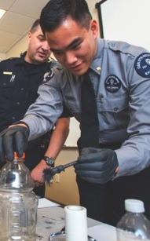




PROGRAMS ARE BASED ON
5 AREAS OF EMPHASIS
CAREER
OPPORTUNITIES
LEADERSHIP
EXPERIENCE
LIFE SKILLS
CITIZENSHIP
CHARACTER
EDUCATION

Slide 27
FIVE PROGRAM EMPHASES
Career Opportunities
Real-world career skills facilitated by caring professionals
Leadership Experience
Training opportunities to develop the leadership skills that employers desire as well as leadership opportunities
Life Skills
Conflict resolution, problem solving, teamwork, and communication
Citizenship
Service learning opportunities in your community
Character Education
Professionalism and ethical decision making

Slide 28

Exploring is based on a unique and dynamic relationship between youth and the organizations in their communities. Local community organizations initiate a specific Exploring Post or Club by matching their people and program
resources to the interests of young people in the
community. Exploring Posts and Clubs can specialize in a variety of career skills.
Notes:
PRESENTER NOTES:
Explain that any business or organization can sponsor an explorer post or club. It is the business or organization that will select in which of the 12 Exploring career fields they most identify with. This is the field in which they will be registered in the local council.
Also explain a post or club can register as a "general careers" program.

Slide 29












12 CAREER FIELDS
Notes:
Remove animation on this slide

Slide 30
The Value Proposition
Who Benefits from Exploring?
Employees
Schools
Parents
Companies/Businesses
Youth
Notes:
PRESENTER NOTES:
Explain that any business or organization can sponsor an explorer post or club. It is the business or organization that will select in which of the 12 Exploring career fields they most identify with. This is the field in which they will be registered in the local council.
Also explain a post or club can register as a "general careers" program.

Slide 31
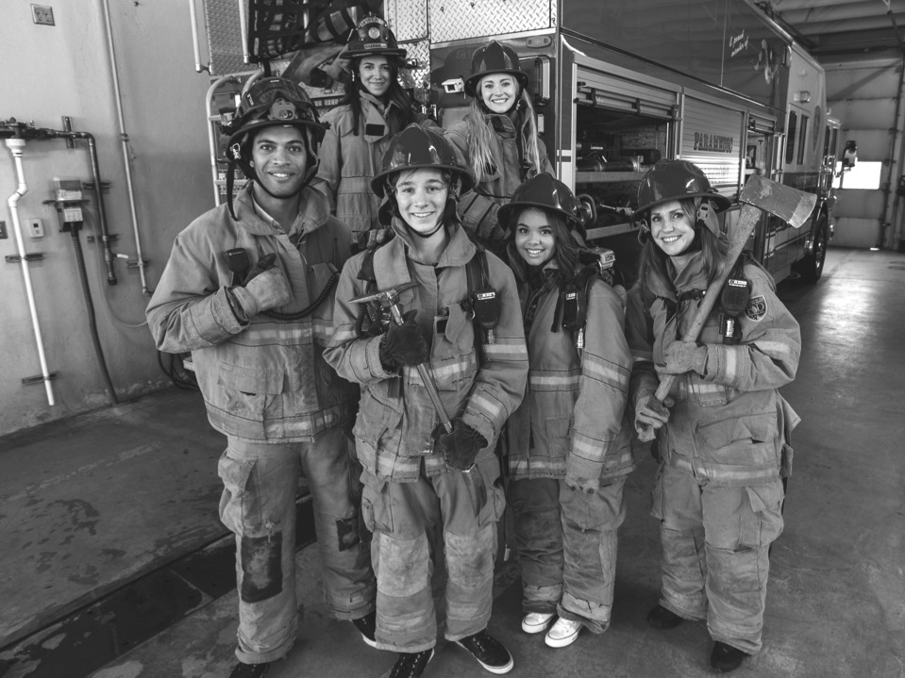

BENEFITS
EMPLOYEE BENEFITS
• Increased realization that we are ALL responsible for molding today’s
youth and tomorrow’s leaders
• Greater awareness of role within the company
• Greater community involvement
• Enhanced communication, planning, and program development skill
• Being an integral part of shaping a young man’s or woman’s future
• Increased opportunity for advancement within the company
Notes:
PRESENTER NOTES:
Ask the audience if they agree with these benefits based on what they've heard in the presentation so far. Have an open, honest and frank conversation with them. This will be an opportunity for you - the sales person - to identify potential roadblocks and begin to develop solutions for them.

Slide 32
BENEFITS
YOUTH BENEFITS
• Practical, real-world career experiences and insight
• Stimulated interest in continual education
• Building of leadership, self-confidence, and problem-solving skills
• Cooperative relationship between adults and youth
• Community service to others
• New friends
• Obtain experiences that can be listed on college, job, and scholarship applications

Slide 33
BENEFITS
COMPANY BENEFITS
• Cultivate future employees
• Reduce employee turnover and training expenses
• Impact the education process of youth
• Supplement future employee training or screening programs
• Prepare young adults for transition from school to work
• Develop future responsible and caring adults
• Improve employee morale
• Demonstrate visible commitment to the welfare of the community

Slide 34
BENEFITS
SCHOOL BENEFITS
• Meet state or federal career education standards
• Partner with local businesses in your community
• Extend the classroom beyond the school day
• Gain access to free career interest survey

Slide 35
CLUBS
POSTS
YOUTH 6th-8th graders
ADULTS Min. 2 required
PROGRAM More general, may also be career-specific
ACTIVITIES Limited for safety purposes; ex: shooting
YOUTH 14-20 year olds
ADULTS Min. 4 required
PROGRAM More career-specific, may also be general
ACTIVITIES Higher risk activities are allowed; ex: ridealongs,
PURPOSE Provide experiences to help young people become responsible and caring adults, and to provide hands-on career experiences.
EMPHASES 1. Career 2. Leadership 3. Life Skills 4. Citizenship 5. Character
METHODS Voluntary association between youth and adults
Recognition of achievement
Democratic processes
Interactive experiences
PARTICIPATING Businesses, youth organizations, government agencies,
ORGANIZATIONS professional organizations, non-profits, educational institutions
Notes:
PRESENTER NOTES:
Explain that any business or organization can sponsor an explorer post or club. It is the business or organization that will select in which of the 12 Exploring career fields they most identify with. This is the field in which they will be registered in the local council.
Also explain a post or club can register as a "general careers" program.

Slide 36


The frequency of the meetings and length of the program each year is up to the Participating Organization.
For example, this could be a 12 month or 12 week program.
SAMPLE PROGRAM CALENDAR(S)
ENGINEERING & TECH
MONTHLY MEETINGS--YEAR-ROUND
September
Open House
October
Chemical Engineering
November
Youth Officer Elections
December
Holiday Party
January
Industrial Technology
February
Electrical Engineering
March
Computer Science
April
Fluid Power Technology
May
Ethics in Engineering
June
Visit with Engineering Firm
July
Civil Engineering
August
Mechanical Engineering
Flexible
Notes:
PRESENTER NOTES:
BE SURE TO DELETE THE CALENDARS/SLIDES THAT ARE NOT RELEVANT TO THE CAREER INDUSTRY TO WHICH YOU’RE PRESENTING.
Remind the audience that they have flexibility is setting the schedule for their own program. Here are some options:
Year round – may or may not include summer
Weekly
Monthly
3 months at a time, different group of youth each time, 3 times per year
Weeknights or weekends

Slide 37

Exploring in comparison to Traditional Scouting
 | SCOUTS BSA | VENTURING | SEA SCOUTING | EXPLORING
UNIT | Troop | Crew | Ship | Club or Post
LEADER | Scoutmaster | Advisor | Skipper | Sponsor/Advisor
YOUTH LEADER | Senior Patrol Leader | President | Boatswain | President or Agency Nomenclature
YOUTH PARTICIPANT | Scout | Venturer | Sea Scout | Participant or Explorer
RE-REGISTRATION | Charter Renewal | Charter Renewal | Charter Renewal | Renewal
SPONSOR | Chartered Org | Chartered Org | Charter Org | Participating Org
SPONSORING AGREEMENT | Charter | Charter | Charter | Memorandum of Understanding (MOU)
UNIT SERVICE | Commissioner | Commissioner | Commissioner | Service Team
YOUTH RUN | Yes | Yes | Yes | Yes
AGE SPAN | 11-18 | 13-20 | 13 - 20 | 11-13 & 14-20
RELIGIOUS DECLARATION | Duty to God | Duty to God | Duty to God | None
UNIFORM | Scouts BSA | Venturing (Unit Selected) | Sea Scouting (Unit Selected) | Club/Post Selected, not required

Slide 38
REGISTRATION BASICS
YOUTH
POST: ___ and have completed eighth grade OR 15 years of age but not yet ___ years old
CLUB: 6th-8th graders who have completed the ____ grade and are at least 10 years old but have not completed the eighth grade and are not yet ____ years old.
ADULTS
___ years age or older
POST: Min of 4 adults
  ______________ (CC)
  2 ____________ (MC)
  _______________ (EA)
CLUB: 2 adults _______________ (ES)
_______________ (AS)
PAPERWORK
New Post/Club ____________
4 _________ Apps
5 _________ Apps
Annual ______________
of Understanding
$____ General Liability Insurance Fee
$____ per person registration fee
14
21
Application
21
Adult
Committee Chair
2 Committee Members
Youth
5th
Advisor
Memorandum
Sponsor
100
15
Assoc Sponsor
50
Exploring Youth Participants “EP’s” ages 18-20 must complete an
Exploring ________ Application & Successfully Complete Safeguarding Youth (YPT.)
Adult

Slide 39
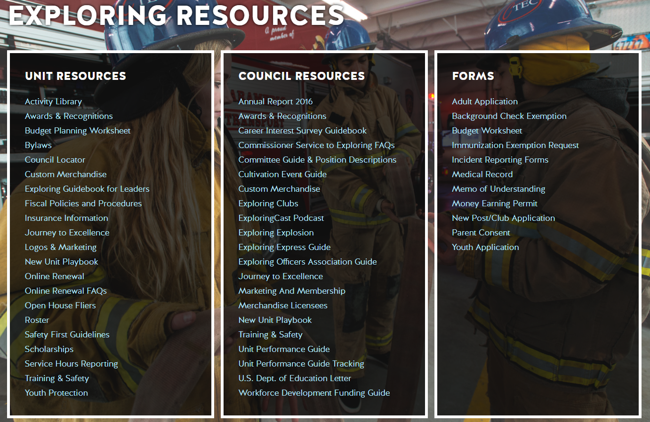
Where can I find all of the forms to help organize a new Club or Post ?

Slide 40
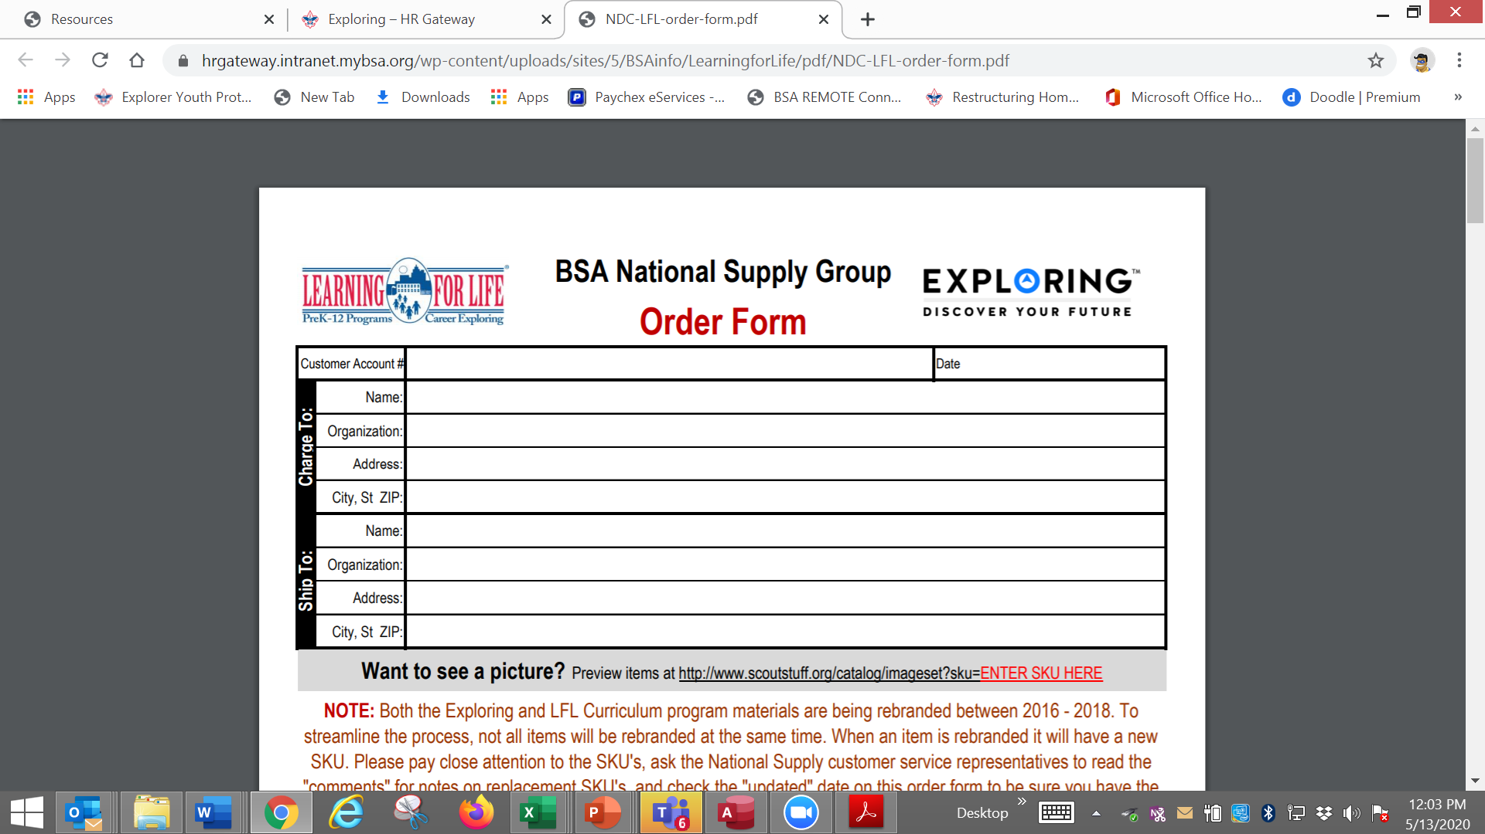

Slide 41
KNOW YOUR AUDIENCE
What are the main fundamental differences in organizing
a new Pack, Troop, Crew, or Ship…
VS.
Organizing a new Exploring Post or Club ?
PRIOR KNOWLEDGE/SKILLS OF ADULT LEADERS
WHY DOES THIS MAKE EXPLORING THE IDEAL UNIT TO ORGANIZE?

Slide 42
Organizing a New Post/Club
“The Four Phases”

Slide 43
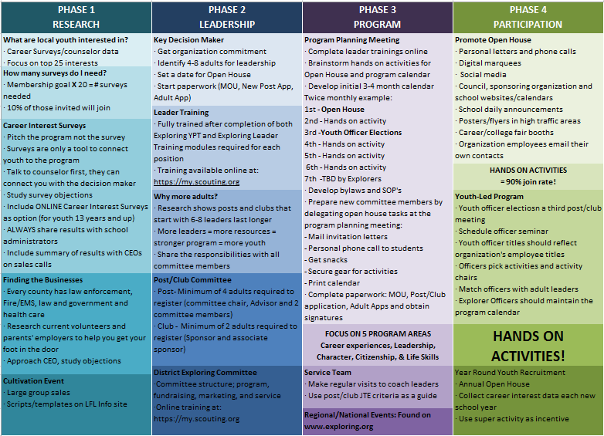

Slide 44
4 Steps/Phases in Organizing a new Post/Club
1. Research-
Conduct the Career interest surveys
and develop business/community prospects
2. Leadership-
Meeting with the top leadership within the
businesses/community and identifying program
leaders; includes training of leaders
3. Program-
Develop the organization’s meeting/program
themes and prepare for an open house
4. Participation-
Recruiting youth through an organized open house and
involvement of youth in program development

Slide 45
MOST IMPORTANT PART
OF EACH PHASE?
Phase 1 : Career Interest Surveys
Phase 2: Training
Phase 3: All-In-One Program Planning Meeting
Phase 4: Open House

Slide 46
Career Interest Surveys
The # 1
Leading Indicator for Exploring Growth

Slide 48
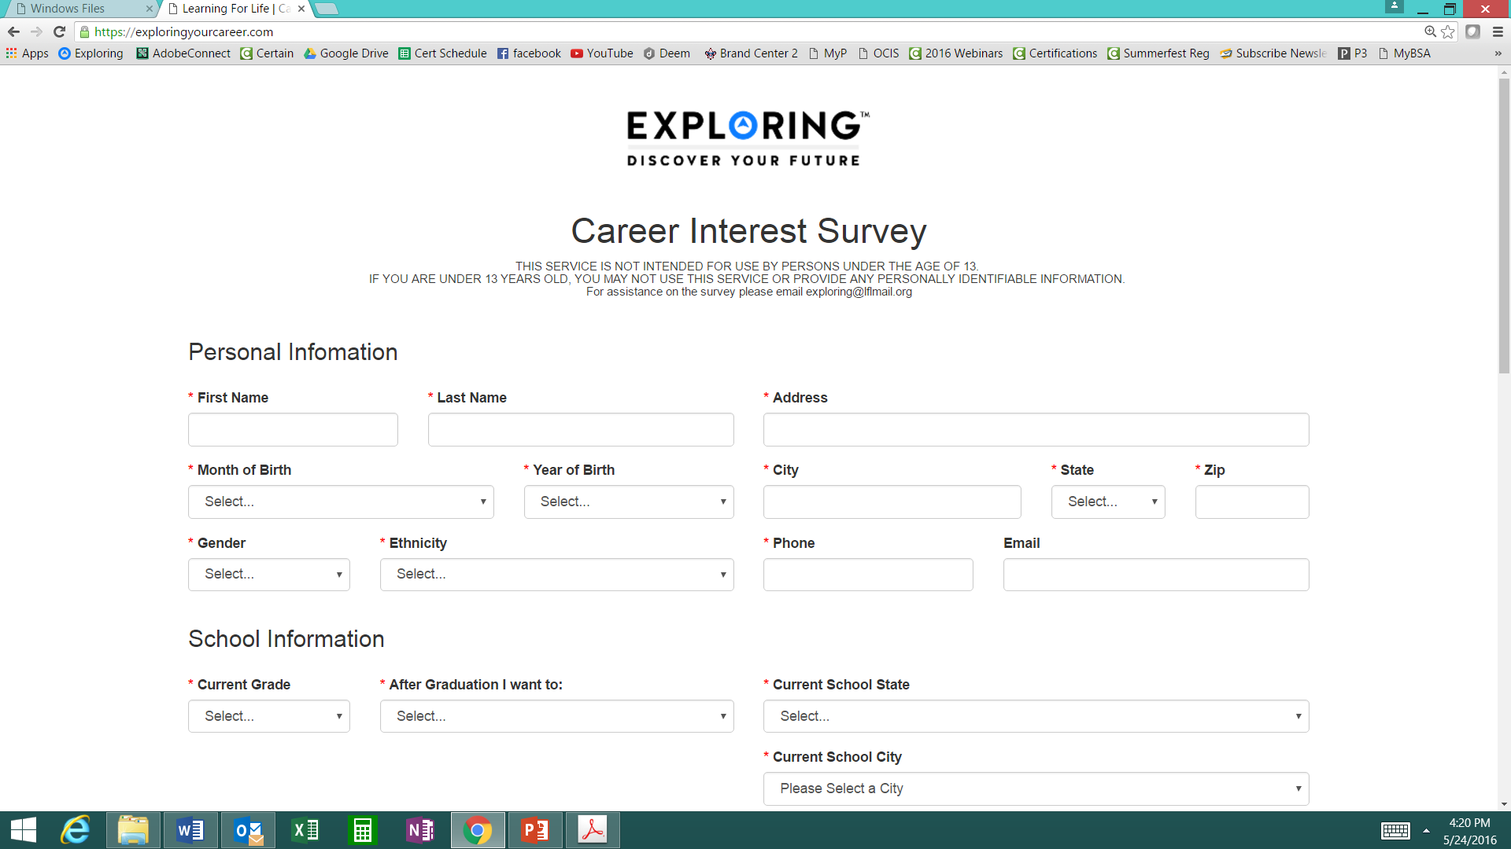
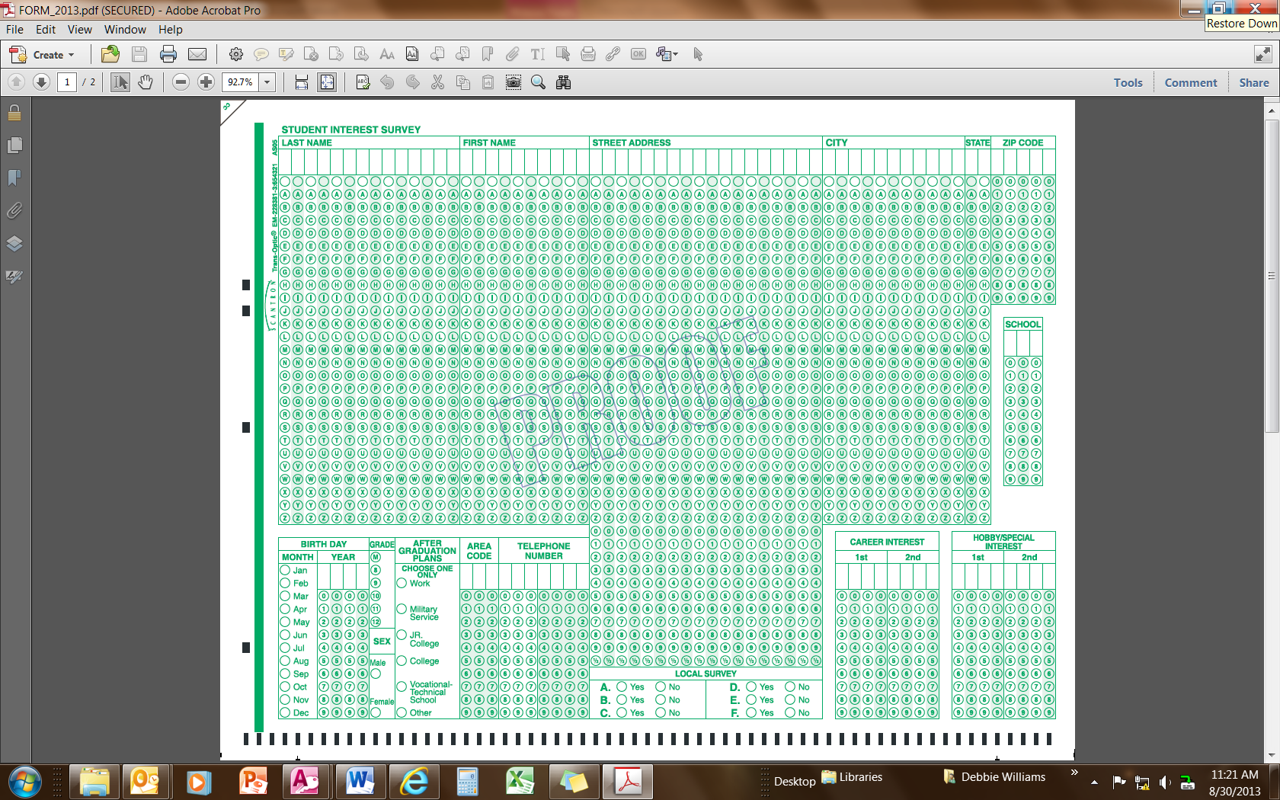
Phase 1 – Research
Career Interest Surveys (two choices)
pa
pa
Online Survey:
www.exploringyourcareer.com
Paper Scantron Survey

Slide 49


BACK SIDE
FRONT SIDE
Paper Scantron Survey Available through NDC

Slide 51
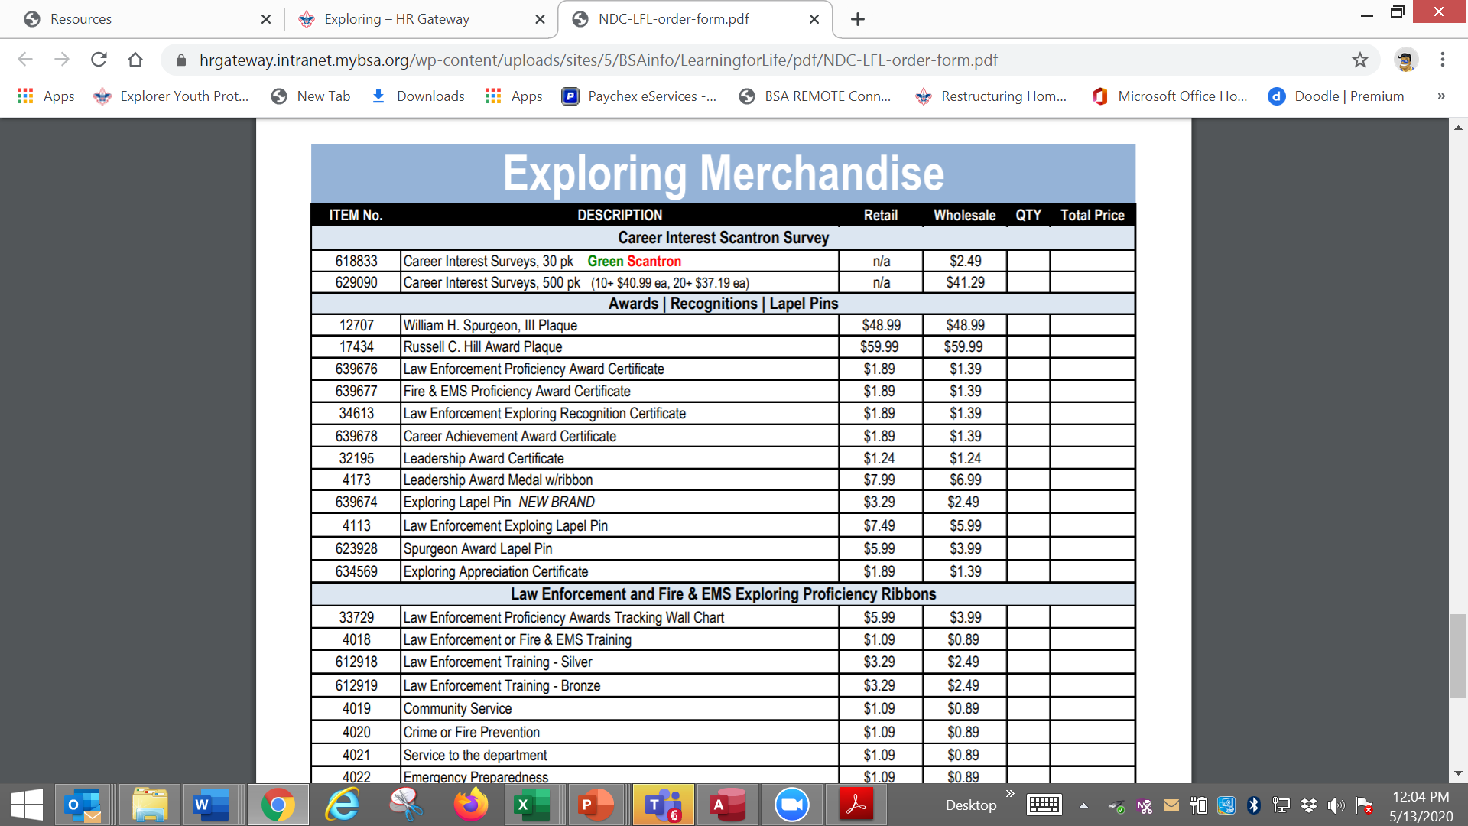

Slide 52
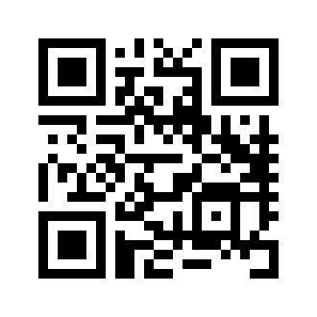
Online Career Interest Survey
www.exploringyourcareer.com
TRY IT NOW!
Use QR code or simply type address in web browser
Notes:
A “QR” or Quick Response code was created to take students directly to the survey site. It is available on posters, post cards, business cards, and book marks.
How do you use this? Email it to all teachers, they can open it from email and project it one screen for students to use their smartphones!

Slide 53
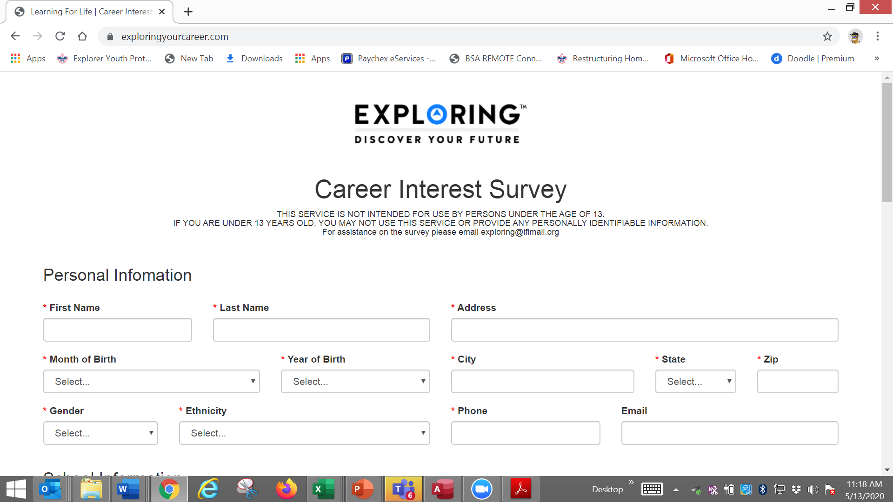

Slide 54
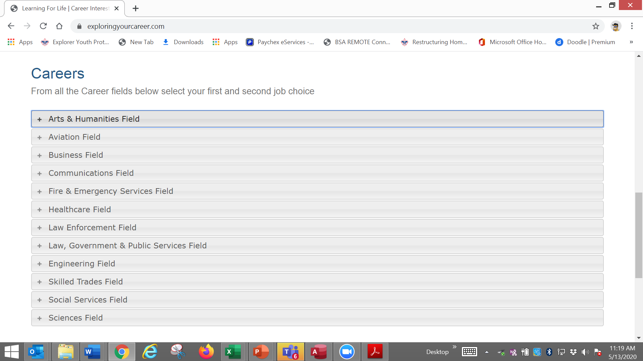

Slide 55
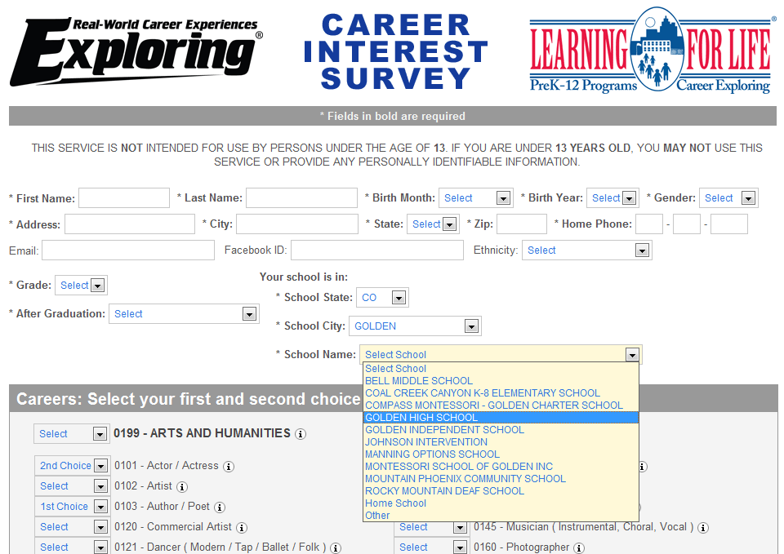
www.exploringyourcareer.org
Two career & hobby choices
School names
pre-loaded
Notes:
REFER TO HANDOUT IN YOUR FOLDER.
This is a screen shot of the new Online Career Interest Survey that was activated on Jan 1, 2012.
The careers & hobbies match the paper version. So schools and administer the survey either on paper or electronically.
The online version can be accessed from any device that can access the Internet – including smart phones.
Results are sent instantly to a secure website where councils can access the results and provide them to schools in the same format as the paper survey.
Instructions for accessing results can be found in the LFL internal site.
Students 13 yrs. and younger cannot legally complete this survey online. If they enter data, the system will not save it.
You can also add schools/colleges to this list if they do not populate when you put in your respective zip code. Simply e-mail us at exploring@lflmail.org and request your specific school to be added, with zip code

Slide 56
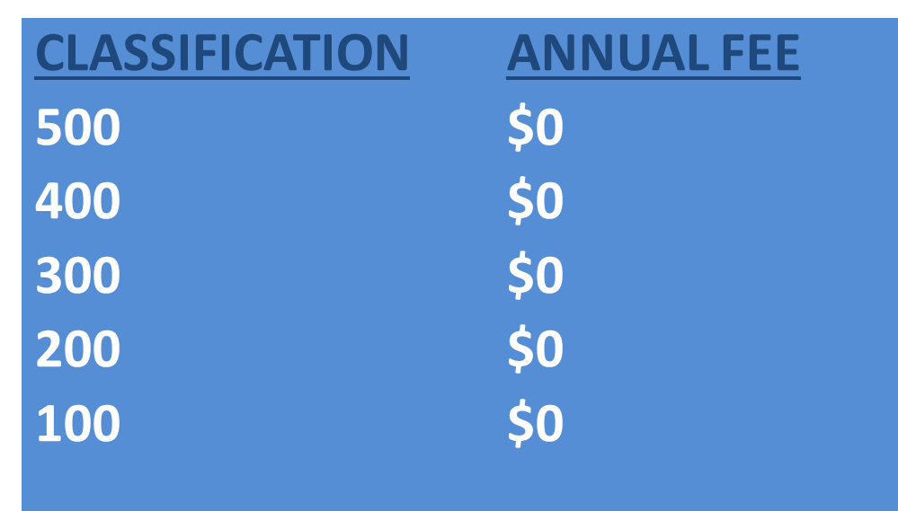
Online Career Interest Survey COSTS
Unlimited schools and unlimited surveys for students 13 years of age and older

Slide 57
REPORTS GENERATED FROM THE SURVEYS

Slide 58
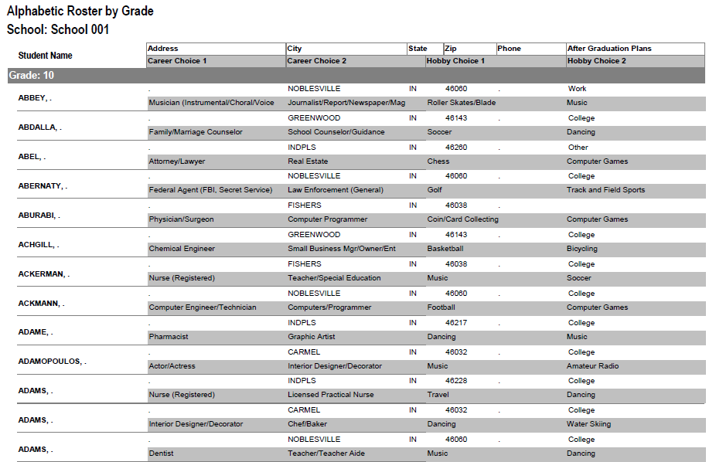
RESULTS REPORT: School
Grade: 10
ABBEY, Susie 123 Main St Noblesville IN 46060 Work
Career 1 Career 2 Hobby 1 Hobby 2
Musician Journalist Roller Skate /Blade Music
58
Notes:
58
No matter the survey format you use, the reports are generated the same way.
**GOOD data to establish credibility at/during your sales call
This is one set of sample results provided at no cost to schools. Very helpful for Guidance Counselors.
All students, by grade, alphabetically. Shows:
Career interests
Hobby interests
Post-high school plans
Other results include all students interested in each career (all the attorneys, architects, dentists, electricians, etc). Helpful for Guidance Counselor planning, career speakers, college days and college fairs.
Be sure to return results to the Guidance Counselor when you say you will – under promise and over deliver. Do not promise results in one week if you cannot do it. Say 2-3 weeks, then they will be very happy if they do receive them in a week or ten days.

Slide 59

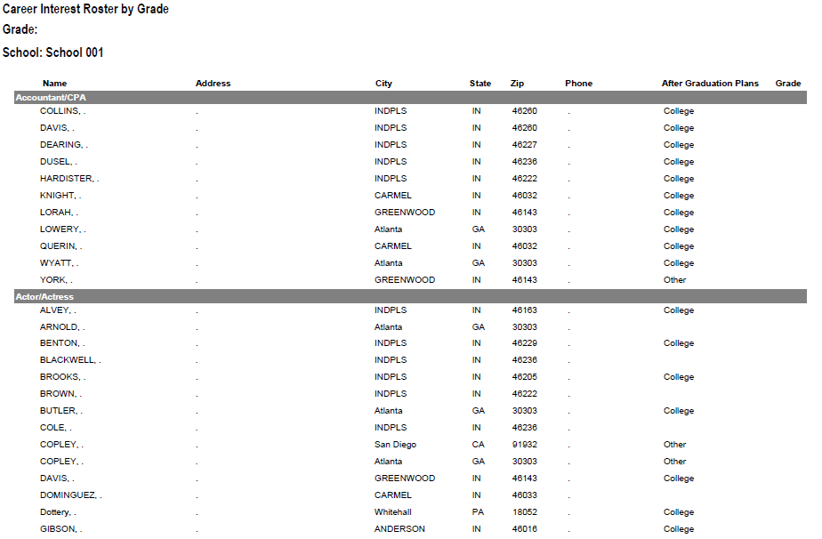
RESULTS REPORT: School
59
Notes:
59
This is another set of sample results provided at no cost to schools. Very helpful for Guidance Counselors.
This report includes all students interested in each career (all the attorneys, architects, dentists, electricians, etc.). Helpful for Guidance Counselor planning and career speakers.
The After Graduation Plans is important to Guidance Counselors
College
Junior college
Military Service
Technical school
Work
Other
Why are these reports help full to the school…to you?

Slide 60
Summary Career Interest Report by Council
Code Career Count
0712 Nurse (Registered) 798
0145 Musician (Instrumental/Choral/Voice) 751
0903 Attorney/Lawyer 733
1625 Teacher/Teacher Aide 678
0300 Business (General) 645
0719 Physician/Surgeon 604
0101 Actor/Actress 600
0130 Fashion Designer/Model/Buyer 579
0721 Psychiatrist/Psychologist 578
0170 Professional Athlete 507
0180 Photographer 461
1305 Architect 437
0725 Veterinarian 429
0102 Artist 427
0718 Physical Corrective Therapist 313
1300 Engineering (General) 208
MOST IMPORTANT TO YOU

Slide 61
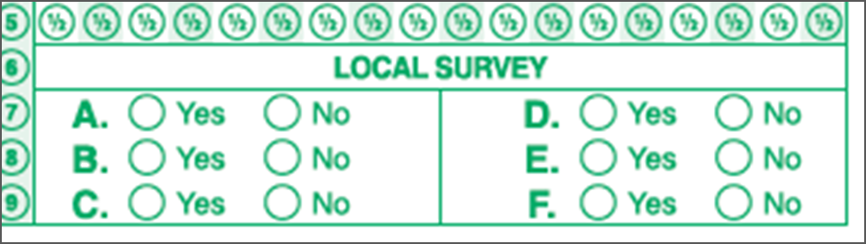
Career Interest Survey Questions
Opportunity for 6 “Yes” or “No” questions
Unique feature of our survey
Anything school officials want to know
  Are you planning to take the SAT / ACT?
  Are drugs a problem in our school?
  Is there enough student parking?

Slide 62
www.exploring.org

Slide 63

Career Interest Survey Guidebook
Be sure you have the most recent version
Download at www.exploring.org
One stop shop for all CIS resources
Table of Contents
  Page 5 | At A Glance
  Page 7 | Overcoming Objections
  Page 44 | Appendix

Slide 64
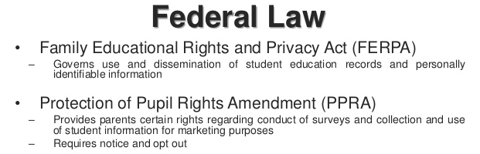
Confidential Information

Slide 65

U.S. Department of Education
Career Interest Survey Letter of Support

Slide 66
ALTERNATE METHODS?
1. Use school information already available
2. Ask youth to develop contacts
3. Develop cultivation events
4. Invite Eagle Scouts / Scouts to join
5. Booth at schools open house night and career days /career fairs
6. Annual Exploring open houses for ALL Posts and Clubs
7. Follow up leads from the Exploring Lead
Generator

Slide 67
CTE
(Career Technical Educator)
Workshop
Top 5 Schools
“Rank Them”
Use AI ?

Slide 68




Slide 69


Slide 70
Leads are being generated from Exploring.org and include anyone interested in joining, leading, sponsoring, or
otherwise supporting Exploring in their area.
Scout Executives, Assistant Scout Executives and DFS’s receive weekly lead reports.
Exploring Executives and staff advisors receive immediate notifications of each lead generated.
To make changes to any of these settings, email your request to exploring@lflmail.org.
WHEN YOU RECEIVE AN IMMEDIATE NOTIFICATION EMAIL:
1. In the email, you will see a note to “copy & paste the following URL into your browser to mark lead as contacted”.
By following this directive, you are changing the status of your lead to “contacted”. You will no longer receive email notifications for that particular lead. The lead will begin to show as “contacted” on your SE’s weekly report.
Invite the person to attend an existing post/club meeting to get a feel for the program and connect them to
appropriate Exploring advisors.

Slide 71
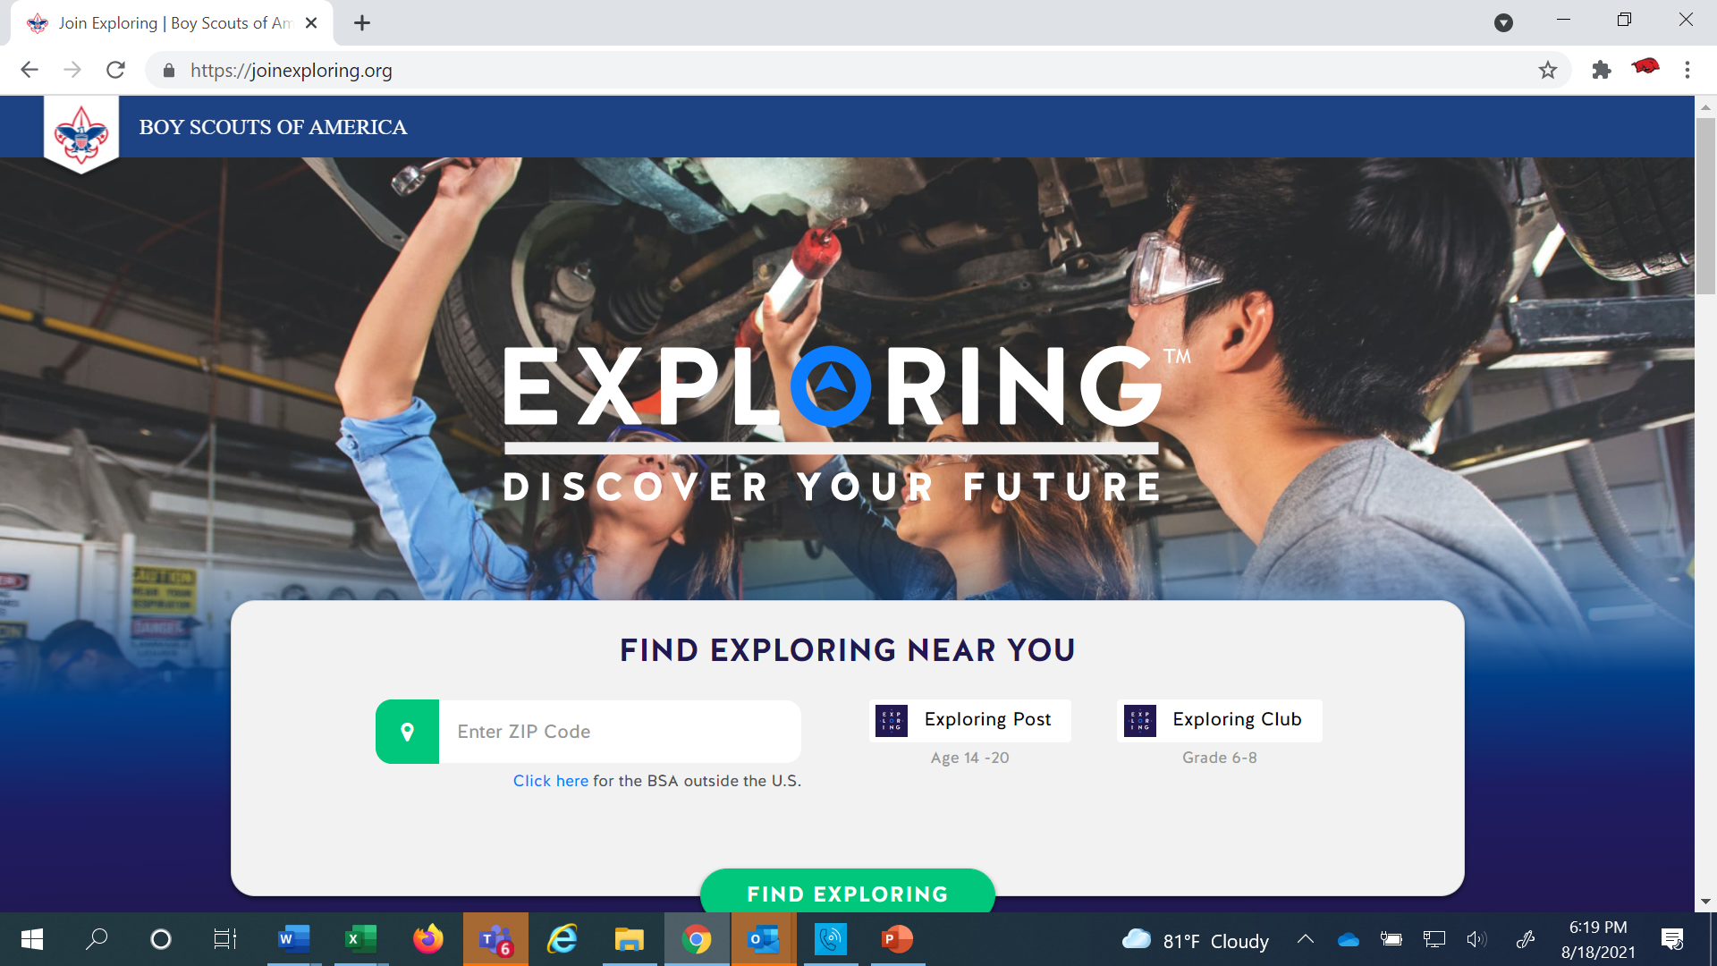
www.joinexploring.org

Slide 72
BASED ON SURVEY RESULTS
1. Focus on Top 4 students interests
2. Identify companies in those 4 interest areas
3. Identify the path to the CEO
  Council board contacts
  School board/admins
  PAS find
  Nominating committee
  Applications

Slide 73
WHO SHOULD MAKE THE ASK?
VIP ?
Things that make you go
Hmmmmmmm

Slide 75

Phase 2 - Leadership
CEO’s Police/Fire Chiefs Administrators
Industry Experts Retirees Community Leaders

Slide 76


Exploring Sales Packets
&
Career Field Brochures
Notes:
15 Sec
Introduce Explorer

Slide 77

Moving forward with the CEO
1) Get organization’s commitment
2) Identify 6-8 adults
- CEO invites them
- You provide guidance
3) Set 2 dates for:
  - All-In-One program planning
  meeting
  - Open House
4) Start Paperwork
  - New Club/Post Application
  - MOU, Adult Application

Slide 78
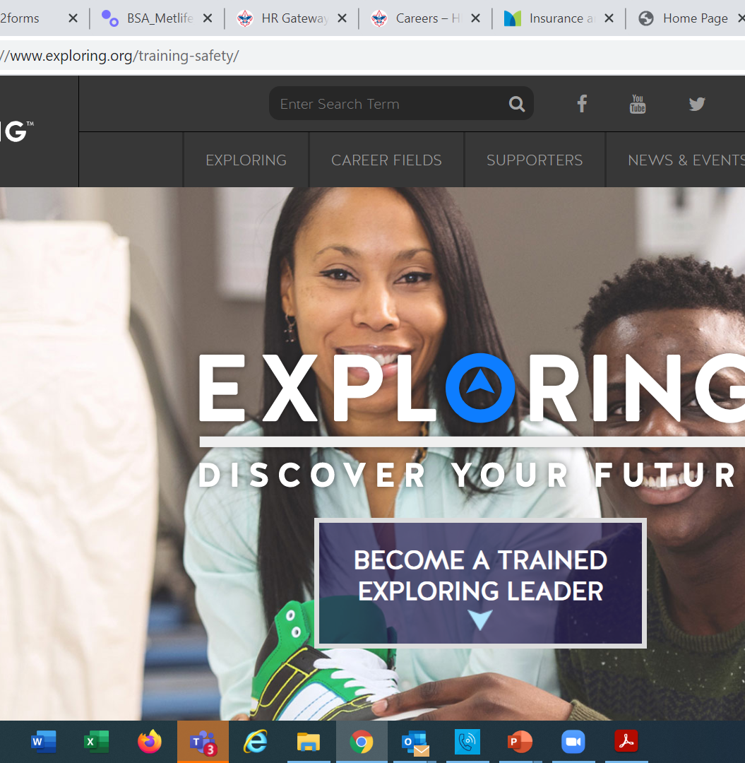
  Exploring Training

Slide 79
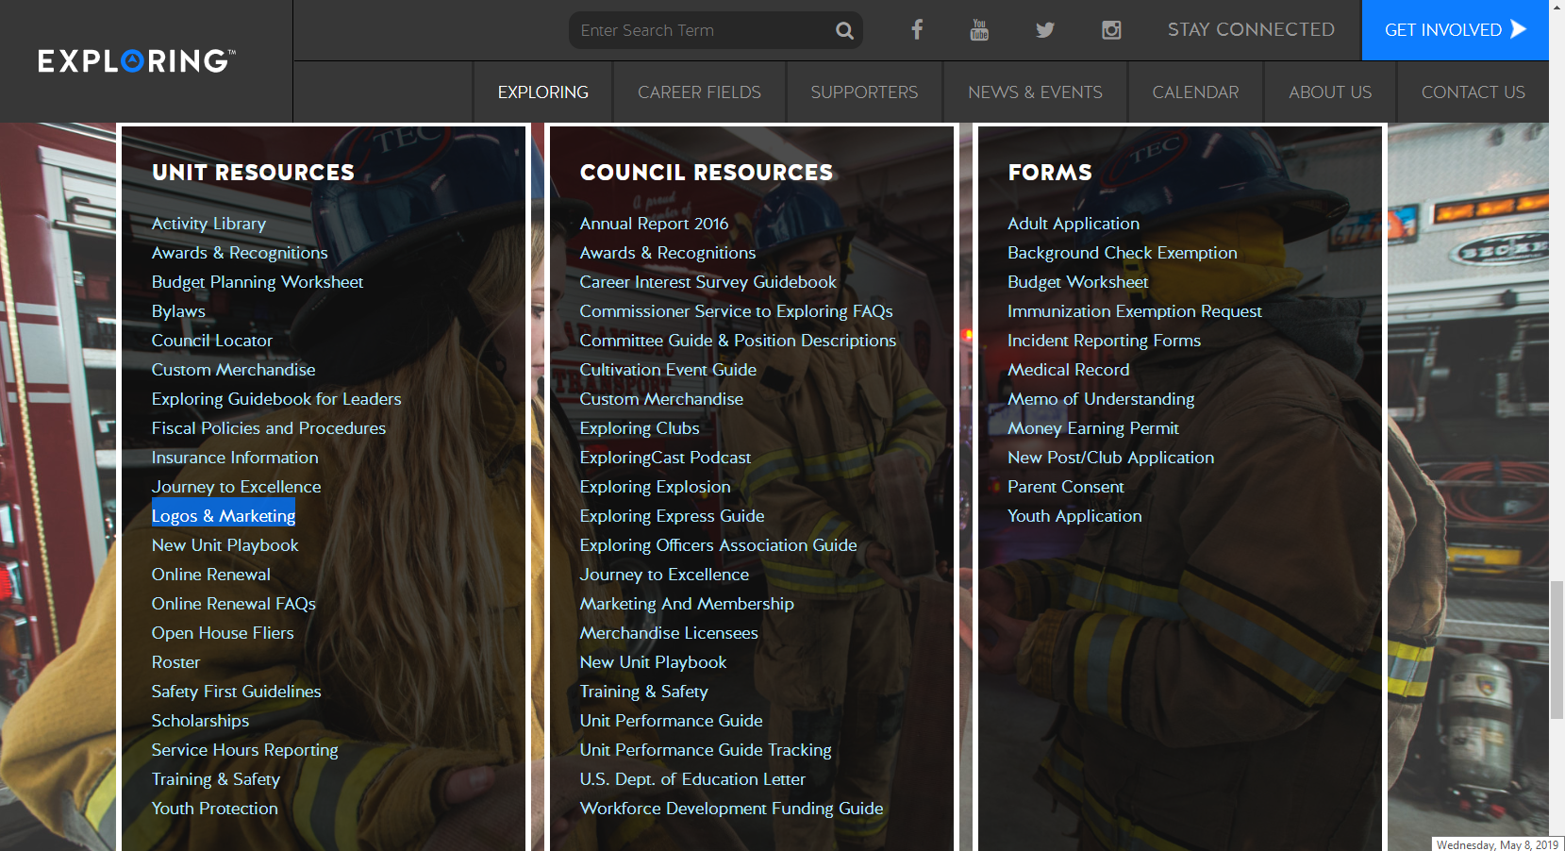

Slide 80
Exploring Position-Specific Training Modules Update Status …
The Exploring Leader Training Modules have also been formatted to be experienced through the learning center via computer or smart device.
Login in to https://my.scouting.org/ . If you need to create an account and do not know your member ID number, please contact your local BSA council office/service center
Once you log in, locate the blue box on the right side of your screen labeled “Click here to access Exploring Training”
After logging in, you may also click “Menu” in the top left corner and select “My Training”. Under Training Courses by Program, select “Exploring Adult Training”
You may select between the three available Exploring learning plans (based on position). Anyone is welcome to complete the trainings
NOTE: In addition, the “Servicing Exploring Units Module for Commissioners” has been updated within the Learn Center.
We would like to sincerely thank the many Exploring professionals and volunteers that helped make this important update happen!

Slide 81
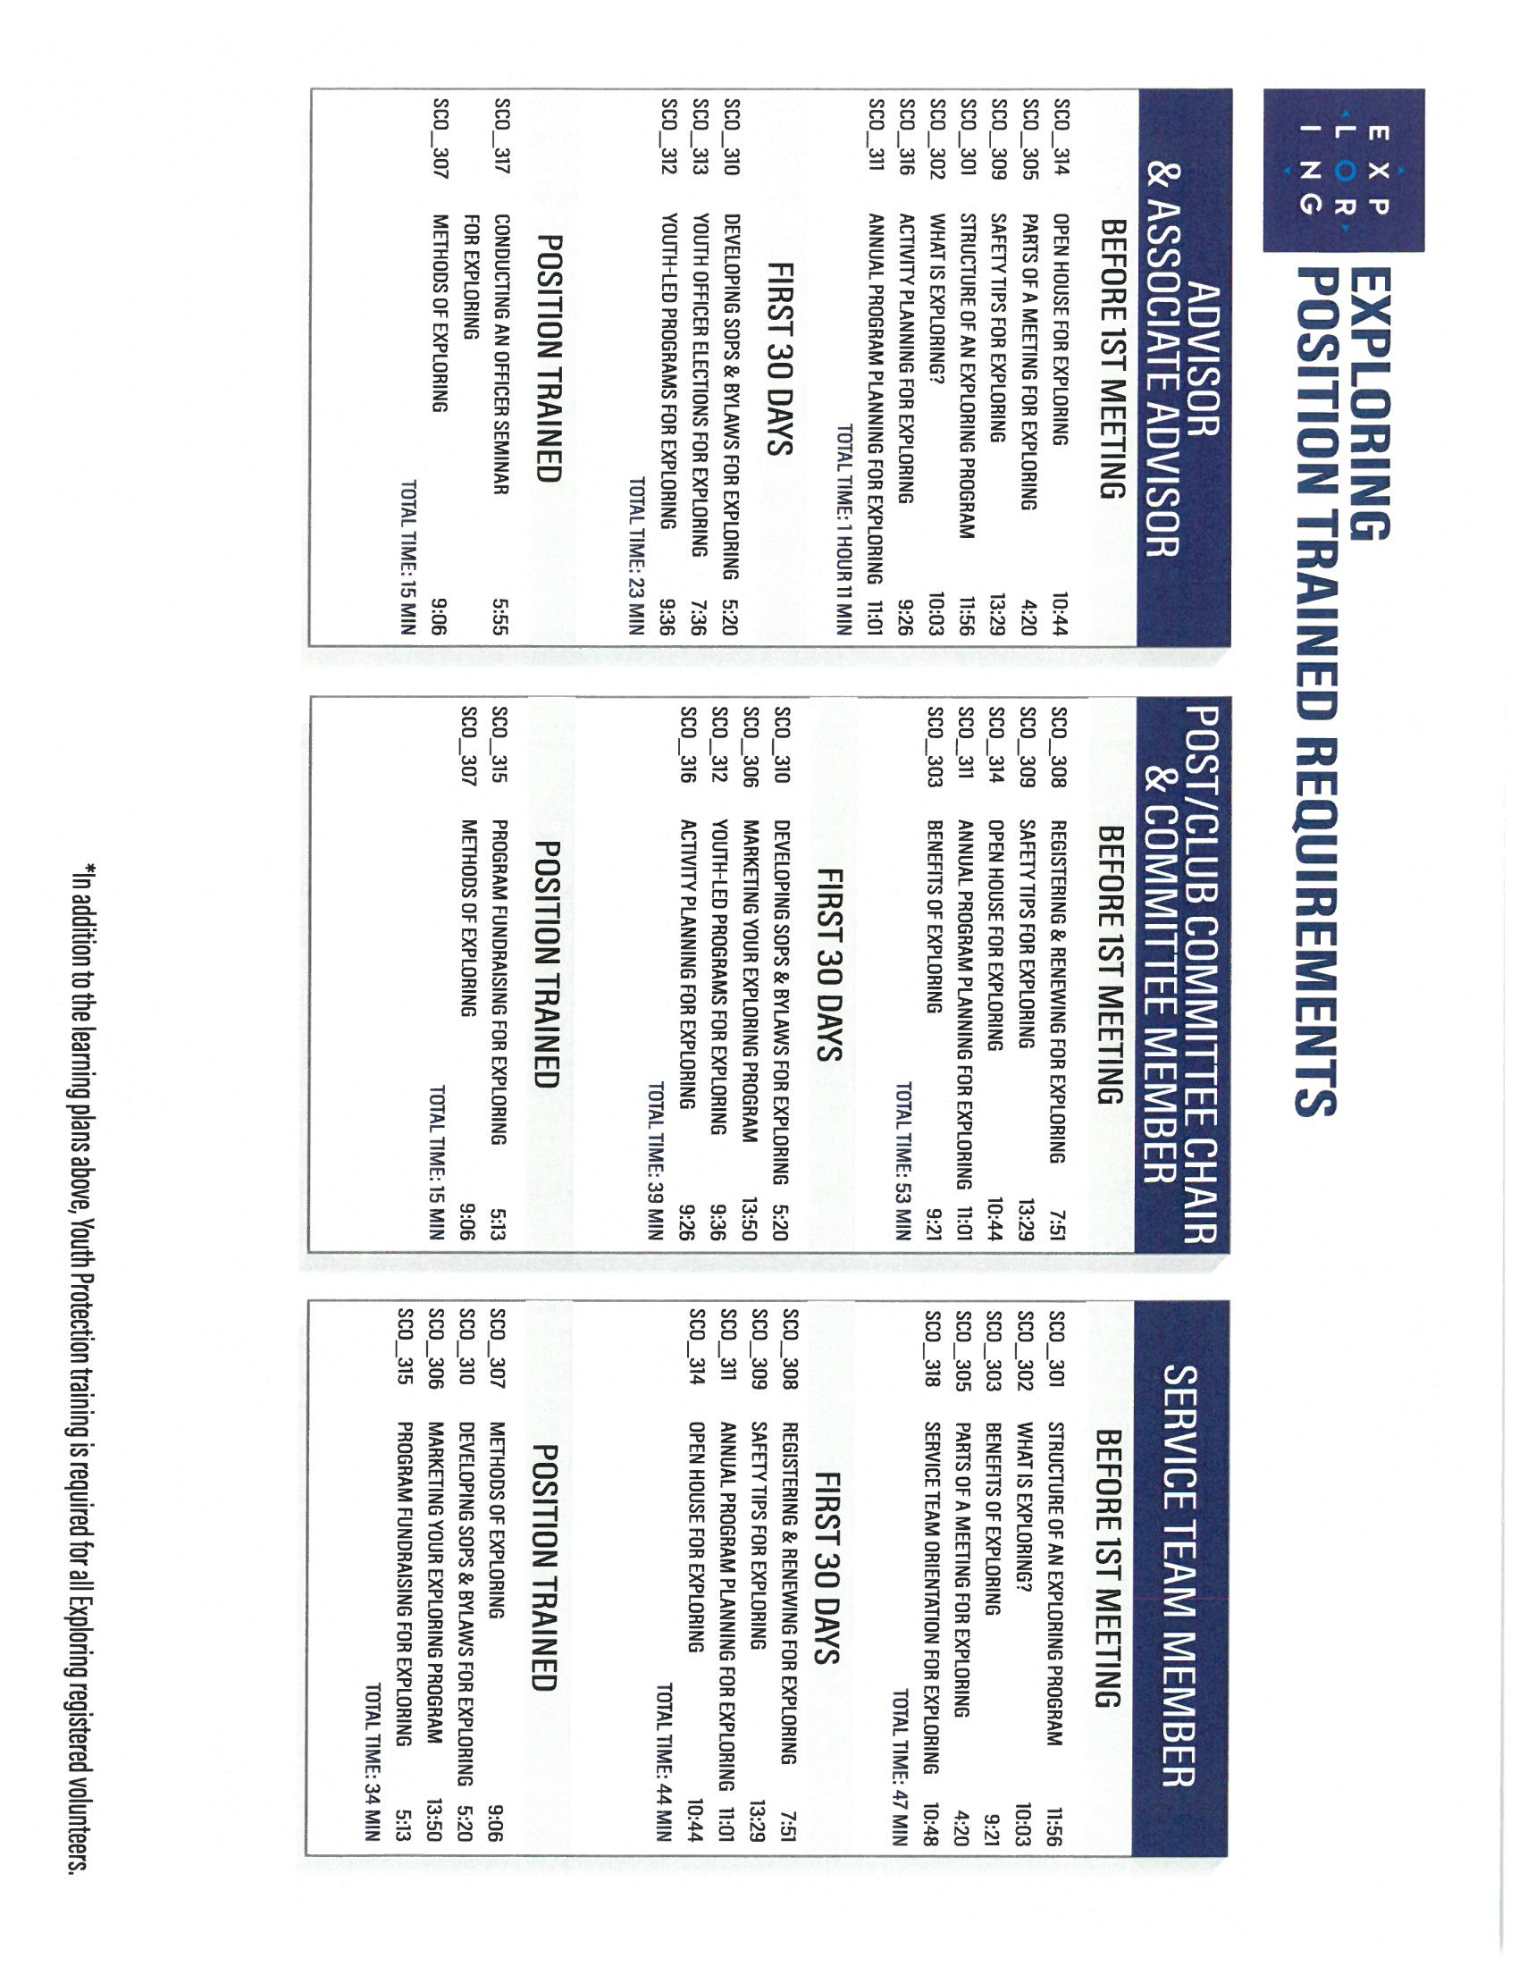
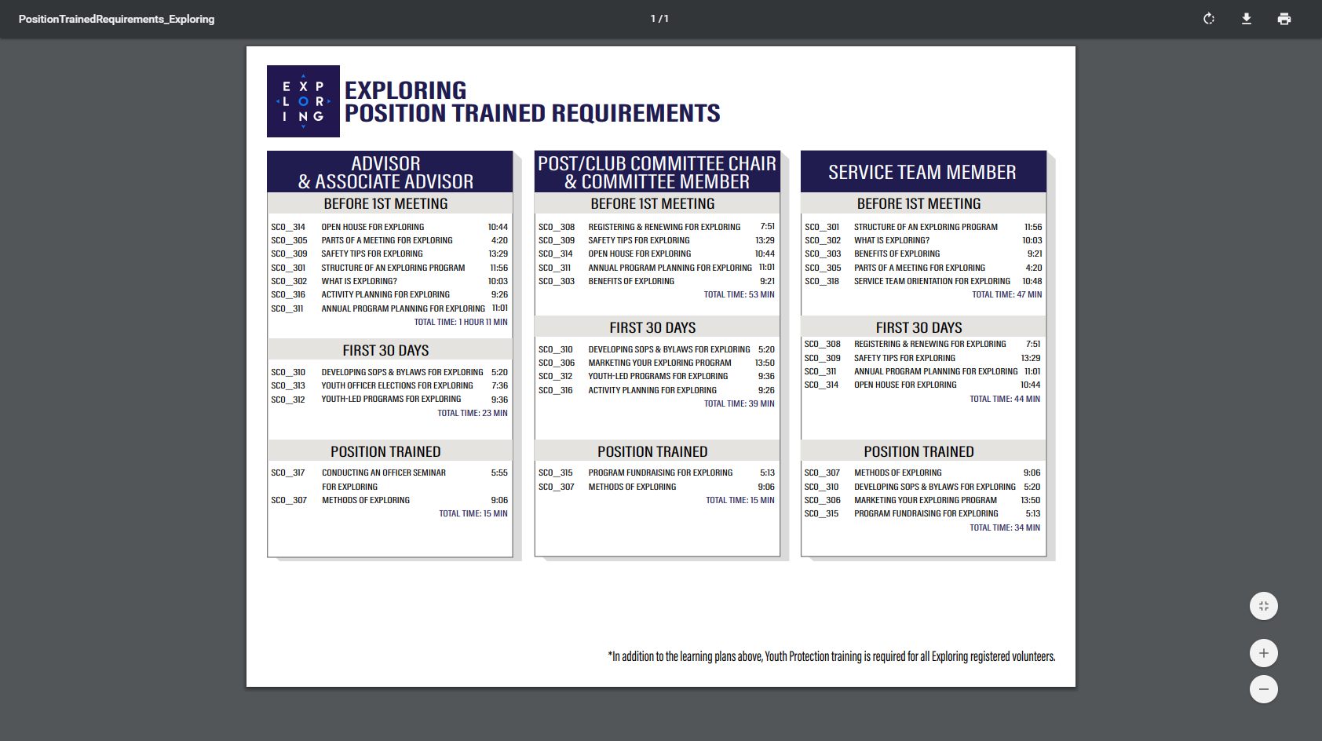

Slide 82

Exploring Guidebook
https://www.exploring.org/wp-content/uploads/2016/10/Exploring-Guidebook-Sept2017.800-10018.pdf

Slide 83
Safeguarding Youth
(Youth Protection)
Training
https://my.scouting.org/

Slide 84
Exploring Youth Training Update
https://www.scouting.org/training/youth-protection/venturing/

Slide 85
Exploring Safety First Guidelines
LFL-safety-first-guidelines-3.21.17-interim-revision-8.4.25.pdf

Slide 86
Questions?

Slide 87
Council
Online Survey Sign-up www.exploringyourcareer.com
1 Professional Scouter from each council to work with your Scout Executive and Susan Fitzhugh susan.fitzhugh@scouting.org

Slide 88

Drone Exploring
ryan.moon@scouting.org

Slide 89
EXPLORING CERTIFICATION

Slide 90
INCENTIVES

Slide 91
EXPLORING EXPLOSION 3.0
KICK-OFF CAMPAIGN
ONE NEW POST OR CLUB IN EVERY DISTRICT

Slide 92
Specific strategies to build growth momentum with local councils :
(Membership assumptions built on 1200 750 Districts to grow Exploring by 39,000 Youth)
Pre-COVID/Bankruptcy “Participating Organization” research (prospect and evaluation)
  100,000-38000= 62,000 X 15 % return = Potential of 9,300 new Explorers
Conducting Career Interest Surveys and Open Houses www.exploringyourcareer.com (minimum of 2 schools per district & Open Houses for every existing Post)
  1878 units / 2 = 939 units x (10 average youth) = Potential of 9,390 new Explorers
The Exploring Explosion 3.0 Kick-Start Campaign (one new Post or Club) per District
  750 districts x 1 new unit = 750 x 12 (average youth per new unit) = Potential of 9,000 new Explorers
From Character to Careers-Scouts BSA Promotion (find your career through Exploring)
  Recruit 750 districts x 15 Scouts BSA members to Exploring = Potential of 11,250 new Explorers
Realign partnerships with IACP, NSA, NSRO (become their official recruiting source) & create national partnership with Toyota (skilled trades/auto technician)
  Potential unknown

Slide 93
2025 NATIONAL EXPLORING LIVE HOURS
The National Exploring Live Hour is a monthly Zoom video conference that will help engage and equip
Exploring volunteers and professionals to grow, support, and learn more about Exploring. Each month the National Exploring Live Hour will be led by our National Exploring Chair and the National Director of Exploring. The live hours will include sharing best practices and ideas that are happening within our councils, highlighting successful growth campaigns, and inspiring new ideas through various trainings. This will also offer an opportunity for local councils to collaborate with territory and national counterparts to generate innovative solutions to real-life Exploring challenges.
National Exploring Live Hour Schedule
1:00 PM – 2:00 PM Central Standard Time, Monthly
Register for each of the National Exploring Live Hour ZOOM presentations at:
https://reservations.scouting.org/profile/form/index.cfm?PKformID=0x156865abcd

Slide 94
Notes:
TW: Let's talk about the business first. There's a widely accepted maxim in business that says it costs 5x more to get a new customer than to retain a customer you already have. Is that true in Scouting? Probably it's not too far off. We spend a lot of effort trying to attract new Cub Scouts (and I don't think anyone would agree that this isn't necessary), and we at least sort of have a plan for short term retention as we try to attract them into a Scouts BSA troop, but we have no plan at all to retain them after that - yet, we have the tools to do it if we chose.

Slide 95
SESSION # 2

Slide 96
Notes:
TW: Let's talk about the business first. There's a widely accepted maxim in business that says it costs 5x more to get a new customer than to retain a customer you already have. Is that true in Scouting? Probably it's not too far off. We spend a lot of effort trying to attract new Cub Scouts (and I don't think anyone would agree that this isn't necessary), and we at least sort of have a plan for short term retention as we try to attract them into a Scouts BSA troop, but we have no plan at all to retain them after that - yet, we have the tools to do it if we chose.

Slide 98
Important resources to help plan the program…
Career Opportunity Worksheet -- www.exploring.org and click on relevant career field icon and scroll to the bottom of the page.
Activity Library (including Life Skills Section) https://www.exploring.org/activity-library/
Organization’s Resources/Employees
  A. Current work curriculum (developed by the company)
  B. Employee’s expertise/knowledge (Use All-in One Program Planning Meeting-found in the Exploring Guidebook for Leaders)
Career Achievement Award (Posts) & Career Awareness Award (Clubs)
  http://www.exploring.org/wp-content/uploads/2017/06/Career-Achievement-Award-May2017.pdf
  http://www.exploring.org/wp-content/uploads/2018/05/Career-Awareness-Award-FINAL.pdf
Exploring Guidebook for Leaders https://www.exploring.org/wp-content/uploads/2016/10/Exploring-Guidebook-Sept2017.800-10018.pdf
Safety First Guidelines/Guide to Safe Scouting (Guide is being Updated—Please follow all CURRENT (SGY/YPT) Policies
LFL-safety-first-guidelines-3.21.17-interim-revision-8.4.25.pdf
7. Online Exploring Adult Leader Specific Training & Youth Protection Training
https://www.exploring.org/training-safety/ or www.myscouting.org
8. Unit Performance Guide (Chapter 5- Exploring) –Details about organizing a new Post/Club
http://www.exploring.org/wp-content/uploads/2021/04/522-02516_UPG.compressed.pdf
9. AI tools through “Teams” “Copilot” to help organize meeting plans
Also visit www.exploringexplosion.org and scroll to the bottom of the website to find additional resources…

Slide 100

Phase 3 – Program
All-In-One Program Planning Meeting
1) Paperwork
2) Adult Explorer Leader Training
  - Youth Protection for Explorers
  - Adult Explorer Leader Training
3) Open House Planning
  - Brainstorm session
  Why did you choose this career for yourself?
  What are hands on activities that you can do with youth?
  - Develop a 3-4-month calendar (use Activity Library)
  - Choose Open House “hands-on activities”
4) Prepare Post Committee Members for Open House

Slide 101
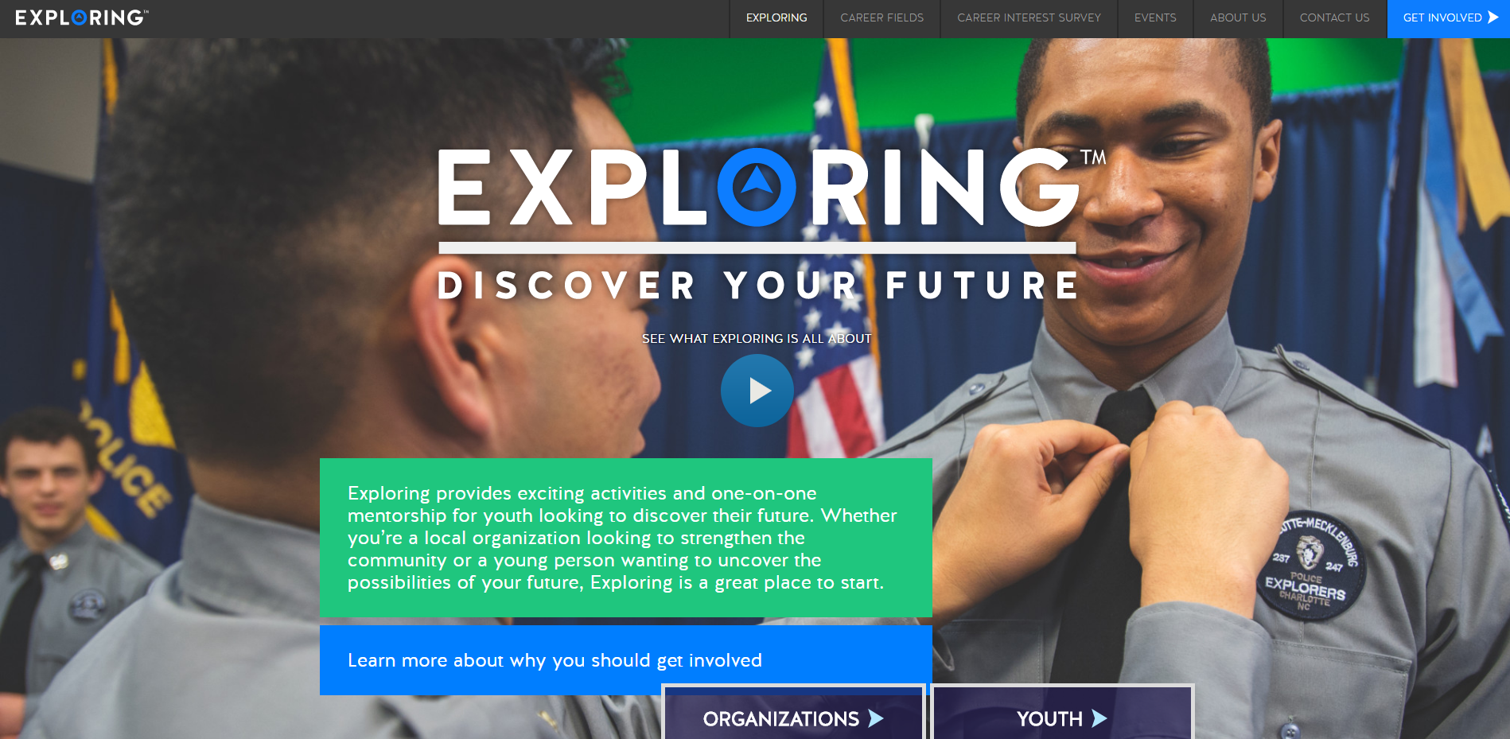

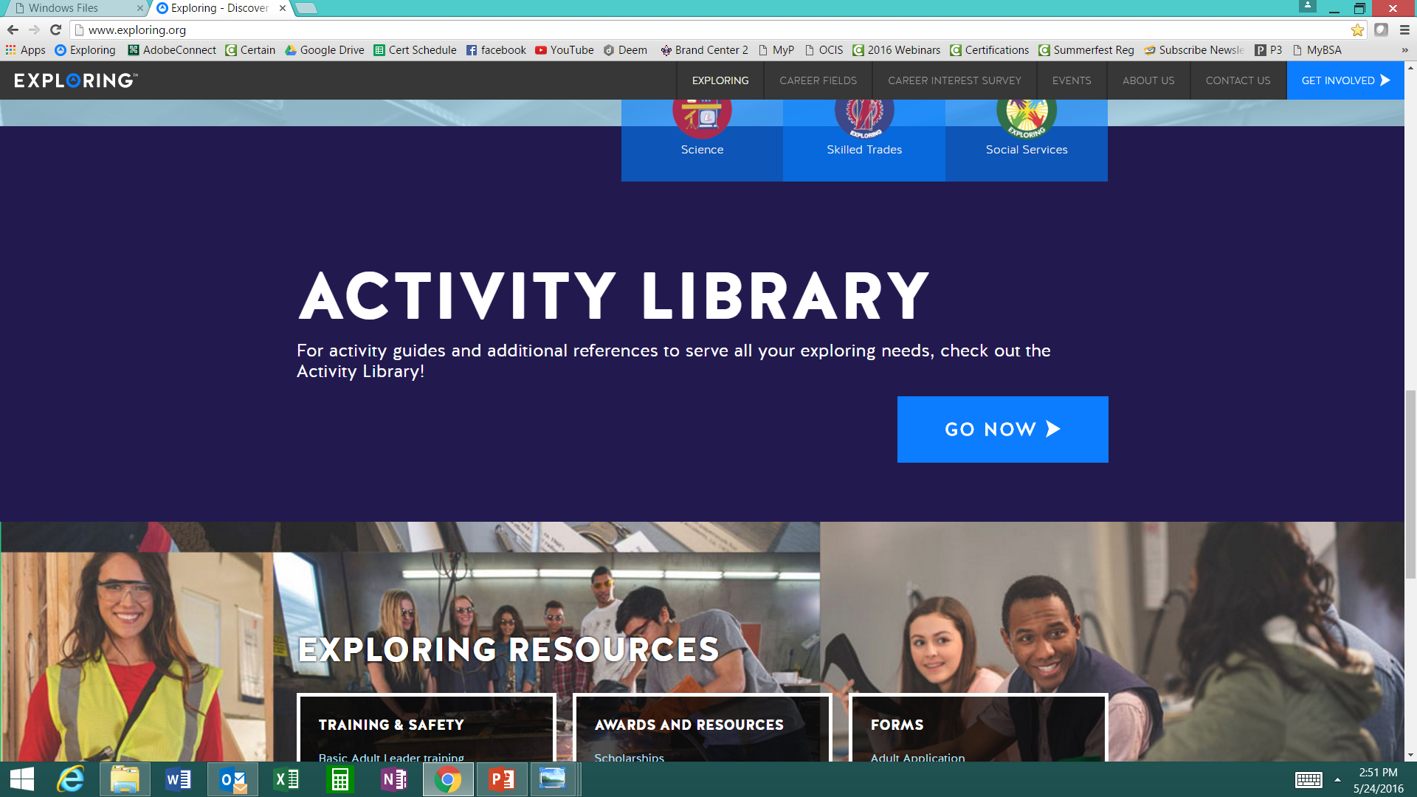

www.exploring.org
Notes:
Program planning is also a service that is provided by the local Boy Scout Council. This Activity Library is an all new supplement to the process. You will find it on www.exploring.org

Slide 102
SAMPLE PROGRAM CALENDARS
The frequency of your meetings and length of your program each year is up to you. For example, this could be a 12 month or 12 week program.
ENGINEERING & TECH
MONTHLY MEETINGS YEAR-ROUND
September
Open House
October
Chemical engineering
November
Youth Officer Elections
December
Holiday Play – open house
January
Industrial Technology
February
Electrical engineering
March
Computer science
April
Fluid power technology
May
Ethics in engineering
June
Visit with engineering firm
July
Civil engineering
August
Mechanical engineering
Notes:
PRESENTER NOTES:
BE SURE TO DELETE THE CALENDARS/SLIDES THAT ARE NOT RELEVANT TO THE CAREER INDUSTRY TO WHICH YOU’RE PRESENTING.
Remind the audience that they have flexibility is setting the schedule for their own program. Here are some options:
Year round – may or may not include summer
Weekly
Monthly
3 months at a time, different group of youth each time, 3 times per year
Weeknights or weekends

Slide 103

Phase 3 – Program
Planning the Open House
1) From your BRAINSTORM session…
  - Pick the 4-5 best activities for a quick hands-on
  format at the Open House
2) At the open house…“Go shopping”
  - 4-5 stations (rotations)
  - 4-5 minutes each

Slide 105
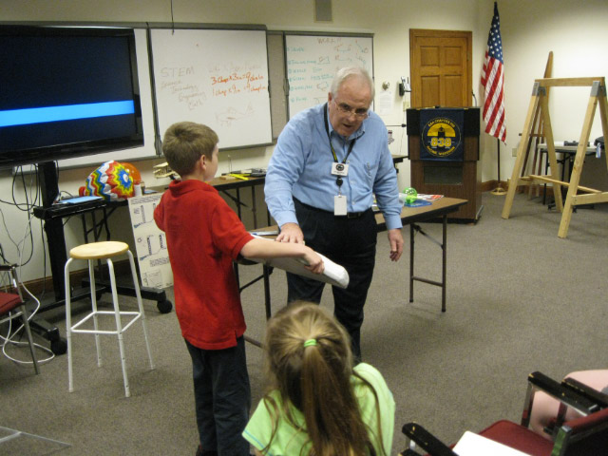
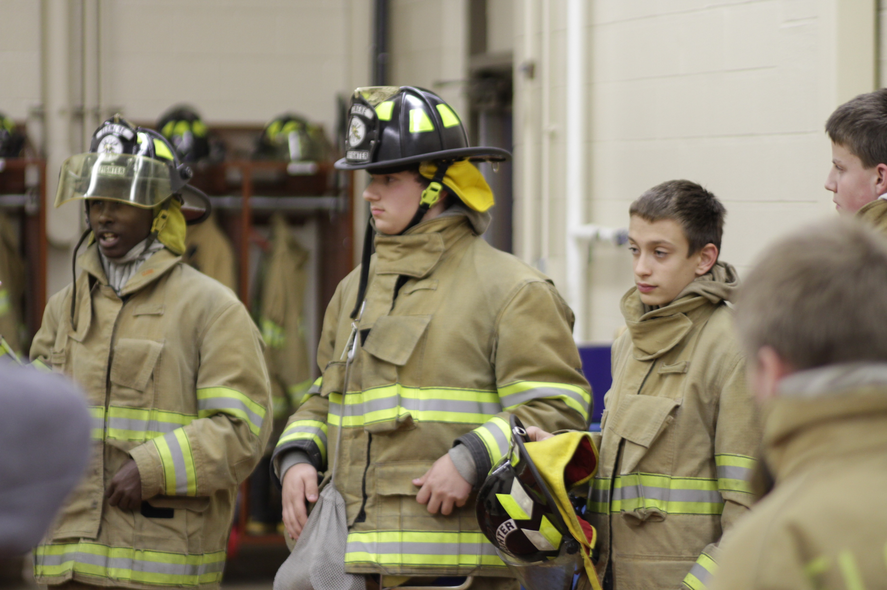
Phase 4 – Participation
SIMPLE OPEN HOUSE AGENDA
OPEN HOUSE AGENDA
Welcome
What is Exploring?
Video
HANDS-ON ACTIVITIES
Activity Interest Survey (customized)
Calendar
ASK TO JOIN
Applications & fees
Snacks

Slide 106
Exploring Sales Packets
&
Career Field Brochures
Notes:
15 Sec
Introduce Explorer

Slide 107
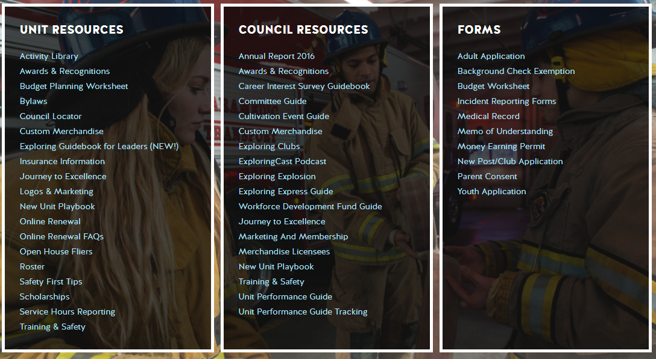
Resources to help you… www.exploring.org

Slide 108
Other
Resources &
Websites

Slide 110
MOST IMPORTANT PART
OF EACH PHASE (Review)
Phase 1 : Career Interest Surveys
Phase 2: Training
Phase 3: All-In-One Program Planning Meeting
Phase 4: Open House

Slide 111

EXPLORING PARTICIPANT POLICY
“EP” (18 THROUGH 20 YR OLD EXPLORERS)
Effective August 1, 2020, all applicants 18 through 20 years old must complete and submit an adult application, consent to a criminal background check, and successfully complete Youth Protection training.
However, an 18- through 20-year-old will still be considered an Adult Exploring Participant in the post and will not be considered an adult leader. Therefore, an “EP” will not be allowed to fulfill adult leadership roles pertaining to Two-Adult Leadership and other requirements that require leadership to be at least 21 years of age.
All Exploring Participants “EP” will continue to count as youth within your youth membership reports.
Visit the link below for an infographic as well as a Q & A to assist you in implementing this important new policy. http://filestore.scouting.org/filestore/se-packet/2020-08-10/Exploring-Participant-Policy-FINAL-2.pdf

Slide 112
EXPLORING REGISTRATION FEES
Effective August 1, 2023, Exploring fee updates:
- Exploring Youth $50.00
- Exploring Adult Participants (18-20) $50.00
- Exploring Adults $50.00
- Exploring Post/Club Annual Renewal Fee $100.00
- There is no additional “Joining Fee” for Exploring
The updated membership fees will take effect August 1, 2023, for new members in the 2023-2024 program year.
The national membership fee helps cover the cost of essential services, including program resources, liability insurance for those participating in approved Scouting activities, criminal background checks, youth protection, and the development of intellectual property for national, council, and unit programs. As we move forward, we will continue to look at the membership fee structure and how we deliver the Scouting program for future generations.

Slide 113
NEWLY UPDATED EXPLORING APPLICATIONS
The newly updated Exploring applications are available now for download online at www.exploring.org
New Post/Club Application (SKU# 655197)
Youth Application (SKU# 634698)
Adult Application (SKU# 634699)
-Includes the new 18-20 Exploring Participant (EP) Code, which will became mandatory beginning August 1st, 2020.
*New applications are available at the National Distribution Center .

Slide 114


Slide 115
ONLINE
REGISTRATION
&
ONLINE
UNIT RENEWAL
FOR EXPLORING

Slide 116
ONLINE
REGISTRATION

Slide 117
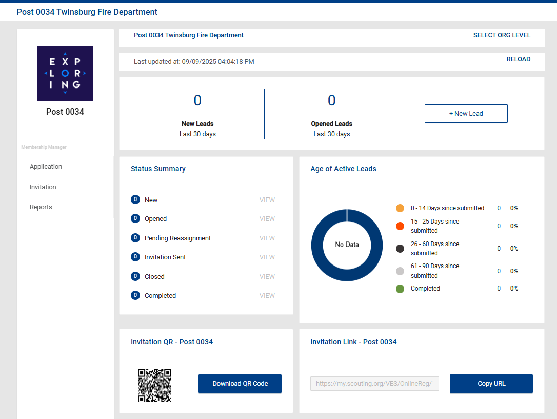
Invitation Manager

Slide 118
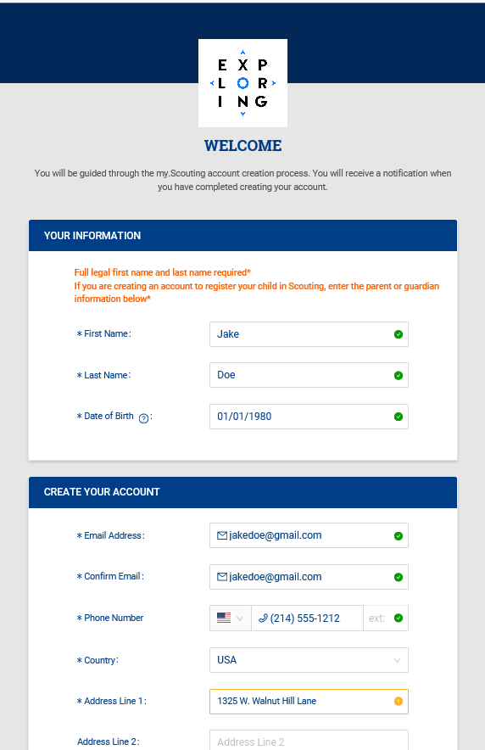
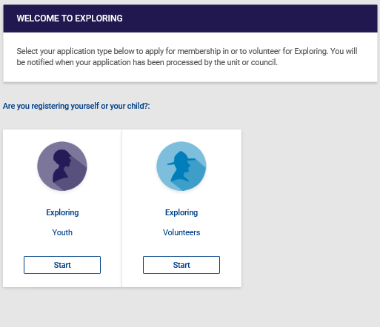
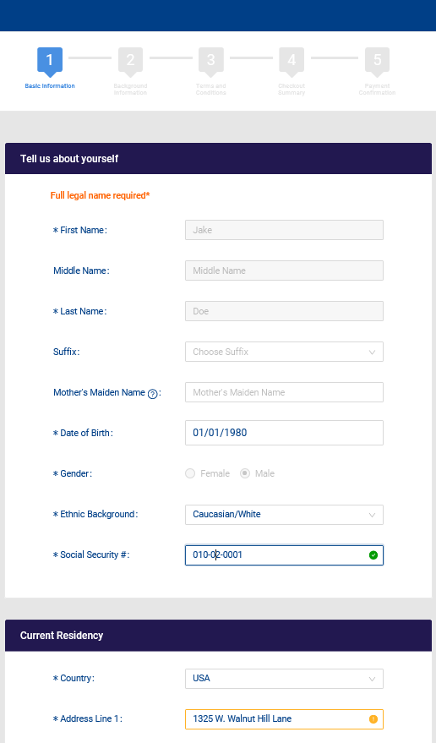
Create Account & Complete Application

Slide 119
ONLINE UNIT
RENEWAL/
“RECHARTERING”
FOR EXPLORING

Slide 120
https://www.scouting.org/commissioners/internet-rechartering/
Information included is:
Training Video
FAQ’s
User Guides
Internet Recharter Guidelines
Summary of Enhancements
Recharter Demo Tool
New Online Rechartering/Renewal System
https://advancements.scouting.org/login
Manager of Shared Services
Member Data Outsourcing Solutions

Slide 121

Scouting America Renewal System Overview

Slide 122
Renewal Membership / Units
For all Youth and Adult members in the BSA
All Membership Terms are for 12 months
Membership Renewal will only have a two-month lapse
New Unit Renewal will only have a two-month lapse
Parent/Guardian e-mails are needed
Text notice will be sent too
Parents can Opt-Out and Units can Opt-out the member too

Slide 123
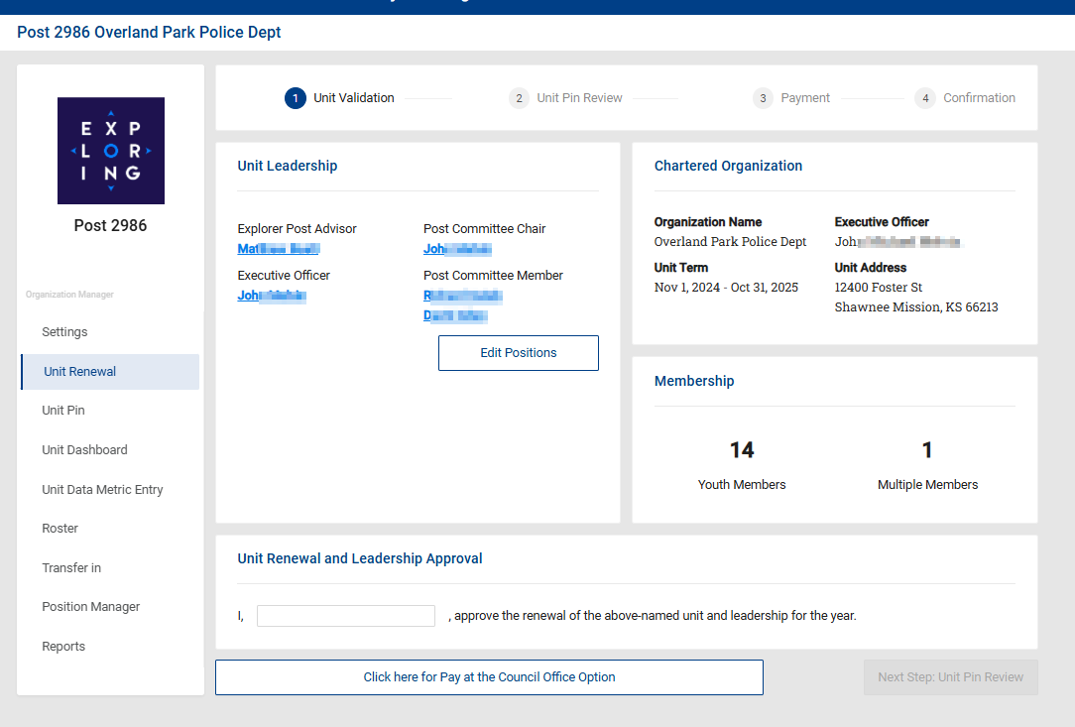
Renewal Membership – Unit Renewals

Slide 124
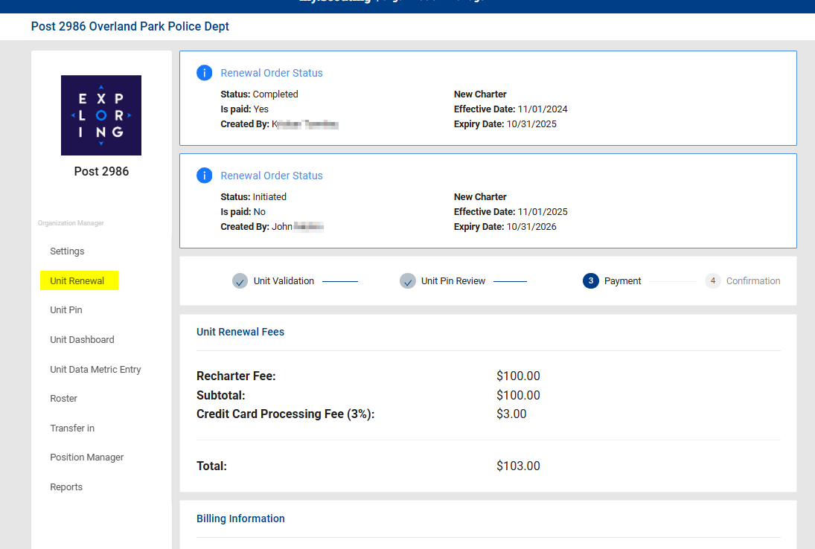
Renewal Membership – Unit Renewals

Slide 125





Renewal of Membership
For all youth and adult
members of the Scouting America
Auto Renewal Membership
Family/Self Pay
Auto Renewal Membership
Unit Pay
An email notification and a renewal link will be sent 60 days before membership expires.
The link provided in the email will direct individuals to a renewal form on My.Scouting
If registered in multiple positions, select the primary position. Renewing the primary position will automatically renew multiple positions.
The individual pays with a credit card and submits the renewal.
The unit will approve the membership renewal.
In Organization Manager, the unit selects the
Unit Pay option.
Unit Key 3s are notified each month about which members are due to renew that month.
Using the Roster tab, the unit selects which members they are renewing.
The unit can choose not to renew a member
(opt-out). The unit can also change the Scout’s Life subscription settings for each person.
The unit pays with a credit card or establishes a securely stored electronic fund transfer payment (ACH) and submits the renewal.

Slide 126
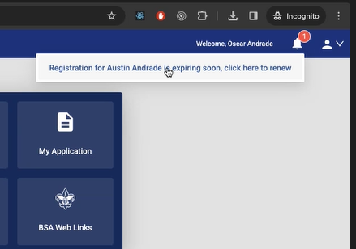
Renewal Membership – Family / Self Pay

Slide 127
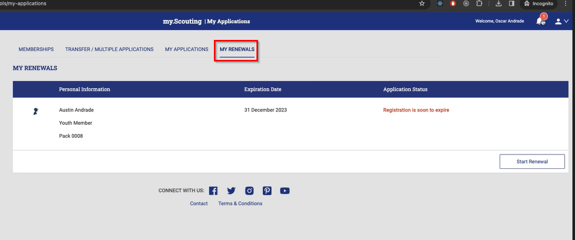
Renewal Membership – Family / Self Pay

Slide 128
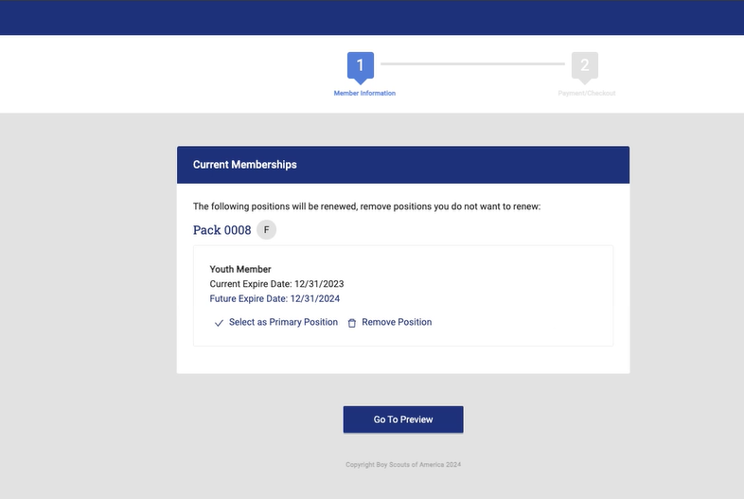
Renewal Membership – Family / Self Pay

Slide 129
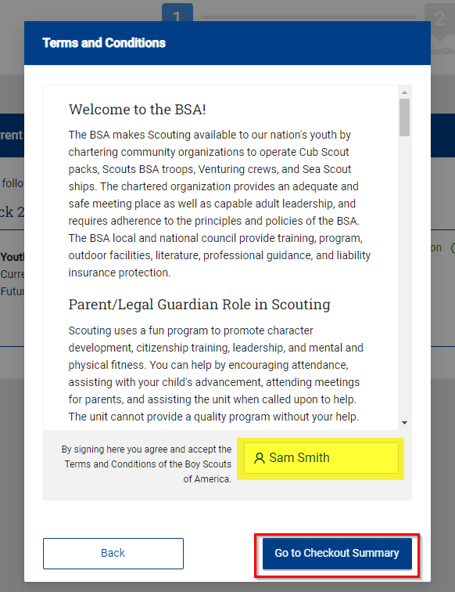
Renewal Membership – Family / Self Pay

Slide 130
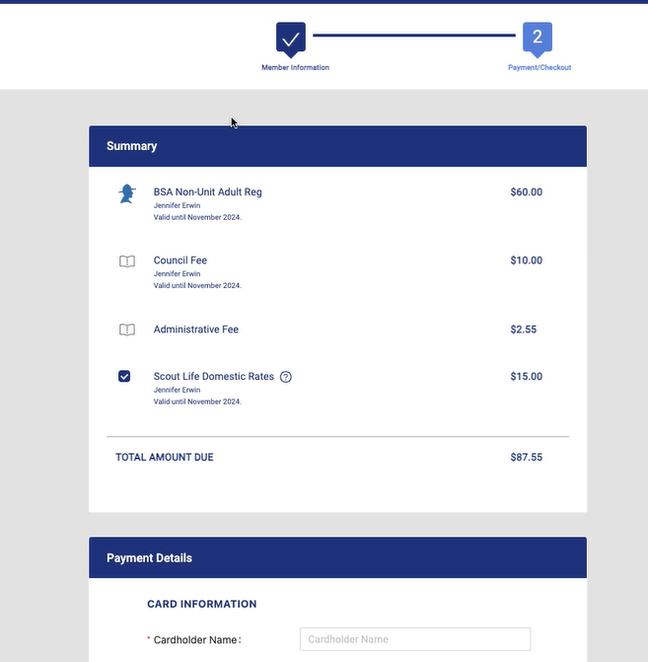
Renewal Membership – Family / Self Pay

Slide 131
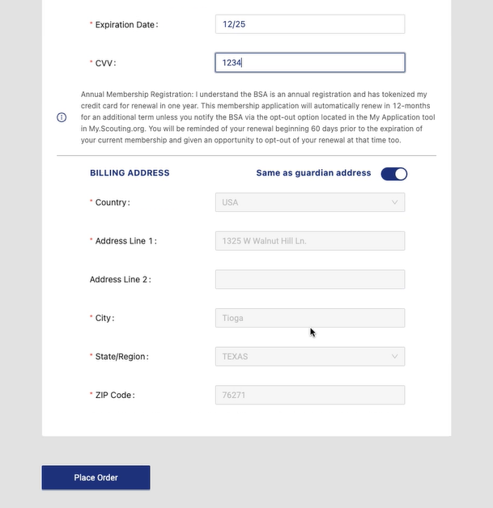
Renewal Membership – Family / Self Pay

Slide 132
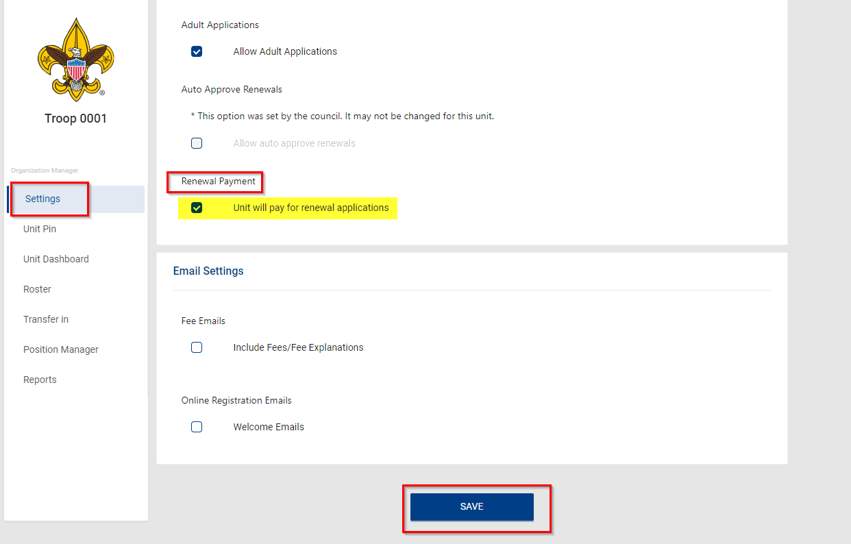
Renewal Membership – Unit Pay

Slide 133
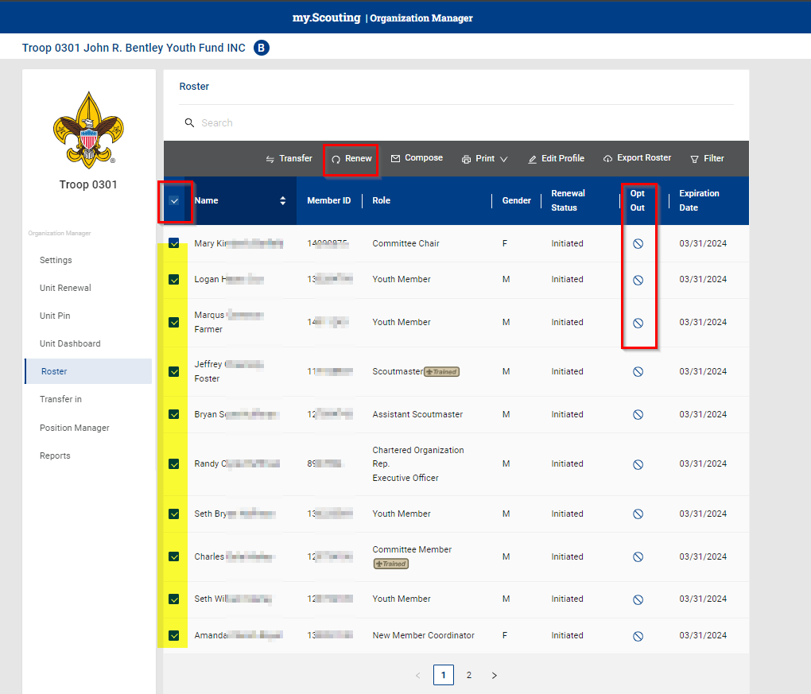
Renewal Membership – Unit Pay

Slide 134
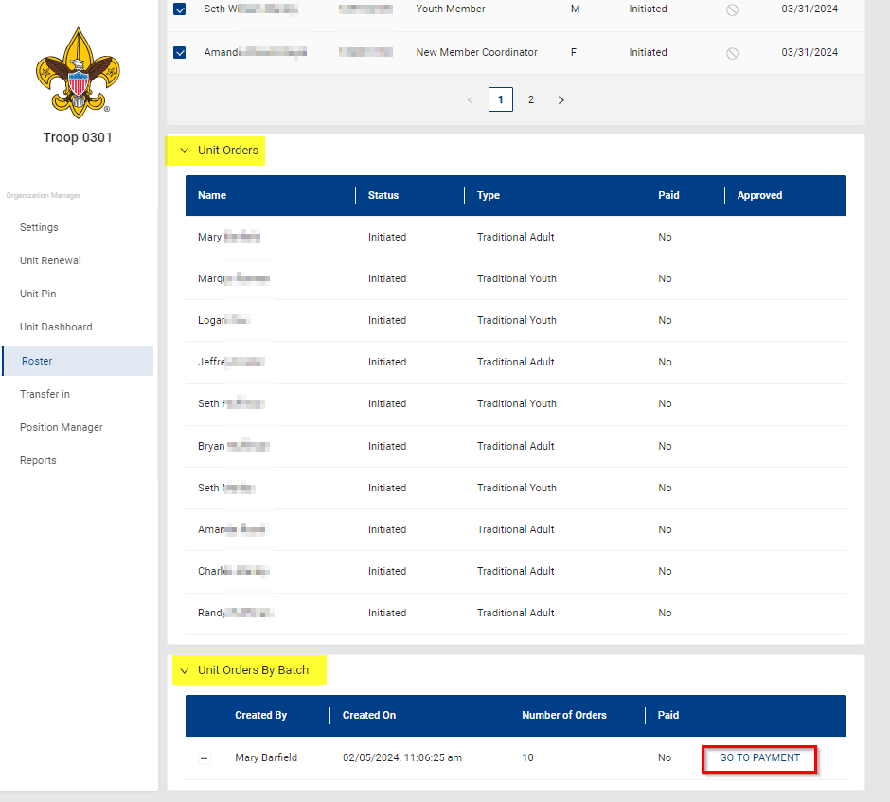
Renewal Membership – Unit Pay

Slide 135
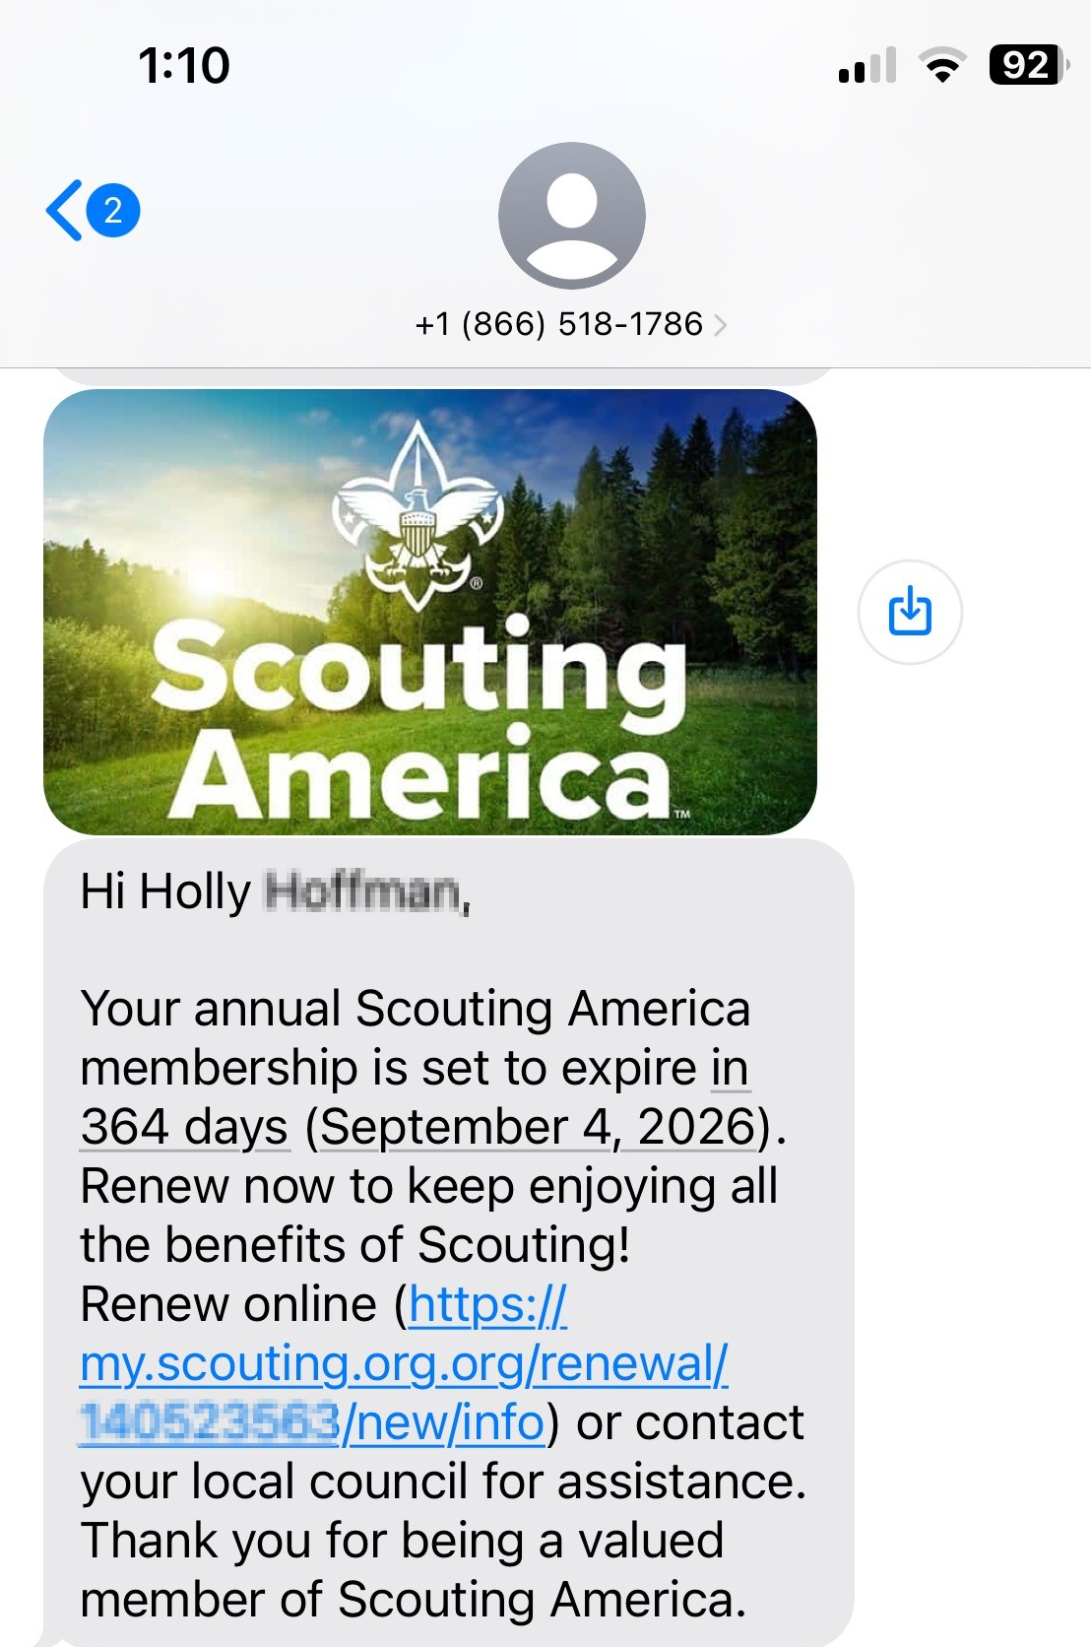
Member Renewal Cycle – December 2025
430,642 Members Renew
Emails beginning 60 days out from the expiration date – 5 emails
Texts sent beginning 45 days out – 4 texts sent
Monthly Renewal Communication Sequence
November 1st – Email Sent
November 15th – Text Message Sent
November 30th – Email Sent
December 15th – Text Message Sent
December 31st - Email and a Text Message Sent
January 7th – Email Message Sent
January 15th – Text Message Sent
135

Slide 136
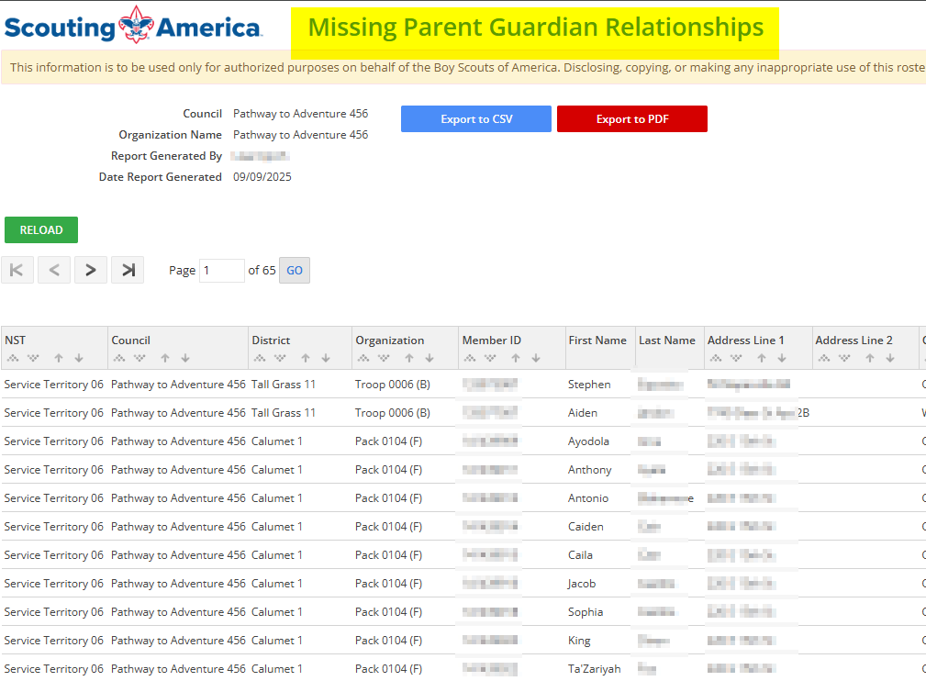
Renewal Membership – Missing Parent Guardian Relationship

Slide 137
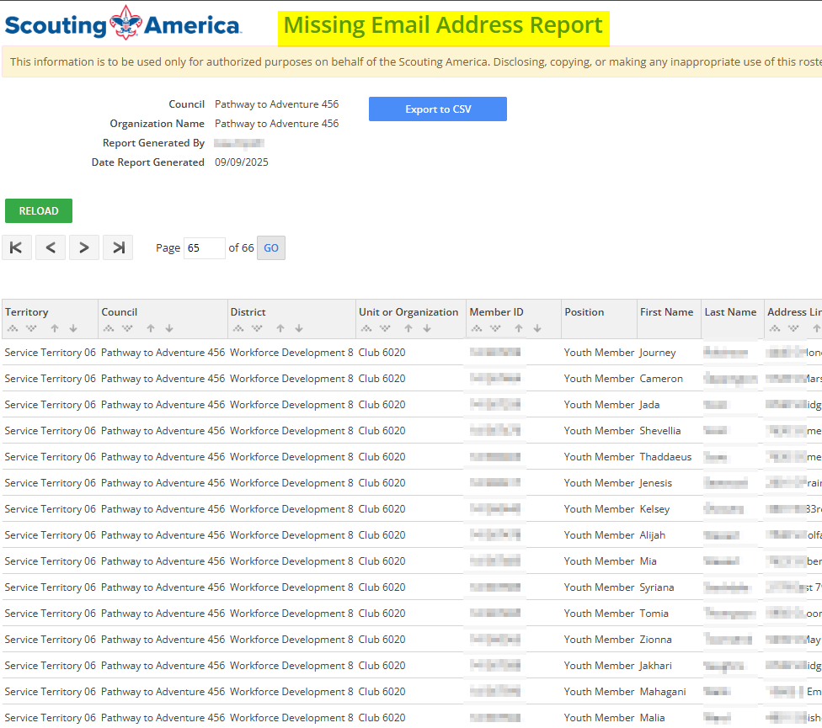
Renewal Membership – Missing Email Address Report

Slide 138

Renewal Membership – Member without Unit Report

Slide 139

Renewal Membership – Members Due to Renew Report

Slide 140

Renewal Membership – Members Opt-Out Report

Slide 142

Newest Technology for Exploring
BeAnExplorer “Equivalent”
“joinexploring.org”
“joinexploring.com”
Scoutbook for Exploring
Online Registration
Online Renewal
Scoutly

Slide 143


Successful Councils…
Intentionally Providing a Pathway to Exploring Growth and
Strategic Planning In Your Council

Slide 144
OPEN HOUSES
INSERT HERE
COUNCIL/DISTRICT YEARLY MEMBERSHIP PLANS
(Recruitment/Retention Cycle)
Career Interest Surveys

Slide 145

12 Keys To Success

Slide 146

“Action Planning”
The Beginning of your Strategic Plan
The foundation of your plan will begin here

Slide 147

1. Recruit a council Exploring volunteer chair and committee
2. Appoint a Council Exploring Champion
“Staff Advisor”
3. Create a public presence for Exploring
(council website, newsletters, social media)

Slide 148

4. Train key volunteers and staff on the 4
Phases of Post/Club Organization
5. Set specific goals for Career Interest
Surveys or gathering of data from select high schools
6. Set goals to host Open Houses for all
Posts/Clubs (i.e. School Night for
Scouting)

Slide 149
7. Create a campaign to emphasize
Post/Club unit support (through
Service Teams/Commissioners)
8. Integrate Exploring into council activities and events
9. Promote Exploring to all current customers (i.e. “Scouts BSA”)

Slide 150
10. Host a council community cultivation event, focusing on a specific career.
11. Involve the Council Executive Board to help open doors within the community and to help create a list of businesses to match the
Career Interest Survey results.
12. Ensure that Exploring is included in the
Council Strategic Plan, PDS Goals, and
Board Meetings.

Slide 151



STAY CONNECTED
page | @lflexploring
group | Exploring Success!
group | National Explorer Alumni Association
learningforlifeusa
exploring.org | Stay Connected
exploring@lflmail.org

Slide 152
BONUS SLIDES
FUNDRAISING FOR EXPLORING

Slide 153

  Fundraising and Cultivation Events
www.exploring.org
Simply scroll to the bottom of the home page and search within the 3 boxes labeled:
“Unit Resources”, Council Resources”, & “Forms”

Slide 154

Funding http://www.exploring.org/wp-content/uploads/2016/10/Workforce-Development-Funding-Campaign_Final_11.7.16.pdf
Cultivtion Events http://www.exploring.org/wp-content/uploads/2015/11/800-060_Cultivation-Event_FINAL_7.13.16.pdf

Slide 155

Fundraising

Slide 156


Camp Cards
VS.
Career Cards

Slide 157

FUNDRAISING
Awards
Council/district coordinated events

Slide 158


Slide 159


Slide 160


Cultivation Event – Texarkana, TX

Slide 162

NEED HELP???
We have National Volunteers ready to answer questions and give you help …

Slide 163

National Learning for Life Executive Board Chair
Bernie Lockard
Scouting…
Eagle Scout (1972)
Order of the Arrow Vigil Honor
Cubmaster
Pack Committee Chairman
Assistant Scoutmaster
Scoutmaster
Unit Commissioner
Wood Badge Course Director
NYLT Course Director
District Chairman
President, Laurel Highlands Council’s Board of Directors (2013 - 2014)
2019 World Jamboree Scoutmaster
Chair, National Venturing Committee (2020 - 2022)
2023 & 2017 National Jamboree Staff
National Eagle Scout Association Scholarship Committee (2013 - Present)
BSA Recognition…
Award of Merit – 1998
Silver Beaver – 2001
Distinguished Citizen – 2010
Rockefeller Award – 2010
Silver Antelope – 2014
National Outstanding Eagle Scout Award - 2015
National Venturing Leadership Award – 2022
Silver Buffalo - 2024
Personal…
Married to Robyn L. Ashbridge, father of five and grandfather of seven
President, The Lockard Company, Indiana, PA
Graduate of Carnegie-Mellon University, Pittsburgh, PA, with B.S. in Administration and Management Science, Economics, Mathematics (Graduated With Honors)

Slide 164

National Exploring Program Chair
Craig Martin
bruin1967@aol.com
(719) 331-6406
Recent Scouting History
Unit Commissioner & Exploring Service Team Member, Pathway to the
Rockies Council ~ 2013 - Present
Council Commissioner, Pikes Peak Council (now Pathway to the Rockies Council) ~ 2009 – 2012
Exploring History
National Exploring Program Chair, National LFL Executive Board ~ 2022 - Present
National Exploring Program Committee Chair ~ 2022 - Present
Exploring Chair, National Commissioner Service Team, ~ 2019 – 2022
National Exploring Service Team Chair, National LFL Executive Board ~ 2018 – 2022
Exploring Committee Chair, BSA Western Region (Area 2) – 2012- 2020
Non-Military Professional Career
Deputy Chief Engineer, GPS Systems Engineering & Integration Program, TASC Inc. ~ 2015-2016
Program Manager and Senior System Engineer, TASC Inc. ~ 1998 – 2015
Military Career
Colonel, United States Air Force ~ Retired in 1998 after 30-year Career in USAF Space & Missile and Research & Development Programs

Slide 165

National Exploring Program Commissioner
Richard (Dick) Davies
Richard.davies.nyc@gmail.com
(914) 327-7430
Recent Scouting History
Interim Scout Executive for two years Greater
New York Councils ~ 2021 – 2022
Stepped down as Council Commissioner to take role
Formerly VP – Membership, VP – Scoutreach and Manhattan Borough President
Eagle Scout from Wisconsin
Exploring History
Exploring Chair, National Commissioner Service Team ~ Nov 2022 – TBD
National Exploring Program Commissioner, National LFL Executive Board ~ Nov 2022 -TBD
Area and Northeast Regional Exploring Chair and Board Member ~ 2018 – 2021
National Exploring Committee ~ 1976 – 1979
National Explorer President ~ 1976-77; Youth Member of National Executive Board
Professional Career
Since 2016, angel investor and advisory board member for start-up companies
Consultant to investment management industry
Most of career on business side of investment management industry (business unit management, client and product development) with Alliance Bernstein and Russell investments
Last ten years through 2016 working with largest 401k and other defined contribution plans around the world.

Slide 166

Helen Stiff-Williams, Ed. D.
Consultant and Adjunct Professor
National Learning for Life Curriculum-Based Program Chair
PROFESSIONAL POSITIONS HELD
Consultant, National Teacher Training, July 2021- present
Adjunct Professor, Regent University, July 2021- present
Organizational Leadership Coach, July 2021- present
Professor of Teacher Education and Interdisciplinary Studies
College of Arts and Sciences, Regent University, 2019-2021
Professor of Education
School of Education, Regent University, Virginia Beach, VA, 1998 - 2019
Director
  Center for Character Education and Civic Development, 2006- 2012
Chairman and Professor of Education
Department of Education, Hampton University, Hampton, VA, 1995 -1998
Adjunct Faculty and Educational Consultant
  Division of Continuing Education, University of Virginia, 1994 - 2000
Division Chief
Virginia Department of Education, Richmond, VA, 1990 - 94
Assistant Superintendent
  King George County Public Schools, Central Administration, King
George, VA
Middle School Principal
Charlottesville City Schools, Buford Middle School, Charlottesville, VA
Elementary Principal
Cumberland County Schools, Cumberland, VA
Adjunct Faculty Member
Longwood College, Department of Education, Farmville, VA
Assistant High School Principal
  Prince Edward County Public Schools, Farmville, VA
Assistant Elementary Principal
Prince Edward County Public Schools, Farmville, VA
EDUCATION:
University of Virginia, Charlottesville, VA, Doctorate of Education, Administration,
Supervision, and Curriculum
Longwood University, Farmville, VA, Master of Science, Supervision
Hampton University, (formerly known as Hampton Institute) Hampton, VA, Bachelor of
Science with High Honors, History Education.

Slide 167

National Exploring Program Committee

Slide 168
National Exploring Program Chair
Craig Martin
bruin1967@aol.com
(719) 331-6406
Recent Scouting History
Unit Commissioner & Exploring Service Team Member, Pathway to the
Rockies Council ~ 2013 - Present
Council Commissioner, Pikes Peak Council (now Pathway to the Rockies Council) ~ 2009 – 2012
Exploring History
National Exploring Program Chair, National LFL Executive Board ~ 2022 - Present
National Exploring Program Committee Chair ~ 2022 - Present
Exploring Chair, National Commissioner Service Team, ~ 2019 – 2022
National Exploring Service Team Chair, National LFL Executive Board ~ 2018 – 2022
Exploring Committee Chair, BSA Western Region (Area 2) – 2012- 2020
Non-Military Professional Career
Deputy Chief Engineer, GPS Systems Engineering & Integration Program, TASC Inc. ~ 2015-2016
Program Manager and Senior System Engineer, TASC Inc. ~ 1998 – 2015
Military Career
Colonel, United States Air Force ~ Retired in 1998 after 30-year Career in USAF Space & Missile and Research & Development Programs

Slide 169

Craig Martin
National Exploring Program Chair,
Learning for Life Executive Board
Bruin1967@aol.com
719-331-6406
Richard (Dick) Davies
National Exploring Program Commissioner,
Learning for Life Executive Board
Exploring Chair,
National Commissioner Service Team
Richard.davies.nyc@gmail.com
914-327-7430
u

Slide 170
Nat’l Exploring Committee Members…
National Exploring Program Chair Craig Martin
National Exploring Program Commissioner Richard (Dick) Davies
National Exploring Membership Growth / Retention Lead Jeffrey (Jeff) Schweiger
National Exploring Awards & Recognition Lead Richard (Rick) Belford
National Exploring Training Lead Roger Engelbart
National Exploring Health & Safety / YPT Lead Linda Hassler
National Exploring Marketing / Communications Lead (Website / Social Media) TBD *
National Exploring Materials & Literature Lead Timothy (Tim) Buckles
National Exploring Career Fields Development Lead TBD *
National Exploring Youth Officer Advisor TBD *
National Exploring Youth Chair TBD
National Exploring Partnerships / Relationships Lead TBD *
National Exploring Resource Advisor Stuart Mahler
National Special Needs Committee Liaison for Exploring Britt Flather
National Exploring Members-at-Large (National Exploring Resource Associate Advisors)
  National Exploring Subject Matter Expert Don Deeker
  National Exploring Subject Matter Expert Kenneth (Ken) Leedham
  National Exploring Subject Matter Expert Joseph (Joe) Marinelli
  National Exploring Subject Matter Expert Suzie Steiner
  National Exploring Subject Matter Expert Rick TerBorch
* Note: Welcome recommendations from anyone

Slide 171
National Exploring Subject Matter Experts & Exploring Resource Associate Advisors
In support to our fourteen Scouting America Council Service Territories (CSTs), our National Exploring Program is currently supporting each CST, along with their territory’s councils, with a National Exploring Subject Matter Expert (SME), who serves as that territory’s National Exploring Resource Associate Advisor (RAA). As a caveat, we do not presume this role is either formally or informally part of the CST organizational structure but rather a service being made available by the National Exploring Program to each CST and/or their councils. Additionally, we have a National Exploring RAA dedicated to supporting the California Highway Patrol (CHP) and the councils with CHP Law Enforcement Posts as well as the posts themselves

Slide 172

Council Service Territories (CSTs)…
COUNCIL

Slide 173
Current National Exploring SMEs / RAAs Team...
CST 1 ~ Suzie Steiner (Mountain West Council), who is currently an Advisor for an Exploring STEM / Robotics Post, which also encompasses trades such as machining & welding and business careers, and has previously been an assistant district commissioner, assistant & roundtable commissioner and Cub Scout den leader. National Exploring Resource Associate Advisor (RAA) supporting the CST 1 and councils within the territory
suzie@openlabidaho.org
((208) 869-2403
CST 3~ Stuart Mahler (Golden Gate Area Council), who is currently an Assistant Council Commissioner and LFL Council Exploring Chair and Executive Board Member as well as a retired police officer, an advisor in the 1987 Law Enforcement Exploring National Academy, staff member on three National Exploring Law Enforcement Exploring Conferences and Law Enforcement Explorer in his youth. National Exploring Resource Advisor (RAA) supporting the CST 3 and councils within the territory
mdc.stuart@gmail.com
(925) 519-6957
CST 4 & 5 ~ Roger Engelbart (Greater St Louis Area Council), who is currently the Assistant Council Commissioner for Training and the Engineering Chair for the Council Exploring Committee, as well as a retired Boeing Engineer involved in Nondestructive Evaluation. National Exploring Training Lead and National Exploring Resource Associate Advisor (RAA) supporting the CST 4 & 5 and councils within those two territories
engelbart301@sbcglobal.net
(314) 920-8968

Slide 174
Current National Exploring SMEs / ERAs Team...
CST 6 ~ Richard (Dick) Davies (Glacier's Edge Council) who is the National Exploring Commissioner, Exploring Chair for the National Commissioner Service Team & National Exploring Program Committee Vice-Chair, as well as VP - Development in Glacier's Edge Council (Madison, WI), Greater New York Councils Executive Board Member, former Interim Scout Executive for the Greater New York Councils (2021 & 2022), past Northeast Region Exploring Chair and Board Member, and, in his youth, National Explorer President (1976-77) & Youth Member of National Executive Board. National Exploring Resource Associate Advisor (RAA) supporting the CST 6 and councils within the territory
richard.davies.nyc@gmail.com
(914) 327-7430
CST 7 ~ Don Decker (Bay Area Council) - Eagle Scout, Woodbadge staff member, retired BSA Professional Scouter, Business and Banking Explorer as a youth, and currently a full time Agriculture Specialist, US Customs and Border Protection Agency. National Exploring Resource Associate Advisor (RAA) supporting the CST 7 and councils within the territory
donedecker@gmail.com
( 832) 266-7145
CST 8 ~ Craig Martin (Pathway to the Rockies Council), who is the National Exploring Program Committee Chair as well as a retired Senior Systems Engineer supporting Department of Defense satellite programs and a retired USAF Colonel with extensive experience building, testing, launching & operating US Air Force satellites and testing air-to-air & air-to-ground missile systems. National Exploring Resource Associate Advisor (RAA) supporting the CST 8 and councils within the territory
bruin1967@aol.com
(719) 331-6406

Slide 175
Current National Exploring SMEs / ERAs Team...
CST 9 ~ Richard (Rick) Belford (Western Massachusetts Council), who is currently the Vice President of Membership, Executive Board member, and Committee Chair for five units - a Cub Scout Pack, a girl troop, a boy troop, a Sea Scout Ship and an Aviation Explorer Post. Also a former Scouting Professional/District Executive, a retired DOD/Federal employee and a retired USAF Chief Master Sergeant. National Exploring Awards & Recognition Lead and Resource Associate Advisor (RAA) supporting the CST 9 Program Lead and councils within that territory.
o rebwmc234@gmail.com
o (860) 402-4836
CST 10 ~ Joseph (Joe) Marinelli (Seneca Waterways Council), who is the Council Executive Committee’s & Board’s former Vice President of Exploring, past President of the Finger Lakes Council and Executive Director, Finger Lakes STEM Hub as well as a retired Regional Supervising Superintendent & BOCES (service agency) CEO for 25 school districts in upstate New York. National Exploring Resource Associate Advisor (RAA) ) supporting the CST 10 and councils within the territory
josephjmarinelli@aol.com
(585) 704-4659
CST 12 – Jeff Schweiger (National Capital Area Council), who is currently an Assistant Council Commissioner (STEM, Exploring, Communications and Resources) as well as Membership Growth and Retention Lead on the National Exploring Committee. He is a retired Naval Officer and presently works for a national security government contractor. An Eagle Scout, he also was a member of a communications (print journalism) Exploring Post as a youth. National Exploring Resource Associate Advisor (RAA) supporting the CST 12 & 14 and councils within those two territories
Scouter.jeff@earthlink.net
(703) 472-0669

Slide 176
Current National Exploring SMEs / ERAs Team...
CST 13 ~ Linda Hassler (Monmouth Council) who is currently a member of her Monmouth Council Board of Directors and Troop 140 Committee Member as well as an Assistant Professor at Rutgers’ School of Nursing, former Northeast Region Area 5 Exploring Chair, former Exploring Post Advisor and a Tennis Explorer in her youth. National Exploring Health & Safety / YPT Lead and National Exploring Resource Associate Advisor (RAA) supporting the CST 13 and councils within the territory
Lindajhassler@gmail.com
(732) 687-7208
CST 14 ~ Jeff Schweiger
CST 15 & 16 ~ Kenneth (Ken) Leedham (Gulf Stream Council) who is currently a District Commissioners, Exploring service team member, associate post advisor, merit badge counselor and Wood Badge staff member as well as a full-time police officer and Law Enforcement Explorer in his youth. National Exploring Resource Associate Advisor (RAA) supporting the CST 15 & 16 and councils within those two territories
treasurecoastscouting@gmail.com
(772) 370-2800
CHP ~ Rick TerBorch (Los Padres Council), who is the former National Service Territory (NST) 3 Commissioner, Assistant Council Commissioner and Council Executive Board Member as well as a retired Chief of Police in Arroyo Grande, CA, past Los Padres Council President & Council Commissioner, past National Law Enforcement Exploring Committee Member, Exploring Advisor and over 35+ years in Law Enforcement Exploring. National Exploring Resource Associate Advisor (RAA) supporting the California Highway Patrol (CHP) and the councils with CHP Law Enforcement Posts.
rterborch@earthlink.net
(805) 441-1721

Slide 177


Exploring Associate Resource Advisors
Serve the Entire Country
Find your Council Service Territory & assigned ERAA at
www.exploring.org/about-us

Slide 178
Current National Exploring SMEs / RAAs Team...
Additionally, any of these National Exploring RAAs are available to any of the CSTs and their councils on the following Exploring Career Fields
Aviation ~ Rick Belford & Roger Engelbart
Business ~ Rick Belford (Contracting & Procurement)
Communications ~ Rick Belford (Broadcasting & Public Relations)
Engineering & Technology ~ Roger Engelbart, Craig Martin and Suzie Steiner (Robotics)
Health Care ~ Linda Hassler
Law & Government ~ Craig Martin & Rick Belford (Military Careers)
Law Enforcement ~ Ken Leedham, Stuart Mahler & Rick Terborch
Skilled Trades ~ Joe Marinelli & Suzie Steiner
Social Services ~ Joe Marinelli (Education), Linda Hassler (College Professor), Rick Belford (Non-Profit / Not-For-Profit Management) and Suzie Steiner (STEM)
Other Career Fields ~ National Exploring RAA, assisting your CST, will find the best individual to assist you for other Exploring Career Fields

Slide 179
What’s New for Exploring in 2025

Slide 180

Exploring Safety First Guidelines
National Exploring Committee’s Health & Safety & YPT Lead’s Team has been updating the “Exploring Safety First Guidelines” and has now passed their proposed revision to the BSA Health and Safety Team for their review and comments
Expect the updated “Exploring Safety First Guidelines” release in late 2025

Slide 181
“Safeguarding Youth” Training Replacing YPT
Scouting America Youth Protection Mission Statement: True youth protection can be achieved only through the focused commitment of everyone in Scouting and Learning for Life / Exploring. It is the mission of Youth Protection volunteers and professionals to work within Scouting America and Learning for Life / Exploring to maintain a culture of Youth Protection awareness and safety at the national, territory, council, district, and unit levels.
Required Youth Protection Training: “Safeguarding Youth” Learning Plan / Total time: 90 minutes
Description: Safeguarding youth is a value at the core of the Scouting and Learning for Life / Exploring movement. It is vital to maintain a culture of active supervision, awareness, and safety at all levels of Scouting and Learning for Life / Exploring. “Safeguarding Youth” training will help you prevent harm to youth, is required for all Scouting America and Learning for Life / Exploring registered volunteers and is a joining requirement. You must complete all the lessons in this course and achieve an 80% or better score on the Course Test to receive credit for this training.
“Safeguarding Youth” training is required for all Scouting America & Learning for Life / Exploring registered volunteers and is a joining requirement.
“Safeguarding Youth” training must be taken every year. If a volunteer’s “Safeguarding Youth” training is not current at the time of annual registration renewal, the volunteer will not be re-registered.

Slide 182
Exploring Leadership Experience*
* Coming soon for Exploring participants with expected roll-out in late Summer 2025
Resume Builder that will help recognize Explorers
This online, mentor assisted, self-paced and guided experience will allow our Explorers to…
Have an opportunity to discover their inner leadership potential
Gain practical leadership experience – participate in a capstone project
Work with a mentor to gain professional leadership experience
Be recognized with a Nationally Certified Leadership Experience Certificate that will help improve their resume and recognize their overall Exploring Experience.

Slide 183
2025 NATIONAL EXPLORING LIVE HOURS
The National Exploring Live Hour is a monthly Zoom video conference that will help engage and equip
Exploring volunteers and professionals to grow, support, and learn more about Exploring. Each month the National Exploring Live Hour will be led by our National Exploring Chair and the National Director of Exploring. The live hours will include sharing best practices and ideas that are happening within our councils, highlighting successful growth campaigns, and inspiring new ideas through various trainings. This will also offer an opportunity for local councils to collaborate with territory and national counterparts to generate innovative solutions to real-life Exploring challenges.
National Exploring Live Hour Schedule
1:00 PM – 2:00 PM Central Standard Time, Monthly
Register for each of the National Exploring Live Hour ZOOM presentations at:
https://reservations.scouting.org/profile/form/index.cfm?PKformID=0x156865abcd

Slide 184
www.exploring.org

Slide 185
OPEN HOUSES
INSERT HERE
COUNCIL/DISTRICT YEARLY MEMBERSHIP PLANS
(Recruitment/Retention Cycle)
Career Interest Surveys

Slide 186
Questions?

Slide 187
Other Items
1. Exploring Certification
2. Scouting U “Continuing Hours” Credit
3. Exploring Explosion 3.0

Slide 188
Growth Planning Time
What is next ?

Slide 189
What is Exploring Explosion 3.0 ?
Exploring Explosion 3.0 is a nationwide Exploring membership campaign focusing on Exploring membership growth through the training, inspiration, and recognition of all professionals and interested volunteers.
As part of Exploring Explosion 3.0, national coordinated trainings led by the National Director of Exploring and the National Exploring Committee will assist in the following:
Teaching the 4 Phases of organizing a new Exploring Club or Post. Participants will learn the “A to Z” of Exploring.
Sharing the most valuable resources to help both professionals and volunteers become more confident in growing Exploring.
Connecting professionals and volunteers across the country to share best practices while becoming more effective in growing Exploring within their geographic areas. This includes learning from the people who have been the most successful.
Offering cool and crazy incentives throughout the campaign.
All new Exploring Clubs and Posts organized from October 1, 2025, through December 31, 2026, will qualify for the incentives offered during this Exploring Explosion 3.0 campaign.

Slide 190
How to get started?
Scout Executives or his/her designee completes the Exploring Explosion 3.0 link (for Scout Executives only). This link was included in the Scout Executive’s Packet and sent directly to the Scout Executives from the National Exploring Service Center.
Unit Serving Executives, volunteers, and any other interested council staff sign up for the Exploring online trainings. The trainings will be conducted in two separate online training sessions, and you must attend both sessions to complete the training. The trainings will include a total of 4 Phases, also known as the 4 phases of organizing an Exploring Club/Post.
  Training session # 1 will include: (Phase 1 Research & Phase 2 Leadership)
  Training session # 2 will include: (Phase 3 Program & Phase 4 Participation)
  Though participating in these trainings, professionals will have an opportunity to complete and receive professional credit for “Exploring Certification”, which will be reflected on their professional record and also count toward Scouting U continuing education hours.

Slide 191
All Professionals & Volunteers
Exploring Explosion 3.0 Trainings
(How to Organize a New Club/Post)
www.exploringexplosion.org www.exploring.org
Sign-up for the trainings by clicking the link BELOW now!
Exploring Trainings
If the link above does not work, simply copy/paste this link below into your browser:
https://forms.cloud.microsoft/Pages/ResponsePage.aspx?id=oAiQ_UZ4iUmkxXfPrT9-TouC9g-d07BHg11mfqsGhC5UOVpCU0FRRVVaSk1TWEdZUEZJOUZYNlY5Qy4u

Slide 192
Cool and crazy prizes and incentives will be announced throughout the campaign to help inspire Exploring growth for all participants. This information may be sent to all professionals and will be shared in the Scout Executive’s Packet, National Volunteers Newsletter, and posted on: www.exploringexplosion.org
Stay Tuned! —More to come on Exploring Explosion 3.0!
This will be a fun campaign for all professionals and volunteers! Everyone can get involved and create an Exploring Explosion in every council across America. Get creative and use a spark to help create ideas and innovations to grow Exploring. You may even consider organizing a Club or Post within your own professional career to help our youth “Discover Their Future”.
INCENTIVES

Slide 193
Website and Communication!
The website that is currently under construction and being updated to assist in communicating throughout this campaign is: www.exploringexplosion.org
Another great website to become familiar with is: www.exploring.org
Contact Email for questions: Exploring@lflmail.org
COMMUNICATION

Slide 194
Specific strategies to build growth momentum with local councils
(Membership assumptions built on 1200 750 Districts to grow Exploring by 39,000 Youth)
Pre-COVID/Bankruptcy “Participating Organization” research (prospect and evaluation)
  100,000-38000= 62,000 X 15 % return = Potential of 9,300 new Explorers
Conducting Career Interest Surveys and Open Houses www.exploringyourcareer.com (minimum of 2 schools per district & Open Houses for every existing Post)
  1878 units / 2 = 939 units x (10 average youth) = Potential of 9,390 new Explorers
The Exploring Explosion 3.0 Kick-Start Campaign (one new Post or Club) per District
  750 districts x 1 new unit = 750 x 12 (average youth per new unit) = Potential of 9,000 new Explorers
From Character to Careers-Scouts BSA Promotion (find your career through Exploring)
  Recruit 750 districts x 15 Scouts BSA members to Exploring = Potential of 11,250 new Explorers
Realign partnerships with Law Enforcement National Agencies-- IACP, NSA, NASRO (become their official recruiting source) & create national partnership with Toyota (skilled trades/auto technician)
  Potential unknown
Recruit, Train, and Inspire a lead council Volunteer (Exploring Chair) and council Professional (Exploring Staff Advisor) to champion Exploring within every council in the country
  Potential unknown

