Slide 1
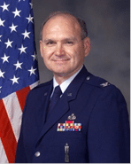

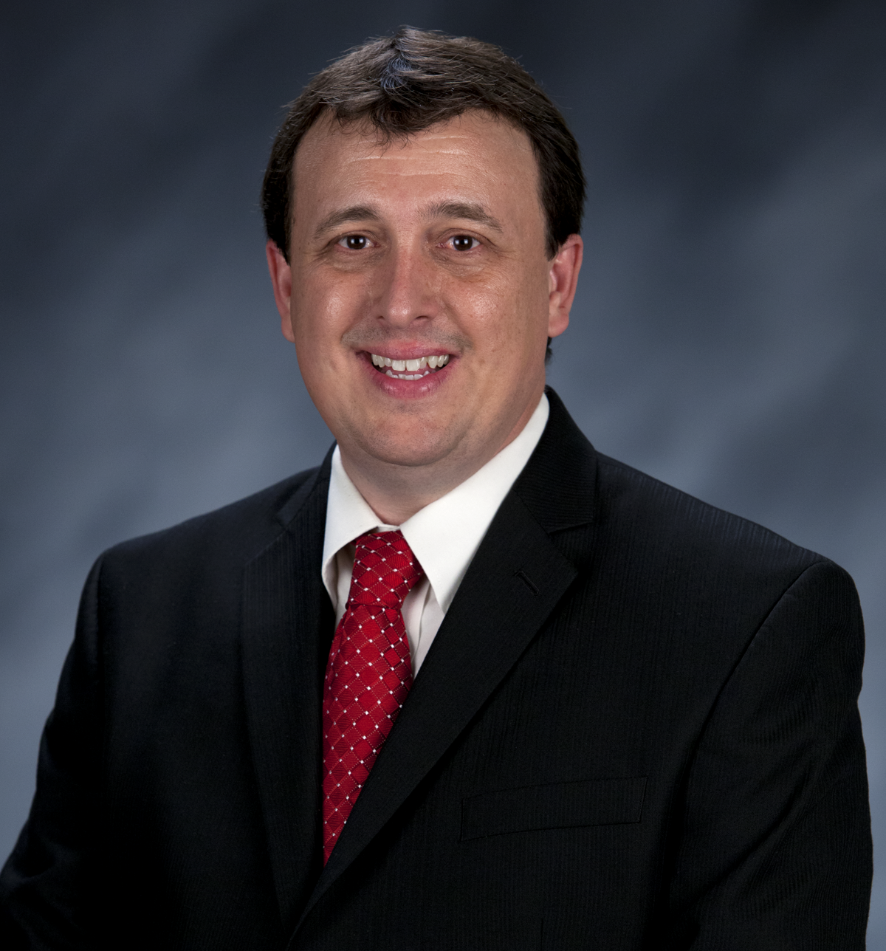
Craig Martin
Vice-Chair,
National Exploring Program Chair
NATIONAL EXPLORING
LIVE HOUR
December 10th, 2025
Tim Anderson
National Director
Learning for Life & Exploring
Older Youth Programs

Slide 2


National Exploring Live Hour Meeting
10 December 2025
Craig Martin
National Exploring Program Chair,
Learning for Life Executive Board
Bruin1967@aol.com
719-331-6406
Richard (Dick) Davies
National Exploring Program Commissioner,
Learning for Life Executive Board
Exploring Chair,
National Commissioner Service Team
Richard.davies.nyc@gmail.com
914-327-7430
u

Slide 3

Safety Moment ~ Winter Hazard -Hypothermia* * Scouting Safety Moments’ Hypothermia (see https://www.scouting.org/health-and-safety/safety-moments/hypothermia/ )

Slide 4

Hypothermia…
Hypothermia is an abnormally low body temperature that is dangerous and potentially fatal if not properly cared for
Hypothermia most often occurs when individuals are exposed to extremely cold temperatures for extended periods of time
However, it can also occur in warmer environments in situations such as wearing wet clothing in windy conditions, becoming chilled from being in the rain for an extended period, or being submersed in cold water
Planning is essential before a Winter trip, activity or outing to make sure you are prepared for possible situational changes in environmental conditions

Slide 5
Hypothermia…
Hypothermia occurs when the body loses heat faster than it can be generated
Once the body temperature begins to drop, the heart, brain, and other organs start losing their ability to function properly
Left untreated, these vital organs will begin to fail, eventually leading to death
A person experiencing hypothermia often isn’t aware of their condition because the onset is gradual and, as hypothermia progresses, they become confused and agitated
To prevent hypothermia, be aware of your environment and dress accordingly
Cover as much exposed skin surface as possible to help prevent heat loss
Avoid activities and clothing that will cause you to sweat a lot
Combination of wet clothing and cold temperatures will cause additional heat loss
Wear multiple layers and stay dry

Slide 6
Hypothermia ~ What to look for?
Signs/Symptoms of Hypothermia
Feeling cold, shivering uncontrollably
Cool or cold skin on the abdomen, chest, or back
Presence of the “umbles”
Stumbles: loss of control over movement
Mumbles: slurred or incoherent speech
Fumbles: poor coordination or reaction time
Grumbles: change in behavior or attitude
Fatigue
As hypothermia progresses, the person will exhibit:
Stiff muscles
No shivering
Skin that feels ice-cold and may appear bluish
Confusion, agitation, memory loss
Slow, weak pulse
Slow, shallow breathing
Loss of consciousness
The Risk Factors
Exhaustion
Victims who are very young or old; the body’s thermoregulation is not at its peak
Alcohol or drug use
Certain medical conditions and medications can affect one’s ability to regulate body temperature
Cold, damp weather conditions

Slide 7
Care of Hypothermia…
Get the victim out of the cold
Remove wet clothing and wrap them up in warm, dry clothes. Add additional layers such as a sleeping bag, blankets, or some form of plastic to hold in body heat
If the victim is conscious and able to swallow, offer warm liquids to drink. Do not give alcoholic drinks
Handle them gently . Excessive movements or rough handling can lead to cardiac arrest
Apply warm, dry compresses to the neck, chest, and groin areas. Do not apply heat to the arms or legs, because this speeds cold blood back to the heart, lungs, and brain, causing the core temperature to drop even lower; this can be fatal
Do not apply direct heat as with hot water bottles, a heating pad, or a heating lamp. This extreme heat can cause skin damage, an irregular heart rhythm, or even cardiac arrest
If a person with severe hypothermia who is unconscious seems to not have a pulse or not be breathing, perform CPR. CPR should continue during rewarming. Sometimes, people experiencing hypothermia can be successfully resuscitated
Get emergency care / call 911

Slide 8
Hypothermia Resources…
BSA Safety Moments @ https://www.scouting.org/health-and-safety/safety-moments/hypothermia/
Centers for Disease Control and Prevention—Hypothermia @ https://www.cdc.gov/disasters/winter/staysafe/hypothermia.html
Mayo Clinic—Hypothermia @ https://www.mayoclinic.org/diseases-conditions/hypothermia/symptoms-causes/syc-20352682

Slide 9
Current Exploring Participation Status

Slide 10
Exploring Membership Growth Opportunity…
As of… | Units |  | Youth Membership |  | Adult Membership
 | Clubs | Posts | Clubs | Posts | Clubs | Posts
31 Jan 2020 * | 395 | 4,055 | 14,903 | 80,474 | 704 | 19,095
21 Nov 2025 | 194 | 1,519 | 4,264 | 24,351 | 793 | 9,287
Opportunity | 201 | 2,536 | 10,639 | 56,123 | 89+ | 9,808
* Just before the COVID-19 Pandemic shut-down all in-person meetings
Positive upward or Negative downward trend since 17 Oct 2025; Clubs Units up 8, Posts Units up 3, Club Youth Membership up 337, Post Youth Membership up 67, Cubs Adult Membership up 27 and Post Adult Membership down 80

Slide 11
Exploring Participants as of 21 November 2025
Clubs/Posts = 1,713 (+11) Youth = 28,615 (+404) Adults = 10,080 (-53)
Career Area Units Youth Adults
Aquatics 1 24 6
Arts & Humanities 5 (+1) 40 (+11) 45 (+5)
Aviation 47 (-2) 700 (-7) 335 (-13)
Business 8 372 37 (-6)
Education 39 1,424 (-3) 197 (-4)
Communications 3 130 (+1 ) 29 (+1)
Engineering & Technology 23 (-1) 873 (-42) 161 (+2)
Explorer Clubs 194 (+8) 4,264 (+337) 793 (+27)
Fire/Emergency Services 430 (-2) 5,042 (-101) 2,639 (-33)
General Interest 66 2,558 (+120) 404
Health Care 70 (+1) 1,939 (+78) 366
Law Enforcement 634 (+5) 7,144 (-11) 3,869 (-30)
Law / Gov’t / Public Service 75 1,836 (+21) 464 (-4)
Science 14 692 (-8) 75 (-2)
Skilled Trades 13 196 (-24) 78 (-3)
Social Services 4 (+1) 114 (+2) 18 (+3)
STEM 10 (-1) 260 (-24) 97 (+1)
No Special Interest Selected 77 (+1) 1,004 (+83) 472 (+2)
NOTE: Numbers in parentheses are changes since 17 October 2025. Jeff Schweiger, National Exploring Membership & Retention Lead, observed that currently 128 clubs do not reflect “0999” special interest code (SIC) which will require each of these clubs’ council registrar to correct

Slide 12
National LFL / Exploring Executive Board Chair Comments
Bernard (Bernie) Lockard

Slide 13
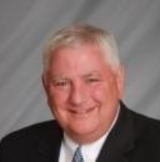
Bernie Lockard’s Background…
Scouting…
Eagle Scout (1972)
Order of the Arrow Vigil Honor
Cubmaster
Pack Committee Chairman
Assistant Scoutmaster
Scoutmaster
Unit Commissioner
Wood Badge Course Director
NYLT Course Director
District Chairman
President, Laurel Highlands Council’s Board of Directors (2013 - 2014)
2019 World Jamboree Scoutmaster
Chair, National Venturing Committee (2020 - 2022)
2023 & 2017 National Jamboree Staff
National Eagle Scout Association Scholarship Committee (2013 - Present)
Chair, National BSA Council Finance & Fundraising Committee (2022 – Present)
BSA Recognition…
Award of Merit – 1998
Silver Beaver – 2001
Distinguished Citizen – 2010
Rockefeller Award – 2010
Silver Antelope – 2014
National Outstanding Eagle Scout Award - 2015
National Venturing Leadership Award – 2022
Silver Buffalo - 2024
Personal…
Married to Robyn L. Ashbridge, father of five and grandfather of seven
President, The Lockard Company, Indiana, PA
Graduate of Carnegie-Mellon University, Pittsburgh, PA, with B.S. in Administration and Management Science, Economics, Mathematics (Graduated With Honors)

Slide 14
National Exploring Program Commissioner Comments
Richard (Dick) Davies

Slide 15
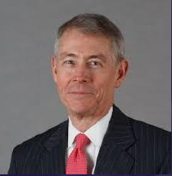
National Exploring Program Commissioner
Richard (Dick) Davies
Richard.davies.nyc@gmail.com
(914) 327-7430
Recent Scouting History
Interim Scout Executive for two years Greater New York Councils ~ 2021 – 2022
Stepped down as Council Commissioner to take role
Formerly VP – Membership, VP – Scoutreach and Manhattan Borough President
Eagle Scout from Wisconsin
Exploring History
Exploring Chair, National Commissioner Service Team ~ Nov 2022 – TBD
National Exploring Program Commissioner, National LFL Executive Board ~ Nov 2022 -TBD
Area and Northeast Regional Exploring Chair and Board Member ~ 2018 – 2021
National Exploring Committee ~ 1976 – 1979
National Explorer President ~ 1976-77; Youth Member of National Executive Board
Professional Career
Since 2016, angel investor and advisory board member for start-up companies
Consultant to investment management industry
Most of career on business side of investment management industry (business unit management, client and product development) with Alliance Bernstein and Russell investments
Last ten years through 2016 working with largest 401k and other defined contribution plans around the world.

Slide 16
Quarterly Exploring Webinars for Commissioners
OUR NATIONAL EXPLORING COMMISSIONER RICHARD (DICK) DAVIES, IN HIS ROLE ON THE NATIONAL COMMISSIONER SERVICE TEAM, IS HOSTING QUARTERLY WEBINARS FOR SCOUTING AMERICA’S UNIT COMMISSIONERS WHO ARE SERVING EXPLORING POSTS
Most recent one, on September 30th, was entitled “Developing Post Programming: #2 in a Series for Unit Commissioners Serving Explorer Posts”
During this webinar, Dick highlighted that Exploring is more a methodology than a program. Volunteers and professionals alike often have the mistaken belief that they must have a proposed Post program developed before scheduling a sales call to start a new Exploring Post. While it may be helpful to share some program ideas with a potential sponsor, part of organizing a new Post is facilitating an “All-In-One Program Planning” brainstorming meeting with the new Post Committee and other interested staff members of the sponsoring organization to create an initial 3–4-month program based on the resources and ideas of the sponsor. After that point, the youth post officers will work with their Advisors to shape the ongoing program
In this webinar, Dick facilitated an interactive exercise (based on a real-world example) to brainstorm the beginning program for a new Post in the hospitality industry. This workshop also helped Commissioners seeking to enhance the program for Posts struggling to grow and retain members. The webinar demonstrated how free artificial intelligence tools can be amazingly helpful in generating program ideas for any type of Post even those with somewhat obscure career specialties!
The next zoom webinar will be in January 2026 featuring Scouting America’s Glen Pounder discussing the unique Safeguarding Youth issues for Exploring adult program participants (NOTE: Specific January 2026 date will be set in mid-December 2025)

Slide 17
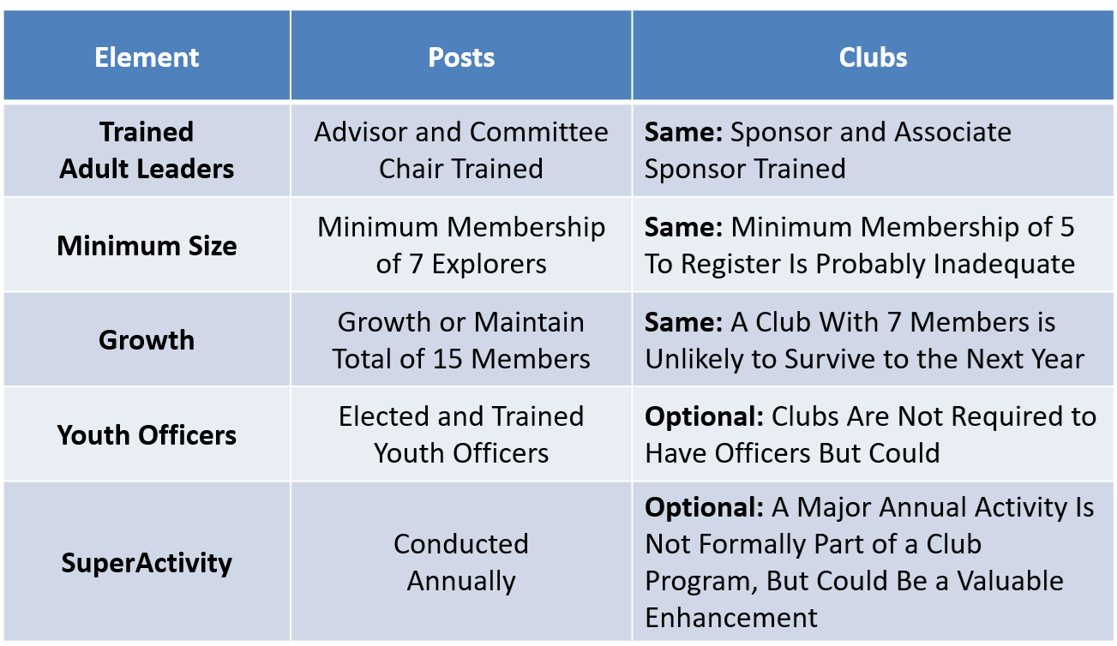
Exploring Metrics Guidelines Replacing JTE for Posts & Clubs
Objective: Sustainable Programs

Slide 18
Proposed Exploring Post Metrics from National Exploring Program Commissioner Dick Davies
Guidelines Leading to Sustainable Effective Explorer Posts
Experienced Exploring volunteers examined characteristics of Posts which maintain successful programs over a period of years while attracting and retaining youth for meaningful multi-year experiences. The following are the first three of five quality guidelines:
Trained Adult Leaders – Training would be desirable for all adult leaders but at a minimum, the Post Advisor and Committee Chair should complete online training on the basics of running an Explorer Post, including critical youth protection policies. It’s easy to appreciate why adult leadership would benefit from an introductory orientation to Exploring.
Minimum Membership of 7 – Posts which start with or can’t sustain membership of at least 7 are unlikely to survive to the next year and may lack the critical mass to run exciting, captivating programs. Several Post members are likely to drift away for various reasons during the year and may not show up for additional years in their Post.
Growing Membership (or at Least Maintain 15 Members) – Growing youth membership is a sign of a healthy Post especially for Posts below 15 in size. At that point, sponsor program resources may be maxed out. Importantly the Post has likely reached the scale to survive natural attrition.

Slide 19
Proposed Exploring Post Metrics from National Exploring Program Commissioner Dick Davies continued
Quality Guidelines Leading to Sustainable Effective Explorer Posts
Experienced Exploring volunteers examined characteristics of Posts which maintain successful programs over a period of years while attracting and retaining youth for meaningful multi-year experiences. The following are the last two of five quality guidelines:
Trained Youth Leaders – Exploring is a hands-on youth led program with the mentorship and program support of adult advisors. Leadership development is an important element of emphasis of the program. The election of youth officers (or their appointment in the case of some public safety agencies) is an important method of Exploring. It motivates youth to stay involved for multiple years as they move up in the Post and learn important life skills leading teams.
Annual Superactivity – A Superactivity is the program highlight in a Post’s annual activity calendar. It involves special planning and coordination and may involve travel and possibly overnight stays. Examples include a special tour of a major career-oriented site or participation in another Council’s Exploring event or competition. A special event of this type makes it more likely the Explorer will return to the Post in the new school year. A Superactivity is important in improving youth retention.

Slide 20
Marketing & Technology Chair, Nat’l LFL Exec Board Comments
Jeffrey (Jeff) Schweiger

Slide 21
National Exploring Program Committee

Slide 22
Nat’l Exploring Committee Members…
National Exploring Program Chair Craig Martin
National Exploring Program Commissioner Richard (Dick) Davies
National Exploring Membership Growth / Retention Lead Jeffrey (Jeff) Schweiger
National Exploring Awards & Recognition Lead Richard (Rick) Belford
National Exploring Training Lead Roger Engelbart
National Exploring Health & Safety / YPT Lead Linda Hassler
National Exploring Marketing / Communications Lead (Website / Social Media) TBD *
National Exploring Materials & Literature Lead Timothy (Tim) Buckles
National Exploring Career Fields Development Lead TBD *
National Exploring Youth Officer Advisor TBD *
National Exploring Youth Chair TBD
National Exploring Partnerships / Relationships Lead TBD *
National Exploring Resource Advisor Stuart Mahler
National Special Needs Committee Liaison for Exploring Britt Flather
National Exploring Members-at-Large (National Exploring Resource Associate Advisors)
National Exploring Subject Matter Expert Don Deeker
National Exploring Subject Matter Expert Joseph (Joe) Marinelli
National Exploring Subject Matter Expert Suzie Steiner
National Exploring Subject Matter Expert Rick TerBorch
* Note: Welcome recommendations from anyone

Slide 23
National Exploring Resource Advisor
Stuart Mahler

Slide 24
National Exploring Subject Matter Experts & Exploring Resource Associate Advisors
In support to our fourteen Scouting America Council Service Territories (CSTs), our National Exploring Program is currently supporting each CST, along with their territory’s councils, with a National Exploring Subject Matter Expert (SME), who serves as that territory’s National Exploring Resource Associate Advisor (RAA). As a caveat, we do not presume this role is either formally or informally part of the CST organizational structure but rather a service being made available by the National Exploring Program to each CST and/or their councils. Additionally, we have an National Exploring RAA dedicated to supporting the California Highway Patrol (CHP) and the councils with CHP Law Enforcement Posts as well as the posts themselves

Slide 25
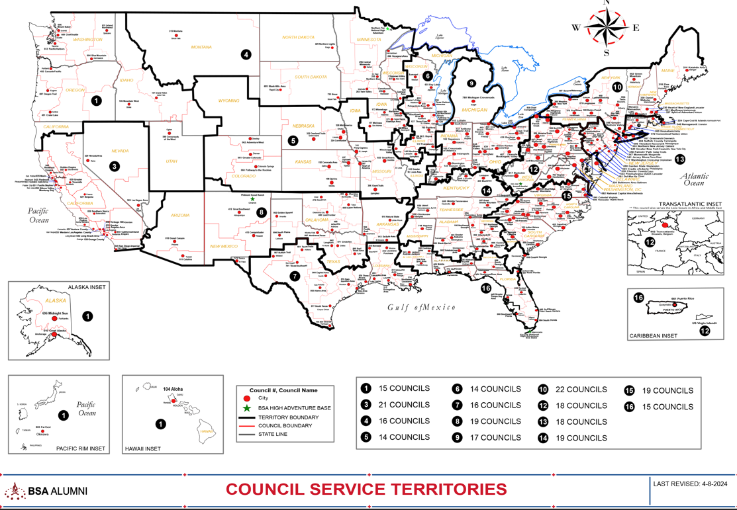
Council Service Territories (CSTs)…
COUNCIL

Slide 26
Current National Exploring SMEs / RAAs Team...
CST 1 ~ Suzie Steiner (Mountain West Council), who is currently an Advisor for an Exploring STEM / Robotics Post, which also encompasses trades such as machining & welding and business careers, and has previously been an assistant district commissioner, assistant & roundtable commissioner and Cub Scout den leader. National Exploring Resource Associate Advisor (RAA) supporting the CST 1 and councils within the territory
suzie@openlabidaho.org
((208) 869-2403
CST 3~ Stuart Mahler (Golden Gate Area Council), who is currently an Assistant Council Commissioner and LFL Council Exploring Chair and Executive Board Member as well as a retired police officer, an advisor in the 1987 Law Enforcement Exploring National Academy, staff member on three National Exploring Law Enforcement Exploring Conferences and Law Enforcement Explorer in his youth. National Exploring Resource Advisor (RAA) supporting the CST 3 and councils within the territory
mdc.stuart@gmail.com
(925) 519-6957
CST 4 & 5 ~ Roger Engelbart (Greater St Louis Area Council), who is currently the Assistant Council Commissioner for Training and the Engineering Chair for the Council Exploring Committee, as well as a retired Boeing Engineer involved in Nondestructive Evaluation. National Exploring Training Lead and National Exploring Resource Associate Advisor (RAA) supporting the CST 4 & 5 and councils within those two territories
engelbart301@sbcglobal.net
(314) 920-8968

Slide 27
Current National Exploring SMEs / ERAs Team...
CST 6 ~ Richard (Dick) Davies (Glacier's Edge Council) who is the National Exploring Commissioner, Exploring Chair for the National Commissioner Service Team & National Exploring Program Committee Vice-Chair, as well as VP - Development in Glacier's Edge Council (Madison, WI), Greater New York Councils Executive Board Member, former Interim Scout Executive for the Greater New York Councils (2021 & 2022), past Northeast Region Exploring Chair and Board Member, and, in his youth, National Explorer President (1976-77) & Youth Member of National Executive Board. National Exploring Resource Associate Advisor (RAA) supporting the CST 6 and councils within the territory
richard.davies.nyc@gmail.com
(914) 327-7430
CST 7 ~ Don Decker (Bay Area Council) - Eagle Scout, Woodbadge staff member, retired BSA Professional Scouter, Business and Banking Explorer as a youth, and currently a full time Agriculture Specialist, US Customs and Border Protection Agency. National Exploring Resource Associate Advisor (RAA) supporting the CST 7 & 16 and councils within the territory
donedecker@gmail.com
( 832) 266-7145
CST 8 ~ Craig Martin (Pathway to the Rockies Council), who is the National Exploring Program Committee Chair as well as a retired Senior Systems Engineer supporting Department of Defense satellite programs and a retired USAF Colonel with extensive experience building, testing, launching & operating US Air Force satellites and testing air-to-air & air-to-ground missile systems. National Exploring Resource Associate Advisor (RAA) supporting the CST 8 & 14 and councils within the territory
bruin1967@aol.com
(719) 331-6406

Slide 28
Current National Exploring SMEs / ERAs Team...
CST 9 ~ Richard (Rick) Belford (Western Massachusetts Council), who is currently the Vice President of Membership, Executive Board member, and Committee Chair for five units - a Cub Scout Pack, a girl troop, a boy troop, a Sea Scout Ship and an Aviation Explorer Post. Also a former Scouting Professional/District Executive, a retired DOD/Federal employee and a retired USAF Chief Master Sergeant. National Exploring Awards & Recognition Lead and Resource Associate Advisor (RAA) supporting the CST 9 Program Lead and councils within that territory.
o rebwmc234@gmail.com
o (860) 402-4836
CST 10 ~ Joseph (Joe) Marinelli (Seneca Waterways Council), who is the Council Executive Committee’s & Board’s former Vice President of Exploring, past President of the Finger Lakes Council and Executive Director, Finger Lakes STEM Hub as well as a retired Regional Supervising Superintendent & BOCES (service agency) CEO for 25 school districts in upstate New York. National Exploring Resource Associate Advisor (RAA) ) supporting the CST 10 and councils within the territory
josephjmarinelli@aol.com
(585) 704-4659
CST 12 – Jeff Schweiger (National Capital Area Council), who is currently an Assistant Council Commissioner (STEM, Exploring, Communications and Resources) as well as Membership Growth and Retention Lead on the National Exploring Committee. He is a retired Naval Officer and presently works for a national security government contractor. An Eagle Scout, he also was a member of a communications (print journalism) Exploring Post as a youth. National Exploring Resource Associate Advisor (RAA) supporting the CST 12 & 15 and councils within those two territories
Scouter.jeff@earthlink.net
(703) 472-0669

Slide 29
Current National Exploring SMEs / ERAs Team...
CST 13 ~ Linda Hassler (Monmouth Council) who is currently a member of her Monmouth Council Board of Directors and Troop 140 Committee Member as well as an Assistant Professor at Rutgers’ School of Nursing, former Northeast Region Area 5 Exploring Chair, former Exploring Post Advisor and a Tennis Explorer in her youth. National Exploring Health & Safety / YPT Lead and National Exploring Resource Associate Advisor (RAA) supporting the CST 13 and councils within the territory
Lindajhassler@gmail.com
(732) 687-7208
CST 14 ~ Craig Martin
CST 15 ~ Jeff Schweiger
CST 16 ~ Don Decker
CHP ~ Rick TerBorch (Los Padres Council)*, who is the former National Service Territory (NST) 3 Commissioner, Assistant Council Commissioner and Council Executive Board Member as well as a retired Chief of Police in Arroyo Grande, CA, past Los Padres Council President & Council Commissioner, past National Law Enforcement Exploring Committee Member, Exploring Advisor and over 35+ years in Law Enforcement Exploring. National Exploring Resource Associate Advisor (RAA) supporting the California Highway Patrol (CHP) and the councils with CHP Law Enforcement Posts.
rterborch@earthlink.net
(805) 441-1721
* Stuart Mahler (CST 3 Exploring Resource Advisor) is Rick’s CHP Contact Alternate

Slide 30
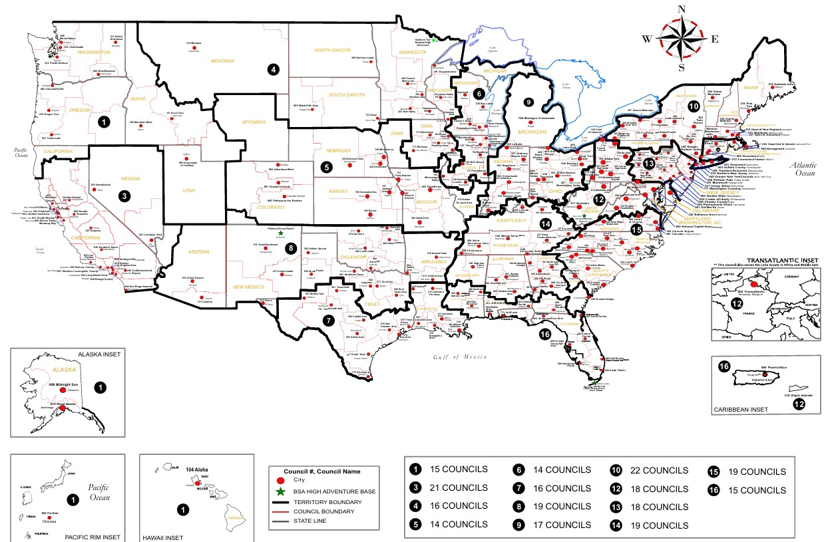

Exploring Associate Resource Advisors Serve the Entire Country
Find your Council Service Territory & assigned ERAA at
www.exploring.org/about-us

Slide 31
Current National Exploring SMEs / RAAs Team...
Additionally, any of these National Exploring RAAs are available to any of the CSTs and their councils on the following Exploring Career Fields
Arts & Humanities ~ Tim Buckles
Aviation ~ Rick Belford & Roger Engelbart
Business ~ Rick Belford (Contracting & Procurement)
Communications ~ Rick Belford (Broadcasting & Public Relations)
Engineering & Technology ~ Roger Engelbart, Craig Martin and Suzie Steiner (Robotics)
Health Care ~ Linda Hassler
Law & Government ~ Craig Martin & Rick Belford (Military Careers)
Law Enforcement ~ Stuart Mahler & Rick Terborch
Skilled Trades ~ Joe Marinelli & Suzie Steiner
Social Services ~ Joe Marinelli (Education), Linda Hassler (College Professor), Rick Belford (Non-Profit / Not-For-Profit Management) and Suzie Steiner (STEM)
Other Career Fields ~ National Exploring RAA, assisting your CST, will find the best individual to assist you for other Exploring Career Fields

Slide 32
What’s New for Exploring in 2025

Slide 33
National LFL / Exploring Program Office Staffing Update
On 10 November 2025, Dedra Coldiron-Douglas joined the office as the new Administrative Assistant working with Susan Fitzhugh (Senior Administrative Assistant)
On 1 December 2025, Carlos Coronado (who was the Assistant Director of Field Service with Heart of America Council joined the office as the new Exploring Program Growth & Retention Executive

Slide 34
National Scouting America Council Office Staffing Update
Hiring three Program Growth & Retention Executives for
Venturing / Sea Scouts Program*
Cub Scouting Program
Scouts BSA Program
* For Tim Anderson’s Older Youth Programs staff

Slide 35
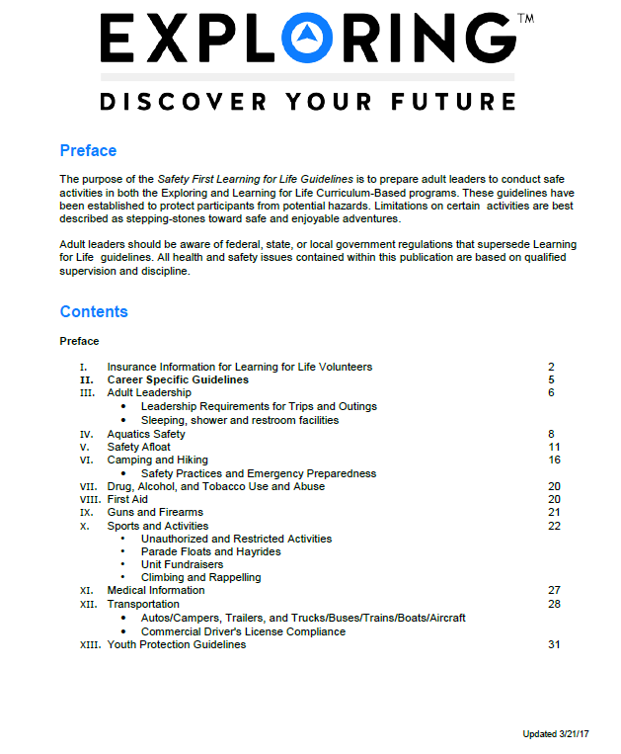
Exploring Safety First Guidelines
National Exploring Committee’s Health & Safety & YPT Lead’s Team updated the “Exploring Safety First Guidelines” and passed their proposed revision to the BSA Health and Safety Team for their review and comments
Expect the updated “Exploring Safety First Guidelines” release in early 2026

Slide 36
Exploring Safety First Guidelines Update
On 10 June 2025, National Exploring Director Tim Anderson issued the following direction to all Scouting America Council Scout Executives… Learning for Life, Exploring, and Scouting America are updating the standard regarding Ride-Alongs for all programs, including but not limited to Law Enforcement Exploring. When youth under 18 years of age participate in Ride-Alongs, all parties involved must adhere to all current Safeguarding Youth policies and guidelines (formerly known as Youth Protection) for all participants. This includes ensuring that at least two registered adult leaders, each 21 years of age or older and trained in Safeguarding Youth or Youth Protection, are present for the Ride-Along. If the Ride-Along includes a female youth participant, at least one of the registered adult leaders participating in the Ride-Along must also be female.
This standard is mandatory and takes effect on June 30, 2025; however, it should be implemented as soon as possible. While we acknowledge that this change may pose challenges in certain Ride-Along scenarios, it must be strictly enforced to guarantee the safety of both our youth participants and adult leaders. We will update other documents that refer to Ride-Alongs soon. In the meantime, please ensure that your units participating in Ride-Alongs are notified about the standard and its effective date. Additionally, remind the Participating Organization to verify that all adults, including young adult participants (aged 18-20), are current with their Youth Protection Training or promptly complete the Safeguarding Youth training. You may access the training at: https://www.scouting.org/training/youth-protection/ Scout Executives, if you have any questions concerning this update, please reach out to us at Exploring@learningforlife.org

Slide 37

Exploring Leadership Experience…
VISION: Nationally recognized program that offers young men and women an opportunity to enhance their understanding of leadership in the workplace through interactive instruction, self-reflection, and practical application while working with an adult mentor to gain professional leadership experience. The Exploring Leadership Experience will be available to all Explorers registered in an Exploring post who meet the requirements.

Slide 38
Exploring Leadership Experience continued
ELIGIBILITY REQUIREMENTS: Explorers must first meet the following basic qualifications:
Currently registered in an Exploring post with at least three months of tenure as an active, registered Explorer.
Plans to complete the Exploring Leadership Experience requirements before his or her 21st birthday.
Has earned the Exploring Achievement Award within any career field OR has held a leadership role either within or outside the post in the past 12 months.

Slide 39
Exploring Leadership Experience continued
ON-LINE LEARNING MODULES: The Exploring Leadership Experience is designed to be a self-paced, experiential learning process for each Explorer who commits to completing the program. A critical component of this learning process is a series of self-paced, online leadership development modules that Explorers must complete on their journey to improved leadership skills. Explorers
are required to complete each series of leadership skills modules in the order listed in the next slide. However, the modules within each series can be completed in any order.

Slide 40
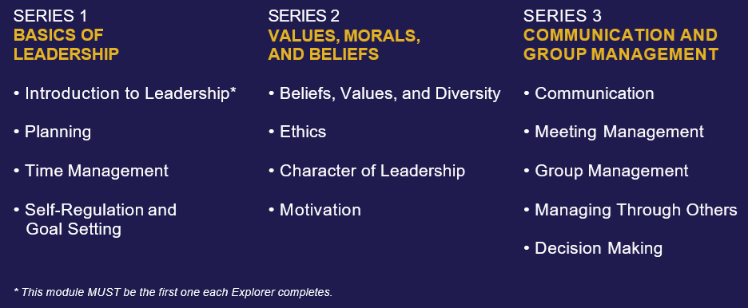
Exploring Leadership Experience continued
ON-LINE LEARNING MODULES: continued
NOTE: All the above modules are up-to-date and currently reside in Scouting America’s Learn Center, except the “Introduction to Leadership” module which is tied to the Exploring Leadership Experience Guidebook

Slide 41

Exploring Leadership Experience continued
GUIDEBOOK: We are currently finalizing edits, which should be completed in December 2025, and submitted to Scouting America’s Editorial Operations for their final updates & release
INTRODUCTION TO LEADERSHIP LEARNING MODULE: We will finalize the module’s edits based on the finalized guidebook, which should also be completed in December 2025, and submitted to ScoutingU Instructional Design for the module’s update & insertion into Scouting America’s Learn Center
EXPLORING LEADERSHIP EXPERIENCE ROLL-OUT: Expected in January-February 2026

Slide 42
2025 National Exploring Program Priorities Mapped to Scouting America’s 2025 Organizational Goals

Slide 43
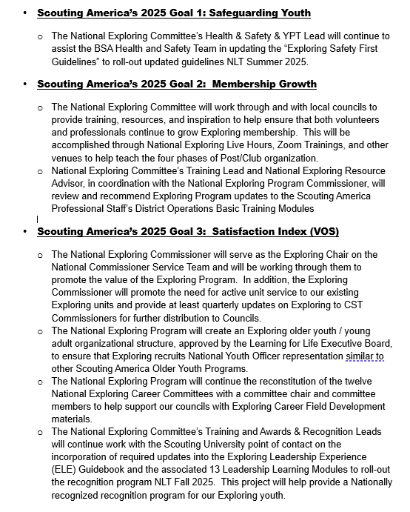
2025 National Exploring Priorities mapped to Scouting America’s 2025 Organizational Goals

Slide 44
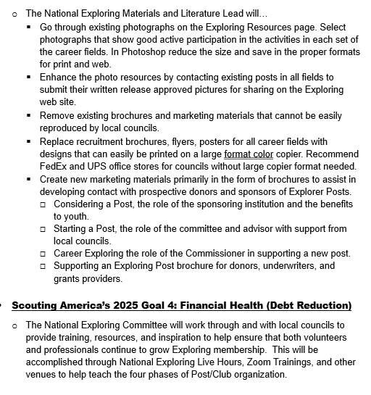
2025 National Exploring Priorities mapped to Scouting America’s 2025 Organizational Goals continued

Slide 45

LEARNING FOR LIFE CORPORATE MISSION:
To develop and deliver engaging, research based academic, character, leadership and career focused programs aligned to state and national standards that guide and enable all students to achieve their full potential.
THE CORPORATION
NON-DISCRIMINATION STATEMENT:
Learning for Life programs are designed for all age groups from pre‐kindergarten and not yet age 21. Youth participation is open to any youth in the prescribed age group for that particular program. Adults are selected by the participating organization for Involvement in the program. Color, race, religion, gender, sexual orientation, ethnic background, disability, economic status or citizenship is not criteria for participation by youth or adults.
Notes:
AFFILIATION STATEMENT
Learning for Life is one of the programs that local Boy Scouts of America councils are authorized to deliver, with local executive board approval. Learning for Life is an affiliate of the Boy Scouts of America that is comprised of both a written character education curriculum for PreK – 12th graders and students with special needs, as well as Interactive career Exploring programs for 6th graders thru 20 year olds. Youth participation is open to any youth in the prescribed age group for that particular Program. Adults, 21 years of age and older, are selected by participating organizations for involvement in the Learning for Life programs. Color, race, religion, gender, sexual orientation, ethnic background, disability, economic status or citizenship is not criteria for participation by youth or adults. Youth and adults involved with Learning for Life programs, including Exploring, are registered with Learning for Life as participants. Learning for Life participants are not members of the Boy Scouts of America. Learning for Life, a District of Columbia non‐profit corporation, is a separate 501(c)(3) Corporation, with a Board of Directors that is separate from the Boy Scouts of America. While they have different policies, there are occasions when local Learning for Life and Traditional BSA programs may participate in an event. Both programs will be required to follow the appropriate guidelines, especially regarding safety. Completion of training, registration and annual fees are program specific and not transferable between programs

Slide 46

Learning for Life Curriculum-Based Programs consists of grade specific, age-oriented, character education lesson plans that are utilized in schools and other educational settings to help instill character and ethical decision making in our youth. The available lesson plans that are offered for Learning for Life Groups include PreK-12 grades, Champions for students with special needs, along with additional digital resources. Learning for Life uses these interactive lessons to help youth make informed decisions while becoming better students and citizens.
CURRICULUM PROGRAM VISION:
To provide engaging and relevant PreK‐12 solutions that positively impact academic performance, social & emotional maturity, character development, and career education for all students.
www.learningforlife.org

Slide 47

Exploring is a co-ed program for youth that are in the 6th grade through 20 years old. Exploring provides opportunities for real-world hands-on career experiences, while helping them “Discover their Future”. The program links youth with mentors and experts with partner businesses and agencies in their communities. Participating in an Exploring Club or Post ensures youth make informed decisions about careers they may or may not be interested in pursuing, while allowing businesses and organizations the opportunity to meet and cultivate future employees.
EXPLORING MISSION:
Deliver character-building experiences and mentorship that allow youth to achieve their full potential in both life and work.
EXPLORING VISION :
Shape the workforce of tomorrow by engaging and mentoring today’s youth in career and life enhancing opportunities.
www.exploring.org

Slide 48
A little about each program
Learning for Life Curriculum-Based Programs consists of grade specific, age-oriented, character education lesson plans that are utilized in schools and other educational settings to help instill character and ethical decision making in our youth. The available lesson plans that are offered for Learning for Life Groups include PreK-12 grades, and Champions for students with special needs. Learning for Life uses these interactive lessons to help youth make informed decisions while becoming better students and citizens.
Exploring is a co-ed program for youth that are in the 6th grade through 20 years old. Exploring provides opportunities for real-world hands-on career experiences, while helping them “Discover their Future”. The program links youth with mentors and experts with partner businesses and agencies in their communities. Participating in an Exploring Club or Post ensures youth make informed decisions about careers they may or may not be interested in pursuing, while allowing businesses and organizations the opportunity to meet and cultivate future employees.

Slide 49

National Learning for Life/Exploring
National Professional Staff Direct Support
Tim Anderson
National Director,
Learning for Life/Exploring
Older Youth Programs
Dedra Douglas
Administrative Assistant
John Mosby
Asst. Chief Scout Executive & EVP
(BSA)
Susan Fitzhugh
Sr. Administrative Assistant
Carlos Coronado
National Exploring Growth & Retention Executive

Slide 50

National Director/President
Tim Anderson (E)
(V) = Volunteer
(E) = Employee/Professional
LFL Executive Board Secretary
Steven Hardy (E)
LFL Executive Board Treasurer
Lisa Fritschel (E)
NATIONAL LEARNING FOR LIFE EXECUTIVE BOARD
(Board Member)
National
Exploring Program Chair
Craig Martin (V)
*National Learning for Life Executive Board Chair*
Bernard “Bernie” Lockard (V)
----------------------------------------------------------------------------------------------
National Learning for Life
Immediate Past Executive Board Chair/Governance
Mark Wiesenhahn (V)
(Board Member)
National Learning for Life Curriculum Based Program Chair
Dr. Helen Stiff-Williams (V)
(Board Member)
National
Exploring Program Commissioner
Richard “Dick” Davies (V)
(Board Member)
National Learning for Life Curriculum
Based Program Commissioner
Vacant (V)
(Board Member)
National LFL/EXP
Fundraising & Development Chair
Vacant (V)
(Board Member)
National LFL/EXP
Membership & Retention Chair
Vacant (V)
(Board Member)
National LFL/EXP
Partnerships & Relationships Chair
Vacant (V)
(Board Member)
National LFL/EXP
Safeguarding Youth/
Health & Safety Chair
Vacant (V)
(Board Member)
National LFL/EXP
Technology/Website Chair
Jeff Schweiger
(Board Member)
National LFL/EXP
Marketing & Social Media Chair
Vacant (V)

Slide 51
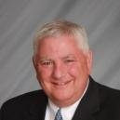

National Learning for Life Executive Board Chair
Bernie Lockard
Scouting…
Eagle Scout (1972)
Order of the Arrow Vigil Honor
Cubmaster
Pack Committee Chairman
Assistant Scoutmaster
Scoutmaster
Unit Commissioner
Wood Badge Course Director
NYLT Course Director
District Chairman
President, Laurel Highlands Council’s Board of Directors (2013 - 2014)
2019 World Jamboree Scoutmaster
Chair, National Venturing Committee (2020 - 2022)
2023 & 2017 National Jamboree Staff
National Eagle Scout Association Scholarship Committee (2013 - Present)
BSA Recognition…
Award of Merit – 1998
Silver Beaver – 2001
Distinguished Citizen – 2010
Rockefeller Award – 2010
Silver Antelope – 2014
National Outstanding Eagle Scout Award - 2015
National Venturing Leadership Award – 2022
Silver Buffalo - 2024
Personal…
Married to Robyn L. Ashbridge, father of five and grandfather of seven
President, The Lockard Company, Indiana, PA
Graduate of Carnegie-Mellon University, Pittsburgh, PA, with B.S. in Administration and Management Science, Economics, Mathematics (Graduated With Honors)

Slide 52
National Exploring Program Chair
Craig Martin
bruin1967@aol.com
(719) 331-6406
Recent Scouting History
Unit Commissioner & Exploring Service Team Member, Pathway to the
Rockies Council ~ 2013 - Present
Council Commissioner, Pikes Peak Council (now Pathway to the Rockies Council) ~ 2009 – 2012
Exploring History
National Exploring Program Chair, National LFL Executive Board ~ 2022 - Present
National Exploring Program Committee Chair ~ 2022 - Present
Exploring Chair, National Commissioner Service Team, ~ 2019 – 2022
National Exploring Service Team Chair, National LFL Executive Board ~ 2018 – 2022
Exploring Committee Chair, BSA Western Region (Area 2) – 2012- 2020
Non-Military Professional Career
Deputy Chief Engineer, GPS Systems Engineering & Integration Program, TASC Inc. ~ 2015-2016
Program Manager and Senior System Engineer, TASC Inc. ~ 1998 – 2015
Military Career
Colonel, United States Air Force ~ Retired in 1998 after 30-year Career in USAF Space & Missile and Research & Development Programs

Slide 53
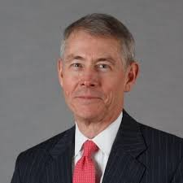
National Exploring Program Commissioner
Richard (Dick) Davies
Richard.davies.nyc@gmail.com
(914) 327-7430
Recent Scouting History
Interim Scout Executive for two years Greater
New York Councils ~ 2021 – 2022
Stepped down as Council Commissioner to take role
Formerly VP – Membership, VP – Scoutreach and Manhattan Borough President
Eagle Scout from Wisconsin
Exploring History
Exploring Chair, National Commissioner Service Team ~ Nov 2022 – TBD
National Exploring Program Commissioner, National LFL Executive Board ~ Nov 2022 -TBD
Area and Northeast Regional Exploring Chair and Board Member ~ 2018 – 2021
National Exploring Committee ~ 1976 – 1979
National Explorer President ~ 1976-77; Youth Member of National Executive Board
Professional Career
Since 2016, angel investor and advisory board member for start-up companies
Consultant to investment management industry
Most of career on business side of investment management industry (business unit management, client and product development) with Alliance Bernstein and Russell investments
Last ten years through 2016 working with largest 401k and other defined contribution plans around the world.

Slide 54
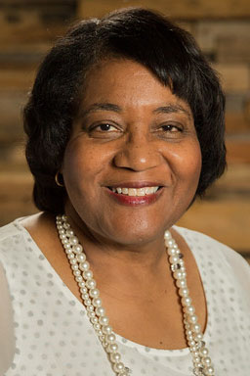
Helen Stiff-Williams, Ed. D. Consultant and Adjunct Professor
National Learning for Life Curriculum-Based Program Chair
PROFESSIONAL POSITIONS HELD
Consultant, National Teacher Training, July 2021- present
Adjunct Professor, Regent University, July 2021- present
Organizational Leadership Coach, July 2021- present
Professor of Teacher Education and Interdisciplinary Studies
College of Arts and Sciences, Regent University, 2019-2021
Professor of Education
School of Education, Regent University, Virginia Beach, VA, 1998 - 2019
Director
Center for Character Education and Civic Development, 2006- 2012
Chairman and Professor of Education
Department of Education, Hampton University, Hampton, VA, 1995 -1998
Adjunct Faculty and Educational Consultant
Division of Continuing Education, University of Virginia, 1994 - 2000
Division Chief
Virginia Department of Education, Richmond, VA, 1990 - 94
Assistant Superintendent
King George County Public Schools, Central Administration, King
George, VA
Middle School Principal
Charlottesville City Schools, Buford Middle School, Charlottesville, VA
Elementary Principal
Cumberland County Schools, Cumberland, VA
Adjunct Faculty Member
Longwood College, Department of Education, Farmville, VA
Assistant High School Principal
Prince Edward County Public Schools, Farmville, VA
Assistant Elementary Principal
Prince Edward County Public Schools, Farmville, VA
EDUCATION:
University of Virginia, Charlottesville, VA, Doctorate of Education, Administration,
Supervision, and Curriculum
Longwood University, Farmville, VA, Master of Science, Supervision
Hampton University, (formerly known as Hampton Institute) Hampton, VA, Bachelor of
Science with High Honors, History Education.

Slide 55

What is Exploring Explosion 3.0 ?
Exploring Explosion 3.0 is a nationwide Exploring membership campaign focusing on Exploring membership growth through the training, inspiration, and recognition of all professionals and interested volunteers.
As part of Exploring Explosion 3.0, national coordinated trainings led by the National Director of Exploring and the National Exploring Committee will assist in the following:
Teaching the 4 Phases of organizing a new Exploring Club or Post. Participants will learn the “A to Z” of Exploring.
Sharing the most valuable resources to help both professionals and volunteers become more confident in growing Exploring.
Connecting professional and volunteers across the country to share best practices while becoming more effective in growing Exploring within their geographic areas. This includes learning from the people who have been the most successful.
Offering cool and crazy incentives throughout the campaign.
All new Exploring Clubs and Posts organized from October 1, 2025, through December 31, 2026, will qualify for the incentives offered during this Exploring Explosion 3.0 campaign.

Slide 56
Stay Tuned! —more to come on Exploring Explosion 3.0!
This will be a fun campaign for all professionals and volunteers! Everyone can get involved and create an Exploring Explosion in every council across America. Get creative and use a spark to help create ideas and innovations to grow Exploring. You may even consider organizing a Club or Post within your own professional career to help our youth “Discover Their Future”.
Initial sign-up sent to Scout Executives
Tim Anderson
National Director,
Learning for Life/Exploring & Older Youth Programs
Exploring@lflmail.org

Slide 57
National Exploring Live Hour Meeting
12 November 2025
Craig Martin
National Exploring Program Chair,
Learning for Life Executive Board
Bruin1967@aol.com
719-331-6406
Richard (Dick) Davies
National Exploring Program Commissioner,
Learning for Life Executive Board
Exploring Chair,
National Commissioner Service Team
Richard.davies.nyc@gmail.com
914-327-7430
u

Slide 58

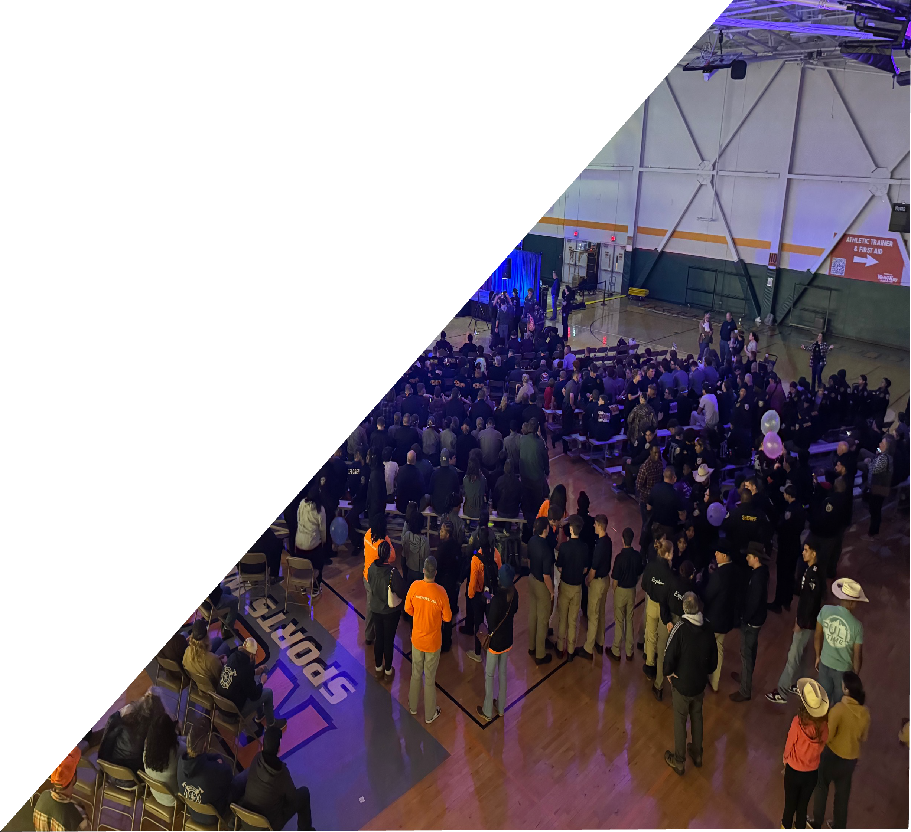



Slide 59

2025 Statistics
Total Attendance | 1626
5K Runners | 120
Fire/EMS Posts | 13
Law Enforcement Posts | 43
Venturing Crews | 31
Sea Scout Ships | 11
Scouts BSA Troops | 8
Representing 41 unique
councils, 15 States

Slide 60



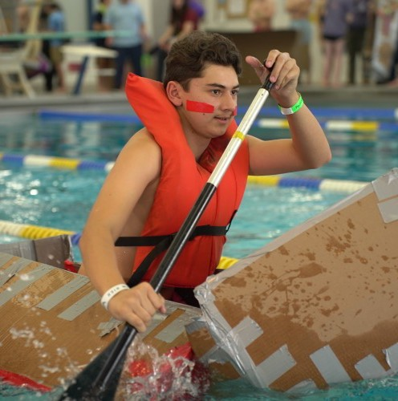
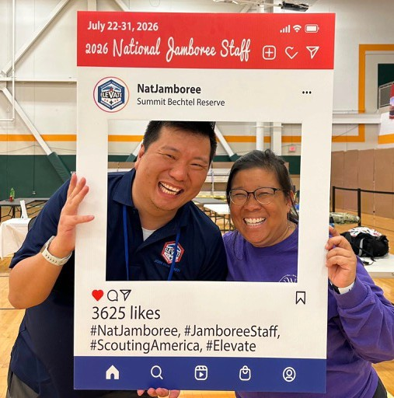
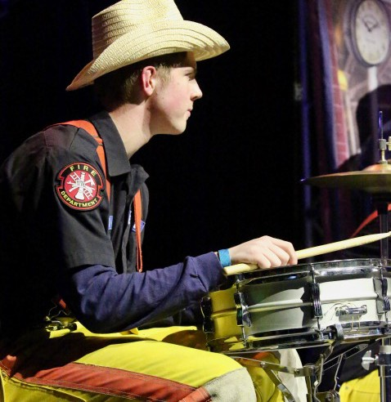





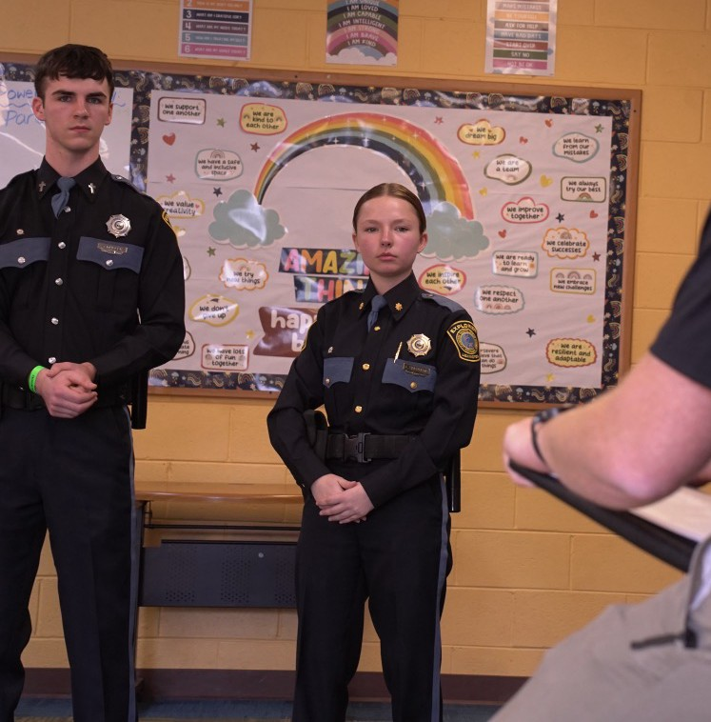
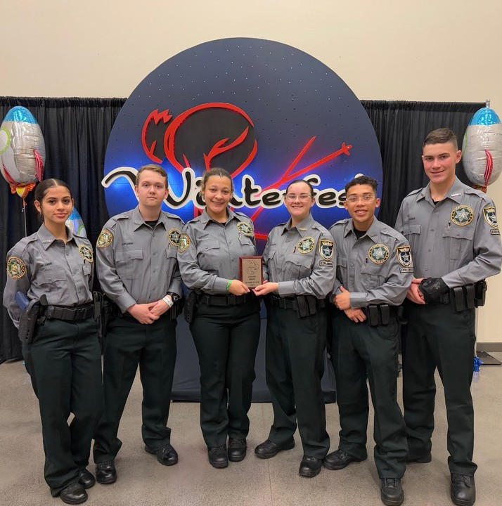
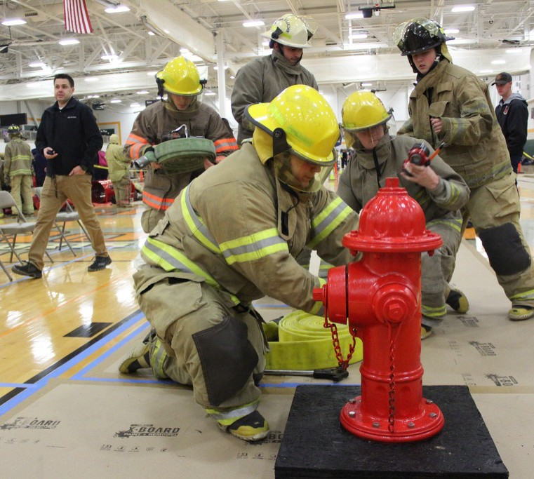


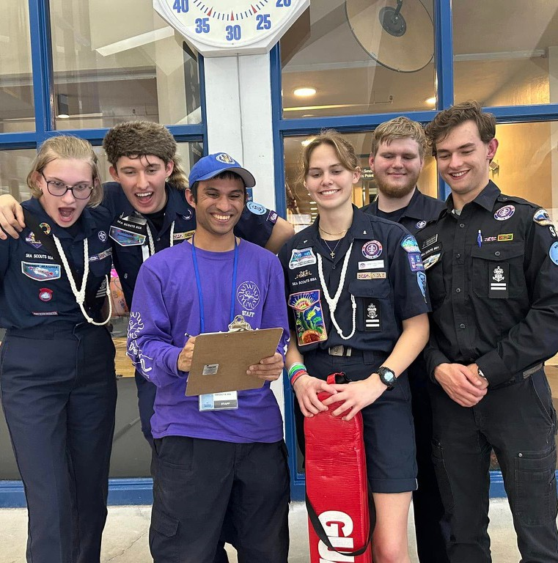
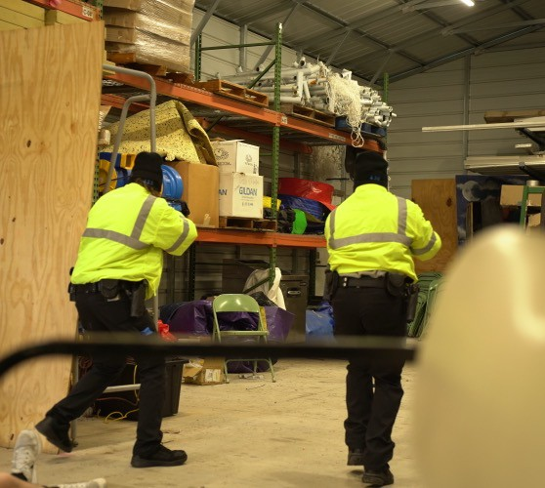
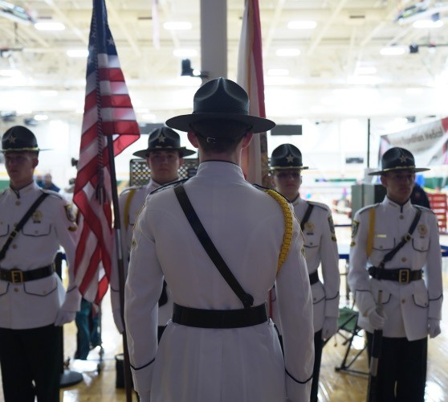
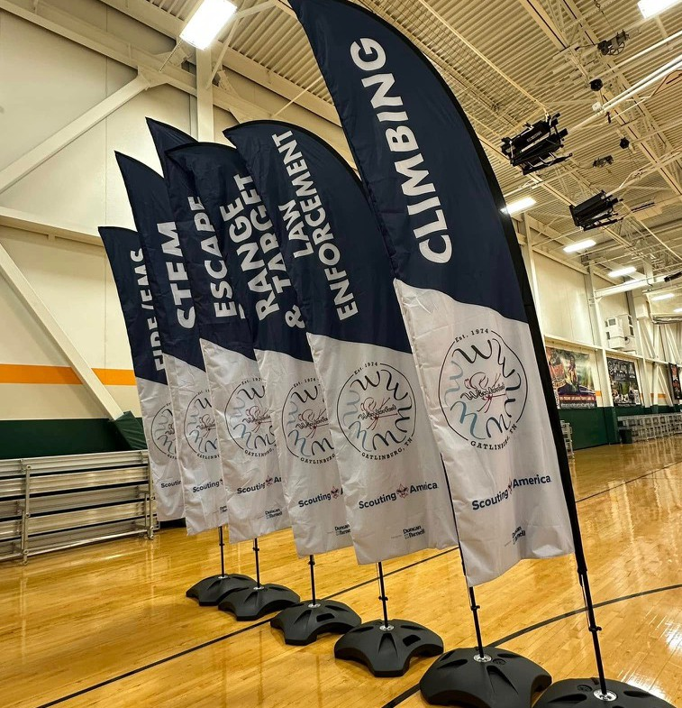



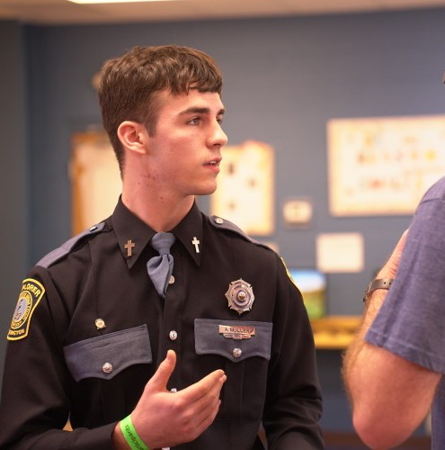
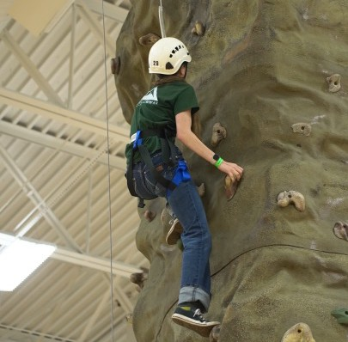



Slide 61


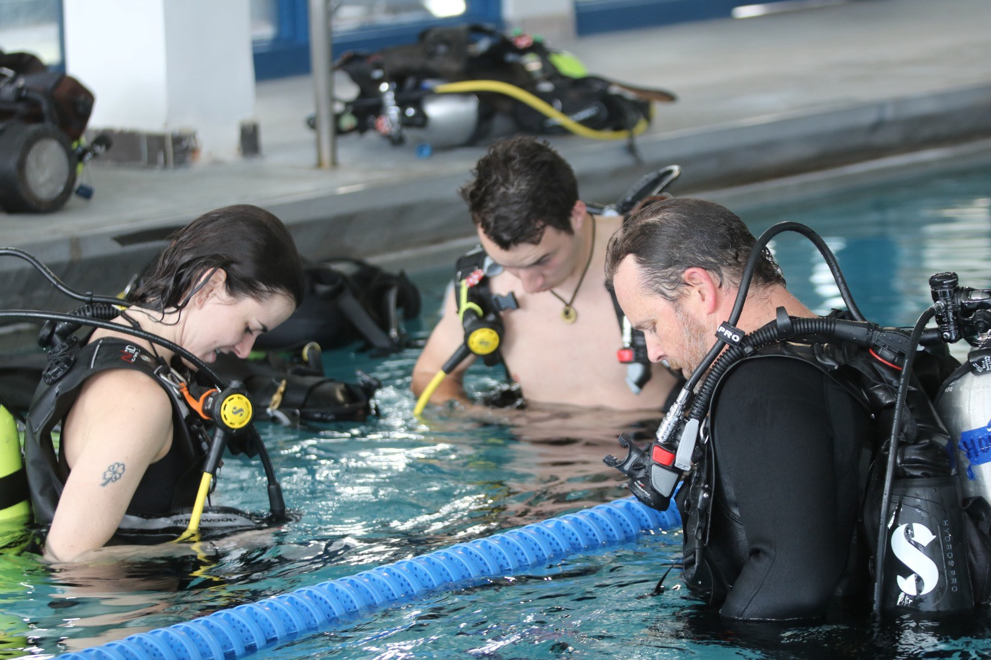

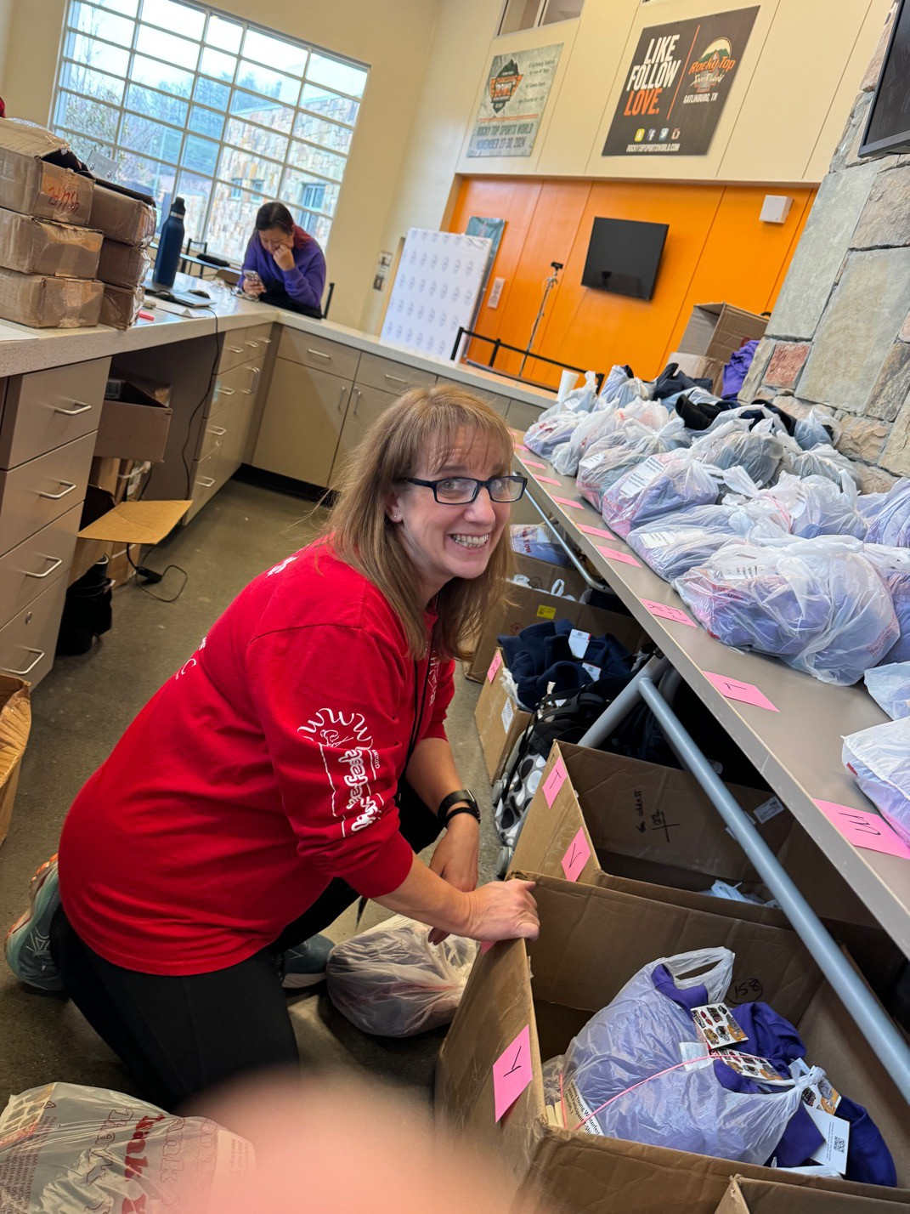

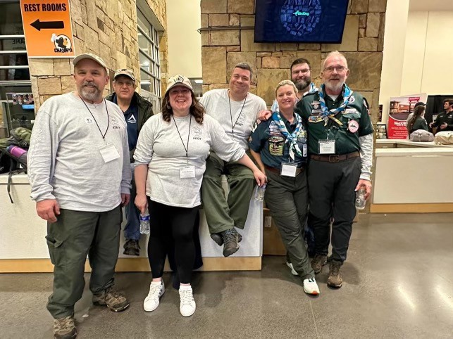
2025 Volunteer Statistics
214 Volunteers representing
36 councils &
20 from Scouting America National
An average of
47.34
hours per volunteer
OR 9,515 total volunteer hours
~$590
per volunteer
OR $126,260.00 total volunteer spend
9.3% Holding a National Position (or Committee post)
29% NOAC/Nat’l Jamboree/World Jamboree Staff
45% OA Members
9 Baden Powell Fellows

Slide 62



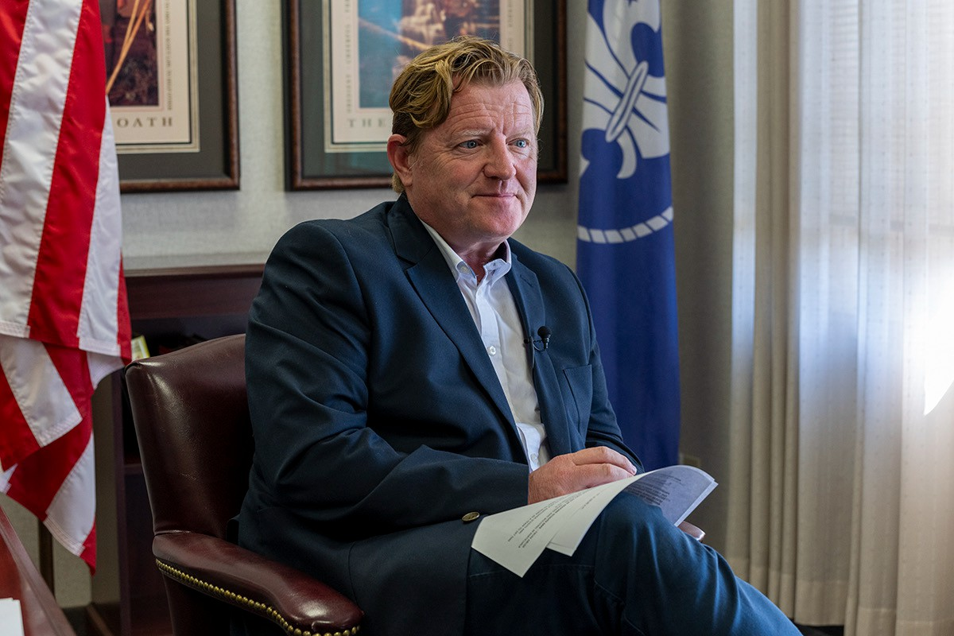





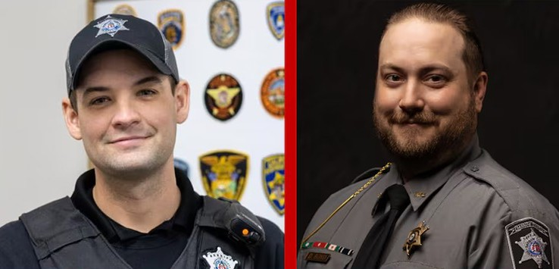
Glen Pounder
2025 Special Programming
Keynote Speaker from Scouting America
Sgt. Donovan Boyd & Deputy Tanner Good Apalachee HS Active Shooter Town Hall and Q&A with Barrow County

Slide 63
https://www.bsawinterfest.org/

Slide 64
National LFL / Exploring Program Office Staffing Update
As of 10 November 2025, Dedra Douglas joined the National Service Center as the new Administrative Assistant working with Susan Fitzhugh (Senior Administrative Assistant)
On 1 December 2025, Carlos Coronado (who is currently the Assistant Director of Field Service with Heart of America Council) will be joining the National Service Center as the new Exploring Program Growth & Retention Executive

Slide 65
National Scouting America Council Office Staffing Update
Hiring three Program Growth & Retention Executives for
Venturing / Sea Scouts Program*
Cub Scouting Program
Scouts BSA Program
* For Tim Anderson’s Older Youth Programs staff

Slide 66
Exploring Adventure Clubs / Posts
&
Aviation Drone Exploring*
* Presented during 18 September 2025 National Learning for Life Executive Board Meeting by Ryan Moon, Director 0f New Programs

Slide 67


Slide 68
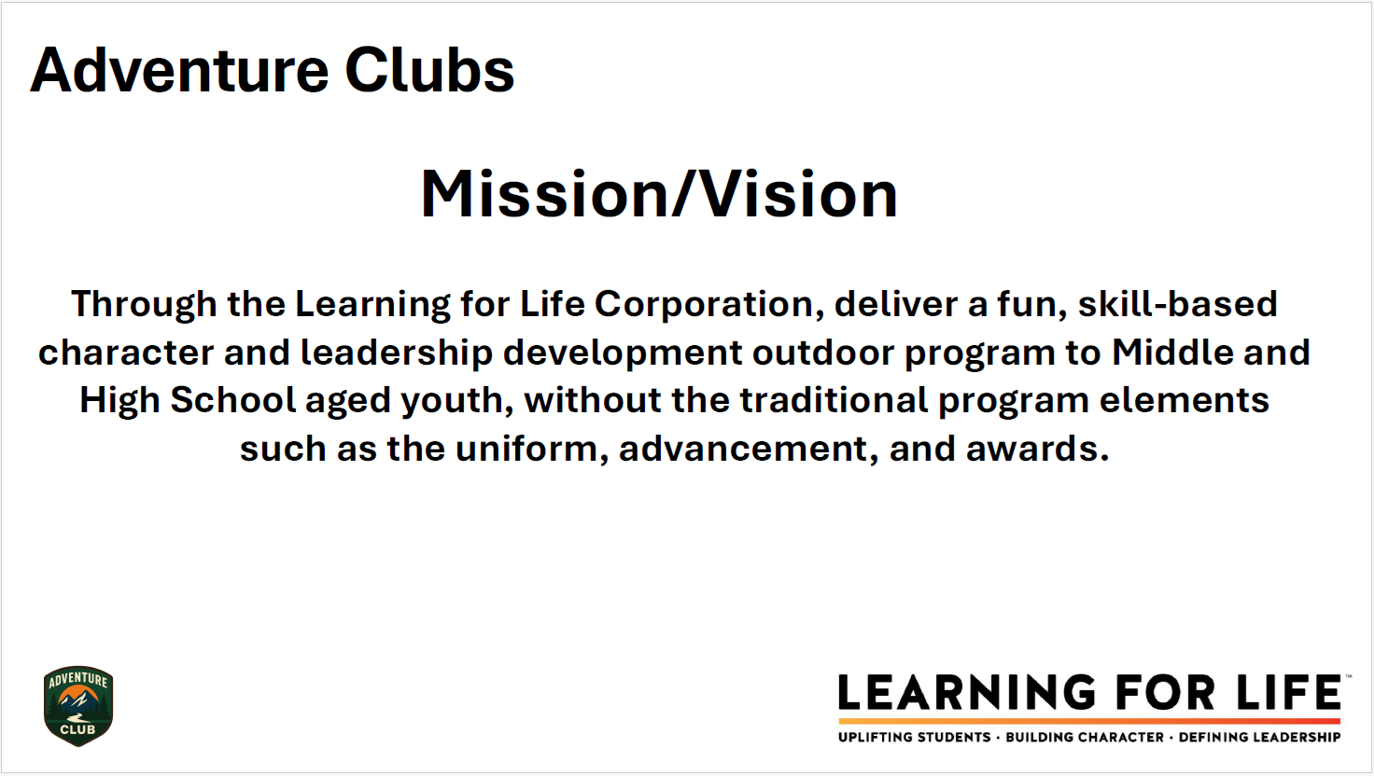

Slide 69
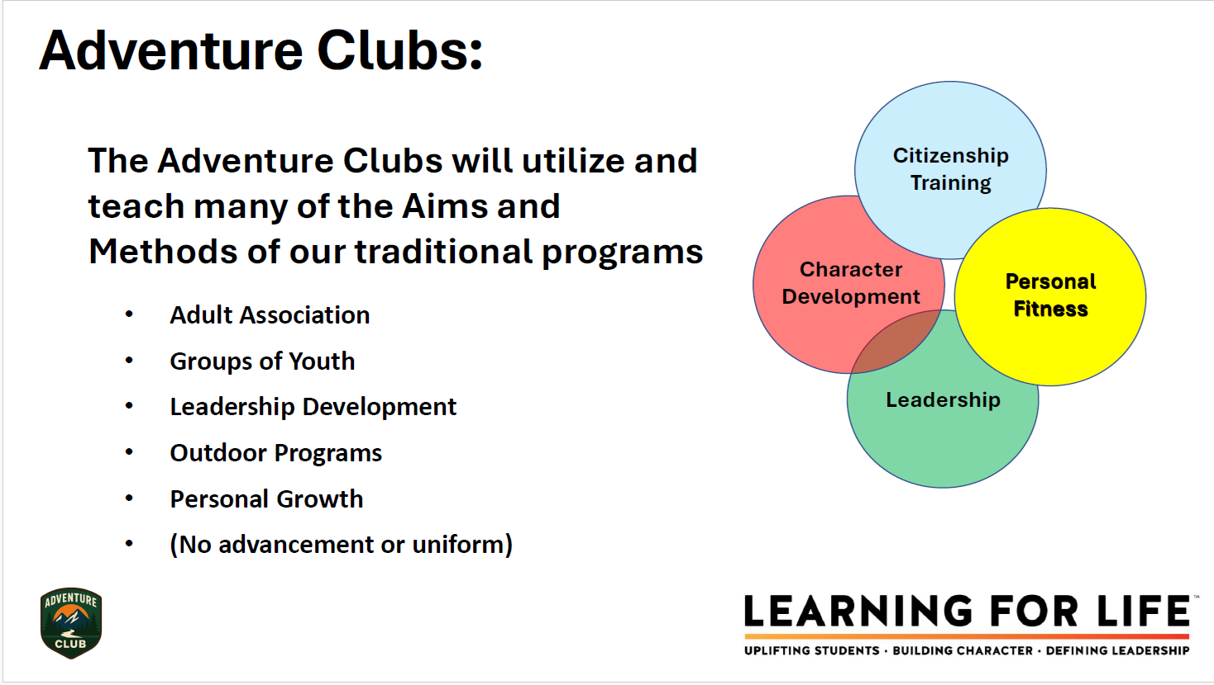

Slide 70
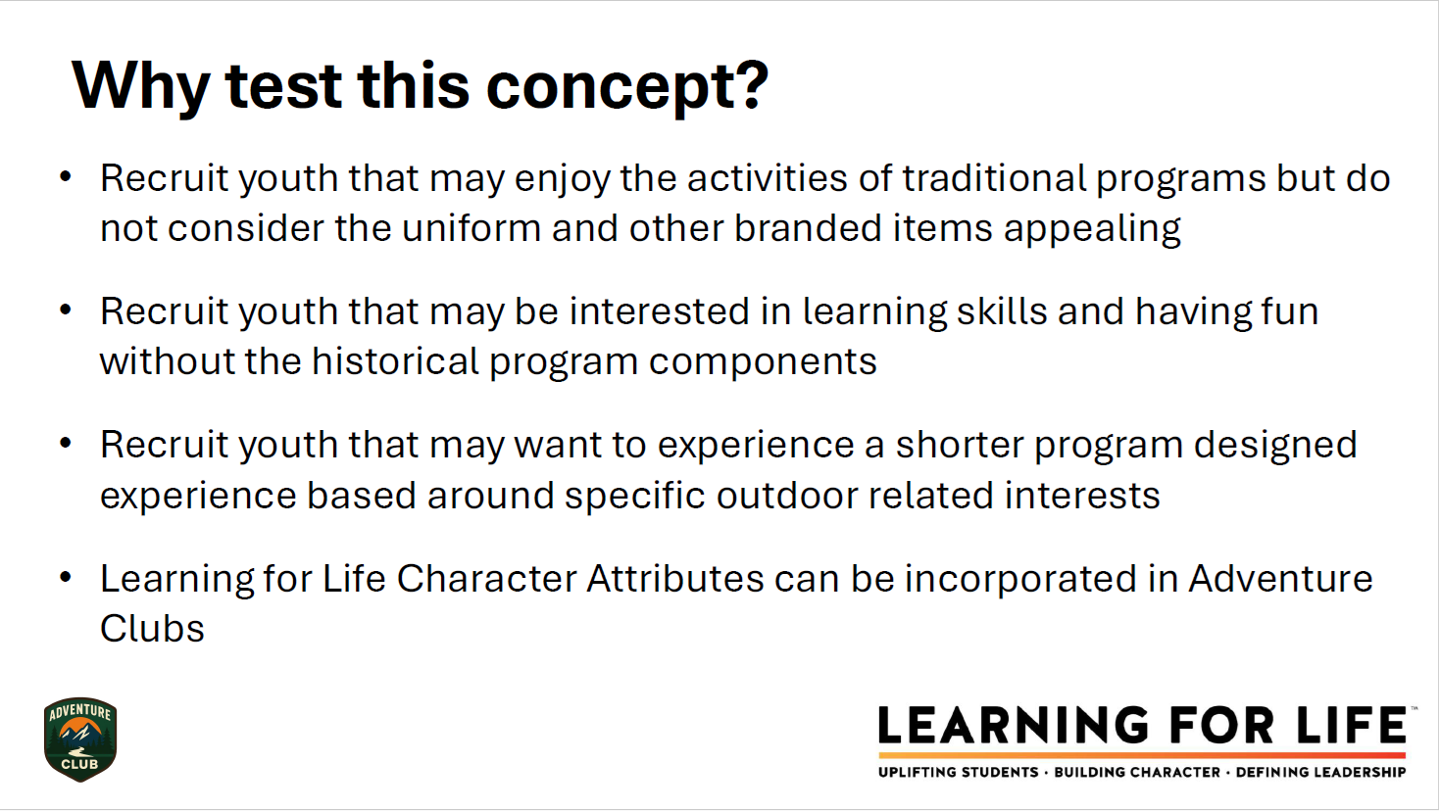

Slide 71


Slide 72


Slide 73
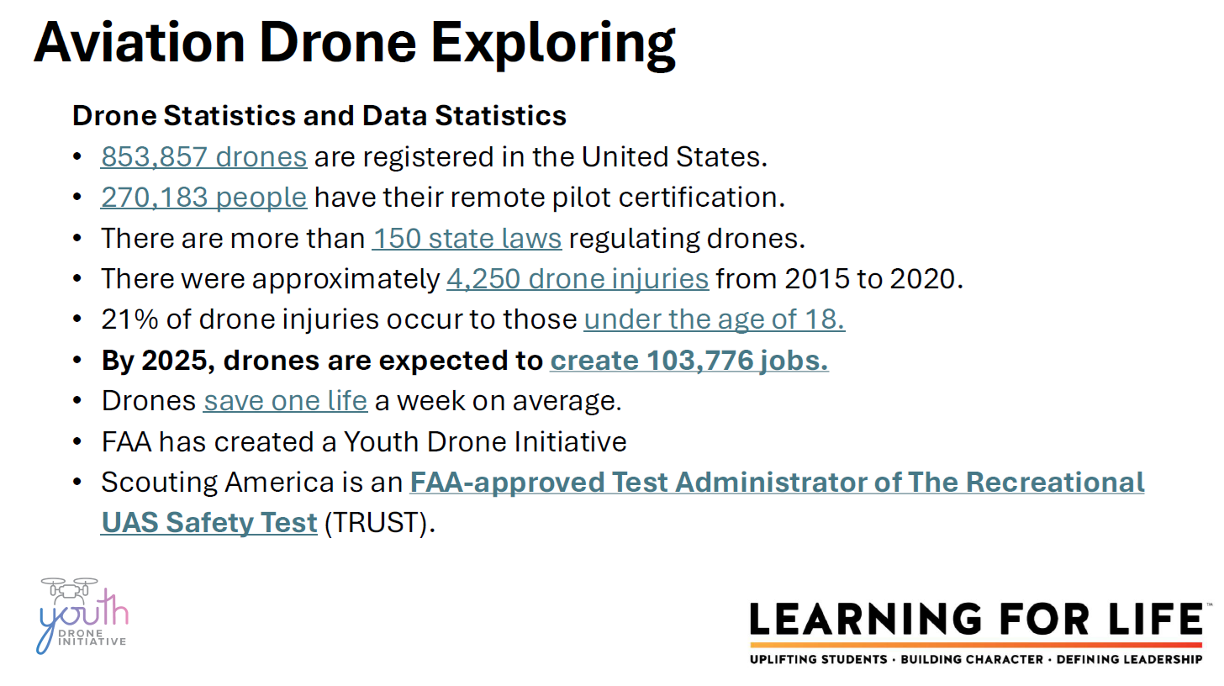

Slide 74
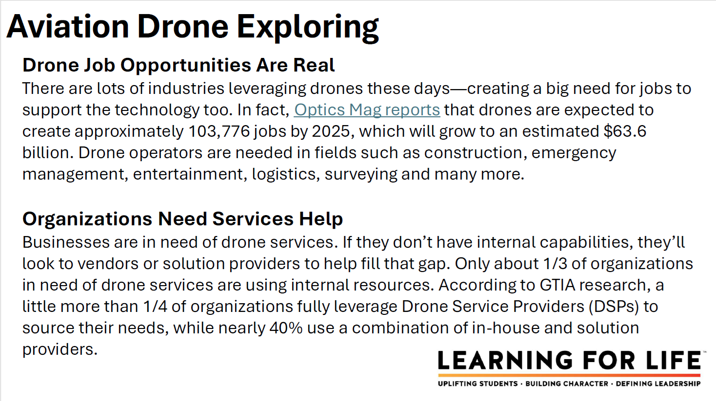

Slide 75
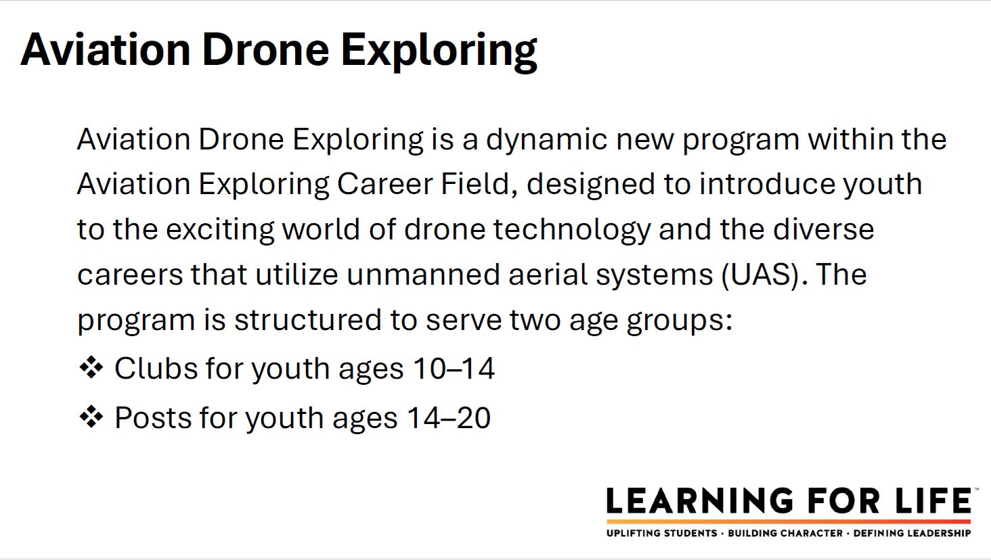

Slide 76
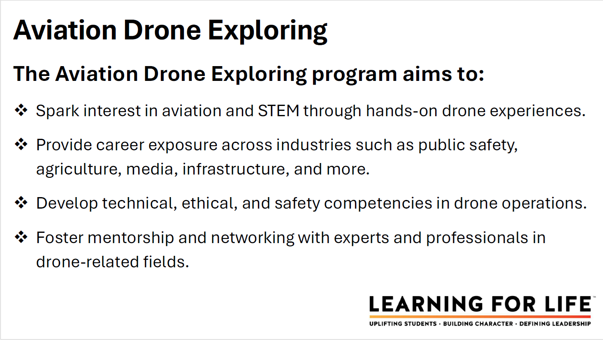

Slide 77
For more information on either program:
Please contact Ryan Moon
Ryan.moon@scouting.org

Slide 78
Topic(s) of the Month
Exploring Program Fundraising & Cultivation Events
www.exploring.org
Simply scroll to the bottom of the home page and search within the 3 boxes labeled:
“Unit Resources”, Council Resources”, & “Forms”

Slide 79

CULTIVATION EVENTS 1. What is a cultivation event? 2. When do you hold cultivation event? 3. Where do you hold cultivation event?

Slide 80

Fundraising and Cultivation Events
www.exploring.org
Simply scroll to the bottom of the home page and search within the 3 boxes labeled:
“Unit Resources”, Council Resources”, & “Forms”

Slide 81

FUNDRAISING EVENTS
Council / District Coordinated Events
Principal / Teacher of year
Program Manager of year
Advisor of the year
(Police / Firefighter / School Counselor)
Other suggestions?

Slide 82
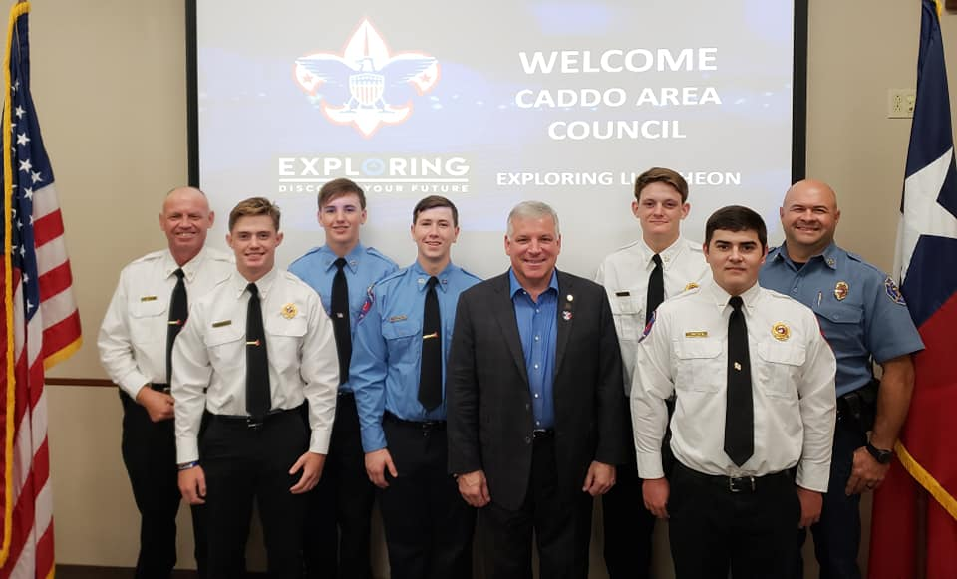
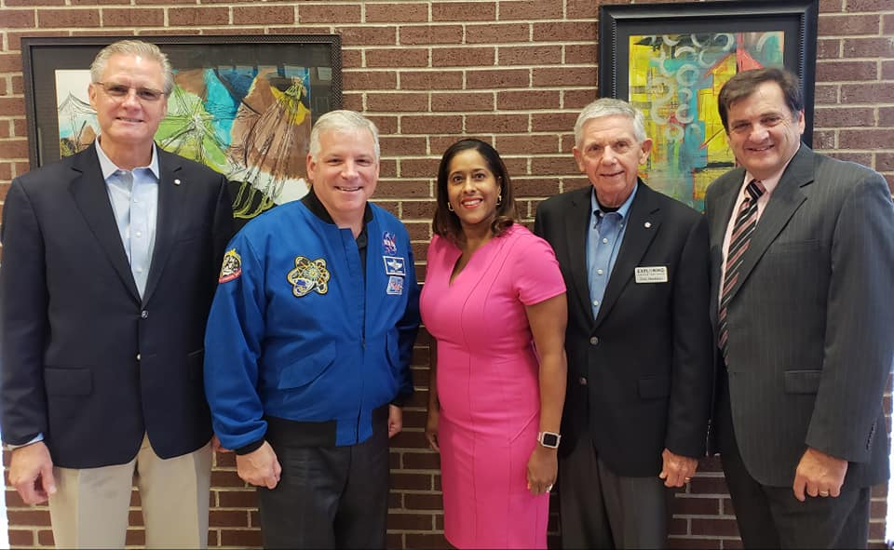
Cultivation/Fund-Raising Event
Texarkana, TX

Slide 83

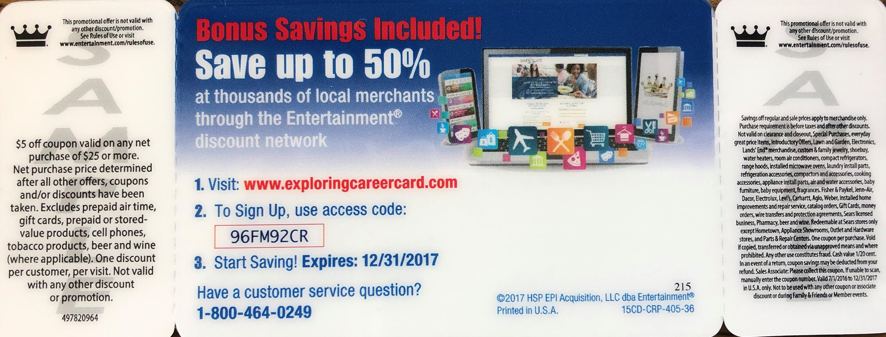
Camp Cards
VS.
Career Cards

Slide 84

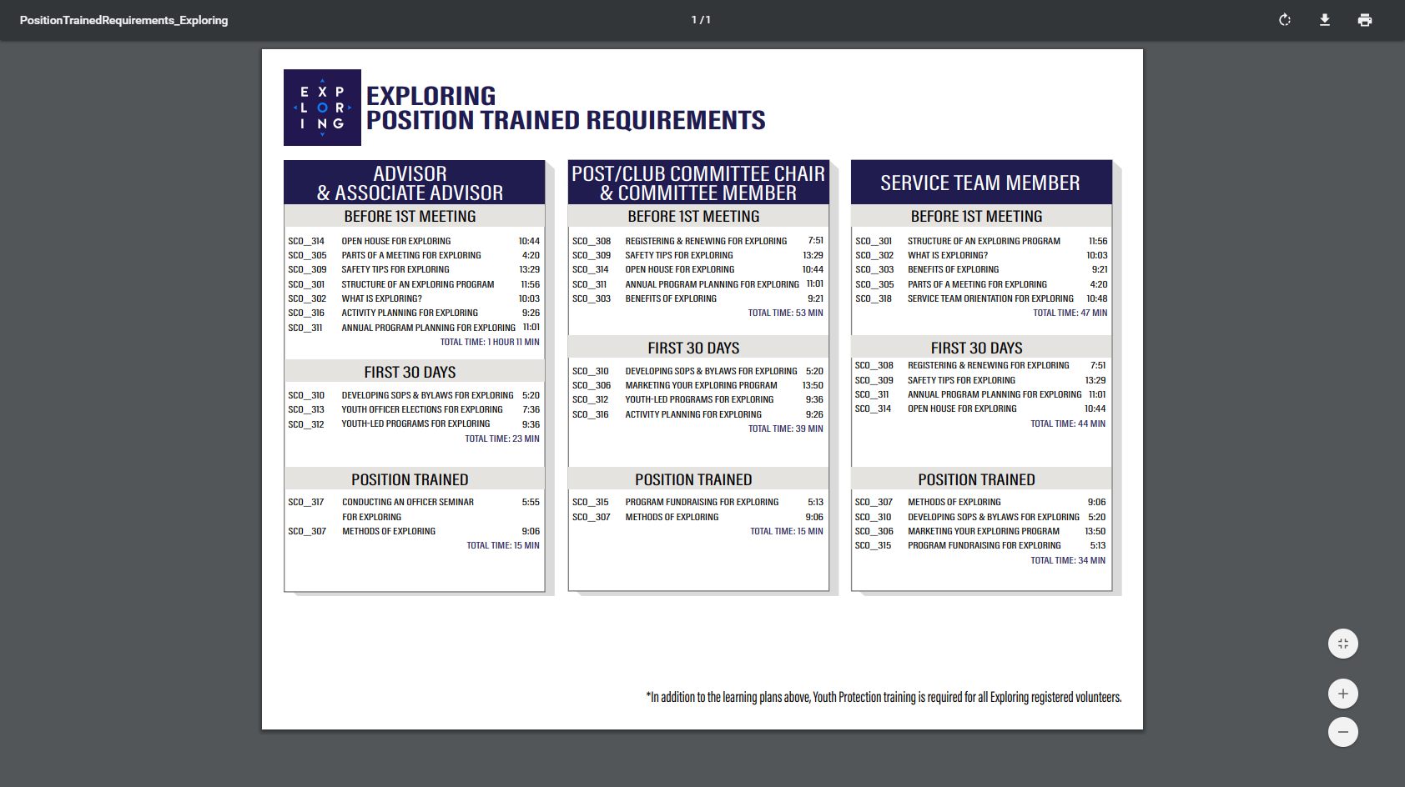
ONLINE REGISTRATION & ONLINE UNIT RENEWAL FOR EXPLORING

Slide 85
https://www.scouting.org/commissioners/internet-rechartering/
Information included is:
Training Video
FAQ’s
User Guides
Internet Recharter Guidelines
Summary of Enhancements
Recharter Demo Tool
New Online Rechartering/Renewal System
https://advancements.scouting.org/login
Manager of Shared Services
Member Data Outsourcing Solutions

Slide 86


Slide 87
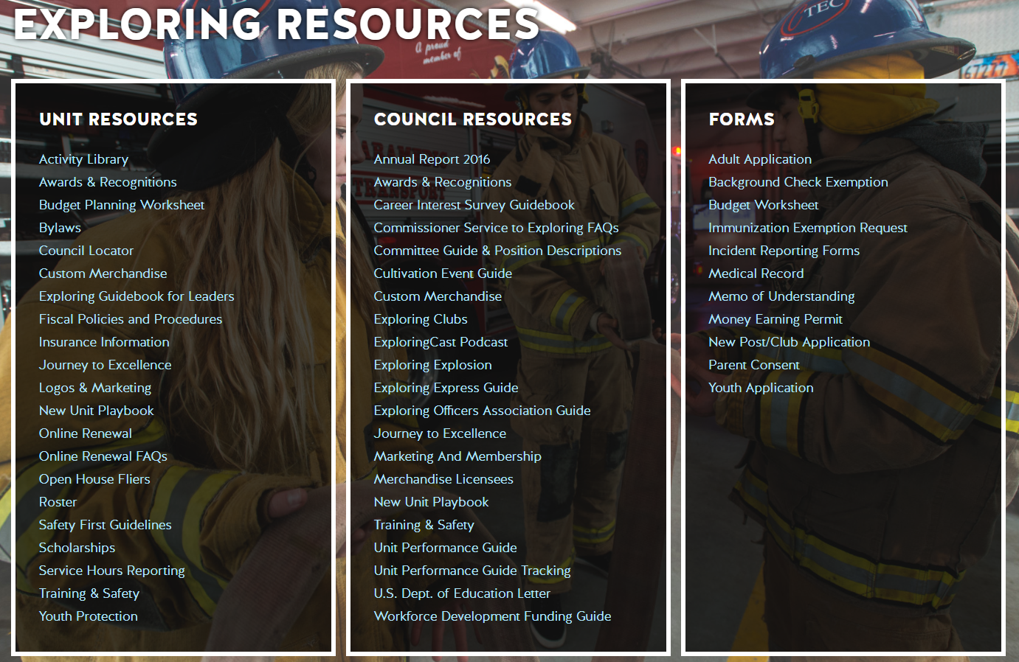
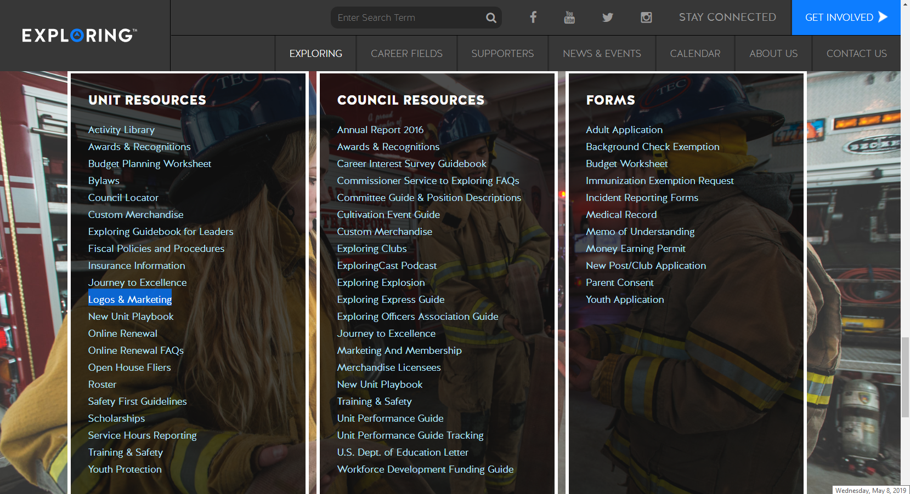

Slide 88

Youth Protection Training Safeguarding Youth
https://my.scouting.org/

Slide 89
Exploring Youth Training Update
https://www.scouting.org/training/youth-protection/venturing/

Slide 90
Barriers to Abuse Update
As part of our ongoing commitment to abuse prevention, the Boy Scouts of America, to include Exploring, is updating the adult supervision requirements for overnight activities
This update enhances the minimum “two deep leadership” requirements by additionally requiring every adult present on overnight activities to be a registered member of the Boy Scouts of America or Exploring
These adults must submit an adult application and registration fee, undergo a criminal background check, a volunteer screening database check and must complete mandatory Youth Protection training.
A limited exception for parents and legal guardians of Cub Scout youth attending overnight with their children is planned due to the family centric nature of Cub Scouting
All Cub Scout Packs, Scouts BSA Troops, Venturing Crews, Sea Scouting Ships, Exploring Posts, council, and district overnight programs will be required to comply with this update by September 1, 2023. We encourage early adoption prior to the effective date
This updated Barrier to Abuse will be referenced as part of the Guide to Safe Scouting, Exploring’s Safety First Guidelines, Youth Protection and Adult Leadership section, Scouting’s Barriers to Abuse. Youth Protection and Barriers to Abuse FAQ’s will be expanded to include additional FAQ’s as they are developed

Slide 91



STAY CONNECTED
page | @lflexploring
group | Exploring Success!
group | National Explorer Alumni Association
learningforlifeusa
exploring.org | Stay Connected
exploring@lflmail.org

Slide 92
Questions?

Slide 93

2025 NATIONAL EXPLORING LIVE HOURS
The National Exploring Live Hour is a monthly Zoom video conference that will help engage and equip
Exploring volunteers and professionals to grow, support, and learn more about Exploring. Each month the National Exploring Live Hour will be led by our National Exploring Chair and the National Director of Exploring. The live hours will include sharing best practices and ideas that are happening within our councils, highlighting successful growth campaigns, and inspiring new ideas through various trainings. This will also offer an opportunity for local councils to collaborate with territory and national counterparts to generate innovative solutions to real-life Exploring challenges.
National Exploring Live Hour Schedule
1:00 PM – 2:00 PM Central Standard Time, Monthly
Register for each of the National Exploring Live Hour ZOOM presentations at:
https://reservations.scouting.org/profile/form/index.cfm?PKformID=0x156865abcd

Slide 94
Exploring at Home (Discuss Best Practices) Idea Sharing Questions and Answers from the Field https://drive.google.com/file/d/1Bo7U0iJ8Ti-bmyIFtxGfG0TIt3dB1xX4/view?usp=sharing
After the Live Hour Discussions
(Open Dialogue)

Slide 95


Good News from the Field!

Slide 96
v
END OF DECEMBER 2025
EXPLORING LIVE HOUR
PRESENTATION SLIDES
All other slides below are informational

Slide 97
v
EXPLORING UPDATES
REMINDERS
Tim Anderson
National Director
Learning for Life & Exploring
National Director Older Youth Programs

Slide 98
EXPLORING PARTICIPANT POLICY “EP” (18 THROUGH 20 YR OLD EXPLORERS) Effective August 1, 2020, all applicants 18 through 20 years old must complete and submit an adult application, consent to a criminal background check, and successfully complete Youth Protection training. However, an 18- through 20-year-old will still be considered an Adult Exploring Participant in the post and will not be considered an adult leader. Therefore, an “EP” will not be allowed to fulfill adult leadership roles pertaining to Two-Adult Leadership and other requirements that require leadership to be at least 21 years of age. All Exploring Participants “EP” will continue to count as youth within your youth membership reports. Visit the link below for an infographic as well as a Q & A to assist you in implementing this important new policy. http://filestore.scouting.org/filestore/se-packet/2020-08-10/Exploring-Participant-Policy-FINAL-2.pdf

Slide 99
EXPLORING REGISTRATION FEES Effective August 1, 2023, Exploring fee updates: - Exploring Youth $50.00 - Exploring Adult Participants (18-20) $50.00 - Exploring Adults $50.00 - Exploring Post/Club Annual Renewal Fee $100.00 - There is no additional “Joining Fee” for Exploring The updated membership fees will take effect August 1, 2023, for new members in the 2023-2024 program year. The national membership fee helps cover the cost of essential services, including program resources, liability insurance for those participating in approved Scouting activities, criminal background checks, youth protection, and the development of intellectual property for national, council, and unit programs. As we move forward, we will continue to look at the membership fee structure and how we deliver the Scouting program for future generations.

Slide 100
NEWLY UPDATED EXPLORING APPLICATIONS The newly updated Exploring applications are available now for download online at www.exploring.org New Post/Club Application (SKU# 655197) Youth Application (SKU# 634698) Adult Application (SKU# 634699) -Includes the new 18-20 Exploring Participant (EP) Code, which will became mandatory beginning August 1st, 2020. *New applications are available at the National Distribution Center .

Slide 101

Newest Technology for Exploring
BeAnExplorer “Equivalent”
“joinexploring.org”
“joinexploring.com”
Scoutbook for Exploring
Online Registration
Online Renewal

Slide 102

*Exploring Leadership Experience
*Coming soon for Exploring youth
Resume Builder that will help recognize Explorers
This online, mentor assisted, self-paced and guided experience will allow our Explorers to…
Have an opportunity to discover their inner leadership potential
Gain practical leadership experience – participate in a capstone project
Work with a mentor to gain professional leadership experience
Be recognized with a Nationally Certified Leadership Experience Certificate that will help improve their resume and recognize their overall Exploring Experience.

Slide 103
Exploring in comparison to Traditional Scouting
 | SCOUTS BSA | VENTURING | SEA SCOUTS | EXPLORING
UNIT | Troop | Crew | Ship | Club/Post
LEADER | Scoutmaster | Advisor | Skipper | Sponsor/Advisor
YOUTH LEADER | Senior Patrol Leader | President | Boatswain | President or Agency Nomenclature
YOUTH PARTICIPANT | Scout | Venturer | Sea Scout | Participant or Explorer
RE-REGISTRATION | Charter Renewal | Charter Renewal | Charter Renewal | MOU Renewal
SPONSOR | Chartered Org | Chartered Org | Charter Org | Participating Org
SPONSORING AGREEMENT | Charter | Charter | Charter | Memorandum of Understanding (MOU)
UNIT SERVICE | Commissioner | Commissioner | Commissioner | Service Team
YOUTH RUN | Yes | Yes | Yes | Yes
AGE SPAN | 11-18 | 13-20 | 13 - 20 | 11-13/14-20
RELIGIOUS DECLARATION | Duty to God | Duty to God | Duty to God | None
UNIFORM | Scouts BSA | Venturing (Unit Selected) | Sea Scouts (Unit Selected) | Club/Post Selected, not required

Slide 104
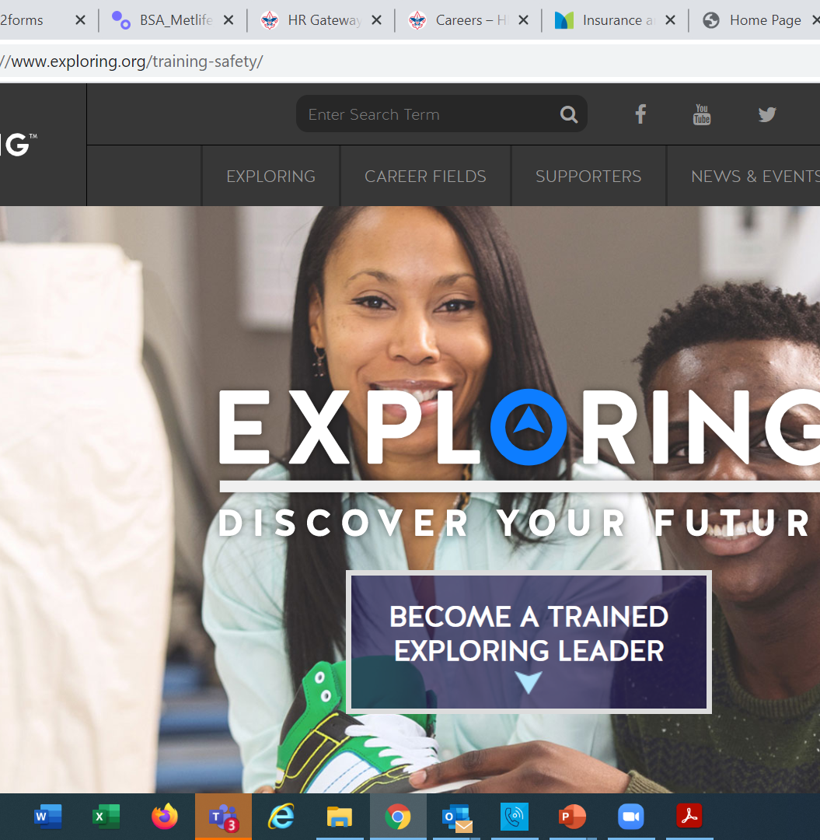
Exploring Training

Slide 105
Exploring Position-Specific Training Modules Update Status

Slide 106
Exploring Position-Specific Training Modules Update Status …
The Exploring Leader Training Modules have also been formatted to be experienced through the learning center via computer or smart device.
Login in to https://my.scouting.org/ . If you need to create an account and do not know your member ID number, please contact your local BSA council office/service center
Once you log in, locate the blue box on the right side of your screen labeled “Click here to access Exploring Training”
After logging in, you may also click “Menu” in the top left corner and select “My Training”. Under Training Courses by Program, select “Exploring Adult Training”
You may select between the three available Exploring learning plans (based on position). Anyone is welcome to complete the trainings
NOTE: In addition, the “Servicing Exploring Units Module for Commissioners” has been updated within the Learn Center.
We would like to sincerely thank the many Exploring professionals and volunteers that helped make this important update happen!

Slide 107
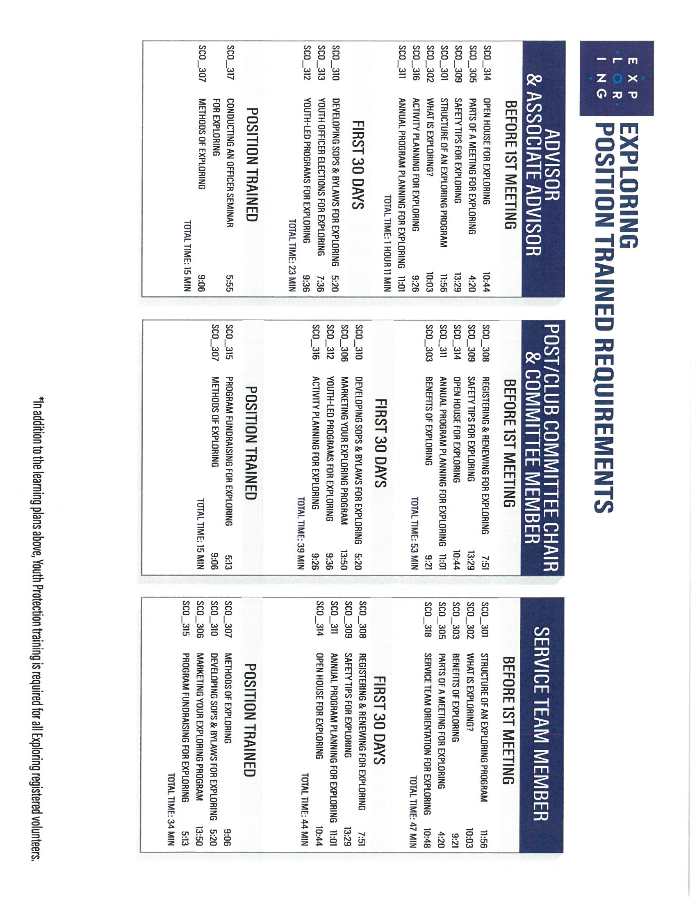
Exploring Position-Specific Training Modules Update Status …
NOW UPDATED AND READY FOR VIEWING

Slide 110
Safeguarding Youth (Youth Protection) Training
https://my.scouting.org/

Slide 111
Exploring Youth Training Update
https://www.scouting.org/training/youth-protection/venturing/

Slide 112
Important resources to help plan the program…
Career Opportunity Worksheet -- www.exploring.org and click on relevant career field icon and scroll to the bottom of the page.
Activity Library (including Life Skills Section) https://www.exploring.org/activity-library/
Organization’s Resources/Employees
A. Current work curriculum (developed by the company)
B. Employee’s expertise/knowledge (Use All-in One Program Planning Meeting-found in the Exploring Guidebook for Leaders)
Career Achievement Award (Posts) & Career Awareness Award (Clubs)
http://www.exploring.org/wp-content/uploads/2017/06/Career-Achievement-Award-May2017.pdf
http://www.exploring.org/wp-content/uploads/2018/05/Career-Awareness-Award-FINAL.pdf
Exploring Guidebook for Leaders https://www.exploring.org/wp-content/uploads/2016/10/Exploring-Guidebook-Sept2017.800-10018.pdf
Safety First Guidelines/Guide to Safe Scouting (Guide is being Updated—Please follow all CURRENT YPT Policies)
https://www.exploring.org/wp-content/uploads/2021/08/LFL-safety-first-guidelines-3.21.17_8.pdf
7. Online Exploring Adult Leader Specific Training & Youth Protection Training
https://www.exploring.org/training-safety/ or www.myscouting.org
8. Unit Performance Guide (Chapter 5- Exploring) –Details about organizing a new Post/Club
http://www.exploring.org/wp-content/uploads/2021/04/522-02516_UPG.compressed.pdf
Also visit www.exploringexplosion.org and scroll to the bottom of the website to find additional resources…

Slide 113
ADDITIONAL SLIDES FOR COUNCIL USE All slides will be emailed to each Exploring Live Hour Participant every month

Slide 114


Successful Councils… Intentionally Providing a Pathway to Exploring Growth and Strategic Planning In Your Council

Slide 115

“Action Planning” The Beginning of your Strategic Plan
The foundation of your plan will begin here

Slide 116
OPEN HOUSES
INSERT HERE
COUNCIL/DISTRICT YEARLY MEMBERSHIP PLANS
(Recruitment/Retention Cycle)
Career Interest Surveys

Slide 117

12 Keys To Success

Slide 118

1. Recruit a council Exploring volunteer chair and committee 2. Appoint a Council Exploring Champion “Staff Advisor” 3. Create a public presence for Exploring (council website, newsletters, social media)

Slide 119

4. Train key volunteers and staff on the 4 Phases of Post/Club Organization 5. Set specific goals for Career Interest Surveys or gathering of data from select high schools 6. Set goals to host Open Houses for all Posts/Clubs (i.e. School Night for Scouting)

Slide 120
7. Create a campaign to emphasize Post/Club unit support (through Service Teams/Commissioners) 8. Integrate Exploring into council activities and events 9. Promote Exploring to all current customers (i.e. “Scouts BSA”)

Slide 121
10. Host a council community cultivation event, focusing on a specific career. 11. Involve the Council Executive Board to help open doors within the community and to help create a list of businesses to match the Career Interest Survey results. 12. Ensure that Exploring is included in the Council Strategic Plan, PDS Goals, and Board Meetings.

Slide 122
Starting a New Post/Club
“The Four Phases”

Slide 123
REGISTRATION BASICS
YOUTH
POST: ___ and have completed eighth grade OR 15 years of age but not yet ___ years old
CLUB: 6th-8th graders who have completed the ____ grade and are at least 10 years old but have not completed the eighth grade and are not yet ____ years old.
ADULTS
___ years age or older
POST: Min of 4 adults
______________ (CC)
2 ____________ (MC)
_______________ (EA)
CLUB: 2 adults _______________ (ES)
_______________ (AS)
PAPERWORK
New Post/Club ____________
4 _________ Apps
5 _________ Apps
Annual ______________ of Understanding
$____ General Liability Insurance Fee
$____ per person registration fee
14
21
Application
21
Adult
Committee Chair
2 Committee Members
Youth
5th
Advisor
Memorandum
Sponsor
100
15
Assoc Sponsor
50
Exploring Youth Participants “EP’s” ages 18-20 must complete an
Exploring ________ Application & Successfully Complete YPT.
Adult

Slide 124
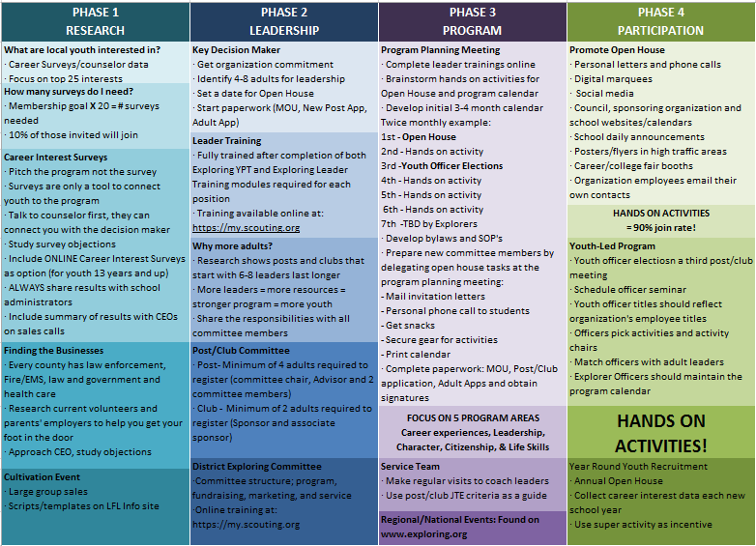

Slide 125
4 Steps/Phases in Organizing a new Post
1. Research-
Conduct the Career interest surveys
and develop business/community prospects
2. Leadership-
Meeting with the top leadership within the
businesses/community and identifying program
leaders; includes training of leaders
3. Program-
Develop the organization’s meeting/program
themes and prepare for an open house
4. Participation-
Recruiting youth through an organized open house and
involvement of youth in program development

Slide 126
MOST IMPORTANT PART OF EACH PHASE?
Phase 1 : Career Interest Surveys
Phase 2: Training
Phase 3: All-In-One Program Planning Meeting
Phase 4: Open House

Slide 127
Career Interest Surveys
The # 1
Leading Indicator for Exploring Growth

Slide 129
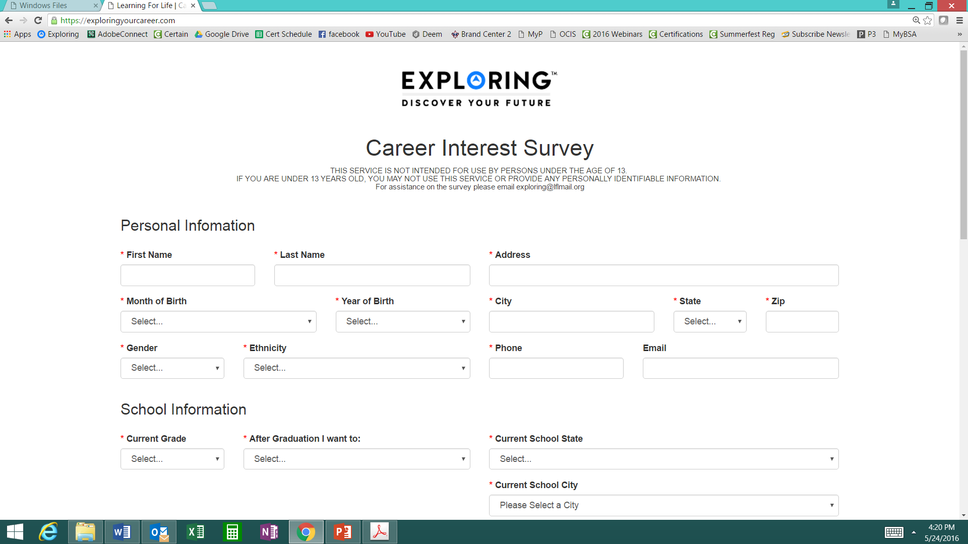

Phase 1 – Research
Career Interest Surveys (two choices)
pa
pa
Online Survey:
www.exploringyourcareer.com
Paper Scantron Survey

Slide 130
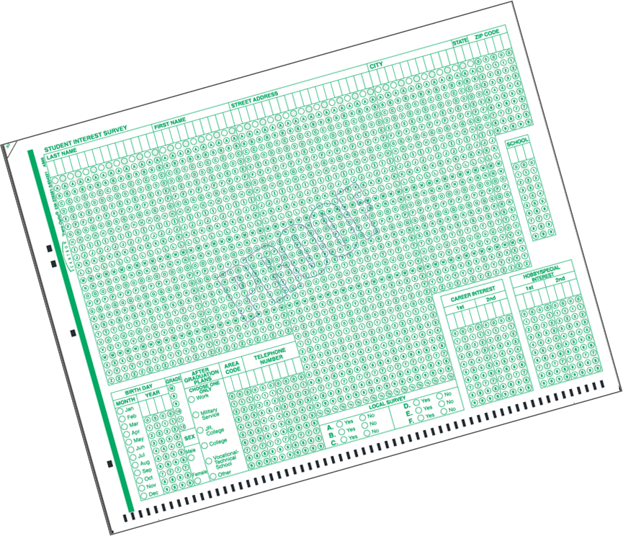

BACK SIDE
FRONT SIDE
Paper Scantron Survey Available through NDC

Slide 131


Slide 132


Slide 133

Online Career Interest Survey
www.exploringyourcareer.com
TRY IT NOW!
Use QR code or simply type address in web browser
Notes:
A “QR” or Quick Response code was created to take students directly to the survey site. It is available on posters, post cards, business cards, and book marks.
How do you use this? Email it to all teachers, they can open it from email and project it one screen for students to use their smartphones!

Slide 134


Slide 135


Slide 136

www.exploringyourcareer.org
Two career & hobby choices
School names
pre-loaded
Notes:
REFER TO HANDOUT IN YOUR FOLDER.
This is a screen shot of the new Online Career Interest Survey that was activated on Jan 1, 2012.
The careers & hobbies match the paper version. So schools and administer the survey either on paper or electronically.
The online version can be accessed from any device that can access the Internet – including smart phones.
Results are sent instantly to a secure website where councils can access the results and provide them to schools in the same format as the paper survey.
Instructions for accessing results can be found in the LFL internal site.
Students 13 yrs. and younger cannot legally complete this survey online. If they enter data, the system will not save it.
You can also add schools/colleges to this list if they do not populate when you put in your respective zip code. Simply e-mail us at exploring@lflmail.org and request your specific school to be added, with zip code

Slide 137

Online Career Interest Survey COSTS
Unlimited schools and unlimited surveys for students 13 years of age and older

Slide 138
REPORTS GENERATED FROM THE SURVEYS

Slide 139

RESULTS REPORT: School
Grade: 10
ABBEY, Susie 123 Main St Noblesville IN 46060 Work
Career 1 Career 2 Hobby 1 Hobby 2
Musician Journalist Roller Skate /Blade Music
139
Notes:
139
No matter the survey format you use, the reports are generated the same way.
**GOOD data to establish credibility at/during your sales call
This is one set of sample results provided at no cost to schools. Very helpful for Guidance Counselors.
All students, by grade, alphabetically. Shows:
Career interests
Hobby interests
Post-high school plans
Other results include all students interested in each career (all the attorneys, architects, dentists, electricians, etc). Helpful for Guidance Counselor planning, career speakers, college days and college fairs.
Be sure to return results to the Guidance Counselor when you say you will – under promise and over deliver. Do not promise results in one week if you cannot do it. Say 2-3 weeks, then they will be very happy if they do receive them in a week or ten days.

Slide 140


RESULTS REPORT: School
140
Notes:
140
This is another set of sample results provided at no cost to schools. Very helpful for Guidance Counselors.
This report includes all students interested in each career (all the attorneys, architects, dentists, electricians, etc.). Helpful for Guidance Counselor planning and career speakers.
The After Graduation Plans is important to Guidance Counselors
College
Junior college
Military Service
Technical school
Work
Other
Why are these reports help full to the school…to you?

Slide 141
Summary Career Interest Report by Council
Code Career Count
0712 Nurse (Registered) 798
0145 Musician (Instrumental/Choral/Voice) 751
0903 Attorney/Lawyer 733
1625 Teacher/Teacher Aide 678
0300 Business (General) 645
0719 Physician/Surgeon 604
0101 Actor/Actress 600
0130 Fashion Designer/Model/Buyer 579
0721 Psychiatrist/Psychologist 578
0170 Professional Athlete 507
0180 Photographer 461
1305 Architect 437
0725 Veterinarian 429
0102 Artist 427
0718 Physical Corrective Therapist 313
1300 Engineering (General) 208
MOST IMPORTANT TO YOU

Slide 142

Career Interest Survey Questions
Opportunity for 6 “Yes” or “No” questions
Unique feature of our survey
Anything school officials want to know
Are you planning to take the SAT / ACT?
Are drugs a problem in our school?
Is there enough student parking?

Slide 143
www.exploring.org

Slide 144

Career Interest Survey Guidebook
Be sure you have the most recent version
Download at www.exploring.org
One stop shop for all CIS resources
Table of Contents
Page 5 | At A Glance
Page 7 | Overcoming Objections
Page 44 | Appendix

Slide 145
ALTERNATE METHODS? 1. Use school information already available 2. Ask youth to develop contacts 3. Develop cultivation events 4. Invite Eagle Scouts / Scouts to join 5. Booth at schools open house night and career days /career fairs 6. Annual Exploring open houses for ALL Posts and Clubs 7. Follow up leads from the Exploring Lead Generator

Slide 146
BASED ON SURVEY RESULTS
1. Focus on Top 4 students interests
2. Identify companies in those 4 interest areas
3. Identify the path to the CEO
Council board contacts
School board/admins
PAS find
Nominating committee
Applications

Slide 147
Career Interest Survey Guidebook
Be sure you have the most recent version
Download at www.exploring.org
One stop shop for all CIS resources
Table of Contents
Page 5 | At A Glance
Page 7 | Overcoming Objections
Page 44 | Appendix

Slide 148


Slide 149
Leads are being generated from Exploring.org and include anyone interested in joining, leading, sponsoring, or
otherwise supporting Exploring in their area.
Scout Executives, Assistant Scout Executives and DFS’s receive weekly lead reports.
Exploring Executives and staff advisors receive immediate notifications of each lead generated.
To make changes to any of these settings, email your request to exploring@lflmail.org.
WHEN YOU RECEIVE AN IMMEDIATE NOTIFICATION EMAIL:
1. In the email, you will see a note to “copy & paste the following URL into your browser to mark lead as contacted”.
By following this directive, you are changing the status of your lead to “contacted”. You will no longer receive email notifications for that particular lead. The lead will begin to show as “contacted” on your SE’s weekly report.
Invite the person to attend an existing post/club meeting to get a feel for the program and connect them to
appropriate Exploring advisors.

Slide 150

www.joinexploring.org

Slide 152

Phase 2 - Leadership
CEO’s Police/Fire Chiefs Administrators
Industry Experts Retirees Community Leaders

Slide 153

Moving forward with the CEO
1) Get organization’s commitment
2) Identify 6-8 adults
- CEO invites them
- You provide guidance
3) Set 2 dates for:
- All-In-One program planning
meeting
- Open House
4) Start Paperwork
- New Club/Post Application
- MOU, Adult Application

Slide 154
Exploring Training

Slide 156
Phase Two: Training

Slide 158
Important resources to help plan the program…
Career Opportunity Worksheet -- www.exploring.org and click on relevant career field icon and scroll to the bottom of the page.
Activity Library (including Life Skills Section) https://www.exploring.org/activity-library/
Organization’s Resources/Employees
A. Current work curriculum (developed by the company)
B. Employee’s expertise/knowledge (Use All-in One Program Planning Meeting-found in the Exploring Guidebook for Leaders)
Career Achievement Award (Posts) & Career Awareness Award (Clubs)
http://www.exploring.org/wp-content/uploads/2017/06/Career-Achievement-Award-May2017.pdf
http://www.exploring.org/wp-content/uploads/2018/05/Career-Awareness-Award-FINAL.pdf
Exploring Guidebook for Leaders https://www.exploring.org/wp-content/uploads/2016/10/Exploring-Guidebook-Sept2017.800-10018.pdf
Safety First Guidelines/Guide to Safe Scouting (Guide is being Updated—Please follow all CURRENT YPT Policies)
https://www.exploring.org/wp-content/uploads/2021/08/LFL-safety-first-guidelines-3.21.17_8.pdf
7. Online Exploring Adult Leader Specific Training & Youth Protection Training
https://www.exploring.org/training-safety/ or www.myscouting.org
8. Unit Performance Guide (Chapter 5- Exploring) –Details about organizing a new Post/Club
http://www.exploring.org/wp-content/uploads/2021/04/522-02516_UPG.compressed.pdf
Also visit www.exploringexplosion.org and scroll to the bottom of the website to find additional resources…

Slide 159

Phase 3 – Program
All-In-One Program Planning Meeting
1) Paperwork
2) Adult Explorer Leader Training
- Youth Protection for Explorers
- Adult Explorer Leader Training
3) Open House Planning
- Brainstorm session
Why did you choose this career for yourself?
What are hands on activities that you can do with youth?
- Develop a 3-4-month calendar (use Activity Library)
- Choose Open House “hands-on activities”
4) Prepare Post Committee Members for Open House

Slide 160


SAMPLE PROGRAM CALENDARS
The frequency of your meetings and length of your program each year is up to you. For example, this could be a 12 month or 12 week program.
ENGINEERING & TECH
MONTHLY MEETINGS YEAR-ROUND
September
Open House
October
Chemical engineering
November
Youth Officer Elections
December
Holiday Play – open house
January
Industrial Technology
February
Electrical engineering
March
Computer science
April
Fluid power technology
May
Ethics in engineering
June
Visit with engineering firm
July
Civil engineering
August
Mechanical engineering
Notes:
PRESENTER NOTES:
BE SURE TO DELETE THE CALENDARS/SLIDES THAT ARE NOT RELEVANT TO THE CAREER INDUSTRY TO WHICH YOU’RE PRESENTING.
Remind the audience that they have flexibility is setting the schedule for their own program. Here are some options:
Year round – may or may not include summer
Weekly
Monthly
3 months at a time, different group of youth each time, 3 times per year
Weeknights or weekends

Slide 161

Phase 3 – Program
Planning the Open House
1) From your BRAINSTORM session…
- Pick the 4-5 best activities for a quick hands-on format at the Open House
2) At the open house…“Go shopping”
- 4-5 stations (rotations)
- 4-5 minutes each

Slide 162




www.exploring.org
Notes:
Program planning is also a service that is provided by the local Boy Scout Council. This Activity Library is an all new supplement to the process. You will find it on www.exploring.org

Slide 164


Phase 4 – Participation
SIMPLE OPEN HOUSE AGENDA
OPEN HOUSE AGENDA
Welcome
What is Exploring?
Video
HANDS-ON ACTIVITIES
Activity Interest Survey (customized)
Calendar
ASK TO JOIN
Applications & fees
Snacks

Slide 165

Resources to help you… www.exploring.org

Slide 166
ONLINE REGISTRATION & ONLINE UNIT RENEWAL FOR EXPLORING

Slide 167
ONLINE REGISTRATION

Slide 169

Invitation Manager

Slide 170



Create Account & Complete Application

Slide 171
ONLINE UNIT RENEWAL/ “RECHARTERING” FOR EXPLORING

Slide 172
https://www.scouting.org/commissioners/internet-rechartering/
Information included is:
Training Video
FAQ’s
User Guides
Internet Recharter Guidelines
Summary of Enhancements
Recharter Demo Tool
New Online Rechartering/Renewal System
https://advancements.scouting.org/login
Manager of Shared Services
Member Data Outsourcing Solutions

Slide 173

Scouting America Renewal System Overview

Slide 174
Renewal Membership / Units
For all Youth and Adult members in the BSA
All Membership Terms are for 12 months
Membership Renewal will only have a two-month lapse
New Unit Renewal will only have a two-month lapse
Parent/Guardian e-mails are needed
Text notice will be sent too
Parents can Opt-Out and Units can Opt-out the member too

Slide 175

Renewal Membership – Unit Renewals

Slide 176

Renewal Membership – Unit Renewals

Slide 177





Renewal of Membership
For all youth and adult members of the Scouting America
Auto Renewal Membership Family/Self Pay
Auto Renewal Membership Unit Pay
An email notification and a renewal link will be sent 60 days before membership expires.
The link provided in the email will direct individuals to a renewal form on My.Scouting
If registered in multiple positions, select the primary position. Renewing the primary position will automatically renew multiple positions.
The individual pays with a credit card and submits the renewal.
The unit will approve the membership renewal.
In Organization Manager, the unit selects the Unit Pay option.
Unit Key 3s are notified each month about which members are due to renew that month.
Using the Roster tab, the unit selects which members they are renewing.
The unit can choose not to renew a member (opt-out). The unit can also change the Scout’s Life subscription settings for each person.
The unit pays with a credit card or establishes a securely stored electronic fund transfer payment (ACH) and submits the renewal.

Slide 178

Renewal Membership – Family / Self Pay

Slide 179

Renewal Membership – Family / Self Pay

Slide 180

Renewal Membership – Family / Self Pay

Slide 181

Renewal Membership – Family / Self Pay

Slide 182

Renewal Membership – Family / Self Pay

Slide 183

Renewal Membership – Family / Self Pay

Slide 184

Renewal Membership – Unit Pay

Slide 185

Renewal Membership – Unit Pay

Slide 186

Renewal Membership – Unit Pay

Slide 187

Member Renewal Cycle – December 2025 430,642 Members Renew
Emails beginning 60 days out from the expiration date – 5 emails
Texts sent beginning 45 days out – 4 texts sent
Monthly Renewal Communication Sequence
November 1st – Email Sent
November 15th – Text Message Sent
November 30th – Email Sent
December 15th – Text Message Sent
December 31st - Email and a Text Message Sent
January 7th – Email Message Sent
January 15th – Text Message Sent
187

Slide 188

Renewal Membership – Missing Parent Guardian Relationship

Slide 189

Renewal Membership – Missing Email Address Report

Slide 190

Renewal Membership – Member without Unit Report

Slide 191

Renewal Membership – Members Due to Renew Report

Slide 192

Renewal Membership – Members Opt-Out Report

Slide 194
www.exploring.org

