Slide 1
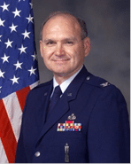

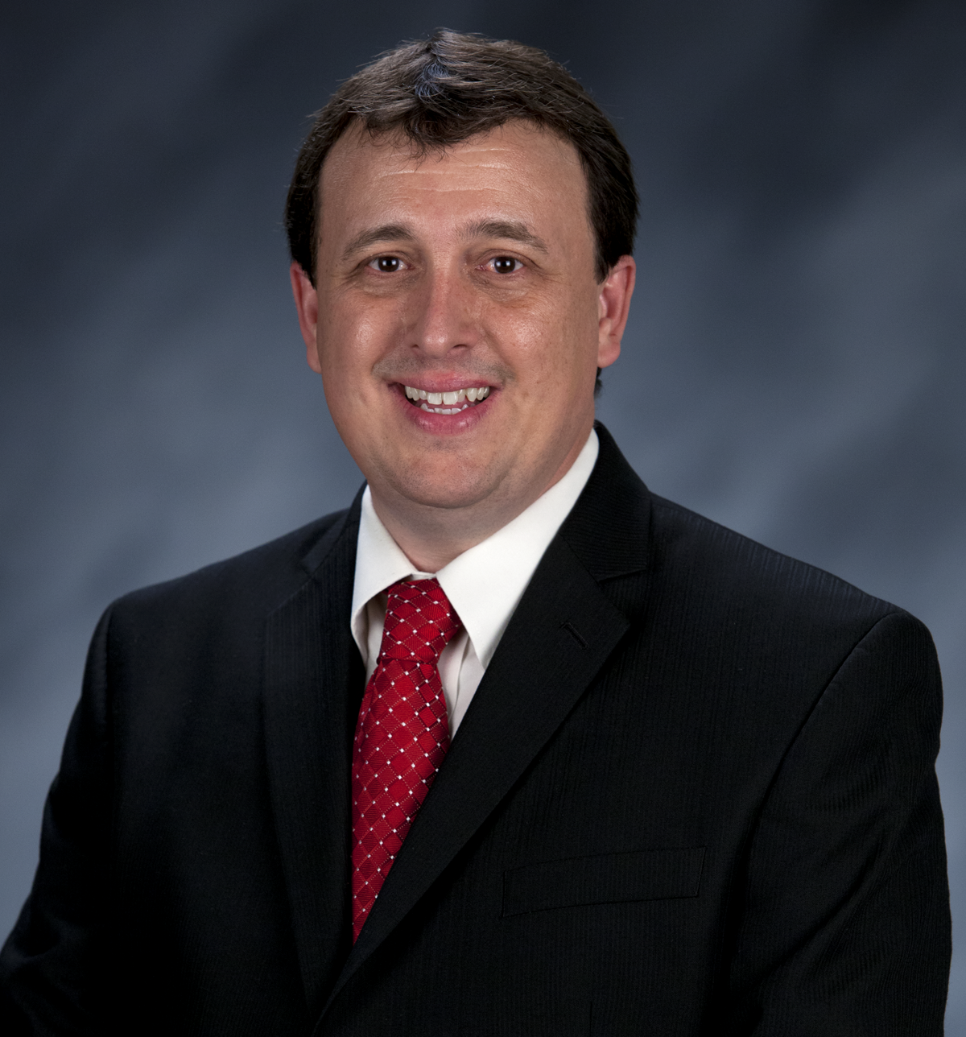
Craig Martin
Vice-Chair,
National Exploring Program Chair
NATIONAL EXPLORING
LIVE HOUR
March 11th, 2026
Tim Anderson
National Director
Learning for Life & Exploring
Older Youth Programs

Slide 2


National Exploring
Live Hour Meeting
Craig Martin
National Exploring Program Chair,
Learning for Life Executive Board
Bruin1967@aol.com
719-331-6406
Richard (Dick) Davies
National Exploring Program Commissioner,
Learning for Life Executive Board
Exploring Chair,
National Commissioner Service Team
Richard.davies.nyc@gmail.com
914-327-7430
u

Slide 3

Safety Moment ~ Frozen Pond Safety* * Julie Dalton, National Venturing Program Chair, present this Safety Moment during 10 February 2026 Scouting America’s National Program Development Meeting which I have augmented with three additional slides )

Slide 4
Frozen Pond Safety General Info…
Frozen pond safety requires verifying ice thickness, as a minimum of 4 inches of clear, solid ice is necessary for walking, and 5-7 inches for snowmobiles. Avoid,, white or bubbly ice, and moving water. Carry safety tools like ice picks, wear a personal flotation device (PFD), never go alone, and keep children and pets on a leash.
Ice Thickness Guidelines
< 4 inches: Stay off.
4 inches: Suitable for walking, skating, and fishing.
5–7 inches: Safe for snowmobiles.
8–12 inches: Safe for cars/small trucks.
12-15 inches: Safe for medium trucks.
Note: These guidelines apply to new, clear, hard ice, not, partially thawed, or slushy ice.

Slide 5
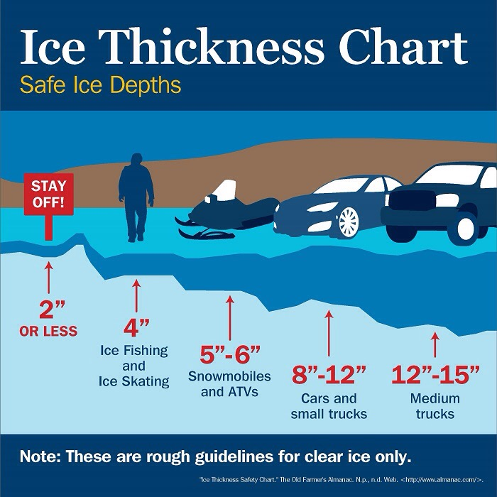
Key Safety Guidelines
Thickness Matters
Check Local Conditions
Avoid Dangerous Conditions
Safety Gear
Never Alone
Notes:
Thickness Matters: 4 inches is the minimum for walking, and 8-12 inches for cars. Remember that snowmobiles are not allowed under Guide to Safe Scouting.
Check Local Conditions: Ice, especially on ponds, can change quickly due to temperature fluctuations, runoff, or springs. Be aware of thawing and re-freezing ice, which can be weaker.
Avoid Dangerous Areas: Stay away from flowing water, dams, and dark/white ice, which is weaker. watch for weak spots like bubbling or cracks.
Safety Gear: Carry flotation devices, ice claws/picks, and a rope.
Never Alone: Always have a partner and keep a safe distance of at least 50 feet between people.

Slide 6

If you Fall in
Don’t Panic
Get out Immediately
Use Tools
Roll Away
Seek Help
Notes:
Don't Panic: Control your breathing to avoid inhaling water.
Get Out Immediately: Turn toward the direction you came from, as that ice was strong enough to support you.
Use Tools: Use ice claws or kick your legs to get your torso onto the ice.
Roll Away: Once out, lay flat and roll away from the hole to distribute weight.
Seek Help: Seek immediate medical attention for potential hypothermia.

Slide 7
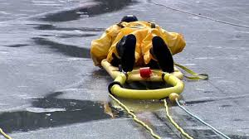
If Someone Else Falls In
Do Not Approach
Call 911
Reach or Throw
Treat for Cold
Notes:
Do Not Approach: Do not walk up to the edge, as you will likely fall in too.
Call 911: Call for emergency services immediately.
Reach or Throw: Use a branch, ladder, rope, or jumper cables to pull them out
Treat for Cold: Get the individual dry and warm

Slide 8
Frozen Pond Safety Tips…
Check Frequently: Ice thickness is inconsistent; check every 150 feet with a drill or auger
Avoid Dangers: Steer clear of ice over flowing water, near bridge pilings, or where bubbles or dark spots are visible
Safety Gear: Carry ice picks (with buoyant handles) and wear a float coat or PFD
Emergency Action: If you fall in, do not panic. Use the 1:10:1 rule: 1 minute to control breathing, 10 minutes of movement to get out, 1 hour before hypothermia sets in
Self-Rescue: Stay calm, turn towards the direction you came, and kick your legs to lift your body onto the ice, then roll away from the hole
Pet Safety: Keep pets on a leash. If a pet falls through, call 9-1-1 rather than attempting a rescue yourself
Avoid Night Skating: Visibility issues make it impossible to spot thin, weak, or dangerous areas
When in Doubt, Stay Off ~ No ice is 100% safe, so it is always better to err on the side of caution and find a designated, safe, and supervised skating area

Slide 9
Frozen Pond Safety Resources…
Know When It's Safe to Be on the Ice @ https://www.almanac.com/ice-thickness-safety-chart
How can you tell if your pond is safe to walk on?
@ https://www.thepondguy.com/learning-center/how-can-you-tell-if-your-pond-is-safe-to-walk-on/?srsltid=AfmBOoo3ARxWlRHkQmTJ9NjQWlD0Q0YA7x-823zRtCn2rS2l9oVZKDjB

Slide 10
Current Exploring Participation Status

Slide 11
Exploring Membership Growth Opportunity…
As of… | Units |  | Youth Membership |  | Adult Membership
 | Clubs | Posts | Clubs | Posts | Clubs | Posts
31 Jan 2020 * | 395 | 4,055 | 14,903 | 80,474 | 704 | 19,095
16 Feb 2026 | 185 | 1,498 | 3,563 | 22,283 | 712 | 8,997
Opportunity | 210 | 2,557 | 11,340 | 58,191 | 8+ | 10,098
* Just before the COVID-19 Pandemic shut-down all in-person meetings
Positive upward or Negative downward trend since 1 Jan 2026; Clubs Units down 2, Posts Units down 4, Club Youth Membership down 581, Post Youth Membership down 1823, Cubs Adult Membership down 29 and Post Adult Membership up 30
NOTE: Our National Exploring Membership Growth / Retention Lead Jeff Schweiger believes loses are an indications of the problems people are having with the registration system

Slide 12
Exploring Participants as of 16 February 2026
Clubs/Posts = 1,683 (-6) Youth = 25,846 (-2404) Adults = 9,709 (-1)
Career Area Units Youth Adults
Aquatics 1 24 6
Arts & Humanities 6 (+1) 47 (+5) 53 (+7)
Aviation 46 627 (+25) 317 (+5)
Business 9 (+2) 441 (+41) 47 (+14)
Education 42 (+1) 1,078 (+18) 206 (+3)
Communications 3 115 (+2) 28 (+2)
Engineering & Technology 25 (+3) 598 (-175) 175 (+14)
Explorer Clubs 185 (-2) 3,563 (-581) 712 (-29)
Fire/Emergency Services 443 (+22) 4,981 (+121) 2,578 (+94)
General Interest 65 (+5) 2,315 (-516) 395 (+20)
Health Care 68 (-2) 1,802 (-141) 385 (+12)
Law Enforcement 647 (+15) 7,208 (-240) 3,854 (+84)
Law / Gov’t / Public Service 74 1,623 (-174) 469
Science 14 801 (-126) 77 (+4)
Skilled Trades 15 (+1) 195 (-27) 90 (+7)
Social Services 3 67 (+2) 16
STEM 8 243 (-4) 77 (-17)
No Special Interest Selected 23 (-50) 358 (-646) 128 (-344)
NOTE: Numbers in parentheses are changes since 1 January 2026. Jeff Schweiger, National Exploring Membership & Retention Lead, observed that currently 114 clubs do not reflect “0999” special interest code (SIC) which will require each of these clubs’ council registrar to correct

Slide 13
National LFL / Exploring Executive Board Chair Comments
Bernard (Bernie) Lockard

Slide 14
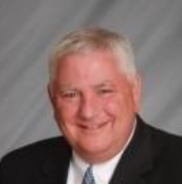
Bernie Lockard’s Background…
Scouting…
Eagle Scout (1972)
Order of the Arrow Vigil Honor
Cubmaster
Pack Committee Chairman
Assistant Scoutmaster
Scoutmaster
Unit Commissioner
Wood Badge Course Director
NYLT Course Director
District Chairman
President, Laurel Highlands Council’s Board of Directors (2013 - 2014)
2019 World Jamboree Scoutmaster
Chair, National Venturing Committee (2020 - 2022)
2023 & 2017 National Jamboree Staff
National Eagle Scout Association Scholarship Committee (2013 - Present)
Chair, National BSA Council Finance & Fundraising Committee (2022 – Present)
BSA Recognition…
Award of Merit – 1998
Silver Beaver – 2001
Distinguished Citizen – 2010
Rockefeller Award – 2010
Silver Antelope – 2014
National Outstanding Eagle Scout Award - 2015
National Venturing Leadership Award – 2022
Silver Buffalo - 2024
Personal…
Married to Robyn L. Ashbridge, father of five and grandfather of seven
President, The Lockard Company, Indiana, PA
Graduate of Carnegie-Mellon University, Pittsburgh, PA, with B.S. in Administration and Management Science, Economics, Mathematics (Graduated With Honors)

Slide 15
National Exploring Program Commissioner Comments
Richard (Dick) Davies

Slide 16
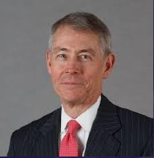
National Exploring Program Commissioner
Richard (Dick) Davies
Richard.davies.nyc@gmail.com
(914) 327-7430
Recent Scouting History
Interim Scout Executive for two years Greater New York Councils ~ 2021 – 2022
Stepped down as Council Commissioner to take role
Formerly VP – Membership, VP – Scoutreach and Manhattan Borough President
Eagle Scout from Wisconsin
Exploring History
Exploring Chair, National Commissioner Service Team ~ Nov 2022 – TBD
National Exploring Program Commissioner, National LFL Executive Board ~ Nov 2022 -TBD
Area and Northeast Regional Exploring Chair and Board Member ~ 2018 – 2021
National Exploring Committee ~ 1976 – 1979
National Explorer President ~ 1976-77; Youth Member of National Executive Board
Professional Career
Since 2016, angel investor and advisory board member for start-up companies
Consultant to investment management industry
Most of career on business side of investment management industry (business unit management, client and product development) with Alliance Bernstein and Russell investments
Last ten years through 2016 working with largest 401k and other defined contribution plans around the world.

Slide 17
Marketing & Technology Chair, Nat’l LFL Exec Board Comments
Jeffrey (Jeff) Schweiger

Slide 18
National Exploring Program Committee

Slide 19
Nat’l Exploring Committee Members…
National Exploring Program Chair Craig Martin
National Exploring Program Commissioner Richard (Dick) Davies
National Exploring Membership Growth / Retention Lead Jeffrey (Jeff) Schweiger
National Exploring Awards & Recognition Lead Richard (Rick) Belford
National Exploring Training Lead Roger Engelbart
National Exploring Health & Safety / YPT Lead Linda Hassler
National Exploring Marketing / Communications Lead (Website / Social Media) TBD *
National Exploring Materials & Literature Lead Timothy (Tim) Buckles
National Exploring Career Fields Development Lead TBD *
National Exploring Youth Officer Advisor TBD *
National Exploring Youth Chair TBD
National Exploring Partnerships / Relationships Lead TBD *
National Exploring Resource Advisor Stuart Mahler
National Special Needs Committee Liaison for Exploring Britt Flather
National Exploring Members-at-Large (National Exploring Resource Associate Advisors)
National Exploring Subject Matter Expert Don Deeker
National Exploring Subject Matter Expert Joseph (Joe) Marinelli
National Exploring Subject Matter Expert Suzie Steiner
National Exploring Subject Matter Expert Rick TerBorch
* Note: Welcome recommendations from anyone

Slide 20
National Exploring Resource Advisor
Stuart Mahler

Slide 21
National Exploring Subject Matter Experts & Exploring Resource Associate Advisors
In support to our fourteen Scouting America Council Service Territories (CSTs), our National Exploring Program is currently supporting each CST, along with their territory’s councils, with a National Exploring Subject Matter Expert (SME), who serves as that territory’s National Exploring Resource Associate Advisor (RAA). As a caveat, we do not presume this role is either formally or informally part of the CST organizational structure but rather a service being made available by the National Exploring Program to each CST and/or their councils. Additionally, we have an National Exploring RAA dedicated to supporting the California Highway Patrol (CHP) and the councils with CHP Law Enforcement Posts as well as the posts themselves

Slide 22
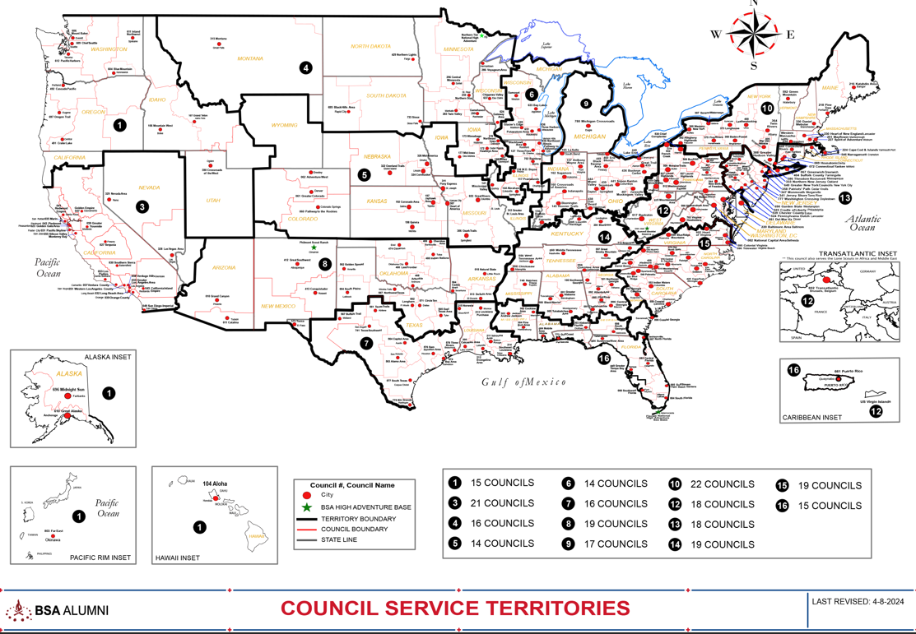
Council Service Territories (CSTs)…
COUNCIL

Slide 23
Current National Exploring SMEs / RAAs Team...
CST 1 ~ Suzie Steiner (Mountain West Council), who is currently an Advisor for an Exploring STEM / Robotics Post, which also encompasses trades such as machining & welding and business careers, and has previously been an assistant district commissioner, assistant & roundtable commissioner and Cub Scout den leader. National Exploring Resource Associate Advisor (RAA) supporting the CST 1 and councils within the territory
suzie@openlabidaho.org
((208) 869-2403
CST 3~ Stuart Mahler (Golden Gate Area Council), who is currently an Assistant Council Commissioner and LFL Council Exploring Chair and Executive Board Member as well as a retired police officer, an advisor in the 1987 Law Enforcement Exploring National Academy, staff member on three National Exploring Law Enforcement Exploring Conferences and Law Enforcement Explorer in his youth. National Exploring Resource Advisor (RAA) supporting the CST 3 and councils within the territory
mdc.stuart@gmail.com
(925) 519-6957
CST 4 & 5 ~ Roger Engelbart (Greater St Louis Area Council), who is currently the Assistant Council Commissioner for Training and the Engineering Chair for the Council Exploring Committee, as well as a retired Boeing Engineer involved in Nondestructive Evaluation. National Exploring Training Lead and National Exploring Resource Associate Advisor (RAA) supporting the CST 4 & 5 and councils within those two territories
engelbart301@sbcglobal.net
(314) 920-8968

Slide 24
Current National Exploring SMEs / ERAs Team...
CST 6 ~ Richard (Dick) Davies (Glacier's Edge Council) who is the National Exploring Commissioner, Exploring Chair for the National Commissioner Service Team & National Exploring Program Committee Vice-Chair, as well as VP - Development in Glacier's Edge Council (Madison, WI), Greater New York Councils Executive Board Member, former Interim Scout Executive for the Greater New York Councils (2021 & 2022), past Northeast Region Exploring Chair and Board Member, and, in his youth, National Explorer President (1976-77) & Youth Member of National Executive Board. National Exploring Resource Associate Advisor (RAA) supporting the CST 6 and councils within the territory
richard.davies.nyc@gmail.com
(914) 327-7430
CST 7 ~ Don Decker (Bay Area Council) - Eagle Scout, Woodbadge staff member, retired BSA Professional Scouter, Business and Banking Explorer as a youth, and currently a full time Agriculture Specialist, US Customs and Border Protection Agency. National Exploring Resource Associate Advisor (RAA) supporting the CST 7 & 16 and councils within the territory
donedecker@gmail.com
( 832) 266-7145
CST 8 ~ Craig Martin (Pathway to the Rockies Council), who is the National Exploring Program Committee Chair as well as a retired Senior Systems Engineer supporting Department of Defense satellite programs and a retired USAF Colonel with extensive experience building, testing, launching & operating US Air Force satellites and testing air-to-air & air-to-ground missile systems. National Exploring Resource Associate Advisor (RAA) supporting the CST 8 & 14 and councils within the territory
bruin1967@aol.com
(719) 331-6406

Slide 25
Current National Exploring SMEs / ERAs Team...
CST 9 ~ Richard (Rick) Belford (Western Massachusetts Council), who is currently the Vice President of Membership, Executive Board member, and Committee Chair for five units - a Cub Scout Pack, a girl troop, a boy troop, a Sea Scout Ship and an Aviation Explorer Post. Also a former Scouting Professional/District Executive, a retired DOD/Federal employee and a retired USAF Chief Master Sergeant. National Exploring Awards & Recognition Lead and Resource Associate Advisor (RAA) supporting the CST 9 Program Lead and councils within that territory.
o rebwmc234@gmail.com
o (860) 402-4836
CST 10 ~ Joseph (Joe) Marinelli (Seneca Waterways Council), who is the Council Executive Committee’s & Board’s former Vice President of Exploring, past President of the Finger Lakes Council and Executive Director, Finger Lakes STEM Hub as well as a retired Regional Supervising Superintendent & BOCES (service agency) CEO for 25 school districts in upstate New York. National Exploring Resource Associate Advisor (RAA) ) supporting the CST 10 and councils within the territory
josephjmarinelli@aol.com
(585) 704-4659
CST 12 – Jeff Schweiger (National Capital Area Council), who is currently an Assistant Council Commissioner (STEM, Exploring, Communications and Resources) as well as Membership Growth and Retention Lead on the National Exploring Committee. He is a retired Naval Officer and presently works for a national security government contractor. An Eagle Scout, he also was a member of a communications (print journalism) Exploring Post as a youth. National Exploring Resource Associate Advisor (RAA) supporting the CST 12 & 15 and councils within those two territories
Scouter.jeff@earthlink.net
(703) 472-0669

Slide 26
Current National Exploring SMEs / ERAs Team...
CST 13 ~ Linda Hassler (Monmouth Council) who is currently a member of her Monmouth Council Board of Directors and Troop 140 Committee Member as well as an Assistant Professor at Rutgers’ School of Nursing, former Northeast Region Area 5 Exploring Chair, former Exploring Post Advisor and a Tennis Explorer in her youth. National Exploring Health & Safety / YPT Lead and National Exploring Resource Associate Advisor (RAA) supporting the CST 13 and councils within the territory
Lindajhassler@gmail.com
(732) 687-7208
CST 14 ~ Craig Martin
CST 15 ~ Jeff Schweiger
CST 16 ~ Don Decker
CHP ~ Rick TerBorch (Los Padres Council)*, who is the former National Service Territory (NST) 3 Commissioner, Assistant Council Commissioner and Council Executive Board Member as well as a retired Chief of Police in Arroyo Grande, CA, past Los Padres Council President & Council Commissioner, past National Law Enforcement Exploring Committee Member, Exploring Advisor and over 35+ years in Law Enforcement Exploring. National Exploring Resource Associate Advisor (RAA) supporting the California Highway Patrol (CHP) and the councils with CHP Law Enforcement Posts.
rterborch@earthlink.net
(805) 441-1721
* Stuart Mahler (CST 3 Exploring Resource Advisor) is Rick’s CHP Contact Alternate

Slide 27
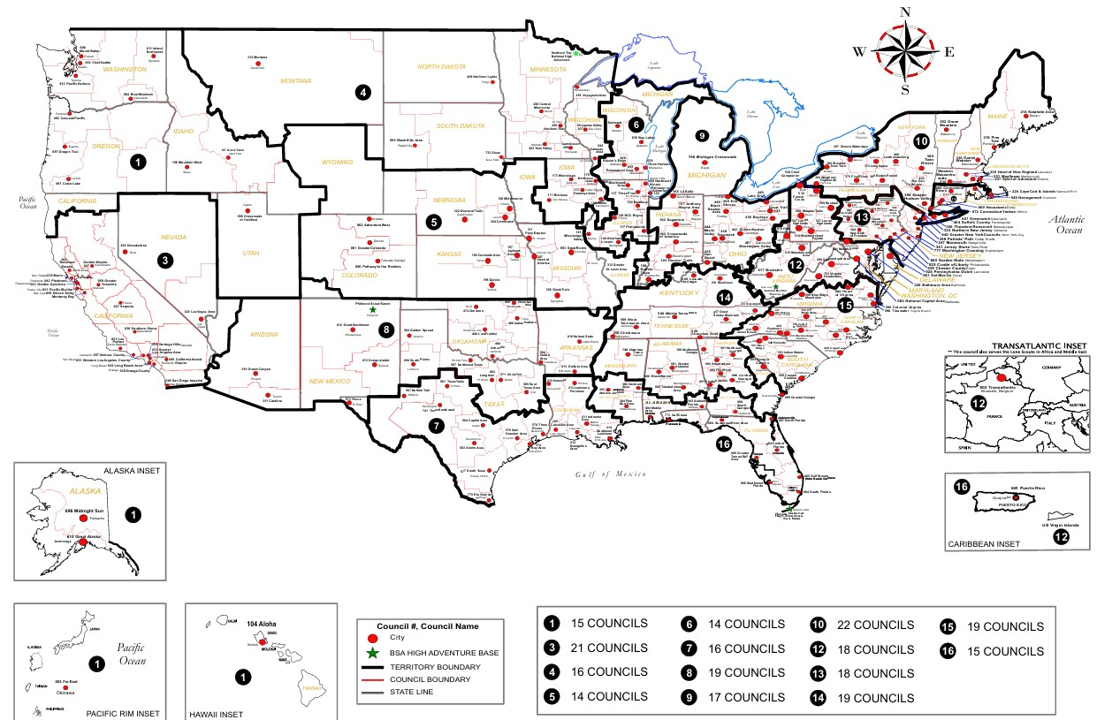

Exploring Associate Resource Advisors Serve the Entire Country
Find your Council Service Territory & assigned ERAA at
www.exploring.org/about-us

Slide 28
Current National Exploring SMEs / RAAs Team...
Additionally, any of these National Exploring RAAs are available to any of the CSTs and their councils on the following Exploring Career Fields
Arts & Humanities ~ Tim Buckles
Aviation ~ Rick Belford & Roger Engelbart
Business ~ Rick Belford (Contracting & Procurement)
Communications ~ Rick Belford (Broadcasting & Public Relations)
Engineering & Technology ~ Roger Engelbart, Craig Martin and Suzie Steiner (Robotics)
Health Care ~ Linda Hassler
Law & Government ~ Craig Martin & Rick Belford (Military Careers)
Law Enforcement ~ Stuart Mahler & Rick Terborch
Skilled Trades ~ Joe Marinelli & Suzie Steiner
Social Services ~ Joe Marinelli (Education), Linda Hassler (College Professor), Rick Belford (Non-Profit / Not-For-Profit Management) and Suzie Steiner (STEM)
Other Career Fields ~ National Exploring RAA, assisting your CST, will find the best individual to assist you for other Exploring Career Fields

Slide 29

Exploring Leadership Experience…
VISION: Nationally recognized program that offers young men and women an opportunity to enhance their understanding of leadership in the workplace through interactive instruction, self-reflection, and practical application while working with an adult mentor to gain professional leadership experience. The Exploring Leadership Experience will be available to all Explorers registered in an Exploring post who meet the requirements.

Slide 30
Exploring Leadership Experience continued
ELIGIBILITY REQUIREMENTS: Explorers must first meet the following basic qualifications:
Currently registered in an Exploring post with at least three months of tenure as an active, registered Explorer.
Plans to complete the Exploring Leadership Experience requirements before his or her 21st birthday.
Has earned the Exploring Achievement Award within any career field OR has held a leadership role either within or outside the post in the past 12 months.

Slide 31
Exploring Leadership Experience continued
ON-LINE LEARNING MODULES: The Exploring Leadership Experience is designed to be a self-paced, experiential learning process for each Explorer who commits to completing the program. A critical component of this learning process is a series of self-paced, online leadership development modules that Explorers must complete on their journey to improved leadership skills. Explorers
are required to complete each series of leadership skills modules in the order listed in the next slide. However, the modules within each series can be completed in any order.

Slide 32
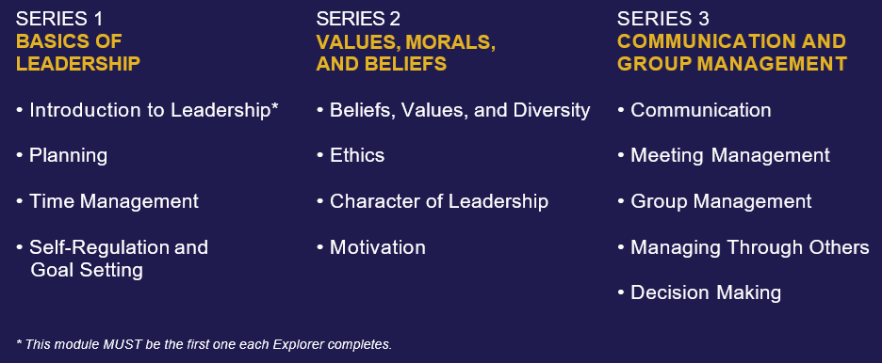
Exploring Leadership Experience continued
ON-LINE LEARNING MODULES: continued
NOTE: All the above modules are up-to-date and currently reside in Scouting America’s Learn Center, except the “Introduction to Leadership” module which is tied to the Exploring Leadership Experience Guidebook

Slide 33

Exploring Leadership Experience continued
GUIDEBOOK: On 9 March 2026, Roger Engelbart & Craig Martin, provided our half dozen final edits to Rachel Buckholz (Scouting America’s Editorial Operations Chief), Tim Anderson & Carlos Coronado.
INTRODUCTION TO LEADERSHIP LEARNING MODULE: We will finalize the module’s edits based on the finalized guidebook. We expect to submit, NLT March 2026, the final module update to ScoutingU Instructional Design for the module’s update & insertion into Scouting America’s Learn Center
EXPLORING LEADERSHIP EXPERIENCE ROLL-OUT: Expected in April/May 2026

Slide 34
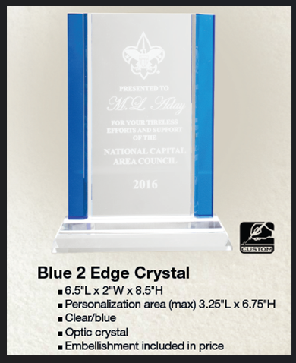
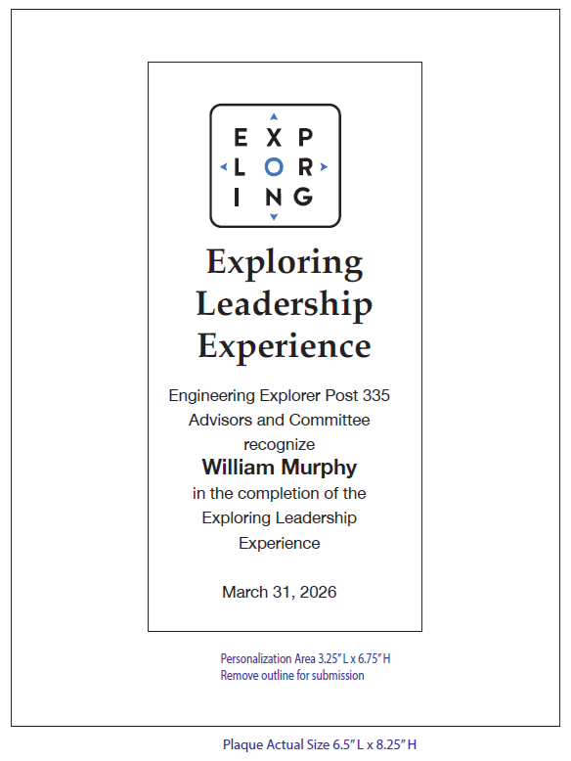
Exploring Leadership Experience Recognition Plaque….

Slide 35

LEARNING FOR LIFE CORPORATE MISSION:
To develop and deliver engaging, research based academic, character, leadership and career focused programs aligned to state and national standards that guide and enable all students to achieve their full potential.
THE CORPORATION
NON-DISCRIMINATION STATEMENT:
Learning for Life programs are designed for all age groups from pre‐kindergarten and not yet age 21. Youth participation is open to any youth in the prescribed age group for that particular program. Adults are selected by the participating organization for Involvement in the program. Color, race, religion, gender, sexual orientation, ethnic background, disability, economic status or citizenship is not criteria for participation by youth or adults.
Notes:
AFFILIATION STATEMENT
Learning for Life is one of the programs that local Boy Scouts of America councils are authorized to deliver, with local executive board approval. Learning for Life is an affiliate of the Boy Scouts of America that is comprised of both a written character education curriculum for PreK – 12th graders and students with special needs, as well as Interactive career Exploring programs for 6th graders thru 20 year olds. Youth participation is open to any youth in the prescribed age group for that particular Program. Adults, 21 years of age and older, are selected by participating organizations for involvement in the Learning for Life programs. Color, race, religion, gender, sexual orientation, ethnic background, disability, economic status or citizenship is not criteria for participation by youth or adults. Youth and adults involved with Learning for Life programs, including Exploring, are registered with Learning for Life as participants. Learning for Life participants are not members of the Boy Scouts of America. Learning for Life, a District of Columbia non‐profit corporation, is a separate 501(c)(3) Corporation, with a Board of Directors that is separate from the Boy Scouts of America. While they have different policies, there are occasions when local Learning for Life and Traditional BSA programs may participate in an event. Both programs will be required to follow the appropriate guidelines, especially regarding safety. Completion of training, registration and annual fees are program specific and not transferable between programs

Slide 36

Learning for Life Curriculum-Based Programs consists of grade specific, age-oriented, character education lesson plans that are utilized in schools and other educational settings to help instill character and ethical decision making in our youth. The available lesson plans that are offered for Learning for Life Groups include PreK-12 grades, Champions for students with special needs, along with additional digital resources. Learning for Life uses these interactive lessons to help youth make informed decisions while becoming better students and citizens.
CURRICULUM PROGRAM VISION:
To provide engaging and relevant PreK‐12 solutions that positively impact academic performance, social & emotional maturity, character development, and career education for all students.
www.learningforlife.org

Slide 37

Exploring is a co-ed program for youth that are in the 6th grade through 20 years old. Exploring provides opportunities for real-world hands-on career experiences, while helping them “Discover their Future”. The program links youth with mentors and experts with partner businesses and agencies in their communities. Participating in an Exploring Club or Post ensures youth make informed decisions about careers they may or may not be interested in pursuing, while allowing businesses and organizations the opportunity to meet and cultivate future employees.
EXPLORING MISSION:
Deliver character-building experiences and mentorship that allow youth to achieve their full potential in both life and work.
EXPLORING VISION :
Shape the workforce of tomorrow by engaging and mentoring today’s youth in career and life enhancing opportunities.
www.exploring.org

Slide 38
A little about each program
Learning for Life Curriculum-Based Programs consists of grade specific, age-oriented, character education lesson plans that are utilized in schools and other educational settings to help instill character and ethical decision making in our youth. The available lesson plans that are offered for Learning for Life Groups include PreK-12 grades, and Champions for students with special needs. Learning for Life uses these interactive lessons to help youth make informed decisions while becoming better students and citizens.
Exploring is a co-ed program for youth that are in the 6th grade through 20 years old. Exploring provides opportunities for real-world hands-on career experiences, while helping them “Discover their Future”. The program links youth with mentors and experts with partner businesses and agencies in their communities. Participating in an Exploring Club or Post ensures youth make informed decisions about careers they may or may not be interested in pursuing, while allowing businesses and organizations the opportunity to meet and cultivate future employees.

Slide 39

National Learning for Life/Exploring
National Professional Staff Direct Support
Tim Anderson
National Director,
Learning for Life/Exploring
Older Youth Programs
Dedra Douglas
Administrative Assistant
John Mosby
Asst. Chief Scout Executive & EVP
(BSA)
Susan Fitzhugh
Sr. Administrative Assistant
Carlos Coronado
National Exploring Growth & Retention Executive

Slide 40

National Director/President
Tim Anderson (E)
(V) = Volunteer
(E) = Employee/Professional
LFL Executive Board Secretary
Steven Hardy (E)
LFL Executive Board Treasurer
Lisa Fritschel (E)
NATIONAL LEARNING FOR LIFE EXECUTIVE BOARD
(Board Member)
National
Exploring Program Chair
Craig Martin (V)
*National Learning for Life Executive Board Chair*
Bernard “Bernie” Lockard (V)
----------------------------------------------------------------------------------------------
National Learning for Life
Immediate Past Executive Board Chair/Governance
Mark Wiesenhahn (V)
(Board Member)
National Learning for Life Curriculum Based Program Chair
Vacant (V)
(Board Member)
National
Exploring Program Commissioner
Richard “Dick” Davies (V)
(Board Member)
National Learning for Life Curriculum
Based Program Commissioner
Vacant (V)
(Board Member)
National LFL/EXP
Fundraising & Development Chair
Vacant (V)
(Board Member)
National LFL/EXP
Membership & Retention Chair
Vacant (V)
(Board Member)
National LFL/EXP
Partnerships & Relationships Chair
Vacant (V)
(Board Member)
National LFL/EXP
Safeguarding Youth/
Health & Safety Chair
Vacant (V)
(Board Member)
National LFL/EXP
Technology/Website Chair
Jeff Schweiger
(Board Member)
National LFL/EXP
Marketing & Social Media Chair
Vacant (V)

Slide 41
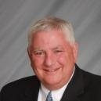

National Learning for Life Executive Board Chair
Bernie Lockard
Scouting…
Eagle Scout (1972)
Order of the Arrow Vigil Honor
Cubmaster
Pack Committee Chairman
Assistant Scoutmaster
Scoutmaster
Unit Commissioner
Wood Badge Course Director
NYLT Course Director
District Chairman
President, Laurel Highlands Council’s Board of Directors (2013 - 2014)
2019 World Jamboree Scoutmaster
Chair, National Venturing Committee (2020 - 2022)
2023 & 2017 National Jamboree Staff
National Eagle Scout Association Scholarship Committee (2013 - Present)
BSA Recognition…
Award of Merit – 1998
Silver Beaver – 2001
Distinguished Citizen – 2010
Rockefeller Award – 2010
Silver Antelope – 2014
National Outstanding Eagle Scout Award - 2015
National Venturing Leadership Award – 2022
Silver Buffalo - 2024
Personal…
Married to Robyn L. Ashbridge, father of five and grandfather of seven
President, The Lockard Company, Indiana, PA
Graduate of Carnegie-Mellon University, Pittsburgh, PA, with B.S. in Administration and Management Science, Economics, Mathematics (Graduated With Honors)

Slide 42
National Exploring Program Chair
Craig Martin
bruin1967@aol.com
(719) 331-6406
Recent Scouting History
Unit Commissioner & Exploring Service Team Member, Pathway to the
Rockies Council ~ 2013 - Present
Council Commissioner, Pikes Peak Council (now Pathway to the Rockies Council) ~ 2009 – 2012
Exploring History
National Exploring Program Chair, National LFL Executive Board ~ 2022 - Present
National Exploring Program Committee Chair ~ 2022 - Present
Exploring Chair, National Commissioner Service Team, ~ 2019 – 2022
National Exploring Service Team Chair, National LFL Executive Board ~ 2018 – 2022
Exploring Committee Chair, BSA Western Region (Area 2) – 2012- 2020
Non-Military Professional Career
Deputy Chief Engineer, GPS Systems Engineering & Integration Program, TASC Inc. ~ 2015-2016
Program Manager and Senior System Engineer, TASC Inc. ~ 1998 – 2015
Military Career
Colonel, United States Air Force ~ Retired in 1998 after 30-year Career in USAF Space & Missile and Research & Development Programs

Slide 43
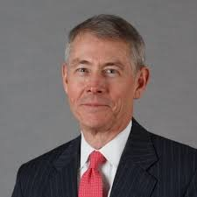
National Exploring Program Commissioner
Richard (Dick) Davies
Richard.davies.nyc@gmail.com
(914) 327-7430
Recent Scouting History
Interim Scout Executive for two years Greater
New York Councils ~ 2021 – 2022
Stepped down as Council Commissioner to take role
Formerly VP – Membership, VP – Scoutreach and Manhattan Borough President
Eagle Scout from Wisconsin
Exploring History
Exploring Chair, National Commissioner Service Team ~ Nov 2022 – TBD
National Exploring Program Commissioner, National LFL Executive Board ~ Nov 2022 -TBD
Area and Northeast Regional Exploring Chair and Board Member ~ 2018 – 2021
National Exploring Committee ~ 1976 – 1979
National Explorer President ~ 1976-77; Youth Member of National Executive Board
Professional Career
Since 2016, angel investor and advisory board member for start-up companies
Consultant to investment management industry
Most of career on business side of investment management industry (business unit management, client and product development) with Alliance Bernstein and Russell investments
Last ten years through 2016 working with largest 401k and other defined contribution plans around the world.

Slide 44
National Exploring Live Hour Meeting
12 November 2025
Craig Martin
National Exploring Program Chair,
Learning for Life Executive Board
Bruin1967@aol.com
719-331-6406
Richard (Dick) Davies
National Exploring Program Commissioner,
Learning for Life Executive Board
Exploring Chair,
National Commissioner Service Team
Richard.davies.nyc@gmail.com
914-327-7430
u

Slide 45
National LFL / Exploring Program Office Staffing Update
As of 10 November 2025, Dedra Douglas joined the National Service Center as the new Administrative Assistant working with Susan Fitzhugh (Senior Administrative Assistant)
On 1 December 2025, Carlos Coronado (who is currently the Assistant Director of Field Service with Heart of America Council) will be joining the National Service Center as the new Exploring Program Growth & Retention Executive

Slide 46
National Scouting America Council Office Staffing Update
Hiring two Program Growth & Retention Executives for
Venturing / Sea Scouts Program*
Cub Scouting Program
* For Tim Anderson’s Older Youth Programs staff

Slide 47
New Programs Update
February 10, 2026
Ryan Moon

Slide 48
Exploring Adventure Clubs / Posts
&
Aviation Drone Exploring*
* Presented during 18 September 2025 National Learning for Life Executive Board Meeting by Ryan Moon, Director 0f New Programs

Slide 49


Slide 50
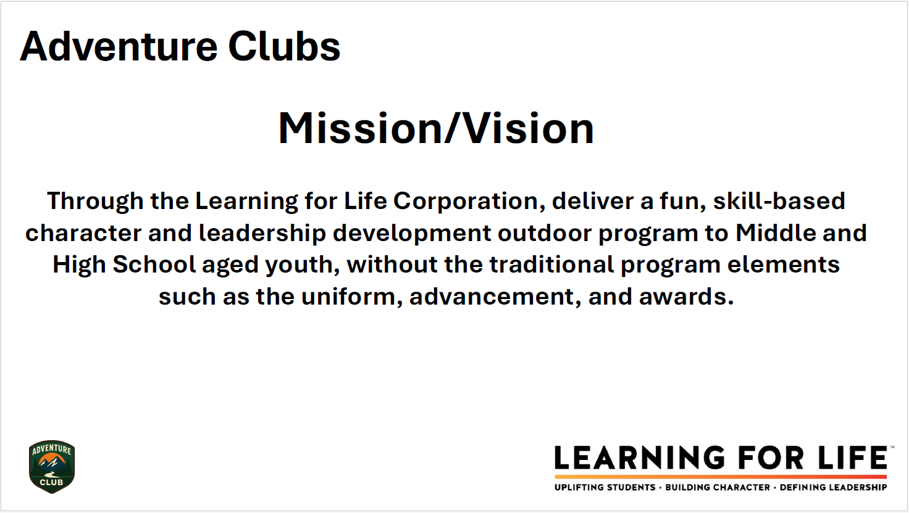

Slide 51
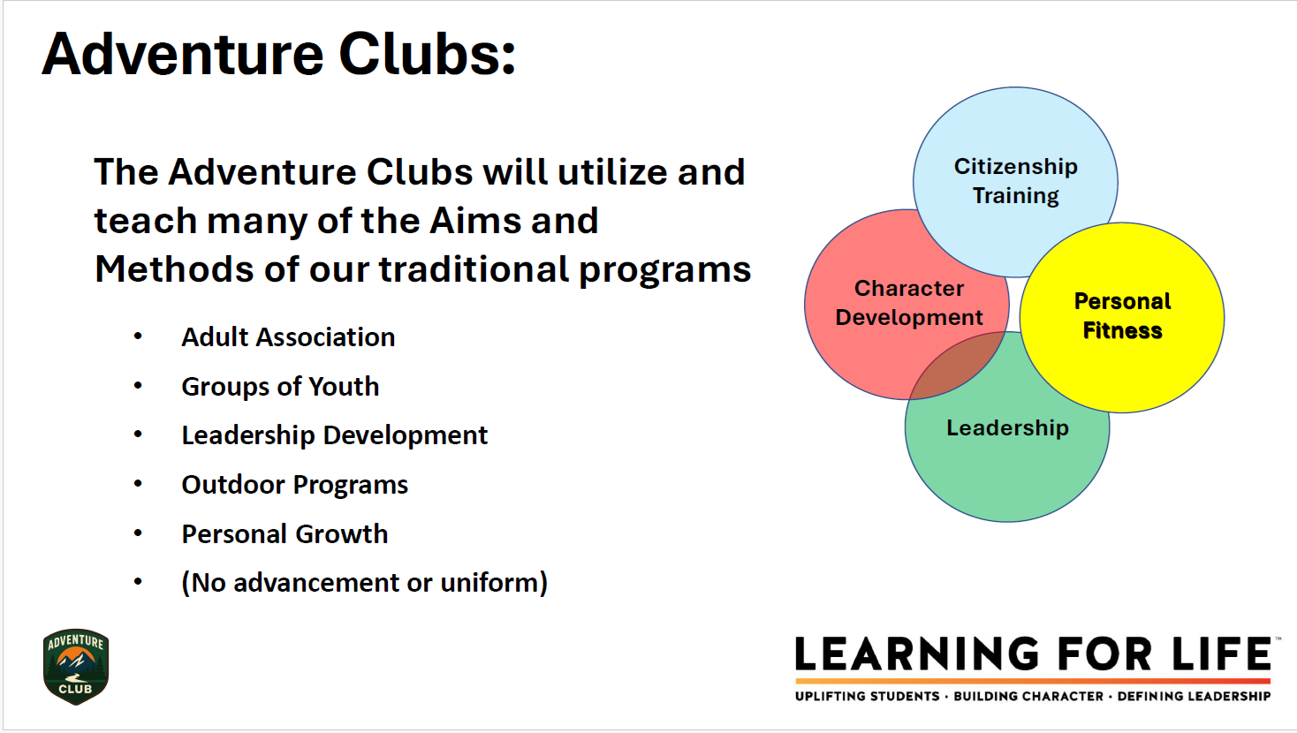

Slide 52
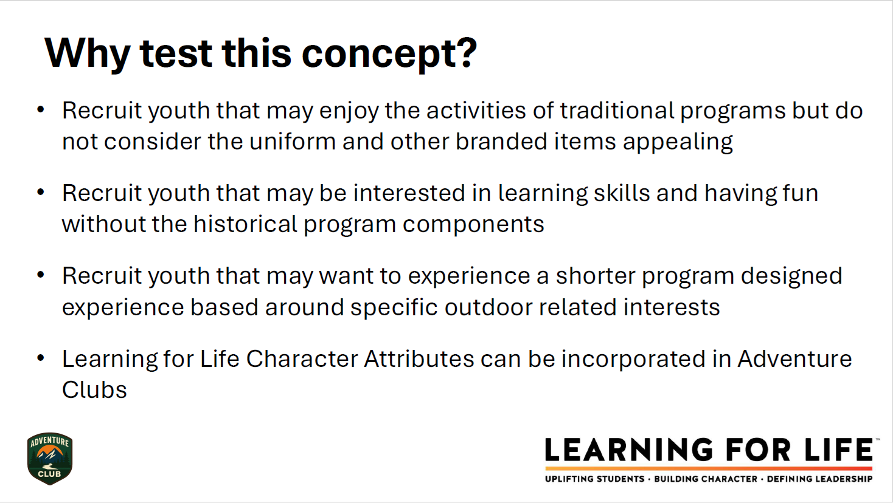

Slide 53


Slide 54


Slide 55
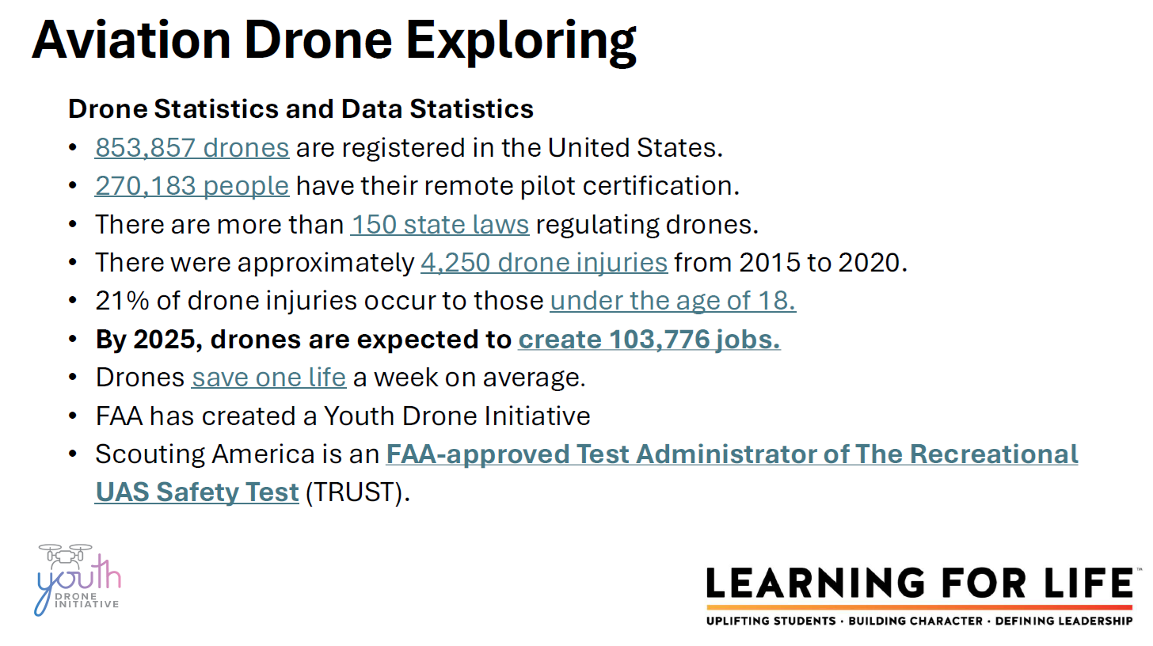

Slide 56
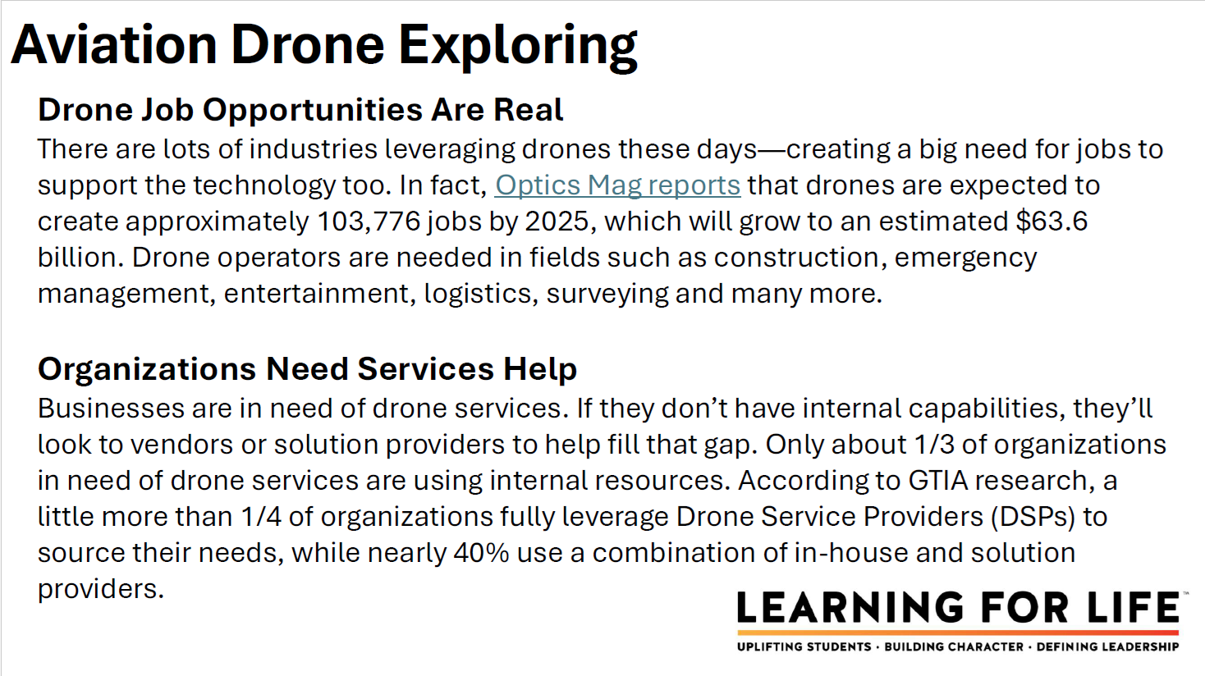

Slide 57
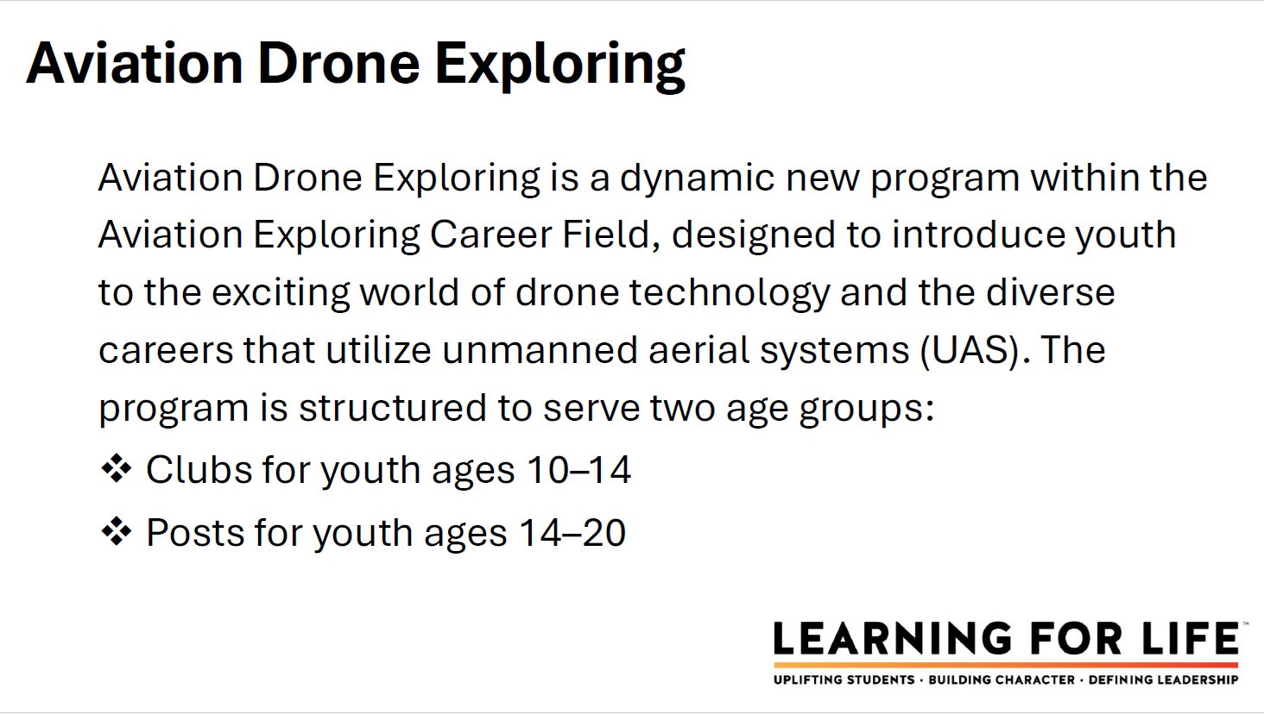

Slide 58


Slide 59
For more information on either program:
Please contact Ryan Moon
Ryan.moon@scouting.org

Slide 60
Topic(s) of the Month
Exploring Explosion (Growth Strategies)
www.exploring.org
Simply scroll to the bottom of the home page and search within the 3 boxes labeled:
“Unit Resources”, Council Resources”, & “Forms”

Slide 61

What is Exploring Explosion 3.0 ?
Exploring Explosion 3.0 is a nationwide Exploring membership campaign focusing on Exploring membership growth through the training, inspiration, and recognition of all professionals and interested volunteers.
As part of Exploring Explosion 3.0, national coordinated trainings led by the National Director of Exploring and the National Exploring Committee will assist in the following:
Teaching the 4 Phases of organizing a new Exploring Club or Post. Participants will learn the “A to Z” of Exploring.
Sharing the most valuable resources to help both professionals and volunteers become more confident in growing Exploring.
Connecting professional and volunteers across the country to share best practices while becoming more effective in growing Exploring within their geographic areas. This includes learning from the people who have been the most successful.
Offering cool and crazy incentives throughout the campaign.
All new Exploring Clubs and Posts organized from October 1, 2025, through December 31, 2026, will qualify for the incentives offered during this Exploring Explosion 3.0 campaign.

Slide 62
Great News! Due to high demand, additional Exploring New Unit Trainings have been scheduled for all Professionals and Volunteers! This is a great opportunity to get your staff and volunteers trained. Let’s be sure that 100 % of our Unit Serving Executives are trained.
Click here to sign up for the trainings today!
Exploring Explosion 3.0 Additional Trainings – Fill out form
If you have problems with the link, please copy/paste the following link into your browser:
https://forms.office.com/r/4Bh8LWJZRK or visit www.exploringexplosion.org

Slide 63
INCENTIVES
Exploring Explosion Growth Incentive 2026

Slide 64
2026 NATIONAL EXPLORING LIVE HOUR (Monthly)
The National Exploring Live Hour is a monthly Zoom video conference that will help engage and equip Exploring volunteers and professionals to grow, support, and learn more about Exploring. Each month the National Exploring Live Hour will be led by our National Exploring Program Chair and the National Director of Exploring. The live hours will include sharing best practices and ideas that are happening within our councils, highlighting successful growth campaigns, and inspiring new ideas through various trainings. This will also offer an opportunity for local councils to collaborate with territory and national counterparts to generate innovative solutions to real-life Exploring challenges.
National Exploring Live Hour Schedule
1:00 PM – 2:00 PM Central Standard Time, Monthly
Register for each of the National Exploring Live Hour ZOOM presentations at:
2026 National Exploring Live Hour Registration

Slide 65

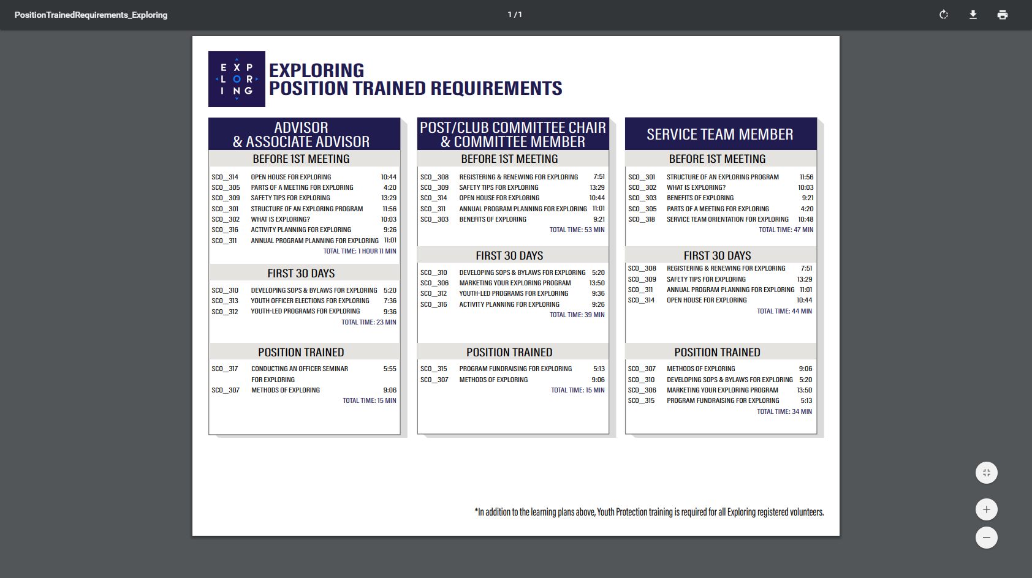
ONLINE REGISTRATION & ONLINE UNIT RENEWAL FOR EXPLORING

Slide 66
https://www.scouting.org/commissioners/internet-rechartering/
Information included is:
Training Video
FAQ’s
User Guides
Internet Recharter Guidelines
Summary of Enhancements
Recharter Demo Tool
New Online Rechartering/Renewal System
https://advancements.scouting.org/login
Manager of Shared Services
Member Data Outsourcing Solutions

Slide 67


Slide 68
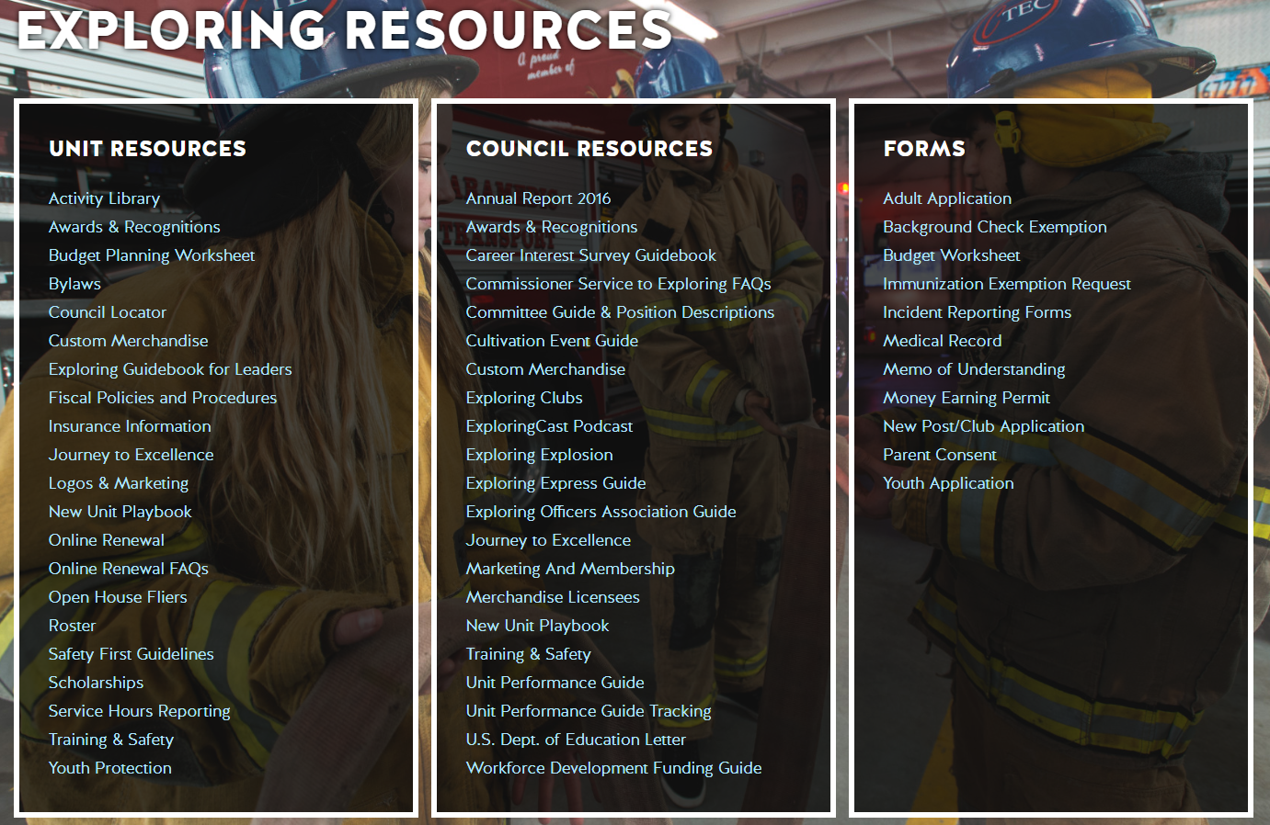
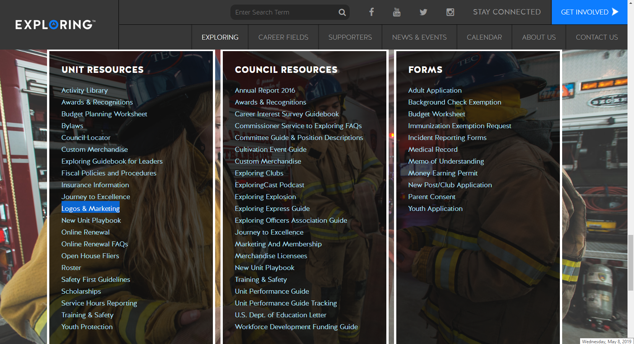

Slide 69

Youth Protection Training Safeguarding Youth
https://my.scouting.org/

Slide 70
Exploring Youth Training Update
https://www.scouting.org/training/youth-protection/venturing/

Slide 71
Barriers to Abuse Update
As part of our ongoing commitment to abuse prevention, the Boy Scouts of America, to include Exploring, is updating the adult supervision requirements for overnight activities
This update enhances the minimum “two deep leadership” requirements by additionally requiring every adult present on overnight activities to be a registered member of the Boy Scouts of America or Exploring
These adults must submit an adult application and registration fee, undergo a criminal background check, a volunteer screening database check and must complete mandatory Youth Protection training.
A limited exception for parents and legal guardians of Cub Scout youth attending overnight with their children is planned due to the family centric nature of Cub Scouting
All Cub Scout Packs, Scouts BSA Troops, Venturing Crews, Sea Scouting Ships, Exploring Posts, council, and district overnight programs will be required to comply with this update by September 1, 2023. We encourage early adoption prior to the effective date
This updated Barrier to Abuse will be referenced as part of the Guide to Safe Scouting, Exploring’s Safety First Guidelines, Youth Protection and Adult Leadership section, Scouting’s Barriers to Abuse. Youth Protection and Barriers to Abuse FAQ’s will be expanded to include additional FAQ’s as they are developed

Slide 72



STAY CONNECTED
page | @lflexploring
group | Exploring Success!
group | National Explorer Alumni Association
learningforlifeusa
exploring.org | Stay Connected
exploring@lflmail.org

Slide 73
Questions?

Slide 74
2026 NATIONAL EXPLORING LIVE HOUR (Monthly)
The National Exploring Live Hour is a monthly Zoom video conference that will help engage and equip Exploring volunteers and professionals to grow, support, and learn more about Exploring. Each month the National Exploring Live Hour will be led by our National Exploring Program Chair and the National Director of Exploring. The live hours will include sharing best practices and ideas that are happening within our councils, highlighting successful growth campaigns, and inspiring new ideas through various trainings. This will also offer an opportunity for local councils to collaborate with territory and national counterparts to generate innovative solutions to real-life Exploring challenges.
National Exploring Live Hour Schedule
1:00 PM – 2:00 PM Central Standard Time, Monthly
Register for each of the National Exploring Live Hour ZOOM presentations at:
2026 National Exploring Live Hour Registration

Slide 75
Exploring at Home (Discuss Best Practices) Idea Sharing Questions and Answers from the Field https://drive.google.com/file/d/1Bo7U0iJ8Ti-bmyIFtxGfG0TIt3dB1xX4/view?usp=sharing
After the Live Hour Discussions
(Open Dialogue)

Slide 76


Good News from the Field!

Slide 77
v
END OF MARCH 2026
EXPLORING LIVE HOUR
PRESENTATION SLIDES
All other slides below are informational

Slide 78
v
EXPLORING UPDATES
REMINDERS
Tim Anderson
National Director
Learning for Life & Exploring
National Director Older Youth Programs

Slide 79
EXPLORING PARTICIPANT POLICY “EP” (18 THROUGH 20 YR OLD EXPLORERS) Effective August 1, 2020, all applicants 18 through 20 years old must complete and submit an adult application, consent to a criminal background check, and successfully complete Youth Protection training. However, an 18- through 20-year-old will still be considered an Adult Exploring Participant in the post and will not be considered an adult leader. Therefore, an “EP” will not be allowed to fulfill adult leadership roles pertaining to Two-Adult Leadership and other requirements that require leadership to be at least 21 years of age. All Exploring Participants “EP” will continue to count as youth within your youth membership reports. Visit the link below for an infographic as well as a Q & A to assist you in implementing this important new policy. http://filestore.scouting.org/filestore/se-packet/2020-08-10/Exploring-Participant-Policy-FINAL-2.pdf

Slide 80
EXPLORING REGISTRATION FEES Effective August 1, 2023, Exploring fee updates: - Exploring Youth $50.00 - Exploring Adult Participants (18-20) $50.00 - Exploring Adults $50.00 - Exploring Post/Club Annual Renewal Fee $100.00 - There is no additional “Joining Fee” for Exploring The updated membership fees will take effect August 1, 2023, for new members in the 2023-2024 program year. The national membership fee helps cover the cost of essential services, including program resources, liability insurance for those participating in approved Scouting activities, criminal background checks, youth protection, and the development of intellectual property for national, council, and unit programs. As we move forward, we will continue to look at the membership fee structure and how we deliver the Scouting program for future generations.

Slide 81
NEWLY UPDATED EXPLORING APPLICATIONS The newly updated Exploring applications are available now for download online at www.exploring.org New Post/Club Application (SKU# 655197) Youth Application (SKU# 634698) Adult Application (SKU# 634699) -Includes the new 18-20 Exploring Participant (EP) Code, which will became mandatory beginning August 1st, 2020. *New applications are available at the National Distribution Center .

Slide 82


Newest Technology for Exploring
BeAnExplorer “Equivalent”
“joinexploring.org”
“joinexploring.com”
Scoutbook for Exploring
Online Registration
Online Renewal

Slide 83

*Exploring Leadership Experience
*Coming soon for Exploring youth
Resume Builder that will help recognize Explorers
This online, mentor assisted, self-paced and guided experience will allow our Explorers to…
Have an opportunity to discover their inner leadership potential
Gain practical leadership experience – participate in a capstone project
Work with a mentor to gain professional leadership experience
Be recognized with a Nationally Certified Leadership Experience Certificate that will help improve their resume and recognize their overall Exploring Experience.

Slide 84

Exploring in comparison to Traditional Scouting
 | SCOUTS BSA | VENTURING | SEA SCOUTS | EXPLORING
UNIT | Troop | Crew | Ship | Club/Post
LEADER | Scoutmaster | Advisor | Skipper | Sponsor/Advisor
YOUTH LEADER | Senior Patrol Leader | President | Boatswain | President or Agency Nomenclature
YOUTH PARTICIPANT | Scout | Venturer | Sea Scout | Participant or Explorer
RE-REGISTRATION | Charter Renewal | Charter Renewal | Charter Renewal | MOU Renewal
SPONSOR | Chartered Org | Chartered Org | Charter Org | Participating Org
SPONSORING AGREEMENT | Charter | Charter | Charter | Memorandum of Understanding (MOU)
UNIT SERVICE | Commissioner | Commissioner | Commissioner | Service Team
YOUTH RUN | Yes | Yes | Yes | Yes
AGE SPAN | 11-18 | 13-20 | 13 - 20 | 11-13/14-20
RELIGIOUS DECLARATION | Duty to God | Duty to God | Duty to God | None
UNIFORM | Scouts BSA | Venturing (Unit Selected) | Sea Scouts (Unit Selected) | Club/Post Selected, not required

Slide 85
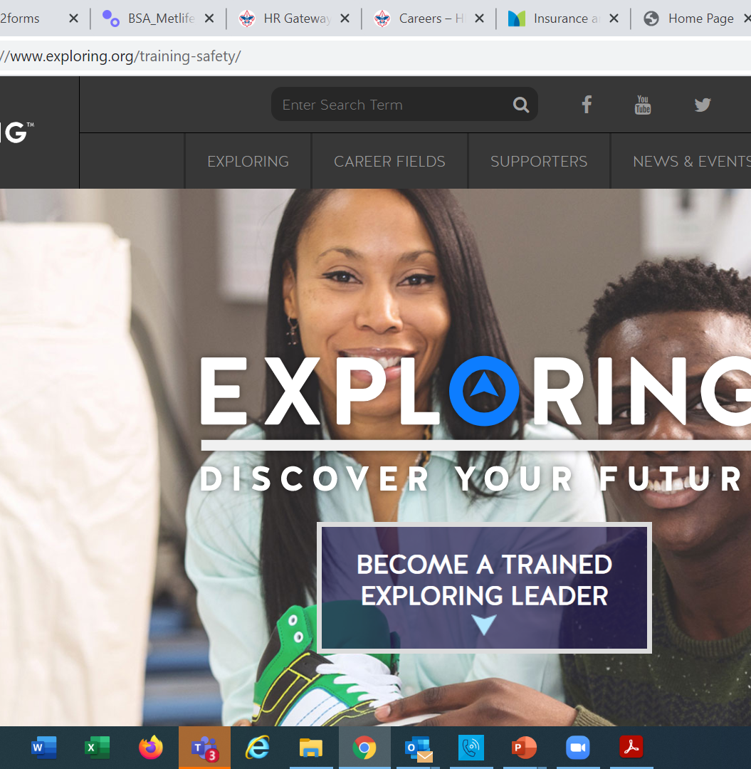
Exploring Training

Slide 86
Exploring Position-Specific Training Modules Update Status

Slide 87
Exploring Position-Specific Training Modules Update Status …
The Exploring Leader Training Modules have also been formatted to be experienced through the learning center via computer or smart device.
Login in to https://my.scouting.org/ . If you need to create an account and do not know your member ID number, please contact your local BSA council office/service center
Once you log in, locate the blue box on the right side of your screen labeled “Click here to access Exploring Training”
After logging in, you may also click “Menu” in the top left corner and select “My Training”. Under Training Courses by Program, select “Exploring Adult Training”
You may select between the three available Exploring learning plans (based on position). Anyone is welcome to complete the trainings
NOTE: In addition, the “Servicing Exploring Units Module for Commissioners” has been updated within the Learn Center.
We would like to sincerely thank the many Exploring professionals and volunteers that helped make this important update happen!

Slide 88
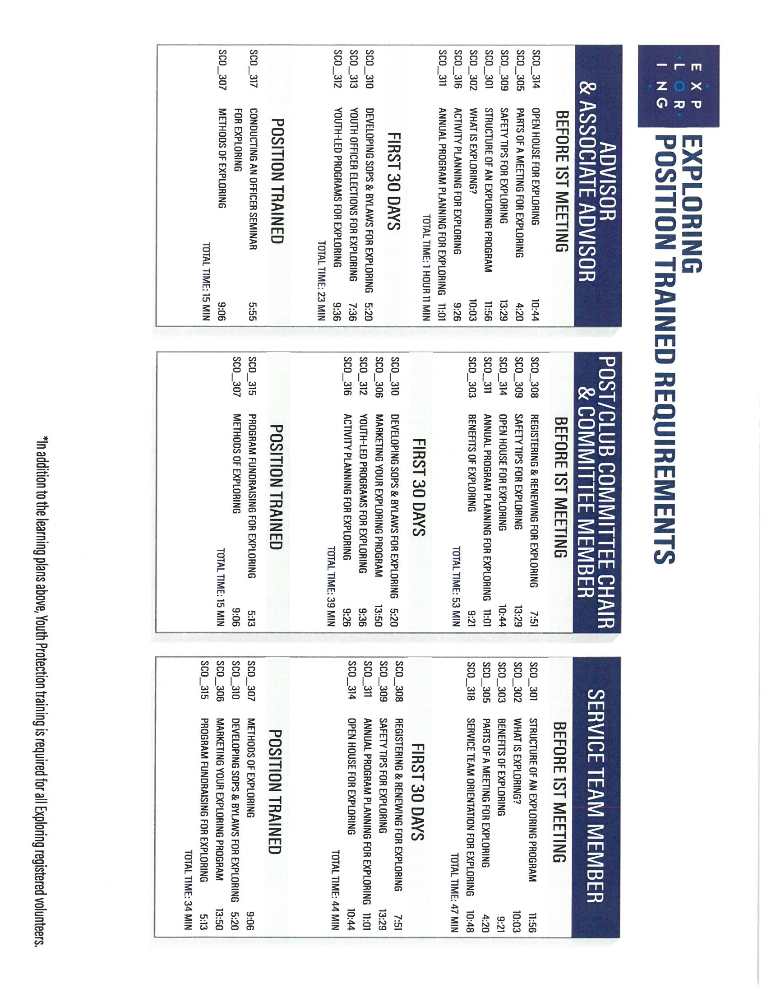
Exploring Position-Specific Training Modules Update Status …
NOW UPDATED AND READY FOR VIEWING

Slide 91
Safeguarding Youth (Youth Protection) Training
https://my.scouting.org/

Slide 92
Exploring Youth Training Update
https://www.scouting.org/training/youth-protection/venturing/

Slide 93
Important resources to help plan the program…
Career Opportunity Worksheet -- www.exploring.org and click on relevant career field icon and scroll to the bottom of the page.
Activity Library (including Life Skills Section) https://www.exploring.org/activity-library/
Organization’s Resources/Employees
A. Current work curriculum (developed by the company)
B. Employee’s expertise/knowledge (Use All-in One Program Planning Meeting-found in the Exploring Guidebook for Leaders)
Career Achievement Award (Posts) & Career Awareness Award (Clubs)
http://www.exploring.org/wp-content/uploads/2017/06/Career-Achievement-Award-May2017.pdf
http://www.exploring.org/wp-content/uploads/2018/05/Career-Awareness-Award-FINAL.pdf
Exploring Guidebook for Leaders https://www.exploring.org/wp-content/uploads/2016/10/Exploring-Guidebook-Sept2017.800-10018.pdf
Safety First Guidelines/Guide to Safe Scouting (Guide is being Updated—Please follow all CURRENT YPT Policies)
https://www.exploring.org/wp-content/uploads/2021/08/LFL-safety-first-guidelines-3.21.17_8.pdf
7. Online Exploring Adult Leader Specific Training & Youth Protection Training
https://www.exploring.org/training-safety/ or www.myscouting.org
8. Unit Performance Guide (Chapter 5- Exploring) –Details about organizing a new Post/Club
http://www.exploring.org/wp-content/uploads/2021/04/522-02516_UPG.compressed.pdf
Also visit www.exploringexplosion.org and scroll to the bottom of the website to find additional resources…

Slide 94
ADDITIONAL SLIDES FOR COUNCIL USE All slides will be emailed to each Exploring Live Hour Participant every month

Slide 95


Successful Councils… Intentionally Providing a Pathway to Exploring Growth and Strategic Planning In Your Council

Slide 96

“Action Planning” The Beginning of your Strategic Plan
The foundation of your plan will begin here

Slide 97
OPEN HOUSES
INSERT HERE
COUNCIL/DISTRICT YEARLY MEMBERSHIP PLANS
(Recruitment/Retention Cycle)
Career Interest Surveys

Slide 98

12 Keys To Success

Slide 99

1. Recruit a council Exploring volunteer chair and committee 2. Appoint a Council Exploring Champion “Staff Advisor” 3. Create a public presence for Exploring (council website, newsletters, social media)

Slide 100

4. Train key volunteers and staff on the 4 Phases of Post/Club Organization 5. Set specific goals for Career Interest Surveys or gathering of data from select high schools 6. Set goals to host Open Houses for all Posts/Clubs (i.e. School Night for Scouting)

Slide 101
7. Create a campaign to emphasize Post/Club unit support (through Service Teams/Commissioners) 8. Integrate Exploring into council activities and events 9. Promote Exploring to all current customers (i.e. “Scouts BSA”)

Slide 102
10. Host a council community cultivation event, focusing on a specific career. 11. Involve the Council Executive Board to help open doors within the community and to help create a list of businesses to match the Career Interest Survey results. 12. Ensure that Exploring is included in the Council Strategic Plan, PDS Goals, and Board Meetings.

Slide 103
Starting a New Post/Club
“The Four Phases”

Slide 104
REGISTRATION BASICS
YOUTH
POST: ___ and have completed eighth grade OR 15 years of age but not yet ___ years old
CLUB: 6th-8th graders who have completed the ____ grade and are at least 10 years old but have not completed the eighth grade and are not yet ____ years old.
ADULTS
___ years age or older
POST: Min of 4 adults
______________ (CC)
2 ____________ (MC)
_______________ (EA)
CLUB: 2 adults _______________ (ES)
_______________ (AS)
PAPERWORK
New Post/Club ____________
4 _________ Apps
5 _________ Apps
Annual ______________ of Understanding
$____ General Liability Insurance Fee
$____ per person registration fee
14
21
Application
21
Adult
Committee Chair
2 Committee Members
Youth
5th
Advisor
Memorandum
Sponsor
100
15
Assoc Sponsor
50
Exploring Youth Participants “EP’s” ages 18-20 must complete an
Exploring ________ Application & Successfully Complete YPT.
Adult

Slide 105
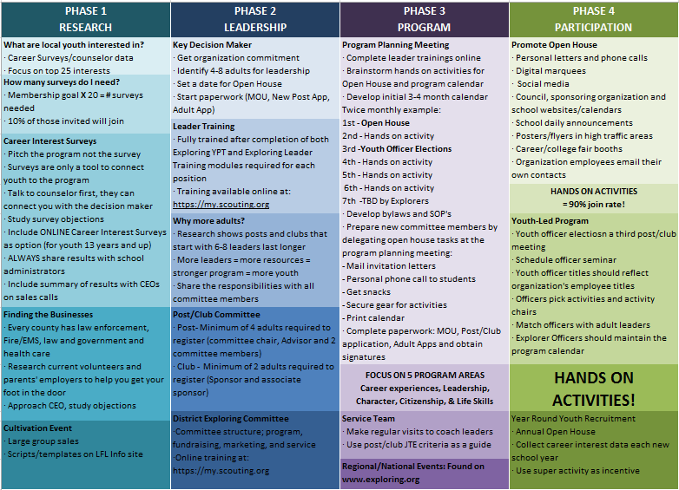

Slide 106
4 Steps/Phases in Organizing a new Post
1. Research-
Conduct the Career interest surveys
and develop business/community prospects
2. Leadership-
Meeting with the top leadership within the
businesses/community and identifying program
leaders; includes training of leaders
3. Program-
Develop the organization’s meeting/program
themes and prepare for an open house
4. Participation-
Recruiting youth through an organized open house and
involvement of youth in program development

Slide 107
MOST IMPORTANT PART OF EACH PHASE?
Phase 1 : Career Interest Surveys
Phase 2: Training
Phase 3: All-In-One Program Planning Meeting
Phase 4: Open House

Slide 108
Career Interest Surveys
The # 1
Leading Indicator for Exploring Growth

Slide 110
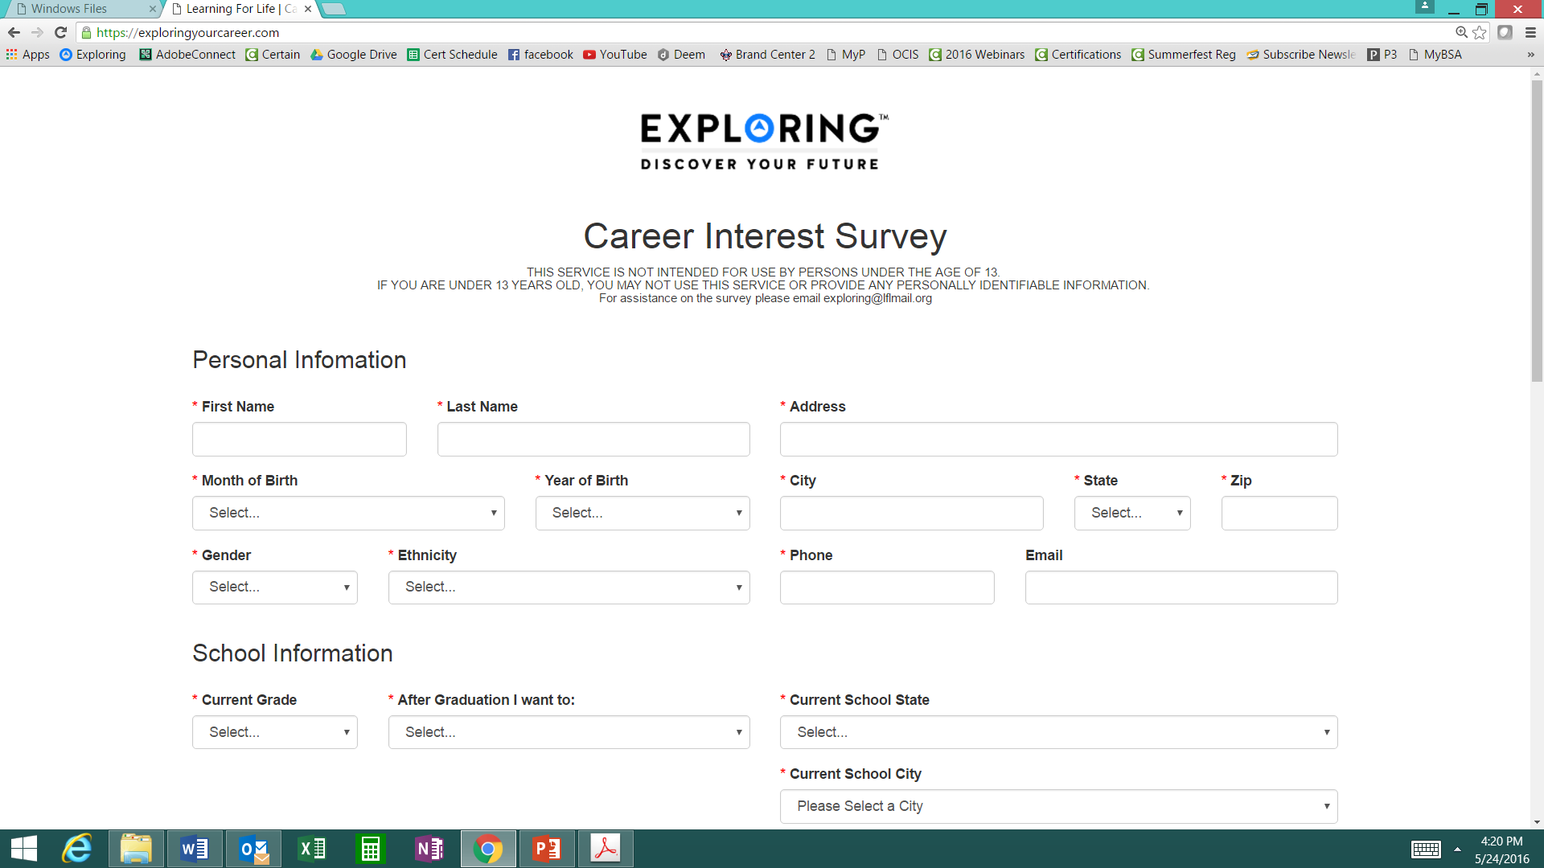
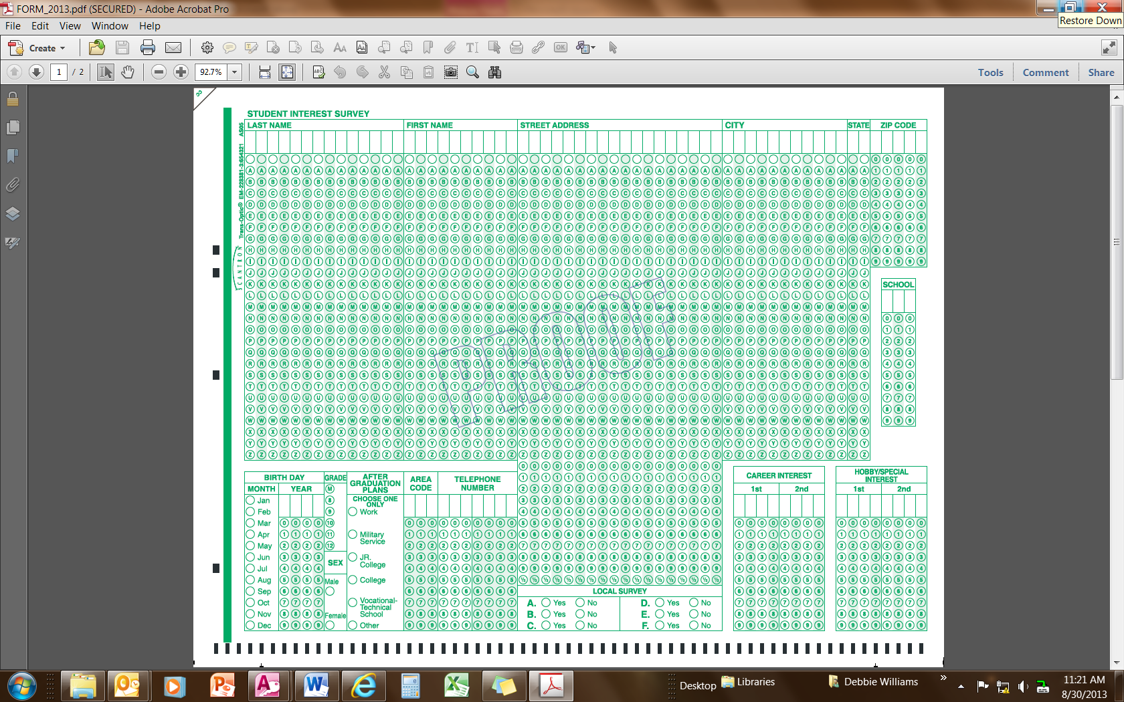
Phase 1 – Research
Career Interest Surveys (two choices)
pa
pa
Online Survey:
www.exploringyourcareer.com
Paper Scantron Survey

Slide 111
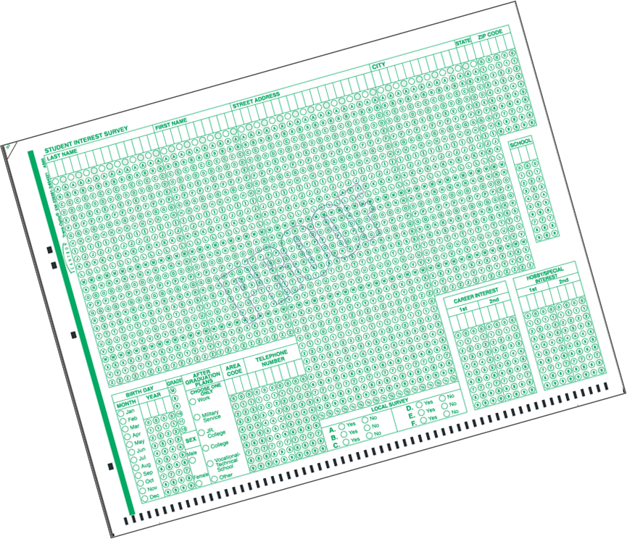
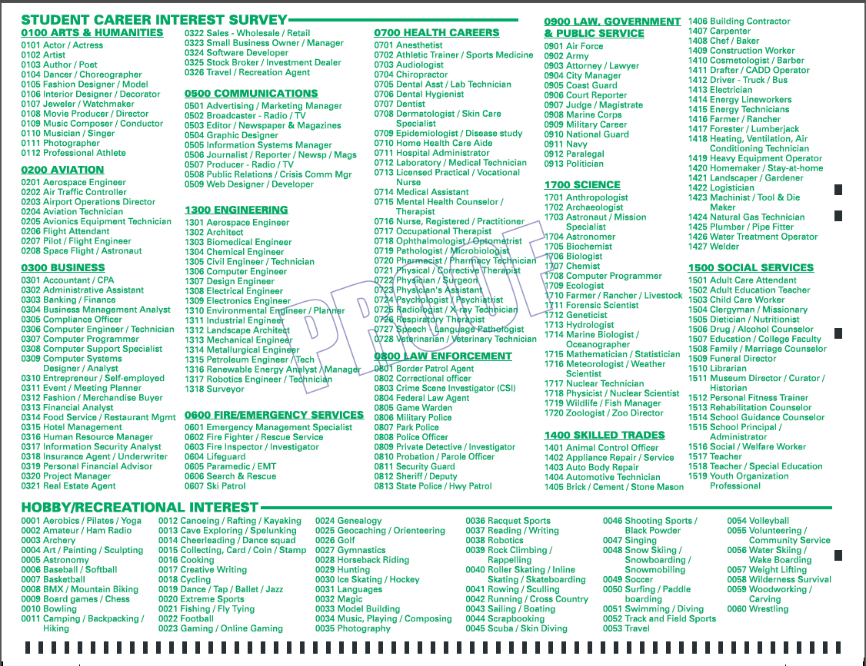
BACK SIDE
FRONT SIDE
Paper Scantron Survey Available through NDC

Slide 112
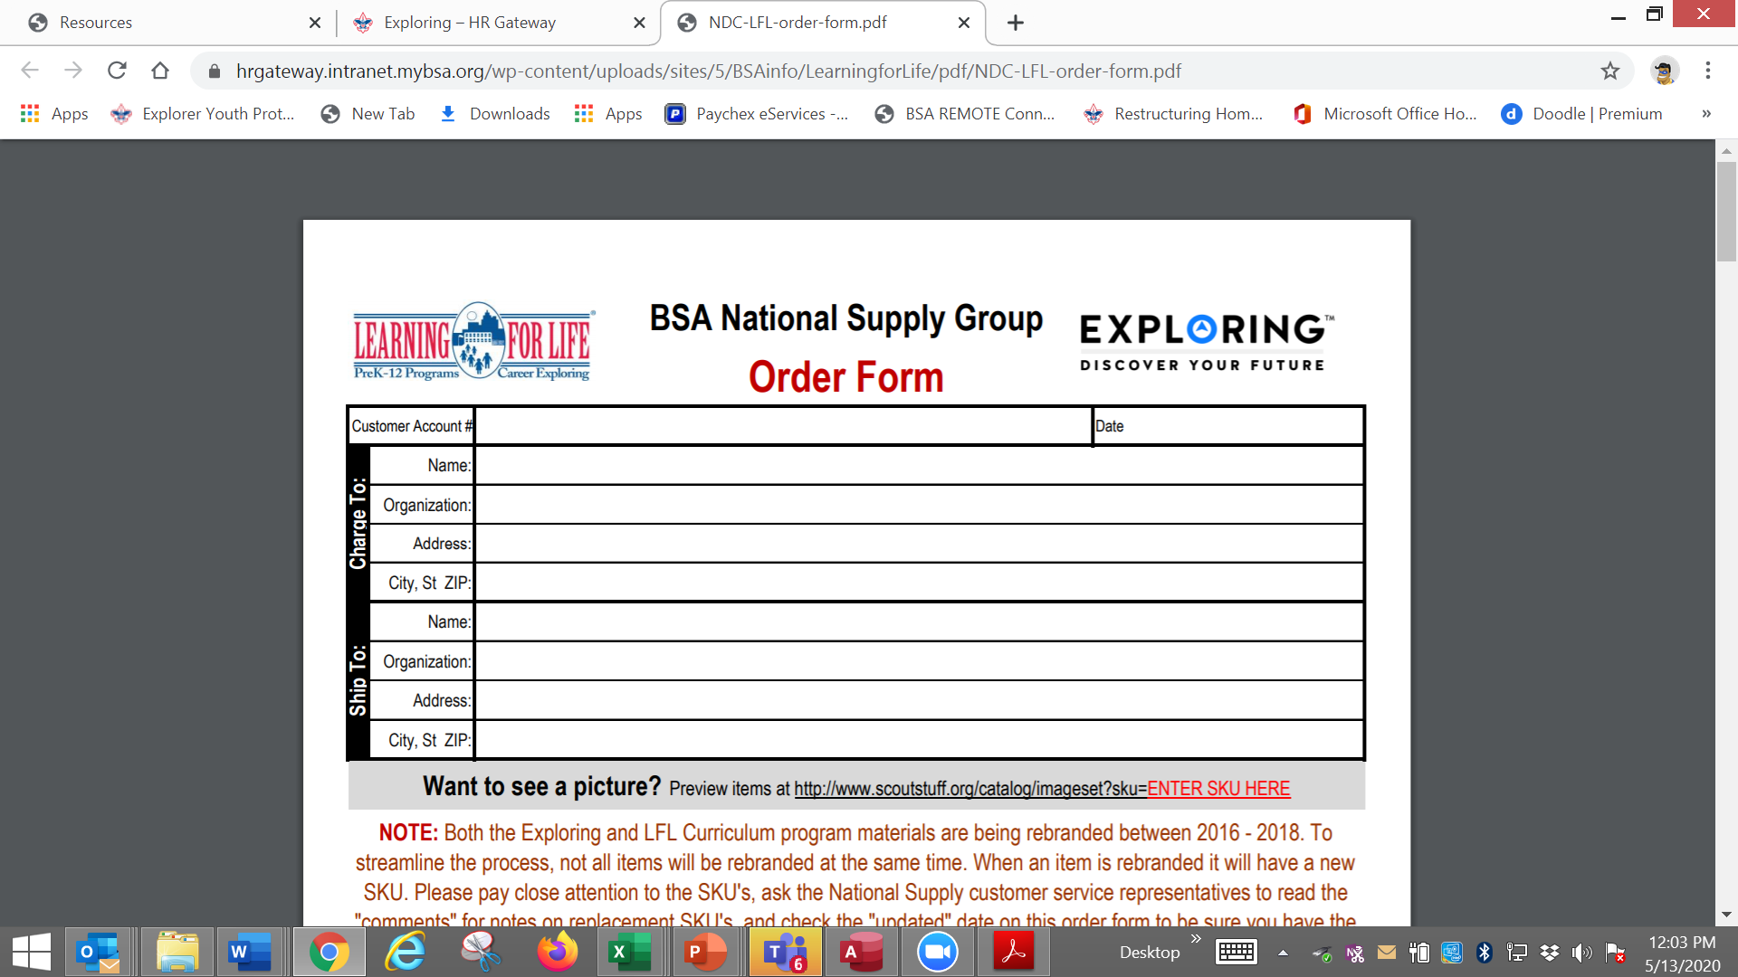

Slide 113
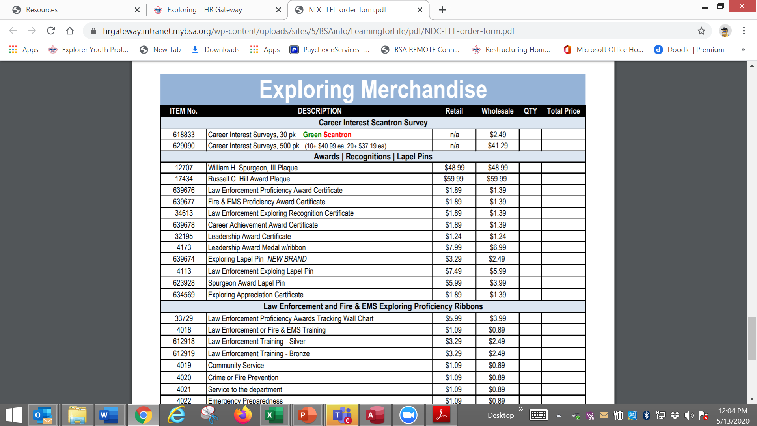

Slide 114
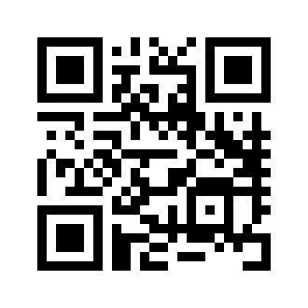
Online Career Interest Survey
www.exploringyourcareer.com
TRY IT NOW!
Use QR code or simply type address in web browser
Notes:
A “QR” or Quick Response code was created to take students directly to the survey site. It is available on posters, post cards, business cards, and book marks.
How do you use this? Email it to all teachers, they can open it from email and project it one screen for students to use their smartphones!

Slide 115
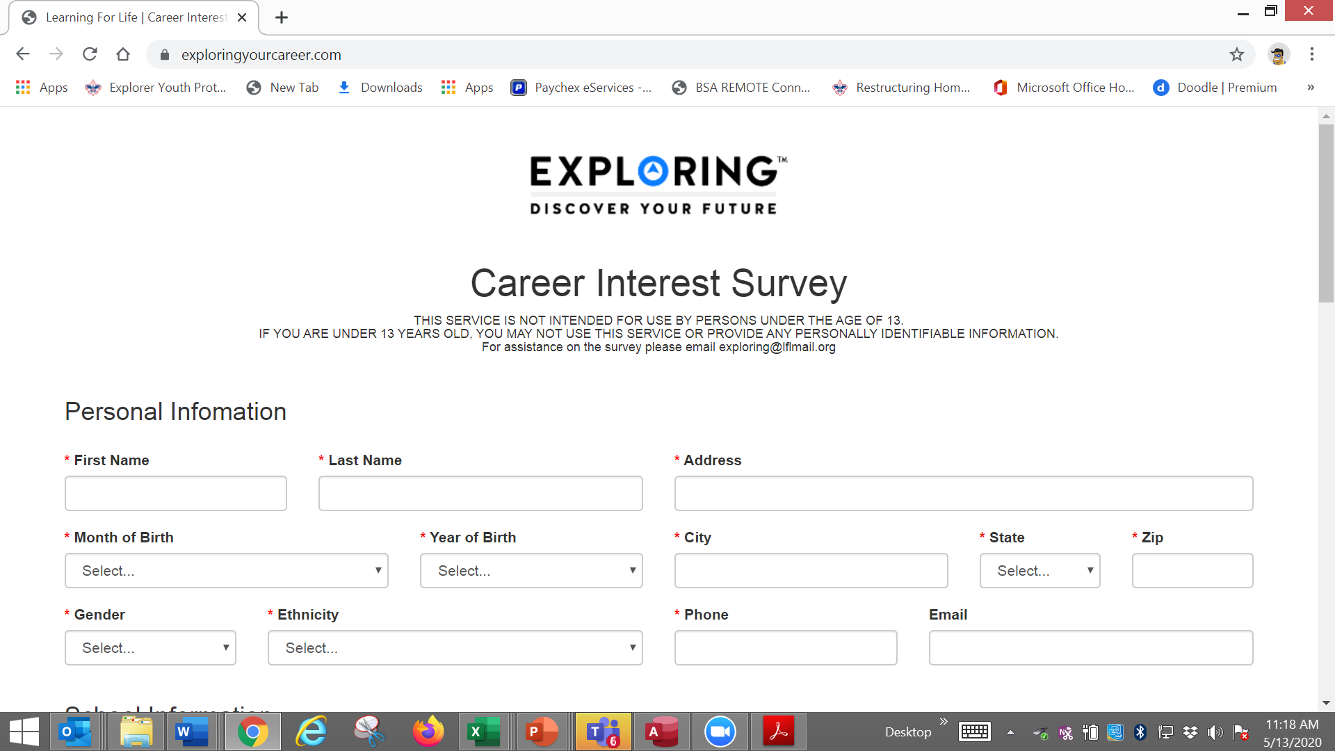

Slide 116
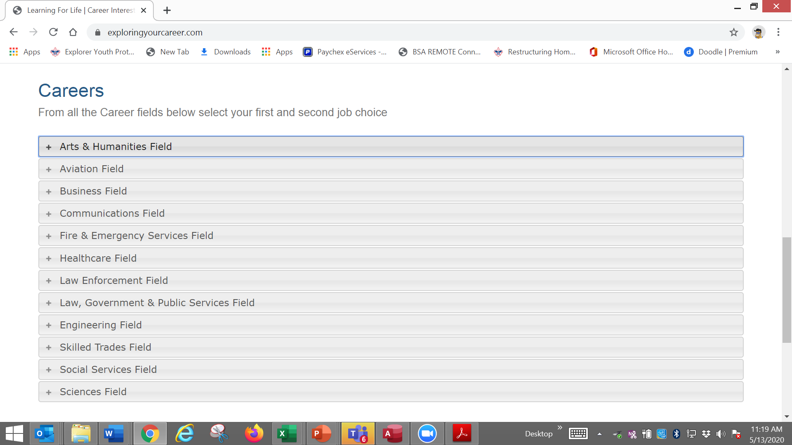

Slide 117
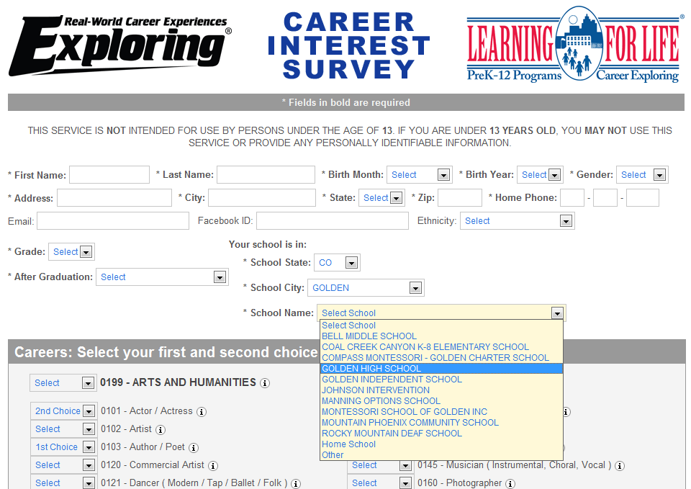
www.exploringyourcareer.org
Two career & hobby choices
School names
pre-loaded
Notes:
REFER TO HANDOUT IN YOUR FOLDER.
This is a screen shot of the new Online Career Interest Survey that was activated on Jan 1, 2012.
The careers & hobbies match the paper version. So schools and administer the survey either on paper or electronically.
The online version can be accessed from any device that can access the Internet – including smart phones.
Results are sent instantly to a secure website where councils can access the results and provide them to schools in the same format as the paper survey.
Instructions for accessing results can be found in the LFL internal site.
Students 13 yrs. and younger cannot legally complete this survey online. If they enter data, the system will not save it.
You can also add schools/colleges to this list if they do not populate when you put in your respective zip code. Simply e-mail us at exploring@lflmail.org and request your specific school to be added, with zip code

Slide 118
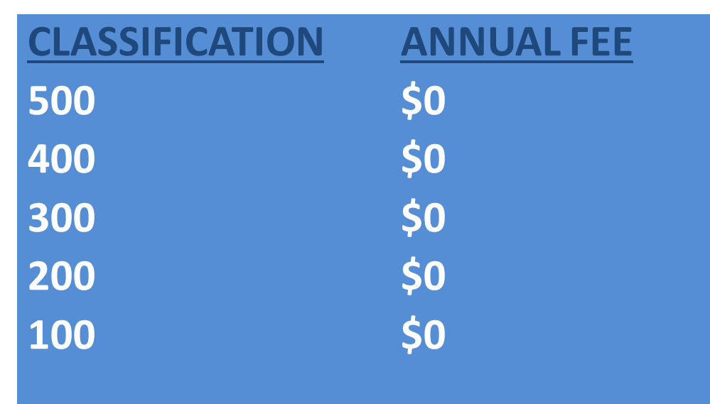
Online Career Interest Survey COSTS
Unlimited schools and unlimited surveys for students 13 years of age and older

Slide 119
REPORTS GENERATED FROM THE SURVEYS

Slide 120
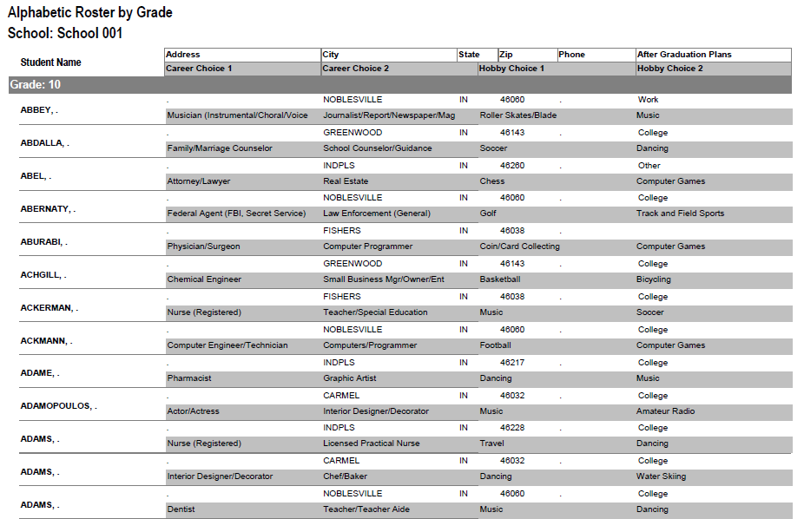
RESULTS REPORT: School
Grade: 10
ABBEY, Susie 123 Main St Noblesville IN 46060 Work
Career 1 Career 2 Hobby 1 Hobby 2
Musician Journalist Roller Skate /Blade Music
120
Notes:
120
No matter the survey format you use, the reports are generated the same way.
**GOOD data to establish credibility at/during your sales call
This is one set of sample results provided at no cost to schools. Very helpful for Guidance Counselors.
All students, by grade, alphabetically. Shows:
Career interests
Hobby interests
Post-high school plans
Other results include all students interested in each career (all the attorneys, architects, dentists, electricians, etc). Helpful for Guidance Counselor planning, career speakers, college days and college fairs.
Be sure to return results to the Guidance Counselor when you say you will – under promise and over deliver. Do not promise results in one week if you cannot do it. Say 2-3 weeks, then they will be very happy if they do receive them in a week or ten days.

Slide 121

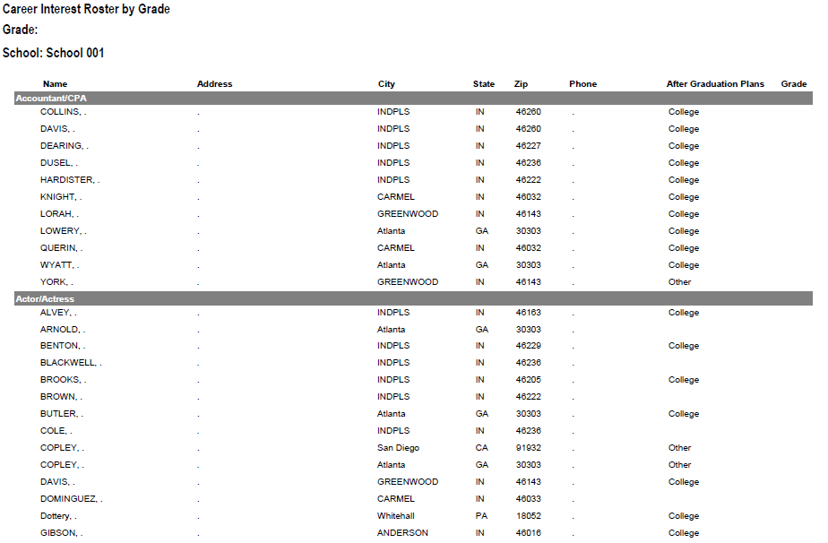
RESULTS REPORT: School
121
Notes:
121
This is another set of sample results provided at no cost to schools. Very helpful for Guidance Counselors.
This report includes all students interested in each career (all the attorneys, architects, dentists, electricians, etc.). Helpful for Guidance Counselor planning and career speakers.
The After Graduation Plans is important to Guidance Counselors
College
Junior college
Military Service
Technical school
Work
Other
Why are these reports help full to the school…to you?

Slide 122
Summary Career Interest Report by Council
Code Career Count
0712 Nurse (Registered) 798
0145 Musician (Instrumental/Choral/Voice) 751
0903 Attorney/Lawyer 733
1625 Teacher/Teacher Aide 678
0300 Business (General) 645
0719 Physician/Surgeon 604
0101 Actor/Actress 600
0130 Fashion Designer/Model/Buyer 579
0721 Psychiatrist/Psychologist 578
0170 Professional Athlete 507
0180 Photographer 461
1305 Architect 437
0725 Veterinarian 429
0102 Artist 427
0718 Physical Corrective Therapist 313
1300 Engineering (General) 208
MOST IMPORTANT TO YOU

Slide 123
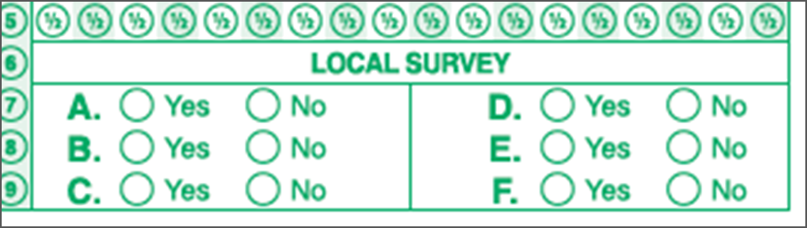
Career Interest Survey Questions
Opportunity for 6 “Yes” or “No” questions
Unique feature of our survey
Anything school officials want to know
Are you planning to take the SAT / ACT?
Are drugs a problem in our school?
Is there enough student parking?

Slide 124
www.exploring.org

Slide 125

Career Interest Survey Guidebook
Be sure you have the most recent version
Download at www.exploring.org
One stop shop for all CIS resources
Table of Contents
Page 5 | At A Glance
Page 7 | Overcoming Objections
Page 44 | Appendix

Slide 126
ALTERNATE METHODS? 1. Use school information already available 2. Ask youth to develop contacts 3. Develop cultivation events 4. Invite Eagle Scouts / Scouts to join 5. Booth at schools open house night and career days /career fairs 6. Annual Exploring open houses for ALL Posts and Clubs 7. Follow up leads from the Exploring Lead Generator

Slide 127
BASED ON SURVEY RESULTS
1. Focus on Top 4 students interests
2. Identify companies in those 4 interest areas
3. Identify the path to the CEO
Council board contacts
School board/admins
PAS find
Nominating committee
Applications

Slide 128
Career Interest Survey Guidebook
Be sure you have the most recent version
Download at www.exploring.org
One stop shop for all CIS resources
Table of Contents
Page 5 | At A Glance
Page 7 | Overcoming Objections
Page 44 | Appendix

Slide 129


Slide 130
Leads are being generated from Exploring.org and include anyone interested in joining, leading, sponsoring, or
otherwise supporting Exploring in their area.
Scout Executives, Assistant Scout Executives and DFS’s receive weekly lead reports.
Exploring Executives and staff advisors receive immediate notifications of each lead generated.
To make changes to any of these settings, email your request to exploring@lflmail.org.
WHEN YOU RECEIVE AN IMMEDIATE NOTIFICATION EMAIL:
1. In the email, you will see a note to “copy & paste the following URL into your browser to mark lead as contacted”.
By following this directive, you are changing the status of your lead to “contacted”. You will no longer receive email notifications for that particular lead. The lead will begin to show as “contacted” on your SE’s weekly report.
Invite the person to attend an existing post/club meeting to get a feel for the program and connect them to
appropriate Exploring advisors.

Slide 131
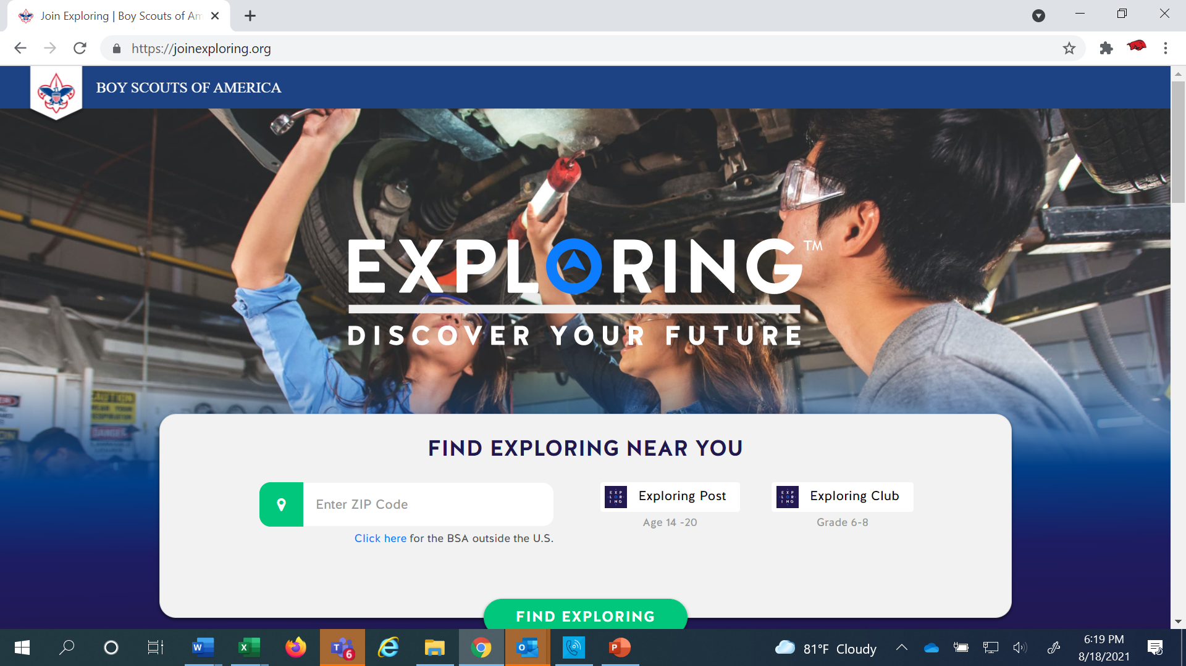
www.joinexploring.org

Slide 133

Phase 2 - Leadership
CEO’s Police/Fire Chiefs Administrators
Industry Experts Retirees Community Leaders

Slide 134

Moving forward with the CEO
1) Get organization’s commitment
2) Identify 6-8 adults
- CEO invites them
- You provide guidance
3) Set 2 dates for:
- All-In-One program planning
meeting
- Open House
4) Start Paperwork
- New Club/Post Application
- MOU, Adult Application

Slide 135
Exploring Training

Slide 137
Phase Two: Training

Slide 139
Important resources to help plan the program…
Career Opportunity Worksheet -- www.exploring.org and click on relevant career field icon and scroll to the bottom of the page.
Activity Library (including Life Skills Section) https://www.exploring.org/activity-library/
Organization’s Resources/Employees
A. Current work curriculum (developed by the company)
B. Employee’s expertise/knowledge (Use All-in One Program Planning Meeting-found in the Exploring Guidebook for Leaders)
Career Achievement Award (Posts) & Career Awareness Award (Clubs)
http://www.exploring.org/wp-content/uploads/2017/06/Career-Achievement-Award-May2017.pdf
http://www.exploring.org/wp-content/uploads/2018/05/Career-Awareness-Award-FINAL.pdf
Exploring Guidebook for Leaders https://www.exploring.org/wp-content/uploads/2016/10/Exploring-Guidebook-Sept2017.800-10018.pdf
Safety First Guidelines/Guide to Safe Scouting (Guide is being Updated—Please follow all CURRENT YPT Policies)
https://www.exploring.org/wp-content/uploads/2021/08/LFL-safety-first-guidelines-3.21.17_8.pdf
7. Online Exploring Adult Leader Specific Training & Youth Protection Training
https://www.exploring.org/training-safety/ or www.myscouting.org
8. Unit Performance Guide (Chapter 5- Exploring) –Details about organizing a new Post/Club
http://www.exploring.org/wp-content/uploads/2021/04/522-02516_UPG.compressed.pdf
Also visit www.exploringexplosion.org and scroll to the bottom of the website to find additional resources…

Slide 140

Phase 3 – Program
All-In-One Program Planning Meeting
1) Paperwork
2) Adult Explorer Leader Training
- Youth Protection for Explorers
- Adult Explorer Leader Training
3) Open House Planning
- Brainstorm session
Why did you choose this career for yourself?
What are hands on activities that you can do with youth?
- Develop a 3-4-month calendar (use Activity Library)
- Choose Open House “hands-on activities”
4) Prepare Post Committee Members for Open House

Slide 141


SAMPLE PROGRAM CALENDARS
The frequency of your meetings and length of your program each year is up to you. For example, this could be a 12 month or 12 week program.
ENGINEERING & TECH
MONTHLY MEETINGS YEAR-ROUND
September
Open House
October
Chemical engineering
November
Youth Officer Elections
December
Holiday Play – open house
January
Industrial Technology
February
Electrical engineering
March
Computer science
April
Fluid power technology
May
Ethics in engineering
June
Visit with engineering firm
July
Civil engineering
August
Mechanical engineering
Notes:
PRESENTER NOTES:
BE SURE TO DELETE THE CALENDARS/SLIDES THAT ARE NOT RELEVANT TO THE CAREER INDUSTRY TO WHICH YOU’RE PRESENTING.
Remind the audience that they have flexibility is setting the schedule for their own program. Here are some options:
Year round – may or may not include summer
Weekly
Monthly
3 months at a time, different group of youth each time, 3 times per year
Weeknights or weekends

Slide 142

Phase 3 – Program
Planning the Open House
1) From your BRAINSTORM session…
- Pick the 4-5 best activities for a quick hands-on format at the Open House
2) At the open house…“Go shopping”
- 4-5 stations (rotations)
- 4-5 minutes each

Slide 143
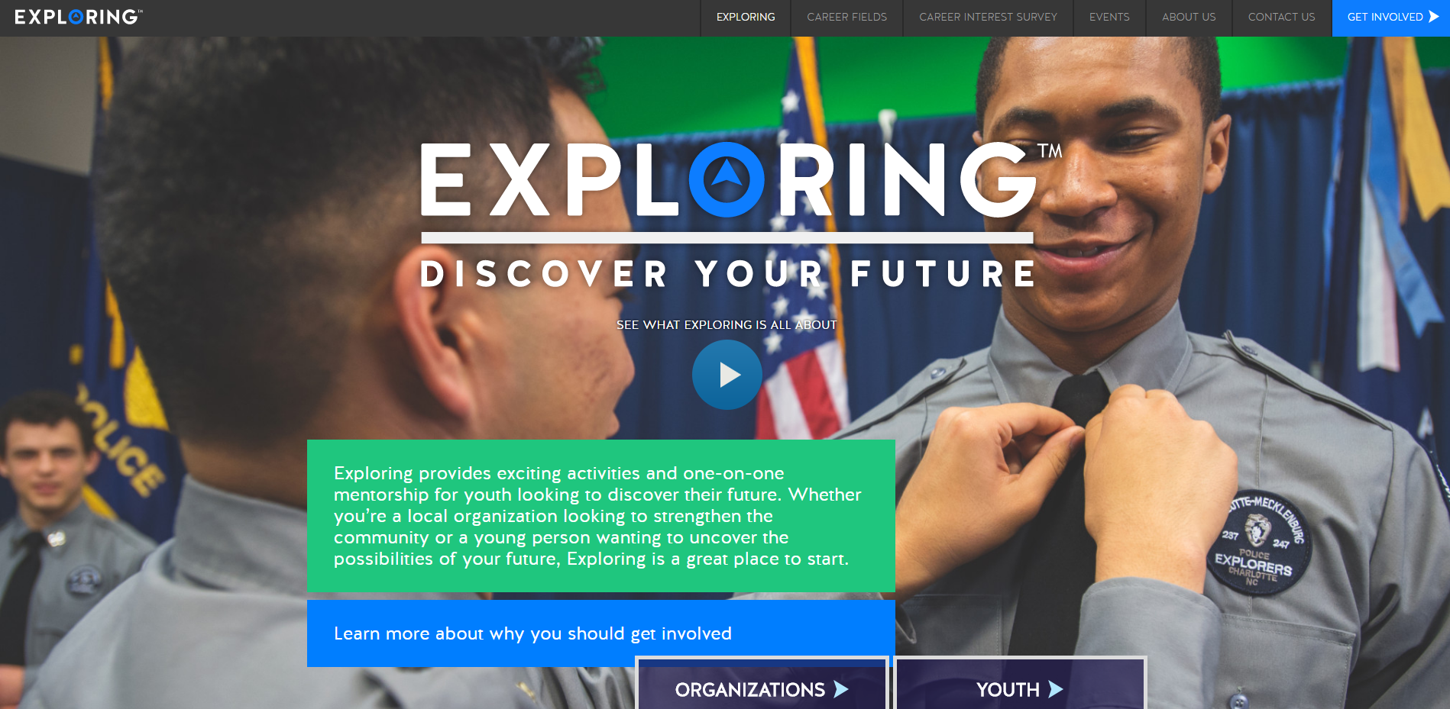

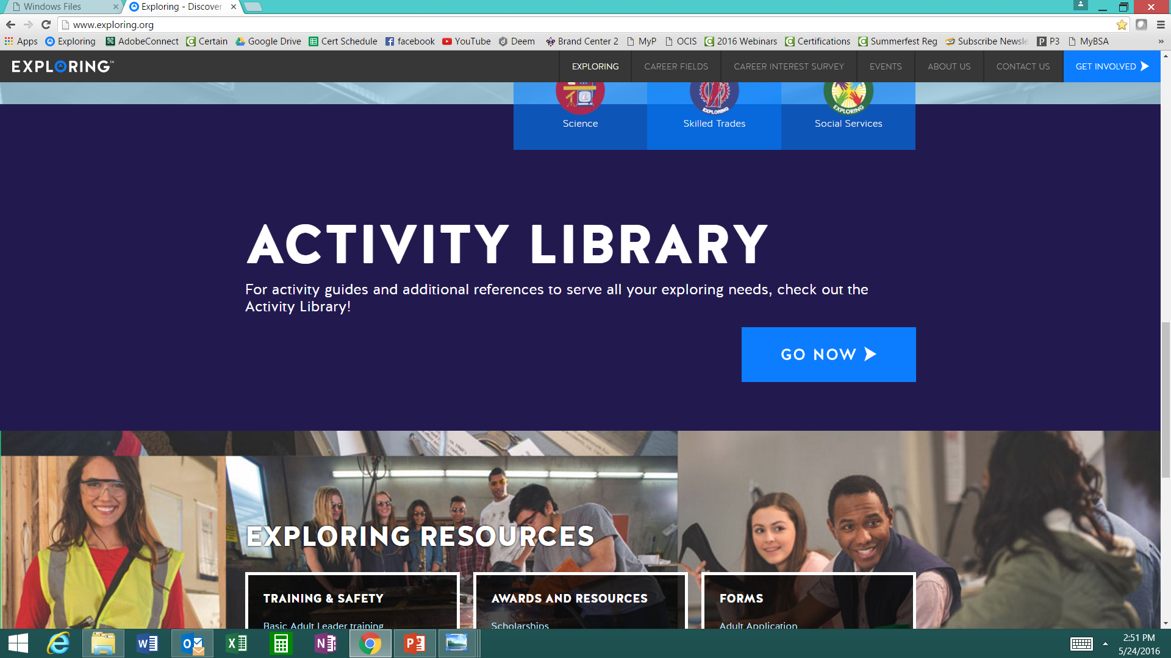

www.exploring.org
Notes:
Program planning is also a service that is provided by the local Boy Scout Council. This Activity Library is an all new supplement to the process. You will find it on www.exploring.org

Slide 145
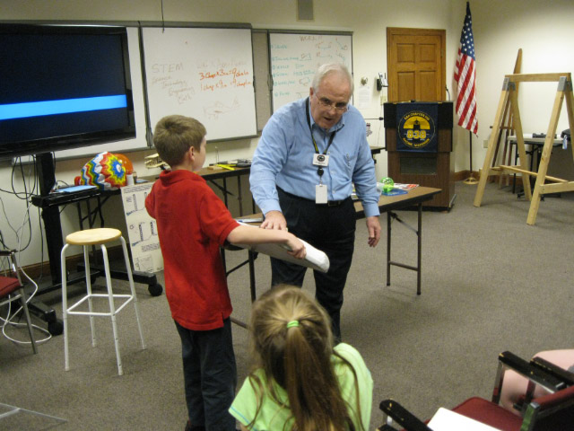
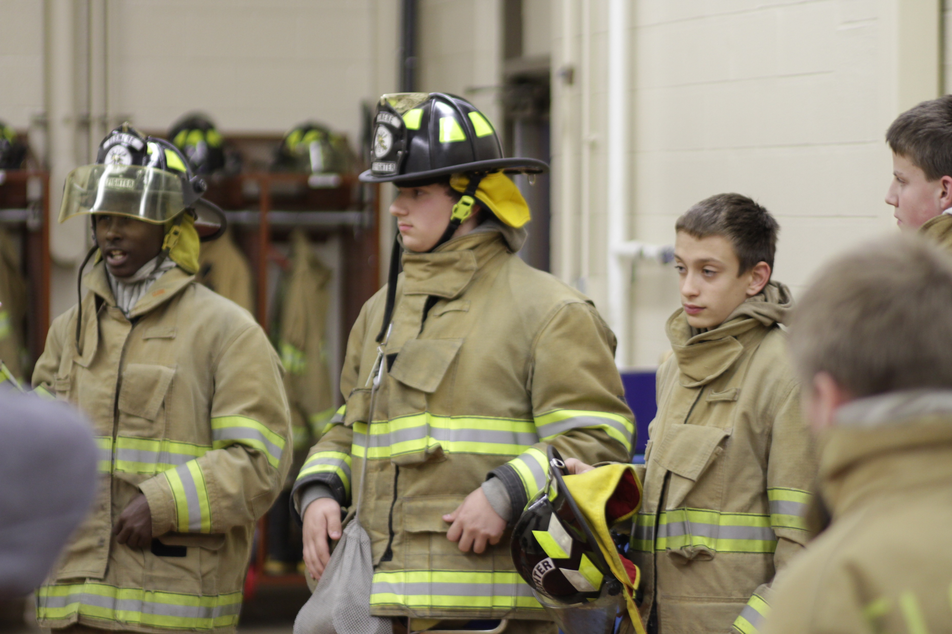
Phase 4 – Participation
SIMPLE OPEN HOUSE AGENDA
OPEN HOUSE AGENDA
Welcome
What is Exploring?
Video
HANDS-ON ACTIVITIES
Activity Interest Survey (customized)
Calendar
ASK TO JOIN
Applications & fees
Snacks

Slide 146
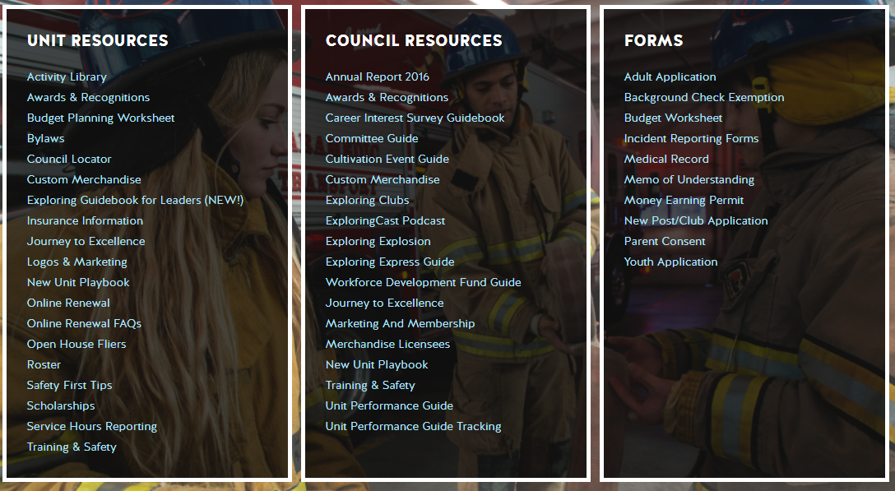
Resources to help you… www.exploring.org

Slide 147
ONLINE REGISTRATION & ONLINE UNIT RENEWAL FOR EXPLORING

Slide 148
ONLINE REGISTRATION

Slide 150
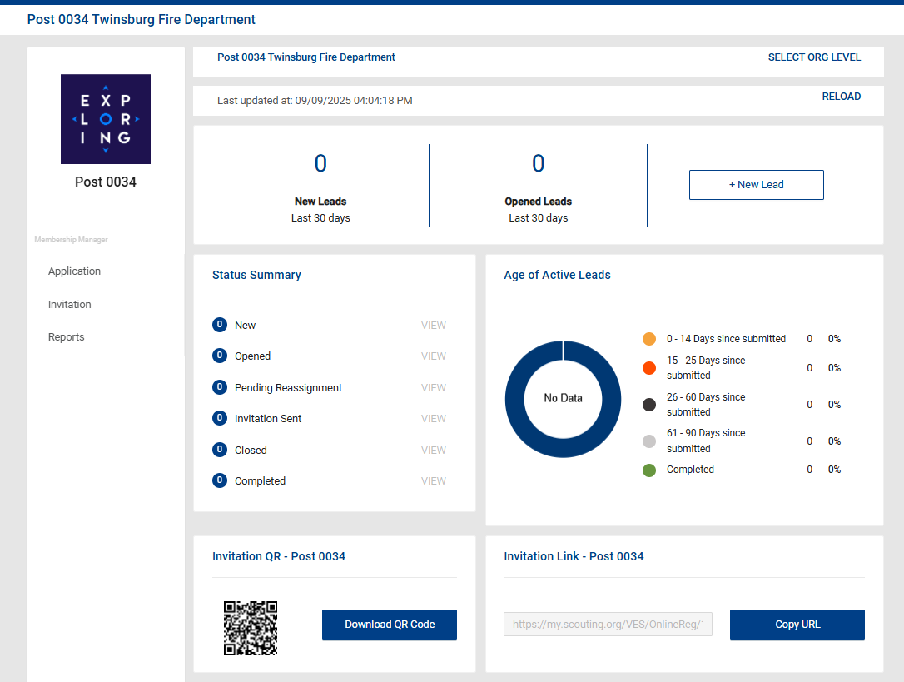
Invitation Manager

Slide 151
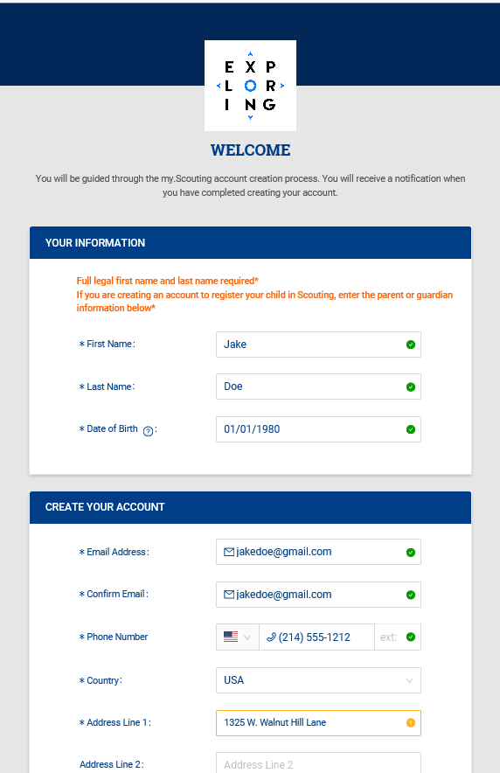
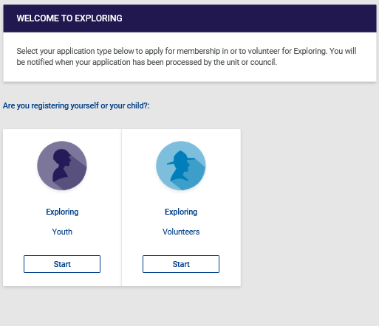
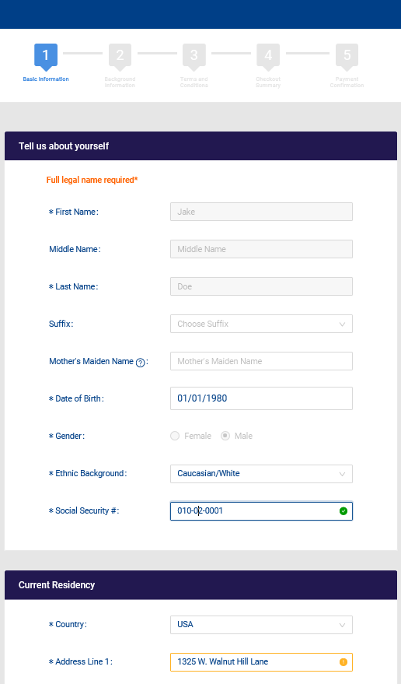
Create Account & Complete Application

Slide 152
ONLINE UNIT RENEWAL/ “RECHARTERING” FOR EXPLORING

Slide 153
https://www.scouting.org/commissioners/internet-rechartering/
Information included is:
Training Video
FAQ’s
User Guides
Internet Recharter Guidelines
Summary of Enhancements
Recharter Demo Tool
New Online Rechartering/Renewal System
https://advancements.scouting.org/login
Manager of Shared Services
Member Data Outsourcing Solutions

Slide 154

Scouting America Renewal System Overview

Slide 155
Renewal Membership / Units
For all Youth and Adult members in the BSA
All Membership Terms are for 12 months
Membership Renewal will only have a two-month lapse
New Unit Renewal will only have a two-month lapse
Parent/Guardian e-mails are needed
Text notice will be sent too
Parents can Opt-Out and Units can Opt-out the member too

Slide 156
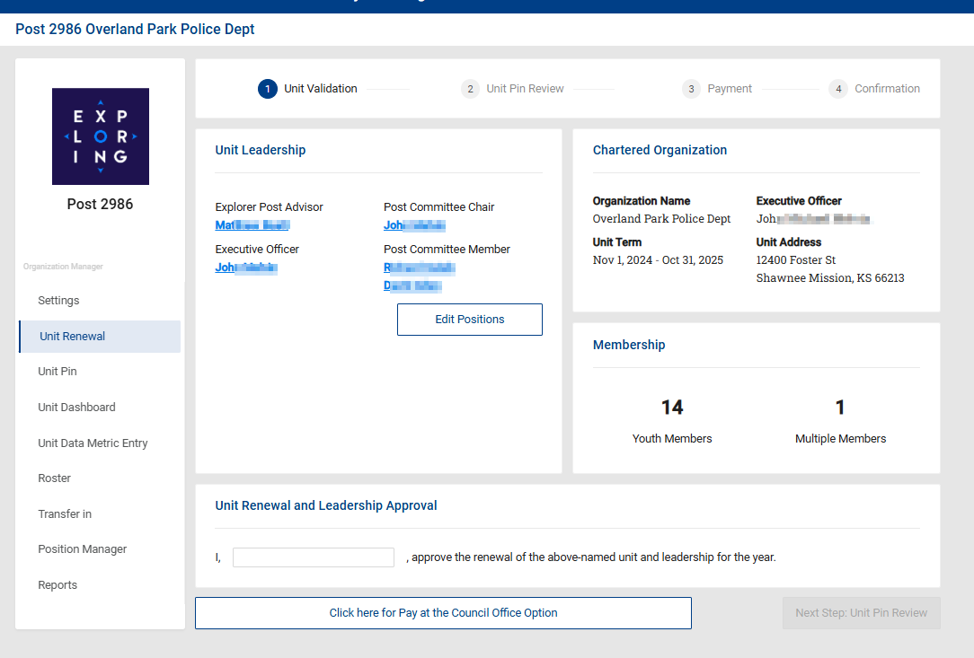
Renewal Membership – Unit Renewals

Slide 157

Renewal Membership – Unit Renewals

Slide 158





Renewal of Membership
For all youth and adult members of the Scouting America
Auto Renewal Membership Family/Self Pay
Auto Renewal Membership Unit Pay
An email notification and a renewal link will be sent 60 days before membership expires.
The link provided in the email will direct individuals to a renewal form on My.Scouting
If registered in multiple positions, select the primary position. Renewing the primary position will automatically renew multiple positions.
The individual pays with a credit card and submits the renewal.
The unit will approve the membership renewal.
In Organization Manager, the unit selects the Unit Pay option.
Unit Key 3s are notified each month about which members are due to renew that month.
Using the Roster tab, the unit selects which members they are renewing.
The unit can choose not to renew a member (opt-out). The unit can also change the Scout’s Life subscription settings for each person.
The unit pays with a credit card or establishes a securely stored electronic fund transfer payment (ACH) and submits the renewal.

Slide 159

Renewal Membership – Family / Self Pay

Slide 160

Renewal Membership – Family / Self Pay

Slide 161

Renewal Membership – Family / Self Pay

Slide 162

Renewal Membership – Family / Self Pay

Slide 163

Renewal Membership – Family / Self Pay

Slide 164

Renewal Membership – Family / Self Pay

Slide 165

Renewal Membership – Unit Pay

Slide 166

Renewal Membership – Unit Pay

Slide 167

Renewal Membership – Unit Pay

Slide 168

Member Renewal Cycle – December 2025 430,642 Members Renew
Emails beginning 60 days out from the expiration date – 5 emails
Texts sent beginning 45 days out – 4 texts sent
Monthly Renewal Communication Sequence
November 1st – Email Sent
November 15th – Text Message Sent
November 30th – Email Sent
December 15th – Text Message Sent
December 31st - Email and a Text Message Sent
January 7th – Email Message Sent
January 15th – Text Message Sent
168

Slide 169

Renewal Membership – Missing Parent Guardian Relationship

Slide 170

Renewal Membership – Missing Email Address Report

Slide 171

Renewal Membership – Member without Unit Report

Slide 172

Renewal Membership – Members Due to Renew Report

Slide 173

Renewal Membership – Members Opt-Out Report

Slide 175
www.exploring.org

Slide 176
2026 NATIONAL EXPLORING LIVE HOUR (Monthly)
The National Exploring Live Hour is a monthly Zoom video conference that will help engage and equip Exploring volunteers and professionals to grow, support, and learn more about Exploring. Each month the National Exploring Live Hour will be led by our National Exploring Program Chair and the National Director of Exploring. The live hours will include sharing best practices and ideas that are happening within our councils, highlighting successful growth campaigns, and inspiring new ideas through various trainings. This will also offer an opportunity for local councils to collaborate with territory and national counterparts to generate innovative solutions to real-life Exploring challenges.
National Exploring Live Hour Schedule
1:00 PM – 2:00 PM Central Standard Time, Monthly
Register for each of the National Exploring Live Hour ZOOM presentations at:
2026 National Exploring Live Hour Registration

