Slide 1
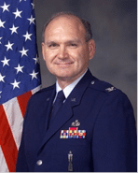

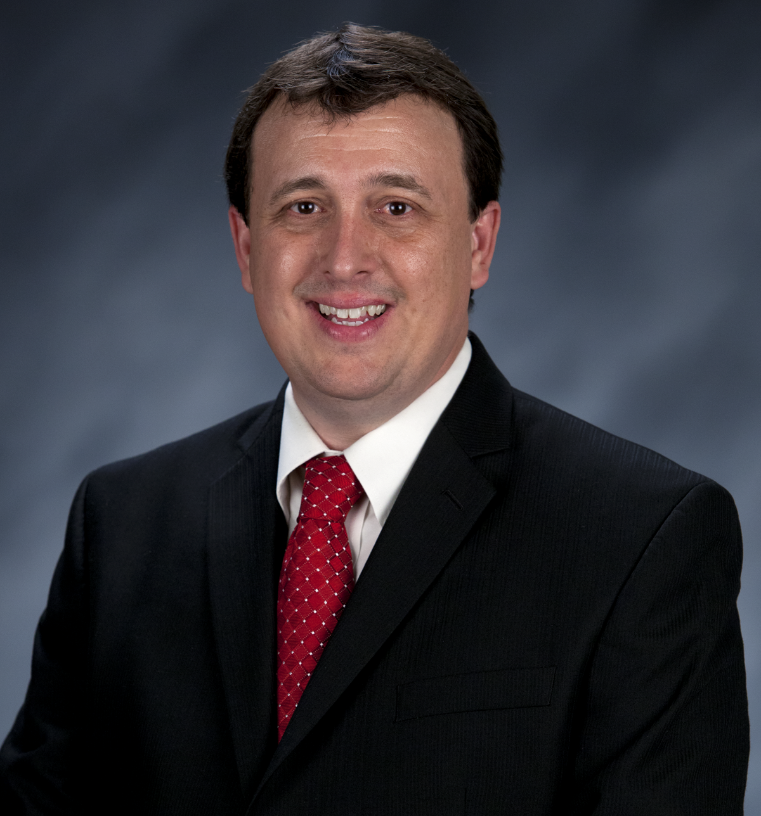
Craig Martin
Vice-Chair,
National Exploring Program Chair
NATIONAL EXPLORING
LIVE HOUR
May 20th, 2026
Tim Anderson
National Director
Learning for Life & Exploring
Older Youth Programs

Slide 2

LEARNING FOR LIFE CORPORATE MISSION:
To develop and deliver engaging, research based academic, character, leadership and career focused programs aligned to state and national standards that guide and enable all students to achieve their full potential.
THE CORPORATION
NON-DISCRIMINATION STATEMENT:
Learning for Life programs are designed for all age groups from pre‐kindergarten and not yet age 21. Youth participation is open to any youth in the prescribed age group for that particular program. Adults are selected by the participating organization for Involvement in the program. Color, race, religion, gender, sexual orientation, ethnic background, disability, economic status or citizenship is not criteria for participation by youth or adults.
Notes:
AFFILIATION STATEMENT
Learning for Life is one of the programs that local Boy Scouts of America councils are authorized to deliver, with local executive board approval. Learning for Life is an affiliate of the Boy Scouts of America that is comprised of both a written character education curriculum for PreK – 12th graders and students with special needs, as well as Interactive career Exploring programs for 6th graders thru 20 year olds. Youth participation is open to any youth in the prescribed age group for that particular Program. Adults, 21 years of age and older, are selected by participating organizations for involvement in the Learning for Life programs. Color, race, religion, gender, sexual orientation, ethnic background, disability, economic status or citizenship is not criteria for participation by youth or adults. Youth and adults involved with Learning for Life programs, including Exploring, are registered with Learning for Life as participants. Learning for Life participants are not members of the Boy Scouts of America. Learning for Life, a District of Columbia non‐profit corporation, is a separate 501(c)(3) Corporation, with a Board of Directors that is separate from the Boy Scouts of America. While they have different policies, there are occasions when local Learning for Life and Traditional BSA programs may participate in an event. Both programs will be required to follow the appropriate guidelines, especially regarding safety. Completion of training, registration and annual fees are program specific and not transferable between programs

Slide 3

  Learning for Life Curriculum-Based Programs consists of grade specific, age-oriented, character education lesson plans that are utilized in schools and other educational settings to help instill character and ethical decision making in our youth. The available lesson plans that are offered for Learning for Life Groups include PreK-12 grades, Champions for students with special needs, along with additional digital resources. Learning for Life uses these interactive lessons to help youth make informed decisions while becoming better students and citizens.
  CURRICULUM PROGRAM VISION:
  To provide engaging and relevant PreK‐12 solutions that positively impact academic performance, social & emotional maturity, character development, and career education for all students.
www.learningforlife.org

Slide 4

  Exploring is a co-ed program for youth that are in the 6th grade through 20 years old. Exploring provides opportunities for real-world hands-on career experiences, while helping them “Discover their Future”. The program links youth with mentors and experts with partner businesses and agencies in their communities. Participating in an Exploring Club or Post ensures youth make informed decisions about careers they may or may not be interested in pursuing, while allowing businesses and organizations the opportunity to meet and cultivate future employees.
EXPLORING MISSION:
Deliver character-building experiences and mentorship that allow youth to achieve their full potential in both life and work.
EXPLORING VISION :
Shape the workforce of tomorrow by engaging and mentoring today’s youth in career and life enhancing opportunities.
www.exploring.org

Slide 5
A little about each program
Learning for Life Curriculum-Based Programs consists of grade specific, age-oriented, character education lesson plans that are utilized in schools and other educational settings to help instill character and ethical decision making in our youth. The available lesson plans that are offered for Learning for Life Groups include PreK-12 grades, and Champions for students with special needs. Learning for Life uses these interactive lessons to help youth make informed decisions while becoming better students and citizens.
Exploring is a co-ed program for youth that are in the 6th grade through 20 years old. Exploring provides opportunities for real-world hands-on career experiences, while helping them “Discover their Future”. The program links youth with mentors and experts with partner businesses and agencies in their communities. Participating in an Exploring Club or Post ensures youth make informed decisions about careers they may or may not be interested in pursuing, while allowing businesses and organizations the opportunity to meet and cultivate future employees.

Slide 6

National Learning for Life/Exploring
National Professional Staff Direct Support
Tim Anderson
National Director,
Learning for Life/Exploring
Older Youth Programs
Dedra Douglas
Administrative Assistant
John Mosby
Asst. Chief Scout Executive & EVP
(BSA)
Susan Fitzhugh
Sr. Administrative Assistant
Carlos Coronado
National Exploring Growth & Retention Executive

Slide 7

National Director/President
Tim Anderson (E)
(V) = Volunteer
(E) = Employee/Professional
LFL Executive Board Secretary
Steven Hardy (E)
LFL Executive Board Treasurer
Lisa Fritschel (E)
NATIONAL LEARNING FOR LIFE EXECUTIVE BOARD
(Board Member)
National
Exploring Program Chair
Craig Martin (V)
*National Learning for Life Executive Board Chair*
Bernard “Bernie” Lockard (V)
----------------------------------------------------------------------------------------------
National Learning for Life
Immediate Past Executive Board Chair/Governance
Mark Wiesenhahn (V)
(Board Member)
National Learning for Life Curriculum Based Program Chair
Vacant (V)
(Board Member)
National
Exploring Program Commissioner
Richard “Dick” Davies (V)
(Board Member)
National Learning for Life Curriculum
Based Program Commissioner
Vacant (V)
(Board Member)
National LFL/EXP
Fundraising & Development Chair
Vacant (V)
(Board Member)
National LFL/EXP
Membership & Retention Chair
Vacant (V)
(Board Member)
National LFL/EXP
Partnerships & Relationships Chair
Vacant (V)
(Board Member)
National LFL/EXP
Safeguarding Youth/
Health & Safety Chair
Vacant (V)
(Board Member)
National LFL/EXP
Technology/Website Chair
Jeff Schweiger
(Board Member)
National LFL/EXP
Marketing & Social Media Chair
Vacant (V)

Slide 8

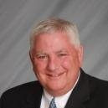

National Learning for Life Executive Board Chair
Bernie Lockard
Scouting…
Eagle Scout (1972)
Order of the Arrow Vigil Honor
Cubmaster
Pack Committee Chairman
Assistant Scoutmaster
Scoutmaster
Unit Commissioner
Wood Badge Course Director
NYLT Course Director
District Chairman
President, Laurel Highlands Council’s Board of Directors (2013 - 2014)
2019 World Jamboree Scoutmaster
Chair, National Venturing Committee (2020 - 2022)
2023 & 2017 National Jamboree Staff
National Eagle Scout Association Scholarship Committee (2013 - Present)
BSA Recognition…
Award of Merit – 1998
Silver Beaver – 2001
Distinguished Citizen – 2010
Rockefeller Award – 2010
Silver Antelope – 2014
National Outstanding Eagle Scout Award - 2015
National Venturing Leadership Award – 2022
Silver Buffalo - 2024
Personal…
Married to Robyn L. Ashbridge, father of five and grandfather of seven
President, The Lockard Company, Indiana, PA
Graduate of Carnegie-Mellon University, Pittsburgh, PA, with B.S. in Administration and Management Science, Economics, Mathematics (Graduated With Honors)

Slide 9
National Exploring Program Chair
Craig Martin
bruin1967@aol.com
(719) 331-6406
Recent Scouting History
Unit Commissioner & Exploring Service Team Member, Pathway to the
Rockies Council ~ 2013 - Present
Council Commissioner, Pikes Peak Council (now Pathway to the Rockies Council) ~ 2009 – 2012
Exploring History
National Exploring Program Chair, National LFL Executive Board ~ 2022 - Present
National Exploring Program Committee Chair ~ 2022 - Present
Exploring Chair, National Commissioner Service Team, ~ 2019 – 2022
National Exploring Service Team Chair, National LFL Executive Board ~ 2018 – 2022
Exploring Committee Chair, BSA Western Region (Area 2) – 2012- 2020
Non-Military Professional Career
Deputy Chief Engineer, GPS Systems Engineering & Integration Program, TASC Inc. ~ 2015-2016
Program Manager and Senior System Engineer, TASC Inc. ~ 1998 – 2015
Military Career
Colonel, United States Air Force ~ Retired in 1998 after 30-year Career in USAF Space & Missile and Research & Development Programs

Slide 10
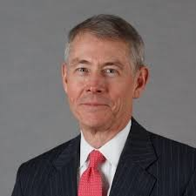
National Exploring Program Commissioner
Richard (Dick) Davies
Richard.davies.nyc@gmail.com
(914) 327-7430
Recent Scouting History
Interim Scout Executive for two years Greater
New York Councils ~ 2021 – 2022
Stepped down as Council Commissioner to take role
Formerly VP – Membership, VP – Scoutreach and Manhattan Borough President
Eagle Scout from Wisconsin
Exploring History
Exploring Chair, National Commissioner Service Team ~ Nov 2022 – TBD
National Exploring Program Commissioner, National LFL Executive Board ~ Nov 2022 -TBD
Area and Northeast Regional Exploring Chair and Board Member ~ 2018 – 2021
National Exploring Committee ~ 1976 – 1979
National Explorer President ~ 1976-77; Youth Member of National Executive Board
Professional Career
Since 2016, angel investor and advisory board member for start-up companies
Consultant to investment management industry
Most of career on business side of investment management industry (business unit management, client and product development) with Alliance Bernstein and Russell investments
Last ten years through 2016 working with largest 401k and other defined contribution plans around the world.

Slide 11
National LFL / Exploring Program Office Staffing Update
As of 10 November 2025, Dedra Douglas joined the National Service Center as the new Administrative Assistant working with Susan Fitzhugh (Senior Administrative Assistant)
On 1 December 2025, Carlos Coronado (who is currently the Assistant Director of Field Service with Heart of America Council) will be joining the National Service Center as the new Exploring Program Growth & Retention Executive

Slide 12
National Scouting America Council Office Staffing Update
Hiring two Program Growth & Retention Executives for
Venturing / Sea Scouts Program*
Cub Scouting Program
* For Tim Anderson’s Older Youth Programs staff

Slide 13


National Exploring Live Hour
20 May 2026
Craig Martin
National Exploring Program Chair,
Learning for Life Executive Board
Bruin1967@aol.com
719-331-6406
Richard (Dick) Davies
National Exploring Program Commissioner,
Learning for Life Executive Board
Exploring Chair,
National Commissioner Service Team
Richard.davies.nyc@gmail.com
914-327-7430
u

Slide 14
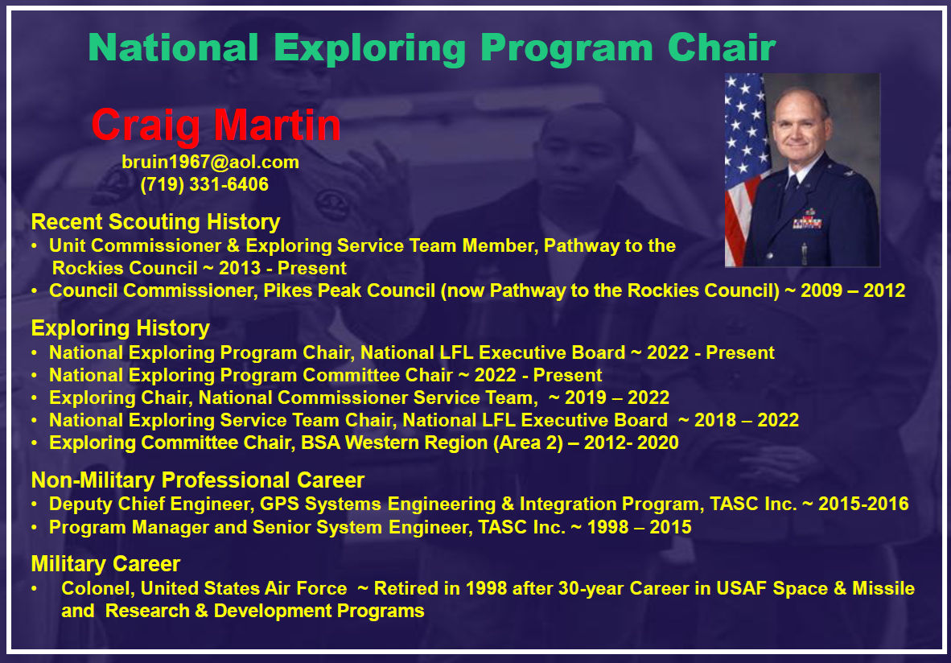
)

Slide 15
Safety Moment ~
Asthma*
* Scouting Safety Moments’ Heat-Related Illness (see https://www.scouting.org/health-and-safety/safety-moments/asthma/)
)

Slide 16

Asthma…
Every day in the U.S., people die from asthma, a chronic lung disease that can worsen at any time and for many different reasons. When asthma is controlled, it should not interfere with a person’s activity; however, when not controlled, it can cause life-threatening symptoms

Slide 17
Asthma ~ Prepared Adult Leaders…
Review each Explorer’s or adult’s Annual Health and Medical Record for health issues, including asthma, before any event
Understand the asthma action plan developed by the parent and Explorer or adult with their health care provider that explains what to do for an asthma attack
Know what triggers the Explorer’s or adult’s asthma and when to get advanced medical care, especially for remote locations
Become familiar with the medications used to treat an asthma attack and how they are used

Slide 18
Asthma Symptoms…
Coughing
Chest tightness
Shortness of breath
Wheezing
Symptoms might be severe enough to limit activity or even result in death if left untreated. Asthma symptoms might be triggered simply by exercise, smoky air, or cold air. Explorers, parents, and adult leaders should be very familiar with the individual’s triggers and the medications used to treat asthma. Medications for treatment should always be readily available
Generally, the more medications a person needs to treat asthma symptoms, the more difficult it is to control. The need for steroid pills (prednisone, Medrol, Decadron, etc.) or injections means that the asthma is hard to control, and the person will be more likely to have symptoms and difficulty with some activities

Slide 19
Asthma Treatment…
The treatment of asthma depends upon its severity. Those with mild disease may only require a rescue inhaler to use when needed, while others will require long-term control medications. It is very important that a person follows the recommendations of their health care provider. Commonly used asthma medications include:
Fast-acting medications ~
  Albuterol (ProAir, Proventil, Ventolin)
  Levalbuterol (Xopenex)
  Epinephrine auto-injector (EpiPen, Adrenaclick, Auvi-Q, etc.)
Controller medications ~
  Steroid inhalers (Asmanex, Flovent, Pulmicort, Qvar)
  Combination inhalers (Advair, AirDuo, Breo, Symbicort, Trelegy, etc.)
  Oral medications (Singulair, Accolate)
Injections used in very serious asthma ~ Xolair, Nucala, Dupixent, etc.

Slide 20
Asthma Resources…
Global Initiative for Asthma ~ https://ginasthma.org/
Mayo Clinic—Asthma ~ https://www.mayoclinic.org/diseases-conditions/asthma/symptoms-causes/syc-20369653
Safe Use of Medication in Scouting ~ https://www.scouting.org/health-and-safety/safety-moments/safe-use-of-medication-in-scouting/

Slide 21
Current Exploring Participation Status

Slide 22
Exploring Membership Growth Opportunity…
As of… | Units |  | Youth Membership |  | Adult Membership
 | Clubs | Posts | Clubs | Posts | Clubs | Posts
31 Jan 2020 * | 395 | 4,055 | 14,903 | 80,474 | 704 | 19,095
7 May 2026 | 147 | 1,221 | 3,017 | 18,804 | 624 | 7,688
Opportunity | 248 | 2,834 | 11,886 | 61,670 | 80 | 11,407
* Just before the COVID-19 Pandemic shut-down all in-person meetings
Positive upward or Negative downward trend since 20 April 2026; Clubs Units minus 8, Posts Units minus 21, Club Youth Membership minus 236, Post Youth Membership minus 430, Cubs Adult Membership minus 10 and Post Adult Membership minus 165

Slide 23
Exploring Participants as of 7 May 2026
Clubs/Posts = 1,368 (-29) Youth = 21,821 (-666) Adults = 8,312 (-175)
Career Area Units Youth Adults
Aquatics 1 24 7
Arts & Humanities 4 40 47
Aviation 45 (-2) 592 (-23) 308 (-10)
Business 10 (+2) 546 (+90) 55 (+12)
Education 36 722 (+8) 228 (+1)
Communications 3 157 (-2) 26
Engineering & Technology 25 (-2) 639 (+7) 168 (-8)
Explorer Clubs 147 (-8) 3,017 (-236) 624 (-10)
Fire/Emergency Services 357 (-10) 3,937 (-208) 2,202 (-69)
General Interest 59 (+3) 2,733 (+204) 347 (+18)
Health Care 60 (-4) 1,559 (-136) 359 (-16)
Law Enforcement 508 (-3) 5,436 (-199) 3,213 (-52)
Law / Gov’t / Public Service 64 (-1) 1,385 (-13) 425 (-11)
Science 10 (-1) 572 (+6) 53 (-5)
Skilled Trades 14 150 (-11) 89 (-5)
Social Services 3 120 (+20) 17 (+1)
STEM 7 107 (-6) 64
No Special Interest Selected 15 (-3) 95 (-98) 92 (-19)
NOTE: Numbers in parentheses are changes since 20 April 2026. Jeff Schweiger, National Exploring Membership & Retention Lead, observed that currently 104 clubs do not reflect “0999” special interest code (SIC) which will require each of these clubs’ council registrar to correct

Slide 24
National LFL / Exploring
Executive Board Chair Comments
Bernard (Bernie) Lockard

Slide 25
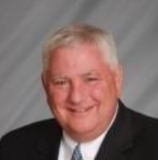
Bernie Lockard’s Background…
Scouting…
Eagle Scout (1972)
Order of the Arrow Vigil Honor
Cubmaster
Pack Committee Chairman
Assistant Scoutmaster
Scoutmaster
Unit Commissioner
Wood Badge Course Director
NYLT Course Director
District Chairman
President, Laurel Highlands Council’s Board of Directors (2013 - 2014)
2019 World Jamboree Scoutmaster
Chair, National Venturing Committee (2020 - 2022)
2023 & 2017 National Jamboree Staff
National Eagle Scout Association Scholarship Committee (2013 - Present)
Chair, National BSA Council Finance & Fundraising Committee (2022 – Present)
BSA Recognition…
Award of Merit – 1998
Silver Beaver – 2001
Distinguished Citizen – 2010
Rockefeller Award – 2010
Silver Antelope – 2014
National Outstanding Eagle Scout Award - 2015
National Venturing Leadership Award – 2022
Silver Buffalo - 2024
Personal…
Married to Robyn L. Ashbridge, father of five and grandfather of seven
President, The Lockard Company, Indiana, PA
Graduate of Carnegie-Mellon University, Pittsburgh, PA, with B.S. in Administration and Management Science, Economics, Mathematics (Graduated With Honors)

Slide 26
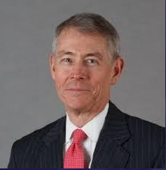
National Exploring Program Commissioner
Richard (Dick) Davies
Richard.davies.nyc@gmail.com
(914) 327-7430
Recent Scouting History
Interim Scout Executive for two years Greater New York Councils ~ 2021 – 2022
Stepped down as Council Commissioner to take role
Formerly VP – Membership, VP – Scoutreach and Manhattan Borough President
Eagle Scout from Wisconsin
Exploring History
Exploring Chair, National Commissioner Service Team ~ Nov 2022 – TBD
National Exploring Program Commissioner, National LFL Executive Board ~ Nov 2022 -TBD
Area and Northeast Regional Exploring Chair and Board Member ~ 2018 – 2021
National Exploring Committee ~ 1976 – 1979
National Explorer President ~ 1976-77; Youth Member of National Executive Board
Professional Career
Since 2016, angel investor and advisory board member for start-up companies
Consultant to investment management industry
Most of career on business side of investment management industry (business unit management, client and product development) with Alliance Bernstein and Russell investments
Last ten years through 2016 working with largest 401k and other defined contribution plans around the world.

Slide 27
Scouting America
National Annual Meeting
12 – 15 May 2026

Slide 28
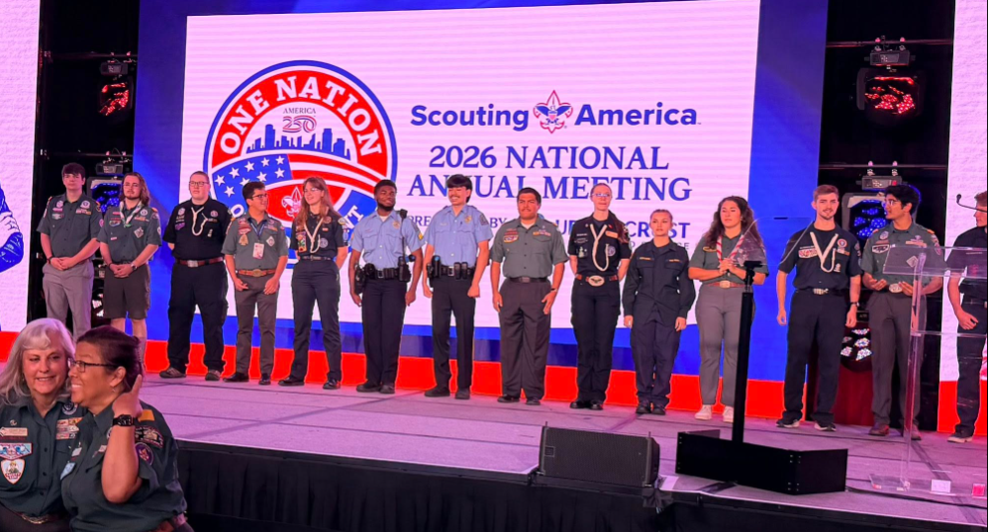
Scouting America NAM…
Along with Jeff Schweiger, National Exploring Membership & Retention Lead, we had three Law Enforcement Explorers from Circle Ten Council (Dallas TX) and one Fire & EMS Explorer (along with her Advisor) from Atlanta Area Council supporting our Exploring NAM Booth

Slide 29
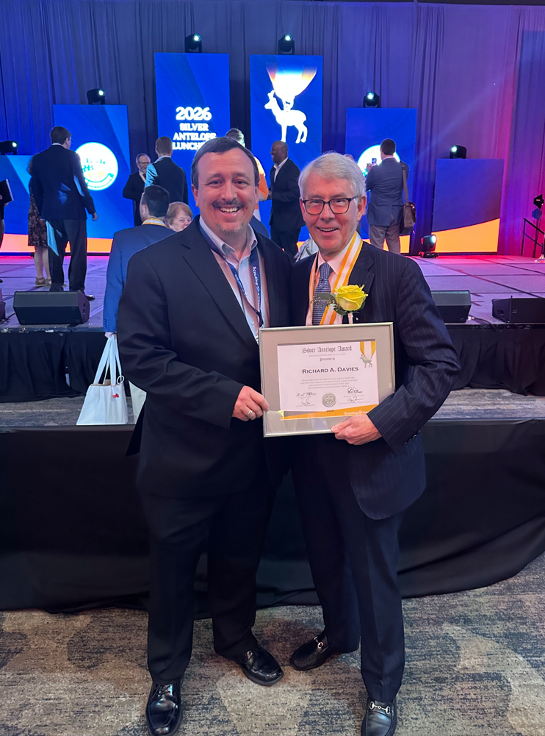
National Exploring Program Commissioner…
Dick Davies received the Silver Antelope Award during the 2026 Scouting America National Annual Meeting

Slide 30
Marketing & Technology Chair,
Nat’l LFL Exec Board
Comments
Jeffrey (Jeff) Schweiger

Slide 31
National Exploring Program Committee

Slide 32
National Exploring Resource Advisor
Stuart Mahler

Slide 33
Nat’l Exploring Committee Members…
National Exploring Program Chair Craig Martin
National Exploring Program Commissioner Richard (Dick) Davies
National Exploring Membership Growth / Retention Lead Jeffrey (Jeff) Schweiger
National Exploring Awards & Recognition Lead Richard (Rick) Belford
National Exploring Training Lead Roger Engelbart
National Exploring Health & Safety / YPT Lead Linda Hassler
National Exploring Marketing / Communications Lead (Website / Social Media) TBD *
National Exploring Materials & Literature Lead Timothy (Tim) Buckles
National Exploring Career Fields Development Lead TBD *
National Exploring Youth Officer Advisor TBD *
National Exploring Youth Chair TBD
National Exploring Partnerships / Relationships Lead TBD *
National Exploring Resource Advisor Stuart Mahler
National Special Needs Committee Liaison for Exploring Britt Flather
National Exploring Members-at-Large (National Exploring Resource Associate Advisors)
  National Exploring Subject Matter Expert Don Deeker
  National Exploring Subject Matter Expert Joseph (Joe) Marinelli
  National Exploring Subject Matter Expert Suzie Steiner
  National Exploring Subject Matter Expert Rick TerBorch
* Note: Welcome recommendations from anyone

Slide 34
National Exploring Subject Matter Experts & Exploring Resource Associate Advisors
In support to our fourteen Scouting America Council Service Territories (CSTs), our National Exploring Program is currently supporting each CST, along with their territory’s councils, with a National Exploring Subject Matter Expert (SME), who serves as that territory’s National Exploring Resource Associate Advisor (ERAA). As a caveat, we do not presume this role is either formally or informally part of the CST organizational structure but rather a service being made available by the National Exploring Program to each CST and/or their councils. Additionally, we have a National ERAA dedicated to supporting the California Highway Patrol (CHP) and the councils with CHP Law Enforcement Posts as well as the posts themselves

Slide 35
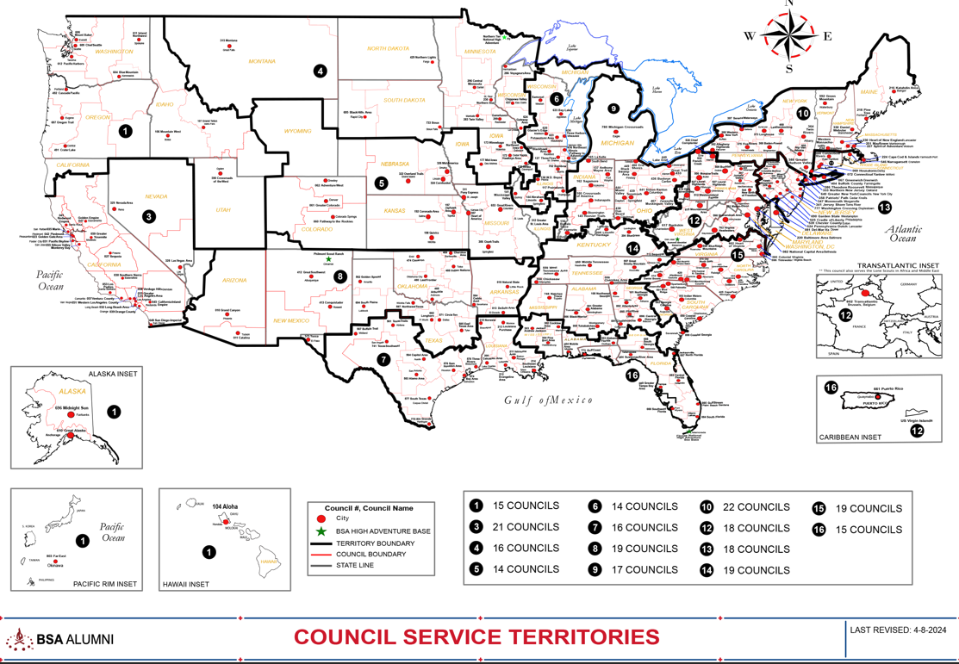
Council Service Territories (CSTs)…
COUNCIL

Slide 36
Current National Exploring SMEs / RAAs Team...
CST 1 ~ Suzie Steiner (Mountain West Council), who is currently an Advisor for an Exploring STEM / Robotics Post, which also encompasses trades such as machining & welding and business careers, and has previously been an assistant district commissioner, assistant & roundtable commissioner and Cub Scout den leader. National Exploring Resource Associate Advisor (ERAA) supporting the CST 1 and councils within the territory
suzie@openlabidaho.org
((208) 869-2403
CST 3~ Stuart Mahler (Golden Gate Area Council), who is currently an Assistant Council Commissioner and LFL Council Exploring Chair and Executive Board Member as well as a retired police officer, an advisor in the 1987 Law Enforcement Exploring National Academy, staff member on three National Exploring Law Enforcement Exploring Conferences and Law Enforcement Explorer in his youth. National Exploring Resource Advisor (ERA) supporting the CST 3 and councils within the territory
mdc.stuart@gmail.com
(925) 519-6957
CST 4 & 5 ~ Roger Engelbart (Greater St Louis Area Council), who is currently the Assistant Council Commissioner for Training and the Engineering Chair for the Council Exploring Committee, as well as a retired Boeing Engineer involved in Nondestructive Evaluation. National Exploring Training Lead and National Exploring Resource Associate Advisor (ERAA) supporting the CST 4 & 5 and councils within those two territories
engelbart301@sbcglobal.net
(314) 920-8968

Slide 37
Current National Exploring SMEs / ERAs Team...
CST 6 ~ Richard (Dick) Davies (Glacier's Edge Council) who is the National Exploring Commissioner, Exploring Chair for the National Commissioner Service Team & National Exploring Program Committee Vice-Chair, as well as VP - Development in Glacier's Edge Council (Madison, WI), Greater New York Councils Executive Board Member, former Interim Scout Executive for the Greater New York Councils (2021 & 2022), past Northeast Region Exploring Chair and Board Member, and, in his youth, National Explorer President (1976-77) & Youth Member of National Executive Board. National Exploring Resource Associate Advisor (ERAA) supporting the CST 6 and councils within the territory
richard.davies.nyc@gmail.com
(914) 327-7430
CST 7 ~ Don Decker (Bay Area Council) - Eagle Scout, Woodbadge staff member, retired BSA Professional Scouter, Business and Banking Explorer as a youth, and currently a full time Agriculture Specialist, US Customs and Border Protection Agency. National Exploring Resource Associate Advisor (ERAA) supporting the CST 7 & 16 and councils within the territory
donedecker@gmail.com
( 832) 266-7145
CST 8 ~ Craig Martin (Pathway to the Rockies Council), who is the National Exploring Program Committee Chair as well as a retired Senior Systems Engineer supporting Department of Defense satellite programs and a retired USAF Colonel with extensive experience building, testing, launching & operating US Air Force satellites and testing air-to-air & air-to-ground missile systems. National Exploring Resource Associate Advisor (ERAA) supporting the CST 8 & 14 and councils within the territory
bruin1967@aol.com
(719) 331-6406

Slide 38
Current National Exploring SMEs / ERAs Team...
CST 9 ~ Richard (Rick) Belford (Western Massachusetts Council), is currently the Council Commissioner and Committee Chair for three units - a Cub Scout Pack, a Scouts BSA troop, and a Sea Scout Ship. He is also a former Scouting Professional/District Executive, a retired DOD/Federal employee and a retired USAF Chief Master Sergeant. National Awards & Recognition Lead and Resource Associate Advisor (ERAA) supporting the CST 9 Program Lead and councils within that territory.
o rebwmc234@gmail.com
o (860) 402-4836
CST 10 ~ Joseph (Joe) Marinelli (Seneca Waterways Council), who is the Council Executive Committee’s & Board’s former Vice President of Exploring, past President of the Finger Lakes Council and Executive Director, Finger Lakes STEM Hub as well as a retired Regional Supervising Superintendent & BOCES (service agency) CEO for 25 school districts in upstate New York. National Exploring Resource Associate Advisor (ERAA) ) supporting the CST 10 and councils within the territory
josephjmarinelli@aol.com
(585) 704-4659
CST 12 – Jeff Schweiger (National Capital Area Council), who is currently an Assistant Council Commissioner (STEM, Exploring, Communications and Resources) as well as Membership Growth and Retention Lead on the National Exploring Committee. He is a retired Naval Officer and presently works for a national security government contractor. An Eagle Scout, he also was a member of a communications (print journalism) Exploring Post as a youth. National Exploring Resource Associate Advisor (ERAA) supporting the CST 12 & 15 and councils within those two territories
Scouter.jeff@earthlink.net
(703) 472-0669

Slide 39
Current National Exploring SMEs / ERAs Team...
CST 13 ~ Linda Hassler (Monmouth Council) who is currently a member of her Monmouth Council Board of Directors and Troop 140 Committee Member as well as an Assistant Professor at Rutgers’ School of Nursing, former Northeast Region Area 5 Exploring Chair, former Exploring Post Advisor and a Tennis Explorer in her youth. National Exploring Health & Safety / YPT Lead and National Exploring Resource Associate Advisor (ERAA) supporting the CST 13 and councils within the territory
Lindajhassler@gmail.com
(732) 687-7208
CST 14 ~ Craig Martin
CST 15 ~ Jeff Schweiger
CST 16 ~ Don Decker
CHP ~ Rick TerBorch (Los Padres Council)*, who is the former National Service Territory (NST) 3 Commissioner, Assistant Council Commissioner and Council Executive Board Member as well as a retired Chief of Police in Arroyo Grande, CA, past Los Padres Council President & Council Commissioner, past National Law Enforcement Exploring Committee Member, Exploring Advisor and over 35+ years in Law Enforcement Exploring. National Exploring Resource Associate Advisor (ERAA) supporting the California Highway Patrol (CHP) and the councils with CHP Law Enforcement Posts.
rterborch@earthlink.net
(805) 441-1721
* Stuart Mahler (CST 3 Exploring Resource Advisor) is Rick’s CHP Contact Alternate

Slide 40
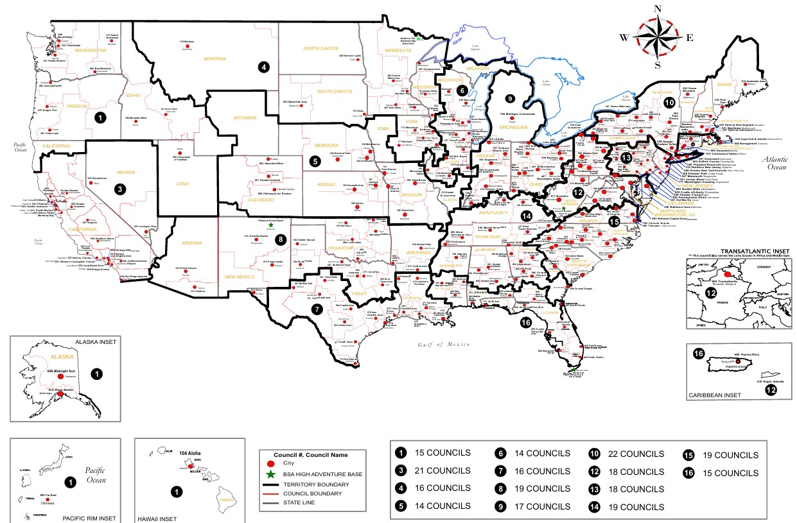

Exploring Associate Resource Advisors
Serve the Entire Country
Find your Council Service Territory & assigned ERAA at
www.exploring.org/about-us

Slide 41
Current National Exploring SMEs / RAAs Team...
Additionally, any of these National Exploring RAAs are available to any of the CSTs and their councils on the following Exploring Career Fields
Arts & Humanities ~ Tim Buckles
Aviation ~ Rick Belford & Roger Engelbart
Business ~ Rick Belford (Contracting & Procurement)
Communications ~ Rick Belford (Broadcasting & Public Relations)
Engineering & Technology ~ Roger Engelbart, Craig Martin and Suzie Steiner (Robotics)
Health Care ~ Linda Hassler
Law & Government ~ Craig Martin & Rick Belford (Military Careers)
Law Enforcement ~ Stuart Mahler & Rick Terborch
Skilled Trades ~ Joe Marinelli & Suzie Steiner
Social Services ~ Joe Marinelli (Education), Linda Hassler (College Professor), Rick Belford (Non-Profit / Not-For-Profit Management) and Suzie Steiner (STEM)
Other Career Fields ~ National Exploring RAA, assisting your CST, will find the best individual to assist you for other Exploring Career Fields

Slide 42
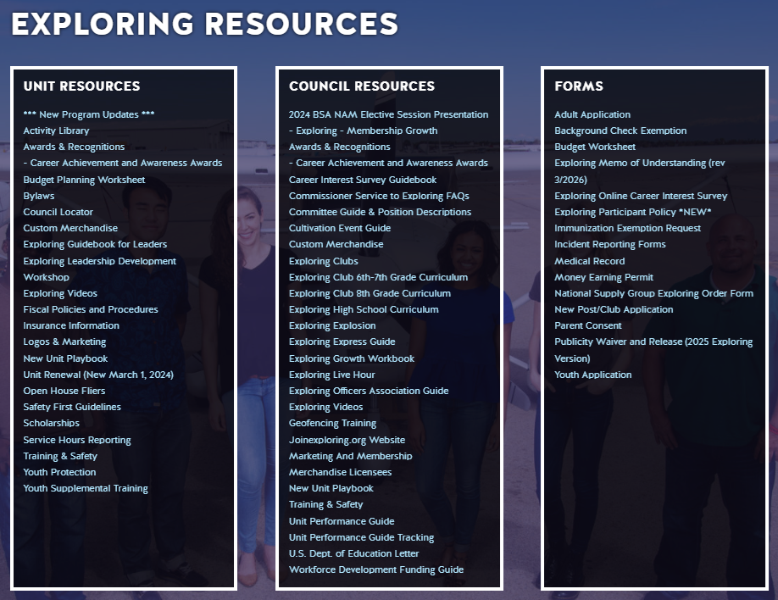
National Exploring Home Page @ exploring.org

Slide 43

Scouting America’s
2026-2027 Organizational Goals

Slide 44
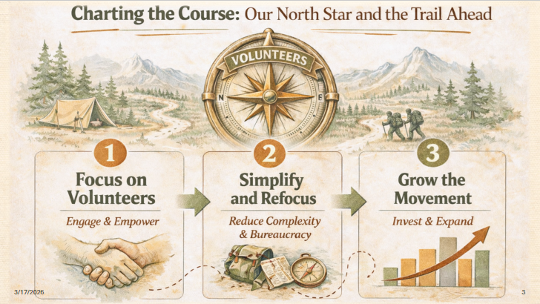
Scouting America’s
2026-2027 Organizational Goals continued

Slide 45
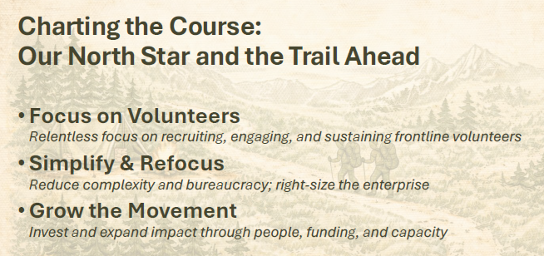
Scouting America’s
2026-2027 Organizational Goals continued

Slide 46
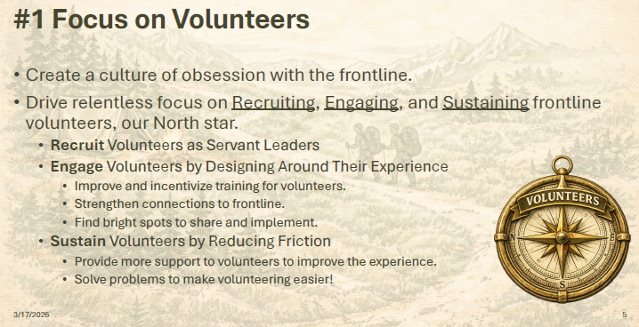
Scouting America’s
2026-2027 Organizational Goals continued

Slide 47
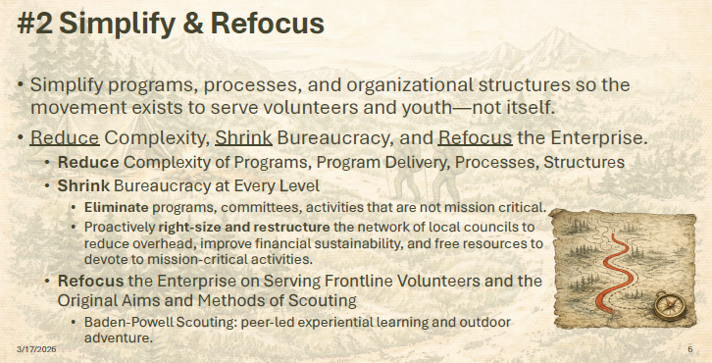
Scouting America’s
2026-2027 Organizational Goals continued

Slide 48
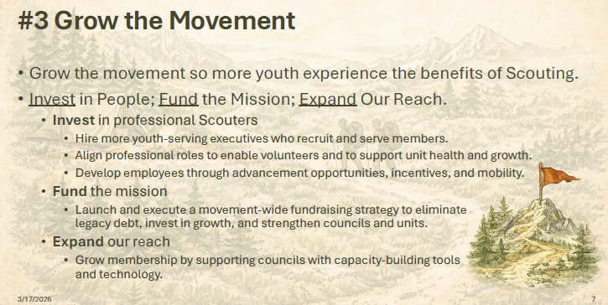
Scouting America’s
2026-2027 Organizational Goals continued

Slide 49
2026-2027 National Exploring Program Priorities (Abridged Version) Mapped to Scouting America’s 2026-2027 Trail Map Priorities

Slide 50
2026 – 2027 National Exploring Priorities…
Scouting America Trail Map Priority #1: Focusing on volunteers
  Update Exploring Safety First Guidelines with Scouting America Health & Safety Team
  Review and Update Exploring Guidebook for Post & Club Leaders (last updated 2017) via SME task force
  Establish National Youth Officer structure aligned with other older youth programs
  Continue to develop the 12 National Exploring Career Committees to support councils
Scouting America Trail Map Priority #2: Simplifying and Refocusing
  Update District Operations Basic Training to have updated information for the Exploring Program
  Enhance resources: expand marketing library using actual photos from council exploring units
  Remove outdated or hard-to-reproduce materials
  Standardize marketing tools: print-ready brochures, flyers, posters
  Develop Donor Materials for prospective sponsors of Explorer Posts

Slide 51
2026 – 2027 National Exploring Priorities…
Scouting America Trail Map Priority #3: Growing the Movement
  Expand training: Provide regularly scheduled Live Hours and Zoom sessions as outlined in Exploring Explosion 3.0 www.exploringexplosion.org
  Train professionals and volunteers on four phases of organizing a Post/Club
  Strengthen National Commissioner Service Team’s view of Exploring Program’s value, as well as promotion of Exploring unit service engagement at the council & district level, and provide quarterly updates to Council Service Territories & their councils
  Survey councils and share proven Exploring membership growth strategies

Slide 52
What’s New for Exploring in 2026

Slide 53

www.exploringexplosion.org

Slide 54

Exploring Explosion
Membership Growth Incentive…

Slide 55
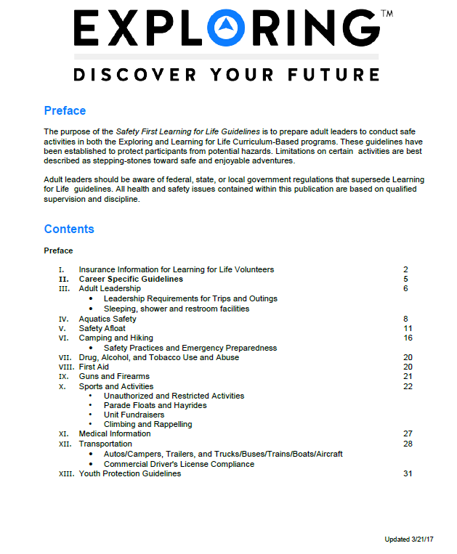
Exploring Safety First Guidelines
National Exploring Committee’s Health & Safety & YPT Lead’s Team updated the “Exploring Safety First Guidelines” and passed their proposed revision to the BSA Health and Safety Team for their review and comments
Expect the updated “Exploring Safety First Guidelines” release in summer 2026

Slide 56
Exploring Safety First Guidelines Update
On 10 June 2025, National Exploring Director Tim Anderson issued the following direction to all Scouting America Council Scout Executives…
Learning for Life, Exploring, and Scouting America are updating the standard regarding Ride-Alongs for all programs, including but not limited to Law Enforcement Exploring. When youth under 18 years of age participate in Ride-Alongs, all parties involved must adhere to all current Safeguarding Youth policies and guidelines (formerly known as Youth Protection) for all participants. This includes ensuring that at least two registered adult leaders, each 21 years of age or older and trained in Safeguarding Youth or Youth Protection, are present for the Ride-Along. If the Ride-Along includes a female youth participant, at least one of the registered adult leaders participating in the Ride-Along must also be female.
This standard is mandatory and takes effect on June 30, 2025; however, it should be implemented as soon as possible. While we acknowledge that this change may pose challenges in certain Ride-Along scenarios, it must be strictly enforced to guarantee the safety of both our youth participants and adult leaders.
We will update other documents that refer to Ride-Alongs soon. In the meantime, please ensure that your units participating in Ride-Alongs are notified about the standard and its effective date. Additionally, remind the Participating Organization to verify that all adults, including young adult participants (aged 18-20), are current with their Youth Protection Training or promptly complete the Safeguarding Youth training. You may access the training at: https://www.scouting.org/training/youth-protection/
Scout Executives, if you have any questions concerning this update, please reach out to us at Exploring@learningforlife.org

Slide 57

Exploring Leadership Experience…
VISION: Nationally recognized program that offers young men and women an opportunity to enhance their understanding of leadership in the workplace through interactive instruction, self-reflection, and practical application while working with an adult mentor to gain professional leadership experience. The Exploring Leadership Experience will be available to all Explorers registered in an Exploring post who meet the requirements.

Slide 58
Exploring Leadership Experience continued
ELIGIBILITY REQUIREMENTS: Explorers must first meet the following basic qualifications:
Currently registered in an Exploring post with at least three months of tenure as an active, registered Explorer.
Plans to complete the Exploring Leadership Experience requirements before his or her 21st birthday.
Has earned the Exploring Achievement Award within any career field OR has held a leadership role either within or outside the post in the past 12 months.

Slide 59
Exploring Leadership Experience continued
ON-LINE LEARNING MODULES: The Exploring Leadership Experience is designed to be a self-paced, experiential learning process for each Explorer who commits to completing the program. A critical component of this learning process is a series of self-paced, online leadership development modules that Explorers must complete on their journey to improved leadership skills. Explorers
are required to complete each series of leadership skills modules in the order listed in the next slide. However, the modules within each series can be completed in any order.

Slide 60
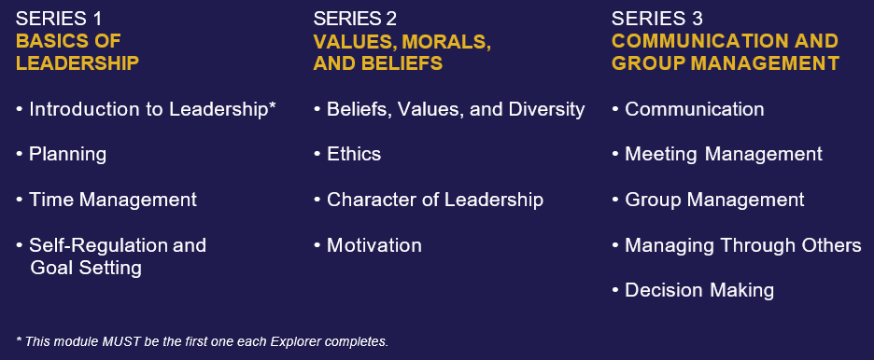
Exploring Leadership Experience continued
ON-LINE LEARNING MODULES: continued
NOTE: All the above modules are up-to-date and currently reside in Scouting America’s Learn Center, except the “Introduction to Leadership” module which is being updated by Scouting University Instructional Design Office

Slide 61

Exploring Leadership Experience continued
GUIDEBOOK: Finalized and is being updated by Scouting America’s Editorial Operations Office
INTRODUCTION TO LEADERSHIP LEARNING MODULE: Finalize and is being updated by Scouting U Instructional Design Office
EXPLORING LEADERSHIP EXPERIENCE ROLL-OUT: Expected in May-June 2026

Slide 62

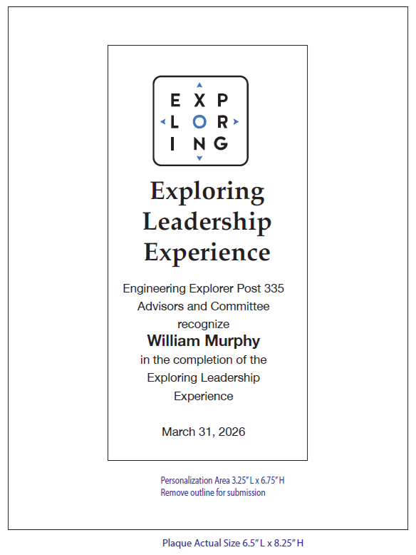
Exploring Leadership Experience Recognition Plaque….

Slide 63
Upcoming Program Development Committee Meetings
On 5 July 2025, Tom Bain, Scouting America’s National Program Development Committee Chair send following e-mail:
We will have the next meeting of the Program Development Committee on Tuesday, August 12th at 5:00 pm PDT / 6:00 pm MDT / 7:00 pm CDT / 8:00 pm EDT. I’ll send an electronic invitation with the Zoom details. The Zoom link will also be in the agenda, which I expect to send out later this month.
For planning purposes, here are the dates for the meetings through December 2026:
14 October 2025
9 December 2025
10 February 2026
14 April 2026
9 June 2026
11 August 2026
13 October 2026
8 December 2026
(NOTE: These are all the second Tuesday of the month and will be at the same time as the 12 August 2025 meeting)

Slide 64
2026
National Exploring Live Hour
Dates & Registration Link

Slide 65
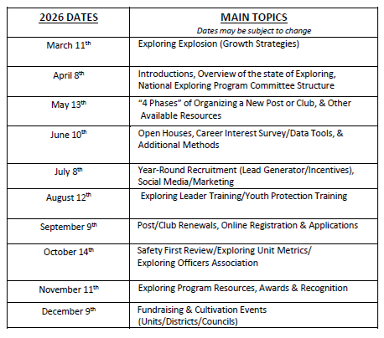
National Exploring Live Hour 2026 Dates
National Exploring Live Hour from 1:00 PM – 2:00 PM Central Standard Time, Monthly
Register for each of the National Exploring Live Hour ZOOM presentations (click below):
2026 National Exploring Live Hour Registration =
https://reservations.scouting.org/profile/form/index.cfm?PKformID=0x167391abcd
NOTE: We changed the May 2026 Live Hour from the 13th to 20th due the 2026 Scouting America NAM occurring between May 12th to May 15th

Slide 66
International Association of Fire Fighters (IAFF)
The fire and EMS industry is struggling with recruitment and retention issues, and we would like to take a more active role in the encouraging a career in the service. For our discussion, when I use the term “affiliate” I am referring to the IAFF local union.
Specifically, we need:
A program that is easily replicated across the United States and Canada
A program that engages youth and transitions into the teenage years. Essentially, club (10 -14) and then Explorer post (14 -21).
I will need to know about:
  Insurance coverage and operating costs
    Essentially what will a department/affiliate be responsible for and what will the Boy Scouts provide.
  Any training that adults must go through
  Materials for distribution that outline the process
    Is there a co-branding opportunity here?
  Are there any limitations on the program?
  How do we design curriculum?
  I remember you mentioned support, what type of support can we anticipate?
  Since this will be a national, potentially international program, how will affiliates/departments access support?
    How does the regions look and work.
I think we will need to have at least one intro meeting and then potentially a follow up with more individuals as the program grow.
I look forward to scheduling a time to speak.
Respectfully,
Thomas Breyer
AGP for Technical Assistance & Information Resources
International Association of Fire Fighters

Slide 67
Exploring Membership Growth Approach
Beta-Test ~
“The Exploring Career Opportunities (ECO) System”

Slide 68
“The ECOsystem” Beta Test
From Scot Fuller, Deputy Scout Executive/COO, Longhorn Council.
I wanted to invite you to participate in a beta test for an innovative program delivery system designed to produce sustainable membership growth through strategic partnerships with school districts. This has worked in a school district, and we wanted to see if this is replicable in other areas in the country. I am looking for a few other councils with a mindset of trying new things to participate with the Longhorn Council so we can share learning experiences with each other. This beta test leverages key partnerships to empower youth from Kindergarten to High School with college and career readiness. Here’s the short of what we are looking to do:
Supercharge CTE Programs with Exploring (The ECOsystem):
  Integration: Exploring is seamlessly integrated into school district CTE programs.
  Community Support: Supported by local service clubs such as Rotary, Optimists, Kiwanis, Lions, and Elks essentially becoming a quasi-Service Team for the Exploring program.
  Streamlined Operations: Requires only one dedicated Council Exploring Professional working alongside a volunteer Exploring Chair and a committee of Exploring Liaisons from local service clubs.
Build Council Credibility and Introduce Character Education Programs:
  Scouting America partners with school districts and community organizations to prepare youth for college and career readiness through a proven, integrated, age-appropriate series of programs from Kindergarten to High School.
  Cub Scouts: Character education supporting families and elementary school teachers.
  Scouts BSA: Leadership skills and support for middle school teachers.
  Venturing: Character education supporting high school outdoor education programs.

Slide 69
“The ECOsystem” Beta Test continued
How to Participate:
Let me know if you want to learn more about this beta test. We are going to have several upcoming opportunities to talk through this and see if this makes sense for you and your council.
Exploring Live Hour: June 12th at 1pm Central Time https://reservations.scouting.org/profile/144800
Ecosystem Approach: June 17th at 1pm Central https://us06web.zoom.us/j/87607386091?pwd=WTqL7ulCmteKegcO04fo4aZdtAgdpS.1
Ecosystem Approach: June 17th at 6pm Central https://us06web.zoom.us/j/82478568334?pwd=OCaifhi371SnxNbRal4S1sz8aoAy7O.1
If you have any questions about this, feel free to reach out.
Scot Fuller, CNP | Deputy Scout Executive/COO
LONGHORN COUNCIL
Boy Scouts of America
C: (817) 231-8508
scot.fuller@scouting.org

Slide 70
The Exploring “ECOsystem” Beta Test continued
“The ECOsystem” is the brainchild of Chris John, Greater Colorado Area Council Exploring Chair
Currently the following councils have “signed up” to participate in this Beta-Test:
  Capital Area Council (Austin TX)
  Indian Waters Council (Columbia SC)
  Longhorn Council (Fort Worth TX)
  Mayflower Council (Milford MA)
  Montana Council (Great Falls MT)
  Orange County Council (Santa Ana CA)
  Western Massachusetts Council (Westfield MA)
Monthly reviews on the 4th Wednesday of each month

Slide 71
Next National Exploring Committee & SMEs Team Meeting…
Our monthly meetings normally occurs on the 4th Monday of the month; therefore, our next Zoom team meeting will be on Monday 22 June 2026 @ 5:00 pm ET / 4:00 pm CT / 3:00 pm MT / 2:00 pm PT

Slide 72
Topic(s) of the Month
4 Phases of Organizing a New Post/Club

Slide 73
REGISTRATION BASICS
YOUTH
POST: ___ and have completed eighth grade OR 15 years of age but not yet ___ years old
CLUB: 6th-8th graders who have completed the ____ grade and are at least 10 years old but have not completed the eighth grade and are not yet ____ years old.
ADULTS
___ years age or older
POST: Min of 4 adults
  ______________ (CC)
  2 ____________ (MC)
  _______________ (EA)
CLUB: 2 adults _______________ (ES)
_______________ (AS)
PAPERWORK
New Post/Club ____________
4 _________ Apps
5 _________ Apps
Annual ______________
of Understanding
$____ General Liability Insurance Fee
$____ per person registration fee
14
21
Application
21
Adult
Committee Chair
2 Committee Members
Youth
5th
Advisor
Memorandum
Sponsor
100
15
Assoc Sponsor
50
Exploring Youth Participants “EP’s” ages 18-20 must complete an
Exploring ________ Application & Successfully Complete YPT.
Adult

Slide 74
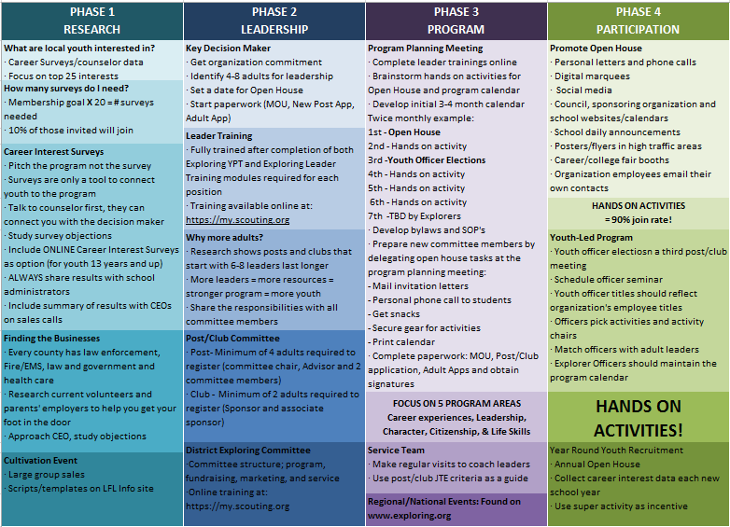

Slide 75
4 Steps/Phases in Organizing a new Post
1. Research-
Conduct the Career interest surveys
and develop business/community prospects
2. Leadership-
Meeting with the top leadership within the
businesses/community and identifying program
leaders; includes training of leaders
3. Program-
Develop the organization’s meeting/program
themes and prepare for an open house
4. Participation-
Recruiting youth through an organized open house and
involvement of youth in program development

Slide 76
MOST IMPORTANT PART
OF EACH PHASE?
Phase 1 : Career Interest Surveys
Phase 2: Training
Phase 3: All-In-One Program Planning Meeting
Phase 4: Open House

Slide 77
Career Interest Surveys
The # 1
Leading Indicator for Exploring Growth

Slide 79
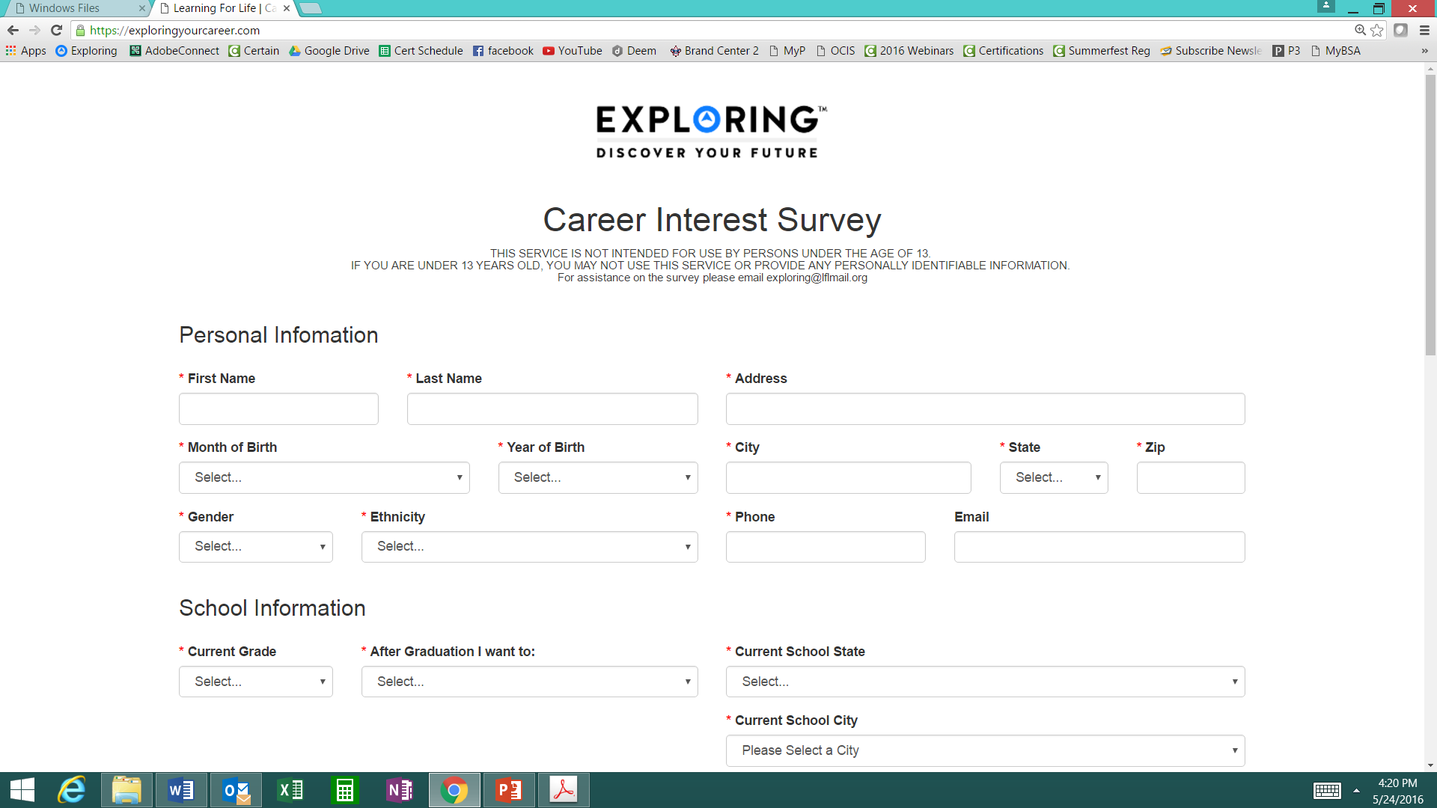
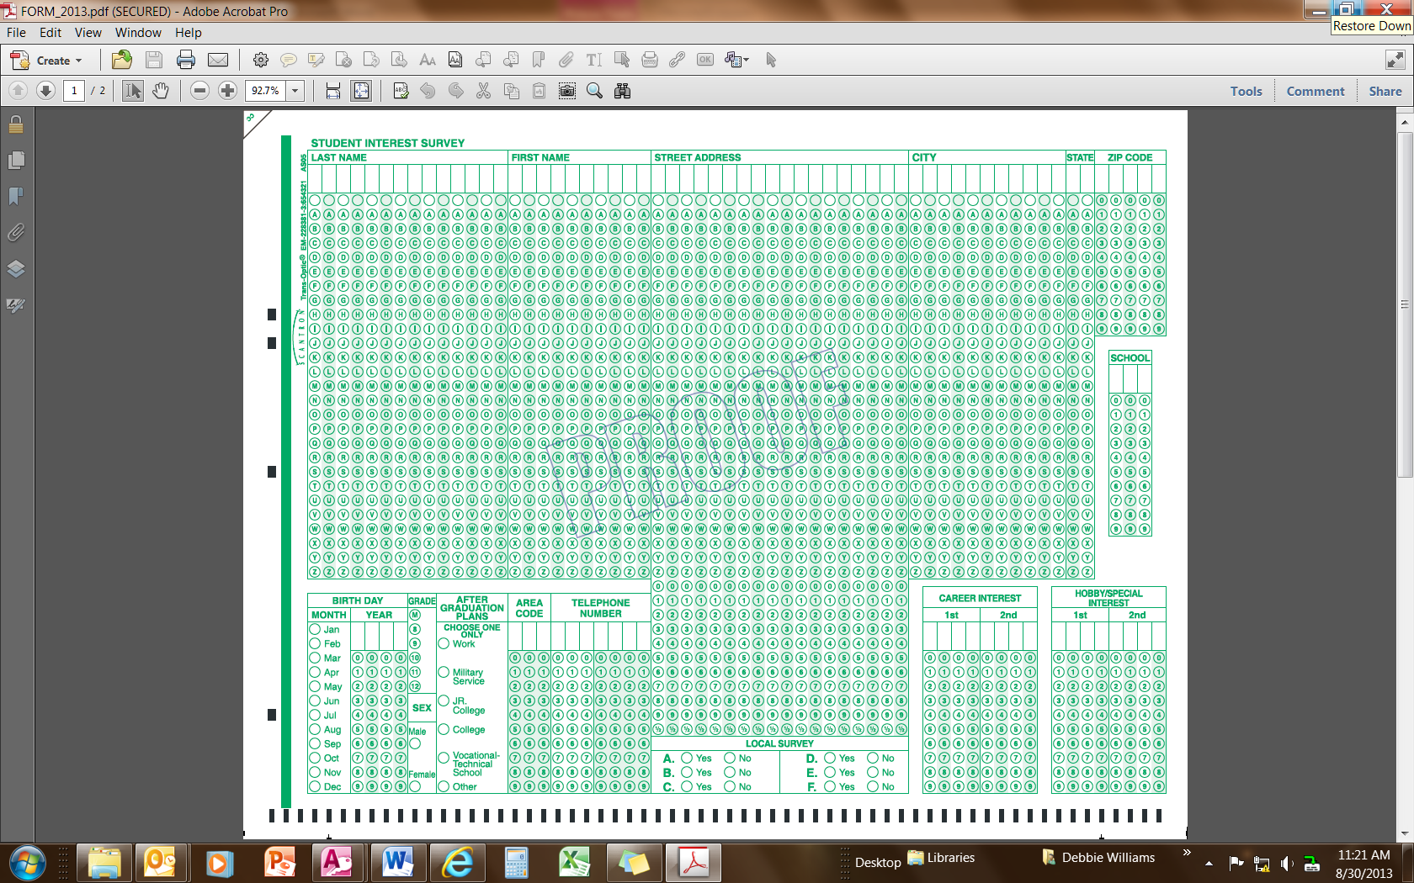
Phase 1 – Research
Career Interest Surveys (two choices)
pa
pa
Online Survey:
www.exploringyourcareer.com
Paper Scantron Survey

Slide 80
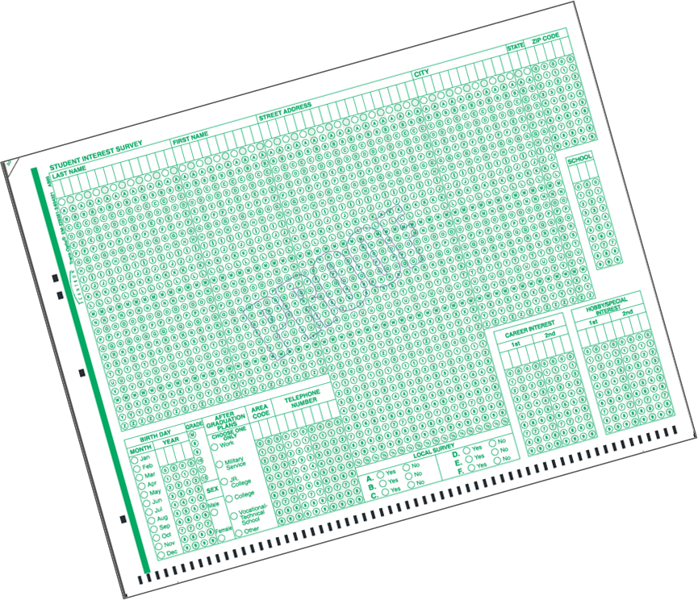
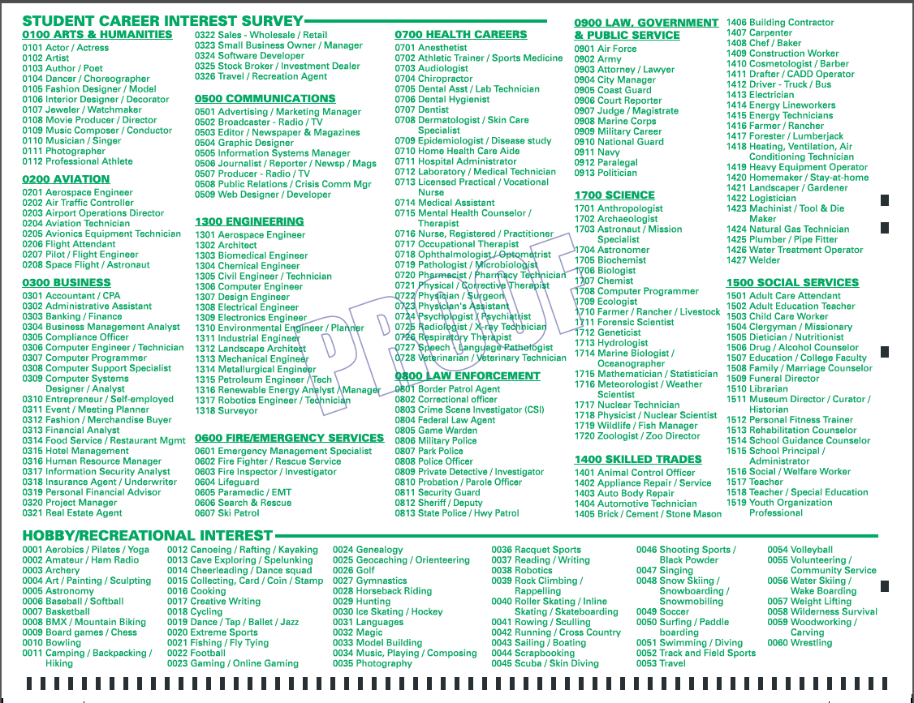
BACK SIDE
FRONT SIDE
Paper Scantron Survey Available through NDC

Slide 81
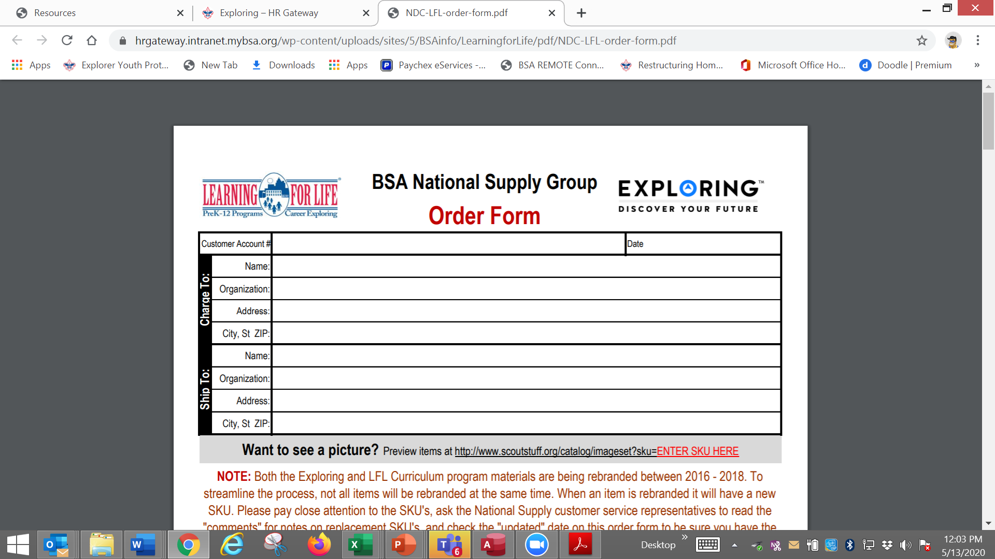

Slide 82
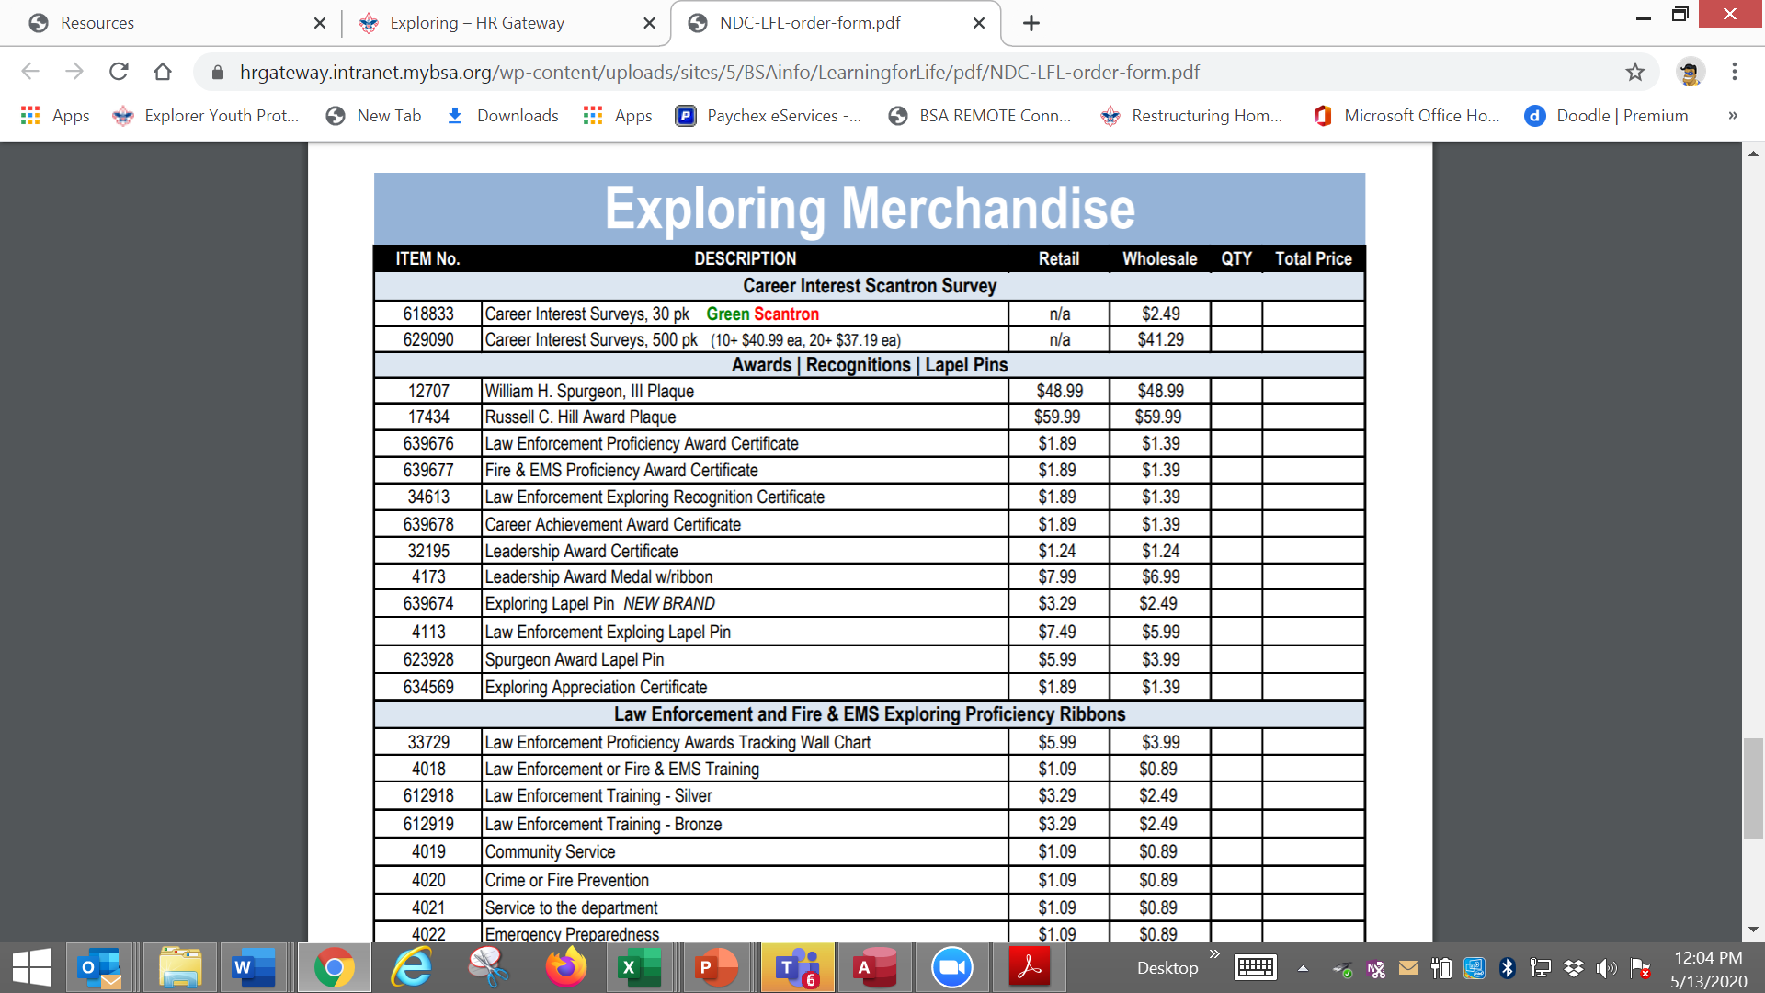

Slide 83

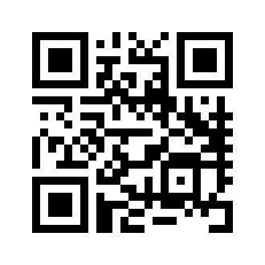
Online Career Interest Survey
www.exploringyourcareer.com
TRY IT NOW!
Use QR code or simply type address in web browser
Notes:
A “QR” or Quick Response code was created to take students directly to the survey site. It is available on posters, post cards, business cards, and book marks.
How do you use this? Email it to all teachers, they can open it from email and project it one screen for students to use their smartphones!

Slide 84
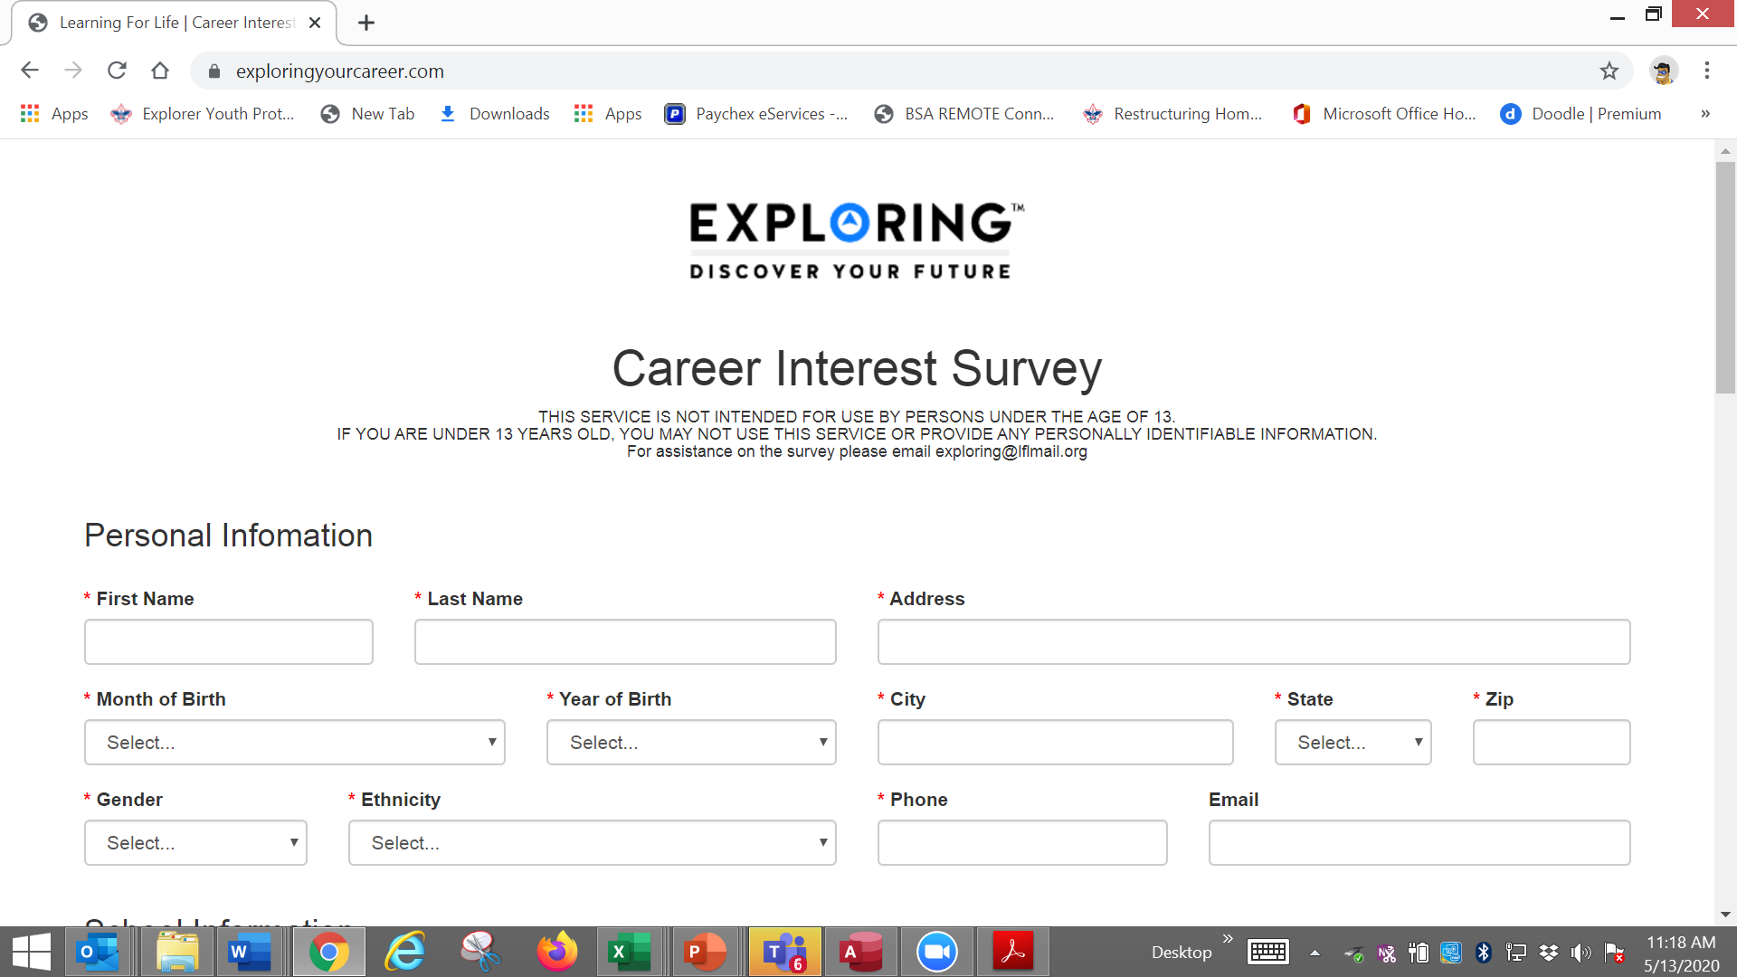

Slide 85
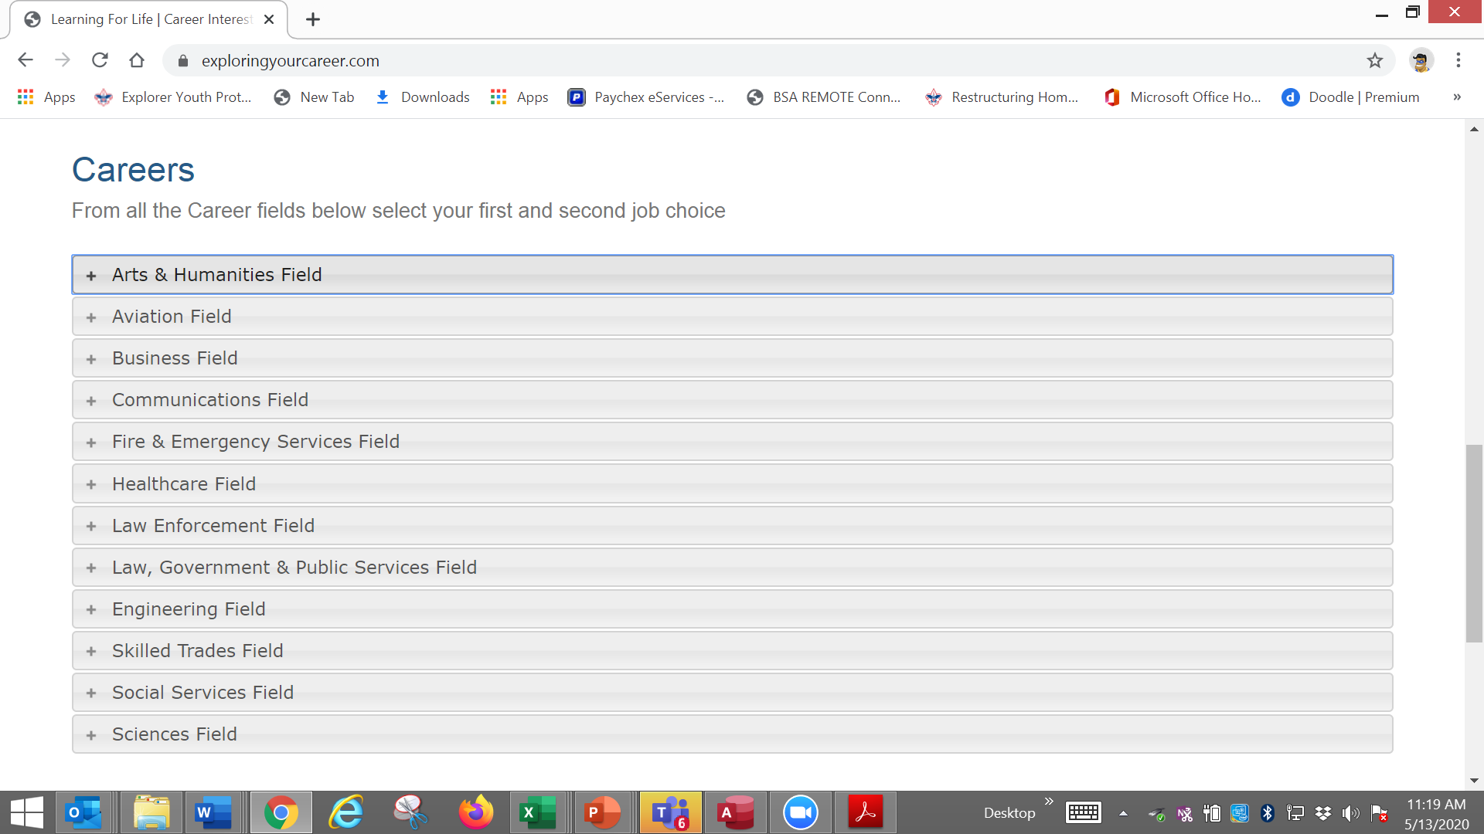

Slide 86
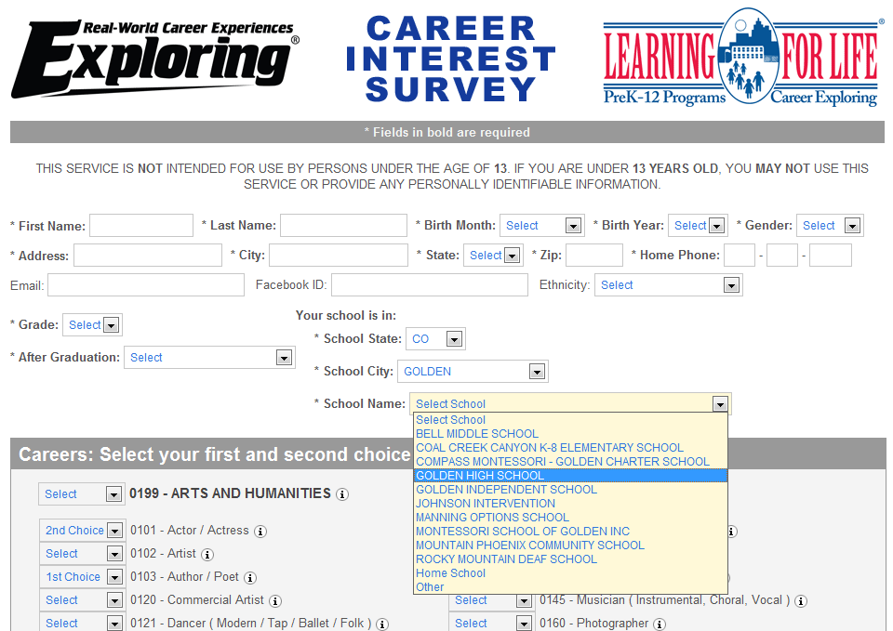
www.exploringyourcareer.org
Two career & hobby choices
School names
pre-loaded
Notes:
REFER TO HANDOUT IN YOUR FOLDER.
This is a screen shot of the new Online Career Interest Survey that was activated on Jan 1, 2012.
The careers & hobbies match the paper version. So schools and administer the survey either on paper or electronically.
The online version can be accessed from any device that can access the Internet – including smart phones.
Results are sent instantly to a secure website where councils can access the results and provide them to schools in the same format as the paper survey.
Instructions for accessing results can be found in the LFL internal site.
Students 13 yrs. and younger cannot legally complete this survey online. If they enter data, the system will not save it.
You can also add schools/colleges to this list if they do not populate when you put in your respective zip code. Simply e-mail us at exploring@lflmail.org and request your specific school to be added, with zip code

Slide 87
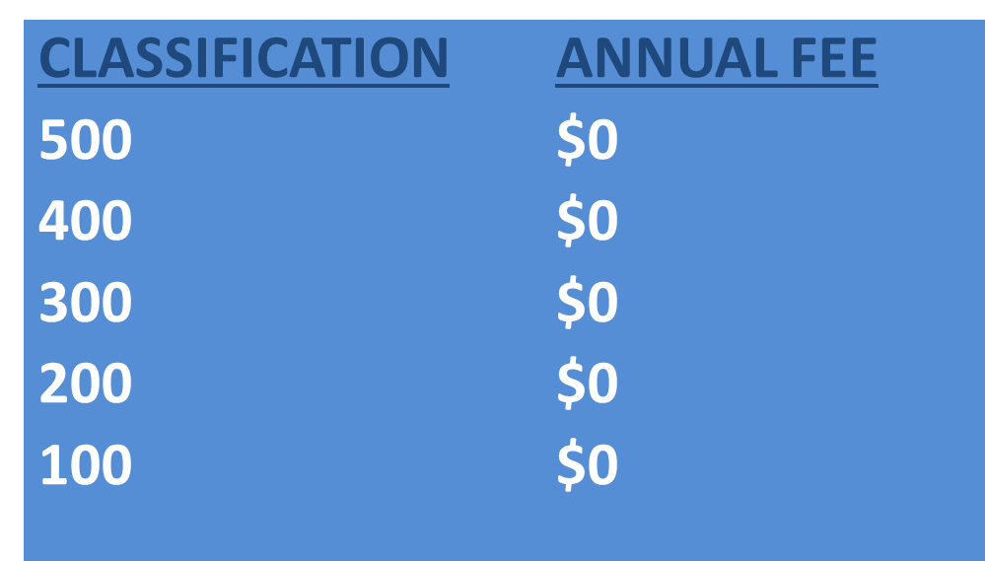
Online Career Interest Survey COSTS
Unlimited schools and unlimited surveys for students 13 years of age and older

Slide 88
REPORTS GENERATED FROM THE SURVEYS

Slide 89
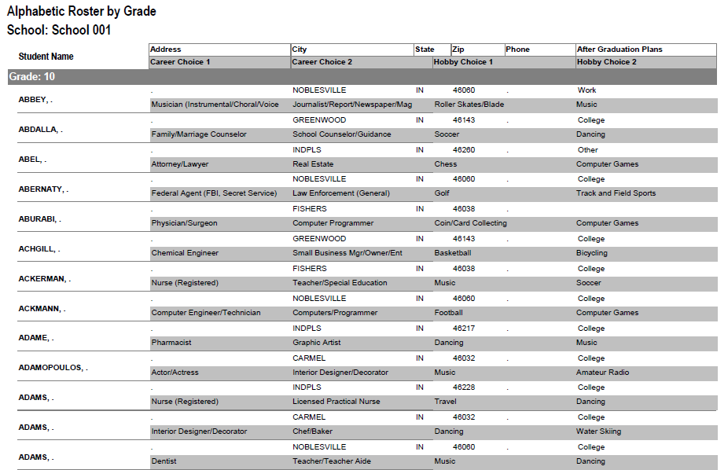
RESULTS REPORT: School
Grade: 10
ABBEY, Susie 123 Main St Noblesville IN 46060 Work
Career 1 Career 2 Hobby 1 Hobby 2
Musician Journalist Roller Skate /Blade Music
89
Notes:
89
No matter the survey format you use, the reports are generated the same way.
**GOOD data to establish credibility at/during your sales call
This is one set of sample results provided at no cost to schools. Very helpful for Guidance Counselors.
All students, by grade, alphabetically. Shows:
Career interests
Hobby interests
Post-high school plans
Other results include all students interested in each career (all the attorneys, architects, dentists, electricians, etc). Helpful for Guidance Counselor planning, career speakers, college days and college fairs.
Be sure to return results to the Guidance Counselor when you say you will – under promise and over deliver. Do not promise results in one week if you cannot do it. Say 2-3 weeks, then they will be very happy if they do receive them in a week or ten days.

Slide 90
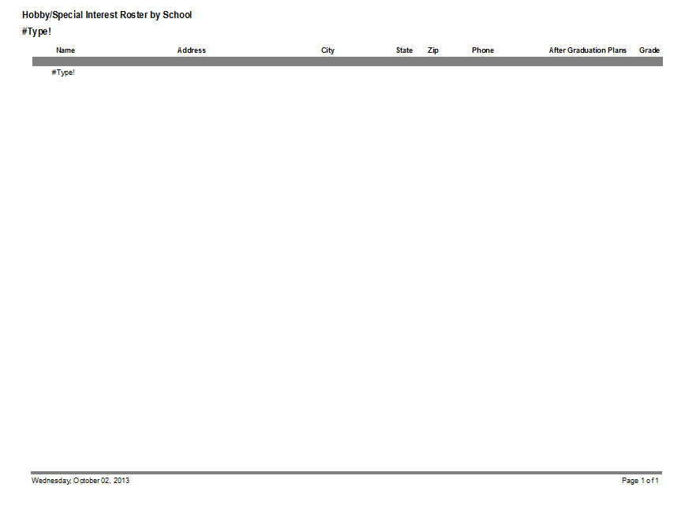
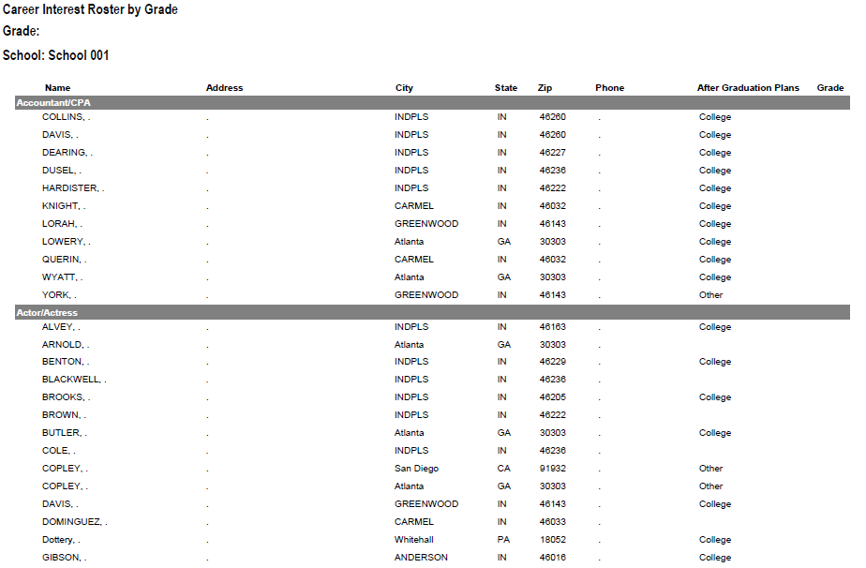
RESULTS REPORT: School
90
Notes:
90
This is another set of sample results provided at no cost to schools. Very helpful for Guidance Counselors.
This report includes all students interested in each career (all the attorneys, architects, dentists, electricians, etc.). Helpful for Guidance Counselor planning and career speakers.
The After Graduation Plans is important to Guidance Counselors
College
Junior college
Military Service
Technical school
Work
Other
Why are these reports help full to the school…to you?

Slide 91
Summary Career Interest Report by Council
Code Career Count
0712 Nurse (Registered) 798
0145 Musician (Instrumental/Choral/Voice) 751
0903 Attorney/Lawyer 733
1625 Teacher/Teacher Aide 678
0300 Business (General) 645
0719 Physician/Surgeon 604
0101 Actor/Actress 600
0130 Fashion Designer/Model/Buyer 579
0721 Psychiatrist/Psychologist 578
0170 Professional Athlete 507
0180 Photographer 461
1305 Architect 437
0725 Veterinarian 429
0102 Artist 427
0718 Physical Corrective Therapist 313
1300 Engineering (General) 208
MOST IMPORTANT TO YOU

Slide 92
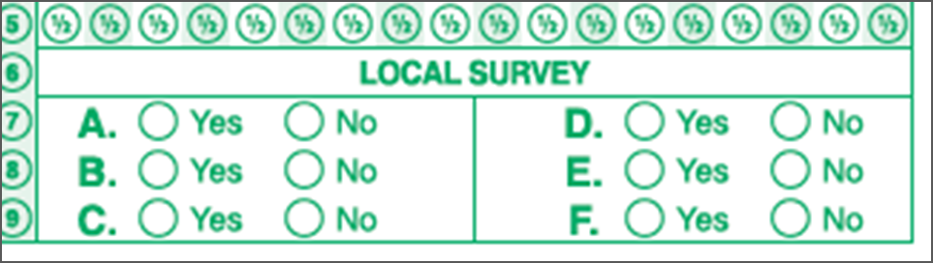
Career Interest Survey Questions
Opportunity for 6 “Yes” or “No” questions
Unique feature of our survey
Anything school officials want to know
  Are you planning to take the SAT / ACT?
  Are drugs a problem in our school?
  Is there enough student parking?

Slide 93
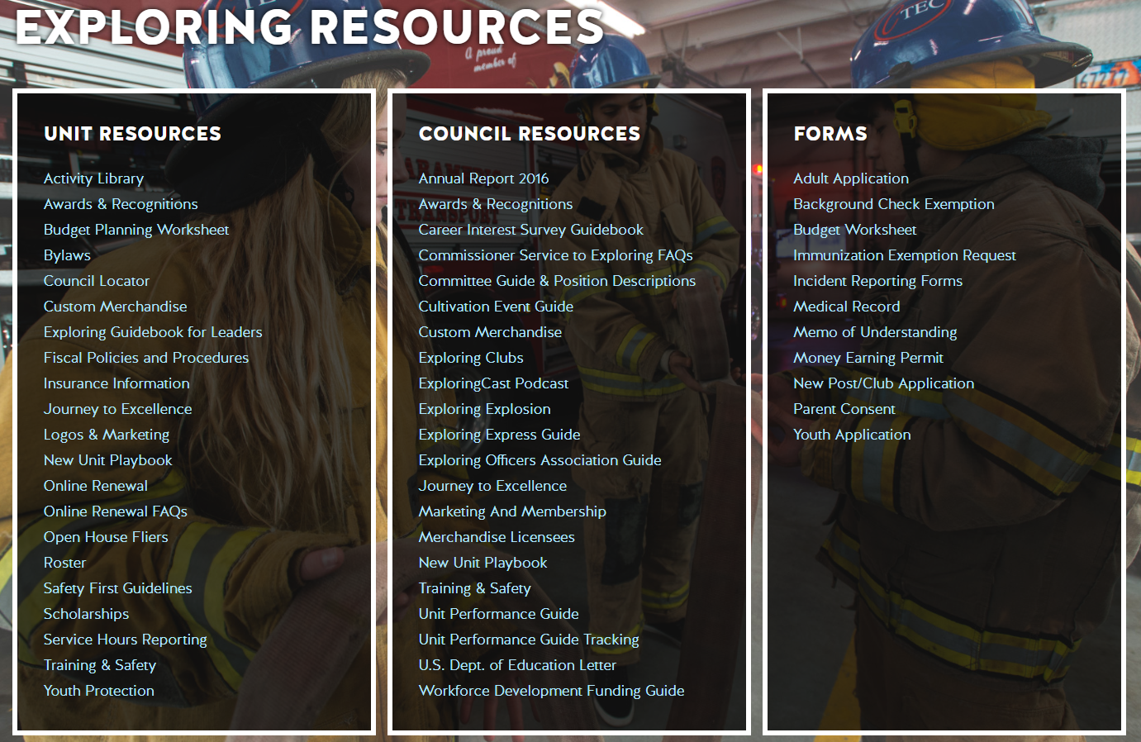
www.exploring.org

Slide 94

Career Interest Survey Guidebook
Be sure you have the most recent version
Download at www.exploring.org
One stop shop for all CIS resources
Table of Contents
  Page 5 | At A Glance
  Page 7 | Overcoming Objections
  Page 44 | Appendix

Slide 95
ALTERNATE METHODS?
1. Use school information already available
2. Ask youth to develop contacts
3. Develop cultivation events
4. Invite Eagle Scouts / Scouts to join
5. Booth at schools open house night and career days /career fairs
6. Annual Exploring open houses for ALL Posts and Clubs
7. Follow up leads from the Exploring Lead
Generator

Slide 96
BASED ON SURVEY RESULTS
1. Focus on Top 4 students interests
2. Identify companies in those 4 interest areas
3. Identify the path to the CEO
  Council board contacts
  School board/admins
  PAS find
  Nominating committee
  Applications

Slide 97
Career Interest Survey Guidebook
Be sure you have the most recent version
Download at www.exploring.org
One stop shop for all CIS resources
Table of Contents
  Page 5 | At A Glance
  Page 7 | Overcoming Objections
  Page 44 | Appendix

Slide 98


Slide 99
Leads are being generated from Exploring.org and include anyone interested in joining, leading, sponsoring, or
otherwise supporting Exploring in their area.
Scout Executives, Assistant Scout Executives and DFS’s receive weekly lead reports.
Exploring Executives and staff advisors receive immediate notifications of each lead generated.
To make changes to any of these settings, email your request to exploring@lflmail.org.
WHEN YOU RECEIVE AN IMMEDIATE NOTIFICATION EMAIL:
1. In the email, you will see a note to “copy & paste the following URL into your browser to mark lead as contacted”.
By following this directive, you are changing the status of your lead to “contacted”. You will no longer receive email notifications for that particular lead. The lead will begin to show as “contacted” on your SE’s weekly report.
Invite the person to attend an existing post/club meeting to get a feel for the program and connect them to
appropriate Exploring advisors.

Slide 100
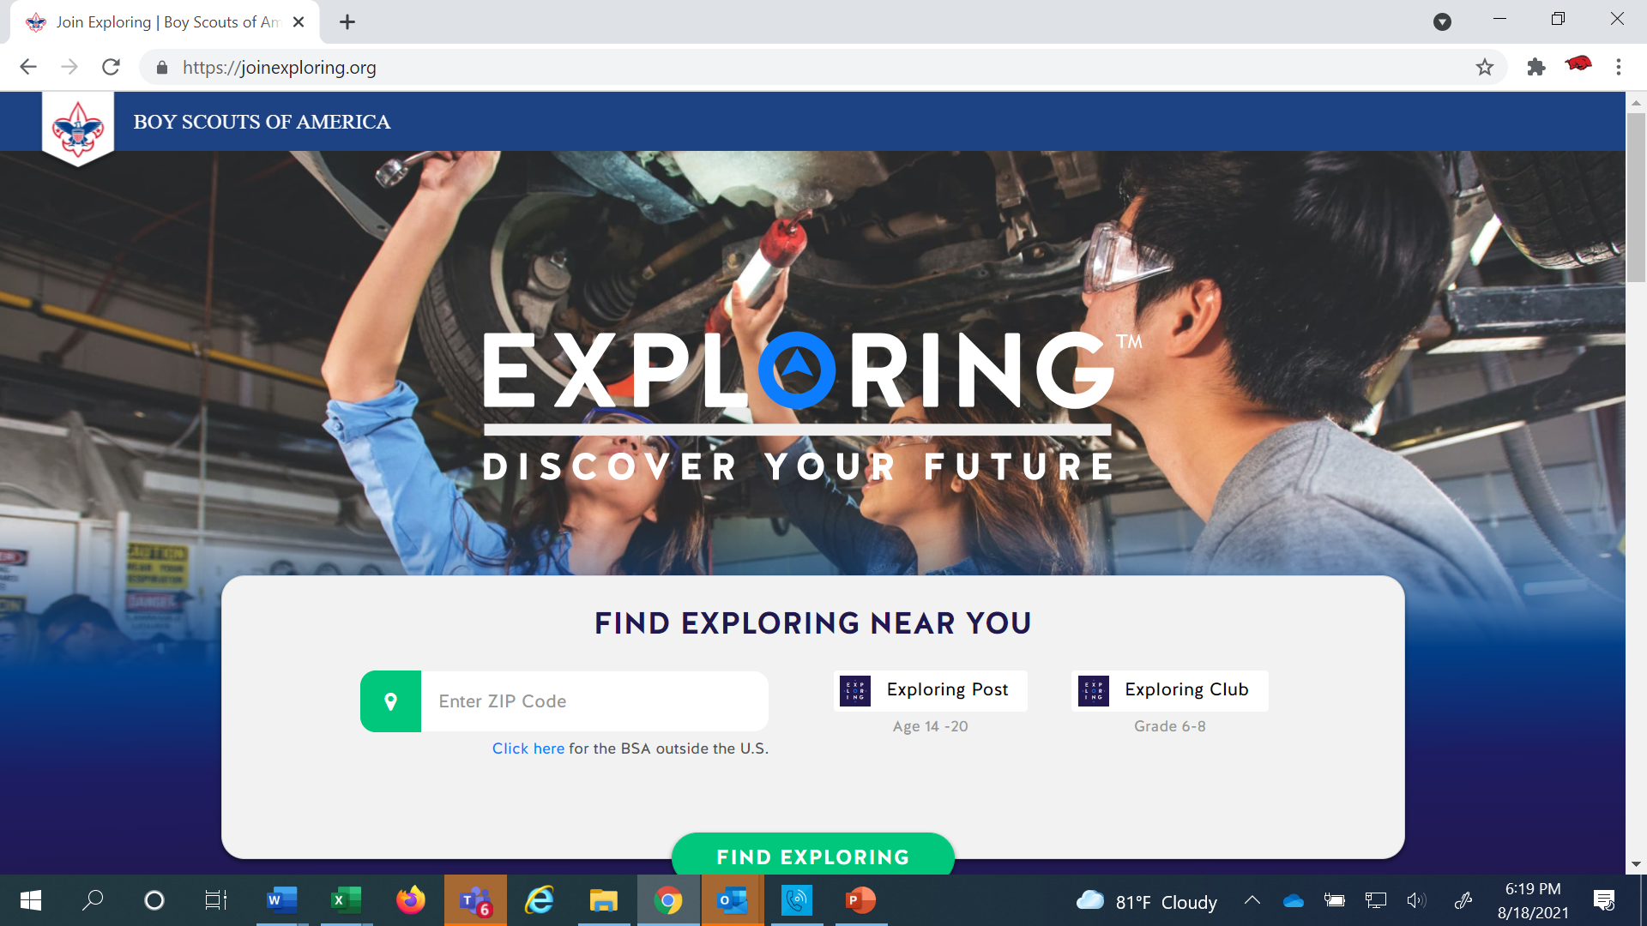
www.joinexploring.org

Slide 102

Phase 2 - Leadership
CEO’s Police/Fire Chiefs Administrators
Industry Experts Retirees Community Leaders

Slide 103

Moving forward with the CEO
1) Get organization’s commitment
2) Identify 6-8 adults
- CEO invites them
- You provide guidance
3) Set 2 dates for:
  - All-In-One program planning
  meeting
  - Open House
4) Start Paperwork
  - New Club/Post Application
  - MOU, Adult Application

Slide 104
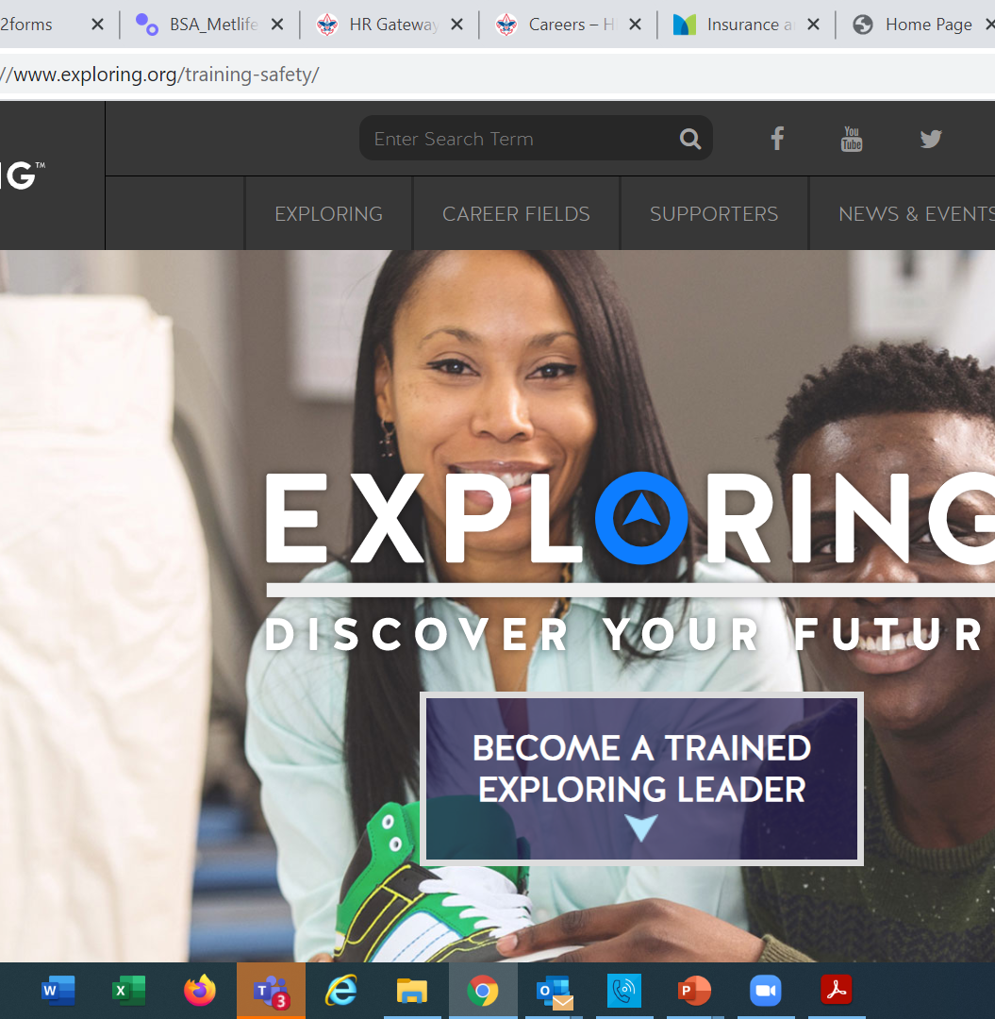
  Exploring Training

Slide 105
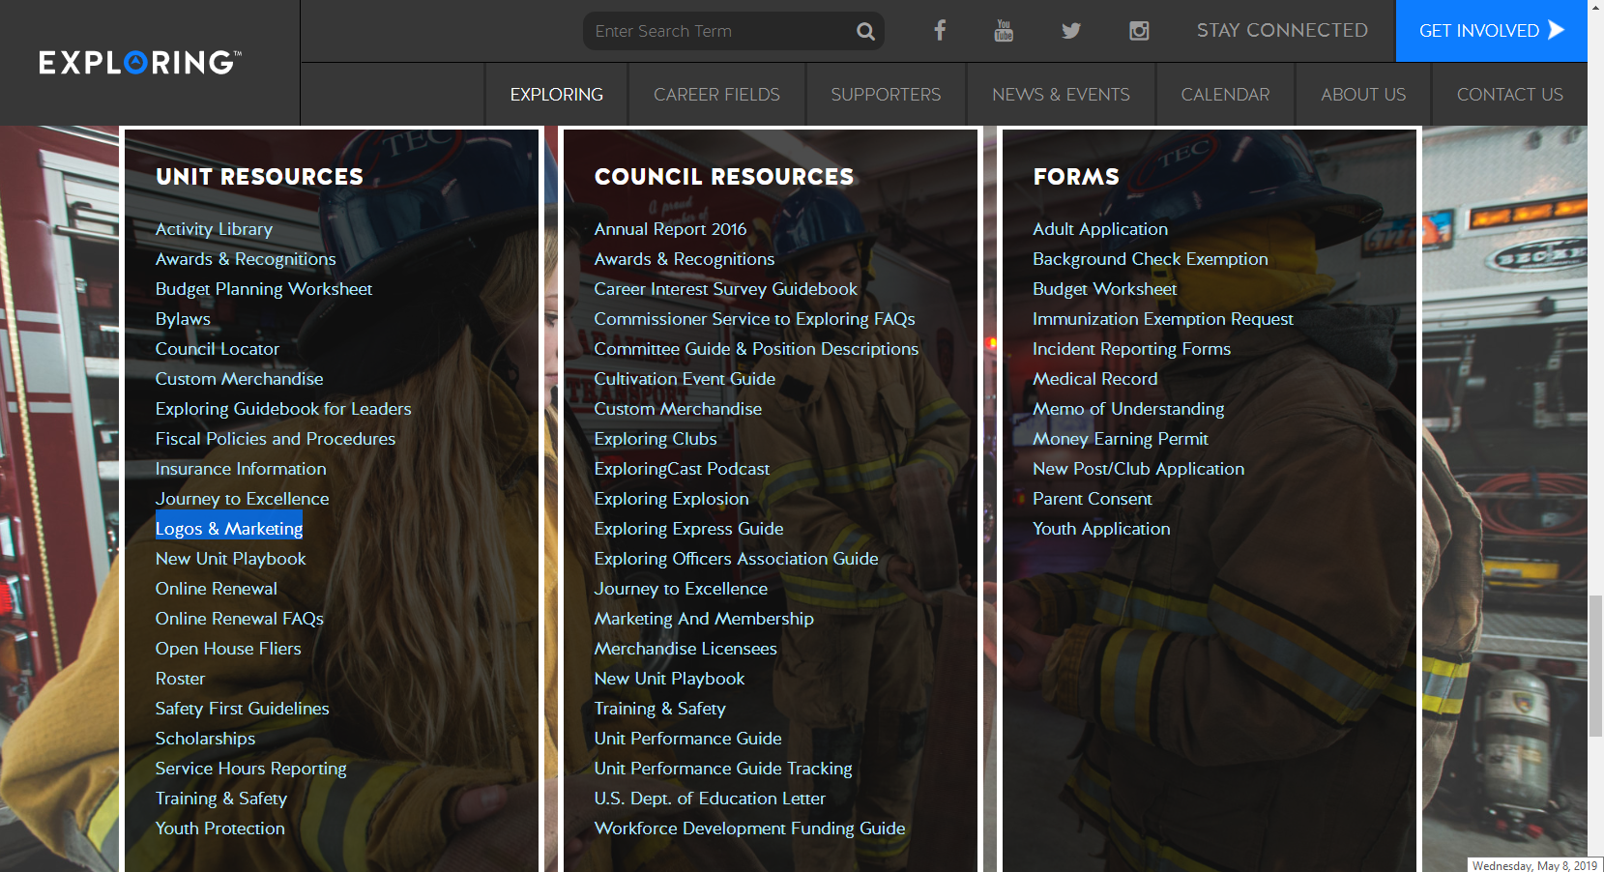

Slide 106
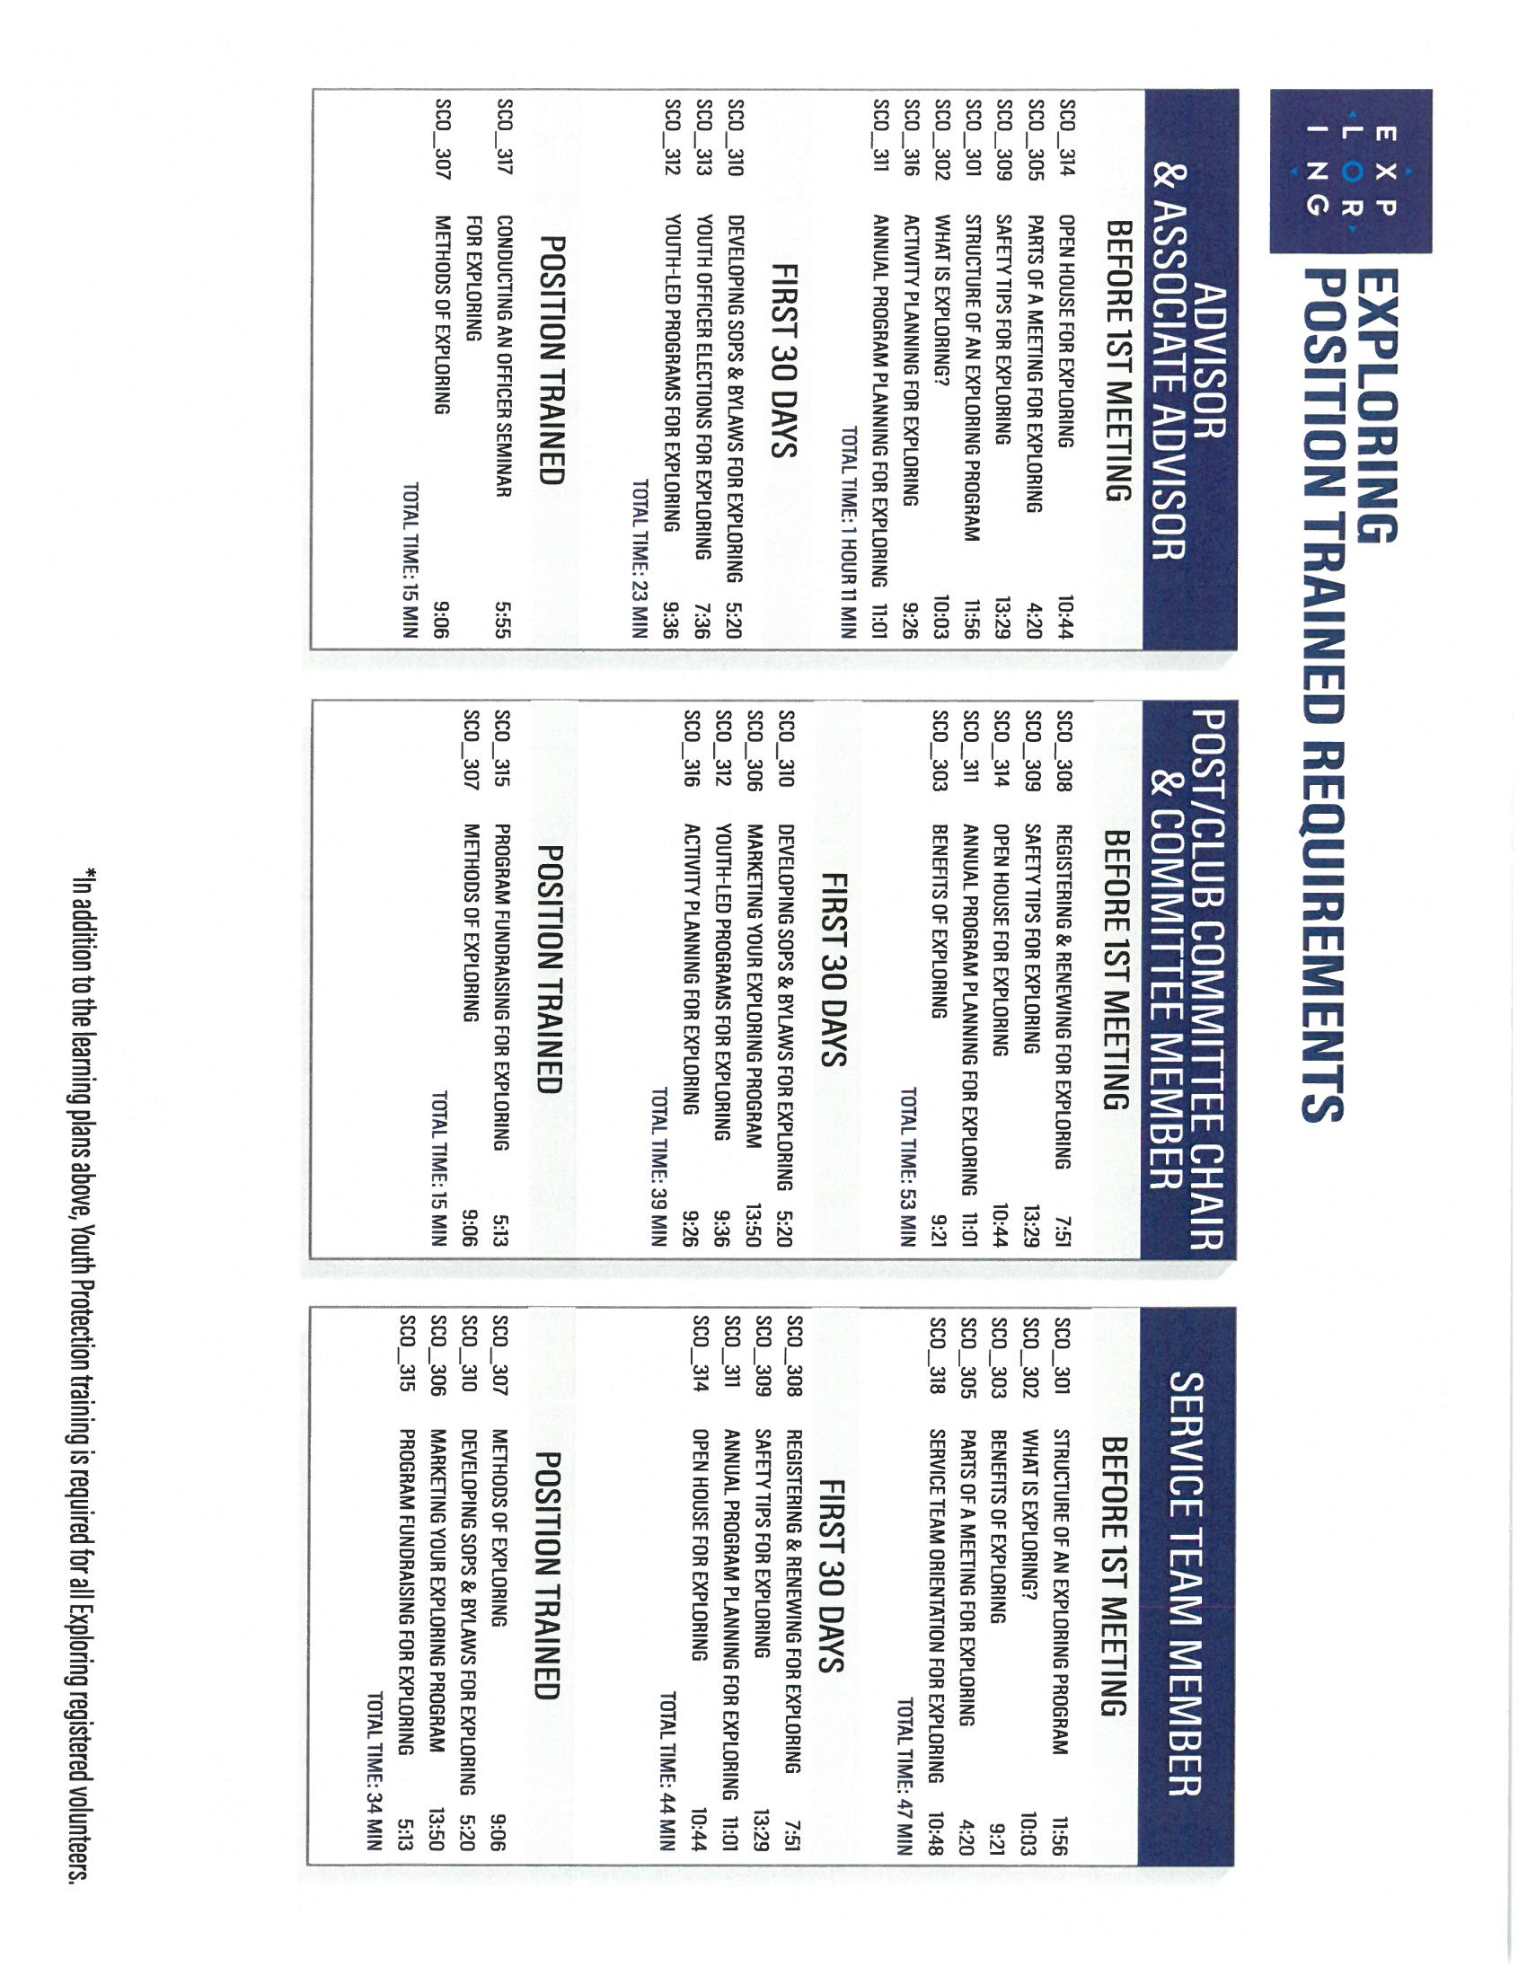
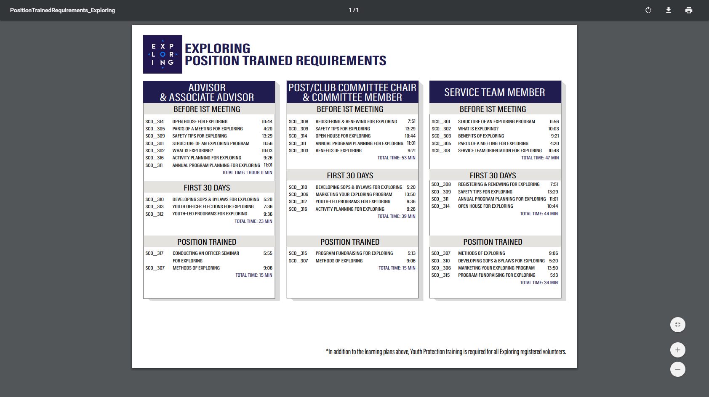
Phase Two: Training

Slide 108
Important resources to help plan the program…
Career Opportunity Worksheet -- www.exploring.org and click on relevant career field icon and scroll to the bottom of the page.
Activity Library (including Life Skills Section) https://www.exploring.org/activity-library/
Organization’s Resources/Employees
  A. Current work curriculum (developed by the company)
  B. Employee’s expertise/knowledge (Use All-in One Program Planning Meeting-found in the Exploring Guidebook for Leaders)
Career Achievement Award (Posts) & Career Awareness Award (Clubs)
  http://www.exploring.org/wp-content/uploads/2017/06/Career-Achievement-Award-May2017.pdf
  http://www.exploring.org/wp-content/uploads/2018/05/Career-Awareness-Award-FINAL.pdf
Exploring Guidebook for Leaders https://www.exploring.org/wp-content/uploads/2016/10/Exploring-Guidebook-Sept2017.800-10018.pdf
Safety First Guidelines/Guide to Safe Scouting (Guide is being Updated—Please follow all CURRENT YPT Policies)
https://www.exploring.org/wp-content/uploads/2021/08/LFL-safety-first-guidelines-3.21.17_8.pdf
7. Online Exploring Adult Leader Specific Training & Youth Protection Training
https://www.exploring.org/training-safety/ or www.myscouting.org
8. Unit Performance Guide (Chapter 5- Exploring) –Details about organizing a new Post/Club
http://www.exploring.org/wp-content/uploads/2021/04/522-02516_UPG.compressed.pdf
Also visit www.exploringexplosion.org and scroll to the bottom of the website to find additional resources…

Slide 109

Phase 3 – Program
All-In-One Program Planning Meeting
1) Paperwork
2) Adult Explorer Leader Training
  - Youth Protection for Explorers
  - Adult Explorer Leader Training
3) Open House Planning
  - Brainstorm session
  Why did you choose this career for yourself?
  What are hands on activities that you can do with youth?
  - Develop a 3-4-month calendar (use Activity Library)
  - Choose Open House “hands-on activities”
4) Prepare Post Committee Members for Open House

Slide 110


SAMPLE PROGRAM CALENDARS
The frequency of your meetings and length of your program each year is up to you. For example, this could be a 12 month or 12 week program.
ENGINEERING & TECH
MONTHLY MEETINGS YEAR-ROUND
September
Open House
October
Chemical engineering
November
Youth Officer Elections
December
Holiday Play – open house
January
Industrial Technology
February
Electrical engineering
March
Computer science
April
Fluid power technology
May
Ethics in engineering
June
Visit with engineering firm
July
Civil engineering
August
Mechanical engineering
Notes:
PRESENTER NOTES:
BE SURE TO DELETE THE CALENDARS/SLIDES THAT ARE NOT RELEVANT TO THE CAREER INDUSTRY TO WHICH YOU’RE PRESENTING.
Remind the audience that they have flexibility is setting the schedule for their own program. Here are some options:
Year round – may or may not include summer
Weekly
Monthly
3 months at a time, different group of youth each time, 3 times per year
Weeknights or weekends

Slide 111

Phase 3 – Program
Planning the Open House
1) From your BRAINSTORM session…
  - Pick the 4-5 best activities for a quick hands-on
  format at the Open House
2) At the open house…“Go shopping”
  - 4-5 stations (rotations)
  - 4-5 minutes each

Slide 112
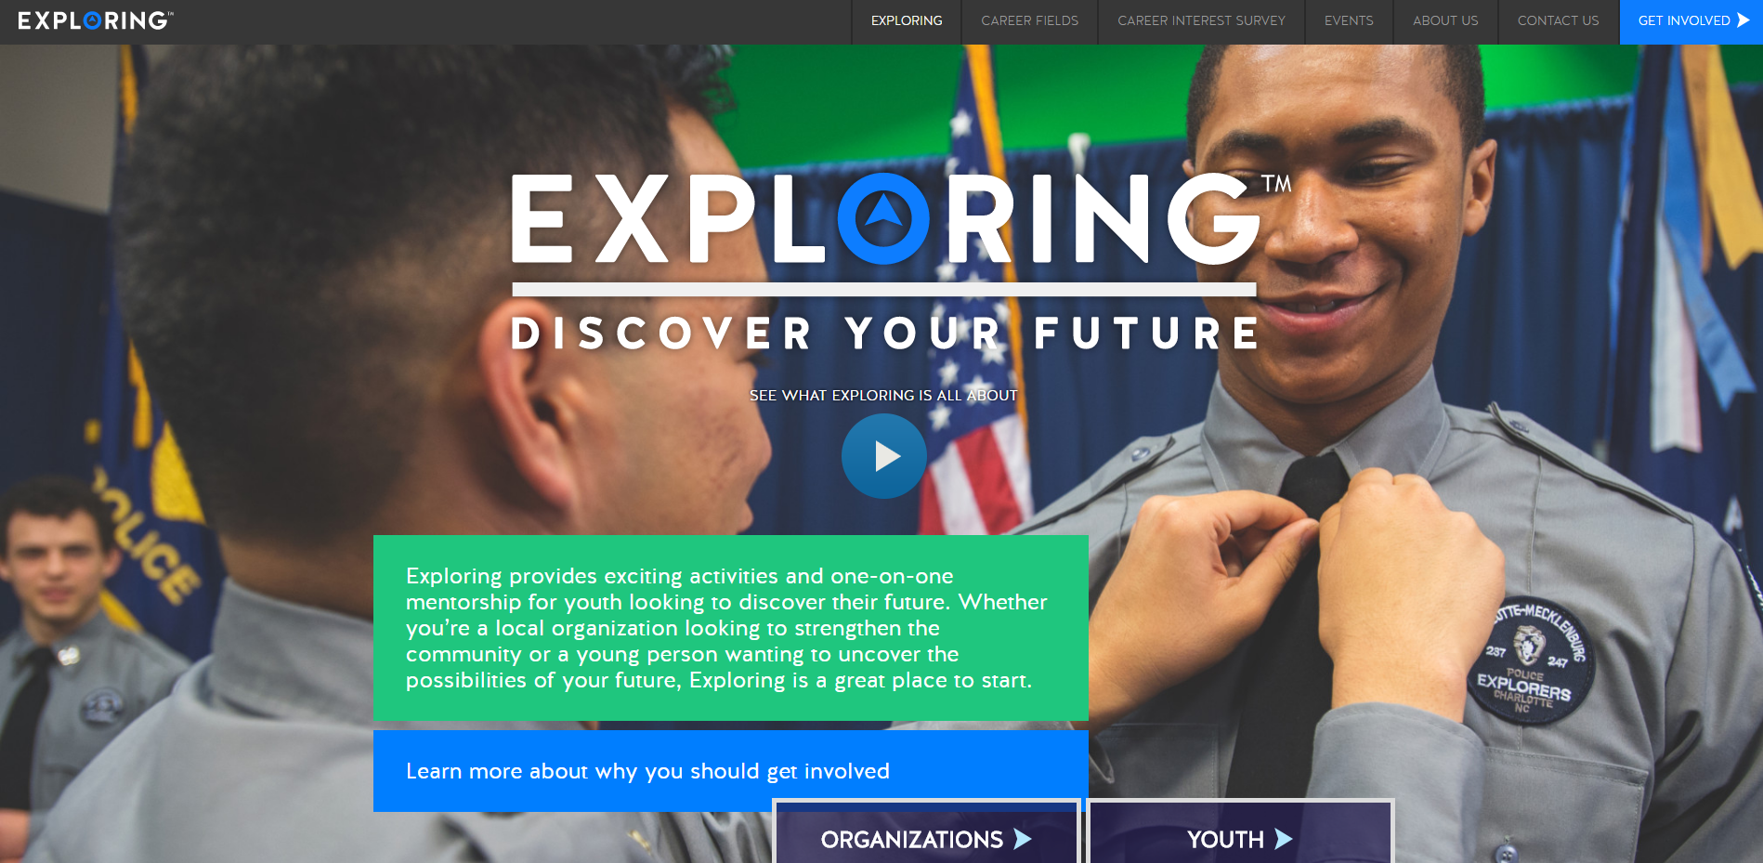

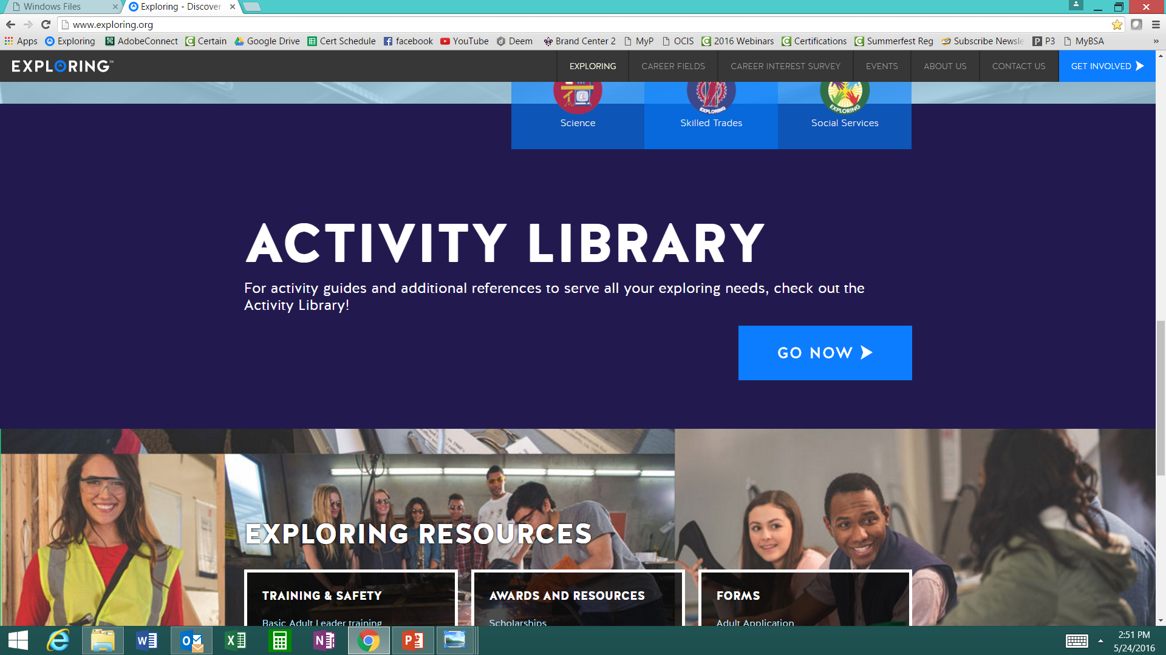

www.exploring.org
Notes:
Program planning is also a service that is provided by the local Boy Scout Council. This Activity Library is an all new supplement to the process. You will find it on www.exploring.org

Slide 114
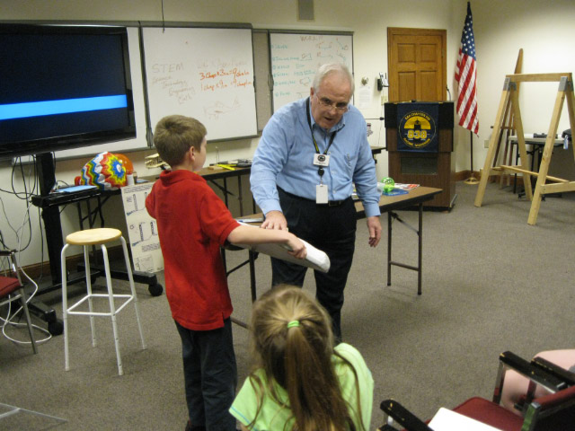
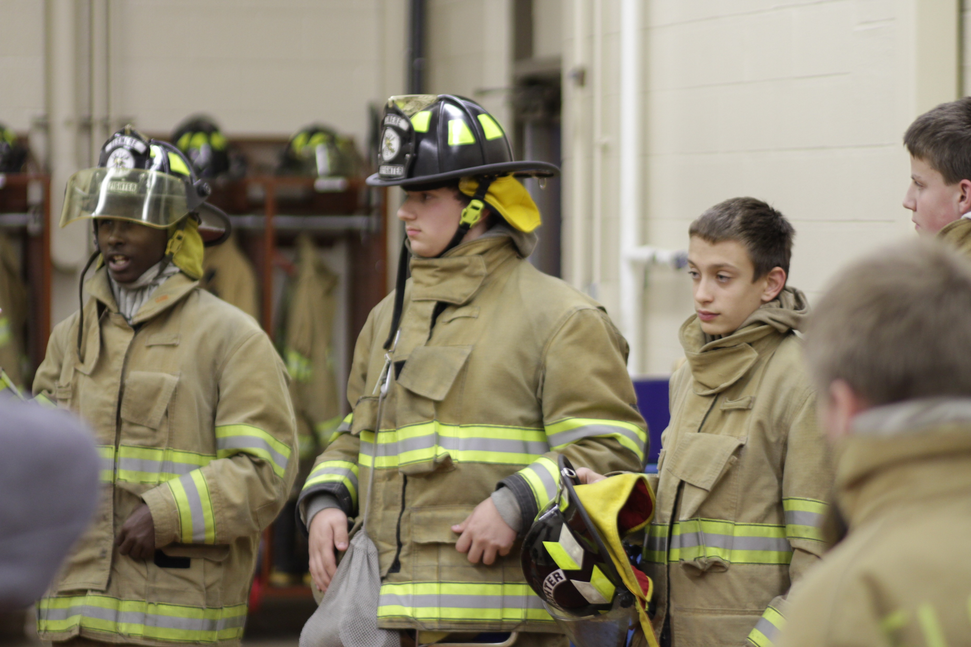
Phase 4 – Participation
SIMPLE OPEN HOUSE AGENDA
OPEN HOUSE AGENDA
Welcome
What is Exploring?
Video
HANDS-ON ACTIVITIES
Activity Interest Survey (customized)
Calendar
ASK TO JOIN
Applications & fees
Snacks

Slide 115
Journey to Excellence
(JTE) unit recognition program to be retired
Effective December 31, 2024, the Journey to Excellence unit recognition program will be retired. Moving forward, metrics for Scouting and Exploring unit success will be seamlessly integrated into unit leader support materials and resources. These metrics will be consistent with those used by the Commissioner corps to support Scouting and Exploring units. This new approach aims to provide a consistent and more streamlined and effective method for evaluating and enhancing unit performance. Feedback from unit leaders and survey results played a crucial role in making this decision. We believe this transition will better support our unit leaders and ultimately improve the experience for all participants as we continue to develop and deliver relevant programs. Units can continue to purchase 2024 Journey to Excellence recognition items through December 31, 2025.

Slide 116

Exploring Youth Training Update
https://www.scouting.org/training/youth-protection/venturing/

Slide 118
Leads are being generated from Exploring.org and include anyone interested in joining, leading, sponsoring, or
otherwise supporting Exploring in their area.
Scout Executives, Assistant Scout Executives and DFS’s receive weekly lead reports.
Exploring Executives and staff advisors receive immediate notifications of each lead generated.
To make changes to any of these settings, email your request to exploring@lflmail.org.
WHEN YOU RECEIVE AN IMMEDIATE NOTIFICATION EMAIL:
1. In the email, you will see a note to “copy & paste the following URL into your browser to mark lead as contacted”.
By following this directive, you are changing the status of your lead to “contacted”. You will no longer receive email notifications for that particular lead. The lead will begin to show as “contacted” on your SE’s weekly report.
Invite the person to attend an existing post/club meeting to get a feel for the program and connect them to
appropriate Exploring advisors.

Slide 119
www.joinexploring.org

Slide 120
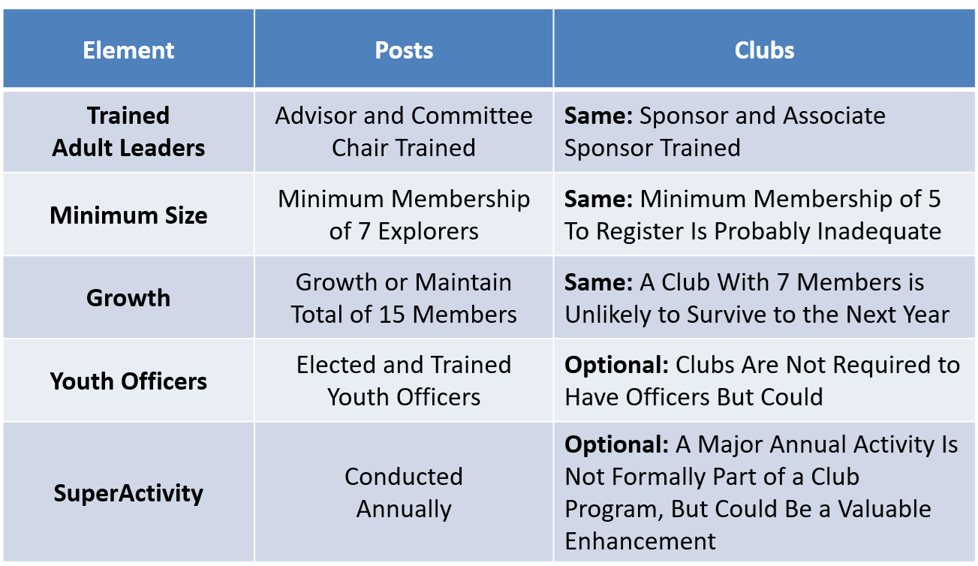
Exploring Metrics Guidelines Replacing JTE for Posts & Clubs
Objective: Sustainable Programs

Slide 121
Most Common Question
“I’m starting a new post specializing in X. I need a sample program to show to the organization head. Where do I get it?”
“All-in-One” Program planning session with Post Committee during formation of the unit.

Slide 122
“AI” Example
“I am working to develop a program appealing to high school students interested in civil engineering careers. This would be an Explorer Post within Scouting America's Exploring Program. Please develop a list of 20 hands-on activities which could be offered by an engineering firm specializing in designing railroad construction projects.”
These activities can be adapted depending on available resources—some with low-cost classroom experiments, others with engineering software, and a few with field visits for maximum engagement.
Would you like me to sequence these into a 6–12 month Explorer Post program calendar (progressing from fundamentals to advanced projects), or keep it as a menu of standalone activities?

Slide 123
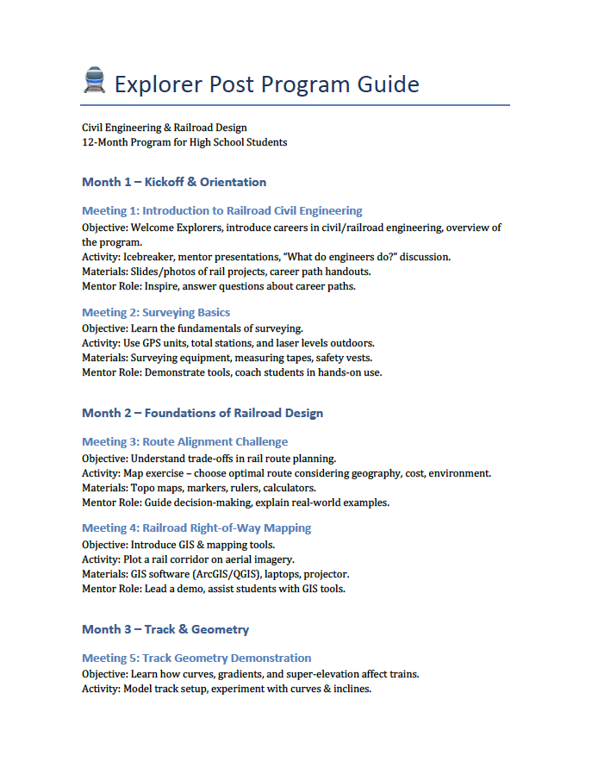
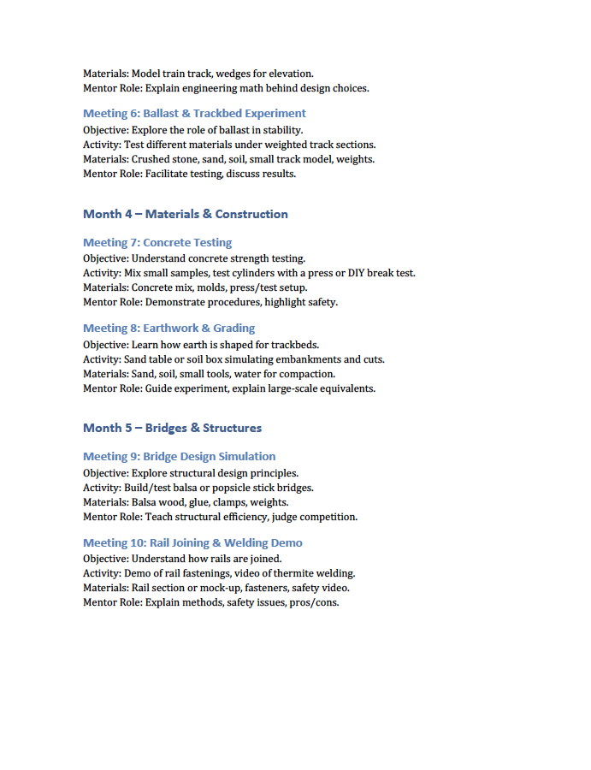
ChatGPT Output

Slide 124



3 Minutes of Effort

Slide 125
Suggested Program Outline
Month 1: Kickoff and Orientation
Month 2: Foundations of Railroad Design
Month 3: Track and Geometry
Month 4: Materials and Construction
Month 5: Earthwork and Grading
Month 6: Rail Operations
Month 7: Safety & Communities
Month 8: Environmental Impact
Month 9: Innovation & Sustainability
Month 10: Field Experience
Month 11: Integration and Capstone Prep
Month 12: Capstone & Celebration
Presentations
Lab Projects
Case Studies
Simulations
Demonstrations
Field Study

Slide 126







PROGRAMS ARE BASED ON
5 AREAS OF EMPHASIS
CAREER
OPPORTUNITIES
LEADERSHIP
EXPERIENCE
LIFE SKILLS
CITIZENSHIP
CHARACTER
EDUCATION
Notes:
PRESENTER NOTES:
Your Exploring program will be based on the expertise and resources of your own business or organization. The adults selected to lead your post or club are the subject matter experts in your industry, so they can provide much more specialized activities than what the national Exploring program provides to you.
Exploring provides the volunteer leaders in your post or club an online activity library (http://www.exploring.org/activity-library/) with easy-to-use activities in each of these 5 program areas. It's important to note none of the activities are mandatory, rather they are there to supplement the program you develop. They are designed for someone who has never worked with youth before.
Each activity in the library is hands-on and interactive in nature. We like to say that Exploring is not Exploring unless it's hands-on and interactive. Facility tours and job shadowing can be part of your program, but it should not be all that is offered to youth who want to learn more about what you do.

Slide 127

Leadership Resources
Chapter 1: Your Role as an Adult Leader
Chapter 6: Council/District Exploring Committee
Chapter 7: For the Youth Leader
EXPLORING LEADER GUIDEBOOK
Why Care About Youth Leadership?
Complete experience
Adult mentorship
Multi-Year Retention
exploring.org/wp-content/uploads/2016/10/Exploring-Guidebook-Sept2017.800-10018.pdf

Slide 128
New Programs Update
February 10, 2026
Ryan Moon

Slide 129
Exploring Adventure Clubs / Posts
&
Aviation Drone Exploring*
* Presented during 18 September 2025 National Learning for Life Executive Board Meeting by Ryan Moon, Director 0f New Programs

Slide 130


Slide 131


Slide 132


Slide 133


Slide 134


Slide 135


Slide 136


Slide 137


Slide 138


Slide 139


Slide 140
For more information on either program:
Please contact Ryan Moon
Ryan.moon@scouting.org

Slide 141

What is Exploring Explosion 3.0 ?
Exploring Explosion 3.0 is a nationwide Exploring membership campaign focusing on Exploring membership growth through the training, inspiration, and recognition of all professionals and interested volunteers.
As part of Exploring Explosion 3.0, national coordinated trainings led by the National Director of Exploring and the National Exploring Committee will assist in the following:
Teaching the 4 Phases of organizing a new Exploring Club or Post. Participants will learn the “A to Z” of Exploring.
Sharing the most valuable resources to help both professionals and volunteers become more confident in growing Exploring.
Connecting professional and volunteers across the country to share best practices while becoming more effective in growing Exploring within their geographic areas. This includes learning from the people who have been the most successful.
Offering cool and crazy incentives throughout the campaign.
All new Exploring Clubs and Posts organized from October 1, 2025, through December 31, 2026, will qualify for the incentives offered during this Exploring Explosion 3.0 campaign.

Slide 142
Great News! Due to high demand, additional Exploring New Unit Trainings have been scheduled for all Professionals and Volunteers! This is a great opportunity to get your staff and volunteers trained. Let’s be sure that 100 % of our Unit Serving Executives are trained.
Click here to sign up for the trainings today!
TBA
If you have problems with the link, please copy/paste the following link into your browser:
TBA

Slide 143
INCENTIVES
Exploring Explosion Growth Incentive 2026

Slide 144
2026 NATIONAL EXPLORING LIVE HOUR (Monthly)
The National Exploring Live Hour is a monthly Zoom video conference that will help engage and equip Exploring volunteers and professionals to grow, support, and learn more about Exploring. Each month the National Exploring Live Hour will be led by our National Exploring Program Chair and the National Director of Exploring. The live hours will include sharing best practices and ideas that are happening within our councils, highlighting successful growth campaigns, and inspiring new ideas through various trainings. This will also offer an opportunity for local councils to collaborate with territory and national counterparts to generate innovative solutions to real-life Exploring challenges.
National Exploring Live Hour Schedule
1:00 PM – 2:00 PM Central Standard Time, Monthly
Register for each of the National Exploring Live Hour ZOOM presentations at:
2026 National Exploring Live Hour Registration

Slide 145

ONLINE
REGISTRATION
&
ONLINE
UNIT RENEWAL
FOR EXPLORING

Slide 146
https://www.scouting.org/commissioners/internet-rechartering/
Information included is:
Training Video
FAQ’s
User Guides
Internet Recharter Guidelines
Summary of Enhancements
Recharter Demo Tool
New Online Rechartering/Renewal System
https://advancements.scouting.org/login
Manager of Shared Services
Member Data Outsourcing Solutions

Slide 147


Slide 149
Youth Protection Training
Safeguarding Youth
https://my.scouting.org/

Slide 150
Exploring Youth Training Update
https://www.scouting.org/training/youth-protection/venturing/

Slide 151
Barriers to Abuse Update
As part of our ongoing commitment to abuse prevention, the Boy Scouts of America, to include Exploring, is updating the adult supervision requirements for overnight activities
This update enhances the minimum “two deep leadership” requirements by additionally requiring every adult present on overnight activities to be a registered member of the Boy Scouts of America or Exploring
These adults must submit an adult application and registration fee, undergo a criminal background check, a volunteer screening database check and must complete mandatory Youth Protection training.
A limited exception for parents and legal guardians of Cub Scout youth attending overnight with their children is planned due to the family centric nature of Cub Scouting
All Cub Scout Packs, Scouts BSA Troops, Venturing Crews, Sea Scouting Ships, Exploring Posts, council, and district overnight programs will be required to comply with this update by September 1, 2023. We encourage early adoption prior to the effective date
This updated Barrier to Abuse will be referenced as part of the Guide to Safe Scouting, Exploring’s Safety First Guidelines, Youth Protection and Adult Leadership section, Scouting’s Barriers to Abuse. Youth Protection and Barriers to Abuse FAQ’s will be expanded to include additional FAQ’s as they are developed

Slide 152



STAY CONNECTED
page | @lflexploring
group | Exploring Success!
group | National Explorer Alumni Association
learningforlifeusa
exploring.org | Stay Connected
exploring@lflmail.org

Slide 153
Questions?

Slide 154
2026 NATIONAL EXPLORING LIVE HOUR (Monthly)
The National Exploring Live Hour is a monthly Zoom video conference that will help engage and equip Exploring volunteers and professionals to grow, support, and learn more about Exploring. Each month the National Exploring Live Hour will be led by our National Exploring Program Chair and the National Director of Exploring. The live hours will include sharing best practices and ideas that are happening within our councils, highlighting successful growth campaigns, and inspiring new ideas through various trainings. This will also offer an opportunity for local councils to collaborate with territory and national counterparts to generate innovative solutions to real-life Exploring challenges.
National Exploring Live Hour Schedule
1:00 PM – 2:00 PM Central Standard Time, Monthly
Register for each of the National Exploring Live Hour ZOOM presentations at:
2026 National Exploring Live Hour Registration

Slide 155
Exploring at Home (Discuss Best Practices)
Idea Sharing
Questions and Answers from the Field https://drive.google.com/file/d/1Bo7U0iJ8Ti-bmyIFtxGfG0TIt3dB1xX4/view?usp=sharing
After the Live Hour Discussions
(Open Dialogue)

Slide 156


Good News from the Field!

Slide 157
v
END OF MAY 2026
EXPLORING LIVE HOUR
PRESENTATION SLIDES
All other slides below are informational

Slide 158
v
EXPLORING UPDATES
REMINDERS
Tim Anderson
National Director
Learning for Life & Exploring
National Director Older Youth Programs

Slide 159
EXPLORING PARTICIPANT POLICY
“EP” (18 THROUGH 20 YR OLD EXPLORERS)
Effective August 1, 2020, all applicants 18 through 20 years old must complete and submit an adult application, consent to a criminal background check, and successfully complete Youth Protection training.
However, an 18- through 20-year-old will still be considered an Adult Exploring Participant in the post and will not be considered an adult leader. Therefore, an “EP” will not be allowed to fulfill adult leadership roles pertaining to Two-Adult Leadership and other requirements that require leadership to be at least 21 years of age.
All Exploring Participants “EP” will continue to count as youth within your youth membership reports.
Visit the link below for an infographic as well as a Q & A to assist you in implementing this important new policy. http://filestore.scouting.org/filestore/se-packet/2020-08-10/Exploring-Participant-Policy-FINAL-2.pdf

Slide 160
EXPLORING REGISTRATION FEES
Effective August 1, 2023, Exploring fee updates:
- Exploring Youth $50.00
- Exploring Adult Participants (18-20) $50.00
- Exploring Adults $50.00
- Exploring Post/Club Annual Renewal Fee $100.00
- There is no additional “Joining Fee” for Exploring
The updated membership fees will take effect August 1, 2023, for new members in the 2023-2024 program year.
The national membership fee helps cover the cost of essential services, including program resources, liability insurance for those participating in approved Scouting activities, criminal background checks, youth protection, and the development of intellectual property for national, council, and unit programs. As we move forward, we will continue to look at the membership fee structure and how we deliver the Scouting program for future generations.

Slide 161
NEWLY UPDATED EXPLORING APPLICATIONS
The newly updated Exploring applications are available now for download online at www.exploring.org
New Post/Club Application (SKU# 655197)
Youth Application (SKU# 634698)
Adult Application (SKU# 634699)
-Includes the new 18-20 Exploring Participant (EP) Code, which will became mandatory beginning August 1st, 2020.
*New applications are available at the National Distribution Center .

Slide 162

Newest Technology for Exploring
BeAnExplorer “Equivalent”
“joinexploring.org”
“joinexploring.com”
Scoutbook for Exploring
Online Registration
Online Renewal

Slide 163

*Exploring Leadership Experience
*Coming soon for Exploring youth
Resume Builder that will help recognize Explorers
This online, mentor assisted, self-paced and guided experience will allow our Explorers to…
Have an opportunity to discover their inner leadership potential
Gain practical leadership experience – participate in a capstone project
Work with a mentor to gain professional leadership experience
Be recognized with a Nationally Certified Leadership Experience Certificate that will help improve their resume and recognize their overall Exploring Experience.

Slide 164

Exploring in comparison to Traditional Scouting
 | SCOUTS BSA | VENTURING | SEA SCOUTS | EXPLORING
UNIT | Troop | Crew | Ship | Club/Post
LEADER | Scoutmaster | Advisor | Skipper | Sponsor/Advisor
YOUTH LEADER | Senior Patrol Leader | President | Boatswain | President or Agency Nomenclature
YOUTH PARTICIPANT | Scout | Venturer | Sea Scout | Participant or Explorer
RE-REGISTRATION | Charter Renewal | Charter Renewal | Charter Renewal | MOU Renewal
SPONSOR | Chartered Org | Chartered Org | Charter Org | Participating Org
SPONSORING AGREEMENT | Charter | Charter | Charter | Memorandum of Understanding (MOU)
UNIT SERVICE | Commissioner | Commissioner | Commissioner | Service Team
YOUTH RUN | Yes | Yes | Yes | Yes
AGE SPAN | 11-18 | 13-20 | 13 - 20 | 11-13/14-20
RELIGIOUS DECLARATION | Duty to God | Duty to God | Duty to God | None
UNIFORM | Scouts BSA | Venturing (Unit Selected) | Sea Scouts (Unit Selected) | Club/Post Selected, not required

Slide 165
  Exploring Training

Slide 166
Exploring Position-Specific Training Modules
Update Status

Slide 167
Exploring Position-Specific Training Modules Update Status …
The Exploring Leader Training Modules have also been formatted to be experienced through the learning center via computer or smart device.
Login in to https://my.scouting.org/ . If you need to create an account and do not know your member ID number, please contact your local BSA council office/service center
Once you log in, locate the blue box on the right side of your screen labeled “Click here to access Exploring Training”
After logging in, you may also click “Menu” in the top left corner and select “My Training”. Under Training Courses by Program, select “Exploring Adult Training”
You may select between the three available Exploring learning plans (based on position). Anyone is welcome to complete the trainings
NOTE: In addition, the “Servicing Exploring Units Module for Commissioners” has been updated within the Learn Center.
We would like to sincerely thank the many Exploring professionals and volunteers that helped make this important update happen!

Slide 168
Exploring Position-Specific Training Modules Update Status …
NOW UPDATED AND READY FOR VIEWING

Slide 171
Safeguarding Youth
(Youth Protection) Training
https://my.scouting.org/

Slide 172
Exploring Youth Training Update
https://www.scouting.org/training/youth-protection/venturing/

Slide 173
Important resources to help plan the program…
Career Opportunity Worksheet -- www.exploring.org and click on relevant career field icon and scroll to the bottom of the page.
Activity Library (including Life Skills Section) https://www.exploring.org/activity-library/
Organization’s Resources/Employees
  A. Current work curriculum (developed by the company)
  B. Employee’s expertise/knowledge (Use All-in One Program Planning Meeting-found in the Exploring Guidebook for Leaders)
Career Achievement Award (Posts) & Career Awareness Award (Clubs)
  http://www.exploring.org/wp-content/uploads/2017/06/Career-Achievement-Award-May2017.pdf
  http://www.exploring.org/wp-content/uploads/2018/05/Career-Awareness-Award-FINAL.pdf
Exploring Guidebook for Leaders https://www.exploring.org/wp-content/uploads/2016/10/Exploring-Guidebook-Sept2017.800-10018.pdf
Safety First Guidelines/Guide to Safe Scouting (Guide is being Updated—Please follow all CURRENT YPT Policies)
https://www.exploring.org/wp-content/uploads/2021/08/LFL-safety-first-guidelines-3.21.17_8.pdf
7. Online Exploring Adult Leader Specific Training & Youth Protection Training
https://www.exploring.org/training-safety/ or www.myscouting.org
8. Unit Performance Guide (Chapter 5- Exploring) –Details about organizing a new Post/Club
http://www.exploring.org/wp-content/uploads/2021/04/522-02516_UPG.compressed.pdf
Also visit www.exploringexplosion.org and scroll to the bottom of the website to find additional resources…

Slide 174
ADDITIONAL SLIDES FOR COUNCIL USE
All slides will be emailed to each
Exploring Live Hour Participant every month

Slide 175


Successful Councils…
Intentionally Providing a Pathway to Exploring Growth and
Strategic Planning In Your Council

Slide 176

“Action Planning”
The Beginning of your Strategic Plan
The foundation of your plan will begin here

Slide 177
OPEN HOUSES
INSERT HERE
COUNCIL/DISTRICT YEARLY MEMBERSHIP PLANS
(Recruitment/Retention Cycle)
Career Interest Surveys

Slide 178

12 Keys To Success

Slide 179

1. Recruit a council Exploring volunteer chair and committee
2. Appoint a Council Exploring Champion
“Staff Advisor”
3. Create a public presence for Exploring
(council website, newsletters, social media)

Slide 180

4. Train key volunteers and staff on the 4
Phases of Post/Club Organization
5. Set specific goals for Career Interest
Surveys or gathering of data from select high schools
6. Set goals to host Open Houses for all
Posts/Clubs (i.e. School Night for
Scouting)

Slide 181
7. Create a campaign to emphasize
Post/Club unit support (through
Service Teams/Commissioners)
8. Integrate Exploring into council activities and events
9. Promote Exploring to all current customers (i.e. “Scouts BSA”)

Slide 182
10. Host a council community cultivation event, focusing on a specific career.
11. Involve the Council Executive Board to help open doors within the community and to help create a list of businesses to match the
Career Interest Survey results.
12. Ensure that Exploring is included in the
Council Strategic Plan, PDS Goals, and
Board Meetings.

Slide 183
Starting a New Post/Club
“The Four Phases”

Slide 184
REGISTRATION BASICS
YOUTH
POST: ___ and have completed eighth grade OR 15 years of age but not yet ___ years old
CLUB: 6th-8th graders who have completed the ____ grade and are at least 10 years old but have not completed the eighth grade and are not yet ____ years old.
ADULTS
___ years age or older
POST: Min of 4 adults
  ______________ (CC)
  2 ____________ (MC)
  _______________ (EA)
CLUB: 2 adults _______________ (ES)
_______________ (AS)
PAPERWORK
New Post/Club ____________
4 _________ Apps
5 _________ Apps
Annual ______________
of Understanding
$____ General Liability Insurance Fee
$____ per person registration fee
14
21
Application
21
Adult
Committee Chair
2 Committee Members
Youth
5th
Advisor
Memorandum
Sponsor
100
15
Assoc Sponsor
50
Exploring Youth Participants “EP’s” ages 18-20 must complete an
Exploring ________ Application & Successfully Complete YPT.
Adult

Slide 186
4 Steps/Phases in Organizing a new Post
1. Research-
Conduct the Career interest surveys
and develop business/community prospects
2. Leadership-
Meeting with the top leadership within the
businesses/community and identifying program
leaders; includes training of leaders
3. Program-
Develop the organization’s meeting/program
themes and prepare for an open house
4. Participation-
Recruiting youth through an organized open house and
involvement of youth in program development

Slide 187
MOST IMPORTANT PART
OF EACH PHASE?
Phase 1 : Career Interest Surveys
Phase 2: Training
Phase 3: All-In-One Program Planning Meeting
Phase 4: Open House

Slide 188
Career Interest Surveys
The # 1
Leading Indicator for Exploring Growth

Slide 190
Phase 1 – Research
Career Interest Surveys (two choices)
pa
pa
Online Survey:
www.exploringyourcareer.com
Paper Scantron Survey

Slide 191
BACK SIDE
FRONT SIDE
Paper Scantron Survey Available through NDC

Slide 194
Online Career Interest Survey
www.exploringyourcareer.com
TRY IT NOW!
Use QR code or simply type address in web browser
Notes:
A “QR” or Quick Response code was created to take students directly to the survey site. It is available on posters, post cards, business cards, and book marks.
How do you use this? Email it to all teachers, they can open it from email and project it one screen for students to use their smartphones!

Slide 197
www.exploringyourcareer.org
Two career & hobby choices
School names
pre-loaded
Notes:
REFER TO HANDOUT IN YOUR FOLDER.
This is a screen shot of the new Online Career Interest Survey that was activated on Jan 1, 2012.
The careers & hobbies match the paper version. So schools and administer the survey either on paper or electronically.
The online version can be accessed from any device that can access the Internet – including smart phones.
Results are sent instantly to a secure website where councils can access the results and provide them to schools in the same format as the paper survey.
Instructions for accessing results can be found in the LFL internal site.
Students 13 yrs. and younger cannot legally complete this survey online. If they enter data, the system will not save it.
You can also add schools/colleges to this list if they do not populate when you put in your respective zip code. Simply e-mail us at exploring@lflmail.org and request your specific school to be added, with zip code

Slide 198
Online Career Interest Survey COSTS
Unlimited schools and unlimited surveys for students 13 years of age and older

Slide 199
REPORTS GENERATED FROM THE SURVEYS

Slide 200
RESULTS REPORT: School
Grade: 10
ABBEY, Susie 123 Main St Noblesville IN 46060 Work
Career 1 Career 2 Hobby 1 Hobby 2
Musician Journalist Roller Skate /Blade Music
200
Notes:
200
No matter the survey format you use, the reports are generated the same way.
**GOOD data to establish credibility at/during your sales call
This is one set of sample results provided at no cost to schools. Very helpful for Guidance Counselors.
All students, by grade, alphabetically. Shows:
Career interests
Hobby interests
Post-high school plans
Other results include all students interested in each career (all the attorneys, architects, dentists, electricians, etc). Helpful for Guidance Counselor planning, career speakers, college days and college fairs.
Be sure to return results to the Guidance Counselor when you say you will – under promise and over deliver. Do not promise results in one week if you cannot do it. Say 2-3 weeks, then they will be very happy if they do receive them in a week or ten days.

Slide 201
RESULTS REPORT: School
201
Notes:
201
This is another set of sample results provided at no cost to schools. Very helpful for Guidance Counselors.
This report includes all students interested in each career (all the attorneys, architects, dentists, electricians, etc.). Helpful for Guidance Counselor planning and career speakers.
The After Graduation Plans is important to Guidance Counselors
College
Junior college
Military Service
Technical school
Work
Other
Why are these reports help full to the school…to you?

Slide 202
Summary Career Interest Report by Council
Code Career Count
0712 Nurse (Registered) 798
0145 Musician (Instrumental/Choral/Voice) 751
0903 Attorney/Lawyer 733
1625 Teacher/Teacher Aide 678
0300 Business (General) 645
0719 Physician/Surgeon 604
0101 Actor/Actress 600
0130 Fashion Designer/Model/Buyer 579
0721 Psychiatrist/Psychologist 578
0170 Professional Athlete 507
0180 Photographer 461
1305 Architect 437
0725 Veterinarian 429
0102 Artist 427
0718 Physical Corrective Therapist 313
1300 Engineering (General) 208
MOST IMPORTANT TO YOU

Slide 203
Career Interest Survey Questions
Opportunity for 6 “Yes” or “No” questions
Unique feature of our survey
Anything school officials want to know
  Are you planning to take the SAT / ACT?
  Are drugs a problem in our school?
  Is there enough student parking?

Slide 204
www.exploring.org

Slide 205
Career Interest Survey Guidebook
Be sure you have the most recent version
Download at www.exploring.org
One stop shop for all CIS resources
Table of Contents
  Page 5 | At A Glance
  Page 7 | Overcoming Objections
  Page 44 | Appendix

Slide 206
ALTERNATE METHODS?
1. Use school information already available
2. Ask youth to develop contacts
3. Develop cultivation events
4. Invite Eagle Scouts / Scouts to join
5. Booth at schools open house night and career days /career fairs
6. Annual Exploring open houses for ALL Posts and Clubs
7. Follow up leads from the Exploring Lead
Generator

Slide 207
BASED ON SURVEY RESULTS
1. Focus on Top 4 students interests
2. Identify companies in those 4 interest areas
3. Identify the path to the CEO
  Council board contacts
  School board/admins
  PAS find
  Nominating committee
  Applications

Slide 208
Career Interest Survey Guidebook
Be sure you have the most recent version
Download at www.exploring.org
One stop shop for all CIS resources
Table of Contents
  Page 5 | At A Glance
  Page 7 | Overcoming Objections
  Page 44 | Appendix

Slide 210
Leads are being generated from Exploring.org and include anyone interested in joining, leading, sponsoring, or
otherwise supporting Exploring in their area.
Scout Executives, Assistant Scout Executives and DFS’s receive weekly lead reports.
Exploring Executives and staff advisors receive immediate notifications of each lead generated.
To make changes to any of these settings, email your request to exploring@lflmail.org.
WHEN YOU RECEIVE AN IMMEDIATE NOTIFICATION EMAIL:
1. In the email, you will see a note to “copy & paste the following URL into your browser to mark lead as contacted”.
By following this directive, you are changing the status of your lead to “contacted”. You will no longer receive email notifications for that particular lead. The lead will begin to show as “contacted” on your SE’s weekly report.
Invite the person to attend an existing post/club meeting to get a feel for the program and connect them to
appropriate Exploring advisors.

Slide 211
www.joinexploring.org

Slide 213
Phase 2 - Leadership
CEO’s Police/Fire Chiefs Administrators
Industry Experts Retirees Community Leaders

Slide 214
Moving forward with the CEO
1) Get organization’s commitment
2) Identify 6-8 adults
- CEO invites them
- You provide guidance
3) Set 2 dates for:
  - All-In-One program planning
  meeting
  - Open House
4) Start Paperwork
  - New Club/Post Application
  - MOU, Adult Application

Slide 215
  Exploring Training

Slide 217
Phase Two: Training

Slide 219
Important resources to help plan the program…
Career Opportunity Worksheet -- www.exploring.org and click on relevant career field icon and scroll to the bottom of the page.
Activity Library (including Life Skills Section) https://www.exploring.org/activity-library/
Organization’s Resources/Employees
  A. Current work curriculum (developed by the company)
  B. Employee’s expertise/knowledge (Use All-in One Program Planning Meeting-found in the Exploring Guidebook for Leaders)
Career Achievement Award (Posts) & Career Awareness Award (Clubs)
  http://www.exploring.org/wp-content/uploads/2017/06/Career-Achievement-Award-May2017.pdf
  http://www.exploring.org/wp-content/uploads/2018/05/Career-Awareness-Award-FINAL.pdf
Exploring Guidebook for Leaders https://www.exploring.org/wp-content/uploads/2016/10/Exploring-Guidebook-Sept2017.800-10018.pdf
Safety First Guidelines/Guide to Safe Scouting (Guide is being Updated—Please follow all CURRENT YPT Policies)
https://www.exploring.org/wp-content/uploads/2021/08/LFL-safety-first-guidelines-3.21.17_8.pdf
7. Online Exploring Adult Leader Specific Training & Youth Protection Training
https://www.exploring.org/training-safety/ or www.myscouting.org
8. Unit Performance Guide (Chapter 5- Exploring) –Details about organizing a new Post/Club
http://www.exploring.org/wp-content/uploads/2021/04/522-02516_UPG.compressed.pdf
Also visit www.exploringexplosion.org and scroll to the bottom of the website to find additional resources…

Slide 220
Phase 3 – Program
All-In-One Program Planning Meeting
1) Paperwork
2) Adult Explorer Leader Training
  - Youth Protection for Explorers
  - Adult Explorer Leader Training
3) Open House Planning
  - Brainstorm session
  Why did you choose this career for yourself?
  What are hands on activities that you can do with youth?
  - Develop a 3-4-month calendar (use Activity Library)
  - Choose Open House “hands-on activities”
4) Prepare Post Committee Members for Open House

Slide 221
SAMPLE PROGRAM CALENDARS
The frequency of your meetings and length of your program each year is up to you. For example, this could be a 12 month or 12 week program.
ENGINEERING & TECH
MONTHLY MEETINGS YEAR-ROUND
September
Open House
October
Chemical engineering
November
Youth Officer Elections
December
Holiday Play – open house
January
Industrial Technology
February
Electrical engineering
March
Computer science
April
Fluid power technology
May
Ethics in engineering
June
Visit with engineering firm
July
Civil engineering
August
Mechanical engineering
Notes:
PRESENTER NOTES:
BE SURE TO DELETE THE CALENDARS/SLIDES THAT ARE NOT RELEVANT TO THE CAREER INDUSTRY TO WHICH YOU’RE PRESENTING.
Remind the audience that they have flexibility is setting the schedule for their own program. Here are some options:
Year round – may or may not include summer
Weekly
Monthly
3 months at a time, different group of youth each time, 3 times per year
Weeknights or weekends

Slide 222
Phase 3 – Program
Planning the Open House
1) From your BRAINSTORM session…
  - Pick the 4-5 best activities for a quick hands-on
  format at the Open House
2) At the open house…“Go shopping”
  - 4-5 stations (rotations)
  - 4-5 minutes each

Slide 223
www.exploring.org
Notes:
Program planning is also a service that is provided by the local Boy Scout Council. This Activity Library is an all new supplement to the process. You will find it on www.exploring.org

Slide 225
Phase 4 – Participation
SIMPLE OPEN HOUSE AGENDA
OPEN HOUSE AGENDA
Welcome
What is Exploring?
Video
HANDS-ON ACTIVITIES
Activity Interest Survey (customized)
Calendar
ASK TO JOIN
Applications & fees
Snacks

Slide 226

Resources to help you… www.exploring.org

Slide 227
ONLINE
REGISTRATION
&
ONLINE
UNIT RENEWAL
FOR EXPLORING

Slide 228
ONLINE
REGISTRATION

Slide 230

Invitation Manager

Slide 231



Create Account & Complete Application

Slide 232
ONLINE UNIT
RENEWAL/
“RECHARTERING”
FOR EXPLORING

Slide 233
https://www.scouting.org/commissioners/internet-rechartering/
Information included is:
Training Video
FAQ’s
User Guides
Internet Recharter Guidelines
Summary of Enhancements
Recharter Demo Tool
New Online Rechartering/Renewal System
https://advancements.scouting.org/login
Manager of Shared Services
Member Data Outsourcing Solutions

Slide 234

Scouting America Renewal System Overview

Slide 235
Renewal Membership / Units
For all Youth and Adult members in the BSA
All Membership Terms are for 12 months
Membership Renewal will only have a two-month lapse
New Unit Renewal will only have a two-month lapse
Parent/Guardian e-mails are needed
Text notice will be sent too
Parents can Opt-Out and Units can Opt-out the member too

Slide 236

Renewal Membership – Unit Renewals

Slide 237

Renewal Membership – Unit Renewals

Slide 238
Renewal of Membership
For all youth and adult
members of the Scouting America
Auto Renewal Membership
Family/Self Pay
Auto Renewal Membership
Unit Pay
An email notification and a renewal link will be sent 60 days before membership expires.
The link provided in the email will direct individuals to a renewal form on My.Scouting
If registered in multiple positions, select the primary position. Renewing the primary position will automatically renew multiple positions.
The individual pays with a credit card and submits the renewal.
The unit will approve the membership renewal.
In Organization Manager, the unit selects the
Unit Pay option.
Unit Key 3s are notified each month about which members are due to renew that month.
Using the Roster tab, the unit selects which members they are renewing.
The unit can choose not to renew a member
(opt-out). The unit can also change the Scout’s Life subscription settings for each person.
The unit pays with a credit card or establishes a securely stored electronic fund transfer payment (ACH) and submits the renewal.

Slide 239

Renewal Membership – Family / Self Pay

Slide 240

Renewal Membership – Family / Self Pay

Slide 241

Renewal Membership – Family / Self Pay

Slide 242

Renewal Membership – Family / Self Pay

Slide 243

Renewal Membership – Family / Self Pay

Slide 244

Renewal Membership – Family / Self Pay

Slide 245

Renewal Membership – Unit Pay

Slide 246

Renewal Membership – Unit Pay

Slide 247

Renewal Membership – Unit Pay

Slide 248

Member Renewal Cycle – December 2025
430,642 Members Renew
Emails beginning 60 days out from the expiration date – 5 emails
Texts sent beginning 45 days out – 4 texts sent
Monthly Renewal Communication Sequence
November 1st – Email Sent
November 15th – Text Message Sent
November 30th – Email Sent
December 15th – Text Message Sent
December 31st - Email and a Text Message Sent
January 7th – Email Message Sent
January 15th – Text Message Sent
248

Slide 249

Renewal Membership – Missing Parent Guardian Relationship

Slide 250

Renewal Membership – Missing Email Address Report

Slide 251

Renewal Membership – Member without Unit Report

Slide 252

Renewal Membership – Members Due to Renew Report

Slide 253

Renewal Membership – Members Opt-Out Report

Slide 255
www.exploring.org

Slide 256
2026 NATIONAL EXPLORING LIVE HOUR (Monthly)
The National Exploring Live Hour is a monthly Zoom video conference that will help engage and equip Exploring volunteers and professionals to grow, support, and learn more about Exploring. Each month the National Exploring Live Hour will be led by our National Exploring Program Chair and the National Director of Exploring. The live hours will include sharing best practices and ideas that are happening within our councils, highlighting successful growth campaigns, and inspiring new ideas through various trainings. This will also offer an opportunity for local councils to collaborate with territory and national counterparts to generate innovative solutions to real-life Exploring challenges.
National Exploring Live Hour Schedule
1:00 PM – 2:00 PM Central Standard Time, Monthly
Register for each of the National Exploring Live Hour ZOOM presentations at:
2026 National Exploring Live Hour Registration

