Slide 1



National Exploring Live Hour
October 14, 2026
Craig Martin
National Exploring Program Chair,
Learning for Life Executive Board
Bruin1967@aol.com
719-331-6406
Richard (Dick) Davies
National Exploring Program Commissioner,
Learning for Life Executive Board
Exploring Chair,
National Commissioner Service Team
Richard.davies.nyc@gmail.com
914-327-7430
u

Slide 2

Safety Moment ~
Concussions*
* Scouting Safety Moments’ Depression (see https://www.scouting.org/health-and-safety/safety-moments/concussions/
)

Slide 3

Concussions…
SUMMARY
A concussion, also known as a traumatic brain injury (TBI), is an injury that results from a blow to the head causing an alteration of brain function. Concussions may also be due to falls or blows to the body that cause the brain to move quickly back and forth.
GENERAL INFORMATION
Concussions are difficult to diagnose and are often called “invisible injuries.” It is important to note that in 90 percent of all youth-related concussions, there is no loss of consciousness. Most people with concussions recover quickly and fully, but for some the symptoms can last for days, weeks, or longer. Recovery may be slower among young children and teenagers. Those who have had a concussion in the past are at greater risk for another one, and recovery may take longer the second time.

Slide 4
Signs & Symptoms of Concussions…
Headache (the most common symptom)
Confusion
Forgetfulness
Dizziness
Loss of balance or coordination
Nausea/vomiting
Blurry or double vision
Sensitivity to light or noise
Sleepiness or lethargy
Personality changes
Loss of consciousness, brief or prolonged
(Note: This does not occur with all concussions.)

Slide 5
Concussion Treatment…
Rest in a quiet, darkened area, such as a room away from activities. Adult leaders should monitor the patient for any change in symptoms. Keep the patient calm and quiet. Allow them to sleep if needed—it is no longer recommended to keep someone with a concussion awake. Limit reading and use of electronics.
If symptoms persist for more than 24 hours or become worse, or if new symptoms appear, the person needs to be evaluated by a physician even if it requires evacuation or removal from an activity. Immediate evacuation should occur if
  The headache becomes worse
  There is repeated vomiting
  The patient suffers a seizure
  Drowsiness increases or the patient can’t be awakened
  Speech is slurred
  The patient seems confused or irritable
  There is increased dizziness or imbalance
  The patient feels weakness or numbness in the arms or legs
  Anyone with a suspected concussion should be evaluated by a physician

Slide 6
Concussion Resources…
CDC Brain Injury Basics ~ https://www.cdc.gov/heads-up/about/index.html
Nationwide Children’s Hospital ~ https://www.nationwidechildrens.org/specialties/concussion-center/concussion-toolkit/a-parents-guide-to-concussions

Slide 7
Current Exploring Participation Status

Slide 8
Exploring Membership Growth Opportunity…
As of… | Units |  | Youth Membership |  | Adult Membership
 | Clubs | Posts | Clubs | Posts | Clubs | Posts
31 Jan 2020 * | 395 | 4,055 | 14,903 | 80,474 | 704 | 19,095
22 Sep 2026 | 160 | 1,330 | 3,440 | 20,747 | 671 | 7,703
Opportunity | 235 | 2,725 | 11,467 | 59,727 | 33 | 11,392
* Just before the COVID-19 Pandemic shut-down of all in-person meetings
Positive upward or Negative downward trend since 18 August 2026; Clubs Units minus 3, Posts Units plus 16, Club Youth Membership plus 235, Post Youth Membership plus 915, Clubs Adult Membership minus 4 and Post Adult Membership plus 100
(On 22 September 2026, Jeff Schweiger shows a combined club & post youth membership of 24,187 in 1490 units, while, on 24 September 2026, Carlos Coronado’s MyBSA shows 26,560 youth members in 1487 units??!! Jeff & Carlos are using different data-base reports as their membership info source. We are still investigating why there is this significant difference between these two reports)

Slide 9
Exploring Participants as of 22 September 2026
Clubs/Posts = 1,490 (+13) Youth = 24,042 (+1150) Adults = 8,374 (+118)
Career Area Units Youth Adults
Aquatics 1 54 7
Arts & Humanities 3 33 (+1) 39 (+2)
Aviation 49 641 (+10) 332 (-3)
Business 10 436 (-2) 47
Communications 4 (+1) 119 20 (-2)
Crisis Chaplaincy 1 6 6
Education 36 1011 (+8) 215 (-5)
Engineering & Technology 24 692 (+104) 137 (+5)
Explorer Clubs 160 (-2) 3,440 (+235) 671 (-4)
Fire/Emergency Services 403 (+11) 4,634 (+421) 2,255 (+80)
General Interest 56 (-2) 2,795 (-153) 316 (-22)
Health Care 61 (+2) 1,706 (+33) 309 (+16)
Law Enforcement 553 (-3) 6,080 (+113) 3,259 (-19)
Law / Gov’t / Public Service 70 (+1) 1,134 (-229) 422 (-8)
Science 10 649 54 (+6)
Skilled Trades 15 143 (+4) 82 (-1)
Social Services 3 110 16
STEM 9 158 (+7) 66 (+3)
No Special Interest Selected 22 (+4) 341 (+234) 124 (+23)
NOTE: Numbers in parentheses are changes since 19 August 2026. Jeff Schweiger, National Exploring Membership & Retention Lead, observed that currently 115 clubs do not reflect “0999” special interest code (SIC) which will require each of these clubs’ council registrar to correct

Slide 10
National Exploring Program Commissioner Comments
Richard (Dick) Davies

Slide 11
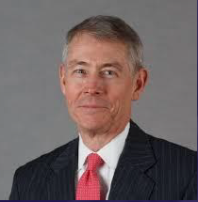
National Exploring Program Commissioner
Richard (Dick) Davies
Richard.davies.nyc@gmail.com
(914) 327-7430
Recent Scouting History
Interim Scout Executive for two years Greater New York Councils ~ 2021 – 2022
Stepped down as Council Commissioner to take role
Formerly VP – Membership, VP – Scoutreach and Manhattan Borough President
Eagle Scout from Wisconsin
Exploring History
Exploring Chair, National Commissioner Service Team ~ Nov 2022 – TBD
National Exploring Program Commissioner, National LFL Executive Board ~ Nov 2022 -TBD
Area and Northeast Regional Exploring Chair and Board Member ~ 2018 – 2021
National Exploring Committee ~ 1976 – 1979
National Explorer President ~ 1976-77; Youth Member of National Executive Board
Professional Career
Since 2016, angel investor and advisory board member for start-up companies
Consultant to investment management industry
Most of career on business side of investment management industry (business unit management, client and product development) with Alliance Bernstein and Russell investments
Last ten years through 2016 working with largest 401k and other defined contribution plans around the world.

Slide 12
Marketing & Technology Chair,
Nat’l LFL Exec Board
Comments
Jeffrey (Jeff) Schweiger

Slide 13
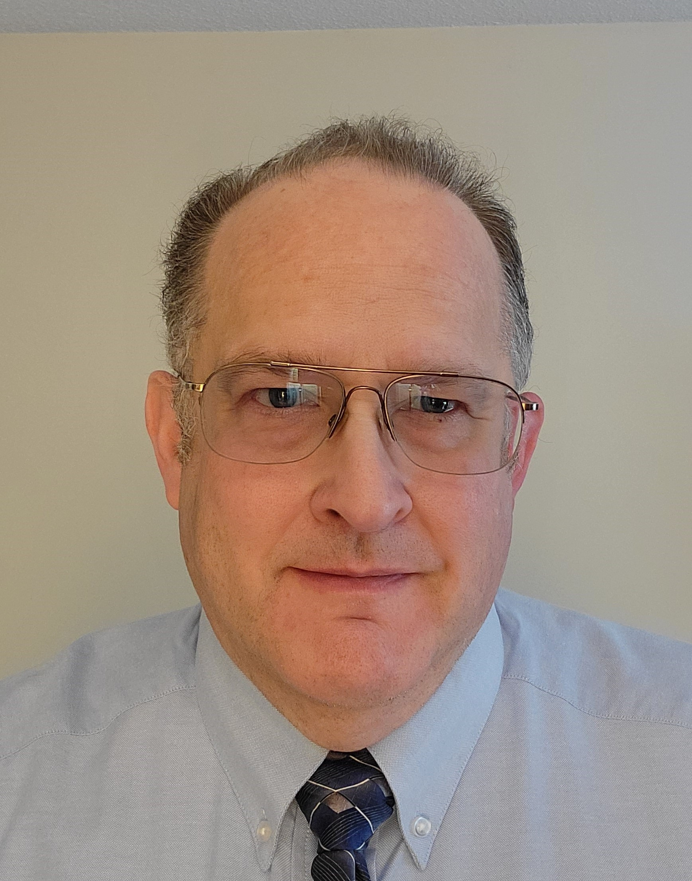
National Exploring Membership Growth and Retention Lead
Jeff Schweiger
scouter.jeff@earthlink.net
exploringmarketing@scouting.org
(703) 472-0669
Scouting History
National Capital Area Assistant Council Commissioner, Council Member-at-Large
National Capital Area Council Assistant District Commissioner, Assistant Roundtable Commissioner, Unit Commissioner, District Committee
Eagle Scout
Exploring History
Marketing & Technology Chair, National Learning for Life Executive Board ~ 2021 – TBD
National Exploring Project Teams Member, later National Exploring Committee ~ 2016 - TBD
National Capital Area Council Assistant Council Commissioner for Exploring ~ 2014 - TBD
Communications (Journalism) Explorer (2 years) ~ Post President (1 year)
Professional Career
U. S. Navy Naval Flight Officer – Retired as Lieutenant Commander, 1994
Government Contractor in Information Technology/National Security 1994 - TBD
Presently Senior Manager, Price to Win, Peraton Inc.

Slide 14
National Exploring Program Committee

Slide 15
Nat’l Exploring Committee Members…
National Exploring Program Chair Craig Martin
National Exploring Program Commissioner Richard (Dick) Davies
National Exploring Membership Growth / Retention Lead Jeffrey (Jeff) Schweiger
National Exploring Awards & Recognition Lead Richard (Rick) Belford
National Exploring Training Lead Roger Engelbart
National Exploring Health & Safety / YPT Lead Linda Hassler
National Exploring Marketing / Communications Lead (Website / Social Media) TBD *
National Exploring Materials & Literature Lead Timothy (Tim) Buckles
National Exploring Career Fields Development Lead TBD *
National Exploring Youth Officer Advisor TBD *
National Exploring Youth Chair TBD
National Exploring Partnerships / Relationships Lead TBD *
National Exploring Resource Advisor Stuart Mahler
National Special Needs Committee Liaison for Exploring Britt Flather
National Exploring Members-at-Large (National Exploring Resource Associate Advisors)
  National Exploring Subject Matter Expert Thomas (Tom) Belford
  National Exploring Subject Matter Expert Donald (Don) Deeker
  National Exploring Subject Matter Expert Joseph (Joe) Marinelli
  National Exploring Subject Matter Expert Lawrence (Larry) Smith
  National Exploring Subject Matter Expert Suzie Steiner
  National Exploring Subject Matter Expert Rick TerBorch
* Note: Welcome recommendations from anyone

Slide 16
National Exploring Resource Advisor
Stuart Mahler

Slide 17
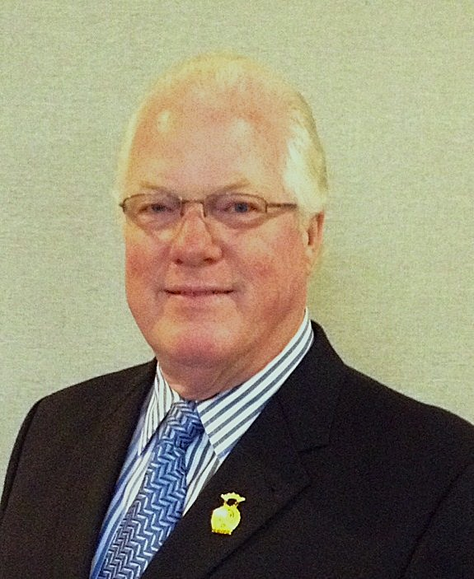
National Exploring Resource Advisor
Stuart Mahler
mdc.stuart@gmail.com
(925) 519-6957
Scouting History
Wood Badge Course Director & Course Advisor (staffed 10 courses)
District Commissioner, District Chair & District Committee
Troop Scoutmaster & Assistant Scoutmaster
Cub Master & Pack Committee
Exploring History
National Exploring Resource Advisor ~ 2022 – TBD
National Exploring Subject Matter Expert ~ 2019 – TBD
Golden Gate Area Assistant Council Commissioner for Exploring ~ 2017 - TBD
Golden Gate Area Council Exploring Chair ~ 2019- TBD
Explorer Advisor - 22 years
National Law Enforcement Exploring Conference – Staff (1988, 1990 & 1992)
National Exploring Academy Advisor- 1987
Law Enforcement Explorer (4 years) - Promoted to sergeant & later captain (Post President)
Professional Career
40-year Public Safety Career ~ Retired as Public Safety Director
Special Weapons & Tactics Team - 22 years
Police Academy Director & Instructor and Adjunct Professor
Officer of the year - 1985

Slide 18
National Exploring Subject Matter Experts & Exploring Resource Associate Advisors
In support to our fourteen Scouting America Council Service Territories (CSTs), our National Exploring Program is currently supporting each CST, along with their territory’s councils, with a National Exploring Subject Matter Expert (SME), who serves as that territory’s National Exploring Resource Associate Advisor (ERAA). As a caveat, we do not presume this role is either formally or informally part of the CST organizational structure but rather a service being made available by the National Exploring Program to each CST and/or their councils.

Slide 19
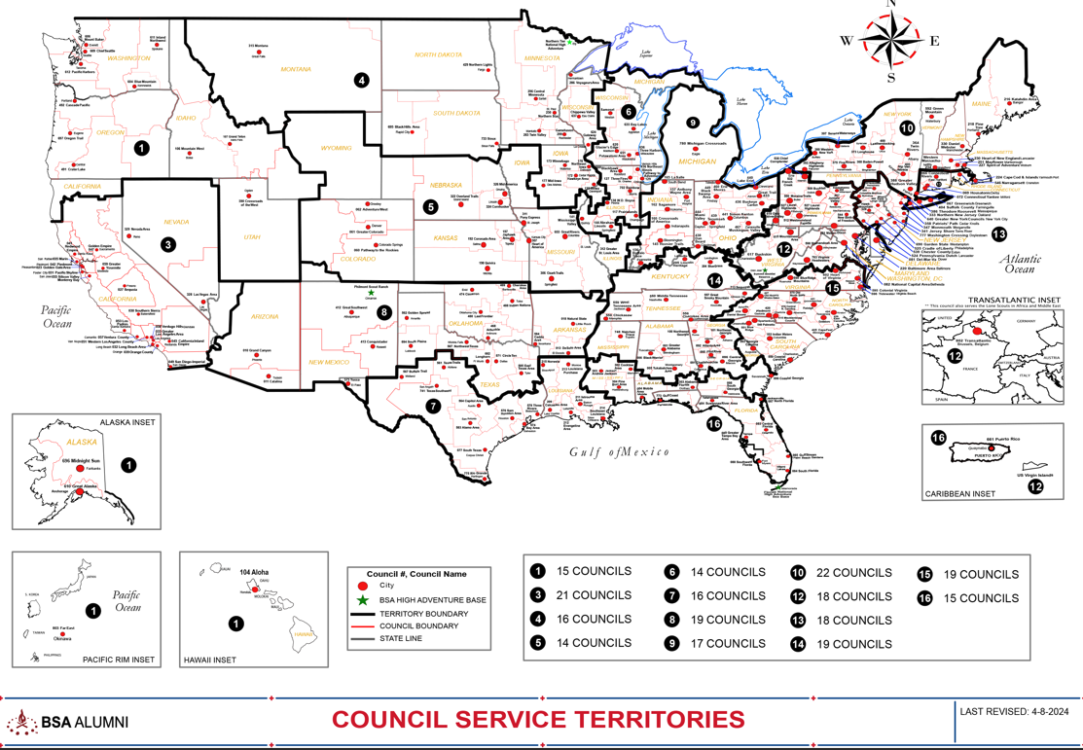
Council Service Territories (CSTs)…
COUNCIL

Slide 20
Current National Exploring SMEs / RAAs Team...
CST 1 ~ Suzie Steiner (Mountain West Council), who is currently an Advisor for an Exploring STEM / Robotics Post, which also encompasses trades such as machining & welding and business careers, and has previously been an assistant district commissioner, assistant & roundtable commissioner and Cub Scout den leader. National Exploring Resource Associate Advisor (ERAA) supporting the CST 1 and councils within the territory
suzie@openlabidaho.org
((208) 869-2403
CST 3~ Stuart Mahler (Golden Gate Area Council), who is currently an Assistant Council Commissioner and LFL Council Exploring Chair and Executive Board Member as well as a retired police officer, an advisor in the 1987 Law Enforcement Exploring National Academy, staff member on three National Exploring Law Enforcement Exploring Conferences and Law Enforcement Explorer in his youth. National Exploring Resource Advisor (ERA) supporting the CST 3 and councils within the territory
mdc.stuart@gmail.com
(925) 519-6957
CST 4 & 5 ~ Roger Engelbart (Greater St Louis Area Council), who is currently the Assistant Council Commissioner for Training and the Engineering Chair for the Council Exploring Committee, as well as a retired Boeing Engineer involved in Nondestructive Evaluation. National Exploring Training Lead and National Exploring Resource Associate Advisor (ERAA) supporting the CST 4 & 5 and councils within those two territories
engelbart301@sbcglobal.net
(314) 920-8968

Slide 21
Current National Exploring SMEs / ERAs Team...
CST 6 ~ Richard (Dick) Davies (Glacier's Edge Council) who is the National Exploring Commissioner, Exploring Chair for the National Commissioner Service Team & National Exploring Program Committee Vice-Chair, as well as VP - Development in Glacier's Edge Council (Madison, WI), Greater New York Councils Executive Board Member, former Interim Scout Executive for the Greater New York Councils (2021 & 2022), past Northeast Region Exploring Chair and Board Member, and, in his youth, National Explorer President (1976-77) & Youth Member of National Executive Board. National Exploring Resource Associate Advisor (ERAA) supporting the CST 6 and councils within the territory
richard.davies.nyc@gmail.com
(914) 327-7430
CST 7 ~ Don Decker (Bay Area Council) - Eagle Scout, Woodbadge staff member, retired BSA Professional Scouter, Business and Banking Explorer as a youth, and currently a full time Agriculture Specialist, US Customs and Border Protection Agency. National Exploring Resource Associate Advisor (ERAA) supporting the CST 7 & 16 and councils within the territory
dondecker@gmail.com
( 832) 266-7145
CST 8 ~ Tom Belford (Western Massachusetts Council) - Sea Scout Commodore, and Assistant Council Commissioner. He has previously served as the Council VOA Advisor for Catalina Council, Arizona, Vice Commodore for two councils and for Western Region Area 6. Tom retired as a Chief Petty Officer from the Navy Reserve after 24 years of military service. (Although he is registered in Western Massachusetts Council, Tom resides in Marana AZ.) National Exploring Resource Associate Advisor (ERAA) supporting the CST 8 and councils within the territory
tbelford1893@outlook.com
(520)488-1731

Slide 22
Current National Exploring SMEs / ERAs Team...
CST 9 ~ Richard (Rick) Belford (Western Massachusetts Council), is currently the Council Commissioner and Committee Chair for three units - a Cub Scout Pack, a Scouts BSA troop, and a Sea Scout Ship. He is also a former Scouting Professional/District Executive, a retired DOD/Federal employee and a retired USAF Chief Master Sergeant. National Awards & Recognition Lead and Resource Associate Advisor (ERAA) supporting the CST 9 Program Lead and councils within that territory.
  rebwmc234@gmail.com
(860) 402-4836
CST 10 ~ Joseph (Joe) Marinelli (Seneca Waterways Council), who is the Council Executive Committee’s & Board’s former Vice President of Exploring, past President of the Finger Lakes Council and Executive Director, Finger Lakes STEM Hub as well as a retired Regional Supervising Superintendent & BOCES (service agency) CEO for 25 school districts in upstate New York. National Exploring Resource Associate Advisor (ERAA) ) supporting the CST 10 and councils within the territory
josephjmarinelli@aol.com
(585) 704-4659
CST 12 – Jeff Schweiger (National Capital Area Council), who is currently an Assistant Council Commissioner (STEM, Exploring, Communications and Resources) as well as Membership Growth and Retention Lead on the National Exploring Committee. He is a retired Naval Officer and presently works for a national security government contractor. An Eagle Scout, he also was a member of a communications (print journalism) Exploring Post as a youth. National Exploring Resource Associate Advisor (ERAA) supporting the CST 12 & 15 and councils within those two territories
Scouter.jeff@earthlink.net
(703) 472-0669

Slide 23
Current National Exploring SMEs / ERAs Team...
CST 13 ~ Linda Hassler (Monmouth Council) who is currently a member of her Monmouth Council Board of Directors and Troop 140 Committee Member as well as an Assistant Professor at Rutgers’ School of Nursing, former Northeast Region Area 5 Exploring Chair, former Exploring Post Advisor and a Tennis Explorer in her youth. National Exploring Health & Safety / YPT Lead and National Exploring Resource Associate Advisor (ERAA) supporting the CST 13 and councils within the territory
Lindajhassler@gmail.com
(732) 687-7208
CST 14 ~ Lawrence (Larry) Smith (Middle Tennessee Council), is an Assistant District Commissioner serving Sea Scout and Exploring units. As a youth, he was a Cub Scout, Boy Scout, and Explorer, and as an adult, has served as Chapter OA Adviser and District Commissioner. He is a former Chief Petty Officer in the US Navy Submarine Service and is retired from Contra Costa County, California. National Exploring Resource Associate Advisor (ERAA) supporting the CST 14 and councils within the territory.
  muir.scouter@gmail.com
925-787-7139
CST 15 ~ Jeff Schweiger
CST 16 ~ Don Decker

Slide 24
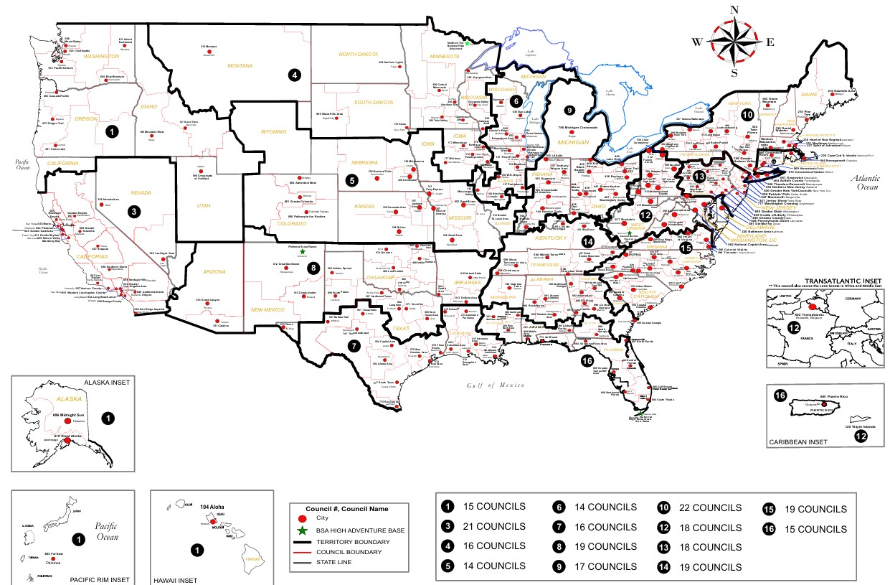

Exploring Associate Resource Advisors
Serve the Entire Country
Find your Council Service Territory & assigned ERAA at
www.exploring.org/about-us

Slide 25
Current National Exploring SMEs / RAAs Team...
Additionally, any of these National Exploring RAAs are available to any of the CSTs and their councils on the following Exploring Career Fields
Arts & Humanities ~ Tim Buckles
Aviation ~ Rick Belford & Roger Engelbart
Business ~ Rick Belford (Contracting & Procurement)
Communications ~ Rick Belford (Broadcasting & Public Relations)
Engineering & Technology ~ Roger Engelbart, Craig Martin and Suzie Steiner (Robotics)
Health Care ~ Linda Hassler
Law & Government ~ Craig Martin & Rick Belford (Military Careers)
Law Enforcement ~ Stuart Mahler & Rick Terborch
Skilled Trades ~ Joe Marinelli & Suzie Steiner
Social Services ~ Joe Marinelli (Education), Linda Hassler (College Professor), Rick Belford (Non-Profit / Not-For-Profit Management) and Suzie Steiner (STEM)
Other Career Fields ~ National Exploring RAA, assisting your CST, will find the best individual to assist you for other Exploring Career Fields

Slide 26
2026-2027 National Exploring Program Priorities (Abridged Version) Mapped to Scouting America’s 2026-2027 Trail Map Priorities

Slide 27
2026 – 2027 National Exploring Priorities…
Scouting America Trail Map Priority #1: Focusing on volunteers
  Update Exploring Safety First Guidelines with Scouting America Health & Safety Team
  Review and Update Exploring Guidebook for Post & Club Leaders (last updated 2017) via SME task force
  Establish National Youth Officer structure aligned with other older youth programs
  Continue to develop the 12 National Exploring Career Committees to support councils
Scouting America Trail Map Priority #2: Simplifying and Refocusing
  Update District Operations Basic Training to have updated information for the Exploring Program
  Enhance resources: expand marketing library using actual photos from council exploring units
  Remove outdated or hard-to-reproduce materials
  Standardize marketing tools: print-ready brochures, flyers, posters
  Develop Donor Materials for prospective sponsors of Explorer Posts

Slide 28
2026 – 2027 National Exploring Priorities…
Scouting America Trail Map Priority #3: Growing the Movement
  Expand training: Provide regularly scheduled Live Hours and Zoom sessions as outlined in Exploring Explosion 3.0 www.exploringexplosion.org
  Train professionals and volunteers on four phases of organizing a Post/Club
  Strengthen National Commissioner Service Team’s view of Exploring Program’s value, as well as promotion of Exploring unit service engagement at the council & district level, and provide quarterly updates to Council Service Territories & their councils
  Survey councils and share proven Exploring membership growth strategies

Slide 29
What’s New for Exploring in 2026

Slide 30
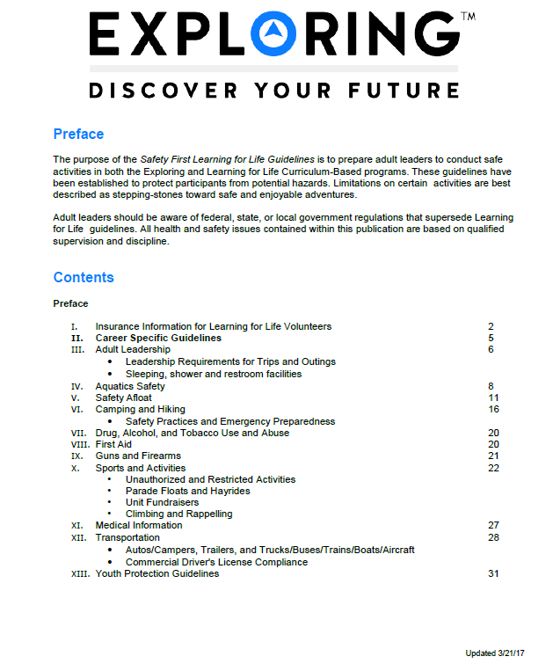
Exploring Safety First Guidelines
National Exploring Committee’s Health & Safety & YPT Lead’s Team updated the “Exploring Safety First Guidelines” and passed their proposed revision to the BSA Health and Safety Team for their review and comments
Expect the updated “Exploring Safety First Guidelines” will be released as second section/part of the “Guide to Safe Scouting”

Slide 31

Exploring Leadership Experience…
VISION: Nationally recognized program that offers young men and women an opportunity to enhance their understanding of leadership in the workplace through interactive instruction, self-reflection, and practical application while working with an adult mentor to gain professional leadership experience. The Exploring Leadership Experience will be available to all Explorers registered in an Exploring post who meet the requirements.

Slide 32
Exploring Leadership Experience continued
ELIGIBILITY REQUIREMENTS: Explorers must first meet the following basic qualifications:
Currently registered in an Exploring post with at least three months of tenure as an active, registered Explorer.
Plans to complete the Exploring Leadership Experience requirements before his or her 21st birthday.
Has earned the Exploring Achievement Award within any career field OR has held a leadership role either within or outside the post in the past 12 months.

Slide 33
Exploring Leadership Experience continued
ON-LINE LEARNING MODULES: The Exploring Leadership Experience is designed to be a self-paced, experiential learning process for each Explorer who commits to completing the program. A critical component of this learning process is a series of self-paced, online leadership development modules that Explorers must complete on their journey to improved leadership skills. Explorers
are required to complete each series of leadership skills modules in the order listed in the next slide. However, the modules within each series can be completed in any order.

Slide 34
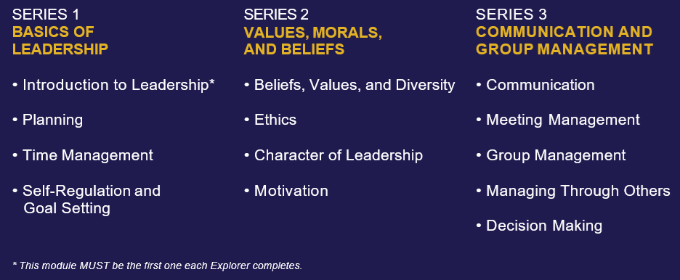
Exploring Leadership Experience continued
ON-LINE LEARNING MODULES: continued
NOTE: All the above modules are up-to-date and currently reside in Scouting America’s Learn Center

Slide 35

Exploring Leadership Experience continued
GUIDEBOOK: Finalized by Scouting America’s Editorial Operations Office
INTRODUCTION TO LEADERSHIP LEARNING MODULE: Finalize by Scouting U Instructional Design Office
EXPLORING LEADERSHIP EXPERIENCE ROLL-OUT: Expected in October 2026

Slide 36
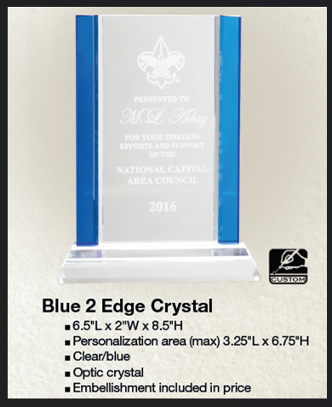
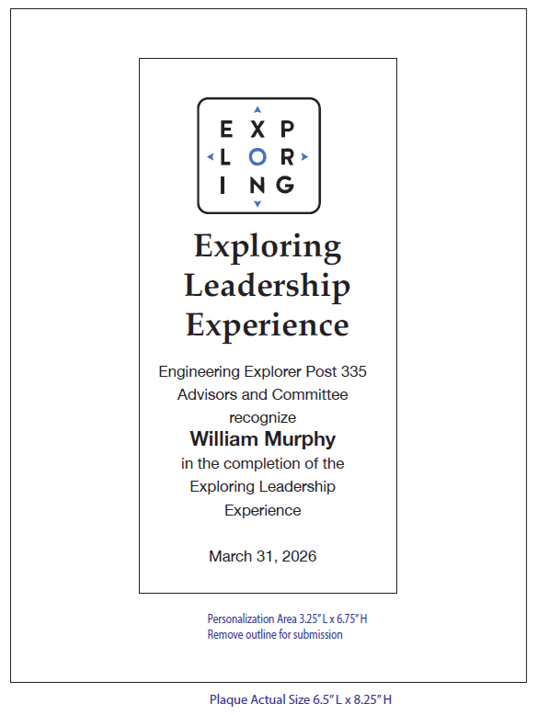
Exploring Leadership Experience Recognition Plaque Example….

Slide 37
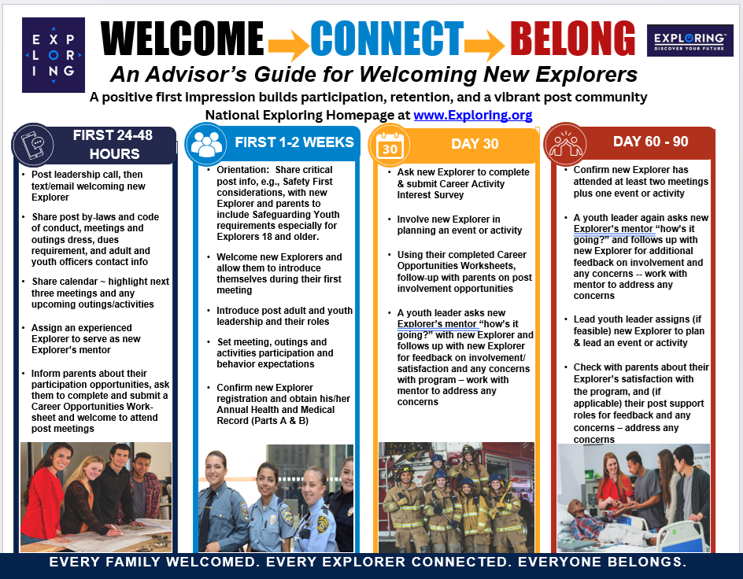
National Exploring Committee’s New Explorers On-Boarding Recommendations*…
* Can be found under the “Unit Resources” box on the National Exploring Home-page

Slide 38

National Exploring Committee’s New Explorers On-Boarding Recommendations*…
* Can be found under the “Unit Resources” box on the National Exploring Home-page

Slide 39
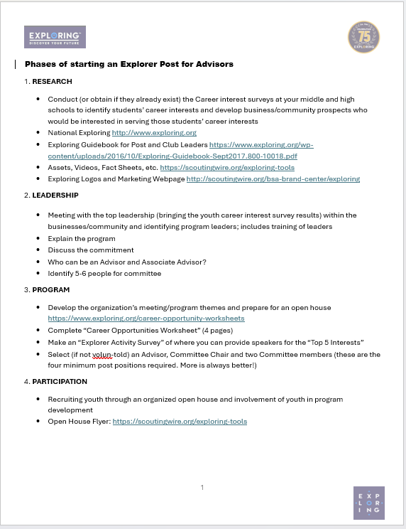
National Exploring Committee’s New Post Advisor On-Boarding Recommendations*…
* Can be found under the “Unit Resources” box on the National Exploring Home-page

Slide 40
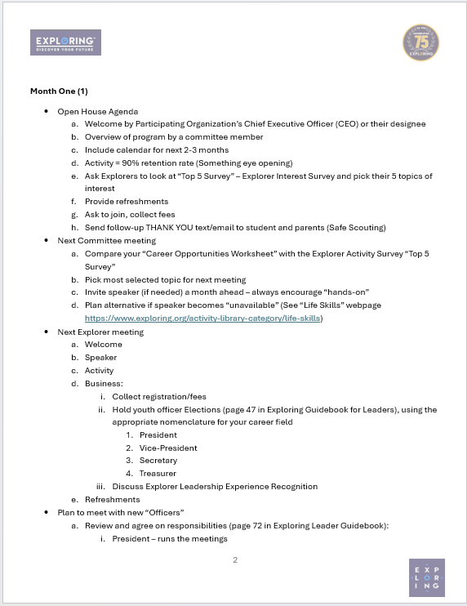
National Exploring Committee’s New Post Advisor On-Boarding Recommendations*…
* Can be found under the “Unit Resources” box on the National Exploring Home-page

Slide 41
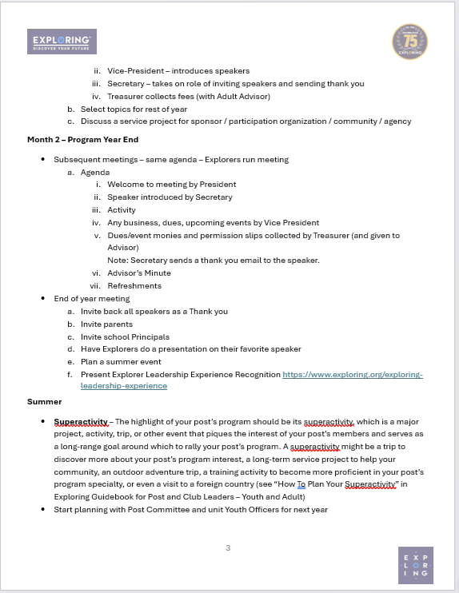
National Exploring Committee’s New Post Advisor On-Boarding Recommendations*…
* Can be found under the “Unit Resources” box on the National Exploring Home-page

Slide 42
Exploring Live Hour
October 14, 2026
Topic
Exploring Officers Association and Exploring Unit Metrics

Slide 43
Dick Davies
Exploring Chair, National Commissioner Service Team
Brooke Ice
Fire Fighter & Paramedic -- Cherokee County Fire Department
Committee Chair/Former Lead Advisor Post 469
Atlanta Area Council
October 14, 2026
Exploring Live Hour

Slide 44

Explorer Officers Association Guide
44

Slide 45
2026: The Year Of Youth Leadership
New Exploring Unit Metrics
Exploring Leadership Experience
National Youth Officers

Slide 46
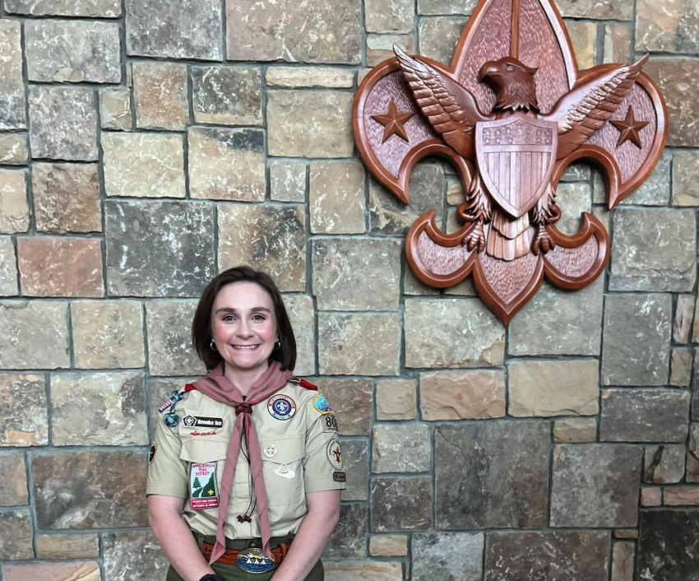
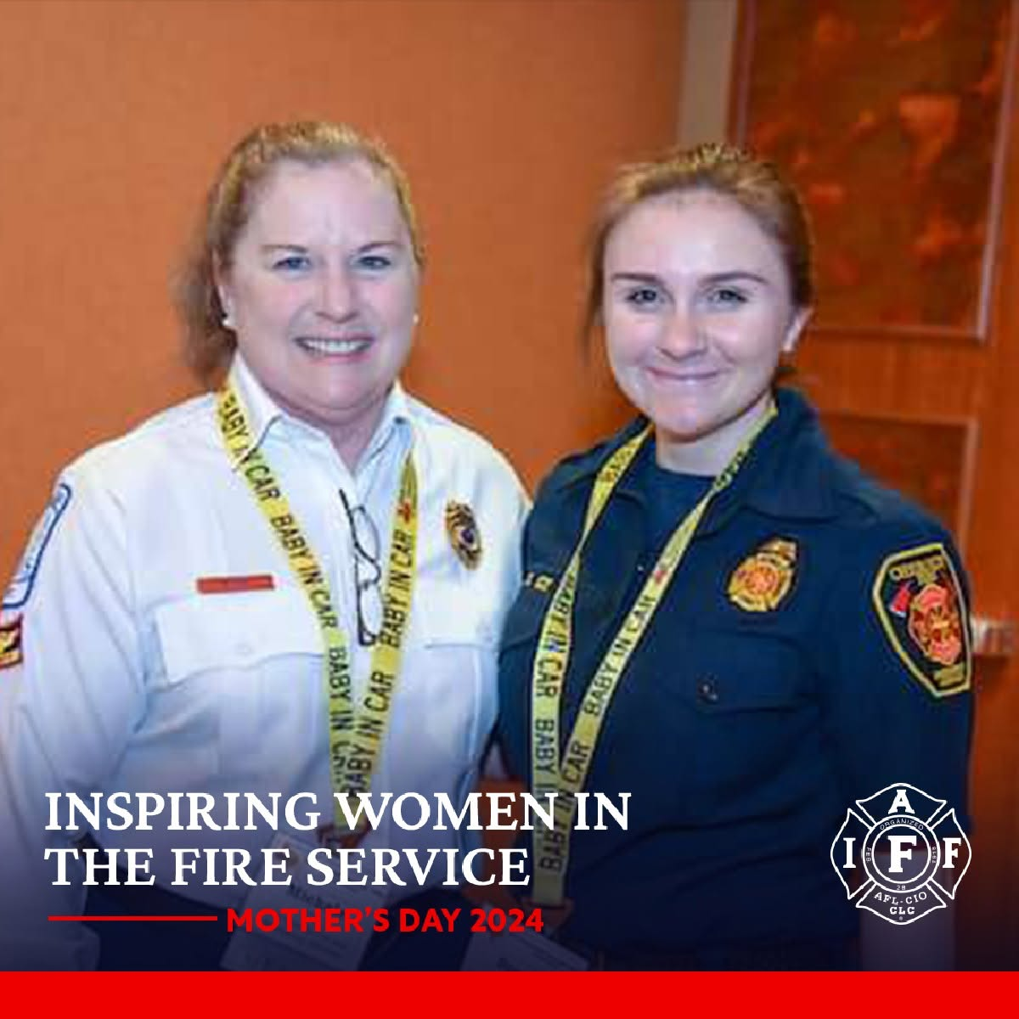
Brooke Ice

Slide 47

What Are Metrics of a Sustainable Post?
Key Leaders Trained (Advisor and Committee Chair)
At Least 7 Members
Membership Growth or 15 Explorers
Elected and Trained Post Officers
Annual Post “Super Activity”
Renewal and
Membership Retention
47

Slide 48
Exploring Membership Retention
12 months as of June 2026

Slide 49

Exploring Explosion
Membership Growth Incentive…
Go to: www.exploringexplosion.org to claim your prizes!

Slide 50
Questions?

Slide 51
What is happening in exploring in your council?

Slide 52
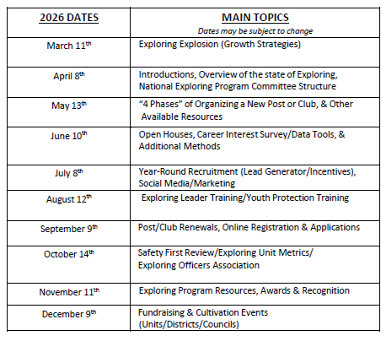
National Exploring Live Hour 2026 Dates
National Exploring Live Hour from 1:00 PM – 2:00 PM Central Standard Time, Monthly
Register for each of the National Exploring Live Hour ZOOM presentations (click below):
2026 National Exploring Live Hour Registration =
https://reservations.scouting.org/profile/form/index.cfm?PKformID=0x167391abcd

